Slide 1

IT Coordinators
MEETING
MAY 2025

Slide 2


Slide 3
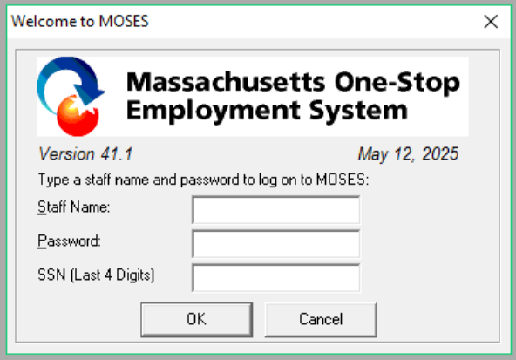
Released
April 16, 2025
To the field

Slide 4
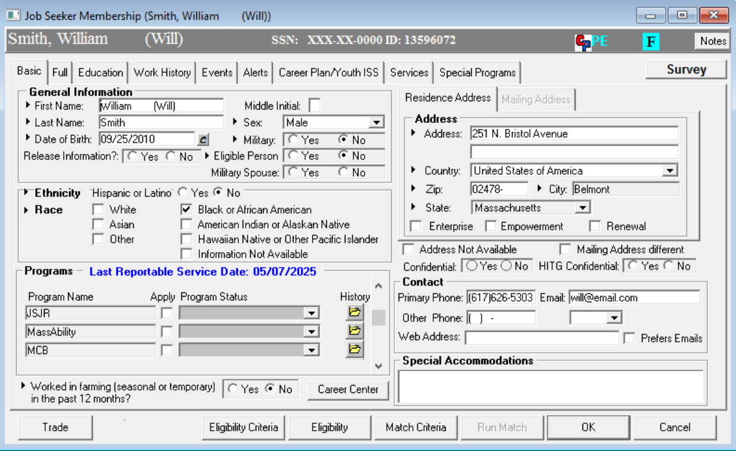
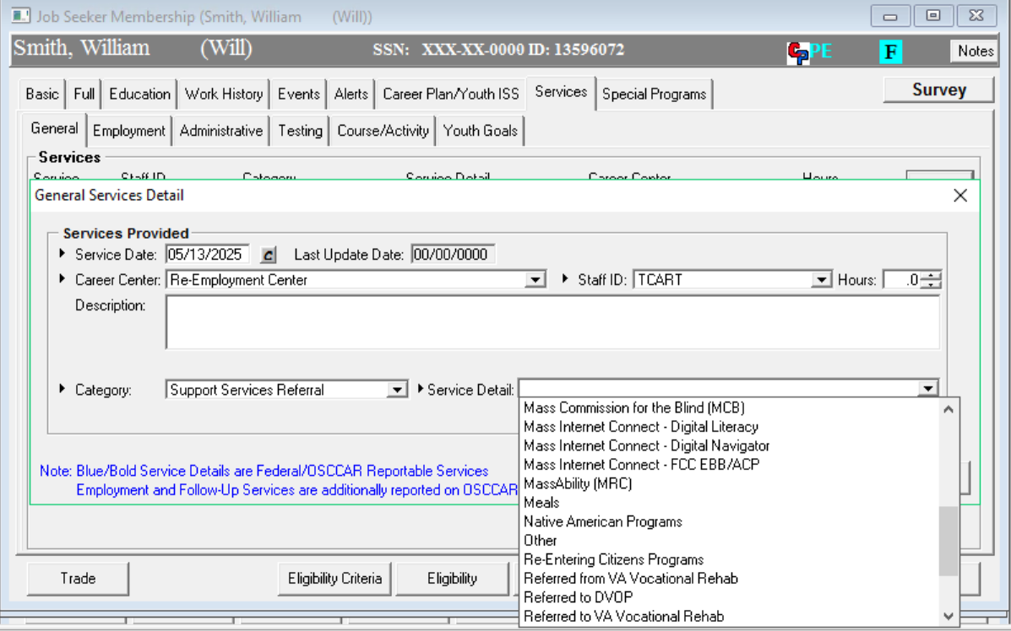
Mass Rehab Commission now called MassAbility
On Job Seeker Basic and General Services – Support Services Referral

Slide 5
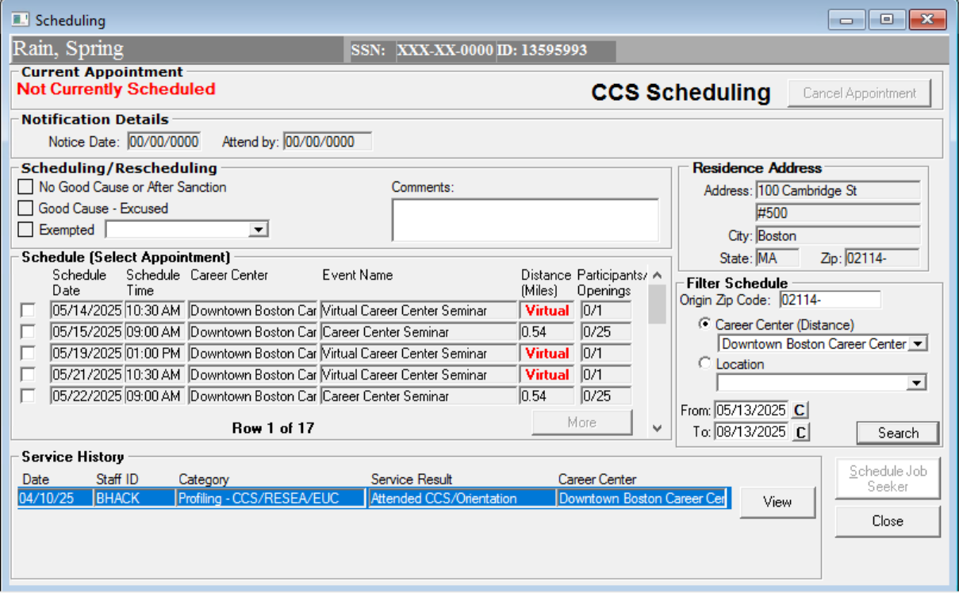
CCS Scheduling - Increase Service History
Display more than 50 histories

Slide 6
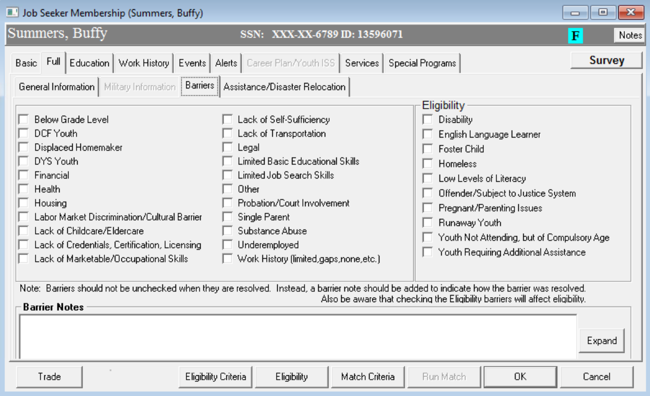
Job Seeker - Full tab - Barriers sub tab - added Single Parent

Slide 7
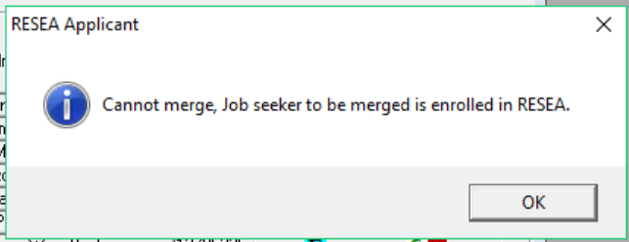
Do not allow Job Seeker merge if the customer to be merged is currently enrolled in RESEA

Slide 8
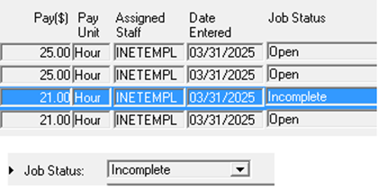
Employer - New Job Order Status – Incomplete

Slide 9
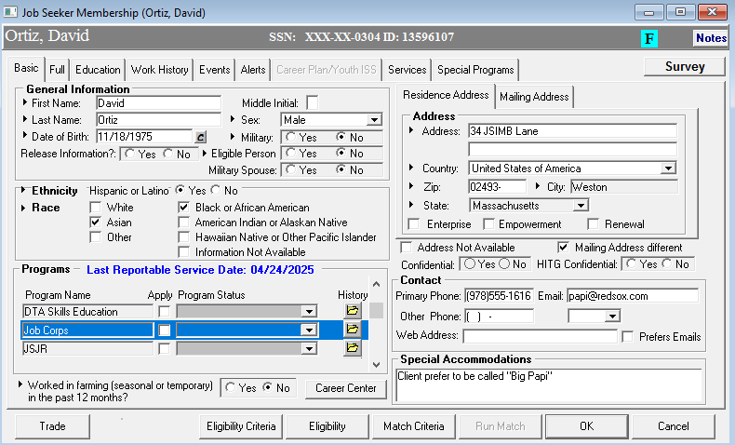
Job Corps added

Slide 10


Slide 11
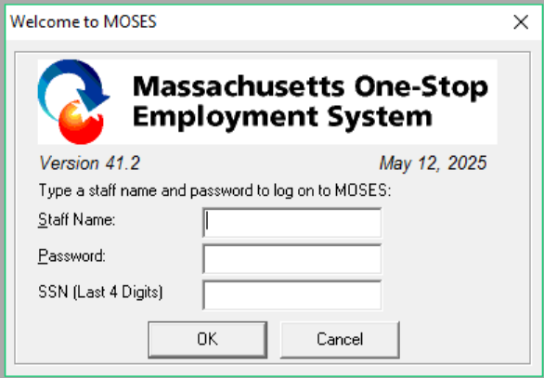
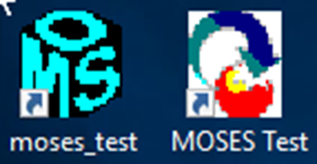
COMING
BEFORE
JULY 1, 2025
FY26

Slide 12
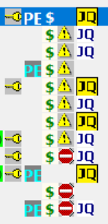

Job Quest Icon
means registered in JobQuest AND registered in MyMassGov
means has JobQuest account BUT NOT registered in MyMassGov

Slide 13
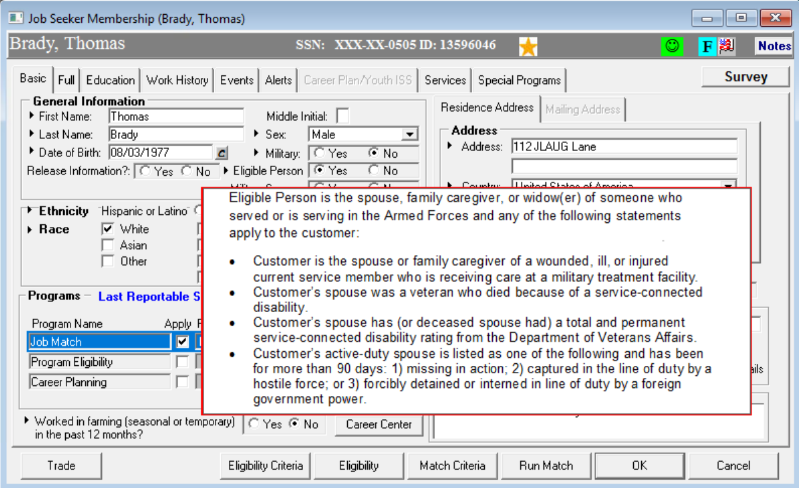
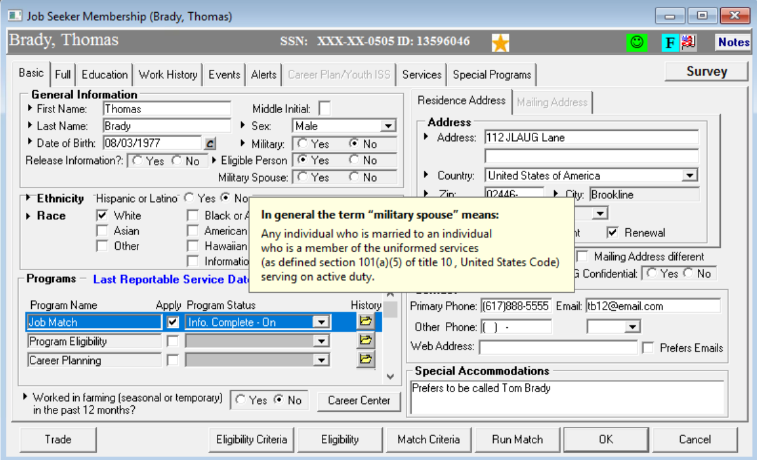
Veterans Fly Away definitions
Now both are hover definitions

Slide 14
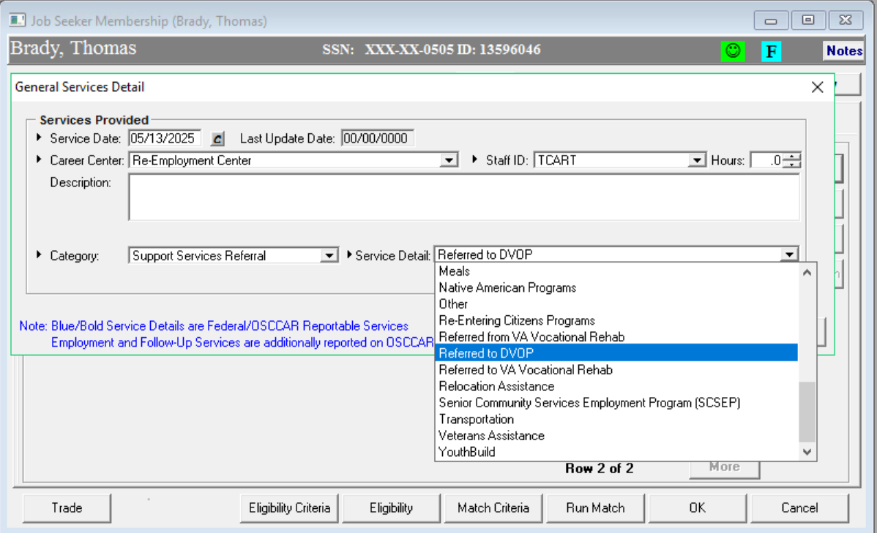
Veterans Program Updates

Slide 15
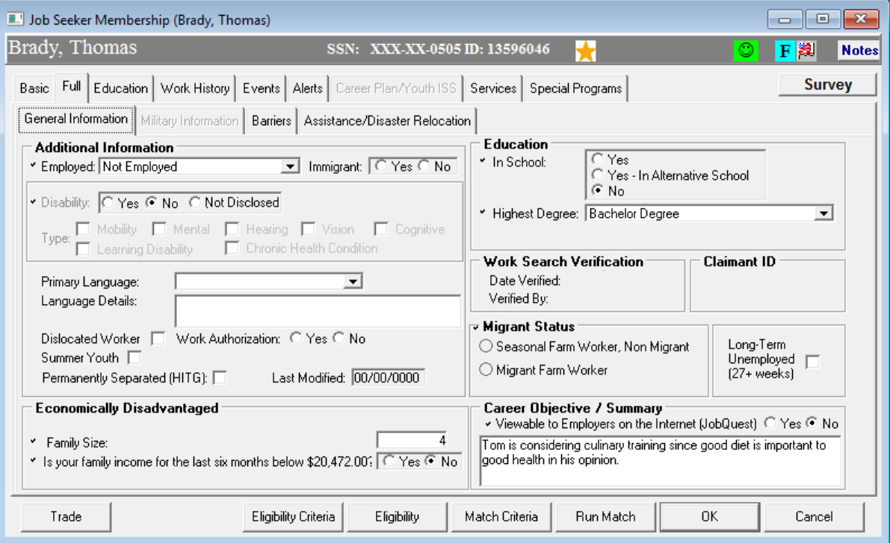
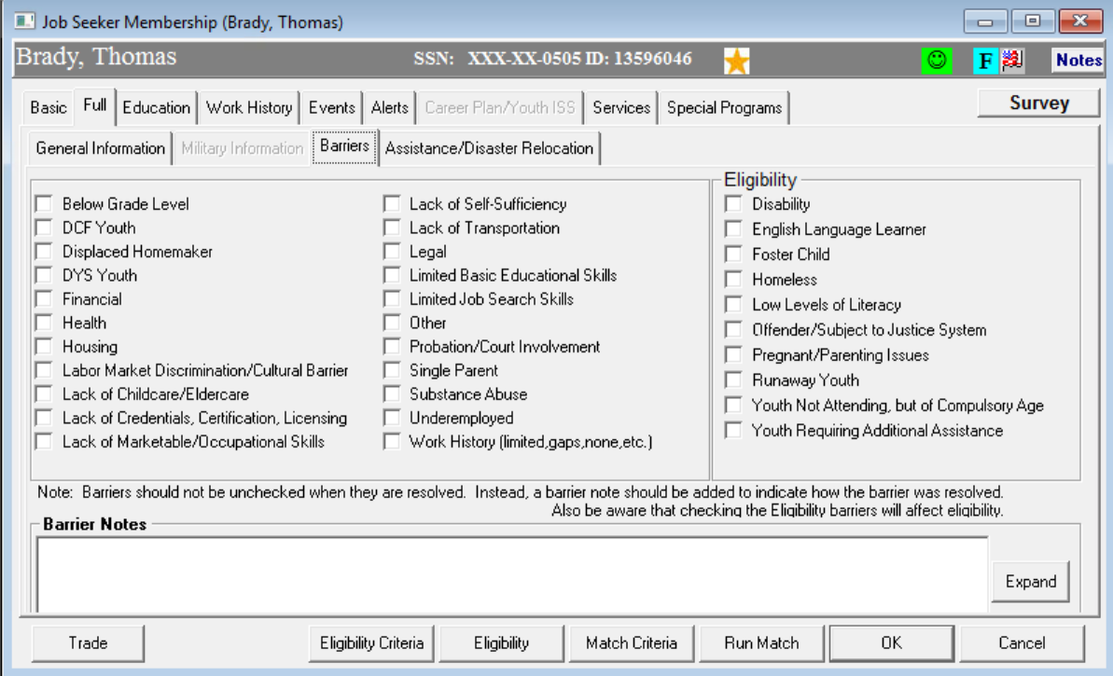
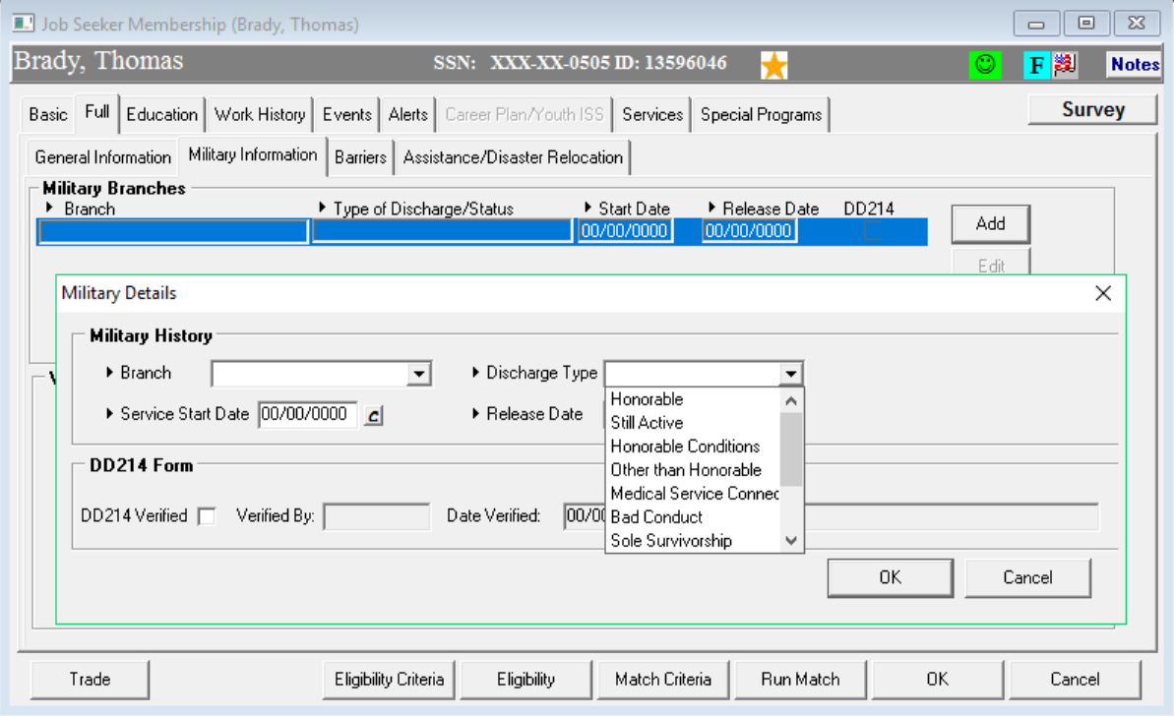
Veterans SOP Updates in Eligibility and MOSES
New: Sole Survivorship

Slide 16

Vet Staff Eligible (Qualifying Situations): Display gold star icon for Veterans who have one or more of the following:
Disability
Vietnam Era Veterans
Recently Released/Discharged within the last three years
Referred by the U.S. Department of Veterans Affairs
Homelessness
Subjected to any stage of the criminal justice process
Age 18 to 24
Less than High School graduate
Public Assistance/Low Income
Unemployed
Single Parent

Slide 17
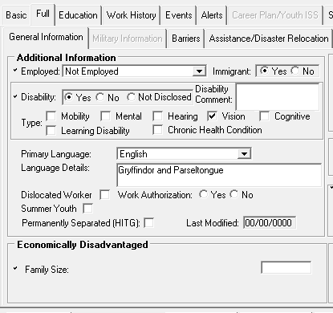

Lower Living Standard updated

Slide 18

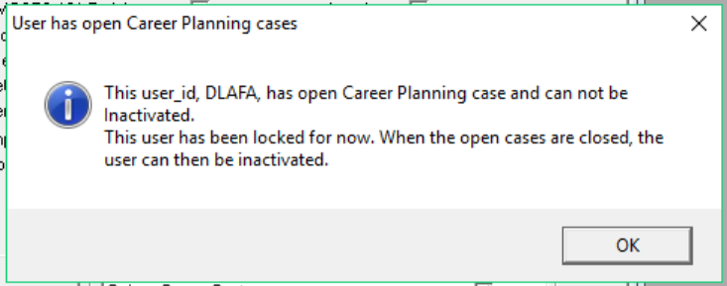
Terminating Staff
CLOSING all Career Plans
Staff with Caseloads can not be closed out
New pop up
Managers will need to clean out Cases to be closed

Slide 19


Slide 20


Slide 21

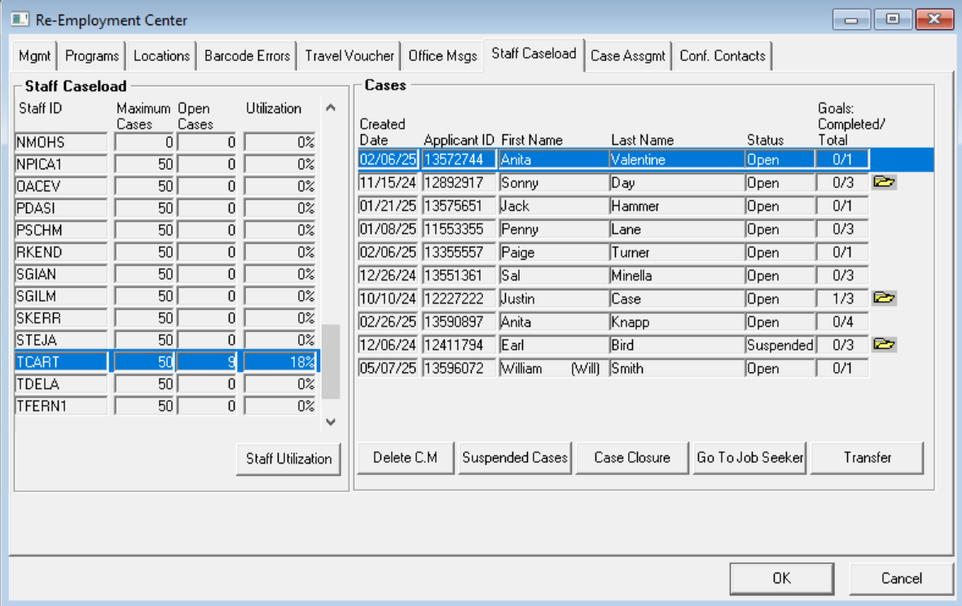
In the works
Career Planning CLEAN UP
5 yr lookback
Archived Staff only
Closing existing Career Plans still active

Slide 22

Testing – TABE – ESOL Clas-E Locator
New TABE Clas-E Locator ESOL
The US Dept of Education - Office of Career, Technical and Adult Education (OCTAE) notified DRC that both TABE 13/14 and CLAS-E C/D have been approved for NRS Reporting and the official notification was published in the Federal Register last summer.

Slide 23
Kevin : Events Category Redesign
For Reporting Purposes
Event Category Current | Event Category Proposed
Assessment/Job Readiness Assessment | Assessment/Job Readiness Assessment
Bundled Services | Bundled Services
Individual Appointment | Individual Appointment
Individual Training Account | Individual Training Account
Labor Market Information | Industry Briefings
Orientation | Informational Sessions
Other | Job Fairs
Rapid Response Orientation | Labor Market Information
Recruitment/Job Fairs | Networking Event
Tax/UI/Hearings | Orientation
Testing | Other
Trade Orientation | Rapid Response Orientation
Workshops | Recruitments
 | Tax/UI/Hearings
 | Testing
 | Trade Orientation
 | Workshops
Split :
Recruitment / Job Fairs to Job Fairs Recruitments
Add:
Information Sessions ; Networking Event ;
and Industry Briefing

Slide 24
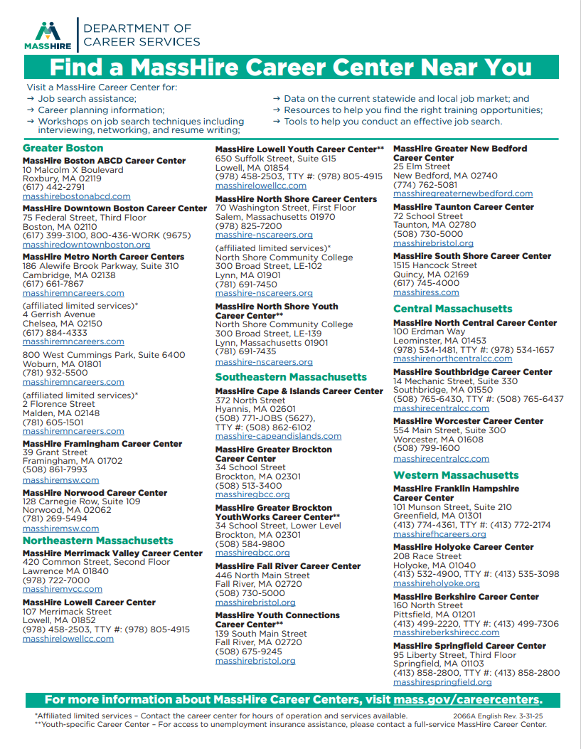
Career Center list updated
Last update was Holyoke Career Center moved 3/31/25
03-31-2025 Edition

Slide 25
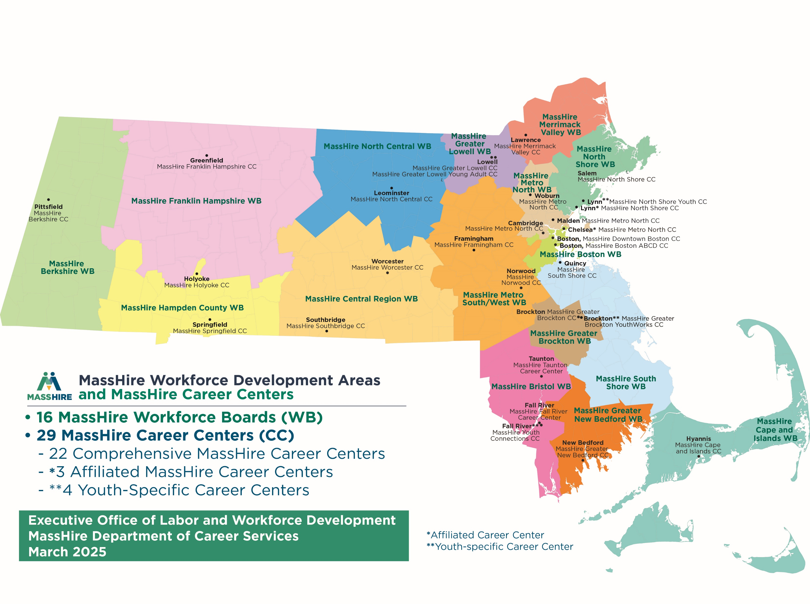
Career Center Map
No changes other than
Called March 2025 edition
March 2025 Edition

Slide 26
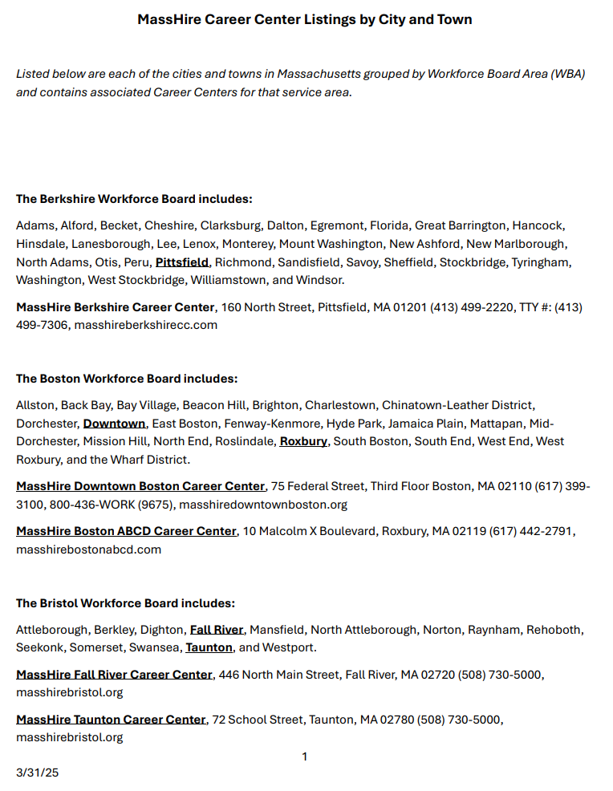
City / Town Listing with Workforce Board Areas
https://www.mass.gov/info-details/moses-training-material

Slide 27


IVRS
Fully Up to Date
As of
April 2025

Slide 28
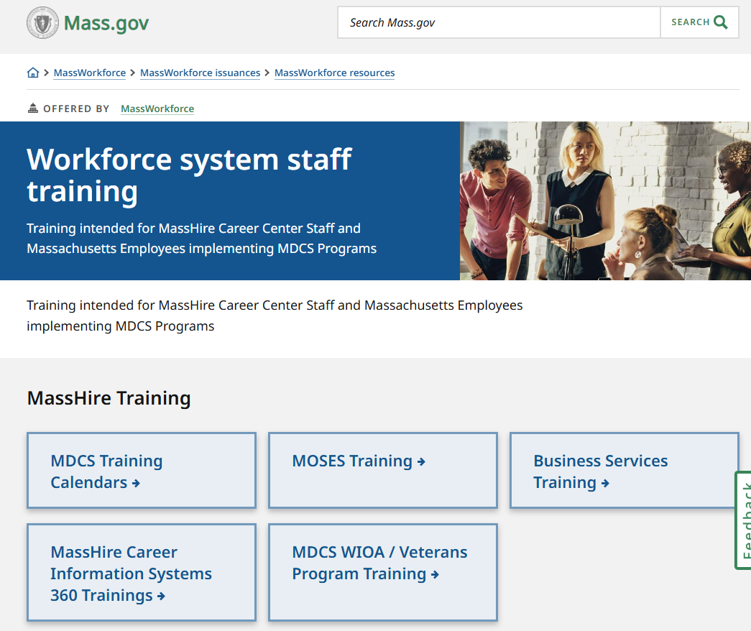
MOSES Training Calendar for
FY 26

Slide 29

?
?
?
Questions?
?
?
?
?
?
?
?
?

