Slide 1
Nursing Facility Satisfaction Survey Options
Nursing Facility Task Force Meeting
Bureau of Health Care Safety and Quality

Slide 2
Department of Public Health Nursing Home Satisfaction Survey
The SFY 2002 budget provided that: “the Division shall develop a confidential satisfaction survey for long-term care facilities . . . of family members, guardians or other resident designees.”
DPH worked with outside experts to develop a survey consisting of 54 satisfaction questions in six domains:
a nursing home's staff and administration,
physical aspects of the home,
activities provided to residents,
personal care,
food and meals and
residents' personal rights
Administered to responsible parties (family members or guardians) in 2005, 2007 & 2009
Mandatory in 2007 and 2009 under 105 CMR 150.002(K) (The facility shall provide Resident survey reports, annual reports and such other reports and information as may be required to the Department in the manner and within the time period prescribed.)
Findings
In 2009 a total of 20,435 surveys were returned giving a response rate of 60%
89% of respondents that year stated that they would recommend the nursing home to a friend
Notes:
LTC QI Fund: primary source of revenue for the Fund consists of fines generated from penalties imposed by the Department of Public Health on long-term care facilities under section 73 of chapter 111 of the M.G.L.

Slide 3
Long Term Care Satisfaction Surveys Used in MA
Since the Nursing Home Satisfaction Survey was last administered over ten years ago, groups of Massachusetts Nursing Facilities have used three different surveys to measure resident and family experience and satisfaction
Survey | Background | Groups Surveyed | Domains Assessed | Questions | Language
Consumer Assessment of Healthcare Providers and Systems (CAHPS) | Agency for Healthcare Research and Quality program that began in 1995 CMS endorsed | Discharged Short Stay Residents, Long Stay Residents and Family | Environment Care Communication and Respect Autonomy Activities | Up to 45 questions | English Spanish
CoreQ | Developed at the University of Pittsburgh and American Health Care Association/National Center for Assisted Living to assess satisfaction | Discharged Short Stay Residents, Long Stay Residents and Family, Assisted Living Residents | Recommend Quality of care | 3-4 questions | English
MyInnerview | National Research Corporation distributes | Long-term care employees and nursing home residents | Quality of life Quality of care Quality of service Global satisfaction | 24 questions | English
Massachusetts Department of Public Health mass.gov/dph
3
Notes:
Core Q:
In recommending this facility to your friends and family, how would you rate it overall?
Overall, how would you rate the staff?
How would you rate the care you receive?
Unlike other types of health care facilities that have CMS or HEDIS requirements to implement an experience survey, long term car does not have this requirement

Slide 4
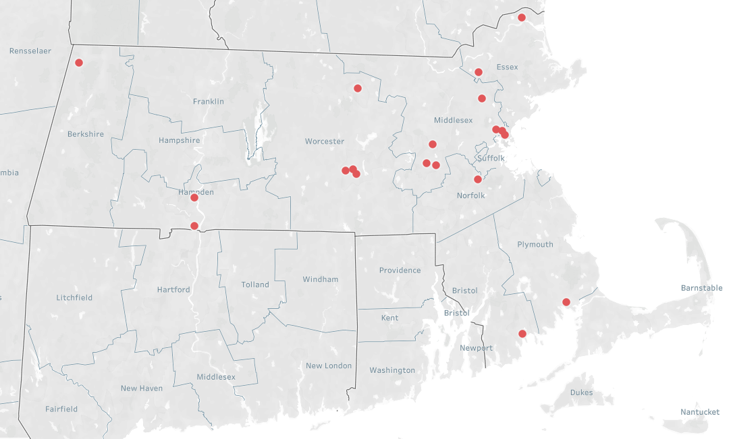
Map of chronically low quality and low occupancy facilities
0
25 Miles
Low Quality (1 or 2 Stars or SFF) from 2017-2019
And Low Occupancy (<80%) in 2019
Note: Facilities without a reported occupancy rate or quality score are excluded from this analysis
Source: MassHealth Occupancy Survey (April 2019), Medicare Star Quality Score (Nov 2017, Nov 2018, Oct 2019)

Slide 5
List of chronically low quality and low occupancy facilities
Facility Name | Operating Company | Overall Occupancy (as of 4.1.19) | MassHealth Share of Residents (as of 4.1.19) | Medicare Score (as of Nov 2017) - Overall | Medicare Score (as of Oct 2019) - Overall | # of Licensed Beds (as of 12.18.19)
AGAWAM HEALTHCARE | Next Step Healthcare | 51% | 84% | 2 | 2 | 176
BRANDON WOODS OF NEW BEDFORD | Essex Group Management Corp. | 78% | 90% | 2 | 1 | 135
DEDHAM HEALTHCARE | Next Step Healthcare | 63% | 87% | 2 | 1 | 145
DEXTER HOUSE HEALTHCARE | Next Step Healthcare | 69% | 84% | 1 | 2 | 130
ELIOT CENTER FOR HEALTH & REHABILITATION | National Health Care Associates, Inc. | 71% | 65% | 2 | 1 | 114
FITCHBURG GARDENS FOR NURSING AND REHABILITATION | Fusion Healthcare Services, Corp | 80% | 89% | 1 | 2 | 87
HERMITAGE HEALTHCARE | Next Step Healthcare | 78% | 81% | 2 | 2 | 101
CASA DE RAMANA REHABILITATION CENTER | Landmark Management Solutions | 60% | 80% | 1 | 2 | 124
MAPLEWOOD REHAB AND NURSING | RegalCare Management Group | 79% | 49% | 1 | 1 | 120
REHABILITATION & NURSING CENTER AT EVERETT | Personal Healthcare LLC | 80% | 86% | 2 | 1 | 183
SWEET BROOK OF WILLIAMSTOWN REHABILITATION & N CTR | SB Operating Company LLC | 65% | 88% | 1 | 1 | 184
WAREHAM HEALTHCARE | Next Step Healthcare | 59% | 81% | 1 | 1 | 175
WEST SIDE HOUSE LTC FACILITY | Essex Group Management Corp. | 67% | 94% | 2 | 2 | 91
BEAR MOUNTAINT AT ANDOVER | Bear Mountain Healthcare | 61% | 80% | 1 | 1 | 135
BEAR MOUNTAIN AT SUDBURY | Bear Mountain Healthcare | 71% | 72% | 2 | 2 | 142
BEAR MOUNTAIN WEST SPRINGFIELD | Bear Mountain Healthcare | 71% | 77% | 1 | 2 | 168
WOODBRIAR HEALTH CENTER | The Pointe Group | 70% | 80% | 2 | 1 | 142
WORCESTER REHABILITATION & HEALTH CARE | Athena Health Care Systems | 79% | 87% | 1 | 1 | 160
Note: No Overall Medicare Score is reported for 2018 because the health inspection component of the survey was suspended from February 2018 to May 2019 in order for CMS for make updates to its survey methodology. However, overall scores were still reported based on the other 2 components of the overall score (staffing and quality measures)
Source: MassHealth Nursing Facility Occupancy Survey April 2019; Medicare Star Quality Score

