Slide 1
Decoding an Enigma: The Important Role Rest Homes Play in the Massachusetts Healthcare Continuum
Becky Annis, Administrator, Pond Home
Ronald J. Pawelski, President Massachusetts Association of Residential Care Homes

Slide 2
Presentation Objectives
Clarify the role Rest Homes play on the Massachusetts healthcare continuum
Present recommended solutions developed by industry experts to address the financial crisis threatening Rest Home survival
Review the human impact related to the closing of a Rest Home

Slide 3
Rest Home- An Operational Definition
Definition: Residential Care Facilities, licensed* as Rest Homes in the Commonwealth, provide cost effective, individualized healthcare including medication management, address resident psych/social needs and provide room and board to an aged, infirm and at times indigent population. This suite of services is provided by licensed staff in a community- based setting. Rest Homes combine elements of a medical and housing model.
*Note: Religious order homes do not require a license from DPH to operate. These homes must meet all local health and safety requirements.

Slide 4
CURRENT Industry Profile
Number of Homes: 67 Free Standing Homes 24 SNF’s with Rest Home wings: Private, For Profit, Not For Profit, Religious Order Affiliated
Number of Licensed Beds: Over 3,000
Daily Rates: Average rate for Free Standing Homes = $98.20 Median =$85.17 based on $4M in incremental funding eff. 7/1/19 (Thank you!)
Funding Sources: Department of Transitional Assistance w/EAEDC Program and SSA, SSDI, SSP and SSI resident contributions, private pay, VA A&A, & LTC insurance. Note: No Federal Match, 100% state funded.
MARCH: Massachusetts Association of Residential Care Homes is the trade association for 60 Rest Homes representing a combination of owner operated, not for profit charitable homes, and religious order homes.
www.residentialcarehomes.org

Slide 5
Rest Homes, a Cost-Effective option
Estimated Annual Cost (median rates as of 2019)
https://www.dibbern.com/nursing-homes/massachusetts/cost-for-massachusetts-nursing-homes.htm
$128k | $64k | $57k | $54k | $37k | $17k
Nursing Home | Assisted Living | Home Health Aide | Home maker Non-Med | Rest Home | Adult Day Care

Slide 6
Rest Home Services Provided for Daily Rate (Median Rate =$85.17)
Comprehensive medical oversite, medication management, address psycho/social needs;
Provide nursing, pharmacy, dietary and social service consultation;
Licensed nursing coverage has increased on average to 2.0 FTE’s to care for those who are aging in place with multiple ADL needs. Majority of homes have licensed RN/LPN staff.
24-hour oversight for assistance, first aid and emergencies;
Medication administration & maintenance of medical record;
3 meals and snacks each day;
Personal care as needed;
5+day a week activity program; majority with daily
Housekeeping and laundry services.

Slide 7
Assisted Living and Nursing Facility Comparison
Rest Homes provide a great option for elders in need of medical care and housing
Rest Home Care is provided in a community-based, less restrictive setting
Rest Homes work in collaboration and consultation with Assisted Living and Nursing facilities
Referrals are received from AL & SNH to Rest Homes as well as in reverse
See comparison chart in handout for further details

Slide 8
WHO Do Rest Homes Serve? M.Bronski, BS,MS,DNP, RN 2015 survey
Race: Over 90% White/Caucasian
Gender: 69% female 31% male
Age: 75% of population 65 or older ; 55% of population is 75 or older
Cognitive Assessment: 80% with some form of cognitive dysfunction
Mental Health: 21% with Alzheimer’s or other dementia; 29% mental health issues; 38% on anti-psychotic medication
ADL Assistance: 31% need assisting with bathroom; 52% with bathing;45% use a cane, walker or wheelchair
Family/Relative Involvement: 29% have no visitors. May have never married, no children or Hx of Homelessness

Slide 9
Financial Challenges Facing the Industry
State Compliance with Minimum wage, Sick Time, Paid Family Leave; ex.:Dodge Park impact PFMLA ($50K) Min Wage ($125K)
Ability to recruit and retain direct care professionals in a highly competitive environment
DPH Licensure Surveys translate into Rest Homes required to address operational expenses and capital expenditures to remain in compliance
Inability to secure low interest loans to address operating and capital improvement and address aging in place population staffing needs.
Inability of future purchasers of Rest Homes to be reimbursed for their purchase price as opposed to being subject to reimbursement for the historically adjusted basis, is having a negative impact on the industry.

Slide 10
Proposed Solutions to Financial Challenges
MARCH established a Rate and Reimbursement committee comprised of owners, executive directors and rate experts (CLA and Marcum). Committee developed the following recommended solutions to address the financial crisis:
Reimburse based on current & actual costs
Recognize financial impact of Federal & State Regulatory Changes
Reimburse for incremental staffing requirements to address the Aging-In-Place issues and homes with increasing dementia care populations.
Provide immediate rate relief for mandated changes per Department of Public Health Survey
Pursue a Federal Waiver to receive Federal Matching Funds
See List of complete recommendations found in handout

Slide 11
Rest Home Closures- The Human Impact
Since 1998, 103 Rest Homes have closed (62%) primarily due to financial reasons resulting in over 4,000 long term residents losing their homes- Average Length of Stay is measured in Years
Residents subjected to trauma associated with involuntary transfer resulting in increased morbidity and mortality- “Stealing of Years”
Over 35% of residents transferred to nursing facilities, some became homeless reverting to previous living arrangement
Loss of jobs with the local economy impacted
An important community- based resource lost

Slide 12
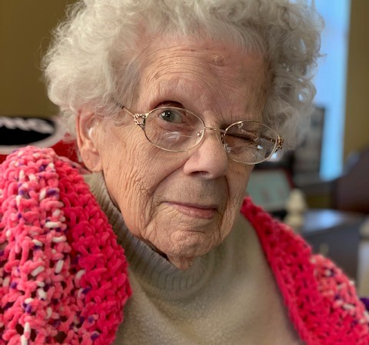
Conclusions
We have presented the important role that Rest Homes play on the healthcare continuum. Rest Homes provide a welcoming home for elderly seeking a medical and housing option in a community- based setting.
We have advanced concrete solutions endorsed by industry experts to solve the financial challenges/crisis facing the industry.
We have provided a reminder on why we should all care when a Rest Home closes, and the human impact associated with a closure
Going forward let’s work together to ensure no home closes for financial reasons.

