Slide 1
EPIA External Report January 2025
Does not include referrals received through BHTRP

Slide 2
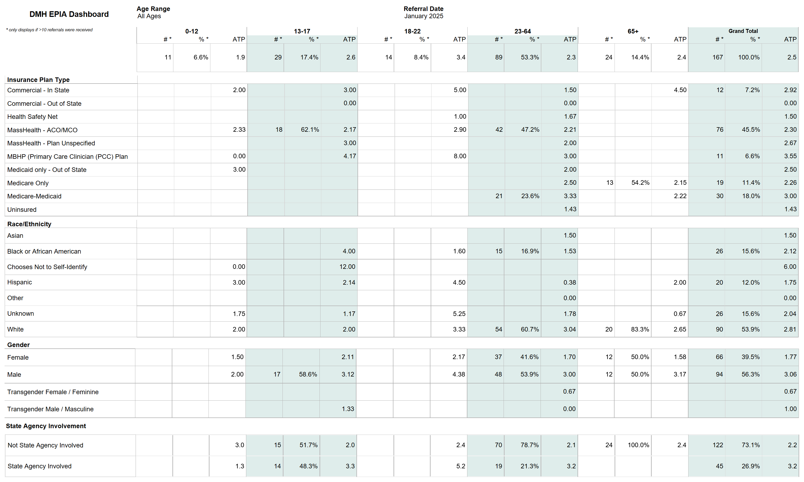

Slide 3
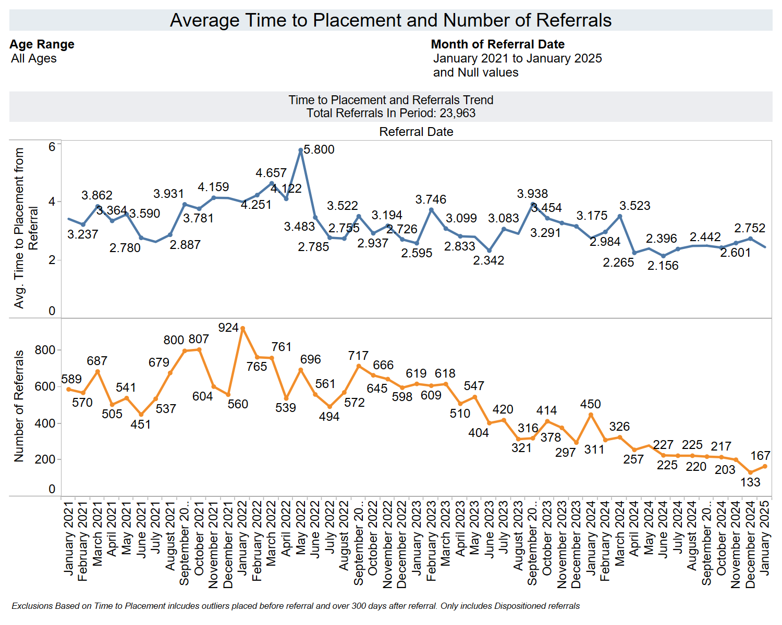

Slide 4
