Slide 1
Juvenile Justice Policy and Data Board
Data Subcommittee
October 10th
2pm – 4pm

Slide 2
Agenda
Welcome and Introductions
Review & Approval of September Meeting Minutes
Presentation on Secure Multi-Party Computation from Dr. Azer Bestavros, Boston University Hariri Institute
Data for Fall Legislative Report

Slide 3
Fall Report: System Trends

Slide 4
System Metrics
Arrests (EOPSS)
Applications for Complaint (MassCourts)
Delinquency Filings (MassCourts)
Arraignments (DCJIS)
Probation Case Loads (MassCourts)
DYS Commitments (DYS)
Overnight Arrests (DYS)
Detention (DYS)
Adjudication (MassCourts)

Slide 5
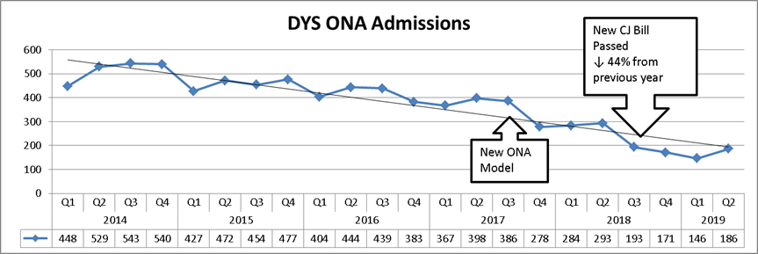
Overnight Arrest Admissions Down 44%

Slide 6
Applications for Complaint Down 25% from FY18 to FY19

Slide 7
Delinquency Filings Down 33% from FY18 to FY19

Slide 8
Detention Admissions Down by 28%

Slide 9
Probation Delinquency-Related Caseload Down 24% from July 2018 to July 2019

Slide 10
DYS First-Time Commitments Down 17%

Slide 11
Data on Specific Statutory Changes

Slide 12
Raising the Lower Age
Data Point | Pre (FY18) | Post (FY19)
Total Arrests | Calendar Year 2017: 53 | Calendar Year 2018: 32
Overnight Arrests | 2 | 0
Applications for Complaint | * (Data coming from Courts) | * (Data coming from Courts)
Delinquency Filings | * (Data coming from Courts) | * (Data coming from Courts)
Detention Admissions | 1 | 0
DYS Commitments | 0 | 0

Slide 13
First Offense Low-Level Misdemeanors
Data Point | Pre (FY18) | Post (FY19)
Total Arrests | Can’t isolate in data | Can’t isolate in data
Overnight Arrests (All Misdemeanors) | 605 | 319
Applications for Complaint | See Chart | See Chart
Delinquency Filings | See Chart | See Chart
DYS Commitments (All Misdemeanors) | 111 | 82

Slide 14
School-Based Offenses
Data Point | Pre (FY18) | Post (FY19)
School-Based Arrests | No Baseline Available | (Waiting for data from DESE)
Applications for Complaint (School-Disturbance) | 1040 | 337
Delinquency Filings (School-Disturbance) | 777 | 244

Slide 15
% Drop in ONA Similar Across Offense Seriousness Levels

Slide 16
Largest Drops in Applications for Complaint for School Disturbances, Alcohol & Property Offenses

Slide 17
Largest Drops in Delinquency Filings for Alcohol, School Disturbance, and Property Offenses

Slide 18
Decrease in Detention Admissions Driven by Drops in Lower Grid Levels

Slide 19
DYS First-Time Commitments Down 17%, Driven Primarily by Drop in Misdemeanor/Grid Level 1 Offenses

Slide 20
Use of Other Community-Based Services
CRA Court Filings
CRA Data – DCF*
BSAS Enrollments
DMH Applications*
Juvenile Court Clinic Evaluation Data*
*Waiting on data

Slide 21
CRA Court Filings Remain Stable

Slide 22
CRA Court Filings by Type

Slide 23
Admissions to BSAS Treatment for Youth 12-17 Down 33%*

Slide 24
Most BSAS Referrals Come from Non-Justice System Sources

Slide 25
Data broken down by race/ethnicity

Slide 26
ONA Admissions by Race/Ethnicity

Slide 27
Complaints & Filings by Race/Ethnicity

Slide 28
Filings for Drug Offenses by Race

Slide 29
BSAS FY18/19 Admissions by Race/Ethnicity

Slide 30
Detention Admissions by Race/Ethnicity

Slide 31
DYS First-Time Commitments by Race/Ethnicity

Slide 32
Next Meeting Date
November 15th, 10am – 12pm 600 Washington, 4th Floor

Slide 33
Contact
Melissa Threadgill Director of Juvenile Justice Initiatives melissa.threadgill@mass.gov 617-979-8368

