Slide 1
Joint AHA Commission Data Brief & Expert Panel
April 18, 2025

Slide 2
Agenda
Call to Order | N/A
Data Brief | 3 – 24
Expert Panel | 25 – 26
Next Steps | 27 – 28

Slide 3
A Home for Everyone Massachusetts’ Comprehensive Housing Plan 2025 - 2035

Slide 4
HAC & Statewide Housing Plan | Timeline
In October 2023, Governor Healey filed Executive Order #621, charging HLC with producing a Comprehensive Statewide Housing Plan (released February 2025) and establishing the HAC to advise HLC throughout the process.
September - December
Finalized Plan
January 2024 - March
March – August
Created Housing Advisory Council
Defined structure, format, and areas of focus
Created public online survey for public to provide input on MA housing needs and focus areas for the plan
1. Held 14 regional listening, encompassing each region of the State, and attended by 1,600 participants
2. Developed initial scope of plan and forecasted population projections in partnership with HAC
Held 23 targeted listening sessions and received input from over 800 participants
Receive final feedback and input from HAC on Phase 1 report.
Phase 1 2/5/25
Phase 2
Spring 2025

Slide 5
Key Findings of the Plan (I/II)
A shortage of homes is the root cause of housing cost crisis
Massachusetts is at risk of losing the homes we have
A growing share of resident's struggle to afford cost of living
There is a growing population with complex housing and medical needs
Housing Crisis affects everyone

Slide 6
Key Findings of the Plan (II/II)
Massachusetts needs to add 222,000 homes to the available housing stock from 2025 – 2035
Net increase in year-round housing units needed to achieve housing abundance, with estimates of the net increase in demand for housing at different income levels.
NOT an estimate of existing affordable housing shortfall or a measure of how many affordable units need to be created through production or conversion.

Slide 7
Components of Anticipated Housing Need
Massachusetts needs to add 222,000 year-round homes to the available housing stock from 2025 – 2035.
About 106,000 homes are needed to accommodate new Millennial and Gen Z households under a moderate growth scenario.
About 56,000 needed to address “latent demand” (doubled-up and overcrowded families, families in shelter, and roommates).
About 9,600 homes needed to compensate for anticipated seasonal conversion.
About 51,000 additional homes for-sale or for-rent needed to achieve a healthy vacancy rate.

Slide 8
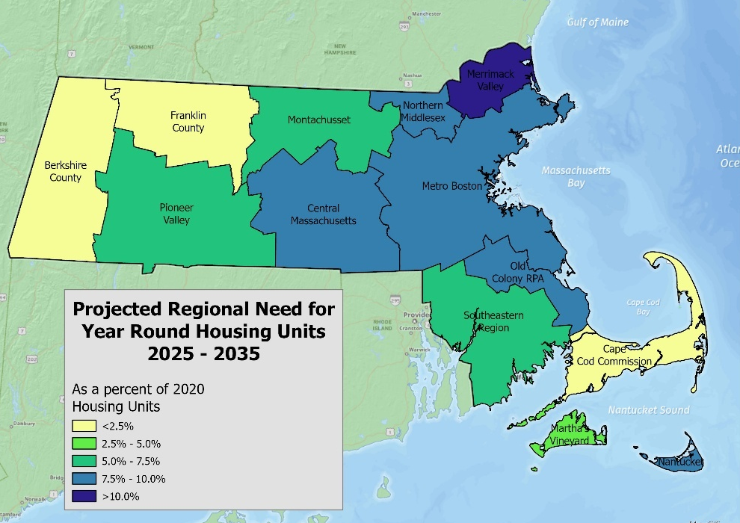
Housing Need by Region
This is the anticipated net increase in year-round housing units that would be needed to achieve housing abundance.
It is not a measure of how many affordable units are needed to serve unmet housing needs of existing low-income residents.
The low-income shortfall may be larger than the net housing need.

Slide 9
Data Brief

Slide 10
Baby Boomers constitute 24% of Massachusetts’ population and head up 36% of its households¹

Slide 11
Massachusetts Older Adult Households
800,000 households (as of 2023)²
72% own their home³, but rates of homeownership are falling nationally, and those who do own their home are more likely to have a mortgage and more debt than in the past.⁴
45% are a person living alone; 40% are two people.⁵
About 57% of Baby Boomers and Silent Generation households occupy a home with three or more bedrooms.⁶
3.7% have offspring age 18 – 35 living at home and not in school (~28,000 households.) ⁷
2.5% of Massachusetts Older Adults live in nursing homes or other group quarters. ⁸

Slide 12
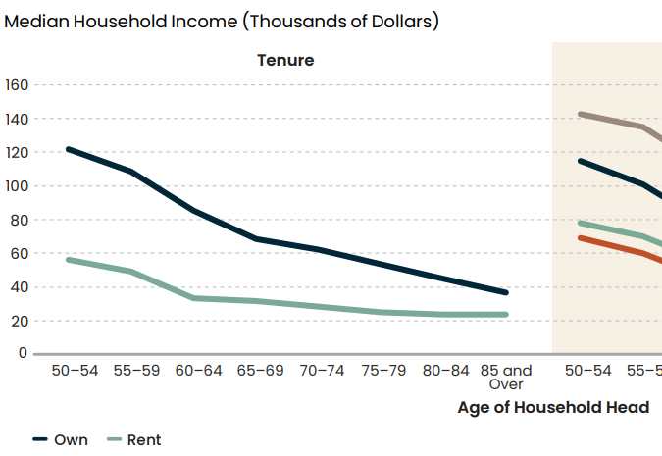
Finances for Older Adults in the U.S. and Massachusetts
Median income for over-65 households in Massachusetts is $63,000. ⁹
In Massachusetts, 85% of Older Adult households receive a Social Security (avg) $22,600 per year. 43% are working and 53% have retirement income. ¹⁰
Typical U.S. homeowner aged 65+ has $499,000 of wealth, but the median older renter has only $10,000 in wealth.¹¹
Massachusetts ranks last out all of 50 states in economic security for older adults, with higher housing costs being the main driver.¹²
Nationwide, income declines with age

Slide 13
Older Adults – Projected Population Growth
Older adult populations are growing in every region, by as much as 50% projected increase over 15 years.¹³
Berkshire, Cape Cod, Franklin, and Marthas Vineyard are projected to grow more slowly, but the 65+ age group is already more than 1/5th of total population in those regions.

Slide 14
Older Adults – Projected Household Growth
The number of Older Adult households is projected to increase by 135,000 from 2025 – 2035, an increase of 15%. ¹⁴
By 2035, all the Baby Boomers will be past the age of 70, with a smaller group of Gen X Older Adults following them.
Most growth of Older Adult households is in those headed by someone 75 or more, which account for almost all net household growth.

Slide 15
Older Adult Households Growing across Massachusetts
Almost one-third of Massachusetts households are headed by an Older Adult¹⁵
By 2035, Older Adult households could constitute fully one third of all households.
In Western MA, Cape, and Martha’s Vineyard, older adults could be more than 40% of all households.

Slide 16
Extremely Low-Income Households in Massachusetts
325,200 renter households; 31% of renter households are ELI¹⁶
122,800 Owner households¹⁷
Statewide, the income limit for a four-person household was $40,850; enough to afford $1,020 per month on housing, without being cost burdened. ¹⁸
For comparison, a full-time minimum wage worker in MA would earn approximately $31,200.
80% of ELI renter households are cost burdened; and 63% of ELI renters experience severe cost burden (paying more than 50% of income on housing.)¹⁹
There is an estimated shortage of 183,000 rental homes affordable and available for extremely low-income renters.²⁰

Slide 17
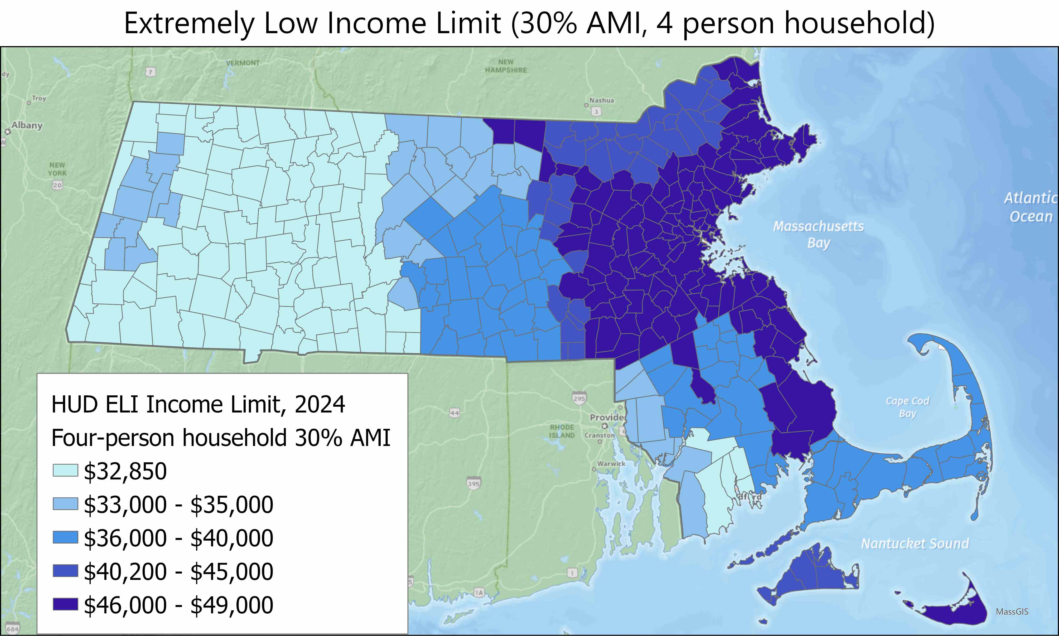
ELI limit varies from $32,000 to $49,000, depending on the region
(For 2-person income limit, multiply by 0.8)

Slide 18
“ELI” Households (<$35,000 per year) projected to grow 13%
Households with income <$35,000 are projected to increase by 83,000 from 2025 to 2035 ²¹
50,000 people living alone
31,600 two-person households (many single parents)

Slide 19
Households with income <$35,000 are projected to grow in every region ​
​

Slide 20
Households in need of accessibility in Massachusetts
800,000 people in Massachusetts have some kind of disability.²²
335,000 households (12% of the total) have a household member with an ambulatory disability (a condition that substantially limits one or more basic physical activities, such as walking, climbing stairs, reaching, lifting, or carrying.)²²
Households with a disability are more likely to be renters: 41% of households with a disability are renters compared to around 36% in the state.²²
Western Massachusetts has a slightly higher share of the population with a disability. Over 15% of people in the Berkshire (BRPC) and Pioneer Valley (PVPC) regions have some type of disability, compared to 12% statewide.²²

Slide 21
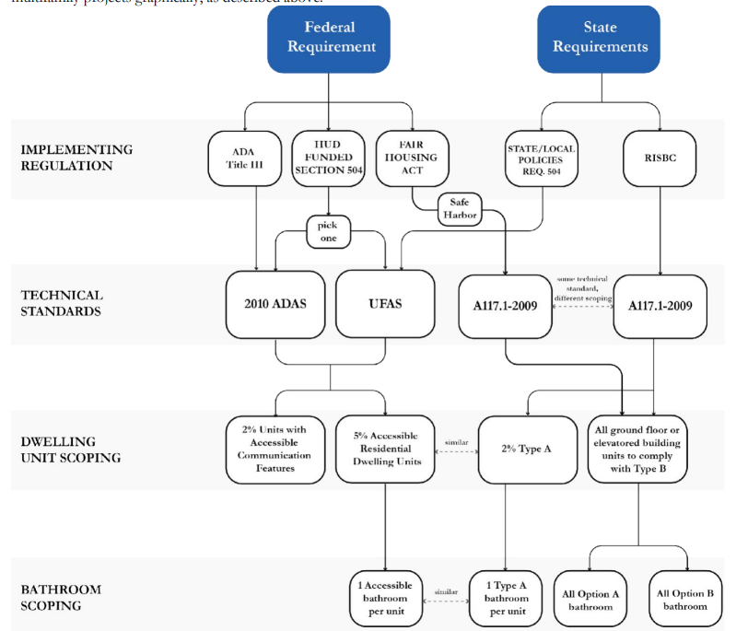
Accessible units are in short supply
Disability and access needs present in many ways and change over time. It is difficult to create a definitive estimate of disability needs.
Wide range of approaches and regulatory requirements for accessibility and adaptability.
Cost data and comprehensive inventory are lacking.
Housing Navigator data indicates there is one accessible and affordable unit for every 63 renters earning 80% or less of AMI.
People with disabilities who need long-term services and support (LTSS) are more likely to have severe cost burden, and live in poor-quality housing.
*Disability is defined by the Census Bureau as having one of the following six disabilities: Ambulatory disability, cognitive disability, hearing disability, independent living disability, self-care disability, and vision disability. People may report multiple disabilities.
Regulatory diagram from KMA’s RI Housing Accessibility Resource Manual²³

Slide 22
Many households fall into two or more of these groups
19% of the 65+ population has an ambulatory disability
Senior Households
Extremely Low Income Households
Households that need accessible housing
Two fifths of people with a disability are 65+
36% of households with a disability make $35,000 or less
41% of ELI renter households are seniors
19% of non-senior ELI households have a disability

Slide 23
Older Adults make up 77% of Lowest Income Household Growth

Slide 24
Questions?

Slide 25
Expert Panel

Slide 26
Expert Panel
Jennifer Molinsky, PhD
Director, Housing an Aging Society Program
Joint Center for Housing Studies of Harvard University
Dan Emmanuel, MSW
Research Manager
National Low Income Housing Coalition (NLIHC)
Katie Denis, APAC-BE
Senior Associate
Kessler, McGuinness & Associates (KMA)

Slide 27
Next Steps

Slide 28
Next Steps
May: Joint meeting on development costs
June: Separate Commission meetings to begin narrowing identified challenges and recommendations

Slide 29
References
University of Massachusetts Donahue Institute, analysis of 2020 Census Data and 2024 H1 Projections
American Community Survey, 2023 1-year estimates, table S0103
American Community Survey, 2023 1-year estimates, table S0103
Housing America's Older Adults 2023; Joint Center for Housing Studies of Harvard University; 2023 (https://www.jchs.harvard.edu/housing-americas-older-adults-2023)
MAPC Analysis of 2017 - 2021 American Community Survey PUMS data
MAPC Analysis of 2017 - 2021 American Community Survey PUMS data
MAPC Analysis of 2017 - 2021 American Community Survey PUMS data
MAPC Analysis of 2017 - 2021 American Community Survey PUMS data
MAPC Analysis of 2017 - 2021 American Community Survey PUMS data
American Community Survey, 2023 1-year estimates, table S0103
Joint Center for Housing Studies of Harvard University; Housing America's Older Adults 2023 (https://www.jchs.harvard.edu/housing-americas-older-adults-2023)
Mutchler, Jan; Velasco Roldán, Nidya; and Su, Yan-Jhu, "Living Below the Line: Economic Insecurity and Older Americans, Insecurity in Massachusetts, 2022" (2023). Center for Social and Demographic Research on Aging Publications. 67. https://scholarworks.umb.edu/demographyofaging/67
A Home for Everyone Housing Demand Projections (MAPC)
A Home for Everyone Housing Demand Projections (MAPC)
A Home for Everyone Housing Demand Projections (MAPC)
National Low Income Housing Coalition, Housing Needs by State, based on 2023 American Community Survey PUMS data; https://nlihc.org/housing-needs-by-state/massachusetts
HUD Comprehensive Housing Affordability Strategy, 2017 –2021
HUD FY 2025 Income Limits Documentation System https://www.huduser.gov/portal/datasets/il/il2025/select_Geography.odn
National Low Income Housing Coalition, Housing Needs by State, based on 2023 American Community Survey PUMS data; https://nlihc.org/housing-needs-by-state/massachusetts
National Low Income Housing Coalition, Housing Needs by State, based on 2023 American Community Survey PUMS data; https://nlihc.org/housing-needs-by-state/massachusetts
A Home for Everyone Housing Demand Projections (MAPC)
University of Massachusetts Donahue Institute, analysis of 2017 – 2021 ACS PUMS data
2025 RIHousing Accessibilty Resource Manual; KMA, 2025; https://www.rihousing.com/wp-content/uploads/Accessibility-Resource-Manual_March-2025.pdf
Data Opens Doors -- Affordable + Accessible Rentals 2024 Report; Housing Navigator, June, 2024; https://housingnavigatorma.org/wp-content/uploads/2024/06/2024-Data-Opens-Doors-Affordable-Accessible-Housing.pdf

