Slide 1
Executive Office of Public Safety and Security
Justice Reinvestment Policy Oversight Board
Cross Tracking Platform Roadmap - 2023
12/1/2022

Slide 2
Agenda
CY2022 Roadmap Updates
CY2022 Q4 Public Platform Releases
Recidivism Progress
CY2023 Q1 and Q2 High-Level Goals and Deliverables

Slide 3
CY2022 Roadmap Updates: Q3/Q4 2022
 | Trial Court & Probation | Law Enforcement | Sheriffs | DOC | Platform | Governance
Lead | Trial Court – Joe Jackson Probation – Michael Coelho* | EOPSS – Abir Sohel MSP – Keith Paquette LEA – Chief Michael Bradley* | EOPSS – Kevin Crowley Sheriff – Carrie Hill | DOC – Shawn Jenkins | EOPSS – Srini Paruchuri and Greg Organ | EOPSS – Rishiraj Keshkamat*
Deliverables | Public Dashboard will provide monthly snapshot population and demographic data (from 1/1 annual snapshot currently shown) Additional public dashboard for Admission and Release data for custodial agencies with drill down/analysis provided by event type Additional programmatic dashboard published to show programs being run by DOC and Sheriffs for inmates across Massachusetts Automated, weekly data loads to CJ360 from MSP, DOC, Sheriffs and Courts SID Reporting and Matching algorithm initiated for the purpose of increased identity matching records and data where no SID or fingerprint records exist Data Quality Dashboard with reporting on operational and data stats along with auditing and error identification Recidivism rules developed and data set collected to allow platform recidivism reporting in 2023 Metrics and reporting established for agency compliance and increased use of SID through the booking process
Critical Tasks | Electronically submit required recidivism data set (e.g. charges and dispositions) to CJ360 platform Describe and explain EACC use constraints and recommend process and technical improvements (Nov. 1, 2022 Dec. 31, 2022) Prepare MassCourts to accept SID electronically from OneIII Include CJ360 as part of court initiatives and investments for 2023/2024 | Begin upgrade of RMS to capture 501 CMR Data elements (to be completed by Feb 28, 2023) Needs assessment complete of Live Scan, RMS and EACC interface capabilities (Nov. 7, 2022) Standardize Booking procedures to include Fingerprint arrests (SOP to be released early October) | Identify data and policy/operations SME teams in each Office for both program and admission/release data Submit program, admissions and release data to CJ360 platform (Oct 1, 2022) Prepare to have OMS accept SID electronically from OneIII (Nov. 15, 2022) Implement standardized booking process per published SOP and monitor, refine, measure and report (Nov. 1, 2022 Dec. 31, 2022) Establish and review metrics on CMR compliance (Nov. 1, 2022 Dec. 31, 2022) | Submit program, admissions and release data to CJ360 platform (Oct 1, 2022) Prepare IMS to accept SID electronically from OneIII(Nov. 30, 2022) Implement standardized booking process per published SOP and monitor, refine, measure and report (Nov. 30, 2022) Establish and review metrics to report on CMR compliance (Nov. 30, 2022) | Collect, process and publish custodial and demographic population data with Monthly Snapshots (from current annual snapshot) (Nov. 2022) Collect, process and refine Platform Data (Nov. 2022) Collect, process and publish custodial Admissions and Release Data (Nov 2022 Dec. 2022) Initiate SID Reporting and Matching algorithm for Internal Dashboard (Nov. 2022) | Establish Charter for Data Governance Council (Oct. 10, 2022) Communicate expectations and name Data Champions/Stewards (Oct. 24, 2022) DGC Kick-Off (Nov. 14, 2022)
Dependencies | [Nov. 1, 2022] Trial Courts: Provide input and recommendations for EACC improvement and report on monthly usage and support increased education on use of EACC [Nov. 1, 2022] Sheriffs and DOC: Data standardization of the admissions and release data may be a challenge due to the various methods of capturing this data at each of the sheriffs and DOC [Nov. 7, 2022] Law Enforcement: Assessment of required technology investments that may be required to enable increased EACC use and RMS upgrades for CMR compliance [Nov. 31, 2022] EOPSS: Further technology investment identified and requested for OneIII, ABIS (AFIS replacement project), IMS, CJIS broker, Platform, Parole (Spirit application), and EACC web modernization
Complete In Progress

Slide 4
Phase 2 Overall Deliverable Status
Deliverable | Expected Completion Date | Status (Red/Yellow/Green)
Public Dashboard will provide monthly snapshot population and demographic data (from 1/1 annual snapshot currently shown) | 11/23/2022 | Complete
Additional public dashboard for Admission and Release data for custodial agencies with drill down/analysis provided by event type | 12/23/2022 | Working through review/approvals with agency data owners prior to publishing on public site.
Additional programmatic dashboard published to show programs being run by DOC and Sheriffs for inmates across MA (internal users – CJIS access certified) | 11/18/2022 | Complete
Automated, weekly data loads to CJ360(non-public) from MSP, DOC, Sheriffs and Courts | 11/18/2022 | Complete
SID Reporting and Matching algorithm initiated for purpose of increased identity matching records and data where no SID or fingerprint records exist | 11/18/2022 | Complete
Data Quality Dashboard with reporting on operational and data stats along with auditing and error identification | 11/18/2022 | Complete
Recidivism rules developed and data set collected to allow platform recidivism reporting in 2023 | 11/30/2022 | Complete
Metrics and reporting established for agency compliance and increased use of SID through the booking process | 12/31/2022 | Activities identified on Sheriff’s Plans; Data Governance will drive this; DOC reported initial metrics

Slide 5
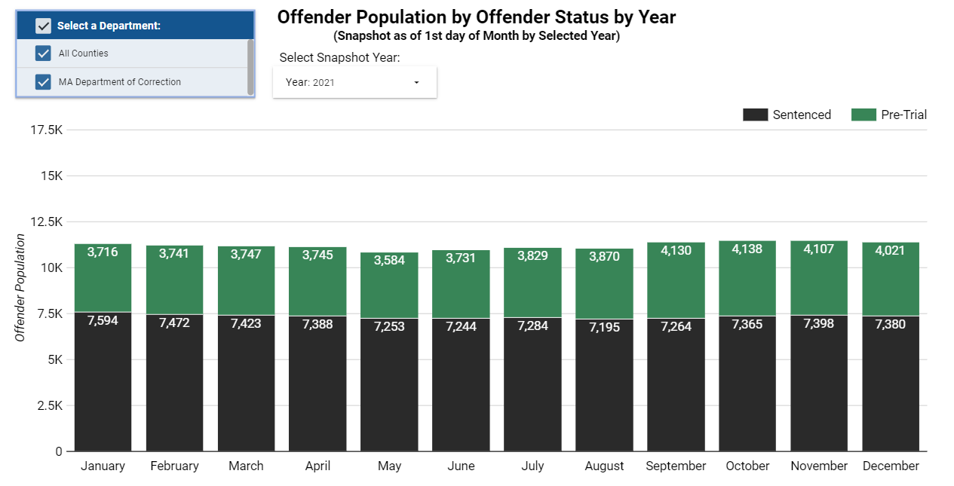
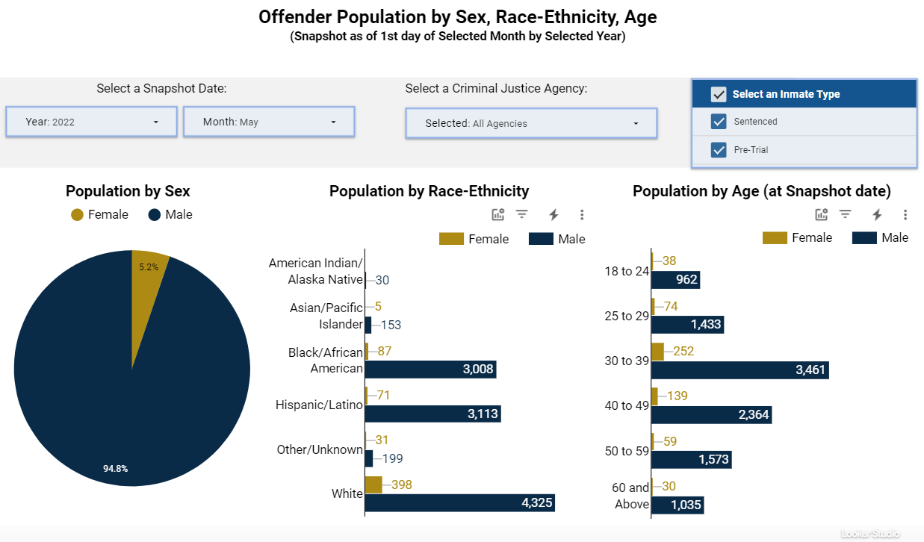
CY2022 Q4 Public Platform Releases: Monthly Snapshot
Before
Challenge
After
Public Platform initially provided annual snapshots only
Users were unable to identify trends within a certain year and draw conclusions
EOPSS and SpringML collaborated to aggregate more granular data from DOC and sheriffs’ agencies to provide monthly snapshots
Public Platform Screenshots
Link to Public Platform

Slide 6
CY2022 Q4 Public Platform Releases: Admissions and Release Data
What is it?
Admission and Release Data provides insights to track offender entrance into and exit from custody of the 13 county Sheriff agencies and the DOC.
Why does it matter?
A holistic view of this data lets us see more granular offender population at a given point in time, and thus accurately track levels and trends over time. Enabling access to this data via a dashboard enhances transparency to the public and is a foundational requirement for recidivism reporting.
Definitions for Admissions and Release Data
Goal for Public Dashboard
What will we show?
This addition to the public-facing dashboard will display interactive visualizations that allow users to view admissions and release data with the ability to filter by locations.
Next Steps:
Data Validation
Final reviews and checks
Agency sign off
Public platform go-live
(Dec 2022)

Slide 7
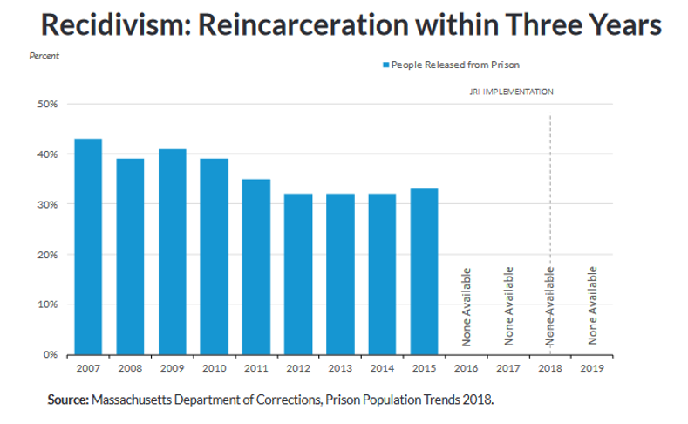
Recidivism Overview
Purpose
To develop a CMR-compliant recidivism reporting system
To develop a sufficiently flexible and robust system that supports other criminal justice data queries
The model has all the elements to construct statutorily and CMR required measures of rearraignment, reconviction and reincarceration at one-, two- and three-year intervals
The model anticipates the potential for future statute changes as well as alternative definitions that future criminal justice audiences may wish to explore

Slide 8
CJ360 Phase 2 Recidivism Model – Progress to Date
The cross-tracking platform foundation enables a comprehensive, trailblazing model across all state and local custodial institutions
Phase 1 – Identify and Collect Data
Phase 2 – Refine Data Quality and Build Model
Phase 3 – Validate and Report per Statute
Established initial data feeds from 13 sheriffs, the DOC, Massachusetts State Police, Trial Court, and Probation to ingest all required data
Established sustainable infrastructure based on automated, regular data feeds that eliminates concerns about stale, out-of-date results
Built foundational recidivism model for three different types of recidivism: Rearraignment, Reconviction, and Reincarceration
Developed a flexible approach that supports both CMR Statue requirements and other types of queries
Phase 3 will begin to develop public reporting of anonymized reincarceration recidivism data, per Statute requirement

Slide 9
CJ360 Phase 2 Recidivism Model – Next Steps
During Phase 3, in order to meet Statute requirements, we will:
Develop report for CMR-required Year 1,2, and 3 reincarceration rates
Organize, normalize, anonymize, and present the events and results from Phase 2 model development to the public
Integrate Parole data into the model, as required by CMR
Will support additional purposes and queries
Improve Data Completeness and Validate
Necessary for a cohesive view across the Commonwealth, avoiding potential skewing/bias by agency (e.g., being able to determine recidivism events vs not having data making recidivism artificially low)
Integrate agencies that are not using PCF numbers (Name and DOB search)
Leverage the probabilistic matching algorithm developed in Phase 2 for Offender 360
Include all releases to the community (mapping of Admissions/Releases part of Phase 2)
Improve Data Quality
Consistent formatting of PCF numbers

Slide 10
CY2023 Q1 and Q2 High-Level Goals and Deliverables
Goals
Deliverables
Expand weekly data feeds to include Parole and some Law Enforcement data
Provide a recidivism for reincarceration dashboard to the public
Provide a program dashboard for the public
Continued work on recidivism modeling and cross-tracking algorithm
Updated data pipelines to include Parole and LEA data
New Recidivism Public Dashboard published for Reincarcerations
New Programmatic Public Dashboard published for Reincarcerations
Recidivism rules developed and data set collected to allow platform recidivism reporting for Reconviction and Rearraignment
Improve and enhance SID Reporting and Matching algorithm for the purpose of increased identity matching records and data where no SID or fingerprint records exist
Enhancements to EACC and increase use of EACC to 60% of criminal complaints filed
Fingerprinting reaches 70% compliance for completeness and accuracy at Custodial Agencies and 50% compliance for completeness and accuracy across local PDs
70% of new records coming into the platform from Custodial Agencies have complete and accurate SIDs and 50% of records ingested into the platform from the Trial Court have complete and accurate SIDs

Slide 11
Appendix: Supplemental Material

Slide 12
CJ360 Workplan: Q3/Q4 2022
 | Trial Court & Probation | Law Enforcement | Sheriffs | DOC | Platform | Governance
Lead | Trial Court – Joe Jackson Probation – TBD | EOPSS – Abir Sohel MSP – Keith Paquette LEA - TBD | EOPSS – Kevin Crowley Sheriff – Carrie Hill | DOC – Shawn Jenkins | EOPSS – Srini Paruchuri and Greg Organ | EOPSS – Maria Michalski and Vamsi Vandrangi
Deliverables | Public Dashboard will provide monthly snapshot population and demographic data (from 1/1 annual snapshot currently shown) Additional public dashboard for Admission and Release data for custodial agencies with drill down/analysis provided by event type Additional programmatic dashboard published to show programs being run by DOC and Sheriffs for inmates across Massachusetts Automated, weekly data loads to CJ360 from MSP, DOC, Sheriffs and Courts SID Reporting and Matching algorithm initiated for the purpose of increased identity matching records and data where no SID or fingerprint records exist Data Quality Dashboard with reporting on operational and data stats along with auditing and error identification Recidivism rules developed and data set collected to allow platform recidivism reporting in 2023 Metrics and reporting established for agency compliance and increased use of SID through the booking process
Critical Tasks | Electronically submit required recidivism data set (e.g. charges and dispositions) to CJ360 platform Describe and explain EACC use constraints and recommend process and technical improvements (Nov. 1, 2022) Prepare MassCourts to accept SID electronically from OneIII Include CJ360 as part of court initiatives and investments for 2023/2024 | Begin upgrade of RMS to capture 501 CMR Data elements (to be completed by Feb 28, 2023) Needs assessment complete of Live Scan, RMS and EACC interface capabilities (Nov. 7, 2022) Standardize Booking procedures to include Fingerprint arrests (SOP to be released early October) | Identify data and policy/operations SME teams in each Office for both program and admission/release data Submit program, admissions and release data to CJ360 platform (Oct 1, 2022) Prepare to have OMS accept SID electronically from OneIII (Nov. 15, 2022) Implement standardized booking process per published SOP and monitor, refine, measure and report (Nov. 30, 2022) Establish and review metrics on CMR compliance (Nov. 30, 2022) | Submit program, admissions and release data to CJ360 platform (Oct 1, 2022) Prepare IMS to accept SID electronically from OneIII(Nov. 30, 2022) Implement standardized booking process per published SOP and monitor, refine, measure and report (Nov. 30, 2022) Establish and review metrics to report on CMR compliance (Nov. 30, 2022) | Collect, process and publish custodial and demographic population data with Monthly Snapshots (from current annual snapshot) (Nov. 2022) Collect, process and refine Platform Data (Nov. 2022) Collect, process and publish custodial Admissions and Release Data (Nov 2022) Initiate SID Reporting and Matching algorithm for Internal Dashboard (Nov. 2022) | Establish Charter for Data Governance Council (Oct. 10, 2022) Communicate expectations and name Data Champions/Stewards (Oct. 24, 2022) DGC Kick-Off (Nov. 14, 2022)
Dependencies | [Nov. 1, 2022] Trial Courts: Provide input and recommendations for EACC improvement and report on monthly usage and support increased education on use of EACC [Nov. 1, 2022] Sheriffs and DOC: Data standardization of the admissions and release data may be a challenge due to the various methods of capturing this data at each of the sheriffs and DOC [Nov. 7, 2022] Law Enforcement: Assessment of required technology investments that may be required to enable increased EACC use and RMS upgrades for CMR compliance [Nov. 31, 2022] EOPSS: Further technology investment identified and requested for OneIII, ABIS (AFIS replacement project), IMS, CJIS broker, Platform, Parole (Spirit application), and EACC web modernization

Slide 13
CJ360 Workplan: Q1/Q2 2023
 | Trial Court & Probation | Law Enforcement | Sheriffs | DOC | Platform | Governance
Lead | Trial Court – Joe Jackson Probation – TBD | EOPSS – Abir Sohel MSP – Keith Paquette LEA - TBD | EOPSS – Kevin Crowley Sheriff – Carrie Hill | DOC – Shawn Jenkins | EOPSS – Srini Paruchuri and Greg Organ | EOPSS – Maria Michalski and Vamsi Vandrangi
Deliverables | New Recidivism Public Dashboard published for Reincarcerations Recidivism rules developed and data set collected to allow platform recidivism reporting for Reconviction and Rearraignment Improve and enhance public dashboard for Admission and Release data for custodial agencies with drill down/analysis provided by event type Improve and enhance programmatic dashboard Improve and enhance SID Reporting and Matching algorithm for the purpose of increased identity matching records and data where no SID or fingerprint records exist Enhancements to EACC and increase use of EACC to 60% of criminal complaints filed Fingerprinting reaches 70% compliance for completeness and accuracy at Custodial Agencies and 50% compliance for completeness and accuracy across local PDs 70% of new records coming into the platform from Custodial Agencies have complete and accurate SIDs and 50% of records ingested into the platform from the Trial Court have complete and accurate SIDs
Critical Tasks | MassCourts accept and incorporate SID from OneIII Electronically submit all required data to CJ360 platform (June 30, 2023) Support, monitor and report on increased use of EACC (monthly) MassCourt enhancements to support CJ360 platform | RMS upgraded to capture all CMR data elements (Feb. 28, 2023). RMS accept and incorporate SID electronically from OneIII RMS and Live Scan interface with EACC Each LEA has a livescan Implement standardized booking process across LEAs per published SOP and monitor, refine, measure and report compliance Data submission into CJ360 platform | OMS accept and incorporate SID electronically from OneIII Refine required data for recidivism reporting Agencies continue to refine and report on booking process and increase fingerprinting of inmates Incorporating SID into OMS | IMS accept and incorporate SID electronically from OneIII Refine required data for recidivism Agencies continue to refine and report on booking process and increase fingerprinting of inmates Incorporating SID into IMS | Enhance the custodial and demographic population data Program Data Published Collect, process and publish recidivism data for reincarcerations Refine Public Dashboard by adding charge information (including other charge data) Improved/Enhanced SID reporting and matching EOPSS hiring | Ensure each participating agency established required data governance foundations Refine and strengthen DGC role and responsibilities Build a Data Literacy program
Dependencies | [Feb. 28, 2023] Law Enforcement: Technology investments may be required to enable increased EACC use and RMS upgrades for CMR compliance [June 30, 2023] Trial Courts: Ability of Court to commit to cleaning and incorporating quality Trial Court data is critical to build quality database in CJ360 (e.g. charges and dispositions) [June 30, 2023] Sheriffs and DOC: Commitment required to ensure booking process is standardized, data is captured and compliance is reported [June 30, 2023] EOPSS: Further technology investment identified and requested for OneIII, ABIS (AFIS replacement project), IMS, CJIS broker, Platform, Parole (Spirit application), and EACC web modernization [June 30, 2023] All Agencies: Active participation in DGC and agency support to standardize offense and charge data will be required for governance to succeed

Slide 14
CJ360 Workplan: Q3/Q4 2023
 | Trial Court & Probation | Law Enforcement | Sheriffs/DOC | AGO/DAs Parole/SORB | Platform | Governance
Lead | Trial Court – Joe Jackson Probation – TBD | EOPSS – Abir Sohel MSP – Keith Paquette LEA - TBD | EOPSS – Kevin Crowley Sheriff – Carrie Hill DOC – Shawn Jenkins | TBD | EOPSS – Srini Paruchuri and Greg Organ | EOPSS – Maria Michalski and Vamsi Vandrangi
Deliverables | Pilot (July 2023) and Publish (Dec 2023) Recidivism Reporting for Reconviction and Rearraignment Enhance dashboards with data related to Risk/Needs, Caretaker and Repro Health Needs Improve and enhance Recidivism Public Dashboard published for Reincarcerations Improve and enhance public dashboard for Admission and Release data for custodial agencies with drill down/analysis provided by event type Improve and enhance programmatic dashboard Improve and enhance SID Reporting and Matching algorithm for the purpose of increased identity matching records and data where no SID or fingerprint records exist Increase use of EACC to 80% of criminal complaints filed Fingerprinting reaches 85% compliance for completeness and accuracy at Custodial Agencies and 65% compliance for completeness and accuracy across local PDs 85% of records coming into the platform from Custodial Agencies have complete and accurate SIDs and 65% of records ingested into the platform from the Trial Court have complete and accurate SIDs
Critical Tasks | Electronically submit all required data set to CJ360 platform (Oct. 31, 2023) Support, monitor and report on increased use of EACC (monthly) Provide Risk/Needs Data (October 31, 2022) MassCourt enhancements to support CJ360 platform | Monitor, review, refine reporting and data submission (monthly) with focus on fingerprinting and use of SID Support, monitor and report on increased use of EACC (monthly) Enhancements of RMS to support CJ360 platform | Electronically submit all required recidivism data set to CJ360 platform (Oct. 31, 2023) Provide Risk/Needs, Caretaker and Repro Health Needs data to platform (Oct. 31, 2023) Agencies continue to refine and report on booking process and increase fingerprinting of inmates Report on % of records electronically incorporating SID into OMS/IMS and into CJ360 Platform (monthly) | SORB and Parole electronically submit required data to CJ360 Platform (Sept 30, 2023) Incorporate the SID into the agencies record keeping or case management systems | Collect, process and publish recidivism data for Reconviction and Rearraignment Enhance public dashboard with new data sets (Risk/Needs, Caretaker and Repro Health Needs Data) Improved/Enhanced SID reporting and matching – including uniform use of SID electronically across all systems | Refine and strengthen Governance Roll out Data Literacy program and training to all participating agencies (Sept. 30, 2023) Build standard data dictionary and standardize key data sets (Sept 30, 2023)
Dependencies | [Sept. 30, 2023] EOPSS: Further technology investment identified and requested for OneIII, ABIS (AFIS replacement project), IMS, CJIS broker, Platform, Parole (Spirit application), and EACC web modernization [Sept. 30, 2023] All Agencies: Active participation in DGC and agency support to standardize offense and charge data will be required for governance to succeed [Dec. 31, 2023] Law Enforcement: Commitment required to ensure booking process is standardized, data is captured and compliance is reported [Dec. 31, 2023] Trial Courts: Ability of Court to commit to cleaning and incorporating quality Trial Court data is critical to build quality database in CJ360 (e.g. charges and dispositions) [Dec. 31, 2023] Sheriffs and DOC: Commitment required to ensure booking process is standardized, data is captured and compliance is reported

Slide 15
Commonwealth Direction
(What we will accomplish)
We will improve the criminal justice system by enhancing the integrity, accuracy, consistency, and transparency of information.
Outcomes
(Where we are going)
Drive Operational Efficiency and Effectiveness
Enable Linkages of Individual Records Across the Criminal Justice System
Increase Criminal Justice Data Availability, Quality, and Trust
Empower Data-Driven Decision Making and Monitoring
Analyze Disparities and Evaluate Effectiveness of Reform Programs
Enable Studies of Recidivism and Other Criminal Justice Research
Data provide insights into agency performance to understand how to improve operations
Individuals are tracked consistently throughout the entire criminal justice System
Criminal justice data can be consistently and securely shared and reused
Data support key decisions for policies and budgeting
Data support understanding racial disparities and the success of reform programs
Data support criminal justice reform studies more intuitively and through easier access
Strategic Focus Areas
(How we will get there)
Common Data Definitions
Governance Framework
Cross-Agency Data Sharing
Execution Oversight
A common data language to support consistent data definitions
Defined interagency roles, responsibilities, accountabilities, and processes
Requirements for the integration and development of supporting technology
Processes and procedures to operationalize and oversee target state implementation
Key Capabilities
(What We Need to Put in Place)
Unique ID
Data
Governance
Process
People / Org.
Technology

