Slide 1
Executive Office of Public Safety and Security
Executive Office of Technology Services and Security
Justice Reinvestment Policy Oversight Board
Cross-Tracking Initiative Update: Data Analytics Platform
06/13/22

Slide 2
Commonwealth Direction
(What we will accomplish)
We will improve the criminal justice system by enhancing the integrity, accuracy, consistency, and transparency of information.
Outcomes
(Where we are going)
Drive Operational Efficiency and Effectiveness
Enable Linkages of Individual Records Across the Criminal Justice System
Increase Criminal Justice Data Availability, Quality, and Trust
Empower Data-Driven Decision Making and Monitoring
Analyze Disparities and Evaluate Effectiveness of Reform Programs
Enable Studies of Recidivism and Other Criminal Justice Research
Data provide insights into agency performance to understand how to improve operations
Individuals are tracked consistently throughout the entire criminal justice System
Criminal justice data can be consistently and securely shared and reused
Data support key decisions for policies and budgeting
Data support understanding racial disparities and the success of reform programs
Data support criminal justice reform studies more intuitively and through easier access
Strategic Focus Areas
(How we will get there)
Common Data Definitions
Governance Framework
Cross-Agency Data Sharing
Execution Oversight
A common data language to support consistent data definitions
Defined interagency roles, responsibilities, accountabilities, and processes
Requirements for the integration and development of supporting technology
Processes and procedures to operationalize and oversee target state implementation
Key Capabilities
(What We Need to Put in Place)
Unique ID
Data
Governance
Process
People / Org.
Technology

Slide 3
Data Analytics Platform Updates and Next Steps
Completed Activities
Continued data and dashboard reviews three times per week in anticipation of dashboard deployment Conducted a data validation for data sources for the public dashboard with all sheriffs and the Department of Correction Completed one round of User Acceptance Testing (UAT) with over 35 participants Continued to establish enduring process for recurring data transfers
Immediate Next Steps
Incorporate refinements from UAT Address long-standing data issues Update dashboard designs Security testing for all dashboards Finalize recurring data transfers for all agencies Deploy Phase I dashboards

Slide 4
CJ360 Platform Development Investments To Date
Capital Costs The FY22 total between the EOTSS IT Capital office and EOPSS approx. $5.3M
Google Infrastructure $2,720,808
Google / SpringML Services $657,548
Gartner Oversight $1,129,610
Resource Investments $525,000 (changes to One III and Parole SPIRIT), $300,000 (EOPSS Staff augmentation)
Highlights of Commonwealth Efforts
DULA
UAT
Data Transfer
700 Hours
20 criminal justice agencies
Multiple 1-on-1 agency meetings and 50+ person meetings
Weekly review and editing of policy language
300 Hours
Multiple preparation meetings
UAT kickoff with 56 participants
~70 people involved in execution
350 Hours
14 Agencies, EOTSS, and EOPSS
Multiple individuals per Agency
Multiple 1-on-1 meetings

Slide 5
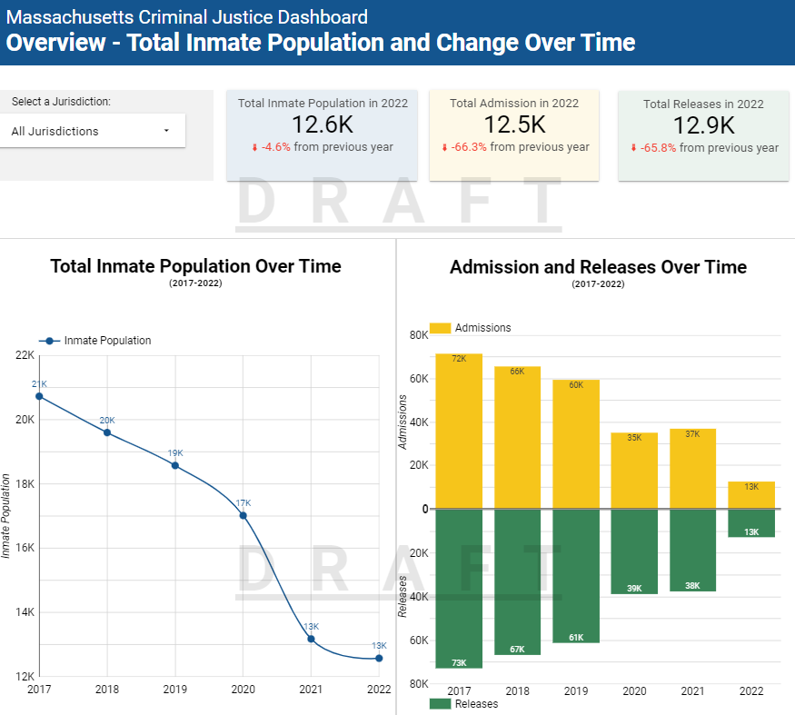
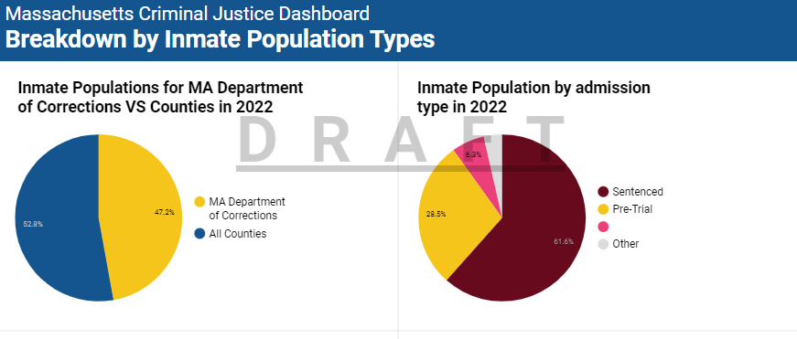
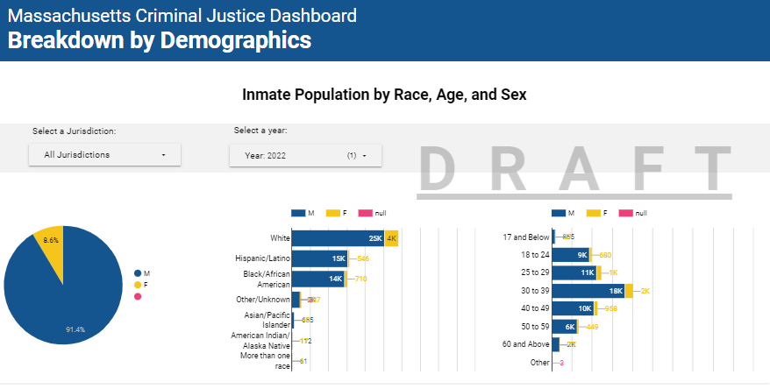
Draft Public Dashboard Screenshots

