Slide 1

Reaching the First (of many) Summits
Data and State Progress Updates
Leading By Example Council Meeting
July 14th, 2026
Presented by
07/14/2026
MA Department of Energy Resources, Leading By Example Division

Slide 2
Agenda
TIME | TOPIC
10:00AM – 10:10AM | Introduction & Agenda
10:10AM – 10:20AM | News, Reminders, and Updates
10:20AM – 10:35AM | Large Building Energy Reporting (LBER) Speaker: Nathan Dziadul, Building Energy Reporting Program Coordinator
10:35AM – 10:50AM | Executive Office of Housing and Livable Communities (EOHLC) Speaker: Greg Abbe, Sr. Climate Programs Specialist
10:50AM – 11:00AM | Q&A
11:00AM – 11:30AM | Progress Report: EO594 Updates Speaker: Sophia Vitello, Data & Project Analyst, DOER LBE
11:30AM – 12:00PM | Discussion
12:00PM | Closing

Slide 3

Welcome, Alessandra!
Alessandra Nagarajan is our Leading by Example Summer Intern!
Alessandra is going into her final year at Suffolk University as an Environmental Studies major.
Her interests relate to climate resiliency strategies in urban environments with an emphasis on environmental justice.

Slide 4




Before we get started…
World Cup Predictions! Who do you think will win?
France
England
?
Spain
Argentina
Notes:
Who do you WANT to win?

Slide 5
LBE Updates & Reminders

Slide 6
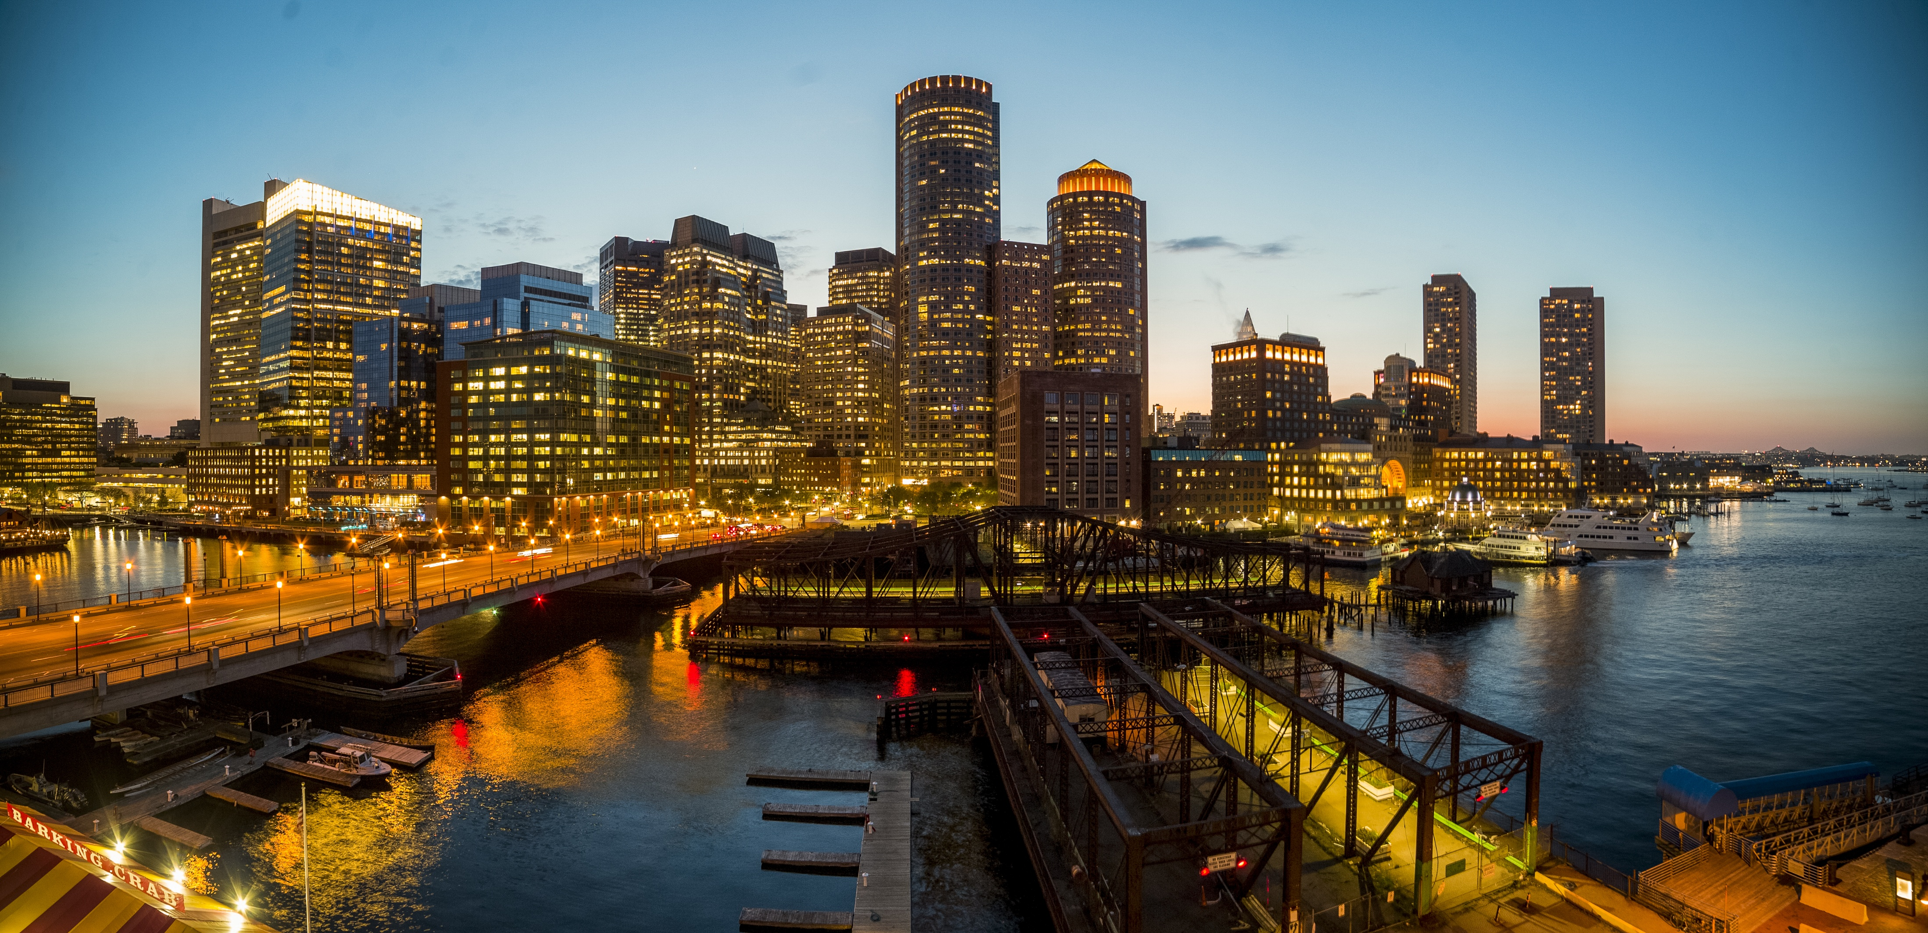
Large Building Energy Reporting (LBER) Reminder
Thank you to those who submitted their energy data by June 30th, 2026 (on 2025 data)!
If you haven’t yet submitted your data, you can still apply for an extension with the Extension Form on the Knowledgebase
We will hear more about the data collected in this program later in this meeting!

Slide 7
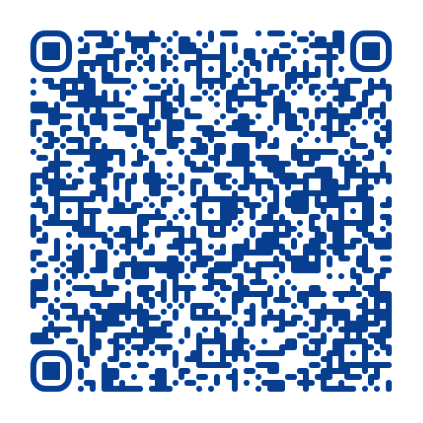
LBE Awards – Nominations Open
This year marks the 20th Annual LBE Awards!
Has your campus or agency adopted or expanded sustainability initiatives? Or do you know an individual that has gone above and beyond in their sustainability work?
They may be eligible for an LBE Award!
Fill out our nomination form by August 31st, 2026 (link also available on our website)

Slide 8

LBE Grants Updates
LBE will amend the following grants in the coming months:
Fleet EVSE (4.0)
  New round of capital funding!
  Continued funding for domicile charging
Equipment Decarbonization Grant
  Increasing project cost coverage percentage
Solar-Decarbonization Grant
  Adding embodied carbon-related adders
  Removing REC settlement requirements
  Increasing total grant program funding amount

Slide 9
Update: Next Council Meeting is now September 15th (10AM-12PM)

Slide 10
In the News

Slide 11
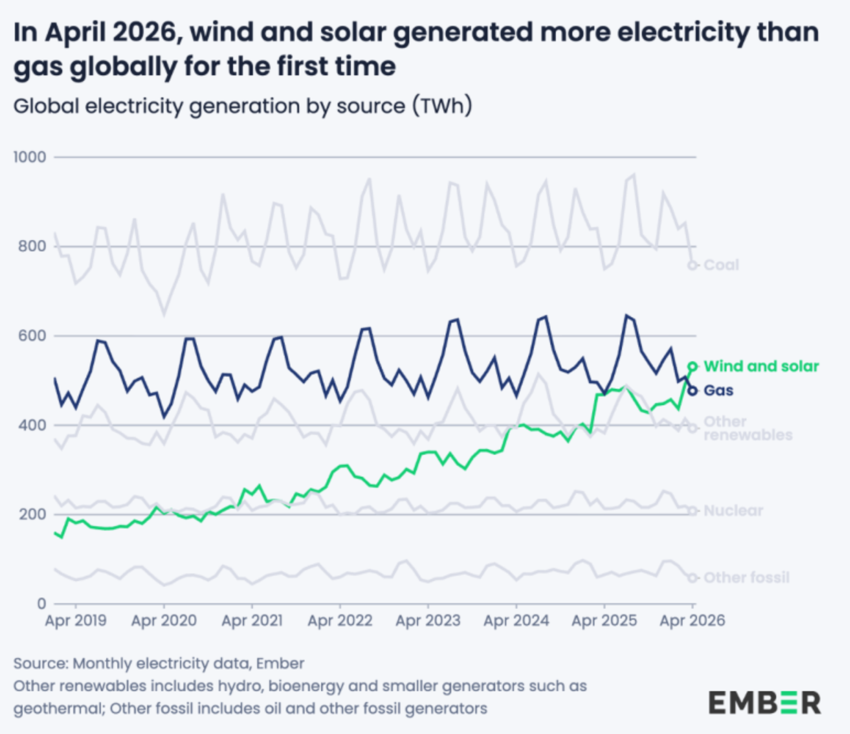
Wind and solar markets continue to rise
According to an Ember report:
Wind and solar produced 22% of the world’s electricity in April 2026
Gas only produced 20%
Attributed to conflicts in the Middle East and volatile fossil fuel markets
Wind and solar increased across nearly every major market in April
Countries are ramping up clean energy targets
Source: In a first, wind and solar generated more power than gas globally in April 2026 | Electrek

Slide 12
Energy Affordability Bill
Aims to save residents $14 billion over 10 years
May 2025 – Proposed by Governor Healey
Proposes to reduce utility bill costs through program reforms, stronger utility oversight, and expanded state authority to procure energy generation
Allows utilities to finance programs (like Mass Save) through securitization.
  February 2026 – Passed House with modifications (i.e., accepted amendments)
  Cuts the Mass Save budget by $1 Billion
  Returns 70% of Alternative Compliance Payments (ACP) to costumers
July 2026 – Passed Senate with modifications (i.e., accepted amendments)
No cut to the Mass Save program. Instead: proposes reforms to the Mass Save program (i.e., Oversight Board)
Proposes phase out gas infrastructure spending (GSEP)
Proposes language to set up rooftop solar for electronic permitting, shifts RPS growth, offshore wind predevelopment.
Codifies Gov. Healey’s data centers framework into law
NEXT: The House and Senate will meet to reconcile their versions of the bill before voting on final legislation which will be placed on the Governor's desk.

Slide 13
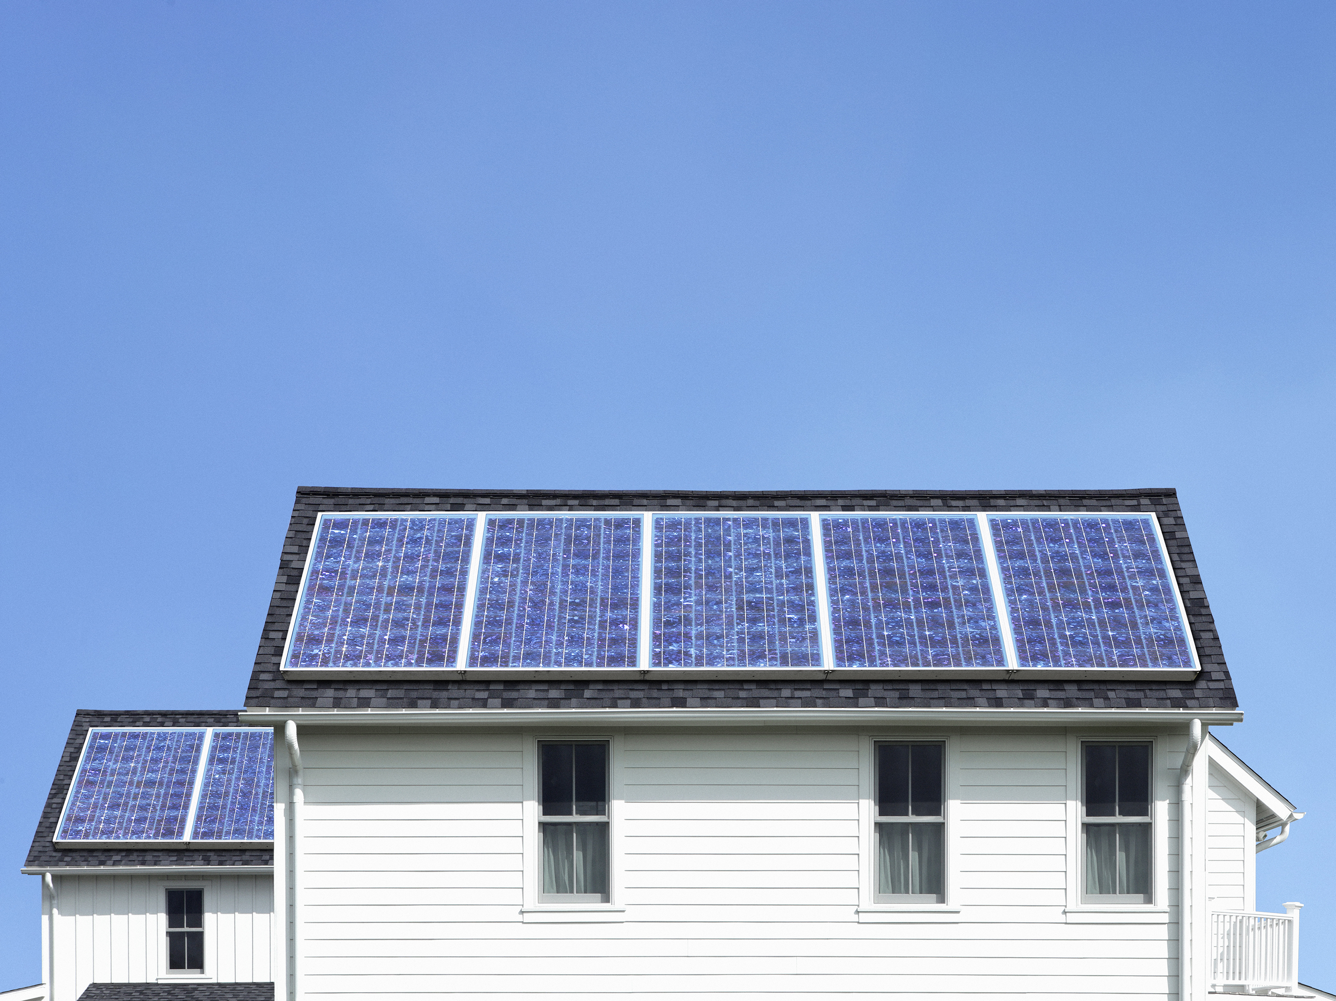
Healey-Driscoll Administration Awards $2.4M in Solar Grants to Ten Nonprofits
Grants will fund over 600 kW of new solar energy in Massachusetts!
Third round of grants under DOER’s Low-Income Services Solar Program (LISSP)
Grants help nonprofits install rooftop solar systems that:
  reduce each organization’s electricity costs by between 70% and 100%
  estimated to save the nonprofits $274,845 each year in energy costs, or about 958,979 kWh of electricity

Slide 14
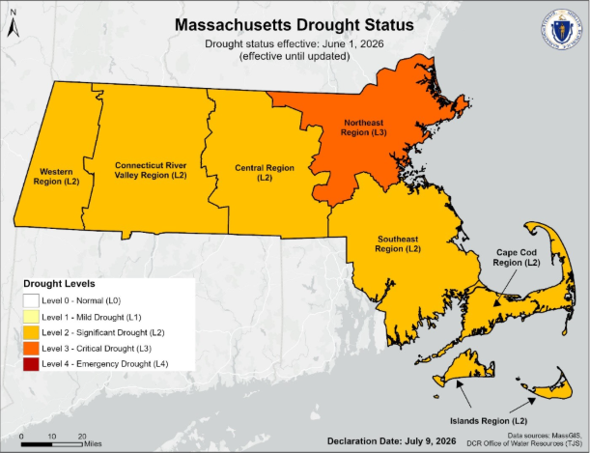
Drought conditions worsen in MA
Massachusetts’ NE region (Essex, Middlesex, and Suffolk Counties, and the Town of Brookline) has been in a Level 3 – Critical Drought for several months, due to continued below-average rainfall and declining groundwater levels.
Non-essential outdoor water use is banned in affected communities.
All other regions are in a Level 2 – Significant Drought.

Slide 15

What can you do to help?
No matter your region, you should minimize your water use!
In the home:
Install WaterSense or Energy Star faucets and toilets
Only wash full loads of laundry/dishes
Take shorter showers (no more than 5 min)
Turn off water while brushing teeth or shaving
Create kitchen compost instead of the garbage disposal
Outside:
Collect and reuse clean household water to water plants (e.g., leftover water from cooking)
Temporarily limit installation of new landscapes and plants
Go to Conserve MA Water for more tips and information!
Notes:
Toilets are #1 for indoor water use

Slide 16
LBER
Nathan Dziadul, Building Energy Reporting Program Coordinator

Slide 17
Large Building Energy Reporting (LBER) (1)
Policy Overview
State law requiring the public reporting of energy use for all buildings with a Gross Floor Area of 20,000 square feet or greater.
Utility companies provide the energy usage data they have for the covered buildings.
Owners provide the data for all other building energy usage, such as delivered fuels or on-site renewables, using ENERGY STAR Portfolio Manager.
MEI and CEI may assist building owners with self-reporting.
DOER uses Boston Energy Reduction Disclosure Ordinance (BERDO) and Cambridge Building Energy Use Disclosure Ordinance (BEUDO) data for buildings covered by those ordinances in Boston and Cambridge.

Slide 18
Large Building Energy Reporting (LBER) (2)
Stats, etc.
Get Help
36,191 buildings are on the 2026 Covered Buildings List
Less than 2% are state-owned buildings
Every campus is a snowflake
Check your compliance status in the newly-enhanced Building Owner Portal.
Read how-to guides and watch video demonstrations on the Large Building Energy Reporting Knowledgebase.
Use the Phone Call Request Form to get one-on-one assistance.
Email the Large Building Energy Reporting team at doer.ber@mass.gov.

Slide 19
Executive Office of Housing and Livable Communities (EOHLC)
Greg Abbe, Senior Climate Programs Specialist

Slide 20
Q&A

Slide 21
FY25 Preliminary Progress Assessment
Executive Order 594
Sophia Vitello
Leading by Example Division
sophia.vitello@mass.gov

Slide 22
Executive Order 594 Data Mandates
E.O. 594: “On an annual basis, LBE shall be responsible for tracking and collecting building and vehicle energy consumption, clean energy development, GHG emissions, and other relevant information associated with state government operations. LBE shall report annually on progress toward meeting the targets and objectives of this Order. Every five years, starting in 2025, LBE shall publish a comprehensive review of portfolio progress and efforts undertaken.”
LBE has drafted the FY25 progress report and is finalizing the report now. Therefore, the data presented here are still preliminary and subject to some changes in the final report.

Slide 23
Time to guess! Type in the chat…
Our FY2025 goal to reduce emissions from onsite fossil fuels is 20%.
What percent do you think we reduced onsite fossil fuel emissions?
Our FY2025 goal for EV charging stations at state facilities is 350 stations.
How many EV charging stations do you think we currently have?
15%
19%
21%
25%
125
325
525
725

Slide 24
Executive Order 594 Targets – Preliminary 2025 Results
Objective | 2025 Target | 2025 Actual | 2030 | 2040 | 2050
Reduce emissions from onsite fossil fuels* | -20% | -25% | -35% | -60% | -95%
Zero-emission vehicles (ZEVs) in entire state fleet | 5% | 5.7% | 20% | 75% | 100%
Reduce fuel oil use* | -90% | -91% | -95% | TBD | TBD
Energy use intensity (site EUI) reduction* | -20% | -17% | -25% | TBD | TBD
EV charging stations at state facilities | 350 stations | 725 stations | 500 stations | TBD | TBD
New light-duty vehicles: Starting in fiscal year 2023, all acquisitions of vehicles with a Gross Vehicle Weight Rating (GVWR) of 8,500 pounds or less must be ZEVs. Starting in fiscal year 2025, all acquisitions of vehicles with a GVWR of 14,000 pounds or less must be ZEVs.
New heavy-duty vehicles: Starting in fiscal year 2030, all acquisitions of vehicles with a GVWR of more than 14,000 pounds must be ZEVs.
*Over a 2004 baseline

Slide 25
Data Collection & Reporting
What Data LBE Collects & Tracks
How LBE Collects Data
Energy use
Emissions
Square footage
Fleet vehicles
EV charging
Renewable deployment & generation
LEED buildings
Pollinator habitat
Embodied carbon efforts
Annual LBE Tracking Form
Online utility databases
  MassEnergyInsight (MEI) &
  Commonwealth Energy Intelligence (CEI)
Statewide contract vendor reports
CAMIS
RTA Fleet Management System
Production Tracking System (PTS)
DCAMM solar data

Slide 26
How is the data helpful?
Internal Reporting & Analysis
External Reporting & Analysis
Track progress toward EO 594 targets
Centralized data collection & reporting
Baseline data for decarbonization projects
Support fleet electrification planning
Provide ad hoc entity or facility analyses
Share relevant data with key agencies to inform policy development
Inform grant development & outreach
Support or report on behalf of state entities for:
  State Large Building Energy Reporting (LBER) program
  Building Emissions Reduction & Disclosure Ordinance (BERDO) in Boston
Provide clean & analyzed data to state entities for other external reporting programs they may participate in (e.g., STARS)

Slide 27
Focus on Onsite Fossil Fuel Emissions
Emissions from grid electricity will continue to decline in large part due to the electricity grid becoming less fossil fuel dependent and more dependent on renewables.
Onsite fossil fuel emissions, on the other hand, are much more under the control of the state entities operating these facilities and thus state entity actions can have a greater impact on achieving onsite fossil fuel emissions reductions compared to grid electricity reductions.

Slide 28
FY04 vs. FY25 GHG Emissions
Natural gas now contributes the largest share of GHG emissions
“Other (Onsite)” includes fuels used for emergency generation or other non-standard operational uses
Notes:
Contribution from vehicle fuels has nearly doubled

Slide 29
FY04-25 Onsite Fossil Fuel Emissions
State portfolio has reduced onsite fossil fuel emissions by 25%, surpassing the FY25 target

Slide 30
Onsite Fossil Fuel Emissions Projections to Meet E.O. 594 Targets
To achieve our targets, onsite fossil fuel emissions must be reduced by an annual average of:
13,419 metric tons by 2030
15,201 metric tons from 2031-2040
21,281 metric tons from 2041-2050

Slide 31
Onsite Fossil Fuel Emissions Progress by Secretariat
7 out of 11 “secretariats” have surpassed the FY25 target
Many large decarbonization projects underway at UMass campuses and DOC facilities

Slide 32
Onsite Fossil Fuel Emissions Highlights
28 state entities met or exceeded the FY25 target; 22 state entities did not meet the target

Slide 33
FY04-25 Fuel Oil Use
State portfolio has reduced fuel oil use by 91%, slightly surpassing the FY25 target

Slide 34
Fuel Oil Use Highlights
Fuel Oil Use (gallons) | FY2004 | FY2025 | Gallon Difference | % change
Mass. Water Resources Authority | 1,692,913 | 1,070,346 | -622,567 | -37%
UMass Amherst | 558,719 | 406,312 | -152,407 | -27%
Dept. of Conservation and Recreation | 295,762 | 106,565 | -189,197 | -64%
MassDOT - Highway & Turnpike Divisions | 283,599 | 104,611 | -178,988 | -63%
Dept. of Developmental Services | 4,021,205 | 88,814 | -3,932,391 | -98%
Dept. of State Police | 146,702 | 64,093 | -82,609 | -56%
Dept. of Correction | 3,119,665 | 58,074 | -3,061,591 | -98%
UMass Medical | 2,296,957 | 55,994 | -2,240,963 | -98%
Military Division | 83,699 | 53,832 | -29,867 | -36%
Mount Wachusett Comm. College | 18,852 | 46,482 | 27,630 | 147%
Trial Court | 149,133 | 36,556 | -112,577 | -75%
MassPort Authority | 3,322,604 | 15,913 | -3,306,691 | -99.5%
Dept. of Youth Services | 64,972 | 14,182 | -50,790 | -78%
Dept. of Fish and Game | 38,409 | 10,288 | -28,121 | -73%
Holyoke Comm. College | 17,906 | 8,017 | -9,889 | -55%
Div. of Capital Asset Management | 197,216 | 7,509 | -189,707 | -96%
Dept. of Mental Health | 1,729,815 | 7,065 | -1,722,750 | -99.6%
Environmental Police | 4,289 | 3,907 | -381 | -9%
Chelsea Soldiers' Home | 34,354 | 3,740 | -30,615 | -89%
Total | 18,076,771 | 2,162,302 | -15,914,469 | -88%
19 state entities still use fuel oil as of FY25
18 of these entities have significantly reduced their fuel oil use since FY04
  6 of these have reduced use by more than 90% (FY25 target)

Slide 35
FY04-25 Energy Use Intensity
State portfolio has reduced EUI by 17%, falling a bit short of the FY25 target

Slide 36
EUI Highlights
30 of the 43 entities for which LBE tracks EUI have reduced EUI
24 entities have decreased EUI by more than 20% (FY25 target)

Slide 37
State Fleet Electrification
As of the end of FY25, state fleet was 5.7% electric, meeting the FY25 target
As of May 2026, the state fleet is 6.9% electric.
OVM fleet data current through May 2026; non-OVM data current through end of FY25
The fleet plans completed by most entities show that state fleet is on track to exceed the FY30 ZEV target if fleets follow the plans.
ZEV: zero-emissions vehicle, includes battery electric (BEV), plug-in hybrid electric (PHEV), and neighborhood/utility electric (NEV/EUV) vehicles
Non-ZEV: includes internal combustion (ICE) and hybrid (HEV) vehicles

Slide 38
State Fleet Electrification (continued)
Executive Branch Agencies account for both the largest share of the fleet and the largest share of zero-emission vehicles.

Slide 39
Fleet Electrification Highlights
Top 5 Entities by # of ZEVs | ZEV | % ZEV
Department of Developmental Services | 130 | 28%
Mass. Water Resources Authority | 43 | 11%
Department of Correction | 42 | 9%
Department of Conservation & Recreation | 69 | 8%
UMass Amherst | 38 | 7%
45 fleets have met or surpassed the FY25 target
33 fleets have not yet met the FY25 target
21 fleets do not yet have any ZEVs

Slide 40
State EV Charging Deployment
776 stations (1,343 ports) active at state sites
State portfolio has well exceeded the FY25 and FY30 targets

Slide 41

State Fleet EVSE Deployment
723 total active fleet ports
From FY23 to FY26, number of fleet ports increased by 677%
Fleet ports support the 530 BEVs & PHEVs currently in the state fleet

Slide 42
EV Charging Highlights
Top 5 Entities | Total Active Ports
MassPort | 121
Department of Conservation & Recreation | 106
UMass Amherst | 98
UMass Chan Medical School | 98
Department of Correction | 92
Total | 515
Top 5 Entities | Active Fleet Ports
Department of Conservation & Recreation | 95
Department of Correction | 92
Department of Developmental Services | 88
MWRA | 33
MassPort | 25
Total | 333

Slide 43
State Solar Deployment
As of end of FY26, there are 38 MW of solar deployed at state sites
Additional 9.5 MW of solar in progress or planned through LBE Solar-Decarbonization Grant

Slide 44
State Solar Highlights
The 8 state entities with more than 1 MW of solar capacity account for 68% of total installed solar capacity

Slide 45
LEED Certified Buildings
As of the end of FY26, there are 106 LEED buildings in the state portfolio for a total of 12.6 million square feet

Slide 46
LEED Highlights
Top 5 entities account for 53% of total state LEED square footage
38 state entities with at least one LEED certified building
54% of LEED square footage is highest certification levels of platinum or gold

Slide 47
Looking Ahead to 2030
The state portfolio has achieved most of the FY25 targets, but the goals for FY30 (and beyond) are much more ambitious. The portfolio has many plans & projects underway to help meet the FY30 target:
Many large-scale campus decarbonization projects planned or in progress
DCAMM has completed many campus decarbonization roadmaps
Fleet electrification plans show fleet on track to surpass FY30 target
Renewable diesel policy for hard-to-electrify use cases (short-term solution)

Slide 48
Discussion!
Any general feedback, comments, and/or questions on data presented?
In what areas do you think your entity is making the most progress and in what areas do you see challenges in achieving the goals?
What additional data can LBE provide to support your work?

Slide 49
Thank You!

