Slide 1
EPIA External Report
June 2024

Slide 2
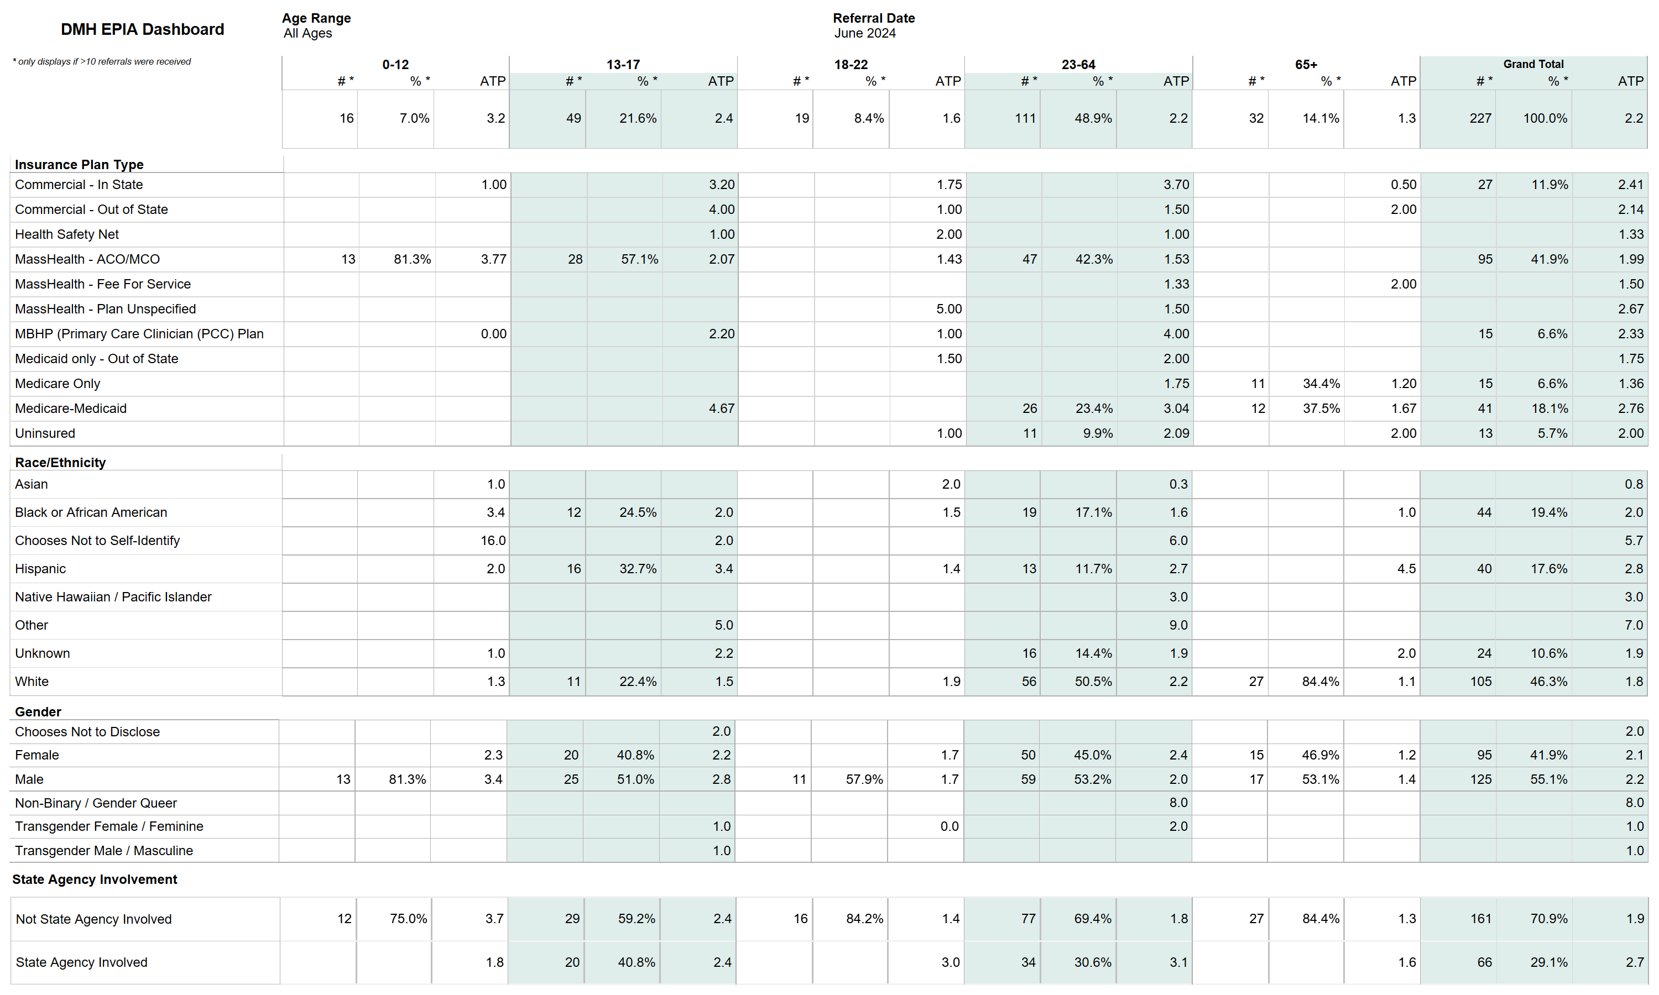

Slide 3
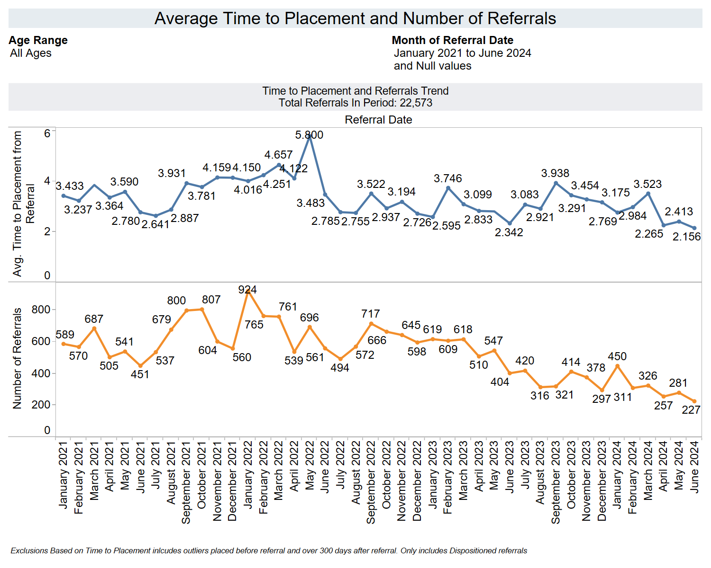

Slide 4
