Slide 1
Jobs for Veterans State Grant (JVSG) Program Training
Program Overview, Intake, Eligibility, Comprehensive Assessment
January 2025
MassHire Programs & Services are funded in full by US Department of Labor (USDOL) Employment and Training Administration grants.
• Additional details furnished upon request

Slide 3
Program Overview

Slide 4
JVSG Program Overview
Purpose: Provides employment and training services to eligible Veterans to help them obtain meaningful careers and to assist employers with hiring and retaining Veterans.
Funding: Federally funded by the U.S. Department of Labor, administered by State Workforce Agencies (MassHire Department of Career Services).
Key Services: Eligible Veterans receive specialized assistance through Disabled Veterans Outreach Program (DVOP) specialists and Employers receive specialized assistance through Local Veterans Employment Representatives (LVERs).
Objectives:
Increase Veteran employment rates
Foster long-term career success
Strengthen employer engagement for Veteran hiring

Slide 5
Intake

Slide 6
Veteran's First Visit to the Career Center
All customers who enter at the Point of Entry (Front Desk) Area will be asked if they have “served in the U.S. Military or are a military spouse”.
If the customer answers “Yes” or informs front desk staff, they are a Service Member or Eligible Spouse; they are immediately eligible for Priority Of Service (POS) and must be informed of that fact.
No proof of eligibility or documentation is required at this point.
Priority of Services vs Eligible Veteran
POS applies with self attestation, and only requires at least 1 day of active duty
Eligible Veteran for JVSG requires 180 days of active duty, for other than training, a barrier to employment, and DD-214 verification.

Slide 7
JVSG Eligibility Screening Initial Assessment (Non-JVSG Staff Member)
Prior to being referred to a DVOP, a Veteran must attend a Career Center Seminar (CCS) and complete the JVSG Eligibility Screening tool.
Both requirements must be completed by non-JVSG staff.
Non-JVSG Staff are required to put an Initial Assessment note under the General Services tab with a corresponding note describing the action taken.
This is a federally mandated requirement.

Slide 9
Eligibility

Slide 10
Identifying Eligible Veteran Customers for JVSG Services (Eligibility Screening Form)
Interest in 1 on 1 career planning or help finding employment? Yes/No
(if YES, please complete this tool to determine whether you are eligible for DVOP Specialist services)
Section A (Current service members)
If you are currently serving on active duty, please select one of the following
Wounded, ill, injured and receiving treatment at military treatment facility or military recovery unit
I am within 1 year of separation or two years of retirement and I have participated in a part of TAP
Section B (Eligible Veterans Section)
Ever served in the military, select those that apply:
Served on active duty for more than 180 consecutive days, and was discharged with other than a Dishonorable Discharge
I was released from active duty, due to a service-connected disability
I was released from active duty by reason of a sole survivorship discharge
I was a member of the National Guard/Reserve component, served on active duty during a time of war, campaign, expedition, or where a campaign badge was authorized.
Section C (Eligible Persons)
Spouse, family caregiver or widow(er) of someone who served or is serving in the Armed Forces
Spouse or family care giver of wounded, ill, or injured current service member who is receiving care at a military treatment facility
Spouse died from service-connected disability

Slide 11
Identifying Eligible Veteran Customers for JVSG Services
My spouse has or my deceased spouse had a Permeant and Total service connect disability rating from the VA
My active-duty spouse is listed as one of the following:
Missing in Action
Captured in the line of duty
Forcibly detained by a Foreign Government
Section D (Qualifying Situations)
Only complete this section if directed by Section B or Section C
Have a disability
Vietnam Era Veteran
Discharged or released from active duty within the last 3 years
Referred from the VA
Homelessness or risk of becoming homeless
Justice Involved
18 to 24 years of age
Lack of High School diploma or equivalent
Received or have in the last 6 months Public assistance programs (SNAP, TANF, SSI) State or local based income programs (Chapter 115)
Total family income does not exceed the higher of the poverty line or 70% of the lower living standard income level
Unemployed, able and available to work
Head of a single parent household

Slide 12
Eligibility Screening Form

Slide 13
Verification of JVSG Eligibility Status
Federal definition of Veterans status takes precedence. (180 consecutive days or more of active duty for other than training)
Veteran status should be established before intensive services are rendered to a customer by a DVOP or LVER (Chapter 42, Title 38, and U.S.C.).
There are numerous forms and certificates used to verify Veteran status.
The DVOP or LVER should be solely responsible to make such verification entries in MOSES.
In the absence of a DVOP or LVER, the Career Center Director/Operations Manager may verify the DD-214.
DD-214 is proof of eligibility to DVOP services under the JVSG State Grant.
Should questions arise in determining such eligibility, call the Veteran Program Coordinator or Intensive Services Coordinator

Slide 14
Verifying JVSG Eligibility Status
If a DD-214 is available, the DVOP will verify the DD-214 in MOSES FULL / MILITARY INFORMATION tab and enroll in the Veteran Program.
If Veteran is being re-entered into JVSG Program, DD-214 needs to be re-verified to determine eligibility.

Slide 15
Not Eligible for JVSG Services
If a Veteran is determined during screening as not meeting JVSG w a Barrier to Employment the non-JVSG staff will discuss this with the Veteran, and they will be offered an appointment with an Employment Counselor.
The Non- JVSG staff will enter an ASSESSMENT / INITIAL ASSESSMENT Service on the GENERAL SERVICES tab and insert the following in the description box of the service:
“Completed JVSG Eligibility Screening Form, Veteran does not meet the BE requirements for DVOP referral at this time. Offered services for Employment Counseling”.
If the Veteran declines the EC services, enter a MOSES Note:
“Veteran has declined EC services at this time”.

Slide 16
Eligible for JVSG Services
If a Veteran is determined eligible by using the JVSG Eligibility Form, they will be referred to the DVOP.
Non- JVSG staff must include an ASSESSMENT / INITIAL ASSESSMENT service on the GENERAL SERVICES tab and insert the following in the description box of the service:
“Met with Veteran after CCS, completed JVSG Eligibility Form, meets eligibility, referred to DVOP”.
Staff will then enter a MOSES Note with the following:
The eligibility criteria that was checked off on the Career Center Membership form (i.e., Service-Connected Disability), and the date and time of the appointment you made for the Veteran.

Slide 17
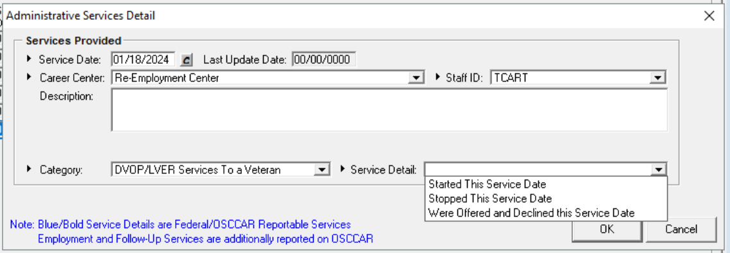
If Veteran Declines JVSG Services
When a Veteran declines JVSG services, the DVOP staff will add the following service on the Administration tab and note in the Notes area.
Services Provided:
Category --> DVOP / LVER SERVICES To a Veteran
Service Detail --> Were Offered and Declined this Service Date
Include a MOSES Note that Veteran services were offered and declined by the customer.
The Veteran will be offered an appointment with non-DVOP staff or advised of walk-in
service availability.

Slide 18
Priority of Service JVSG and WIOA
*VETERANS PRIORITY OF SERVICE
Veterans under WIOA sec. 3(63)(A) and 38 U.S.C. 101 receive priority of service in all Department of Labor-funded training programs under 38 U.S.C. 4215 and described in 20 CFR 1010.
A Veteran must still meet each program’s eligibility criteria to receive services under the respective employment and training program.
Jobs for Veterans State Grant Standard Operating Procedures 100 DCS 15.100
WIOA PRIORITY OF SERVICE
Self-identified Veterans will be provided Priority Of Service (POS) until proof of military service (or proof of Eligible Person status) is required to determine eligibility for WIOA programs.
For further guidance: please refer to WIOA regulations on the determination of eligibility and the point at which a self-identified Veteran must provide proof of status.
Notes:
Basic skills deficient would be anyone with Education levels below 9th grade or an English language learner. CFR is Code of Federal Regulations

Slide 19
Priority of Service (cont.)
Massachusetts Priority of Service (Mass Workforce Issuance 100 DCS 15.100.1)
Eligibility for Priority of Service (POS)
Per TEGL No. 10-09, Veterans, and eligible spouses, including widows and widowers as defined in the statue and regulations are eligible for priority of service. For the purposes of implementing priority of service, the Final Rule requires that program operators use the broad definition of Veteran found in 38 U.S.C. 101(2).
Under this definition, the term “Veteran” means a person who served at least one day in the active military, naval, or air services, and who was discharged or released under conditions other than dishonorable, as specified in 38 U.S.C. 101(2).
Active service includes full-time Federal service in the National Guard or a Reserve component. This definition of “active service” does not include full-time duty performed strictly for training purposes (i.e., that which often is referred to as “weekend” or “annual” training), nor does it include Full-time active duty performed by National Guard personnel who are mobilized by State rather than Federal authorities (State Mobilizations usually occur in response to events such as natural disasters).

Slide 20
Veteran Status for JVSG Eligible
Veteran status:
A person as defined in Title 38 U.S.C. §4211 who:
• Served on active duty for a period of more than 180 days and was discharged or released there from with other than a dishonorable discharge: or
• Was discharged or released from active duty because of a service-connected disability; or
• As a member of a reserve component under an order to active duty pursuant to section 12301(a) (d) or (g), 12302, or 12304 of Title 10, served on active duty during a period of war or in a campaign or expedition for which a campaign badge is authorized and was discharged or released from such duty with other than a dishonorable discharge; or
• Was discharged or released from active duty by reason of a sole survivorship discharge (as that term is defined in (§1174(i) of Title 10).

Slide 21
Categories of Veterans
Combat Veteran
An eligible Veteran any part of whose active military, naval, or air service was in a war or conflict in which campaign badge or expeditionary medal has been authorized.
A complete listing of campaign and expeditionary medals can be located on the Office of Personnel Management website:
www.opm.gov/policy-data-oversight/Veterans-services/vet-guide-for-hr-professionals/
Disabled Veteran
A Veteran rated at 0% who has applied for disability status or is entitled to compensation (or who but for the receipt of military retired pay would be entitled to compensation) under laws administered by the Veterans’ Administration; or a person who was discharged or released from active duty because of a service-connected disability.

Slide 22
Categories of Veterans
Special Disabled Veteran
A Veteran who is entitled to compensation (or who but for the receipt of military retired pay would be entitled to compensation) under laws administered by the Secretary for a disability rated at 30 percent or more or rated at 10 or 20 percent in the case of a Veteran who has been determined to have a serious employment handicap; or a person who was discharged or released from active duty because of service-connected disability.

Slide 23
Categories of Veterans – Other Eligible
Spouse, family caregiver or widow(er) of someone who served or is serving in the Armed Forces
Spouse or family care giver of wounded, ill, or injured current service member who is receiving care at a military treatment facility
Spouse died from service-connected disability
My spouse has or my deceased spouse had a Permeant and Total service connect disability rating from the VA
My active-duty spouse is listed as one of the following:
Missing in Action
Captured in the line of duty
Forcibly detained by a Foreign Government

Slide 24
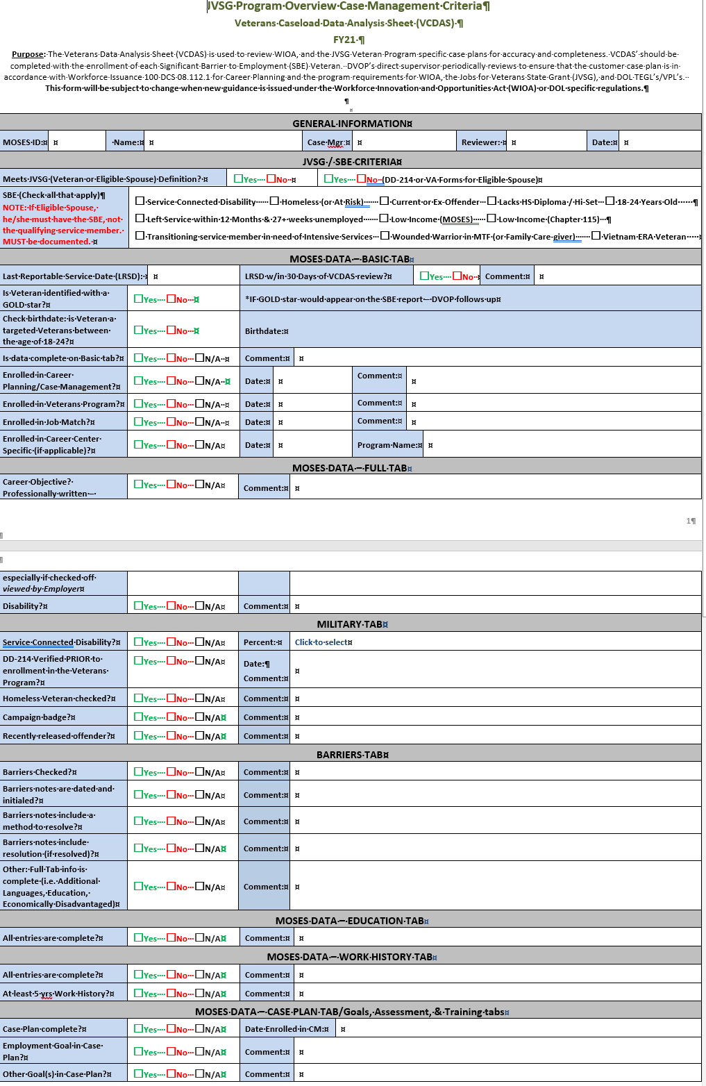
Veterans Caseload Data Analysis Sheet (VCDAS)

Slide 25
Comprehensive Assessment

Slide 26
Comprehensive Assessment
Comprehensive Assessment:
(Required Service by DVOP or in absence of the DVOP the Designee)
A comprehensive assessment is not a one-time event; it is a continuous process that includes gathering, evaluating, and documenting information gained during each conversation, phone call, or interaction with the Veteran job seeker.
The information gathered in during the Comprehensive Assessment will help to identify current resources, possible obstacles/barriers, and serve to help guide the development of the individual’s employment/development plan.
(Career Action Plan).

Slide 27
Comprehensive Assessment Model
First Appointment with DVOP:
Request Veteran brings copy of their DD214 or help in obtaining a copy.
DO NOT INITIATE CASE PLAN OR ENROLL IN THE VETERANS PROGRAM IF DD214 HAS NOT BEEN VERIFIED OR IF YOU HAVE NOT SEEN THE VETERAN
A comprehensive assessment must be conducted when the Veteran has not had a reportable service in 90 days
• Discuss career possibilities with Veteran
• Review and record previous work history
• Inquire on and record if applicable
Disability
Homelessness
• Access and Record Current Skills
Basic Skills
Occupational Skills/Abilities including Military Occupational Specialty (if applicable)
Aptitudes
Interest

Slide 28
Comprehensive Assessment Model (cont.)
DVOP will review all MOSES screens and update any new information (Education, Work History, etc.).
DVOP will also review the JVSG Eligibility Form completed by the non-Veteran staff member to ensure accuracy.
The DVOP will conduct a comprehensive assessment (CA) of the Veteran customer and record the COMPREHENSIVE ASSESSMENT in the GENERAL SERVICES tab and in the service description box will enter:
“Assessment by DVOP, see notes”.
A MOSES Note will be entered and will include a detailed summary of the conversation.
**The first line of the note for the Comprehensive Assessment should state that the Veteran is eligible for JVSG services and the Barriers to Employment which qualify them.**

Slide 29
Comprehensive Assessment Model (cont.)
Questions/Topics during Comprehensive Assessment:
• Current job status (Currently working/day-to-day duties) community program affiliations
• Past job history (What position in military/previous job titles/duties)
• Job readiness (resume review/discuss interview skills)
• Other income (UI benefits/VA compensation/pension/retirement/Social Security Disability/other)
• Educational level
• Current/potential school enrollment
• VA benefit eligibility (GI Bill (which chapter)/Voc. Rehab)
• Military status/history (Character of discharge/Transitioning/Total time served/currently in a reserve component)
• Family situation (dependents/childcare)
• Living situation
• Offender status (Previous incarceration/Do charges effect employment possibilities/locations?)
• Do you have a valid driver’s license? Do you have a car? (If not, other reliable transportation?)

Slide 30
Comprehensive Assessment Model (cont.)
Questions/Topics during Comprehensive Assessment: (Continued)
• Can you pass a CORI?
• Strengths to employment
• What are you good at?
• What have you gained from past experiences?
• What are you confident about?
• Barriers to employment
• Where are you vulnerable?
• What else do you need to do or learn?
• What is missing from your skill set?
• What can you improve upon?
• Lack of experience, outdated skills
• Unrelated work experiences
• Unverifiable skills set
• Any physical limitations?

Slide 31
?
?
?
Questions?
?
?
?
?
?
?
?
?

Slide 32
Jobs for Veterans State Grant (JVSG) Program Training
MOSES Tabs
January 2025
MassHire Programs & Services are funded in full by US Department of Labor (USDOL) Employment and Training Administration grants.
• Additional details furnished upon request

Slide 33
Basic tab
Veterans Caseload Data Analysis Sheet (VCDAS)

Slide 34
Full tab
Veterans Caseload Data Analysis Sheet (VCDAS)

Slide 35
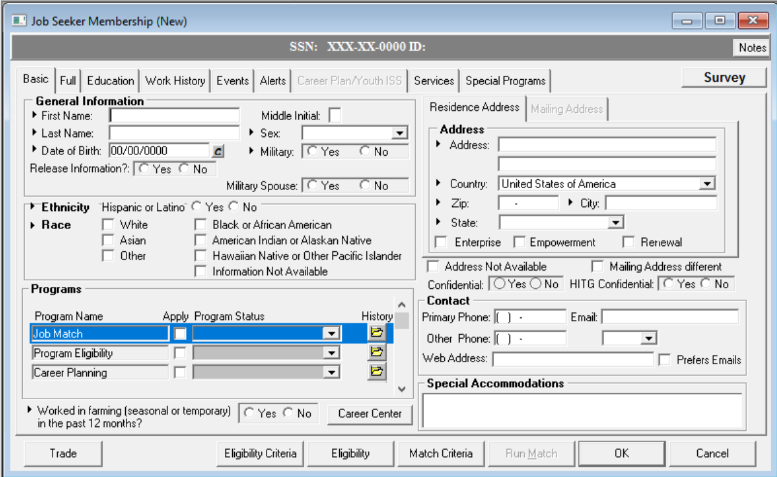
Basic tab

Slide 36
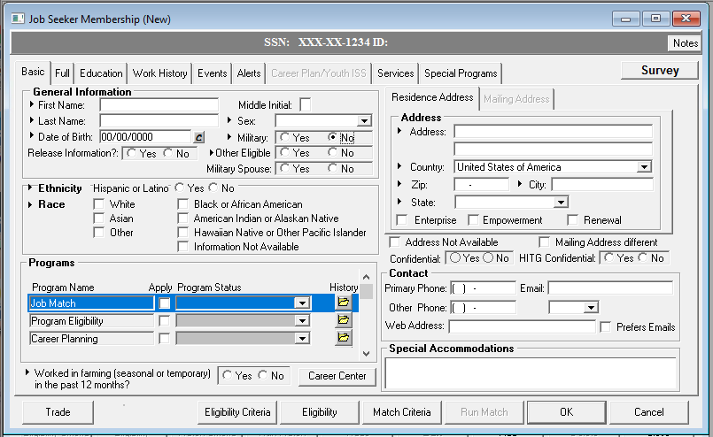
Basic tab
Military = NO
Other Eligible

Slide 37
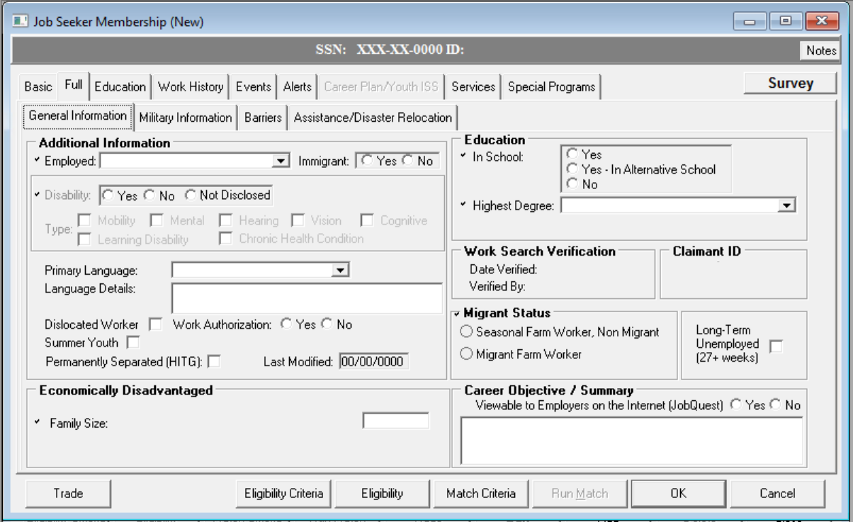
Full tab

Slide 38
Full tab Military Information
Veterans Caseload Data Analysis Sheet (VCDAS)

Slide 39
Service-Connected Disability
“Is your disability service connected?”
Will not appear unless the Customer answered “Yes” to being disabled on the General Information - Full tab.
>10% and Barriers

Slide 40
Military Details
Make sure you verify this information against the DD214 form (official discharge papers from the military).
Field Name Required Action
Branch Select the branch of military service from the dropdown list.
Discharge Type Select the type of military discharge from the dropdown list.
Service Start Date Click the Calendar icon and select the Start Date from the dropdown calendar.
Click the OK button. Or you can type in the Start Date. Certain start and release dates trigger additional radio button options under Veteran Information.
Release Date Click the Calendar icon and select the Release Date from the dropdown calendar. Click the OK button. Or you can type in the Release Date.
Certain start and release dates trigger additional radio button options under Veteran Information.
DD214 Verified Check off the box if Verified.
Verified By This will automatically fill in your MOSES id if you checked the box.
Date Verified This will automatically fill in the date the box was checked.
Verifying Office This will automatically fill in your MOSES ids assigned office if you checked the box.

Slide 41
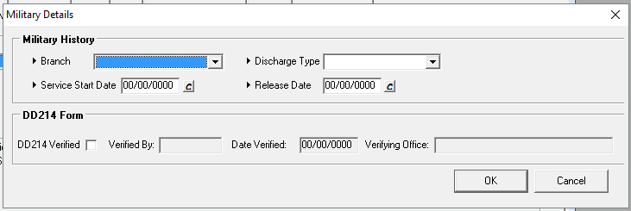
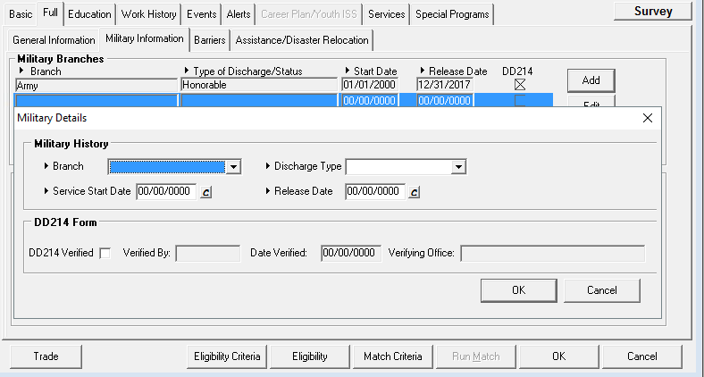
Full tab Military Details
If the Customer served in more than one military branch, click the Add button to display a blank row and fill in the information on the second branch.

Slide 42
Military Information
Served in Vietnam (In Country) Select the Yes or No radio button.
This question is triggered by the start and release dates.
(This field appears only if the user enters a military date range between 2/28/1961 and 8/14/1964.)
Reserve Time/Training Time
Select the Yes or No radio button.
This question is triggered by the start and release dates.
Desert Storm/Desert Shield
Select the Yes or No radio button.
This question is triggered by the start and release dates.
(This field appears if the user enters a military date range between 8/2/1990 and 11/15/1991.)
Operation Iraqi Freedom
Select the Yes or No radio button.
This question is triggered by the start and release dates.
(This field appears if the user enters a military date range between 9/11/2001 and 8/31/2010.)
Operation Enduring Freedom
Select the Yes or No radio button.
This question is triggered by the start and release dates.
(This field appears if the user enters a military date range between 10/7/2001 and 12/28/2014.)

Slide 43
Veteran Information
Field Name |  | Action
Is Your Disability Service Connected? |  | Select the Yes or No radio button to indicate if the disability is service connected. If Yes, select the percentage of the disability that is service connected from the dropdown list. This only field only appears if you checked Yes for Disability on the General Information - Full tab.
Campaign Badge |  | Select the Yes or No radio button.
Homeless Veteran or at risk of being homeless |  | Select Yes, No, or Not Disclosed.
Offender who has ever been incarcerated |  | Select Yes, No, or Not Disclosed.

Slide 44
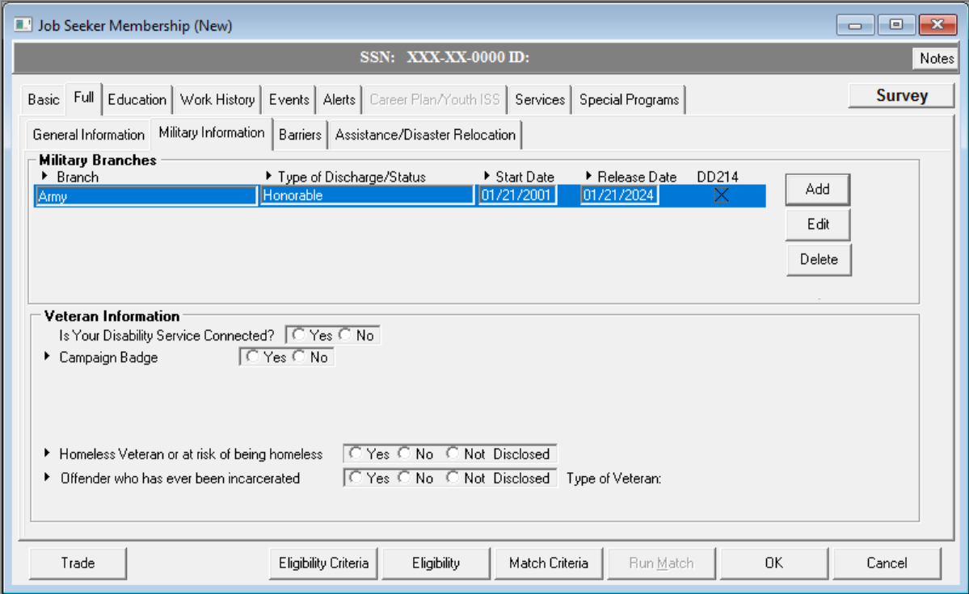
Military Information (continued)

Slide 45
Veteran Information

Slide 46
Barriers to Employment / JVSG Criteria
Veterans Caseload Data Analysis (VCDAS)

Slide 47
Barriers / Categories Assistance
Data Validation elements on Barriers tab that are only captured in Federal reporting from the Eligibility Criteria section of MOSES.
The complete data validation elements list can be found on the last page of the MassWorkforce Issuance 100 DCS 10.109.
• TANF
• SNAP
• Youth Homeless - if Veteran is a youth between the ages of 18-24
• Low income
• ESL Learner
• Basic Skills deficient
Additionally, if the Eligibility Criteria Tab is not active; the testing scores cannot be seen, which could be needed for WIOA Title 1 Program Eligibility or a Measurable Skills Gain.

Slide 48
Barriers tab
Veterans Caseload Data Analysis (VCDAS)

Slide 49
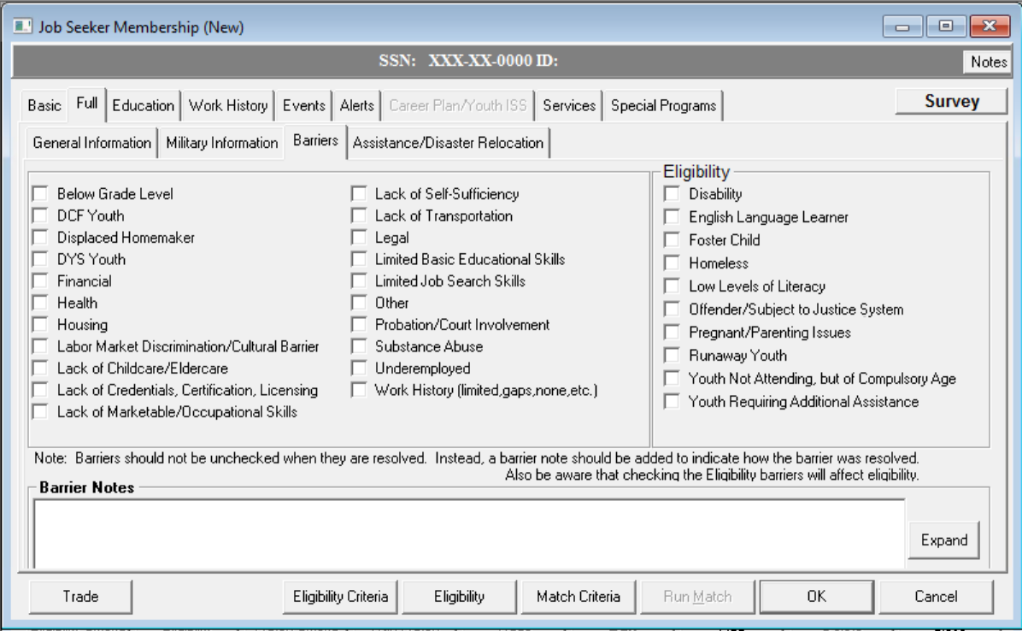
Barriers tab

Slide 50
Barriers Notes
More than > 10% disability
Requires Disability to be Checked in Barriers and addressed
In Barriers Notes

Slide 51
VCDAS Education tab
Veterans Caseload Data Analysis (VCDAS)

Slide 52
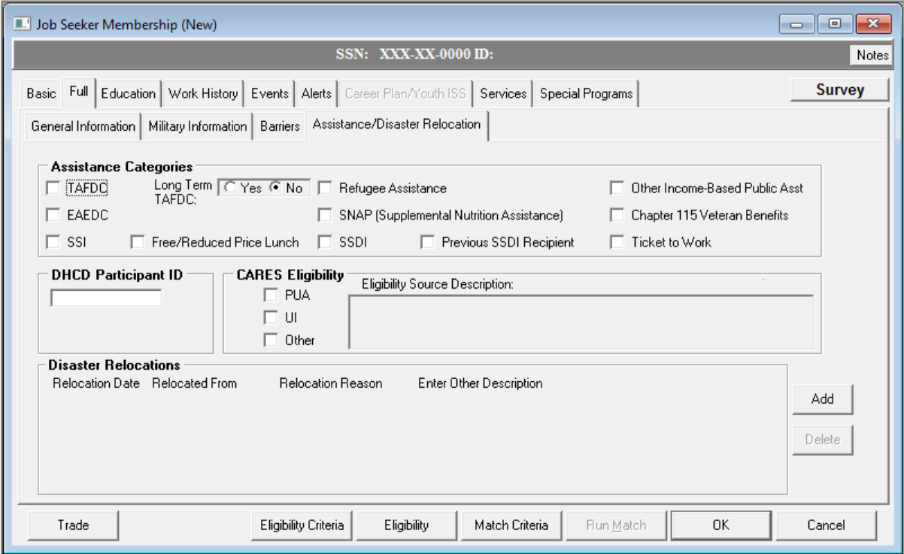
Full Tab Assistance / Disaster

Slide 53
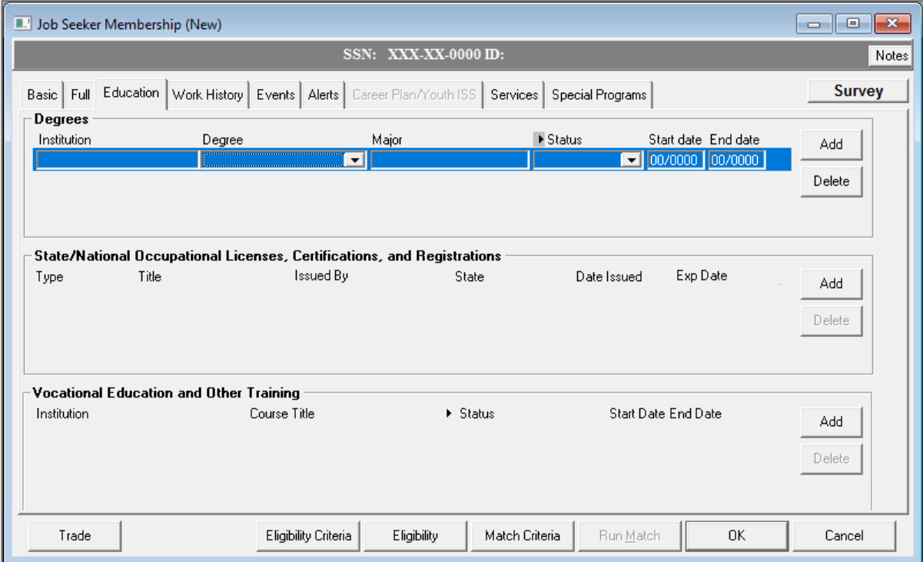
Education tab

Slide 54
Work History
Veterans Caseload Data Analysis (VCDAS)

Slide 55
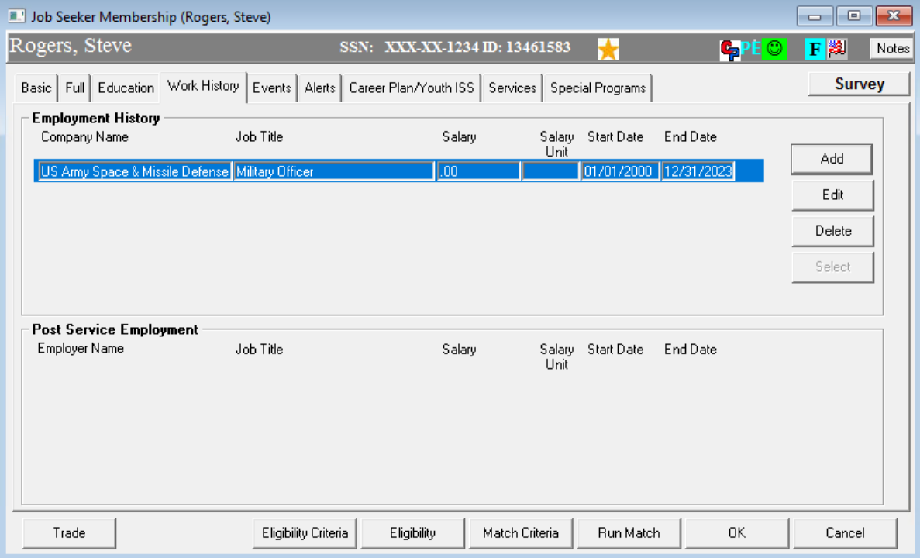
Work History
Must have a minimum of 5 years work experience listed.

Slide 56
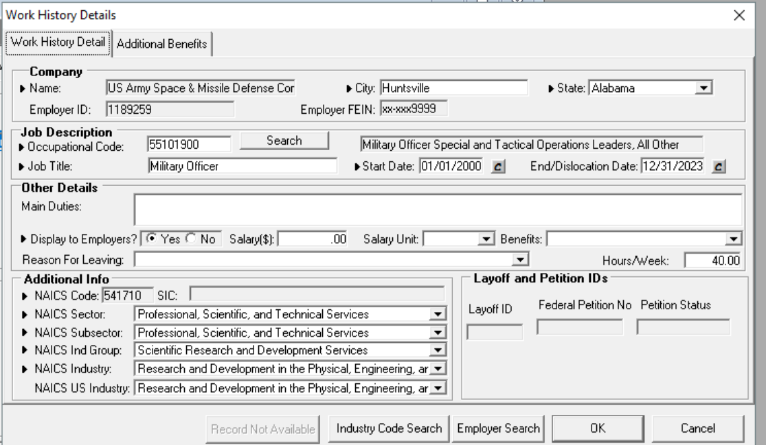
Work History

Slide 57
?
?
?
Questions?
?
?
?
?
?
?
?
?

