Slide 1
Jobs for Veterans State Grant (JVSG) Program Training
Program Enrollment
January 2025
MassHire Programs & Services are funded in full by US Department of Labor (USDOL) Employment and Training Administration grants.
• Additional details furnished upon request

Slide 3
Jobs for Veteran State Grant Program Enrollment
Enrolling in the JVSG Program
• All Veterans who have a DD214 Verified ARE ENROLLED in Veterans Program, Not All are Case Managed
• Select the Veteran program in the Programs Panel on the Basic Screen
Check off the Apply box next to the Veteran program
VET Staff Initiate Case Plan in MOSES at 1ST or 2nd appt. WITH Veteran
• All Veterans with barriers to employment,
i.e., disabled or recently discharged, MUST be case managed
• Enrolling in Case Plan
Select the Career Planning program in the Programs Panel on the Basic Screen
Check off the Apply box next to the Case Management
• Enrolling in the Veterans Program
Select the Veteran (JVSG) program in the Programs Panel on the Basic Screen
Check off the Apply box next to the Veteran program

Slide 4
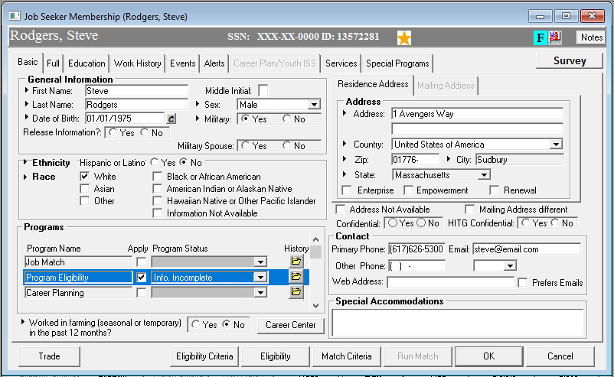
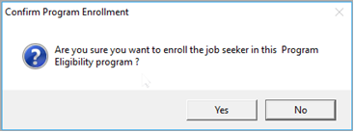
Program Eligibility Enrollment
NOTE: The eligibility criteria tab must be activated to avoid failed elements within the JVSG Program.

Slide 5
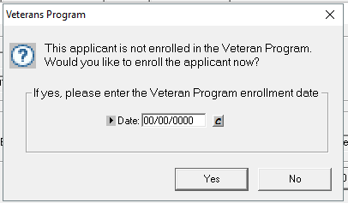
Automatic Program Enrollment
If not currently enrolled in the Veteran Program, a “Would you like to enroll the applicant now?” box appears.
Note: MOSES does not do the automatic enrollment, staff must still manually enroll the Veteran in the JVSG program.
DO NOT ENROLL IN THE VETERANS PROGRAM IF DD-214 HAS NOT BEEN VERIFIED OR IF YOU HAVE NOT SEEN THE VETERAN

Slide 6
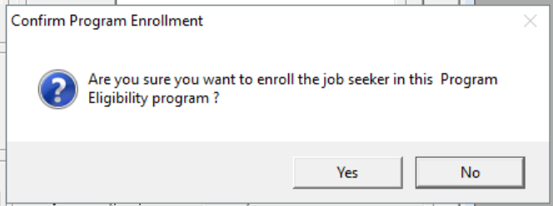
Eligibility Criteria
There are data points (information) that are captured in MOSES for various programs, either through the main tabs (Basic, Full, etc.) or in the Eligibility Criteria.
Many of the PIRL (Participant Individual Record Layout) (federal data points) are only captured in Federal reports from the Eligibility Criteria area.
While for State reports some are from the “main tabs” (Basic, Full, Services).

Slide 7
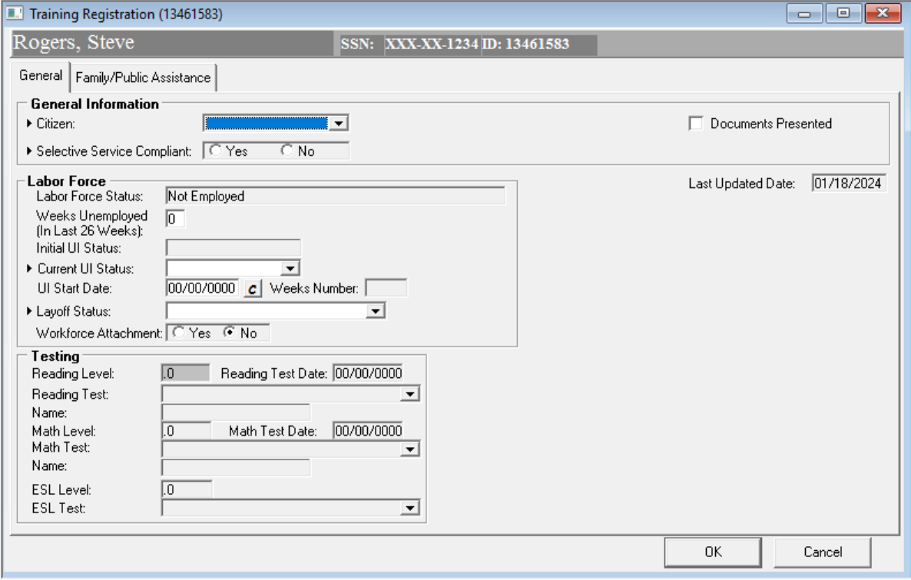
Eligibility Criteria General Information

Slide 8
Eligibility Criteria General Information
Field Name |  | Action
Citizen |  | Select the job seeker's citizenship from the dropdown list.
Alien Registration Number |  | Type the applicant’s alien registration number. MOSES displays the Alien Registration Number field only when you select a citizenship other than US Citizen. Residency Expiration Date is optional.
Selective Service Compliant |  | Select if the applicant has complied with Selective Service requirements. Yes should be selected for all women, young men under the age of 18, and men born before December 31, 1960. Document customer is Selective Service compliant by gender or age. You can check on www.SSS.gov to confirm a Selective Service compliance. Selective Service is based upon a persons gender at birth. Check Yes for males born on or after January 1, 1961 that have registered for Selective Service.

Slide 9
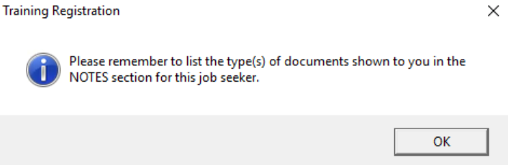
Eligibility Criteria General Information

Slide 10
Eligibility Criteria Labor Force
Current UI Status |  | Select the current UI status that applies. Claimant: Someone collecting Unemployment Insurance funds. Exhaustee: Someone who has collected all their Unemployment Insurance funds. (They have no money left.) Expired: Unemployment Benefits expire after a specific time frame / allotment. This is what this person would be designated, they have exceeded the time frame for their initial UI claim. (It is usually 52 weeks.) Extended Benefits: Applicable when the Federal government has extended unemployment beyond the basic weeks allowed for a claim. Not Applicable: Someone not eligible for Unemployment Assistance under Federal regulations and guidelines. UCX / UCFE: Unemployment claim for Military (X) or Federal Employee (FE).

Slide 11
Eligibility Criteria Labor Force
Labor Force Status |  | This carries over from the Job Seeker – Full tab – General Information sub tab – Employed question.
Weeks Unemployed (In Last 26 Weeks) |  | The number of weeks the job seeker has been unemployed during the last 26 weeks will appear. (If applicable.)
Initial UI Status |  | This field will pre-fill from the UI interface.

Slide 12
Eligibility Criteria Labor Force
UI Start Date |  | Type the date that the job seeker’s current UI claim began. Can carry over from UI claim in system. (Automatic)
Weeks Number |  | This field will pre-fill from the UI interface.
Lay-off Status |  | Select the appropriate status. Not Applicable: As stated. This job seeker has no lay off status. Terminated / Laid Off: A job seeker that has been made redundant / terminated from their job and employer. Unemployed (Previously Self Employed): As stated, an unemployed job seeker that was self-employed but is no longer working.
Workforce Attachment |  | Select Yes or No

Slide 13
VCDAS Eligibility Criteria
Veterans Caseload Data Analysis (VCDAS)

Slide 14
Eligibility Criteria Testing (if applicable) WIOA Co-Enrollment

Slide 15
Eligibility Criteria Testing (if applicable) WIOA Co-Enrollment
Reading Level |  | This will be brought forward from the Services Tab, Testing sub-tab. Click on the check box in the Testing Details screen to indicate the test from the Testing sub-tab you want brought to this area. The box for Use this test score for eligibility must be checked for the score to appear here.
Reading Test |  | This will be brought forward from the Services Tab, Testing sub-tab. Click on the check box in the Testing Details screen to indicate the test from the Testing sub-tab you want brought to this area.
Reading Test Date |  | This will be brought forward from the Services Tab, Testing sub-tab. The test date should be the date the test was taken and not when it was entered into MOSES.
Name |  | This will be brought forward from the Services Tab, Testing sub-tab. This is used only when “Other” is chosen as the test type.

Slide 16
Eligibility Criteria Family / Public Assistance (WIOA CO-Enrollment)
6 Mo. Family Income (Annualized) |  | If provided, enter the actual gross income amount for the most recent 12-month period. If not provided, enter an “annualized” amount based on the most recent gross earnings information provided and calculated in accordance with accepted WIOA / Federal program methods. IF NOT REQUIRED LEAVE BLANK (Do not enter 0 )
WIOA Low-Income |  | MOSES fills this field with Yes or No if the answers provided meet the standards.
Under Poverty Line / 70% Lower Living Standard |  | MOSES fills this field with Yes if the income you entered is under either the Poverty Line or the 70% Lower Living Standard.
Under Poverty Line |  | MOSES fills this field with Yes if the income you entered is under the Poverty Line.
70% Lower Living Standard |  | MOSES fills this field with Yes if the income you entered is under the 70% Lower Living Standard.
High Poverty Area |  | Check this box off if the Youth lives in a High Poverty Area as defined by the Commonwealth of Massachusetts.

Slide 17
Eligibility Criteria Testing (if applicable) (WIOA Co-Enrollment)
Math Level |  | This will be brought forward from the Services Tab, Testing sub-tab. Click on the check box in the Testing Details screen to indicate the test from the Testing sub-tab you want brought to this area. The box for Use this test score for eligibility must be checked for the score to appear here.
Math Test |  | This will be brought forward from the Services Tab, Testing sub-tab.
Math Test Date |  | This will be brought forward from the Services Tab, Testing sub-tab. The test date should be the date the test was taken and not when it was entered into MOSES.
Name |  | This will be brought forward from the Services Tab, Testing sub-tab. This is used only when “Other” is chosen as the test type.

Slide 18
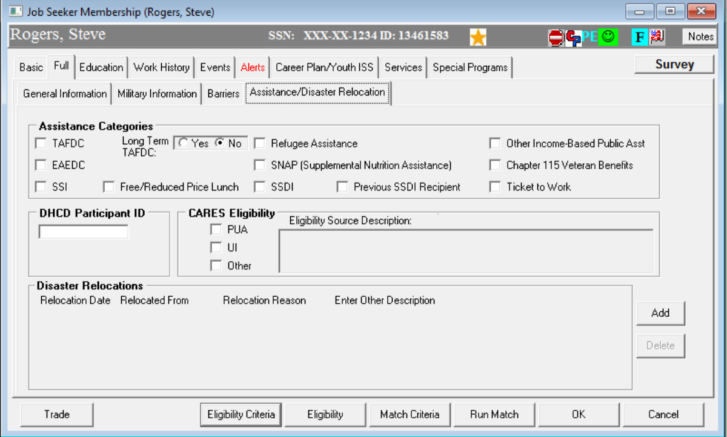
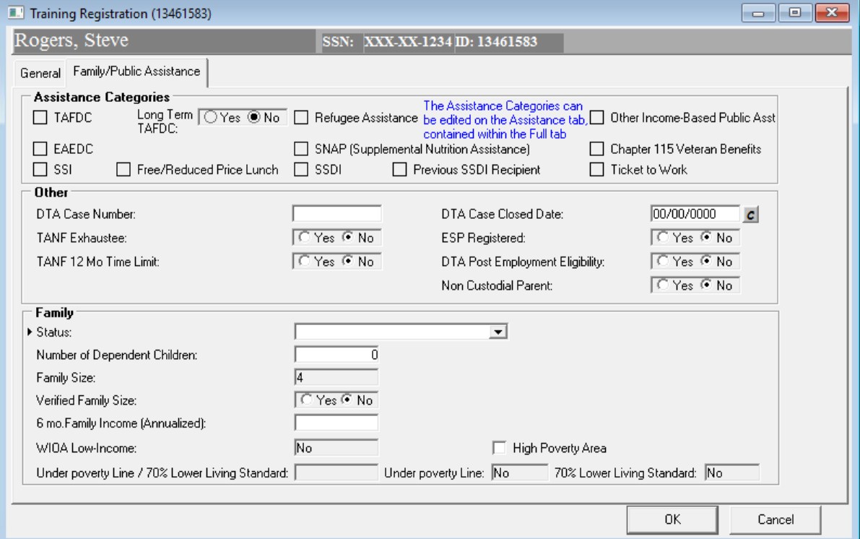
Eligibility Criteria Family / Public Assistance
Assistance Categories carry over from
Full tab – Assistance / Disaster Relocation sub tab.

Slide 19
Eligibility Criteria Family / Public Assistance
Status |  |  | Select one of the following family status options from the dropdown list. Other Family Member: This is usually a son or daughter. Parent in a two parent family: As federally defined. Recognizes same sex marriage. Single Individual, not part of a family: As stated. Single Parent: As stated.
Number of Dependent Children |  |  | Type the number of dependent children in the job seeker's family.
Family Size |  |  | MOSES pre-fills the family size that was entered on the Full tab – General Information sub tab of the Job Seeker Membership window. You cannot change the number here. If the number needs to be adjusted, you must return to the Full tab – General Information sub tab, make the change and save the changes. Doing this will update the Family Size field.
Verified Family Size |  |  | Select whether you have verified the family size.

Slide 20
Eligibility Criteria Family / Public Assistance
Verifying Income in the Eligibility Criteria area
Notes:
This will pull over the family size from the previous screen to fill in the family section. Please do not enter anything in the 6 month family income area unless you have calculated and confirmed it with the customer. If you have not confirmed it, leave it blank.

Slide 21
?
?
?
Questions?
?
?
?
?
?
?
?
?

Slide 22
Jobs for Veterans State Grant (JVSG) Program Training
Shared Customers
January 2025
MassHire Programs & Services are funded in full by US Department of Labor (USDOL) Employment and Training Administration grants.
• Additional details furnished upon request

Slide 23
WIOA Co-Enrollment and Service Integration
Co-enrolling eligible Veterans in JVSG and WIOA maximizes access to resources
Eligible Veterans may access training through WIOA to enhance their skill sets
Co-enrollment is determined on a case-by-case basis based on the Veteran's specific needs and employment objectives
Staff from both JVSG and WIOA programs can coordinate efforts, reducing redundancy and providing a seamless customer experience.
Service integration provides a seamless experience that empowers eligible Veterans to achieve meaningful and sustainable employment

Slide 24
Shared Customers
Receive services from more than one WIOA Partner Program
MassAbility
Massachusetts Commission of the Blind
Department of Transitional Assistance
Senior Community Service Employment Program (SCSEP)
Adult Community Learning Services (Adult Education)
Benefit from services and resources delivered across multiple WIOA Partner Programs.
Record shared customers in MOSES
Joint Partner Policy Commination: 01.2018 – WIOA Partner Shared Customer
Notes:
Shared customers must be documented in Moses and services can not be duplicated.

Slide 25
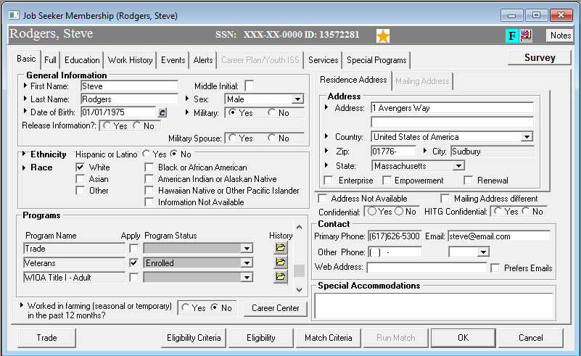
Documenting the Shared Customer in MOSES
Notes:
After you have confirmed your customer is working with a partner agency you will enroll them in the programs section on the Basic tab of Moses. Scroll down until you find the partner and then click apply and save. Of course you will enter notes to tell how you confirmed this and details of services and assistance they receive,

Slide 26
?
?
?
Questions?
?
?
?
?
?
?
?
?

