Slide 1
Jobs for Veterans State Grant (JVSG) Program Training
Career Planning
January 2025
MassHire Programs & Services are funded in full by US Department of Labor (USDOL) Employment and Training Administration grants.
• Additional details furnished upon request

Slide 3
Career Planning
Case Management/Case Management Framework
A customer-centered approach in the delivery of individualized career services, designed to prepare and coordinate comprehensive employment plans for participants, to assure access to the necessary training and supportive services, and to provide support during program participation and after job placement.
This should include at a minimum include comprehensive assessment and documented plan of action.

Slide 4
Individual Employment Plan (IEP)
MassHire Career Center managers and staff must note that career planning can occur across geographic career center service areas.
Customer choice is a cornerstone of the service delivery model under WIOA it is conceivable, and in some geographic areas, likely that the development of a formal Individual Employment Plan (IEP) will involve the provision of services through more than one career center location.
In such cases, the designated MassHire Career Center (MCC) counselor must maintain the overarching responsibility for assisting the customer with the development of an IEP with the optimal mix of services which will help the job seeker reach his/her employment goal(s) regardless of the career center location.

Slide 5
Individual Employment Plan (IEP) continued
The designated MCC counselor must coordinate service delivery, conduct follow-up, and ensure that all necessary data and information is entered into MOSES in a timely manner, notwithstanding what individual, entity or career center is the actual service provider. For the benefit of the customer, communication among staff providing services through different MassHire Career Centers is essential.

Slide 6
Comprehensive Assessment
Current job status/work history/job readiness:
DD-214 verification:
Disability/Service-Connected Disability:
Living Situation:
Family Situation
Making Rent/Mortgage Payments:
Living with relatives?
Homeless or Risk of?
Referrals to Housing Authority/Shelter:
Health:
Health Coverage?
Referral to VA Health Care System or info on Mass Health:
Transportation:
Does Veteran have Transportation in good working order?
Valid Driver’s license
Access to Public Transportation?
Finances:
Eligible/Claim submitted for UI?
Gauge financial situation to determine referral to supportive services:
Out of work for over 27 weeks?
Any other barriers?

Slide 7
Barriers to Employment
Barriers to Employment – Used in the development of the career action plan as characteristics that may hinder a veteran’s hiring, promotion, or participation in the labor force.
Service-Connected Disability
Between the Ages of 18-24
Unemployed
Veteran States they have been formerly incarcerated
Vietnam Veteran or Era
Veteran states that they are homeless or at risk of homelessness
Transitioning service members
Wounded Warrior
Care-giver
Spouse of 100% and/or died of service connected etc.
Single parent
Educationally disadvantaged lacking HS diploma HiSET
Economically disadvantaged low income, or receiving public assistance

Slide 8
Labor Marker Information (LMI)
Example from ONET
13-1161.00 - Market Research Analysts and Marketing Specialists: Sample of reported job titles: Business Development Specialist, Client Service and Consulting Manager, Communications Specialist, Demographic Analyst, Market Analyst, Market Research Analyst, Market Research Consultant.
57 Bachelor's degree
39 Master's degree
4 Post-baccalaureate certificate
Median wages (2018) $30.35 hourly, $63,120 annual
Employment (2018) 682,000 employees
Projected growth (2018-2028) Much faster than average (11% or higher) Much faster than average (11% or higher)
Projected job openings (2018-2028) 90,700
MassHire Career Information Systems (MCIS) or My Next Move for Veterans can also be used for LMI

Slide 9
Case Closures
When should the case plans be closed?
Three or more attempts to contact without results
Non-participation with their individual employment plan
No longer seeking full or part time employment
Employed with employment follow up completed
If not employed an appropriate outcome must be selected
Exclusionary Outcomes

Slide 10
Case Closures/ Outcomes
Attained AA or AS Diploma/Degree
Attained BA OR BS Diploma/Degree
Attained Occupational Skills, Certification, Skills License
Attained GED/HiSET Equivalency
Cannot Locate
Deceased - Exemption
Entered Advanced Training
Entered Military Service
Entered Post-Secondary Education
Entered Qualified Apprenticeship
Family Care
Institutionalized - Exemption
Lacks Transportation
Health/Medical - Exemption
Lost Child Care
Moved from area
Reservist called to Active Duty – Exemption
Retired
Substance Abuse or Dependence
Transfer
Other Services Completed/Not Completed
Met all program goals

Slide 11
Outreach
DVOPs are required to provide outreach as part of their duties.
Barriers to Employment report outreach
Schedule times to call veterans in outlook
Place notes in MOSES each time you dial or email the veteran
Use admin services to document calls and contacts
Partner Organization contact and virtual meeting participation
Talk with your VSO’s at least monthly
Ask your VA, HVRP and CBO for referrals
Coordinate with your RESEA and career center staff
Verify staff are making BE veteran referrals to you such as Rapid Response
Use an online referral form with your contact information prominently displayed on your career center website

Slide 12
Best Practices for Providing Services
Remember the basics (e.g., BE lists, case management, VR&E referrals, UI lists, cold calls)
Don’t forget that the “O” in DVOP is for Outreach
Gain the trust of Veterans to break down communication barriers
Adapt to technology. (This applies to veteran customers and DVOP Specialists alike)
Provide tailored, individualized services
Be empathetic, patient, and results-oriented leaders
After assessment, prioritize and address needs
Be flexible and adaptable

Slide 13
Best Practices for Providing Services continued
Avoid “Autopilot”
Encourage veterans to keep learning
Continue your professional development (e.g., BE training, Priority of Service training)
Collaborate with partners (e.g., to generate leads)
Work with BSR, LVER, and employers to help veteran candidates through each step of the hiring process
Think of checklists as flexible guides
Follow up on job placements
Conduct targeted job searches for customers

Slide 14
Career Planning Requirements
All customers that require individualized career services will have an Individualized Employment Plan (IEP) also known as the Career Action Plan (CAP).
The CAP is an individualized career service consisting of connected activities, jointly developed by the participant and career center staff.
The CAP is an ongoing strategy used to identify:
Employment Goals
Achievement Objectives
Appropriate Combination of Services
The CAP must be monitored by staff to ensure effectiveness.
Career Planning must be documented in the Career Plan in MOSES
MassWorkforce Issuance 100 DCS 08.112.2: Career Planning for WIOA Youth, Adult and Dislocated Worker Customers
Notes:
The CAP or IEP is a living document and must be continually monitored to ensure the customer is on track for success or to see if changes are needed.

Slide 15
Career Planning
MOSES DATA – CASE PLAN TAB/Goals, Assessment, & Training tabs
Case Plan complete? | ☐Yes ☐No ☐N/A | Date Enrolled in CM:
Employment Goal in Case Plan? | ☐Yes ☐No ☐N/A | Comment:
Other Goal(s) in Case Plan? | ☐Yes ☐No ☐N/A | Comment:
Goal Related Task(s) present? | ☐Yes ☐No ☐N/A | Comment:
Assessment Tab Complete? | ☐Yes ☐No ☐N/A | Comment:
LMI Data (Current Skills)? | ☐Yes ☐No ☐N/A | Comment:
LMI includes source? | ☐Yes ☐No ☐N/A | Comment:
LOCAL LMI as per area. LMI includes wage/outlook? | ☐Yes ☐No ☐N/A | Comment:
LMI on proposed skills (Training referral only)? | ☐Yes ☐No ☐N/A | Comment:
Training Tab complete (Training referral only)? | ☐Yes ☐No ☐N/A | Comment:
Veterans Caseload Data Analysis (VCDAS)

Slide 16
Career Planning (DVOP)
The DVOP will not select the Career Planning in the PROGRAMS block on the BASIC screen until:
• The BASIC, FULL, EDUCATION, and WORK EXPERIENCE tabs are complete and accurate. It is
understood that some dates may not be available at the first meeting or two for the education or work history sections; the main entries will be made without dates and updated as the case plan is developed.
• The DD-214 has been verified in the MILITARY INFORMATION tab and enrolled in the Veteran
Program.
• A Comprehensive Assessment service (under General Services - Assessment) and corresponding MOSES Note has been completed by the DVOP.
• Career Center membership and EEO service is current per local policy.

Slide 17
Career Planning (cont.) (DVOP)
Case Management and the Veterans Program (continued)
As a general guide, an appointment should be scheduled within 10 business days after initial
appointment (unless customer requests otherwise).
• Continue to work with Veteran toward employment.
Begin researching/developing employment opportunities for the customer.
• Select from the following services as applicable:
o Services/General: Job Development, as appropriate.
o Record contact results in MOSES Notes.
o Services/General: Job Search, as appropriate.
o Services/Employment: As appropriate.
Maintain required contact with customer following proper case notes procedures.
• MOSES: Services/General Services – Service Category: Received Case Management Services
OR
• MOSES: Services/General Services – Service Category: Counseling: Individual Career/Employment Counseling

Slide 18
Career Planning (cont.)
Career Planning / Case Management and the Veterans Program
The primary focus for career planning / case management is to ensure that we find suitable employment for our Veterans. Develop the Case Plan with the Veteran.
• If Veteran has been unemployed, check off in MOSES
Unemployed box (on the Full tab)
• Assess Veteran Barriers to Employment
• Barriers Tab:
o All barriers Veteran may have, should be checked and a brief description written in the detail box as to how the barrier(s) are going to be resolved.
o Barriers are NEVER unchecked
o Barriers that are resolved should be dated and noted in individual barrier details box before Veteran is exited.
o While those Veterans you are Career Planning / case managing have been identified as having barriers, this does not exclude completing of the Barrier Tab in MOSES.
• Schedule next appointment for Veteran.

Slide 19
Career Plan
The Career Plan / Case Plan will be completed fully and accurately in accordance local guidance.
This includes complete information entered in the GOALS and ASSESSMENT tabs within the Career Plan / case plan.
At a minimum, DVOP’s will include an employment goal, and a task that the customer will register in Job Quest. Follow up will consist of two-way communication. All services should be within 30 days and entered MOSES with appropriate notes.

Slide 20
Career Plan Goals & Tasks
Goals Tab: (Common Goals fall into four basic categories)
• Employment: A description of job the customer will be applying for, if entering training the job the customer will be seeking on completion.
Employment will always be a goal for all case managed Veterans. If entering training an
Occupational goal will also be added
As Applicable:
• Work Readiness:
The need to develop skills needed to find work and to stay in the job once obtained.
• Description of training.
• Dates of training.

Slide 21
Career Plan Goals & Tasks
Goals Tab: (Common Goals fall into four basic categories)
As Applicable: (continued)
• Basic Skills: The training to obtain basic educational credentials and life skills.
• Description of training.
• Dates of training.
• Occupational Skills:
The formal training needed to obtain the skills needed for the career chosen. To Include:
• Description of training.
• Dates of training.

Slide 22
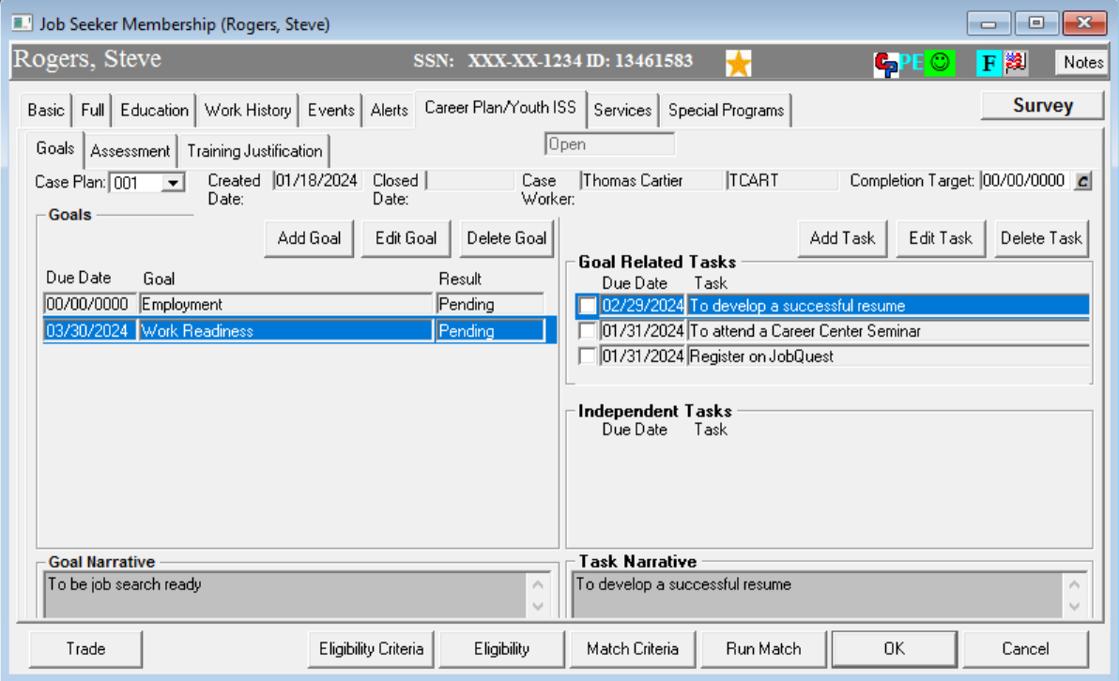
Career Plan Goals & Tasks

Slide 23
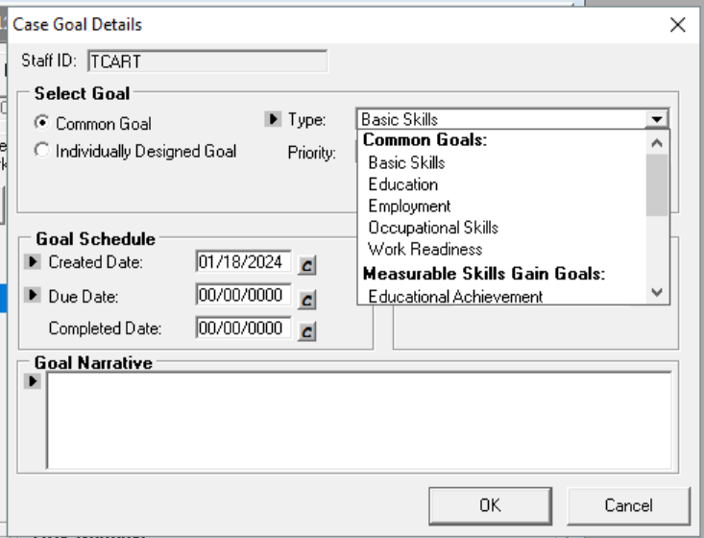
Career Plan Goals & Tasks

Slide 24
Career Plan Assessment
Assessment Tab:
Most of the information is automatically entered by the MOSES system.
• Complete any sections that are not automatically entered.
• LMI on past and future skills should be entered in this tab.
o LMI Information MUST be recorded within the Labor Market for Skills Description Box.
o Include the “local” outlook and cite the source of the information.

Slide 25
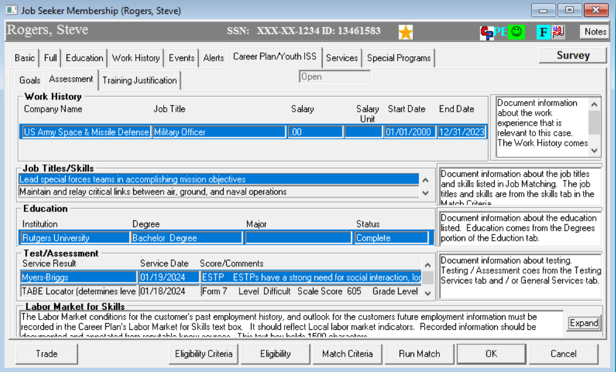
Career Plan Assessment tab

Slide 26
Career Plan Labor Market for Skills
In the Labor Market for Skills box list why this job seeker cannot find suitable employment with his or her current skills. Quote sources. Use Links, Massachusetts Career Information System for written information on occupations. Use Links, Department of Economic Research for the most current statistics on occupations. Demonstrate job seeking through want ads and other sources.

Slide 27
Career Plan Labor Market for Skills
Use MassHire Career Information System (MHCIS) for interpretations of occupational statistics. Several topics can help you, including Wages, Outlook, and Employment. You can use the copy (highlight the text you want, then press CTRL+C at the same time) and paste (locate where you want to put the text, then press CTRL+V at the same time) options. Copy and Paste are also available when you right click after highlighting the area.

Slide 28
Career Plan Labor Market for Skills
Go the Department of Economic Research site for LMI for pure statistics on the occupation, industry, and/or area that interests the Veteran. Once you are in that web site, click the Go button, then choose the area of statistics and the geographic area that you need. The most likely area to explore would be Occupations. This information is the source data for MCIS, but it is in table format. This does not lend itself easily to the cut and paste option mentioned above.

Slide 29
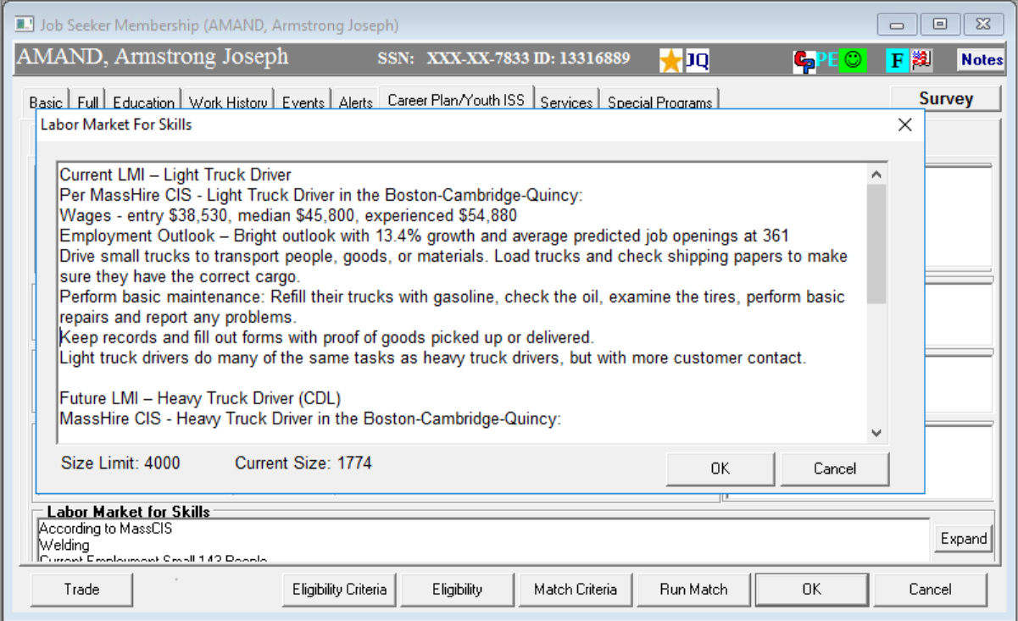
Career Plan Assessment / LMI

Slide 30
Career Plan Training Justification (if applicable)
Should a Veteran be assessed as needing training to make them work ready in the labor market, DVOP will complete a need for training in MOSES Notes that includes reasons why the customer cannot obtain employment with the current skill set, the proposed training, and LMI research supporting the choice of training.
The DVOP will then notify MDCS Operations Manager or Supervisor of the potential Veteran candidate for training and MDCS Operations Manager or Supervisor will review justification and send email to WIOA Operations Manager to expedite the Veteran for training.

Slide 31
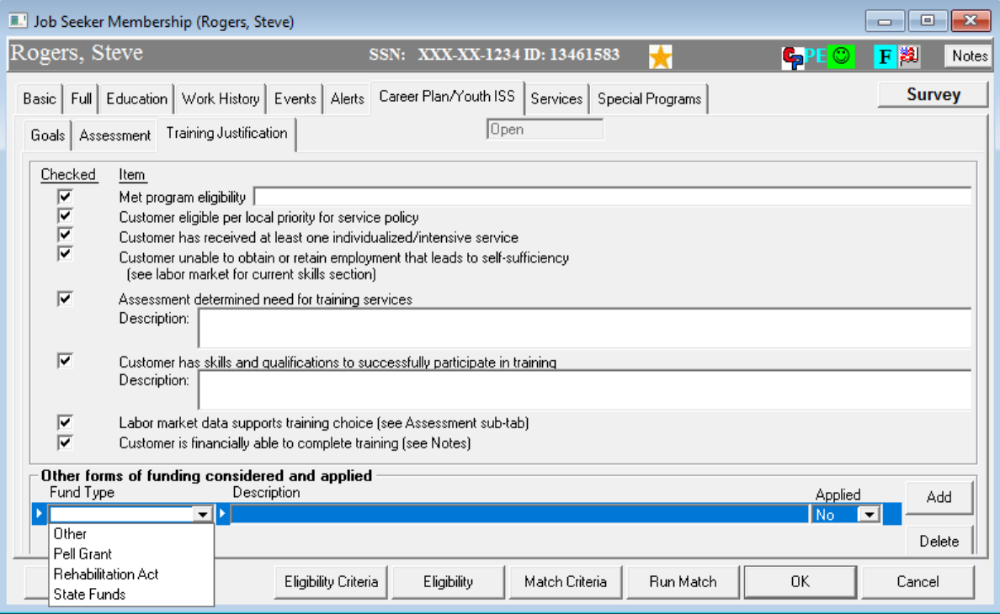
Career Plan Training Justification (if applicable)

Slide 32
?
?
?
Questions?
?
?
?
?
?
?
?
?

