Slide 1

Jobs for Veterans State Grant (JVSG) Program Training
Services
January 2025
MassHire Programs & Services are funded in full by US Department of Labor (USDOL) Employment and Training Administration grants.
• Additional details furnished upon request

Slide 2
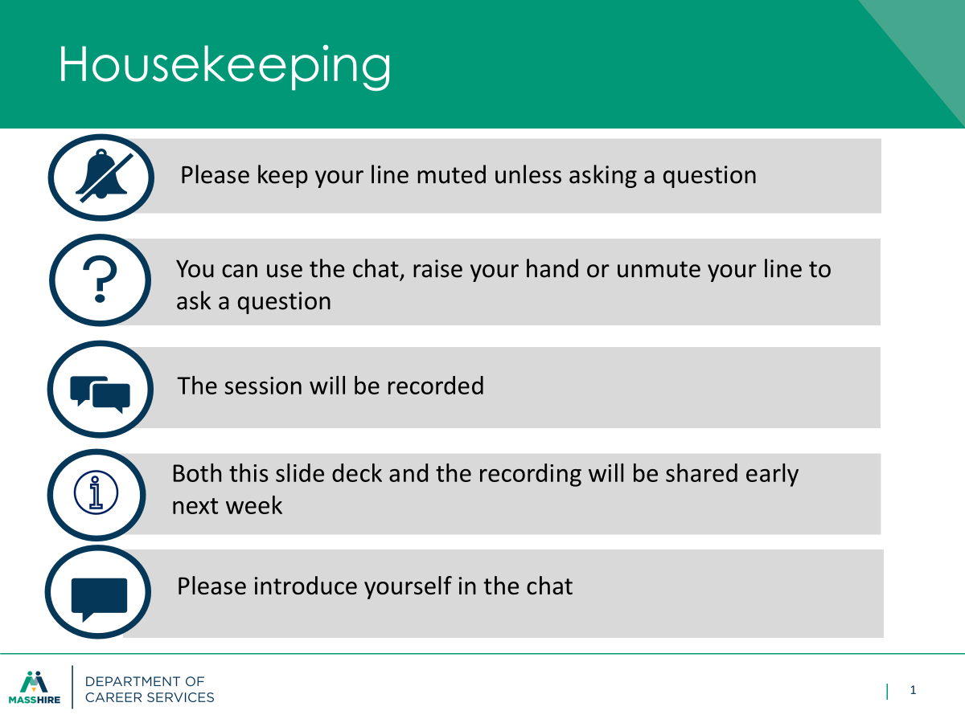

Slide 3
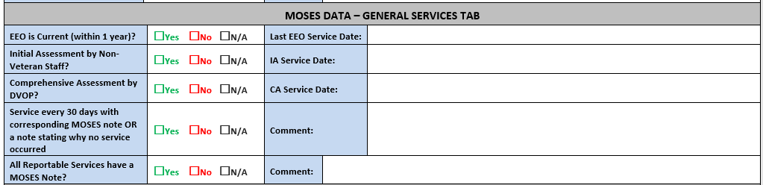
Services
General
Veterans Caseload Data Analysis (VCDAS)

Slide 4
Services
General
Any contact with a vendor/organization on the customer’s behalf should be recorded as follows:
• Services/General Services – Category: Career Planning , Service Detail: Consultation with Other Agencies with a description of the conversation in MOSES notes.
Any referral to an outside agency for supportive or educational services should be recorded as follows (With the exception of referrals to and from Vocational Rehabilitation):
• Services/General Services – Category: Counseling, Service Detail: Referred to Supportive Services or Referred to Educational Services, with a description of the conversation in MOSES notes.
Note: All referrals should be accompanied by a follow-up on the referral with Veteran/agency.

Slide 5
Services
General
Documentation of MOSES Services
Any in-person, actual phone contact, or two-way mail or email contact must be recorded as follows with a description of the conversation in MOSES notes:
• MOSES: Services/General Services – Category: Career Planning, Service Detail: Received Case Management Services
OR
• MOSES: Services/General Services – Category: Counseling, Service Detail: Individual Career/Employment Counseling
Any supportive Services received, uniforms, transportation, etc., should be recorded as follows:
•MOSES Services/General Services – Category: Supportive Services, Service Detail: as applicable with a description of the service in MOSES notes

Slide 6
Services
General
A customer must be contacted by phone, mail, e-mail or personal contact within the required
interval.
If unable to reach a customer, a letter or email must go out. Appropriate services should be entered in MOSES and a record of your attempt to contact customer in MOSES Notes.
• Establish a tickler system to manage the contact requirements or run reports given to you by your center.
• Record contact services in MOSES.
USE GENERAL SERVICE ONLY WHEN THERE HAS BEEN DIRECT COMMUNICATION WITH THE CUSTOMER

Slide 7
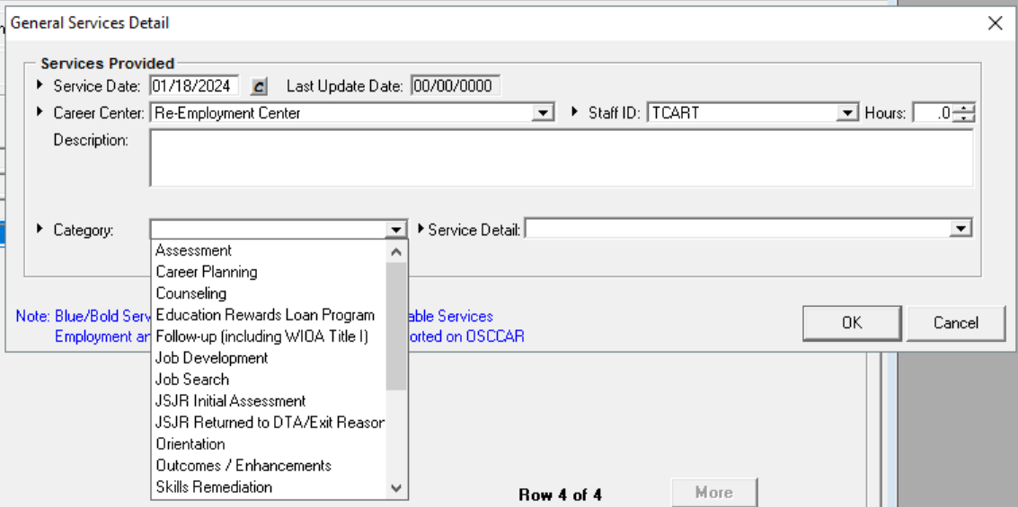
Services
General

Slide 8
Services
Basic Career Services
Basic Career Services:
Universally accessible and made available to all individuals seeking employment and training.
  Services include:
  Eligibility Determination
    Initial Skills Assessment
    Labor Exchange Services
    Information on Programs and Services
    Program Referrals
Basic services must be made available in at least one comprehensive Career Center per local area.
Notes:
Basic services can also include use of the resource room or attending workshops.

Slide 9
Services
Individualized Career Services
Individualized Career Services:
Made available to participants after staff determine such services are required to retain or obtain employment consistent with applicable statutory priorities.
Services Include:
  Specialized Assessment
  Development of Individualized Employment Plan (IEP) or Career Action Plan (CAP)
    Jointly developed by the participant and career planner to create an on-going strategy to identify:
      Employment Goals
      Achievement Objectives
      Appropriate combination of services for the participant to achieve the employment goals
Notes:
These programs require enrollment to be accessable to the customer.

Slide 10
Services
Individualized Career Services
Individualized Career Services: (continued)
Made available to participants after staff determine such services are required to retain or obtain employment consistent with applicable statutory priorities.
  Counseling
  Work Experiences (including transitional jobs)
    Transitional Jobs: time limited and wage-paid work experiences up to 100 percent subsidized.
      Must be combined with career and supportive services
      Established work history, demonstrates success in the workplace and develops skills
      Local Boards may use 10% of funds to support transitional jobs
Notes:
These programs require enrollment to be accessable to the customer.

Slide 11
Staff Assisted (Blue/Bold) Services, etc.

Slide 12
Staff Assisted Services (Blue/Bold)
Staff assisted services trigger and/or extend participation in the program (i.e. any blue/bold service resets the 90-day clock to zero (0))
Staff assisted services provide some benefit to a customer and take substantial staff time.
Services like assessment or career planning or counseling are examples of staff assisted services.
Services like emailing a customer or leaving a phone message are examples of services that are not staff-assisted services.
All services entered should be accompanied by clear notes!!!
“Substantial” Services.

Slide 13
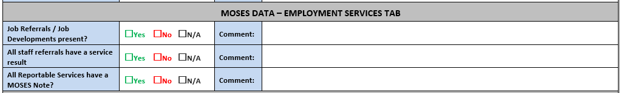

Services
Employment

Slide 14
Services
Employment / Hired (DVOP entered)
The additional parts of the Employment Services Detail window only appear if you selected Obtained Employment, Found Employment, or indicated a service result of Hired when the Service Category is either Job Referral - Staff or Job Development Referral.
The fields required vary depending on the programs where the job seeker is enrolled.
The preferred placement is to select Hired as the service result of a Job Referral-Staff or Job Development Referral.
The next preferred placement is Obtained Employment.
The least ideal is Found Employment.
Note: Local practices can be substituted until Program Policy is updated in JVSG SOP.

Slide 15
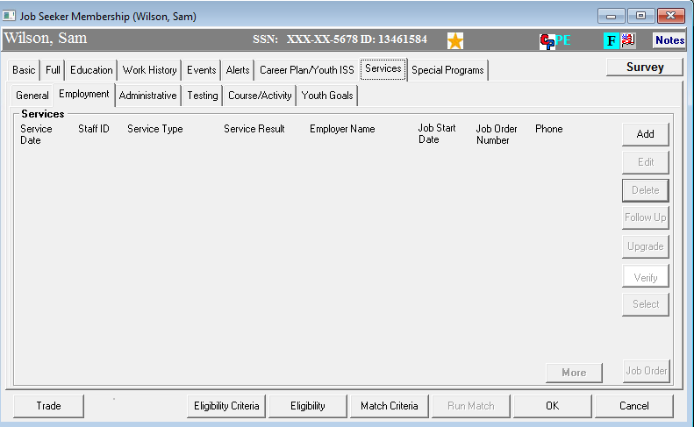
Services
Employment

Slide 16
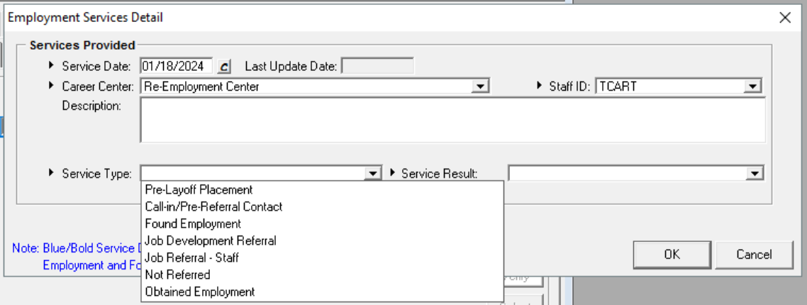
Services
Employment

Slide 17
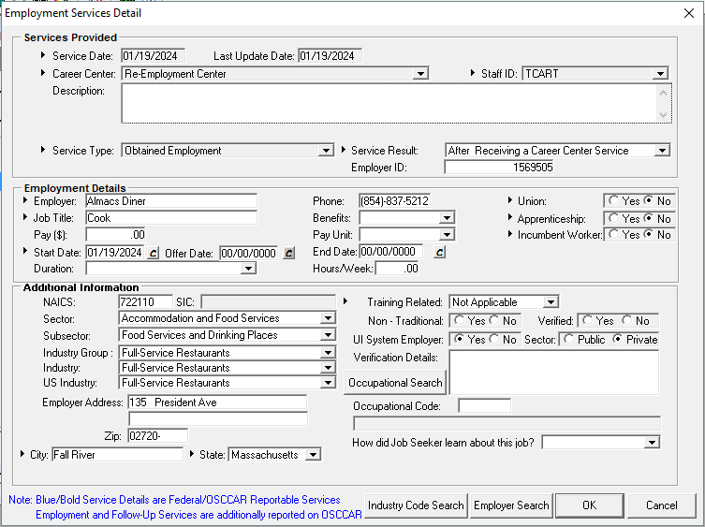
Services
Employment / Hired

Slide 18
Services
Administrative
Veterans Caseload Data Analysis (VCDAS)

Slide 19
Services
Administrative
• Utilize the Administrative tab when applicable and accompanied with a MOSES note.
If Contact is Made:
• MOSES: Services/General Services – Category: Career Planning , Service Detail: Received Case Management Services
OR
• MOSES: Services/General Services – Category: Counseling, Service Detail: Individual Career/Employment Counseling
USE GENERAL SERVICE (BLUE/BOLD)ONLY WHEN THERE HAS BEEN DIRECT COMMUNICATION WITH THE CUSTOMER AND A SERVICE OF SUBSTANCE HAS BEEN DELIVERED

Slide 20
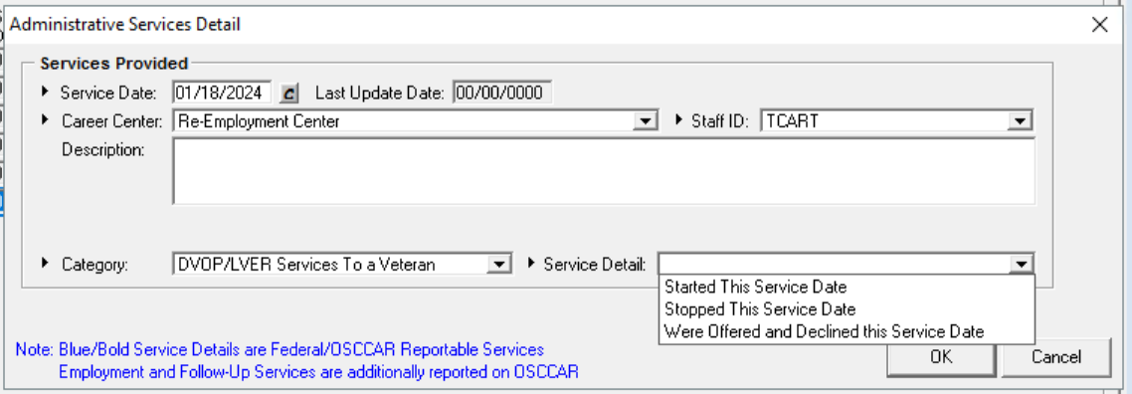
Services
Administrative
DVOP/LVER Services to a Veteran

Slide 21
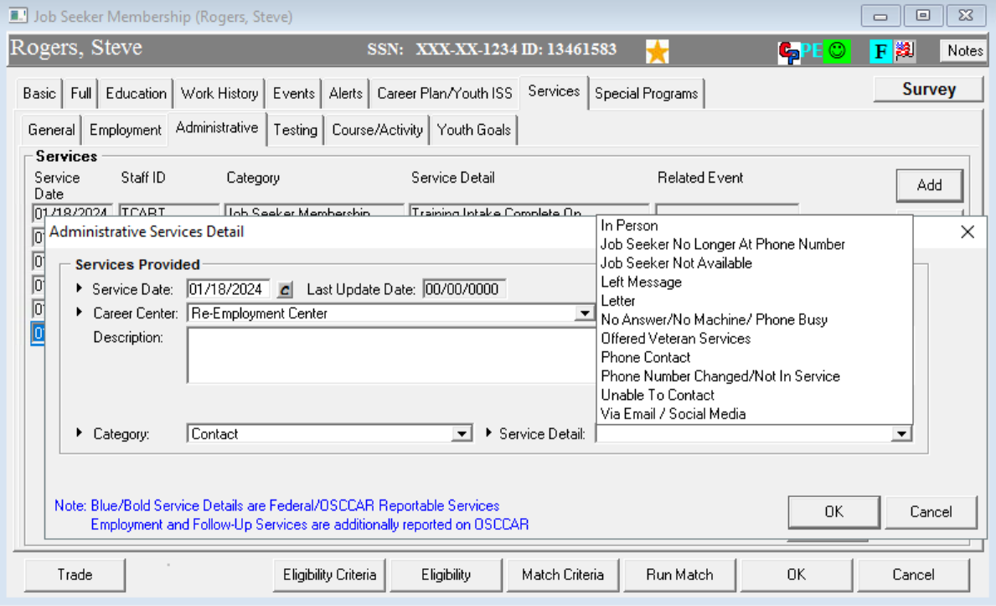
Services
Administrative
USED FOR DOCUMENTING UNSUCCESSFUL CONTACTS

Slide 22

?
?
?
Questions?
?
?
?
?
?
?
?
?

Slide 23
Jobs for Veterans State Grant (JVSG) Program Training
Notes
January 2025
MassHire Programs & Services are funded in full by US Department of Labor (USDOL) Employment and Training Administration grants.
• Additional details furnished upon request

Slide 24
Notes
Veterans Caseload Data Analysis (VCDAS)

Slide 25
Notes
Documenting MOSES Notes
The Career Plan /Case Plan and MOSES Notes describe the Veteran's background and their future goals. To help the Veteran complete the Career Plan / Case Plan and to detect and address any barriers that exist or arise, VET Staff are responsible for regular contact with enrolled Veterans.
MOSES Notes should be consistent with the customized service strategy developed with the Veteran and should parallel the Case Plan.
MOSES Notes should convey how the Case Manager/ Veteran went from point A to point B. An issue or event that is recorded must have a follow-up entry in MOSES.
Note: Mass Workforce Issuance 100 MDCS 08-112.3 Career Planning for WIOA indicates a case manager should contact the customer at intervals of no longer than 30 days

Slide 26
Notes
Writing in MOSES Notes:
MOSES Notes should be free of spelling errors and without personalized abbreviations.
MOSES Notes should contain only observable behavior not opinions or derogatory information about the customer.
MOSES Notes are a summarization of what occurred for each service – information copy or pasted directly from a customer email is not allowable.
Information that is of a highly personal nature should be avoided, if possible, if it cannot be avoided enter the information in MOSES Notes and mark note Confidential.
Every service must be accompanied with a MOSES Note.

Slide 27
Notes
Whenever possible, notes should answer the Who, What, When, Where, Why, and How questions.
Who: Notes should address whether the contact was with the Customer him/herself, or a training vendor, or other individual.
What: Notes should describe the event or occurrence that you are documenting.
When: Notes should address the date in which the contact or event.
Where: As applicable, Notes should include the location of the meeting or event that you are documenting.
Why: As applicable, Notes should describe why the Customer is being contacted, or it should be implicitly obvious to the reader why the Note is being included.
How: Notes should address whether the contact was in person, via telephone, by e-mail, or another method.

Slide 28
Notes
DVOPs must ensure that MOSES Notes tell a continuous story of the services provided and how the Veteran is progressing in their case plan.
DVOPs must add blue bold services that indicate staff assistance as appropriate and add Notes to describe the service provided.
Each Note must contain a next step, i.e., “Scheduled follow-up appointment on <date>”
For Example:
You meet with a Veteran, and record in Notes that the customer’s car is broken, requiring them to miss a few days in a training program and the plan to get it fixed.
The next Note should state if his car was fixed, or how this situation was resolved and the Veteran's next steps.

Slide 29
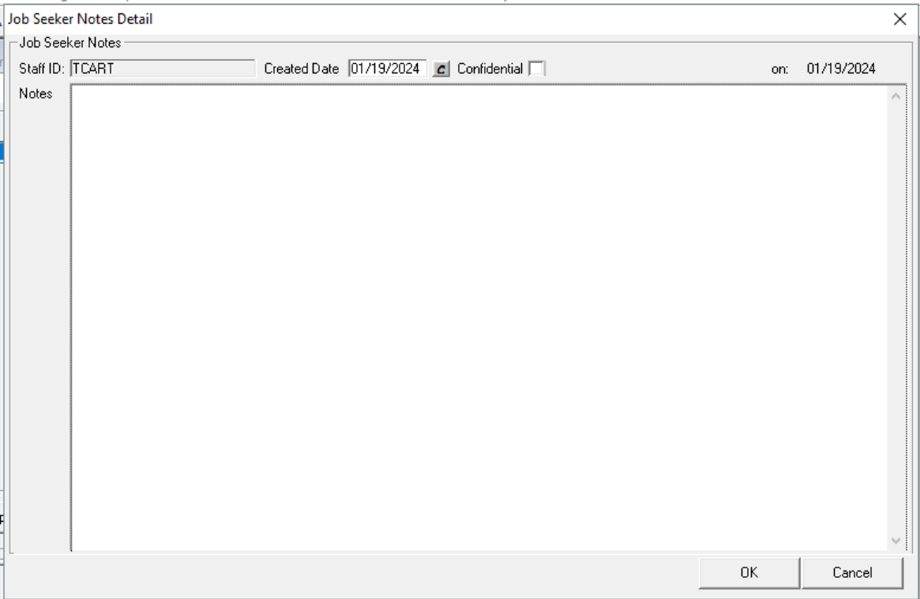

Notes
Holds 4,000 characters

Slide 30
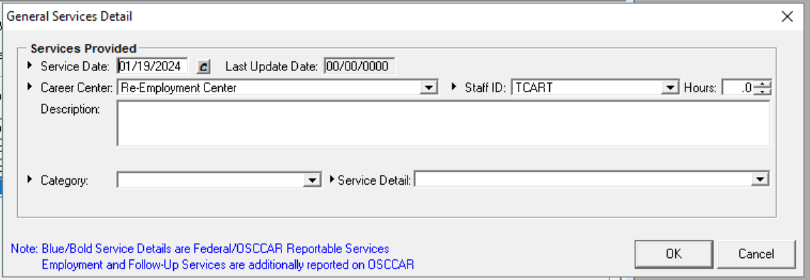
Notes
Holds 250 characters

Slide 31
MOSES Data Entry Requirements
MOSES Data Entry:
LVERs will enter in all employer services with appropriate service summaries (include Notes) provided to organizations in accordance with EOLWD/MDCS Policies and Procedures.
LVERs will inform local areas of new contacts with employers, jobs posted and include local area Career Center BSR teams on future meetings.

Slide 32
Documentation Records
Documentation may be stored electronically; however documentation must be available to program monitors, fiscal monitors, and auditors.
  (Security protocols to safeguard personal information must be in place.)
Local areas must retain records for a period of at least three (3) years after the submittal of the final closeout expenditure report for that funding period.
13

Slide 33
Eligibility Documentation in a Virtual Environment
100 DCS 18.111
  Verifying Eligibility Documentation via Live Stream
  Allows verification of eligibility documentation through livestream or video sharing such as Zoom, Webex, or Adobe Connects or other virtual media platform.
  A printout or an electronic copy of a screenshot containing the eligibility document verified must be included in the customer’s file.
  Electronic Signatures
  Participants must still sign documents when required.
  Fillable forms and the use of electronic signatures is allowed.
  Staff may have the participant email agreement to the content of the required form.
  The email must be kept in the participant file.
  Documenting MOSES
  All Staff must document the “Notes” section in MOSES when eligibility documentation was obtained via live stream and a printout or screen shot of the eligibility document is included in the customer’s file.

Slide 34
?
?
?
Questions?
?
?
?
?
?
?
?
?

