Slide 1

Jobs for Veterans State Grant (JVSG) Program Training
Outcomes and Follow-Up
January 2025
MassHire Programs & Services are funded in full by US Department of Labor (USDOL) Employment and Training Administration grants.
• Additional details furnished upon request

Slide 2
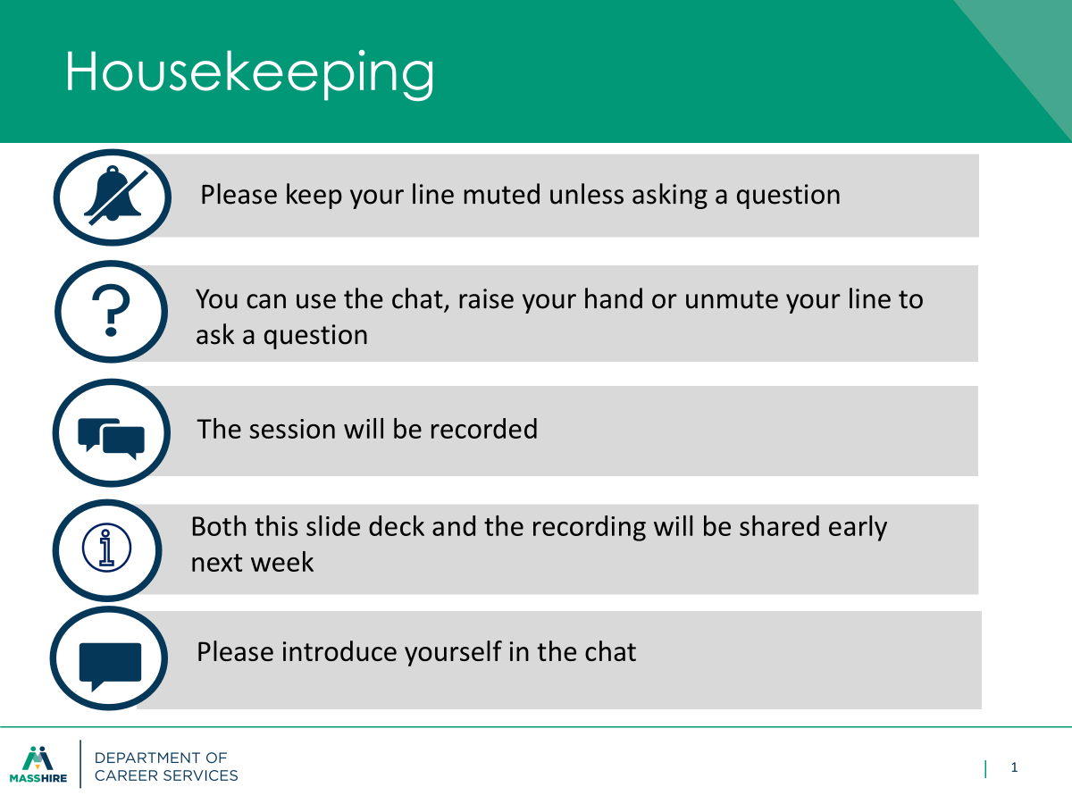

Slide 3
Outcomes
The manager/supervisor will sign the VCDAS form to indicate authorization to close the case plan.
A Note by the DVOP must be recorded in MOSES indicating management approval to close the case plan.
Once the Career Plan / case plan is closed, unless the job seeker returns for services, no recordable (blue) services will be entered. This will allow the Veteran to “soft” (auto) exit from all programs.

Slide 4
Outcomes
The DVOP will continue to work with the Veteran until an outcome has been attained, or unless the Veteran customer no longer desires to utilize services within the Career Center.
If the Veteran is not following through with the DVOP; the current process is to make three (3) separate attempts (within a 3-month reasonable time frame) to reach out to the Veteran and record these attempts in MOSES under the appropriate services category/tabs;
As well as MOSES Notes:
Examples include:
• Telephone call
• Email communication
• Send letter via postal service and/or Email with read receipt

Slide 5
Outcomes
Exclusions from Performance
Must be documented (scrutinized rigorously by feds)
Institutionalized: The participant exits the program because the participant has become incarcerated that last longer than 90 days in a correctional institution or has become a resident of an institution or facility providing 24-hour support such as a hospital or treatment center during the course of receiving services as a participant and is unable to receive services.
Medical Care: The participant exits the program because of medical treatment and that treatment is expected to last longer than 90 days and precludes entry into unsubsidized employment or continued participation in the program.
Deceased: The participant is deceased.
Reservist Called to Active Duty: The participant exits the program because the participant is a member of the National Guard or other reserve military unit of the armed forces and is called to active duty for at least 90 days.

Slide 6
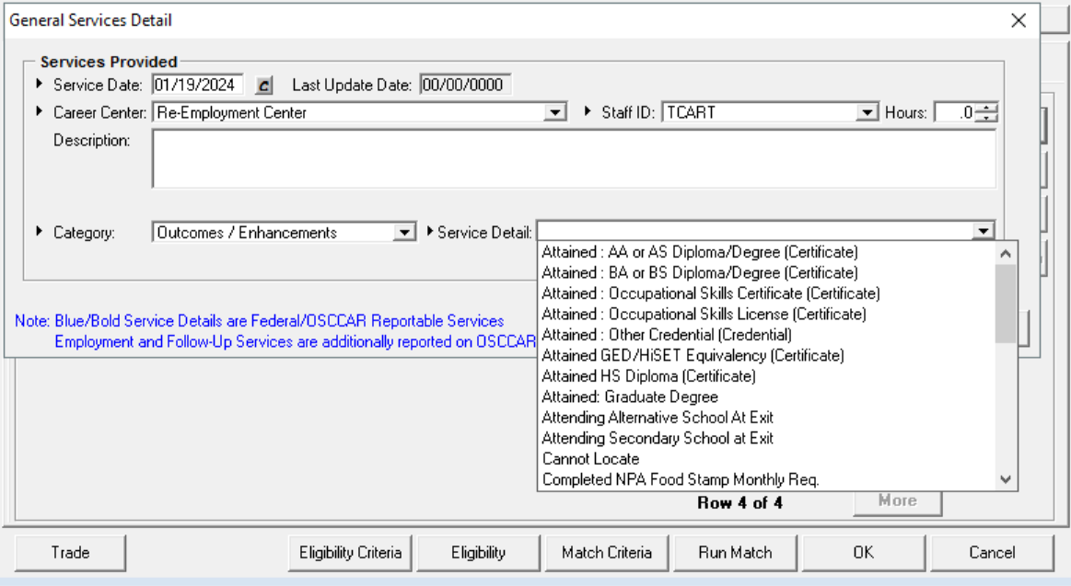
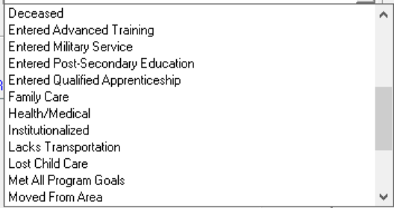
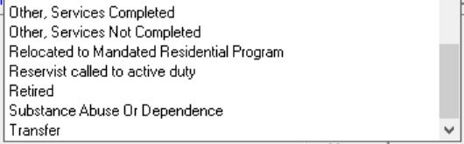
Outcomes
Exclusions from Performance

Slide 7
Definition of WIOA Exit
20 CFR § 677.150(c)
An exit occurs when a participant has not received a [staff-assisted (blue/bold)] service for 90 consecutive days and no future services are planned.
The exit date becomes the last day that the participant receives services.

Slide 8
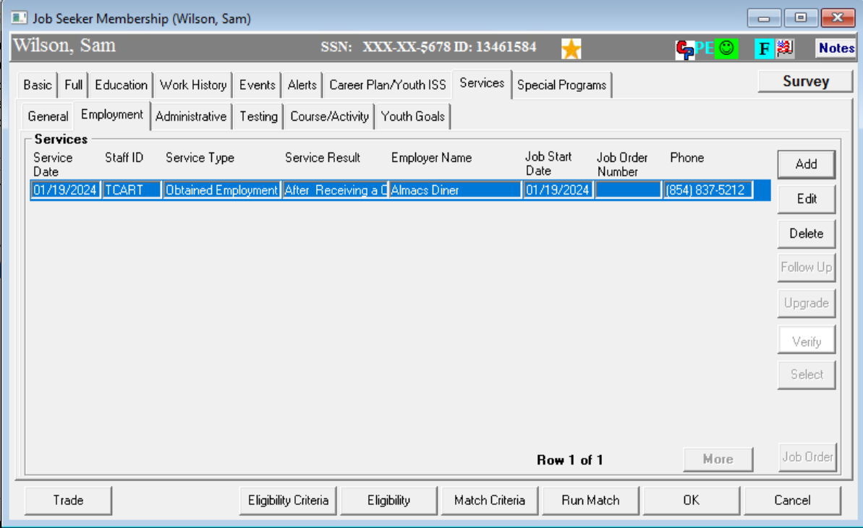
Follow-Ups

Slide 9
Follow-Up Services
Follow-Up Services: Provided for 12 months after the first day participants are placed in unsubsidized employment. Local area policies must define appropriate follow-up services.
Follow-Up Services (General Services) Include:
Providing individuals counseling about the workplace
Career planning and counseling
Information about additional educational opportunities
Referral to support services available in the community and peer support groups
Case management administrative follow-up
Follow-up services for case planning are not to be construed as follow up services required for performance reporting.
100 DCS 08.102.1 WIOA Title I Follow Up Services Policy
http://www.mass.gov/massworkforce/docs/issuances/wioa-policy/08-102.pdf

Slide 10
Follow-Up Services
Follow-Up variants for tracking in MOSES
Required 12 Month Follow-Ups (General Services)
Overarching, required by law
After Exit Follow-Up Services (General Services)
Specific services delivered after exit (e.g. Counseling)
Employment Follow-Up Services (Employment Services)
Possibly extremely important for federal performance

Slide 11
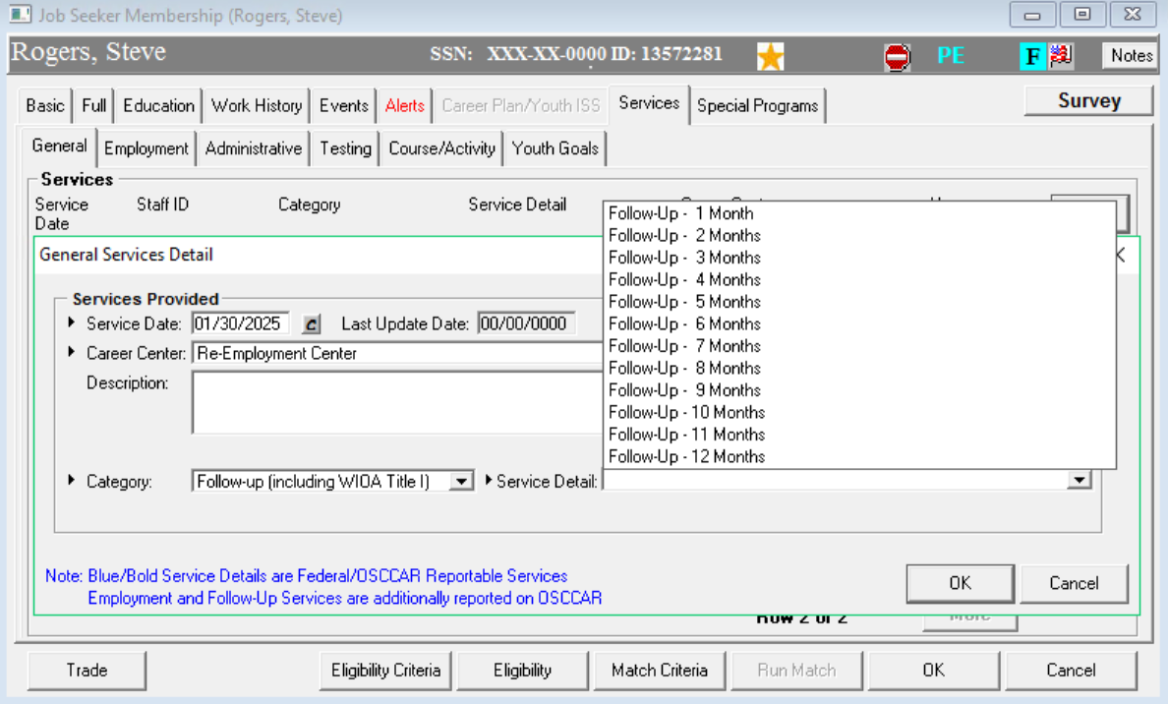
Follow-Up Services
Follow Up Services (General Services)

Slide 12
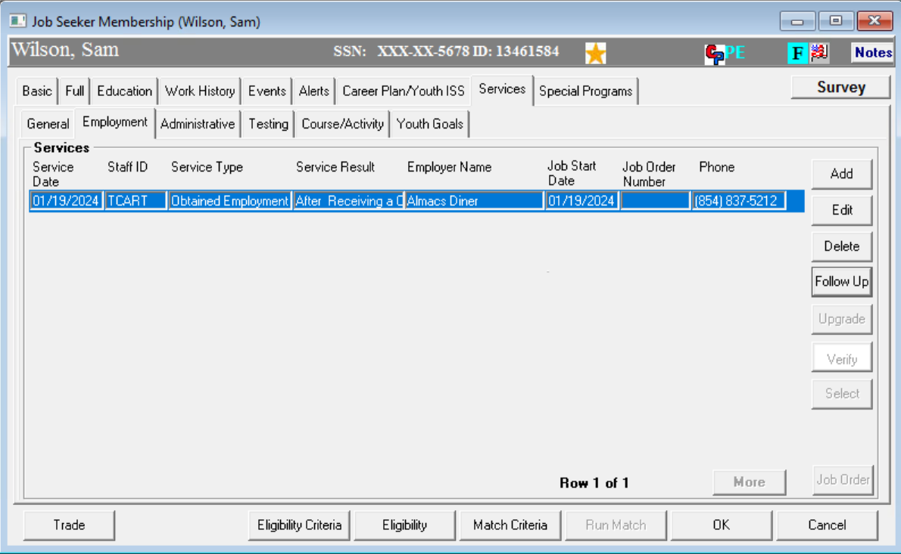
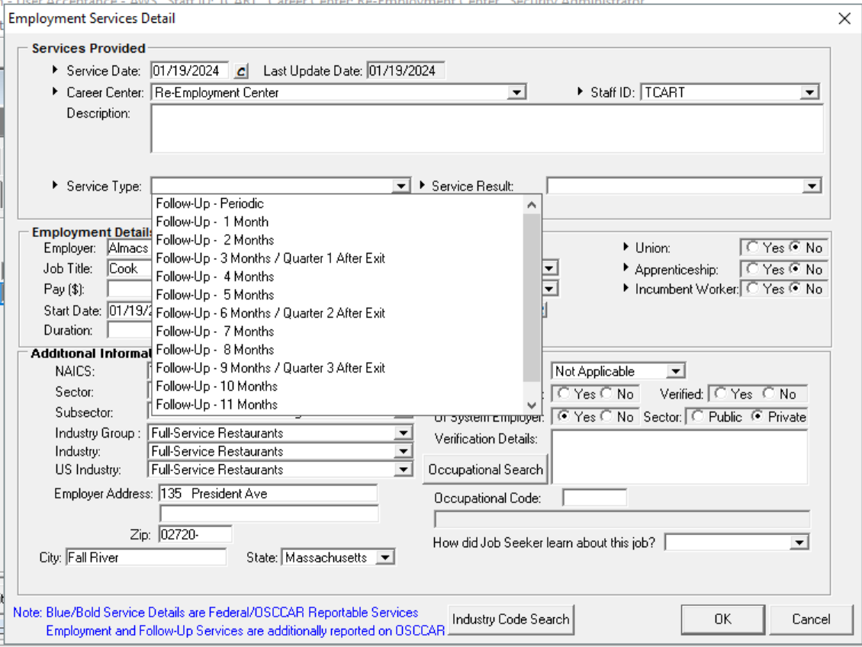
Follow-Up Services
Employment Follow Up Services (Employment Services)

Slide 13

Two Worlds
USDOL data driven, performance reporting world
The real world; customers in pursuit of a more substantial career/life receiving good services from career center staff
Good service delivery in the real world will generally accomplish the performance outcomes desired in the data driven world.
Leslie Abramowitz

Slide 14

?
?
?
Questions?
?
?
?
?
?
?
?
?

Slide 15
Jobs for Veterans State Grant (JVSG) Program Training
Reports
January 2025
MassHire Programs & Services are funded in full by US Department of Labor (USDOL) Employment and Training Administration grants.
• Additional details furnished upon request

Slide 16
Barriers to Employment Reports
The Report Contains:
• Input to select your Career Center
• Ability to select a date range based on a reportable service at the selected Career Center(s)
• Shows a list grouped by Career Center(s) selected which includes only Veterans who meet 1 or more of the following criteria.
• Disability; Vietnam Era Veteran
• Between the Ages of 18-24; justice involved; homeless or risk of; lack of high school diploma
• Exited Military Service within the last 3 years; unemployed; VA Referred
• Low income, head of single parent household, receiving Federal/State/Local assistance

Slide 17
Reports
Report for Identification of Veterans with Barriers to Employment for Veteran Employment Service
The Crystal Report, Identification of Veterans with Barriers to Employment for Veteran Employment Service, is available on Mass Workforce under Crystal Report Project,
https://www.mass.gov/service-details/Veterans-reports .
This report allows career centers to identify the Veterans that are receiving services in their career center that meet the eligibility criteria to receive services from the DVOP.
The DVOP will then connect with those Veterans to provide case management (WIOA Career Planning) and intensive services (WIOA Individualized) if it is determined though the comprehensive Massachusetts Jobs for Veteran State Grant Standard Operating Procedures assessment that they are near job readiness and they maintain compliance with their case manager, and the Veteran wishes to receive in-depth services.
Barriers to employment reports must be run a minimum of bi-weekly (or more frequently as per local policy) to ensure that Veterans in need of in-depth services are identified.

Slide 18
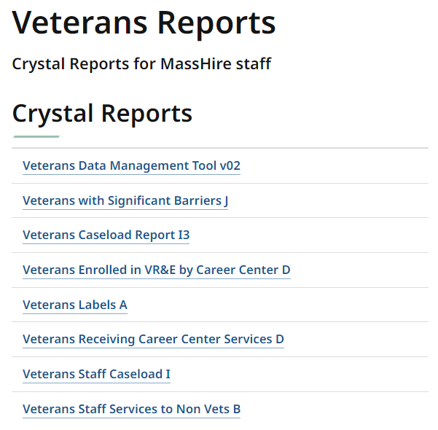
Reports

Slide 19
?
?
?
Questions?
?
?
?
?
?
?
?
?

Slide 20
Jobs for Veterans State Grant (JVSG) Program Training
Resources
January 2025
MassHire Programs & Services are funded in full by US Department of Labor (USDOL) Employment and Training Administration grants.
• Additional details furnished upon request

Slide 21
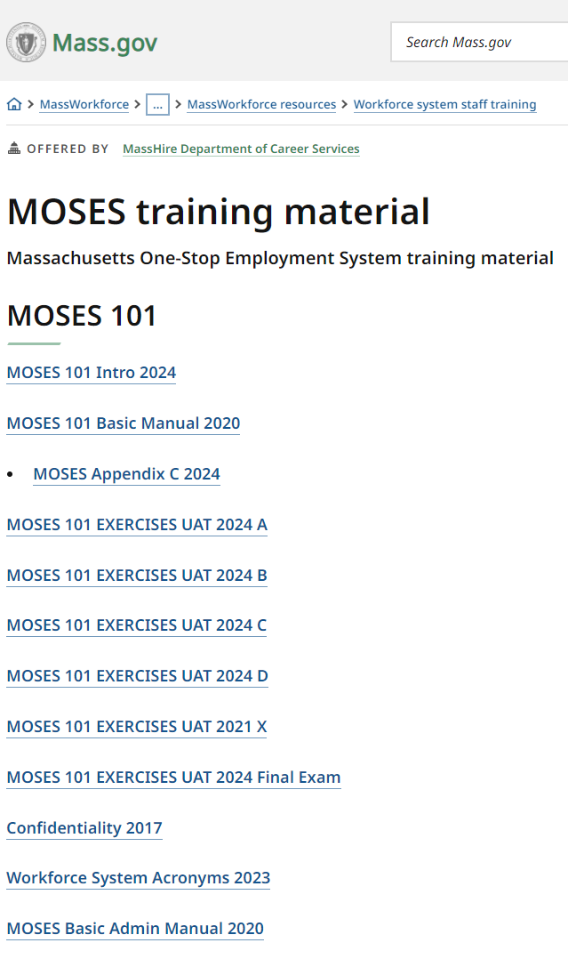
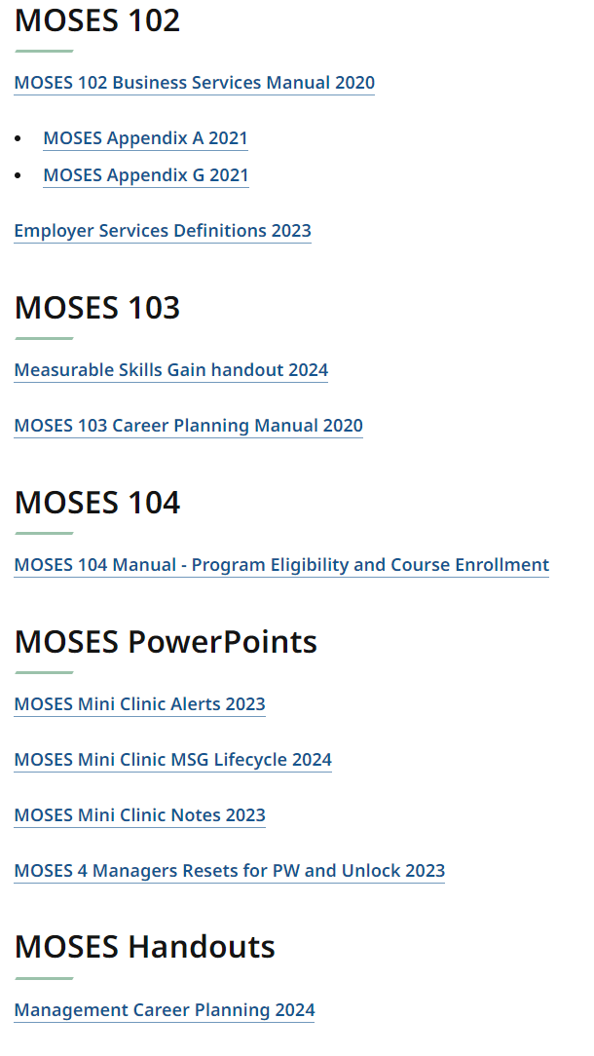
Resources
https://www.mass.gov/info-details/moses-training-material

Slide 22
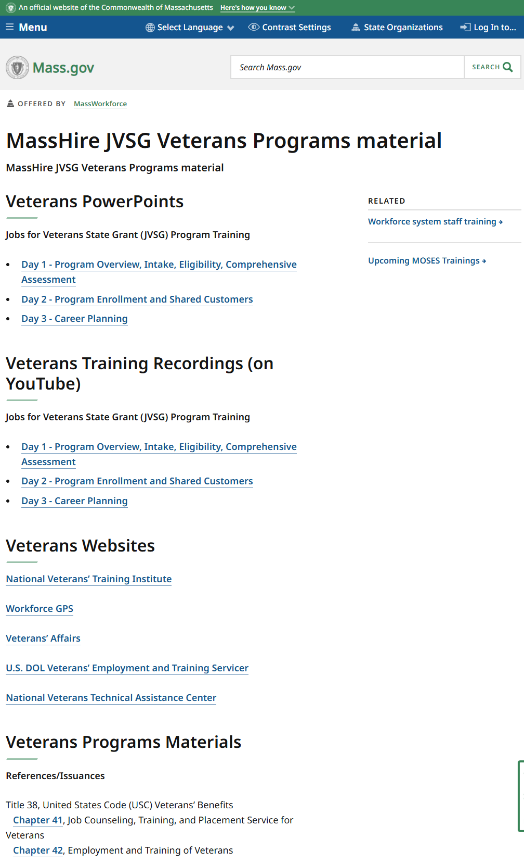
Resources
https://www.mass.gov/info-details/masshire-jvsg-veterans-programs-material

