Slide 1
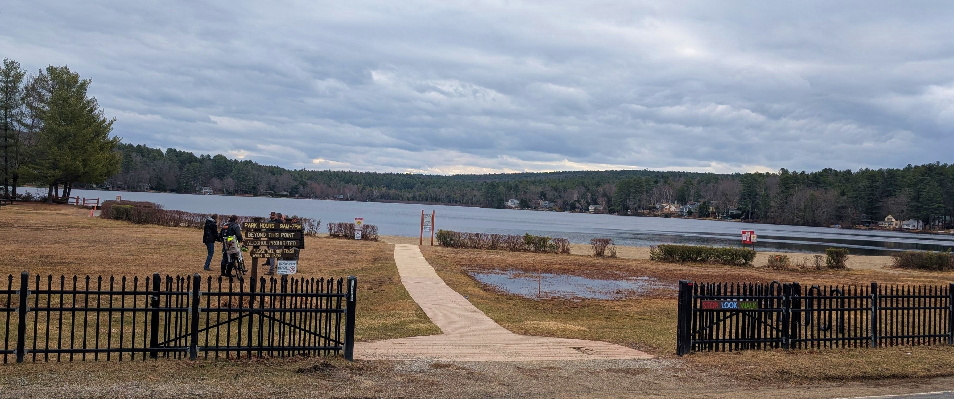

Project Shade | Lake Wyola State Park
PUBLIC MEETING 1
June 4, 2024

Slide 2


COMMONWEALTH OF MASSACHUSSETTS
Governor
Maura T. Healey
Lieutenant Governor
Kimberley Driscoll
Energy and Environmental Secretary
Rebecca L. Tepper
Department of Conservation and Recreation Commissioner
Brian Arrigo

Slide 3

DCR MISSION STATEMENT
To protect, promote and enhance our common wealth of natural, cultural and recreational resources for the well-being of all.

Slide 4
MEETING LOGISTICS
You will have the opportunity to submit comments over the course of the next two weeks at:
DCR Public Comments https://www/mass.gov/forms/dcr-public-comments
Two ways to ask questions during the meeting
Use chat feature
Raise your hand: Click “Reaction”, then click “Raise Hand” and you will be given permissions to unmute and speak.
Please note that this public information meeting will be recorded; the recording will be a public record.

Slide 5
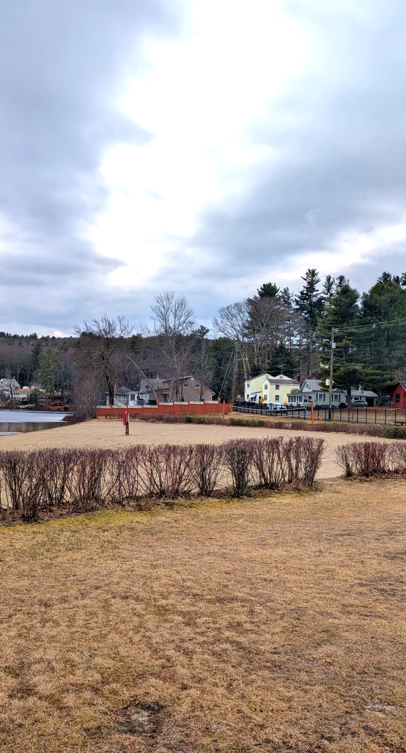
AGENDA
Team Introductions
Project Overview
Next Steps
Discussion / Q&A

Slide 6
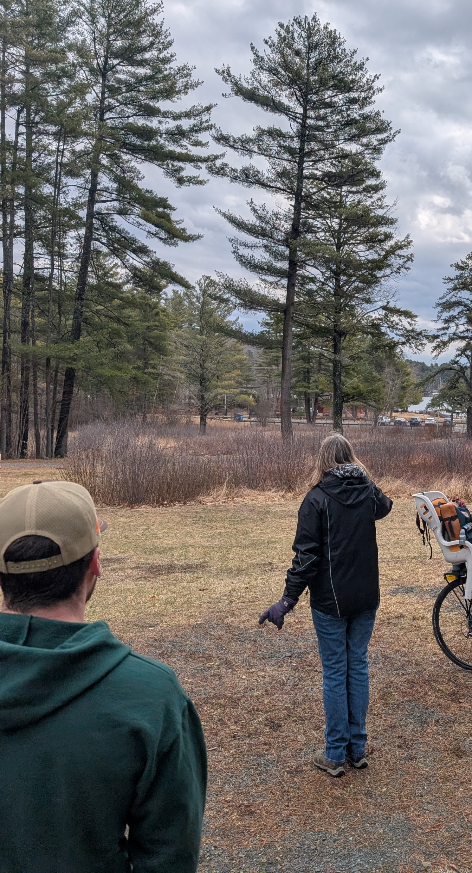




TEAM INTRODUCTIONS
1
CLIENT
Division of Design & Engineering
Department of Conservation & Recreation
DESIGN TEAM
Lead Consultant, Civil Engineering, Permitting
Nitsch Engineering
Landscape Architecture
Kyle Zick Landscape Architecture
Architecture
Dietz & Company Architects
Structural
Spring Line Design

Slide 7
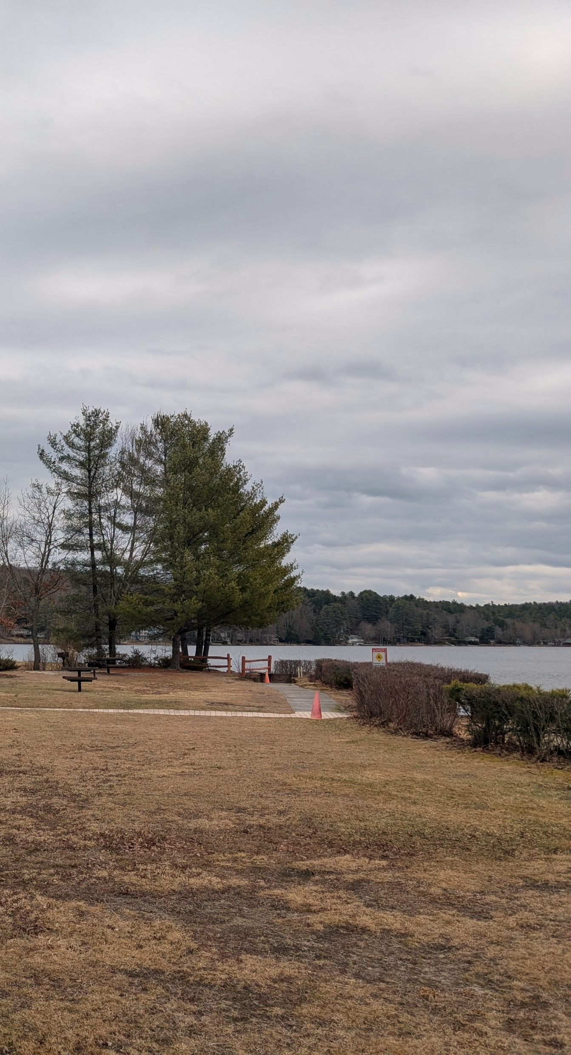
PROJECT OVERVIEW
2
Project Goals
Existing Conditions
Shade Structure Concepts

Slide 8
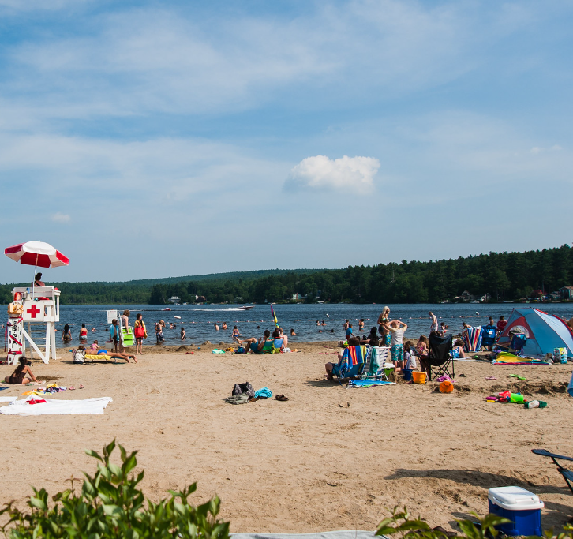
DCR PROJECT SHADE
Pilot project building resilience to extreme heat at State Parks by strategically installing shade structures and expanding tree canopy.
Additional Details and Information available at:
https://www.mass.gov/info-details/dcr-project-shade
Photo Credit: Flickr User Heather Katsoulis

Slide 9
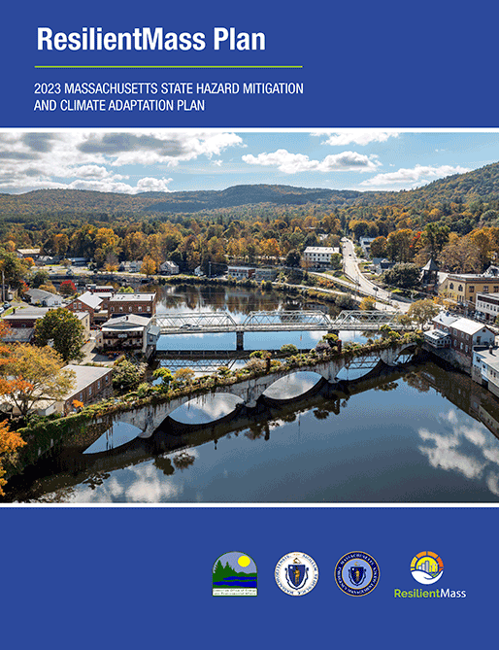
PROJECT CONTEXT
By 2050, Shutesbury could see around 22 days each year with temperatures of 90°F or higher.
428

Slide 10




PROJECT GOALS
SHELTER
ACCESS
RECREATION
ENVIRONMENT
Provide shelter from heat and sun
Increase useability for vulnerable populations
Activating spaces and providing recreational and social amenities
Increase native tree canopy and awareness of heat safety

Slide 11
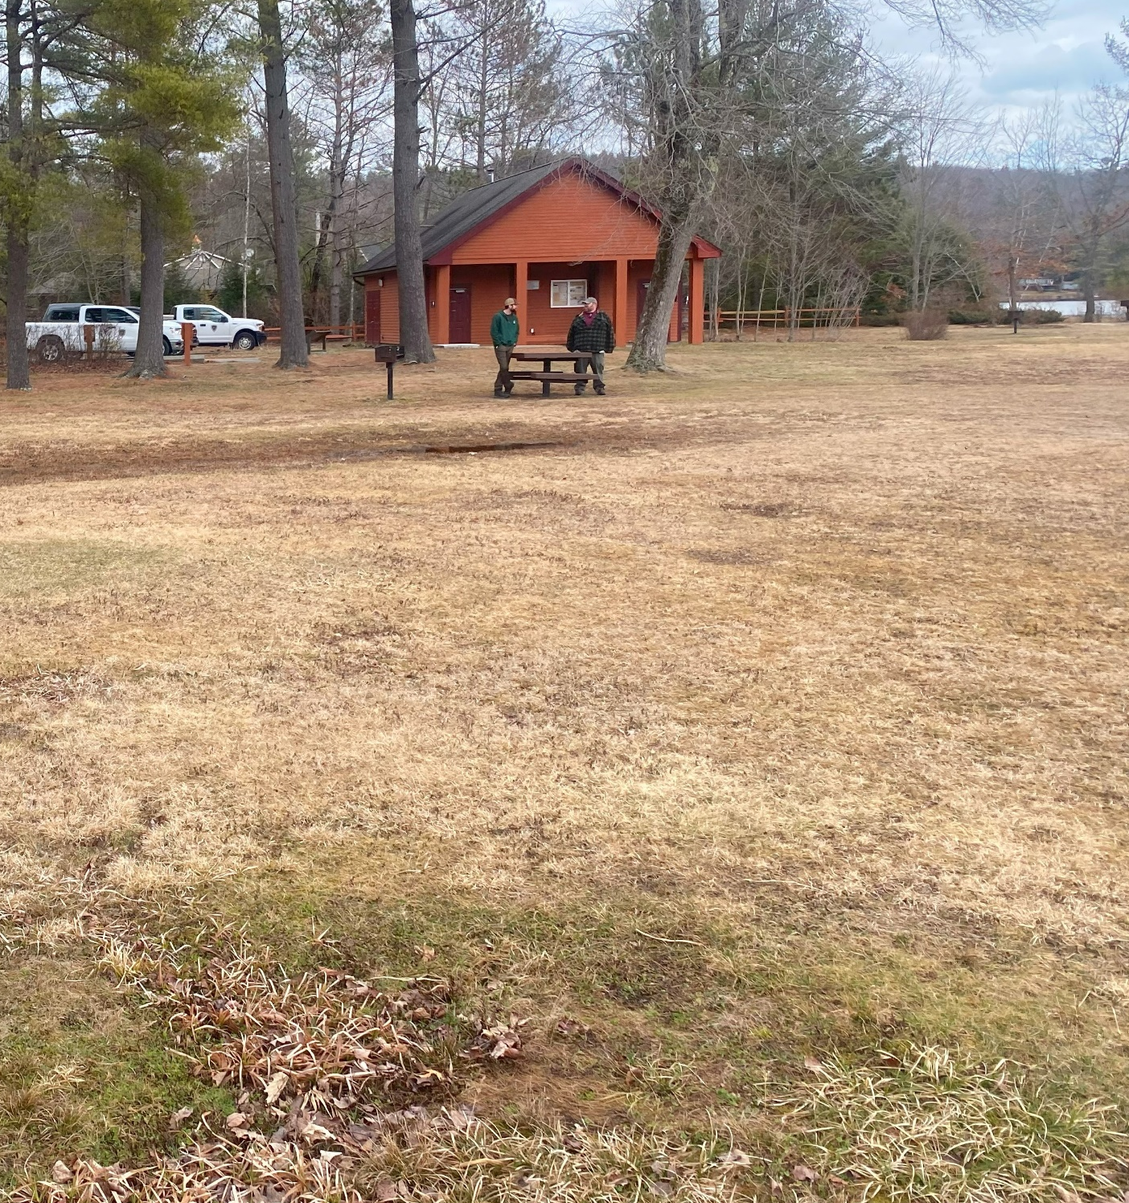
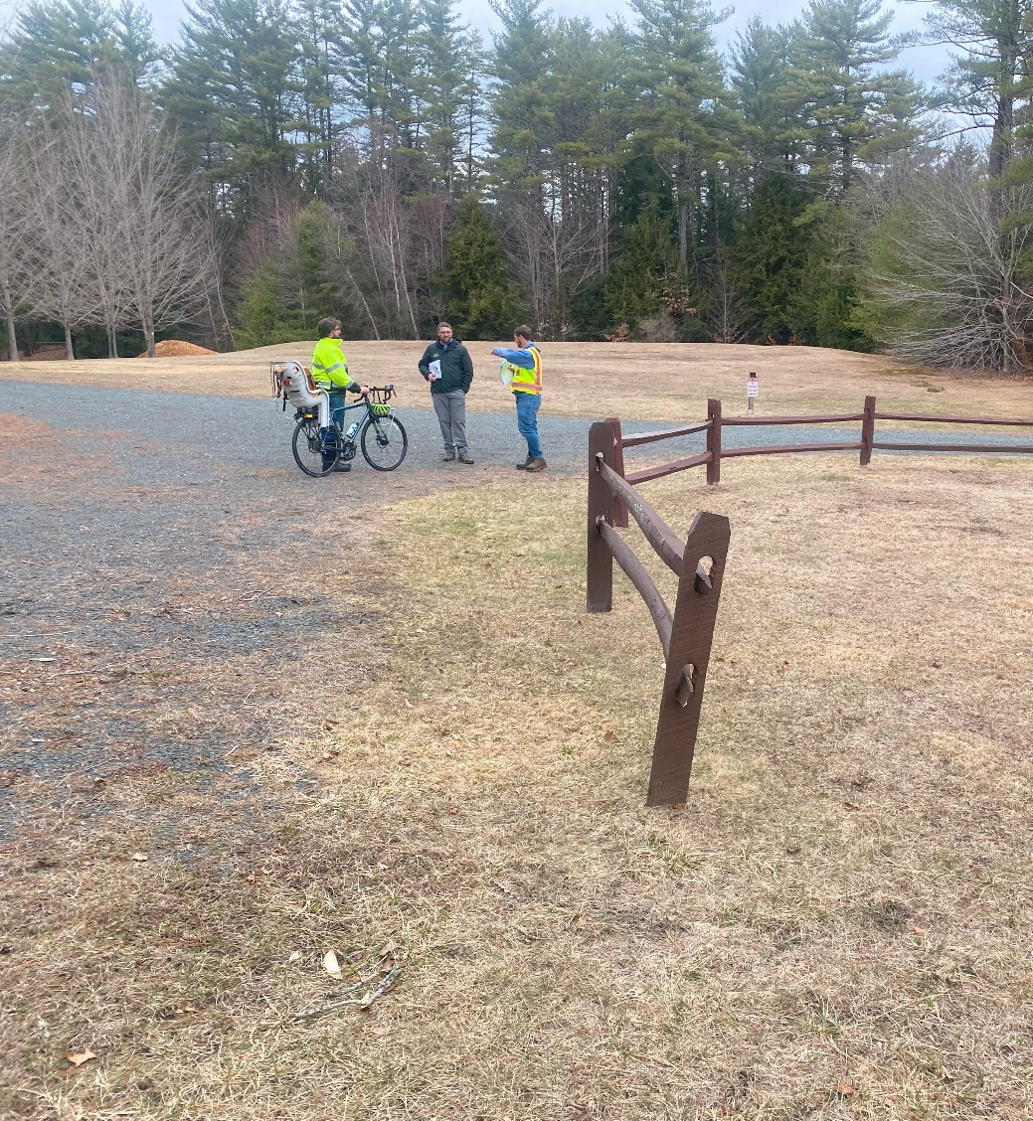
EXISTING CONDITIONS
Lack of shaded seating
Few seating opportunities
No refuge or amenities north of Lakeview Rd

Slide 12
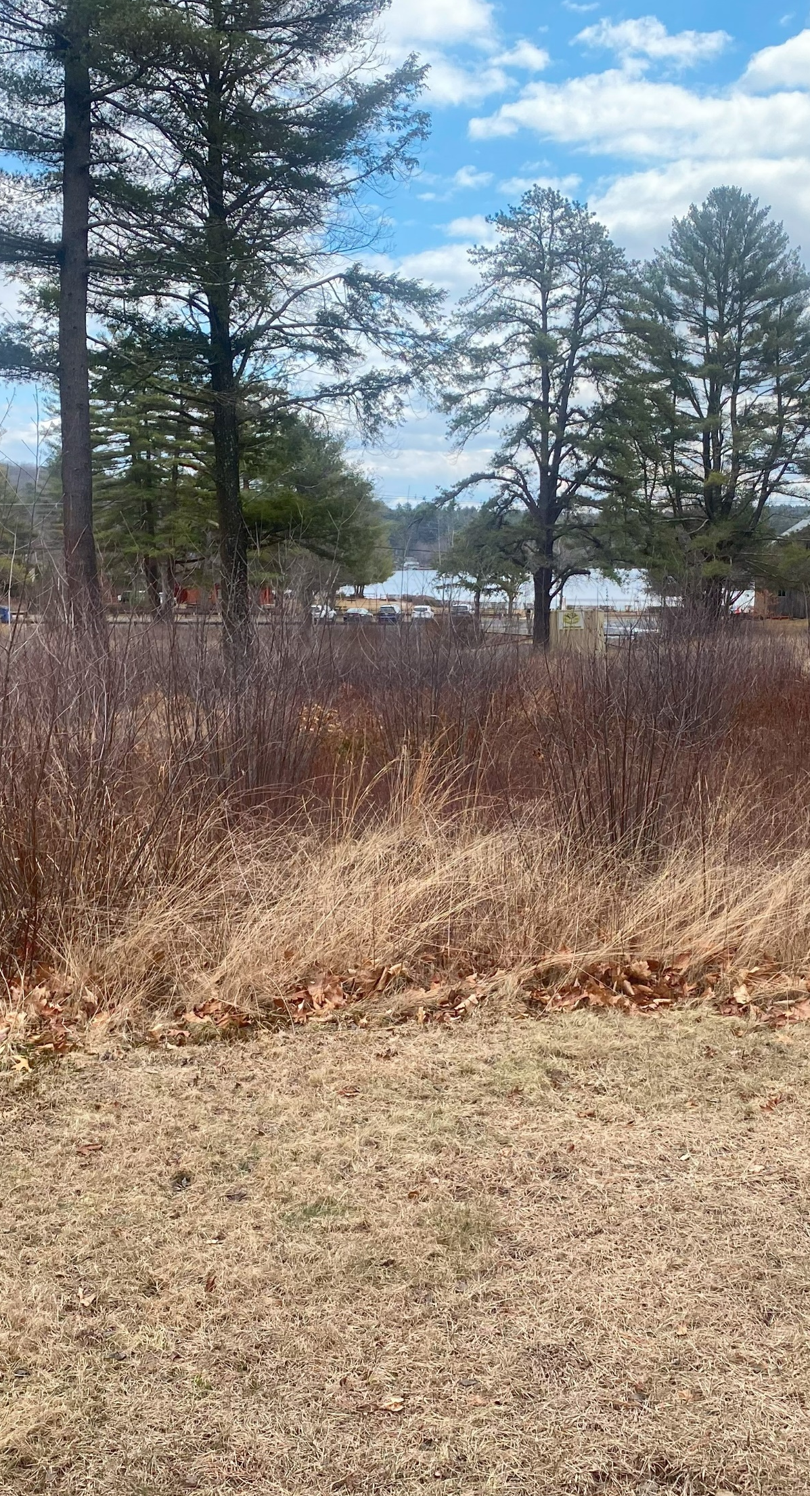
3
Shade Structure Concepts
Medium Pavilion (1)
Small Pavilions (3)

Slide 13
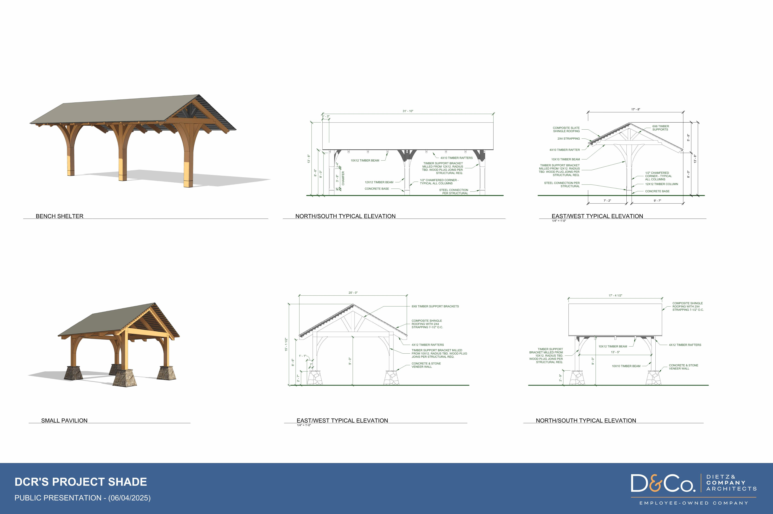
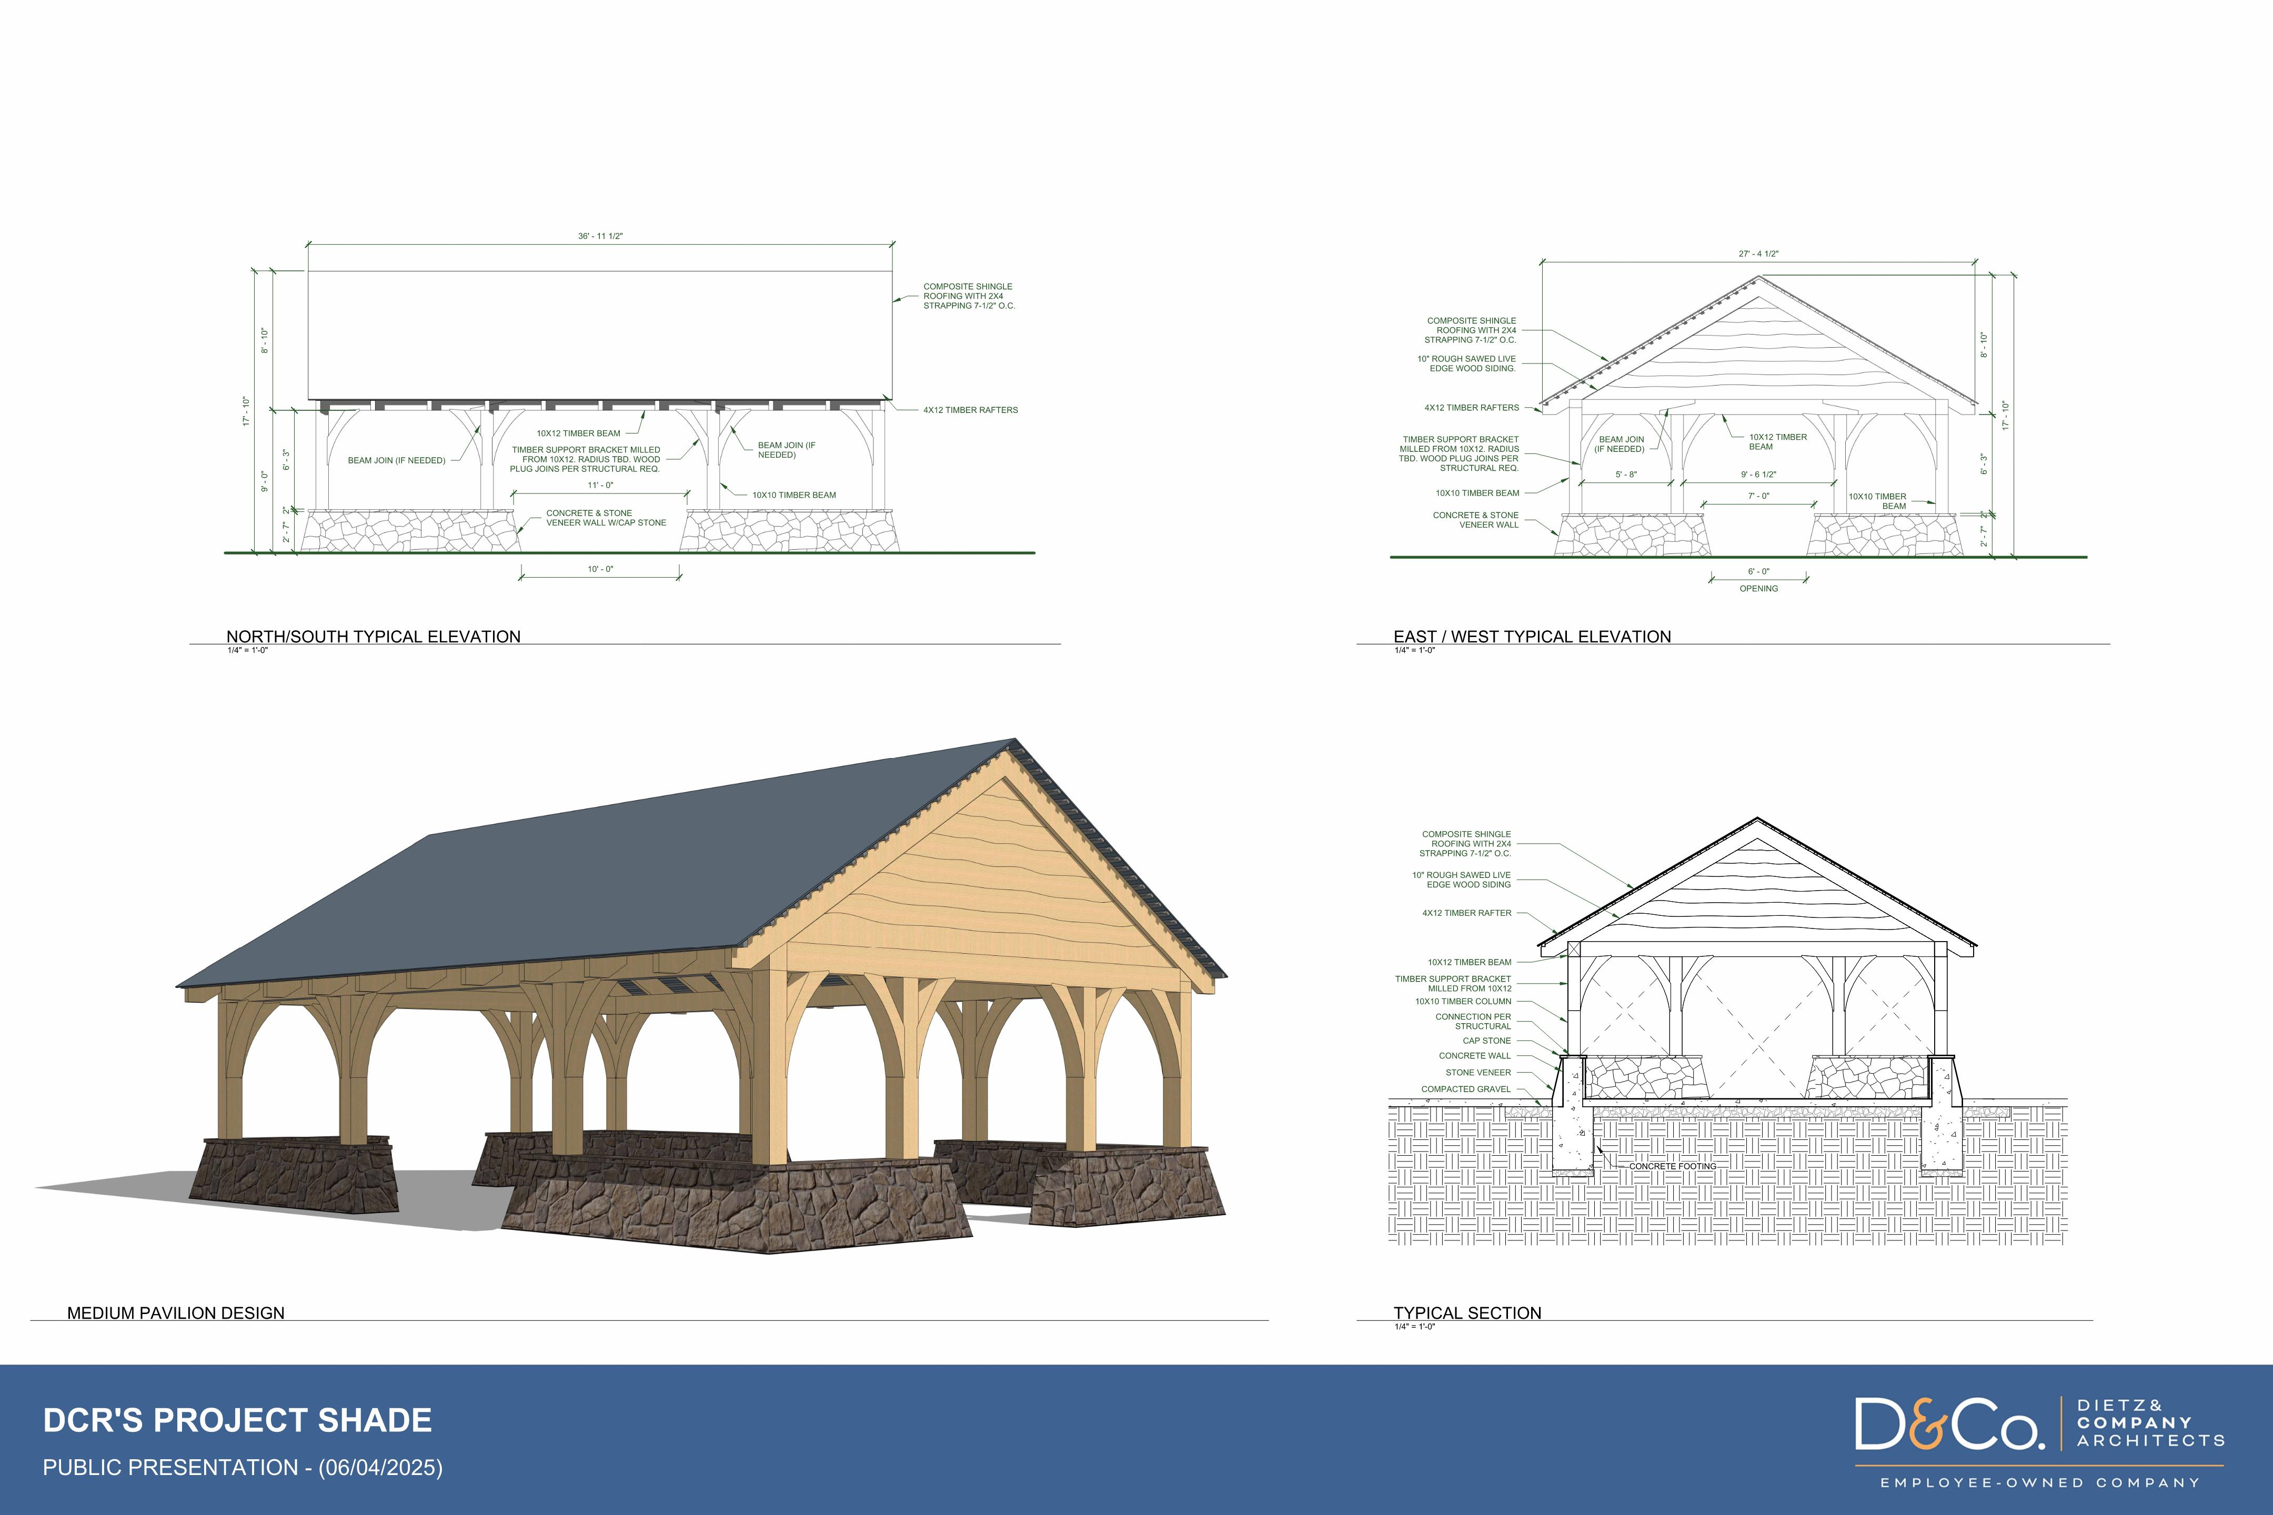
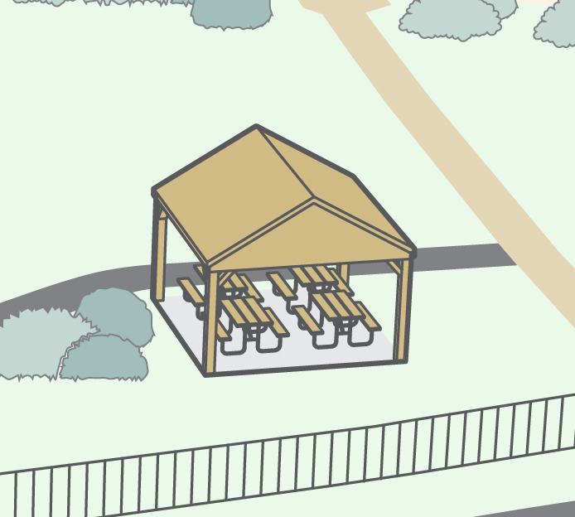
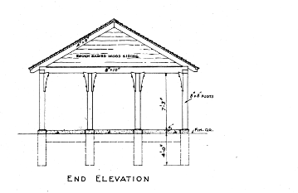
SHADE STRUCTURE CONCEPTS
Pavilion
Small Pavilions
RENDERING?
PROJECT SHADE: LAKE WYOLA STATE PARK
JUNE 2025

Slide 14
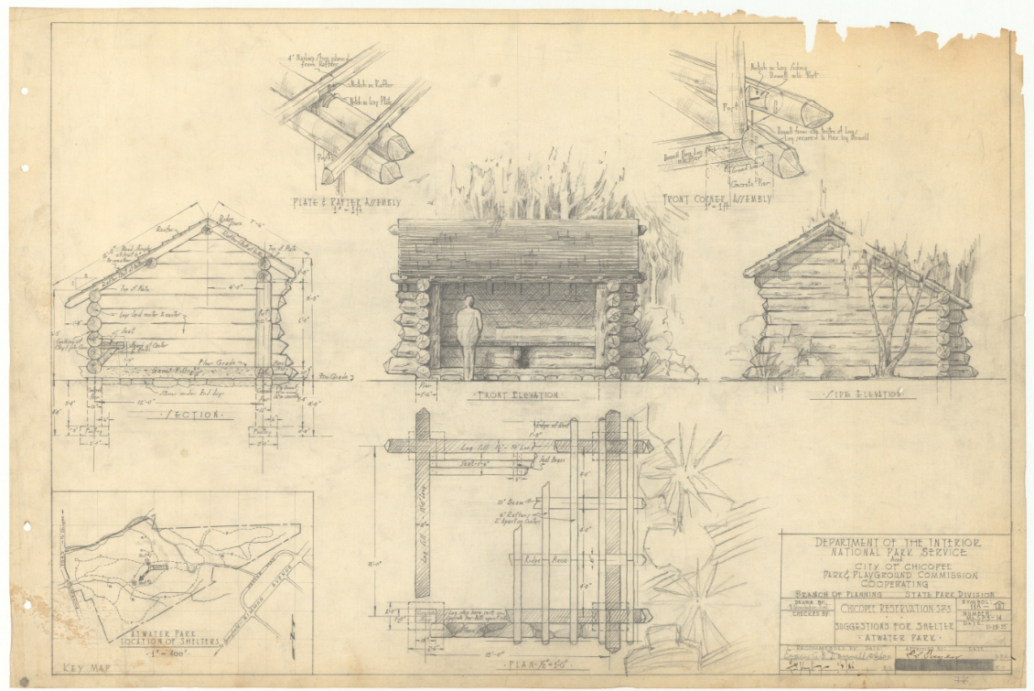

Slide 15
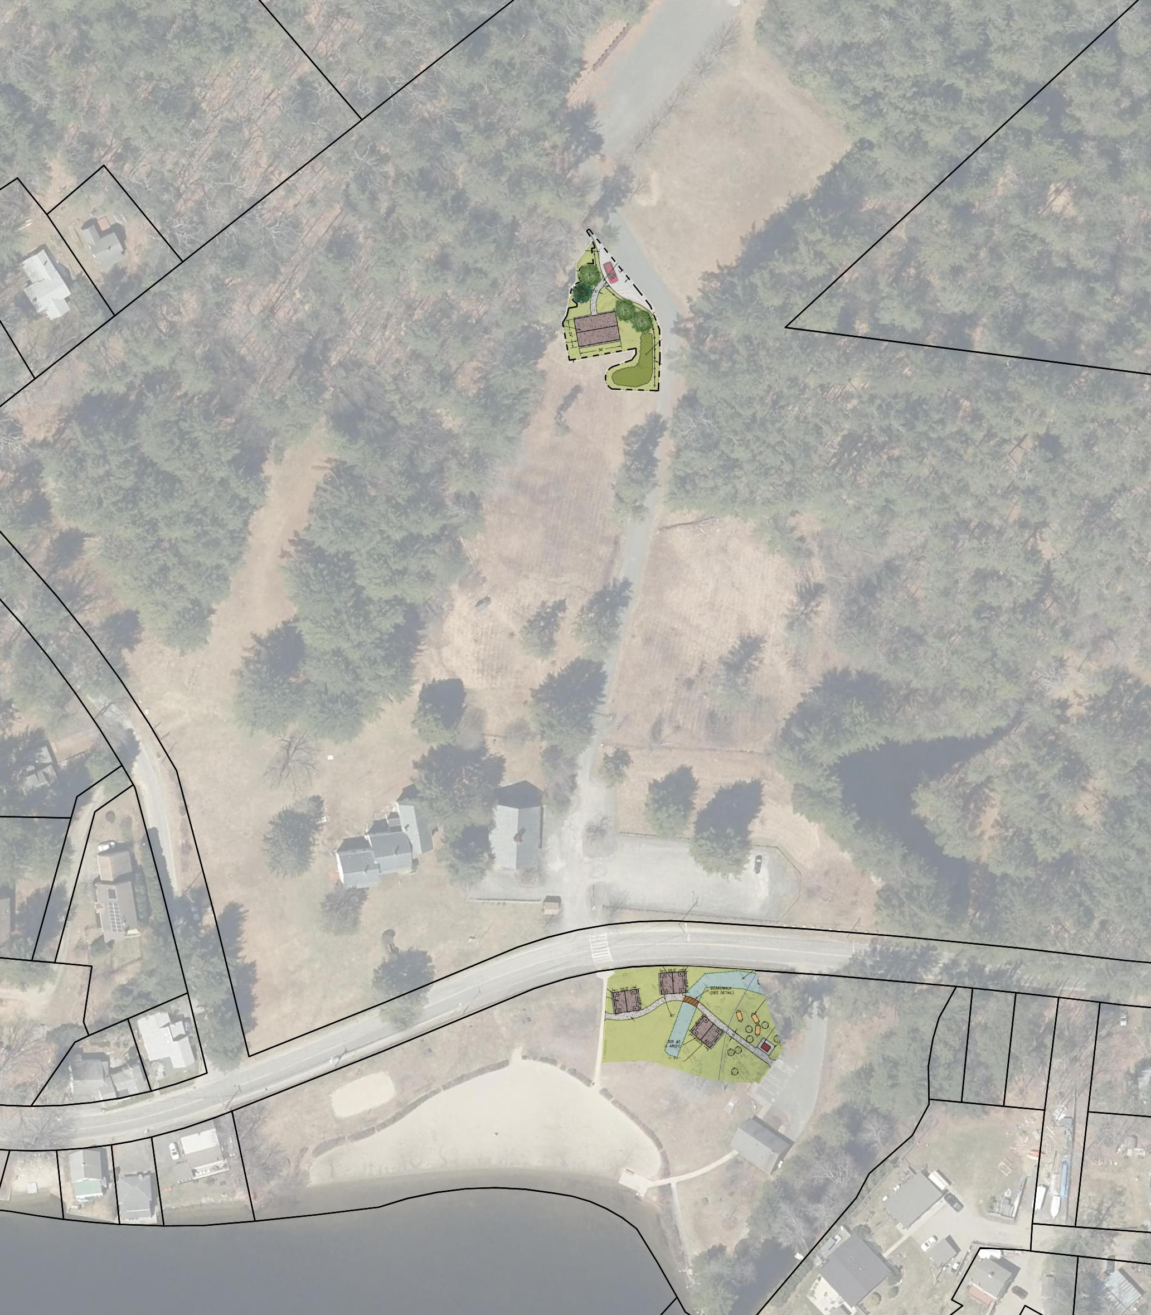
SITE PLAN
Group Gathering Area
Medium Pavilion
Existing Parking Area & Barn
Lakeview Road
Small Pavilion (3)
Restroom Building
Lake Wyola
PROJECT SHADE: LAKE WYOLA STATE PARK
JUNE 2025

Slide 16
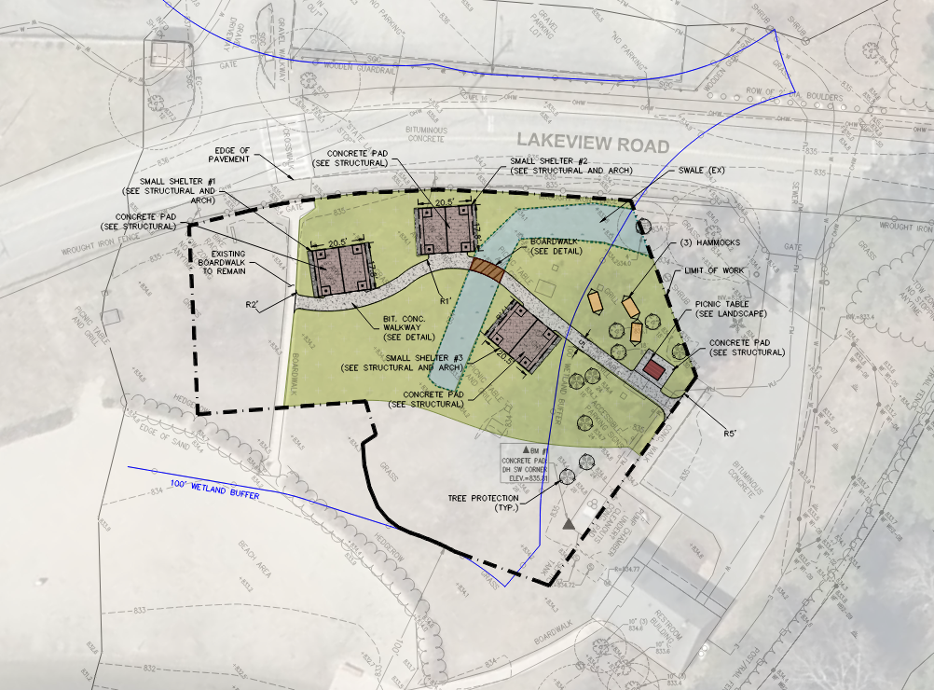
PLAN – SMALL PAVILIONS
PROJECT SHADE: LAKE WYOLA STATE PARK
JUNE 2025

Slide 17
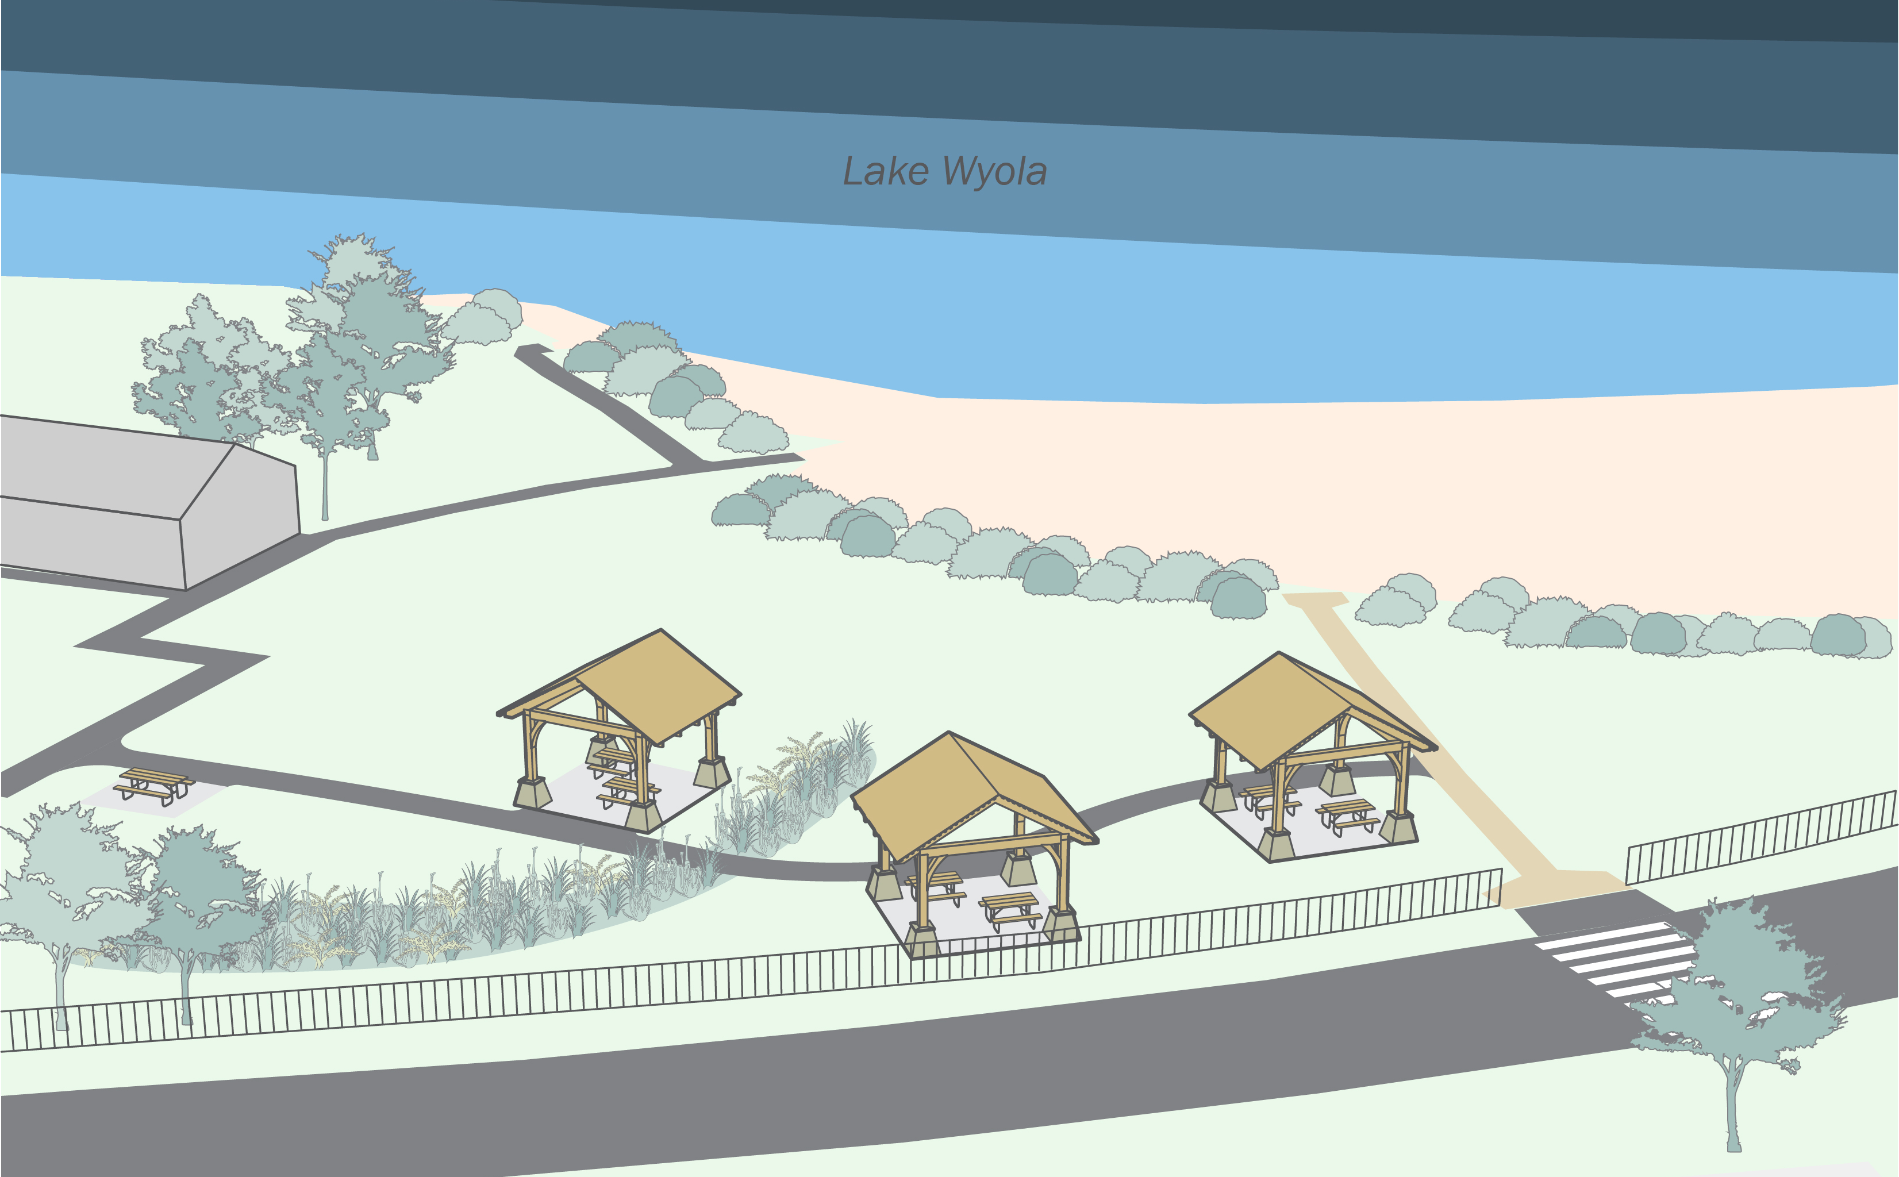
RENDERING – Small Pavilions
PROJECT SHADE: LAKE WYOLA STATE PARK
JUNE 2025

Slide 18
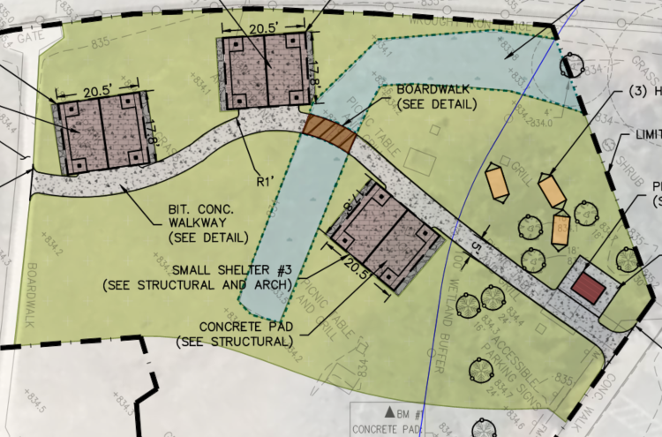
Landscape Improvements
Swale to address ponding
Boardwalk over swale
PROJECT SHADE: LAKE WYOLA STATE PARK
JUNE 2025

Slide 19
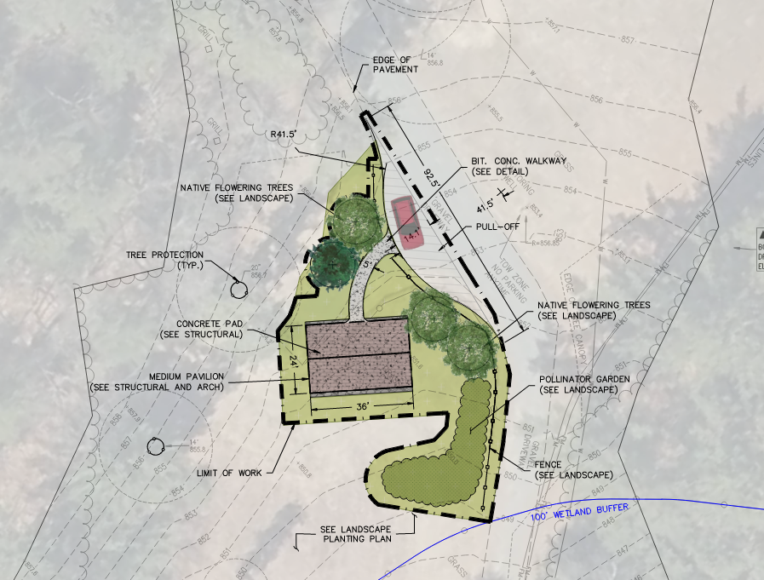
PLAN – MEDIUM PAVILION
PROJECT SHADE: LAKE WYOLA STATE PARK
JUNE 2025

Slide 20
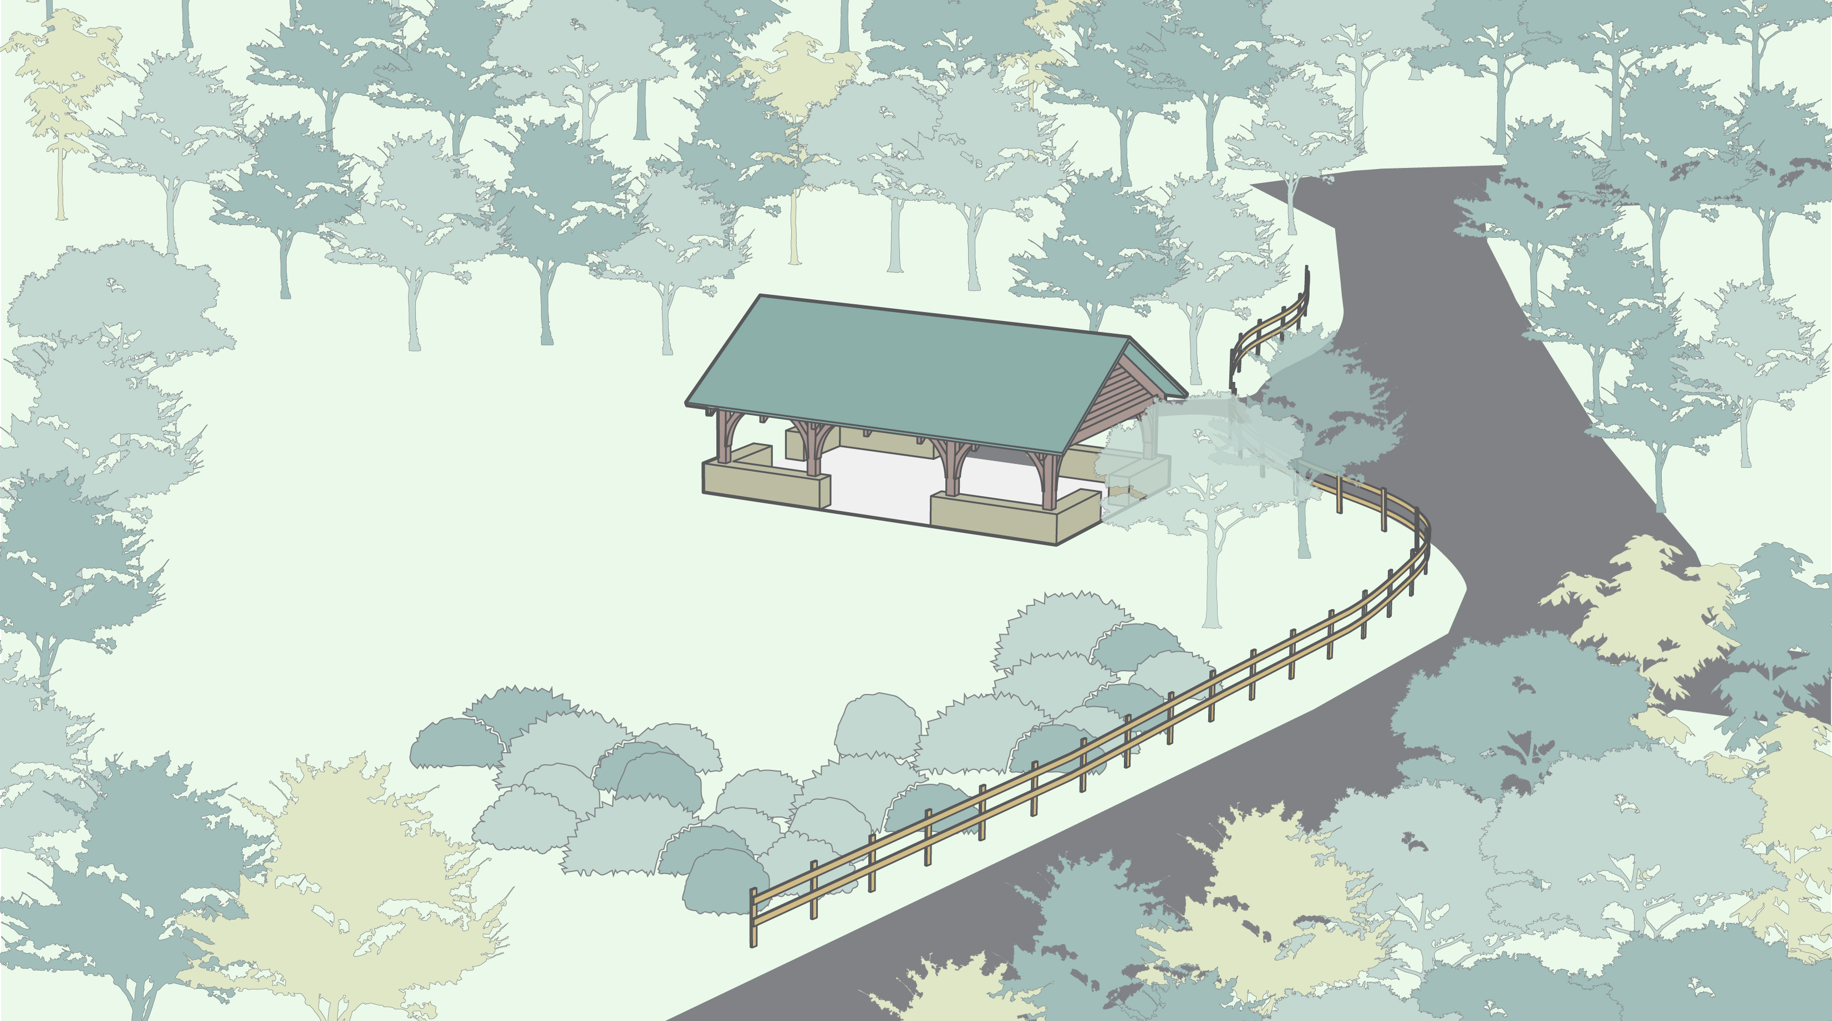
RENDERING – Medium Pavilion
Lakeview Road
PROJECT SHADE: LAKE WYOLA STATE PARK
JUNE 2025

Slide 21
NEXT STEPS
1
2
3
4
5
Concept Design
& Engagement
Design Documentation
Regulatory Compliance
Bidding
Construction
Site Analysis
Public Meeting #1
Conceptual Design Options
Finalize Design Detailing, Specifications & Cost Estimate
Submit to Authorities having jurisdiction for approval
Responses to questions
Conformed Set
Bidder selection
Site Preparation
Shade Structure and Site Improvements Construction
Spring
Summer
Fall
Winter
Spring
Summer
2025
2026

Slide 22
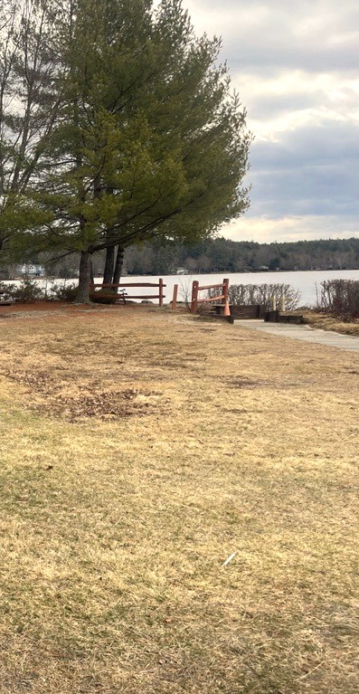
4
DISCUSSION / Q& A
What do you like about the concept plans?
What would you like to see changed?
Are we enhancing Lake Wyola State Park?
Do you like the CCC Style?
How do you feel about the locations of the structures?
Are there any other features you would like to see on the structures?
PROJECT SHADE: LAKE WYOLA STATE PARK
JUNE 2025
Notes:
Zoom – raise hand, or chat your comment/questions

Slide 23
ADDITIONAL INFORMATION
Recording and tonight’s slide deck will be available at:
www.mass.gov/dcr/past-public-meetings
If you have comments on this project:
Submit online: https://www.mass.gov/forms/dcr-public-comments
Deadline: June 18th, 2025 (Two Weeks)
Please note: the contents of comments submitted to DCR, including your name, town, and zip code, will be posted on DCR’s website. Additional contact information provided, notably email address, will be used for outreach on future updates to the subject project of property.
If you wish to subscribe to a DCR general information on project- related listserv:
Contact DCR’s Office of Community Relations via email at mass.parks@mass.gov

Slide 24
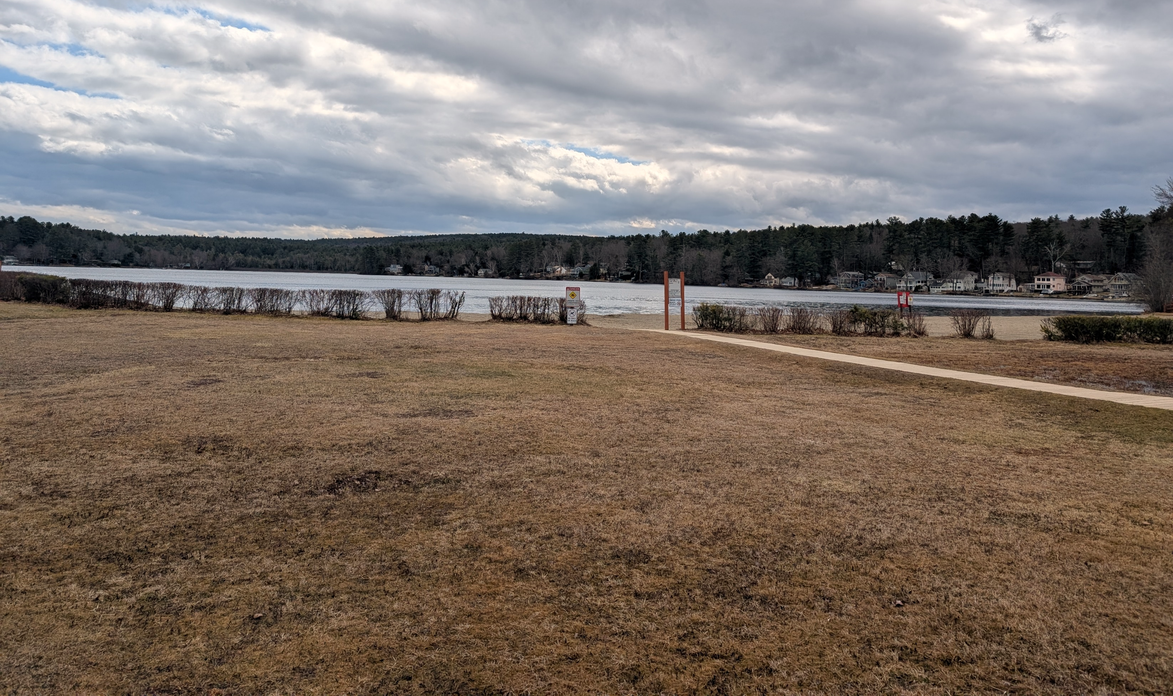
Thank You
DCR Project Shade Website: https://www.mass.gov/info-details/dcr-project-shade

Slide 25
DCR LOCALLY-SOURCED WOOD
PROJECT SHADE: CHICOPEE MEMORIAL STATE PARK
JUNE 2025

