Slide 1
Layoff Aversion:
Requirements & Opportunities
Boston, MA
August 31, 2017

Slide 2
Good afternoon!
Thanks for joining us today to talk about layoff aversion
We think it’s important that this be a conversation—don’t be shy, if you have comments or questions, just let us know!

Slide 3
Today we will talk about:
Part 1: Requirements
From the Law and Regulations
Part 2: Opportunities
Layoff Aversion Mindset
Layoff Aversion Examples
Benefits of Layoff Aversion
Layoff Aversion and Business Engagement
Questions & Discussion

Slide 4
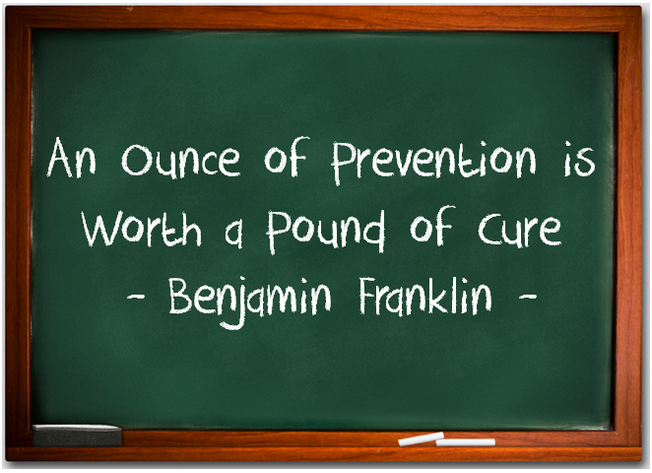
Let’s start with some engagement
Before we start, a few questions to get our brains going:
What does “layoff aversion” mean to you?
When should you attempt layoff aversion efforts?

Slide 5
Part 1: Requirements

Slide 6
Rapid Response in the WIOA law
Statewide Rapid Response activities:
in the case of a permanent closure or mass layoff at a plant, facility, or enterprise, or a natural or other disaster, that results in mass job dislocation, in order to assist dislocated workers in obtaining reemployment as soon as possible
WIOA Section 3(51)
Notes:
Notice there is no mention here of layoff aversion

Slide 7
Rapid Response defined (in the regs)
Rapid Response:
encompasses the strategies and activities necessary to:
(1) Plan for and respond to as quickly as possible following an event described in § 682.302; and
(2) Deliver services to enable dislocated workers to transition to new employment as quickly as possible.
682.300(a)

Slide 8
Purpose of Rapid Response
The purpose of rapid response is to promote economic recovery and vitality by developing an ongoing, comprehensive approach to identifying, planning for, responding to layoffs and dislocations, and preventing or minimizing their impacts on workers, businesses, and communities
682.300(b)
Notes:
Preventing and minimizing—sort of a theme we’ll see here as we go along

Slide 9
Layoff aversion defined
Layoff Aversion defined:
Layoff aversion consists of strategies and activities…to prevent or minimize the duration of unemployment resulting from layoffs.
682.320

Slide 10
The layoff aversion requirement
What Rapid Response activities are required?:
Rapid response activities must include…layoff aversion activities as described in § 682.320, as applicable
682.330

Slide 11
Part 2: Opportunities

Slide 12
A Mindset for Aversion
If you THINK it, you are more likely to DO it
Layoff aversion may require you to re-orient your worldview—the business is your customer
If you always try to prevent or minimize unemployment, you will look for solutions
When you look for solutions you will realize you need partners across the economic spectrum
And you will need to create strategies and activities that are agile to remain relevant in transitioning economy

Slide 13
Characteristics of a mindset for aversion
Innovative & Creative
Proactive & Strategic
Flexible & Adaptable
Persistent & Responsive
Knowledgeable & Curious
And solutions-focused!

Slide 14
Some layoff aversion examples
Ongoing engagement, partnership, and relationship-building activities with businesses in the community;
Providing assistance to businesses in managing reductions in force (including early identification of firms at risk, assessment of the needs of and options, and the delivery of solutions
Funding feasibility studies;
Developing and managing incumbent worker training programs or other worker up skilling approaches;
Connecting companies to Short-time compensation or other programs
Connecting to business loan programs and other resources
Establishing linkages with economic development activities
Partnering or contracting with business-focused organizations to assess risks to companies, propose strategies to address those risks, implement services,
Conducting analyses of the suppliers of an affected company to assess their risks and vulnerabilities
Proactively identifying opportunities for potential economic transition and training needs in growing industry sectors or expanding businesses
Connecting businesses and workers to short-term, on-the-job, or customized training programs and apprenticeships

Slide 15
“The Intervention Timeline”
Ongoing
Layoff aversion policy
Sustained effective partnerships
Gathering and analyzing data
Develop an Early Warning system
Proactive measures
BUSINESS ENGAGEMENT STRATEGY
1+ years out
Work with business to improve their processes (get to know your MEPs!)
Succession planning
Connect with Economic Dev
Talent Development
Recruitment

Slide 16
“The Intervention Timeline”
1 year to 6 months
Support improved business practices
Conduct pre-feasibility or valuation studies (1st step to an ESOP, or other business support efforts)
Assist in the development of new markets
Facilitate business loans
Incumbent worker training
TAA for Firms
6 months to post-layoff
Workshare
Talent transfer
Connect with economic development
Connect with labor

Slide 17
Some benefits of layoff aversion
For Workers
Retaining current jobs
Quickly transition to new jobs
For Employers
Retaining a trained workforce
Reducing the costs of downsizing
Potentially saving the business
Providing a range of other business solutions
For States and Local Workforce Areas
Demonstrates the value of the workforce system
Supports economic vitality and development
For Communities
Less disruptive
Cost savings
Greater revenue from successful businesses
More jobs

Slide 18
Layoff Aversion occupies a unique niche
Layoff aversion HAPPILY blurs the line between business engagement and Rapid Response
Also blurs the lines between “strategy” and “operations”
The timeline helps you figure out what roles make the most sense

Slide 19
Business Engagement
Rapid Response
Layoff Aversion
18

Slide 20
Questions/Comments/Thoughts?

Slide 21
Notes:
A quick plug for the Business Engagement Collaborative

Slide 22
Thank you!
Rob Gamble
The Innovation Foundry
rgamble@innovationfound.com
831-246-3012
Jeff Ryan
Business Engagement Specialist
US DOL/ETA
ryan.jeff@dol.gov
202-693-3546

