Slide 1
The Supportive Planning and Operations Team (SPOT) Initiative
Learning Session #2
July 16, 2018 – Springfield
July 17, 2018 – Raynham
July 18, 2018 – Burlington
July 19, 2018 – Worcester
Disclaimer: Participation in this educational offering is not mandatory for regulatory compliance nor do actions or tools and resources discussed in it ensure regulatory compliance.

Slide 2
Welcome and Introductions
Where in
the world?

Slide 3
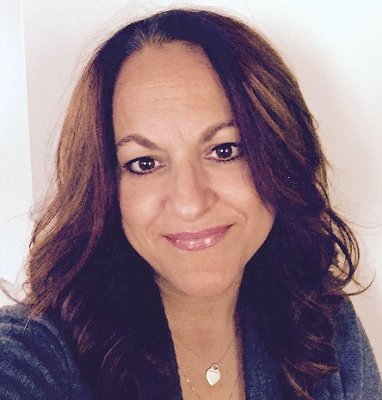
Welcome and Introductions
Teresa M. Mota, BSN, RN
Gabby Katz, MPP
Terry Moore, MPH, BSN
Rosanna Bertrand, PhD
Jen Pettis, MS, RN, WCC
Donna Hurd, MSN, RN

Slide 4
Today’s Objectives
Define adverse events
Discuss the significance of adverse events in nursing homes
Exemplify three types of adverse events identified by the Office of the Inspector General (OIG)
Differentiate adverse drug events from adverse drug reactions
Describe a prescribing cascade

Slide 5
Today’s Objectives (cont.)
Evaluate a facility protocol for a high-risk medication using the Centers for Medicare & Medicaid Services’ (CMS’s) Adverse Drug Event Trigger Tool

Slide 6
Points to Ponder
Please jot down one or more “points to ponder” over the course of our time together.
At the end of the learning session, we’ll discuss these, including:
Why you chose the point(s) and
How you will act on what you learned.

Slide 7
Adverse Events in Nursing Homes

Slide 8
Definition of an Adverse Event
According to the CMS, an adverse event is “an untoward, undesirable, and usually unanticipated event that causes death, serious injury, harm, or the risk thereof.”

Slide 9
Let’s Chat: Adverse Events
When you hear the phrase “adverse events,” what comes to mind?

Slide 10
The Significance of Adverse Events in Nursing Homes
One out of three Medicare beneficiaries experienced an adverse or temporary harm event in their first 35 days of a skilled nursing facility stay.
The result of these events ranged from extending a resident’s stay to causing the resident’s death.
The OIG determined many of these events were likely or clearly preventable.
Levinson, D. R. (2014). Adverse events in skilled nursing facilities: National incidence among Medicare beneficiaries. Retrieved from https://oig.hhs.gov/oei/reports/oei-06-11-00370.pdf

Slide 11
The Significance of Adverse Events in Nursing Homes (cont.)
Much of the preventable harm was attributed to:
Substandard treatment,
Inadequate resident monitoring, or
Failure or delay of necessary care.
Over half of the residents who experienced harm returned to a hospital for treatment, this equates to $2.8 billion spent on hospital treatment for harm caused in SNFs in FY 2011.
Levinson, D. R. (2014). Adverse events in skilled nursing facilities: National incidence among Medicare beneficiaries. Retrieved from https://oig.hhs.gov/oei/reports/oei-06-11-00370.pdf

Slide 12
Three Types of Adverse Events in Nursing Homes

Slide 13
Potentially Preventable Events Related to Medication
Change in mental status/delirium related to use of opiates and psychotropic medication
Bleeding related to use of antithrombotic medication
Thromboembolism related to use of antithrombotic medication
Prolonged constipation/ileus/impaction related to use of opiates
Altered cardiac output related to use of cardiac/blood pressure medication

Slide 14
Potentially Preventable Events Related to Medication (cont.)
Electrolyte imbalance (including dehydration and acute kidney injury) related to use of diuretic medication
Drug toxicities including acetaminophen, digoxin, levothyroxine, angiotensin-converting enzyme (ACE) inhibitors, phenytoin, lithium, valproic acid, and antibiotics
Hypoglycemia related to use of antidiabetic medication
Ketoacidosis related to use of antidiabetic medication

Slide 15
Potentially Preventable Events Related to Resident Care
Falls, abrasions/skin tears, or other trauma related to care
Electrolyte imbalance (including dehydration and acute kidney injury/insufficiency) associated with inadequate fluid maintenance
Thromboembolic events related to inadequate resident monitoring and provision of care
Respiratory distress related to inadequate monitoring and provision of tracheostomy/ventilator care

Slide 16
Potentially Preventable Events Related to Resident Care (cont.)
Exacerbations of preexisting conditions related to inadequate or omitted care
Feeding tube complications (aspiration, leakage, displacement) related to inadequate monitoring and provision of care
In-house acquired/worsened stage pressure ulcers, and unstageable/suspected deep tissue injuries
Elopement

Slide 17
Potentially Preventable Events Related to Infections
Respiratory infections
Pneumonia
Influenza
Skin and wound infections
Surgical site infections (SSIs)
Soft tissue and non-surgical wound infections
Urinary tract infections (UTIs)
Catheter associated UTIs
UTIs
Infectious diarrhea
Clostridium difficile
Norovirus

Slide 18
Let’s Chat: Prioritizing Potentially Preventable Events
How will your team prioritize which of these potentially preventable events to first focus your quality assurance and performance improvement (QAPI) efforts?

Slide 19
Adverse Drug Event Case Exemplar

Slide 20
Case Exemplar: Mr. Edwards

Slide 21
Case Exemplar: Mr. Edwards (cont. 1)
On the first day of the survey, Mr. E:
Had several bruises on his hands and forearms,
Was alert and oriented, but
Wasn’t feeling very well and wanted to rest.
The next day, the nurse reported that Mr. E had been transferred to the hospital due to profuse rectal bleeding in the middle of the night.
He was fearful that he was not going to recover and he experienced a panic attack.
He was admitted to the hospital due to gastrointestinal bleeding secondary to warfarin use.

Slide 22
Case Exemplar: Mr. Edwards (cont. 2)
Warfarin was prescribed for Mr. E for newly-diagnosed atrial fibrillation.
The target international normalized ratio (INR) for Mr. E is 2.0 - 3.0.
Warfarin doses were consistently reviewed in response to his INR results and changes often resulted.
Upon notification of the INR results, the physician routinely ordered the next lab test.

Slide 23
Case Exemplar: Mr. Edwards (cont. 3)
The surveyor identified issues related to warfarin management around the time Mr. E had a dental procedure.
The physician stopped Mr. E's warfarin for five days before surgery and discontinued the INR monitoring during that time.
Following the procedure, the physician resumed Mr. E’s warfarin and ordered a course of erythromycin. The physician did not reorder the INR monitoring.
Mr. E’s INR was 9.2 at the time of his admission to the hospital.

Slide 24
Let’s Chat: Mr. Edwards
What step(s) in your antithrombotic medication procedure or protocol would prevent this situation from occurring in your nursing home?

Slide 25
Review of Quality Measure (QM) Data Regarding Medication Use and Minimum Data Set (MDS)

Slide 26
Select QMs: Massachusetts and National Averages
 | Massachusetts Average | National Average | % Difference for MA vs. National
QM-419 Percentage of long-stay residents who received an antipsychotic medication | 17.82% | 15.48% | +2.34%
QM-434 Percentage of short-stay residents who newly received an antipsychotic medication | 1.57% | 1.98% | -0.41%
QM-452 Percentage of long-stay residents who received an antianxiety or hypnotic medication | 20.12% | 22.45% | -2.33%
Sources:
StateAverages_Download [Microsoft Excel Comma Separated Values File]. (2018, June). Baltimore: Centers for Medicare & Medicaid Services. Retrieved from https://data.medicare.gov/data/nursing-home-compare
DataMedicareGov_MetadataAllTabs_v16 [Microsoft Excel Comma Separated Values File]. (2018, June). Baltimore: Centers for Medicare & Medicaid Services. Retrieved from https://data.medicare.gov/data/nursing-home-compare

Slide 27
MDS Item: N0350 Insulin
2017 (Q1-Q4) Average | Massachusetts Average | National Average | % Difference for MA vs. National
A. Insulin injections (Percentage of active residents that received insulin injections on 1-7 days during the last 7 days or since admission/reentry ) | 63.13% | 66.08% | - 2.95%
B. Orders for insulin (Percentage of active residents for which the physician changed the residents insulin orders on 1-7 days during the last 7 days or since admission/reentry) | 9.76% | 7.74% | + 2.02%
Source:
Centers for Medicare & Medicaid Services. MDS 3.0 Frequency Report [Report generator using data from MDS National Repository]. Retrieved from https://www.cms.gov/Research-Statistics-Data-and-Systems/Computer-Data-and-Systems/Minimum-Data-Set-3-0-Public-Reports/Minimum-Data-Set-3-0-Frequency-Report.html

Slide 28
MDS Item: N0410 Medications Received
2017 (Q1-Q4) Average (Percentage of active residents that received the medications on 1-7 days during the last 7 days or since admission/entry or reentry if less than 7 days) | Massachusetts Average | National Average | % Difference for MA vs. National
A. Antipsychotic | 22.25% | 20.22% | +2.03%
B. Antianxiety | 19.70% | 20.28% | -0.58%
C. Antidepressant | 62.10% | 52.34% | +9.76%
D. Hypnotic | 1.39% | 3.09% | -1.70%
E. Anticoagulant (e.g., warfarin, heparin, or low-molecular weight heparin) | 19.31% | 17.94% | +1.37%
F. Antibiotic | 13.23% | 14.97% | -1.74%
G. Diuretic | 32.41% | 33.20% | -0.78%
H. Opioid | Data not available in frequency report
Source:
Centers for Medicare & Medicaid Services. MDS 3.0 Frequency Report [Report generator using data from MDS National Repository]. Retrieved from https://www.cms.gov/Research-Statistics-Data-and-Systems/Computer-Data-and-Systems/Minimum-Data-Set-3-0-Public-Reports/Minimum-Data-Set-3-0-Frequency-Report.html

Slide 29
Break Time

Slide 30
CMS’s Adverse Drug Event Trigger Tool

Slide 31
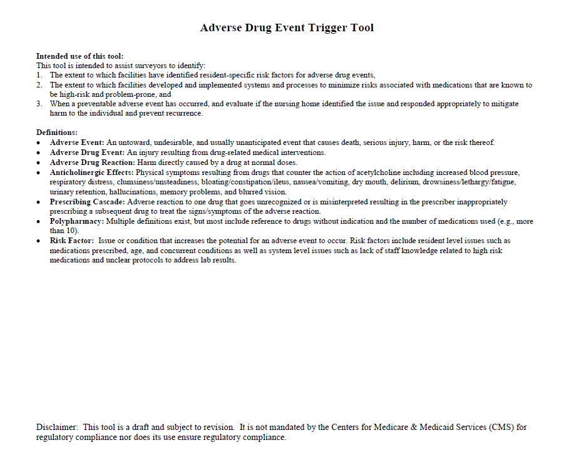
Please refer to your handout.

Slide 32
Adverse Drug Event
Definition: An injury resulting from drug-related medical interventions
What are some examples of adverse drug events?

Slide 33
Adverse Drug Reaction
Definition: Harm directly caused by a drug at normal doses
What are some examples of adverse drug events?

Slide 34
Prescribing Cascade
Definition: Adverse reaction to one drug that goes unrecognized or is misinterpreted resulting in the prescriber inappropriately prescribing a subsequent drug to treat the signs/symptoms of the adverse reaction
Hypertension diagnosis
Amlodipine prescribed
Furosemide prescribed
Lower leg edema

Slide 35
Using the CMS Tool to Evaluate Your Facility’s Medication Protocol
Please work together at your tables to review your facility protocol for a high-risk medication using CMS’s Adverse Drug Event Trigger Tool.
We’ll reconvene in 20-25 minutes for discussion regarding your findings.

Slide 36
Let’s Chat: Results of Review
What did you learn through your review?

Slide 37
Three Applications
Note three ways you can apply what you’ve just learned by evaluating your facility’s medication protocol with the Trigger Tool.
Circle the one you plan to do first.

Slide 38
Debriefing Points to Ponder
Please share one point that you made note of.
Why did you choose this point?
How will you act on what you learned?

Slide 39
October Learning Sessions: Measuring Quality with Process and Outcome Measures
Worcester, MA October 15, 2018
Burlington, MA October 16, 2018
Raynham, MA October 17, 2018
Springfield, MA October 18, 2018

Slide 40
Questions and Discussion

Slide 41
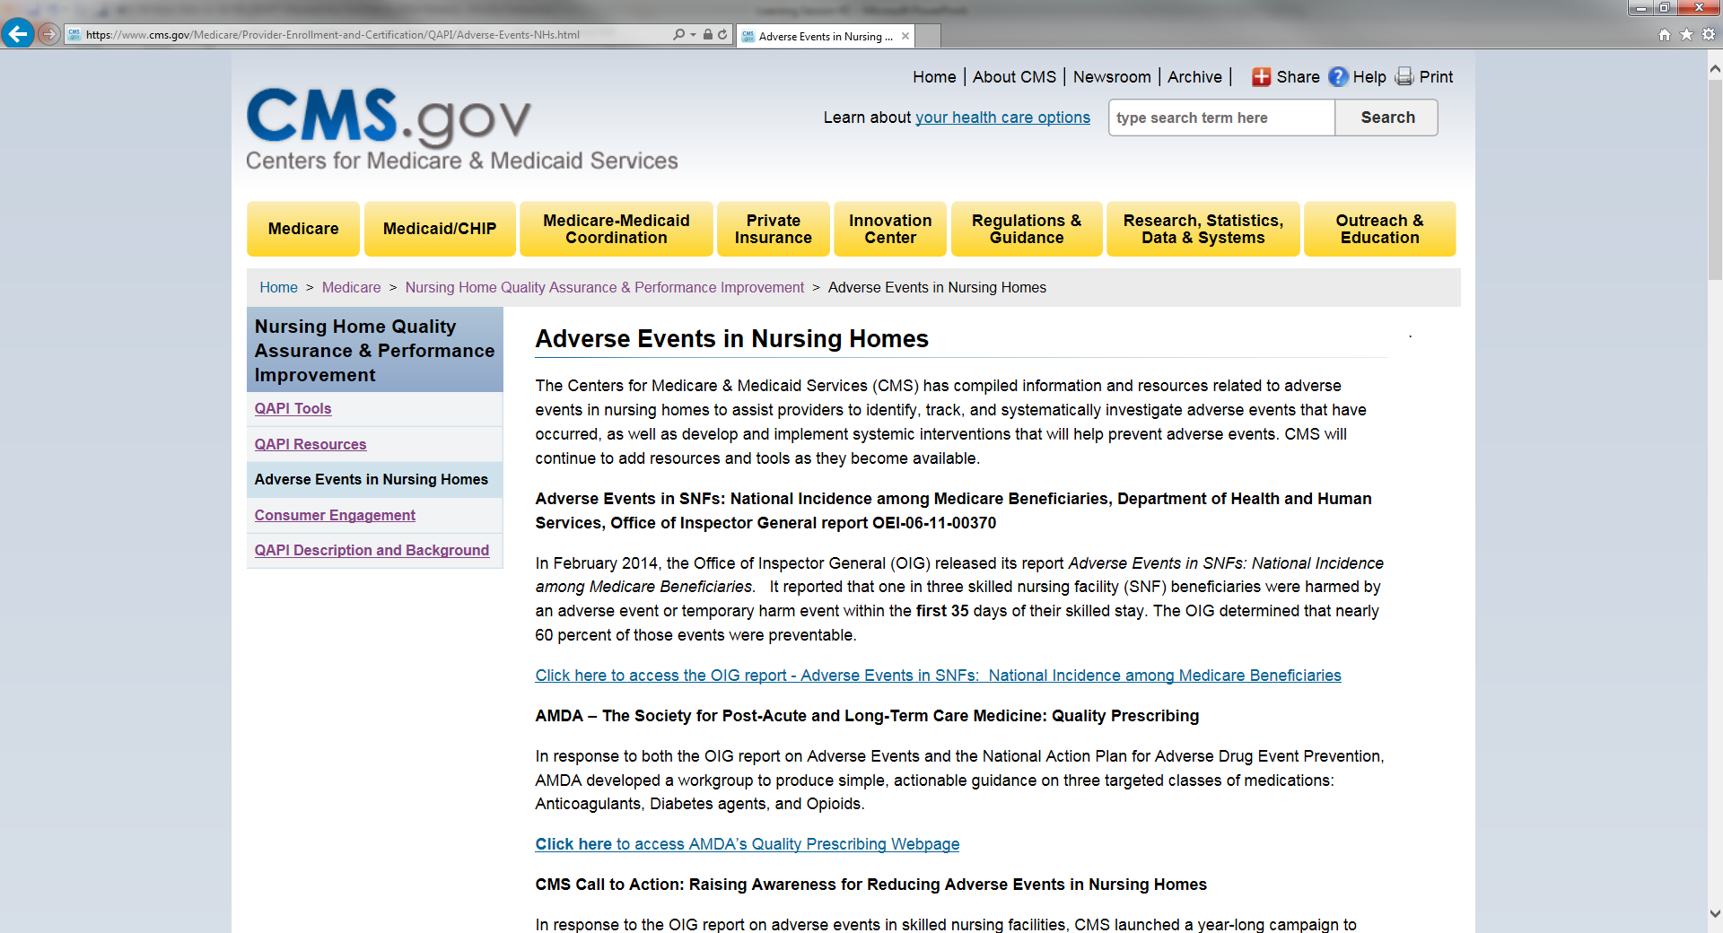
CMS Adverse Event Resources
https://www.cms.gov/Medicare/Provider-Enrollment-and-Certification/QAPI/Adverse-Events-NHs.html

Slide 42
References
Centers for Medicare & Medicaid Services. (n.d.). Potentially preventable adverse events. Retrieved from https://www.cms.gov/Medicare/Provider-Enrollment-and-Certification/QAPI/Downloads/Potentially-Preventable-Adverse-Events.pdf
Centers for Medicare & Medicaid Services. (2016). QAPI news brief, volume 2. Retrieved from https://www.cms.gov/Medicare/Provider-Enrollment-and-Certification/QAPI/Downloads/QAPI-Newsbrief-Volume-2.pdf
Levinson, D. R. (2014). Adverse events in skilled nursing facilities: National incidence among Medicare beneficiaries. Retrieved from https://oig.hhs.gov/oei/reports/oei-06-11-00370.pdf

