Slide 1





The Supportive Planning and Operations Team (SPOT) Initiative
Learning Session #3
October 15, 2018 – Worcester
October 16, 2018 – Burlington
October 17, 2018 – Raynham
October 18, 2018 – Springfield
Disclaimer: Participation in this educational offering is not mandatory for regulatory compliance nor do actions or tools and resources discussed in it ensure regulatory compliance.

Slide 2

Welcome and Introductions
Marooned on a Desert Island

Slide 3




Welcome and Introductions
Rosanna Bertrand, PhD
Terry Moore, MPH, BSN
Teresa M. Mota, BSN, RN
Gabby Katz, MPP

Slide 4
Today’s Objectives
Define process and outcome measures
Identify examples of process and outcome measures
Discuss examples of measure calculations
Identify the four intended purposes of the NHQI QMs
Discuss how to use the CASPER reports to identify areas for improvement
Differentiate incidence and prevalence measures
Determine potential process and outcome measures using a facility care protocol

Slide 5
One Big Thing!
As we move through the morning, think about how you can apply what you learn.
At the end of the session, please be prepared to share your answer to the following question:
What is one thing you learned that can make a big difference in how you track and measure performance in your nursing home?

Slide 6
Process and Outcome Measures

Slide 7

Pop Quiz????
Of the following responses which is a process measure that might be used for a pressure ulcer PIP?
A. The percentage of newly acquired pressure ulcers.
B. A 10 percent reduction in pressure ulcers by the end of 2018 quarter 4.
C. The rate of the adherence to a mobility schedule.
D. All of the above

Slide 8
Defining Process and Outcome Measures
Process measures assess the steps or activities carried out in order to deliver care or services. These measures focus on the action by professionals and staff.
Outcome measures focus on the product (or outcome) of a process or system of care or services, which can identify different or more complex underlying causes.

Slide 9
Potential Data Sources
Minimum Data Set (MDS)
Feedback from Staff, Residents, and Families
Audits of Logs, Trackers, etc.
Quality Measures (QMs)
Medical Record Reviews
Survey Results

Slide 10

E.G. Hunt: Measure Examples
Examples of measures related to quality of life
Examples of measures related to accidents
Examples of measures related to infections
Examples of measures related to medications

Slide 11
Overview of the Nursing Home Quality Measures (QMs)

Slide 12
Four Intended Purposes of QMs
Give consumers information about quality of care to help them choose a nursing home.
Understand the data involving common conditions at the nursing home(s) where they and/or their family members already live.
Facilitate discussions with nursing home staff regarding quality.
Give nursing home staff data to support their quality improvement efforts.

Slide 13
Short Stay (SS) QMs
Percent of Residents who Self-Report Moderate to Severe Pain (SS)
Percent of Residents Who Were Assessed and Appropriately Given the Seasonal Influenza Vaccine (SS)
Percent of Residents Assessed and Appropriately Given the Pneumococcal Vaccine (SS)
Percent of SS Residents Who Newly Received an Antipsychotic Medication (SS)
Percent of Residents who Made Improvements in Function (SS)
Percent of Residents with Pressure Ulcers that are New or Worsened (SS)

Slide 14
SS Pressure Ulcer Measure Changes
Four differences:
  New measure includes unstageable ulcers in the numerator – these items are taken from the discharge assessment.
  M0300 items are used to calculate the QM.
  Risk adjustment now includes Section GG item GG0170C. Mobility; Lying to Sitting on Side of Bed.
  Missing data at discharge in M0300, and resident death are exclusions.

Slide 15
Long Stay (LS) QMs
Percent of Residents Experiencing One or More Falls with Major Injury (LS)
Percent of Residents who Self-Report Moderate to Severe Pain (LS)
Percent of High-Risk Residents with Pressure Ulcers (LS)
Percent of Residents Assessed and Appropriately Given the Seasonal Influenza Vaccine (LS)
Percent of Residents Assessed and Appropriately Given the Pneumococcal Vaccine (LS)
Percent of Residents with a Urinary Tract Infection (LS)
Percent of Low-Risk Residents Who Lose Control of Their Bowels or Bladder (LS)

Slide 16
Long Stay (LS) QMs (continued)
Percent of Residents Who Have/Had a Catheter Inserted and Left in Their Bladder (LS)
Percent of Residents Who Were Physically Restrained (LS)
Percent of Residents Whose Need for Help with Activities of Daily Living Has Increased (LS)
Percent of Residents Who Lose Too Much Weight (LS)
Percent of Residents Who Have Depressive Symptoms (LS)
Percent of LS Residents Who Received An Antipsychotic Medication (LS)
Percent of Residents Whose Ability to Move Independently Worsened (LS)
Percent of Residents Who Received an Antipsychotic Medication (LS)

Slide 17

Let’s Chat: Using the QMs
How does your facility use the QMs?

Slide 18
Overview of the Certification and Survey Provider Enhanced Reports (CASPER) QM Reports

Slide 19

CASPER Reports
There are several types of reports available to providers, including:
  MDS 3.0 Nursing Home (NH) Provider Reports
  MDS 3.0 NH Final Validation Reports
  Reports available for the Skilled Nursing Facility (SNF) Quality Reporting Program (QRP)
  MDS 3.0 QM Reports https://qtso.cms.gov/system/files/2018-03/cspr_sec11_mds_prvdr.pdf

Slide 20
Types of MDS 3.0 QM Reports
MDS 3.0 Facility Characteristics Report
MDS 3.0 Facility Level Quality Measure Report
MDS 3.0 Resident Level Quality Measure Report
MDS 3.0 Monthly Comparison Report

Slide 21
MDS 3.0 Facility Characteristics Report
Please refer to your handout (page 10-11).

Slide 22
MDS 3.0 Facility Characteristics Report
This report:
  Identifies potential areas for further emphasis or review as part of a survey or a facility’s quality assurance and improvement processes, and
  Provides facility demographic information and includes comparison state and national percentages for a specified timeframe.
By comparing the facility percentages with the state and national average percentages, you can determine whether the facility’s demographic characteristics differ from the norm.

Slide 23
MDS 3.0 Facility Level Quality Measure Report
Please refer to your handout (page 11-15).

Slide 24
MDS 3.0 Facility Level Quality Measure Report
For each QM, this report shows the facility percentage and how the facility compares with other facilities in their state and in the nation.
This report helps facilities identify possible areas for further emphasis in facility quality improvement activities or investigation during the survey process.
The report displays QM numerator and denominator counts for a select period and includes the facility’s observed and adjusted triggered percentages as well as state and national average percentage comparisons and a national ranking for each QM.

Slide 25
MDS 3.0 Resident Level Quality Measure Report
Please refer to your handout (page 11-18).
Notes:
Terry.

Slide 26
MDS 3.0 Resident Level Quality Measure Report
This report identifies the residents (active and discharged) that were included in the calculations for the facility and period that were used to produce the MDS 3.0 Facility Level Quality Measure Report.
The report lists the residents by name and indicates the measures, if any, triggered by each.

Slide 27
MDS 3.0 Monthly Comparison Report
Please refer to your handout (page 11-21).

Slide 28
MDS 3.0 Monthly Comparison Report
This report presents observed or adjusted percentages for each QM for the facility, the state, and the nation.
It allows easy comparison of these percentages for each measure for a specified six-month period.
Data for this report are calculated on the first day of each month using accepted assessment records with target dates two months prior to the month of calculation.
  Best practice to as a team review your CASPER report on a monthly basis.

Slide 29
CASPER MDS 3.0 Reports vs. Nursing Home Compare
Measures included
Averaging across quarters
Timing
Reporting periods
Risk adjustment

Slide 30
Identifying Process and Outcome Measures Using a Facility Care Protocol

Slide 31
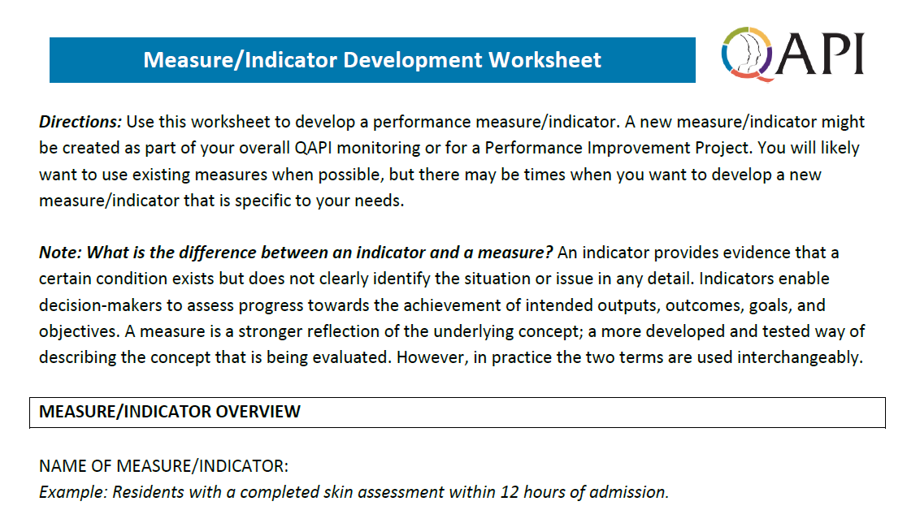
Measure/Indicator Development Worksheet
Please refer to your handout.

Slide 32
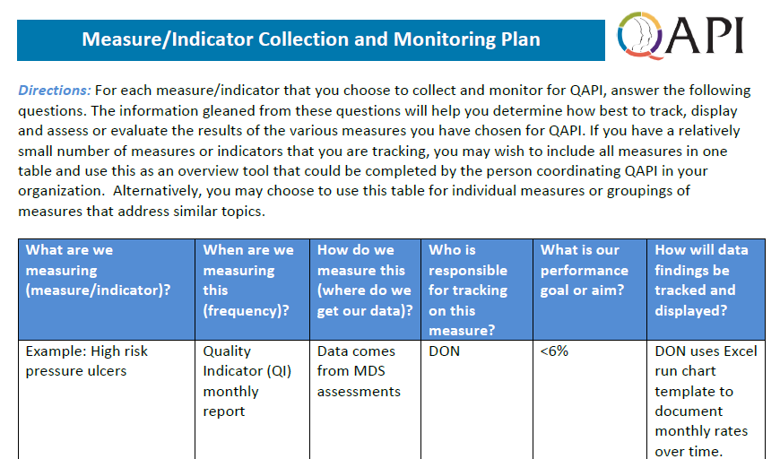
Measure/Indicator Collection and Monitoring Plan
Please refer to your handout.

Slide 33
Displaying Data - Example
In-service training
Revised inter-disciplinary approach
Notes:
Here is an

Slide 34
Calculating Measures

Slide 35

Identifying Process and Outcome Measures Using a Facility Care Protocol
Please work together at your tables to develop process and outcome measures and a measure collection and monitoring plan related to your facility protocol.
We’ll reconvene in approximately 20 minutes for discussion regarding your work.

Slide 36


Let’s Chat: Facility-Specific Measures and Plan
What measures did you develop?
How will you track, display, and assess your results?

Slide 37

Debriefing One Big Thing!
Please share your answer to the following question: What is one thing you learned that can make a big difference in how you track and measure performance in your nursing home?
How will you get started?
Who will be part of the team?

Slide 38


Questions and Discussion

Slide 39
Resources
Quality assurance and performance improvement (QAPI) tools https://www.cms.gov/Medicare/Provider-Enrollment-and-Certification/QAPI/Downloads/ProcessToolFramework.pdf
Centers for Medicare & Medicaid Services (CMS) Quality Measures web page https://www.cms.gov/Medicare/Quality-Initiatives-Patient-Assessment-Instruments/NursingHomeQualityInits/NHQIQualityMeasures.html
MDS 3.0 User Guides & Training Information https://qtso.cms.gov/system/files/2018-03/cspr_sec11_mds_prvdr.pdf

Slide 40

Upcoming Events
Massachusetts Senior Care Annual Meeting & Trade Show
  November 8, 2018 at the DCU Center, Worcester
Town Hall Meetings
  December 10, 2018 in the Public Health Council room at the Offices of the DPH, Boston
  December 11, 2018 at the Hilton Garden Inn, Springfield

