Slide 1

ALCOHOL LICENSEE SEMINAR
1

Slide 2

WELCOME!
TODAY’S SPEAKERS:
Commissioner Jean M. Lorizio, Esq., Chair of the Alcoholic Beverages Control Commission (ABCC)
Ralph Sacramone, Executive Director of the Alcoholic Beverages Control Commission (ABCC)
Kyle E. Gill, Esq., General Counsel, Alcoholic Beverages Control Commission (ABCC)
Ryan Melville, Deputy Executive Director of the Alcoholic Beverages Control Commission (ABCC)
Thomas Carroll Community Outreach & Resource Planning Specialist US Department of Labor

Slide 3
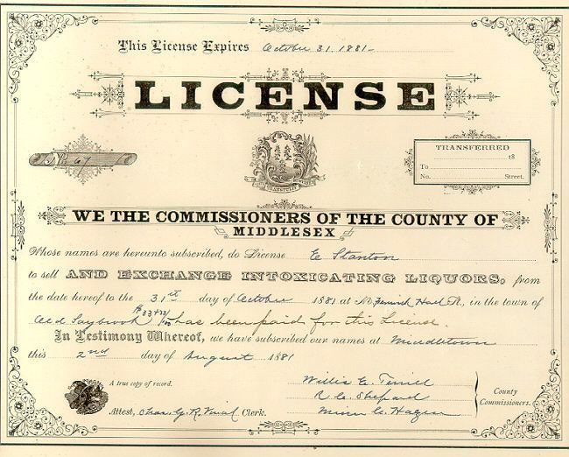
Changes to an existing license:
Change of Ownership
Transfer of Stock, Issuance of stock/new stockholders
Change of Name and/or change of d/b/a
Change of Officers/Directors/Trustees or
change in the corporate structure (such as changing from INC to LLC)
Renovations or alterations to the premises (Abutter notification requirement.)
Change of Manager
Change of Hours (including Sundays)-
Licensees may not utilize their licenses before or after approved hours.
Change of location
Outside Seating (Approval Process)

Slide 4

ABCC NAVIGATION OF WEBSITE
https://www.mass.gov/orgs/alcoholic-beverages-control-commission
Applications Commission Advisories Commission Decisions
Frequently Asked Questions and Guidelines in Multiple Languages
4

Slide 5
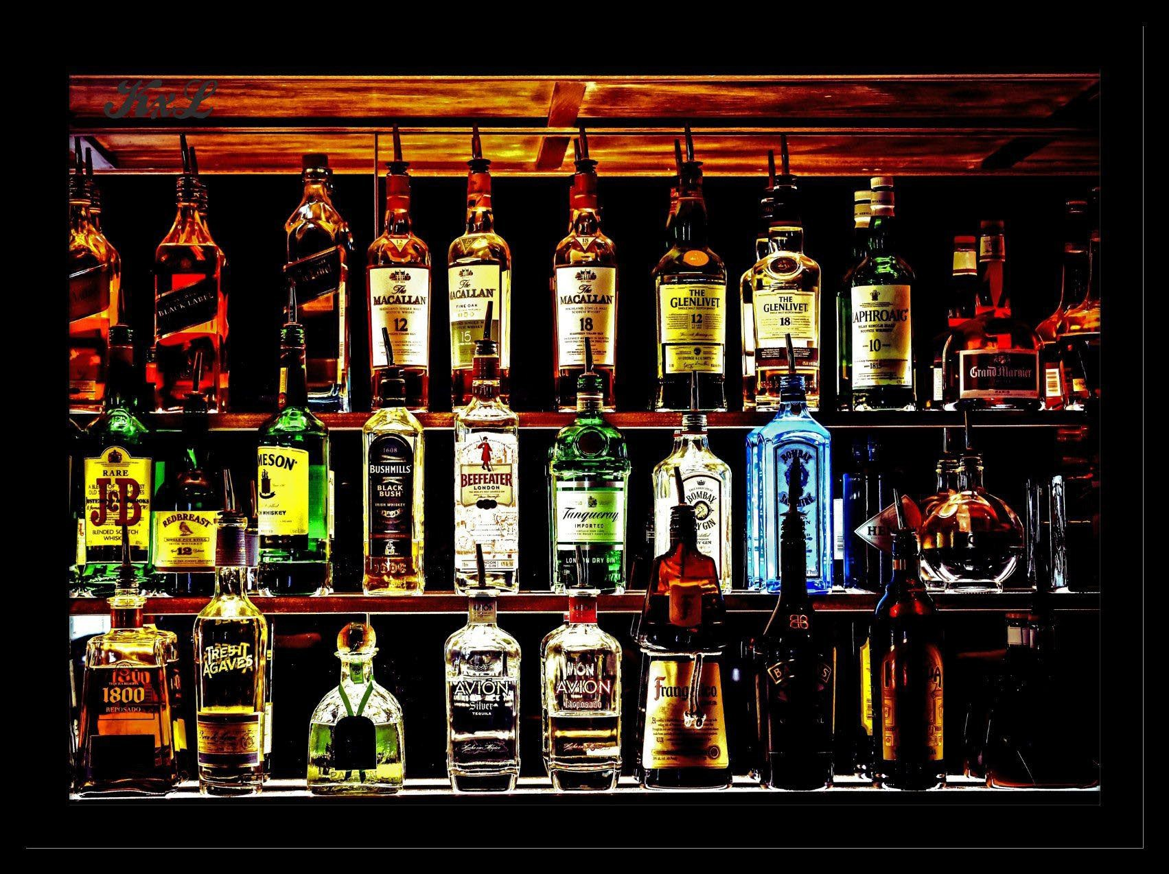
Purchasing alcohol from authorized sources:
Restaurants, clubs and package stores cannot purchase any alcohol from a package store, big box store and/or out-of-state entities. Alcohol must be purchased from a Massachusetts licensed wholesaler/manufacturer.
MGL c. 138 §23

Slide 6

Section 12 and Section 15 Licensees with Same Owner Entity
Alcohol cannot be transferred between entities.
Each entity is its own business.
If this action occurs, the Licensee transferring its alcoholic beverages is acting as a wholesaler which is a violation.
The Licensee receiving the alcoholic beverages will be possessing alcoholic beverages that it is not authorized to sell which is a violation.

Slide 7
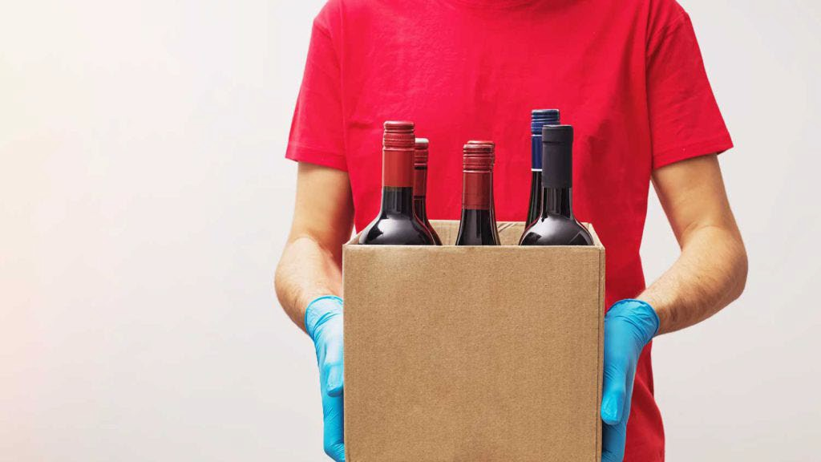
Delivery of alcohol:
A Section 15 licensee is allowed to deliver to Massachusetts consumers if the entity holds a Section 22 transportation permit. They may also use third parties licensed pursuant to M.G.L. c. 138, Section 22 as an express transportation licensee.
Takeaway/delivery of mixed drinks (Mixed Drinks To-Go): Section 12 establishments licensed for on-premises consumption of mixed drinks may permanently continue takeaway and delivery sales of mixed drinks. All mixed drinks sold for takeaway/delivery must be sold with food and at the same price/proportion as mixed drinks for on-premises consumption. Beer and wine by themselves are not included nor are unopened “ready to drink” cocktails.
A Section 12 licensee is allowed to deliver mixed drinks with at least 1 item of food prepared on-site sufficient to serve 1 individual to Massachusetts consumers if the entity holds a Section 22 transportation permit. They may also use third parties licensed pursuant to M.G.L. c. 138, Section 22 as an express transportation licensee.
Sale and delivery of the alcohol extends to the front door of the home to which alcohol is being delivered.
Licensee’s Delivery Agent must verify the legal age and check ID of recipient at the time of delivery.

Slide 8
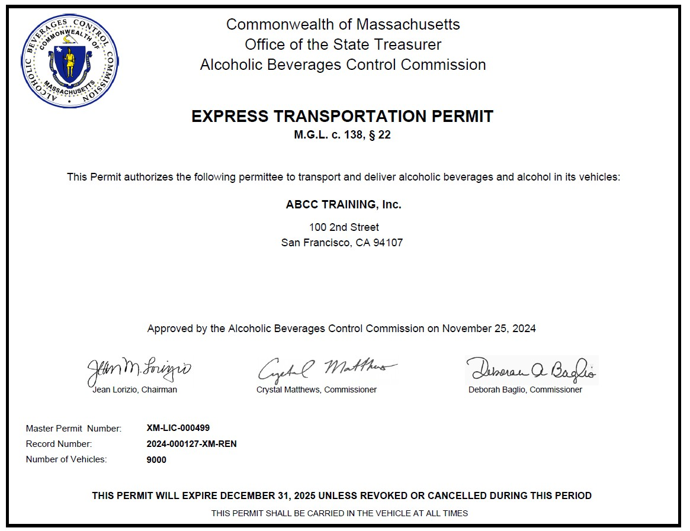

Slide 9
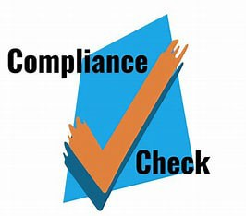
COMPLIANCE CHECKS
Compliance Checks are a training tool required by law.
Municipality and ABCC must conduct compliance checks.
Compliance checks are intended to help the licensee comply with the law and local regulations.
Compliance checks occur at brick-and-mortar locations as well as at deliveries of alcoholic beverages.

Slide 10
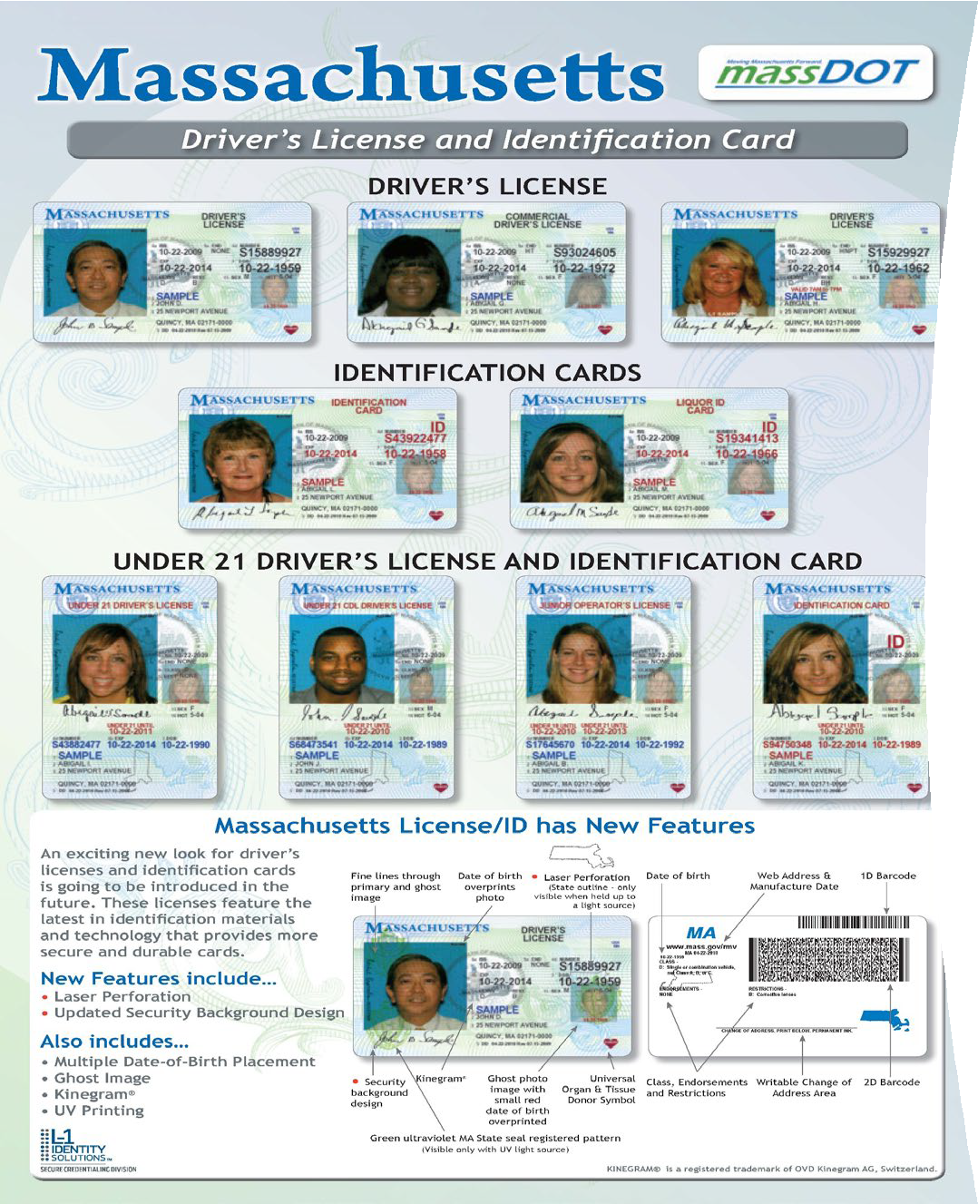
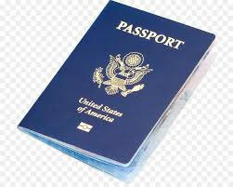
IDENTIFICATIONS THAT LICENSEES MAY REASONABLY RELY ON
Identification of Patrons. Licensees shall ensure that the identification of persons purchasing alcoholic beverages occurs at the point of sale or service.
KNOW THE SIX ACCEPTABLE FORMS OF IDENTIFICATION
Massachusetts Driver’s License
Massachusetts Liquor ID Card Massachusetts ID Card
Passport Issued by the United States or a government that is officially recognized by the United States
A Passport Card for a Passport issued by the United States A Military Identification Card
Valid Driver’s License issued by another state (beginning 4/8/2025)
Global Entry Card issued by US Customs and Border Protection (beginning 4/8/2025)
1.
2.
3.
4.
5.
6.
7.
8.
204 CMR 2.05(2)- Permitting an illegality on the licensed premises, to wit: M.G.L. c. 138, § 34C- Possession of an alcoholic beverage by a person under 21 years of age (Underage drinking with parent(s) or guardian(s) is not allowed by law).
Exception: 18,19, and 20 year olds may handle alcoholic beverages in the course of their employment. This includes selling and transporting alcoholic beverages as well as working as a bartender, stocking shelves, and removing alcoholic beverages from tables (No person under 21 may drink an alcoholic beverage at any time).
Employees 17 years old and under cannot handle alcoholic beverages in any manner during their employment.
10

Slide 11
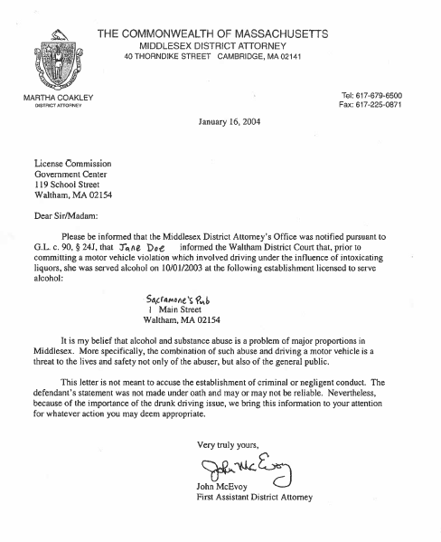
OVERSERVING COMES BACK TO THE LICENSEE
“last place of drink” MGL c. 90 § 24J
Prior to sentencing for conviction of DUI or guilty plea for DUI,
the guilty party must identify the name and location of the last place at which the individual was served.

Slide 12
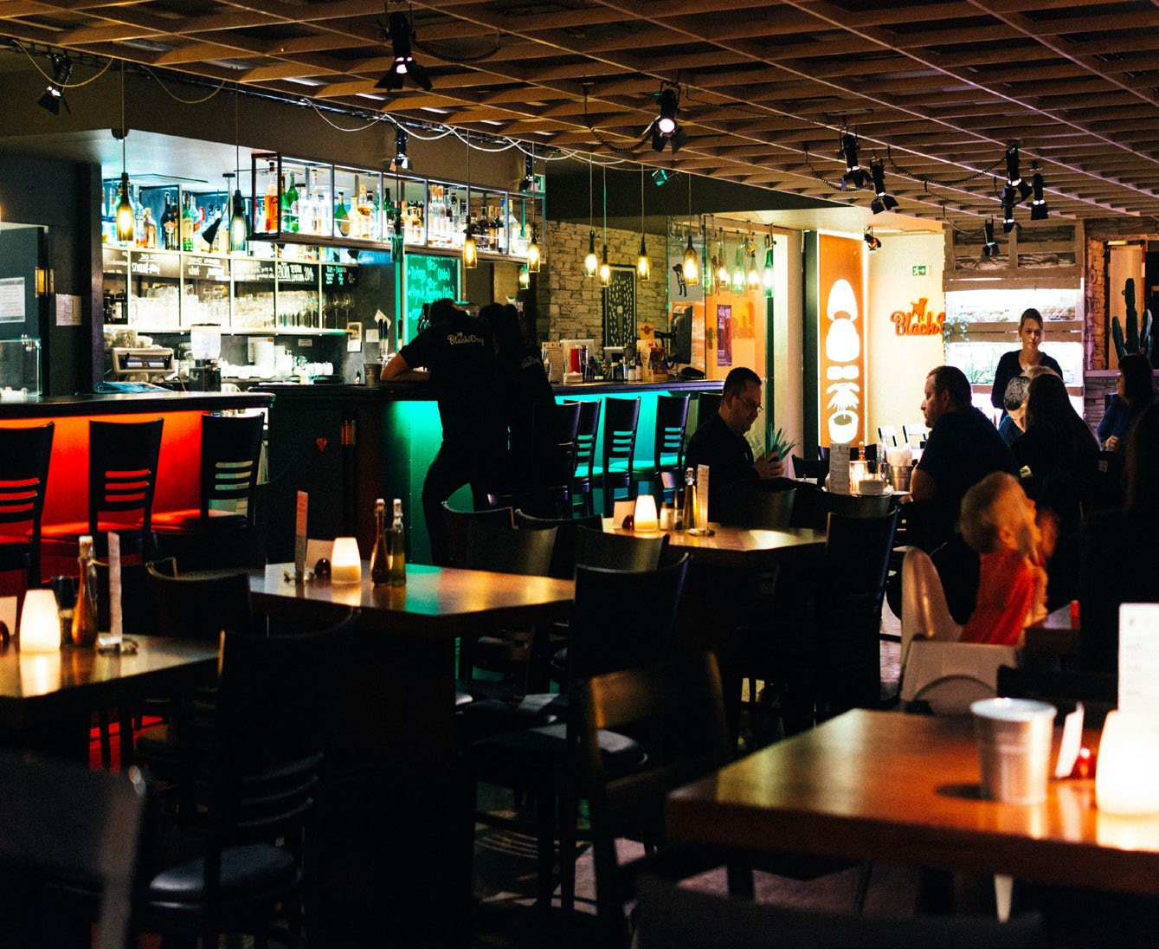
MGL c. 138 § 63A- Hindering or delaying investigator, inspector, or agent of Commission
ABCC, Police, Fire, City Inspectors are authorized to inspect the licensed premises at any time.
Police Department has authority to investigate potential violations of the law at a licensed premises on behalf of the Board, and conduct enforcement.
The Licensee should ensure that staff is aware and prepared to assist in allowing inspection of the licensed premises and responsive to questions during inspection.

Slide 13
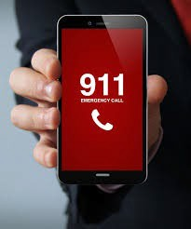
Licensees have a duty to protect their patrons and others from foreseeable harm
A Licensee’s duty to protect patrons may be triggered when the conduct of another patron puts the Licensee or its employees on notice that harm is imminent.
A Licensee may discharge its duty to protect patrons by taking steps to prevent the harm, such as calling the police.
It is the responsibility of each licensee to exercise close supervision of its premises to ensure compliance with the law.
There has been an increase in non-consensual drugging at bars, clubs, and other licensed premises. Licensees are asked to be vigilant.

Slide 14
FOOD AND BEVERAGES CONTAINING HEMP DERIVED CBD AND/OR THC ON LICENSED PREMISES
Please be advised that it is unlawful to manufacture and/or sell food or beverages containing hemp derived CBD and/or THC. This applies to alcoholic and non-alcoholic beverages. These products must be taken off the shelf immediately. Any licensee found in violation of importing, manufacturing, transporting, selling, and/or possessing on its licensed premises food and/or beverages containing hemp derived CBD and/or THC faces potential suspension or revocation of its license. Wholesalers must retrieve all food and beverages containing hemp derived CBD and/or THC sold and/or delivered by them to retail licensed premises at or before their next delivery to each establishment. This Advisory does not apply to marijuana products manufactured under the jurisdiction of the Cannabis Control Commission.
* It has always been illegal for alcoholic beverages to contain any CBD and/or THC. Alcoholic beverages containing CBD and/or THC are considered adulterated beverages.

Slide 15
CHANGES TO M.G.L. c. 138, § 26- RETAIL LICENSE MANAGERS
Local Boards may now approve a license manager who is either a United States citizen or a “qualified alien under the Immigration and Nationality Act, 8 U.S.C. 1101.”
If a proposed license manager is not a United States citizen, they must provide documentation from the United States federal government evidencing they are a “qualified alien under the Immigration and Nationality Act, 8 U.S.C. 1101.” Acceptable documentation includes but is not limited to a Permanent Resident Card “Green Card,” or Employment Authorization Document.
The law also authorizes sole proprietors and partnerships to apply for retail alcoholic beverages licenses issued pursuant to M.G.L. c. 138, § 12 (on-premises) and M.G.L. c. 138, § 15 (off-premises) if all individuals applying are either United States citizens or “qualified alien(s) under the Immigration and Nationality Act, 8 U.S.C. 1101.” This applies to farmer series pouring permits issued pursuant to M.G.L. c. 138, §§ 19 B(n), C(n) and E(o) as well.

Slide 16
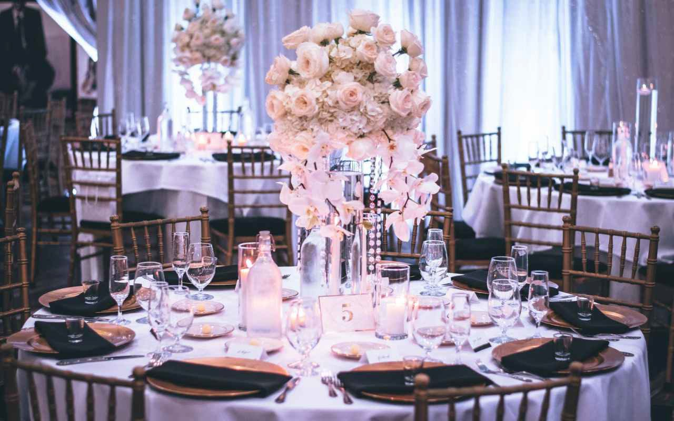
Know the Requirements for Club Licenses MGL c. 138, §12
Alcoholic beverages may only be served to members of the club who are 21/older.
If the member leaves the club, the member’s guest must leave the premises and can no longer be served alcohol.
Clubs are required to file annual reports with the Board and the Commonwealth of Massachusetts.
Clubs may only operate during hours approved by the Local Licensing Authority and the ABCC.
Clubs must purchase alcoholic beverages from authorized sources such as licensed Massachusetts wholesalers/manufacturers.

Slide 17

Working Together
Connect with the Police Department for Assistance
TEAMWORK AND COMMUNICATION ARE THE KEYS TO A WELL-RUN ESTABLISHMENT
Contact your Local Police Department, Local Licensing Authority, and seek other resources for assistance to run an establishment in compliance with municipal licensing rules and ordinances and Massachusetts statutes and regulations
Licensees should use available resources as well as keep communications open to prevent issues. Licensees should not hesitate to contact the following state and federal agencies:
Alcoholic Beverages Control Commission “ABCC” [617-727-3040] Department of Industrial Accidents “DIA” [617-727-4900] Attorney General’s Office “AGO” [617-727-3465]
United States Department of Labor “USDOL” [617-624-6700]
Other issues: overcrowding, promoters, and cover charges.

Slide 18

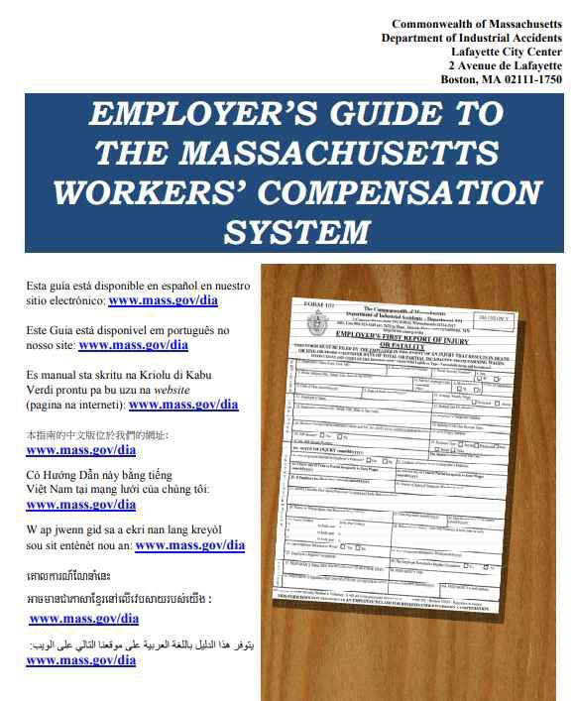
Department of Industrial Accidents
https://www.mass.gov/orgs/department-of-industrial-accidents
Workers’ Compensation Insurance Requirements
-all employers are required to carry workers’ compensation insurance for their employees and themselves at all times (cannot lapse)
-stop work order can be issued to employers who don’t have workers’ compensation insurance, and fines are $100/day beginning on the date the stop work order is issued
DIA online Guides and Resources:
Employer’s Guide to Workers Compensation – in multiple languages
https://www.mass.gov/doc/employers-guide-to-workers-compensation-english-0/download

Slide 19

MA Office of the Attorney General
Many businesses are grappling with policies regarding diversity, equity, inclusion, and access. Attorney General Campbell has issued helpful guidance for businesses on this topic:
www.mass.gov/doc/multi-state-guidance-concerning-diversity-equity-inclusion-and-accessibility-employment-initiatives/download
The state’s was recently broadened to explicitly allow workers to use earned
earned sick time law
sick time to care for themselves or their spouse in the event of pregnancy loss or failed assisted reproduction, adoption, or surrogacy. This new permissible use became effective November 21, 2024.
Download the updated MA Earned Sick Notice of Employee Rights (required poster) here: www.mass.gov/ago/earnedsicktime
The is a new law for MA employers. We have an FAQ, guidance, and
Salary Range Transparency Act
information about a free webinar here:
www.mass.gov/info-details/pay-transparency-in-massachusetts
© 2025 Massachusetts Attorney General’s Office

Slide 20

U.S. Department of Labor
Wage and Hour Division
Boston District Office
Focus on restaurant industry

Slide 21
Wage and Hour Division Jurisdiction
Federal Government Agency that enforces:
The Fair Labor Standards Act (FLSA)
minimum wage; overtime pay; recordkeeping; child labor
The Family and Medical Leave Act (FMLA)
The Migrant and Seasonal Agricultural Worker Protection Act (MSPA or farm workers)
Several immigration related statutes – enforcement of H-1B, H-2A, and H-2B non-immigrant programs
Government Contract / Prevailing Wage requirements of the Davis-Bacon and Related Acts and the Service Contract Act and other statutes applicable to federal contracts for construction and for the provision of goods and services.

Slide 22

FEDERAL LAWS VS. STATE LAWS
Presenter Notes
2025-08-26 12:44:38
--------------------------------------------
All states have child labor laws. Employers must comply with both Federal and state law. In the cases where both Federal and state laws apply but they are different, the more protective standard applies. For example, if the state law requires work permits or meal periods, then these laws must be followed in that state. Similarly, if Federal law states that a 14-year-old may only work until 7 PM and state law would allow the minor to work until 9 PM, then the minor may only work until 7 PM. Reg. 570.25 The Federal Wage and Hour Division works closely with our State partners to increase compliance with youth employment provisions.
See Also: 29 CFR Part 570
Where Federal and State laws differ,
the more protective standard applies, see laws by state:
https://www.dol.gov/agencies/whd/state
Examples: MW, hospitality, etc.

Slide 23
FAIR LABOR STANDARDS ACT
Minimum Wage
$7.25 vs. $15.00 Tipped ees are MW ees
No deductions, walk outs, etc.
Pay for ALL hours worked – early, late, breaks (keep record of breaks)
Overtime
tipped ees $6.75 plus $7.50 (1/2 time of $15.00) OR $14.25 per hour
salaried vs. hourly
salaried exempt overtime vs salaried due overtime wages (Line cook)
dual jobs and overtime - regular rate of pay
if paid cash, still overtime requirement – may have issues with MA DIA (workmens comp) and MA DUA
MISCLASSIFICATION employee vs independent contractor

Slide 24
FAIR LABOR STANDARDS ACT
Record Keeping
must maintain record for 3 years
name and contact information for all employees (includes employees paid by temp agencies)
all information on any independent contractors used by the employer
accurate time records, payroll, and general ledgers
date of birth for any employee 19 and younger (evidence)
Child Labor
must be 14 to work
14/15 year olds
16/17 year olds

Slide 25
Child Labor
14 and 15 year olds
Hours Restrictions in non-agricultural jobs…
Apply to 14- and 15-year-olds only
Not during school hours
No more than 3 hours on a school day or 8 hours on a non-school day
No more than 18 hours during school weeks or 40 hours during non-school weeks
Not before 7 a.m. and not after 7 p.m. except from July 1 to Labor Day when extended until 9 p.m.
No HAZARDOUS OCCUPATIONS
16 and 17 year olds
Federal – no restrictions on hour worked VS. MA state – no more than 48hrs
NO HAZARDOUS OCCUPATIONS (restaurant ex: meat slicer, dough mixer, trash compactor, delivery driver, not allowed on roof, etc. )

Slide 26
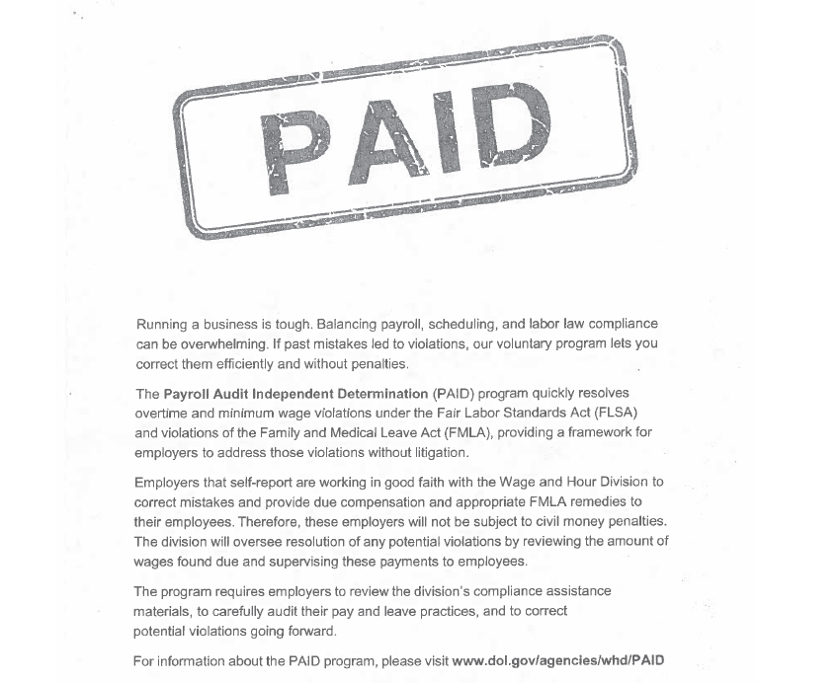
PAID

Slide 27
Other issues
Presenter Notes
2025-08-26 12:44:38
--------------------------------------------
FLSA is for only hours worked vs MA state includes sick hours and vacation pay
Immigration Status
Temp Agencies
Pump Act
Retaliation
Liquor License
Enforcement (unannounced, surveillance)
PAID program
ER and ees both have struggles – equal playing field

Slide 28
INFORMATION
Presenter Notes
2025-08-26 12:44:38
--------------------------------------------
Visit the WHD homepage at: Call the WHD toll-free helpline at 1-866- 4US-WAGE (1-866-487-9243).
https://www.dol.gov/agencies/whd
Child Labor Bulletin 101 https://www.dol.gov/sites/dolgov/files/WHD/legacy/files/childlab or101.pdf

Slide 29

FIND ABCC information and resources and FAQs in Multiple Languages ONLINE
Website Resources: ABCC:
https://www.mass.gov/orgs/alcoholic-beverages-control-commission
Frequently Asked Questions
https://www.mass.gov/info-details/frequently-asked-questions-multilingual
Alcoholic Beverages Control Commission | Mass.gov
Frequently Asked Questions (Multilingual) | Mass.gov

Slide 30

RESOURCES
ABCC Frequently Asked Questions:
https://www.mass.gov/info-details/frequently-asked-questions-multilingual
DIA Employer’s Guide to Workers’ Compensation
https://www.mass.gov/info-details/employers-guide-to-workers-compensation

