Slide 1

Low Income Energy Affordability Network (LEAN)
Presentation to DPU Energy Burden 24-15 Tech Session
June 24, 2024

Slide 2


INTRODUCTION
Low-income focus
Baseline low-income information
Not addressing pending proceedings
USDA 1939

Slide 3
VERIFICATION AND ENROLLMENT
Eligibility (Income Verification, Program Enrollment)
EE: on Discount Rate
  Multi family: 50% of tenants <60% AMI
  Discount Rate (c. 164, sec. 1F(4)(i)
  Public benefit w/income screen at or <60% SMI - see categorical list (income screened by benefit agency, opt-out enrollment automated)
Eligible for LIHEAP (SCSC, in development) -- see chart
Proof of income to utility (utilities; SCSC, in development)

Slide 4
VERIFICATION AND ENROLLMENT continued
Arrearage Management - requirements, benefits, disqualifications vary by utility
  On discount rate
  Some automatic enrollment
  Generally requires $300 arrears 60 days overdue
  Payment plan duration and down payment
Utility reduces an additional portion of outstanding balance with each payment

Slide 5
Categorical Eligibility for Discount
Low Income Home Energy Assistance Program (LIHEAP)/Fuel Assistance
Supplemental Security Income (SSI)
MassHealth – Basic or Standard
Emergency Assistance for the Elderly, Disabled & Children (EAEDC)
Public or Subsidized Housing
Transitional Aid to Families with Dependent Children (TAFDC)
Head Start
Veterans’ Service Benefits (Chapter 115)
Supplemental Nutrition Assistance Program (SNAP/Food Stamps)
Veterans Dependency & Indemnity Compensation (DIC) Surviving Parent or Spouse
School Breakfast/Lunch Program
Veterans Non-Service Disability Pension
Commonwealth Care Plan Types 1, 2 or 3A
Health Safety Net Plan – Primary or Secondary (Not Partial)
Women, Infants & Children (WIC) Nutritional Program

Slide 6
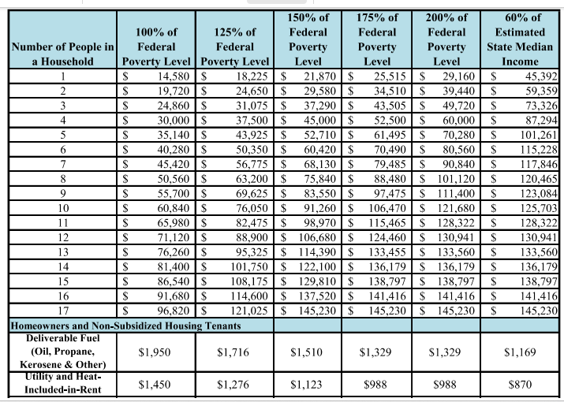
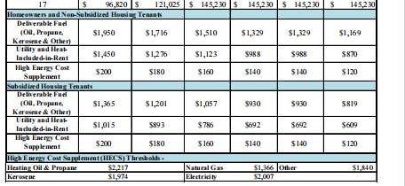
LIHEAP ELIGIBILITY AND BENEFITS FY2024

Slide 7
ENROLLMENT
LIHEAP (FY 2023, EOHLC):
201,492 Households
Electric Discount Rate (Q1 2024, NCLC: compiled from utilities):
319,554 Households
(+ 19% from 2017 Q4)

Slide 8

CUSTOMER OUTREACH
(see Appendix)
LIHEAP marketing, including radio, TV, billboards
Utility marketing, including data matching, automated arrearage management, municipality and EJ targeting (CFP)
CAP marketing, including SCSC, LIMF, targeted household identification (e.g., oil-heated homes for ASHPs)

Slide 9
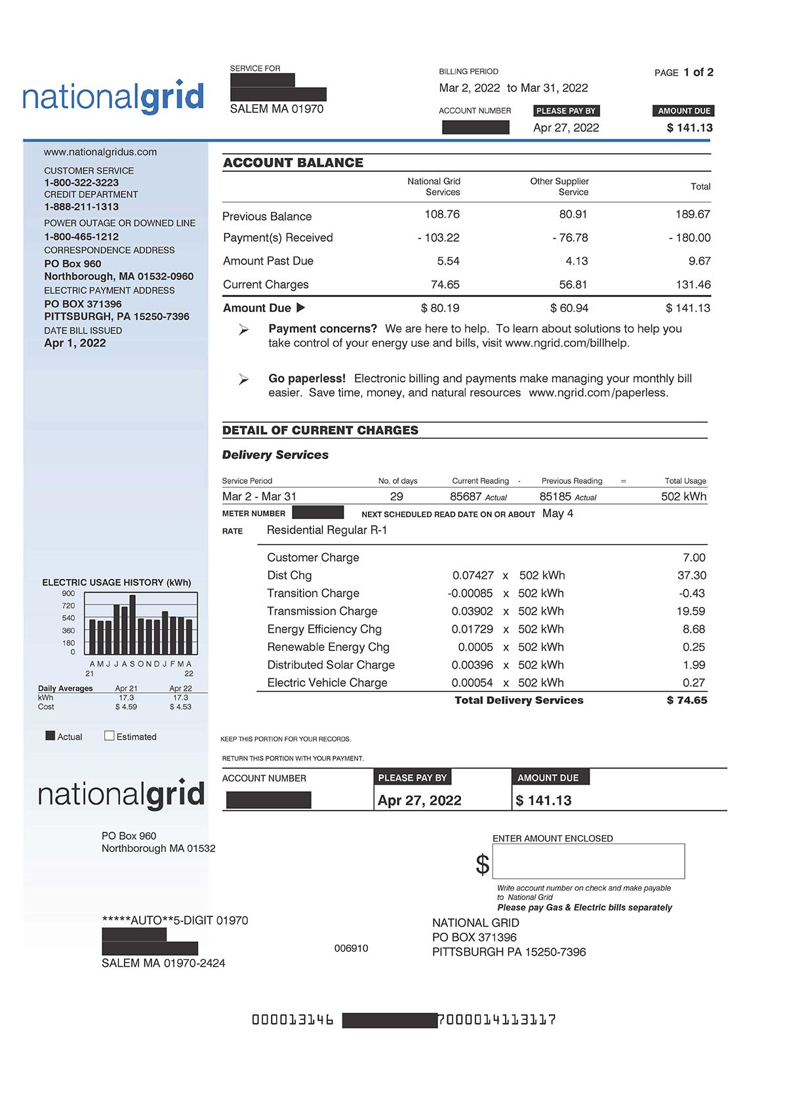
DISCOUNT RATES
Flat discounts v Income tiers v individual Percent of Income Payment Plans (PIPPs)
Current Discount Rates - all flat
Eversource - 42%
National Grid - 32% (changes proposed)
Unitil -- 34.5% (change proposed)
Concerns
  If tiers: match LIHEAP; income screen/appeals freq.
  If PIPP: administrative cost
  Other rate design concerns: Seasonal, Time-of-Use,
  EV charging, Community Solar, heat-included renters (Apdx.)
  Conversions from utility gas to ASHPs

Slide 10
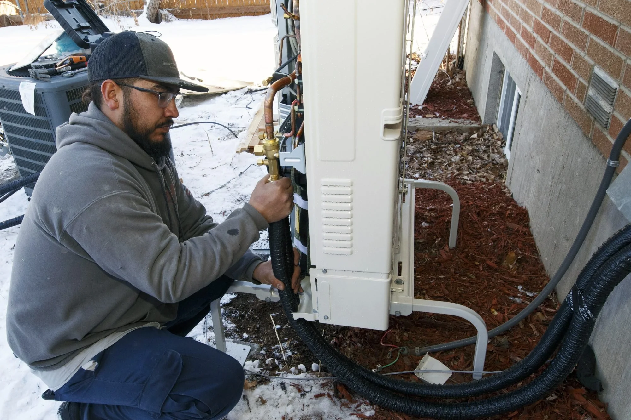
COMMONWEALTH’S ELECTRIFICATION GOALS
Low-income households converting from utility gas heat to ASHPs often confront significant home energy bill increases
~55% are on gas (LIHEAP FY 2023) so current focus is oil, propane, electric resistance (per EEA), cost-effective BUT ...
Staying with utility gas unlikely solution: gas rates likely to rise as others leave gas & fixed system costs remain

Slide 11
ELECTRIFICATION continued
  Energy Burden good -- but not exclusive -- metric
  IF STRUGGLING WITH FOOD AND RENT INFLATION, heating bill increases unaffordable & inequitable.
  U.S. food prices rose by 25 percent from 2019 to 2023 (USDA Economic Research Service)
  LI Discounts also help control costs of arrears, collections and disconnections
  Analysis needed: LEAN electric rate discount analysis: preliminarily, average discount to protect IOU LI customers 40-50%

Slide 12
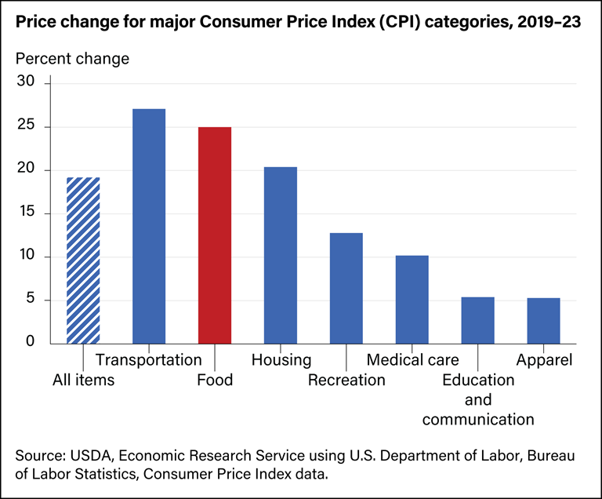

Slide 13
BILL IMPACTS -- FUNDING AND FINANCING
LI ASHP installs mostly other-ratepayer-funded. As volumes increase, additional funding may be needed.
Management of and funding for rate shocks
  stranded gas investment
  new electric grid electrification investment

Slide 14
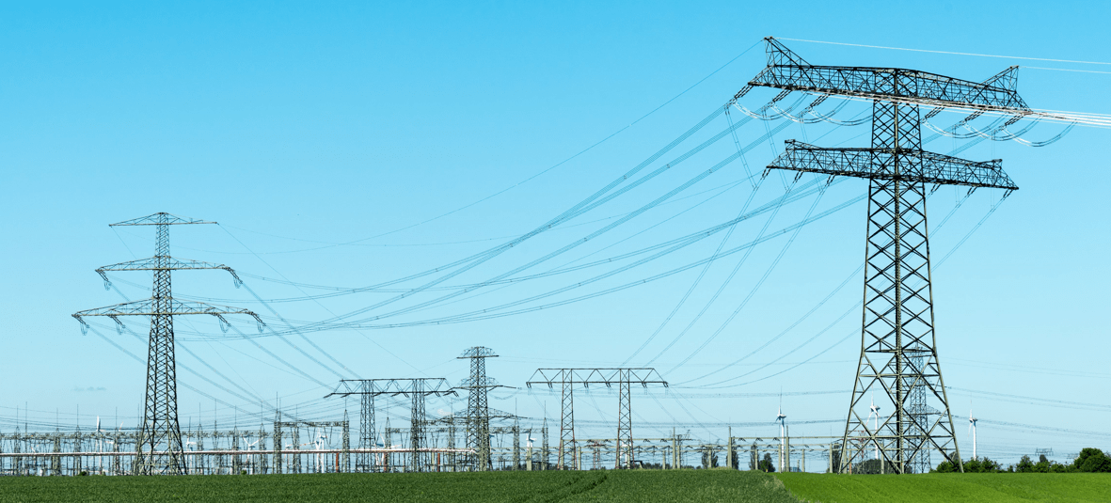
BILL IMPACTS continued
Large electrification investments: utility financing might smooth rate impacts by better matching timing with time of use (ASHPs and EV charging revenue)
General Court statutory and funding changes may be appropriate

Slide 15
THANK YOU.
QUESTIONS?
Jerrold Oppenheim, Counsel
Low-Income Energy Affordability Network (LEAN)
JerroldOpp@DemocracyAndRegulation.com
(978) 283-0897

Slide 16
APPENDIX

Slide 17
Community Action Agencies
1997 Restructuring Statute (effective 1998)
Led by Action and ABCD, created the Low Income Energy Affordability Network (LEAN)
Stakeholder engagement at cornerstone
CAA-CSG partnership helped transform the LI model into much of the MassSave model
“The low-income residential demand side management and education programs shall be implemented through the low-income weatherization and fuel assistance program network and shall be coordinated with all electric and gas distribution companies in the commonwealth with the objective of standardizing implementation." G.L. c. 25, sec. 19(c).”

Slide 18
LEAN
History
  1977 CAPs began delivering Federal DOE WAP
  1998 Utility restructuring brought nominal funding to leverage with DOE funding; LEAN created
  2008 Green Communities Act creates Mass Save Program & expands funding
LEAN leverages multiple funding sources
  Mass Save utilities
  US DOE WAP (Weatherization Assistance Program)
  HEARTWAP (Heating System Repair and Replacement Program, Funded by US HHS
  MassCEC, RMI, US DOE grants, others
Impact
  Between 2010-2021, LEAN served 473,756 participants statewide
  Since 1977 over 255,000 1-4 family weatherized units

Slide 19
Transition from rent-included heat to individual ASHPs
EOHLC additional Heating Deductions (from June 7, 2024) aims to shield state funded public housing residents from the additional energy burden that comes from gas to electric (ASHP) conversions.
Model for other similar low-income multi-family buildings?

Slide 20
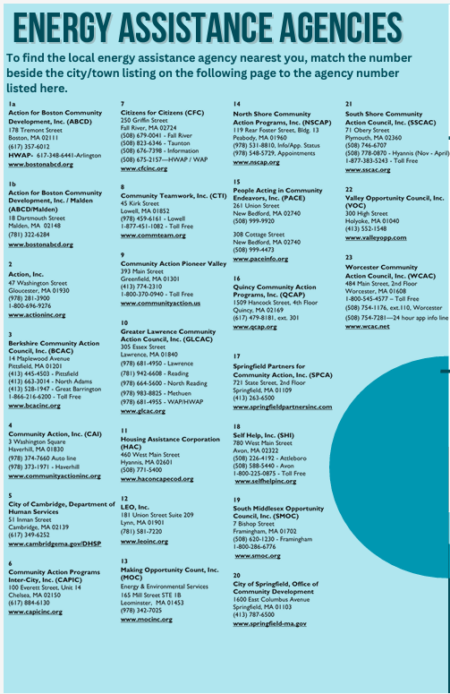
EOHLC/CAP Outreach: “Cold Relief”

Slide 21
CAP Outreach
Joint PA co-branded marketing
  Mailers
  Bill inserts
  E-mail
  Outbound calling
  Outreach campaigns
  Events, Local engagement
Discuss/coordinate contractor marketing
Multifamily owner outreach

Slide 22

Customer Education

Slide 23
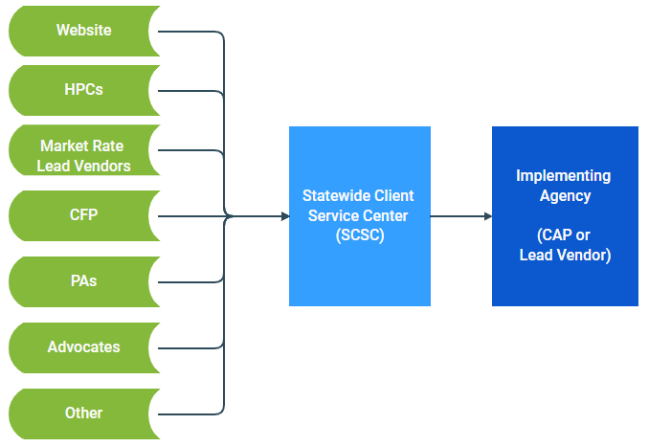
LEAN Statewide Client Services Center (SCSC)
CFP Leads are referred to SCSC through
  Weekly import of web submissions
  Connected phone trees
SCSC will confirm eligibility and refer to an Implementing Agency for assessment (either HPC or CAP)
SCSC accepts pre-scheduled leads from HPCs
Statewide phone number
Web sites (single-family, multi-family)
SCSC Live Language Support:
  English
  French
  Haitian Creole
  Japanese
Korean
Mandarin
Portuguese
Spanish
Vietnamese
Notes:
Can provide SCSC Phone # if needed
LEAN has rolled out the Statewide Client Services Center (SCSC) to centralize intake and referral Single Family leads/referrals to agencies in the CAP network and/or LVI program
Initially a central outreach team, since pivoted to central intake to support influx of IE leads to the network from CFP, Market Rate & other sources

