Slide 1
AQ34 - LPA or CPA Administrative Amendment
MassDEP, Bureau of Air & Waste
1
Notes:
1
Bill Oates

Slide 2
Overview
This presentation is to assist in completing a new AQ34 - LPA or CPA Administrative Amendment
Use this form to report a change in facility ownership, business or facility name, mailing address, telephone number, or primary facility contact
For an owner or operator of a facility to apply for an administrative amendment to their plan approval(s), a complete application must be filed in duplicate. The application must be submitted on Form LPA/CPA Administrative Amendment (BWPAQ 34) and in accordance with the timelines established at 310 CMR 7.02(13). A timely application is one that is submitted no later than 60 days of the initiation of the proposed change
This presentation will take you screen by screen through the EEA ePLACE online permitting application process

Slide 3
General Navigation
Always Click to move to the next page.
Do NOT use the Browser Back Button as this will take you out of the system
Any field with a red asterisk (*)is required before you can move off the page.
Click to save your work and resume at a later time.
Click on the tool tips where applicable to get more details.
Suggested preferred browsers are Chrome and Microsoft Edge

Slide 4
How to Apply
First time users:
Click or type this address on your browser: https://eplace.eea.mass.gov/citizenaccess
Follow the prompts to create a new user account
Log into your account in EEA ePlace using your username/password

Slide 5
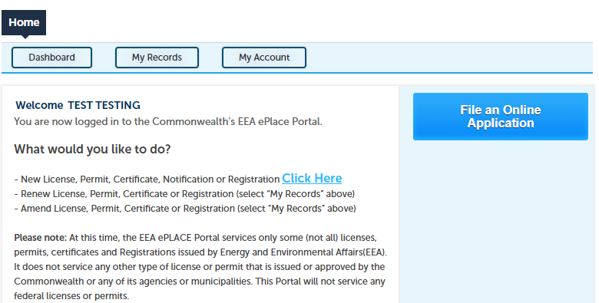
File an Online Application
Click here to start

Slide 6
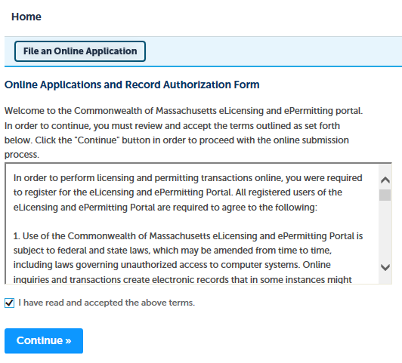
File an Online Application
Read and accept the Terms and Conditions
Click the checkbox and click “Continue”

Slide 7
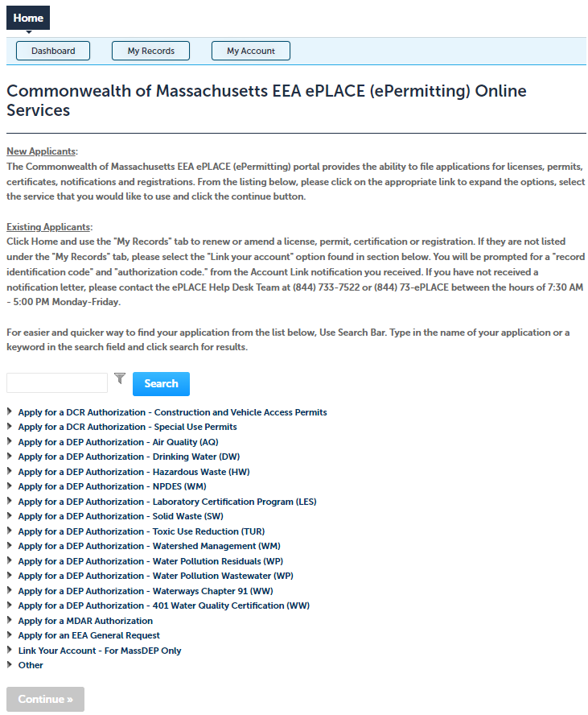
Apply for an AQ34 Amendment
Click on “Apply for a DEP Authorization- Air Quality (AQ) to expand the list of applications
You can also search for the application on the search bar field

Slide 8
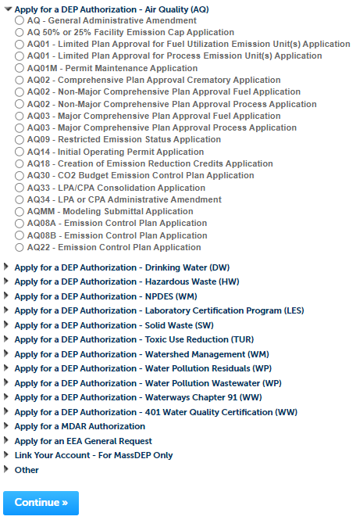
Apply for an AQ34 Amendment
Select “AQ34 - LPA or CPA Administrative Amendment” and click continue at the bottom of the page to start your application

Slide 9
Contact Information: Important NOTE
There are three contact sections in the next screen:
Permittee: the person or signatory authority responsible for signing and accepting all conditions of the Permit
If you are the Permittee, click “Add New” button and select the checkbox “Use Login Information”
If you are not the Permittee you have the option to Add New and enter all the Permittee Information or if the Permittee has an EEA ePlace account, then you have the option to look them up under “Look Up” option
Permittee Company: here enter the company information the Permittee is affiliated with, if applicable.
Application Contributors: use this section if multiple users will be coordinating in the preparation of this application
If you are unable to find the correct contributor, click on the “Save and resume later” button. Advise the contributor to create an account in the EEA ePLACE Portal and then resume the application.

Slide 10
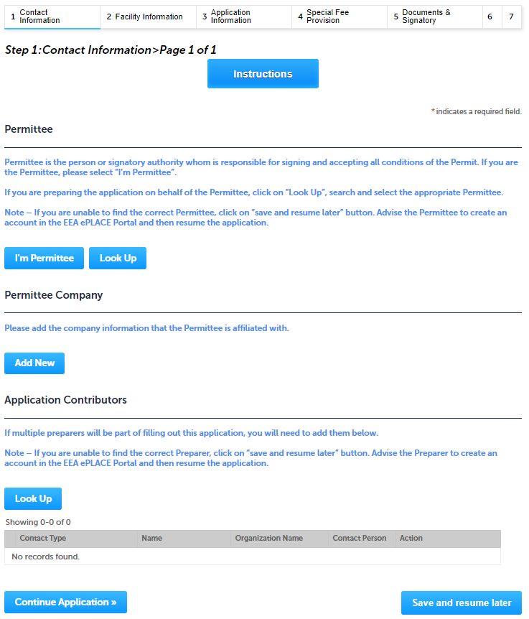
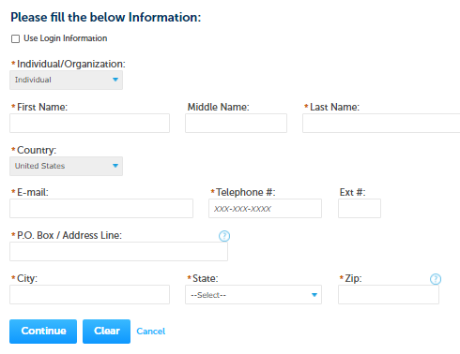
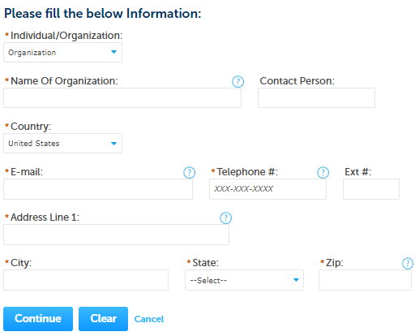
Step 1: Contact Information
Add Permittee, please read the section instructions and add accordingly
Add Permittee Company
Look Up “Application Contributors” , if applicable
Click “Continue Application” to proceed

Slide 11
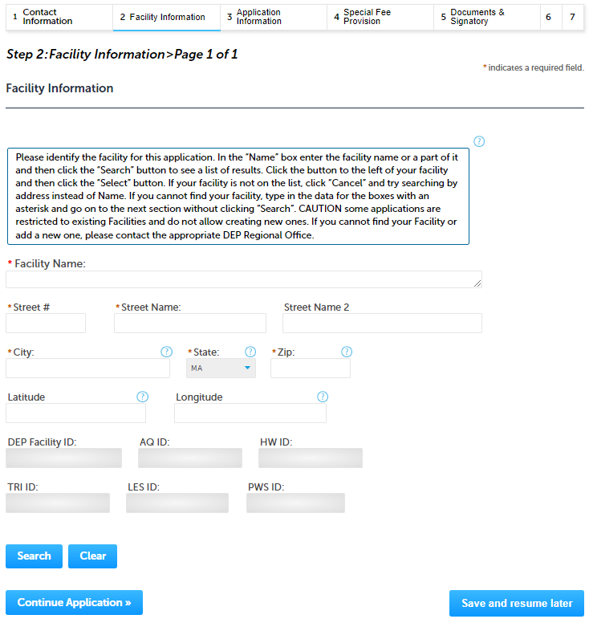
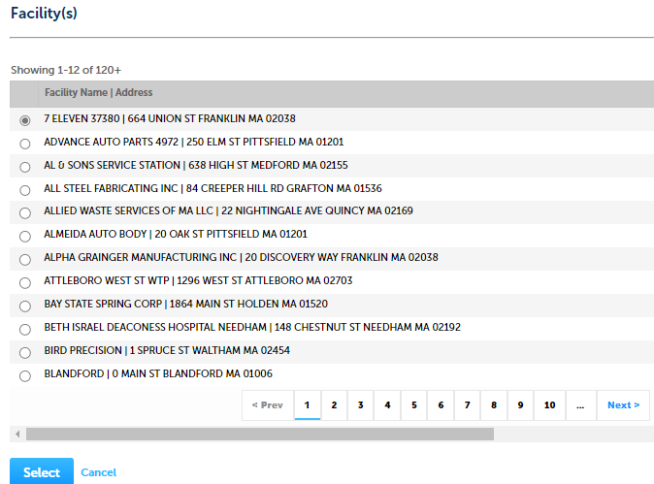
Step 2: Facility Information
Add your Facility information
Please read the instructions on how to find and add your facility
Click "Continue Application" to proceed

Slide 12
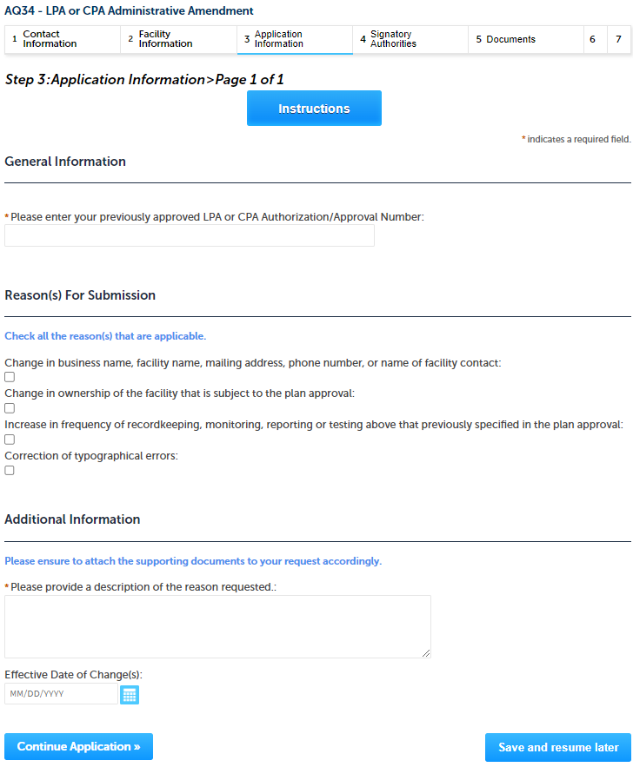
Step 3: Application Information
Enter your previously approved LAP or CPA Authorization/Approval Number
Select the reason(s) for this amendment and enter additional information accordingly
Click “Continue Application” to proceed

Slide 13
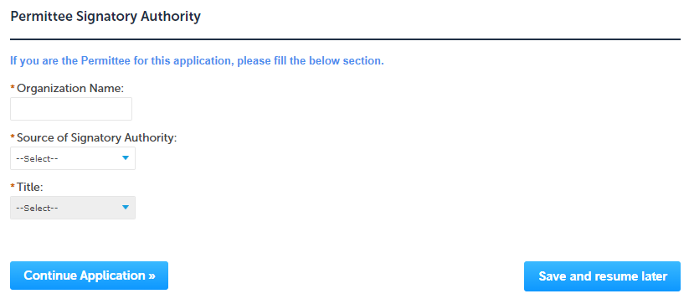
Step 4: Permittee Signature
If you indicated yourself as the “Permittee” for this application (refer to contact information slide) then complete the Signatory Authority section
If you are not the Permittee, then please click on “Continue Application” to proceed

Slide 14
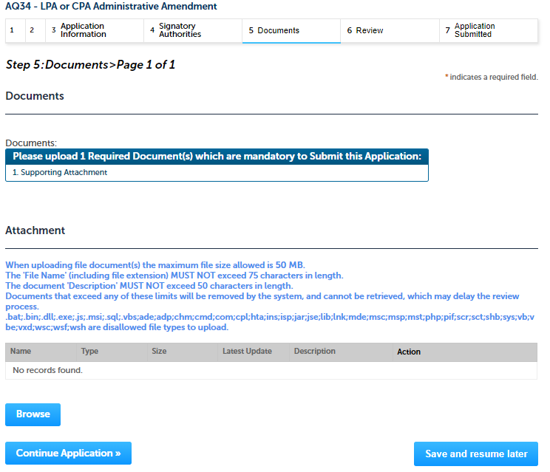
Step 5: Documents
Upload all required documents for your application
The required documents will be listed on the table
To begin attaching documents, click “Browse”

Slide 15
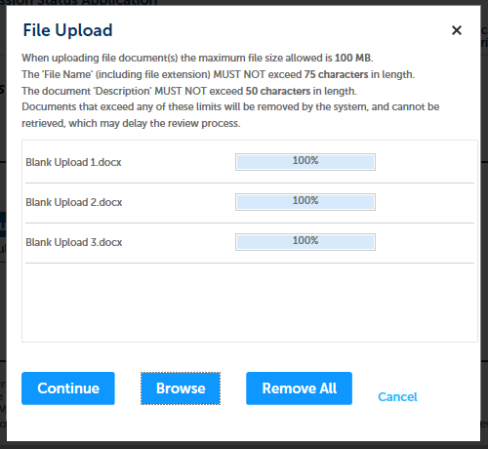
Step 5: Documents (Attaching)
A “File Upload” window opens
Click “Browse”
Choose the file(s) you want to attach.
When all files reach 100%, click “Continue”

Slide 16
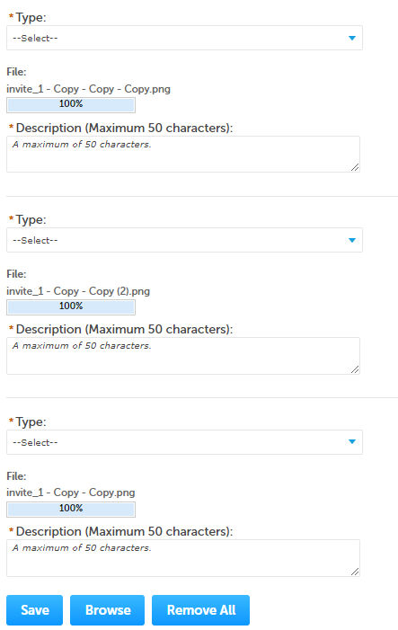
Step 5: Documents (Attaching)
Select the document type
Provide a description of each document that you uploaded
Click “Browse” to add more documents
When all documents are uploaded and described, click “Save”

Slide 17
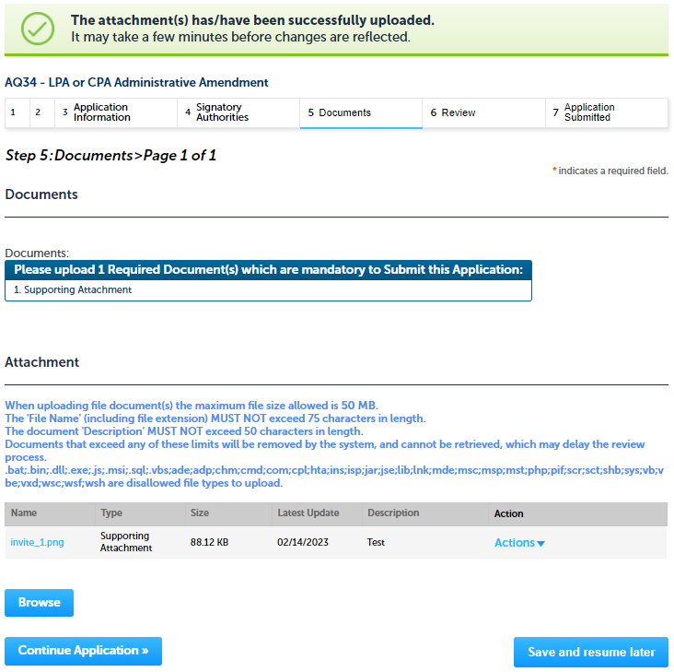
Step 5: Documents (Attaching)
You should see a message that you have successfully attached documents
Review the list of attached documents
When ready, click on “Continue Application” to proceed

Slide 18
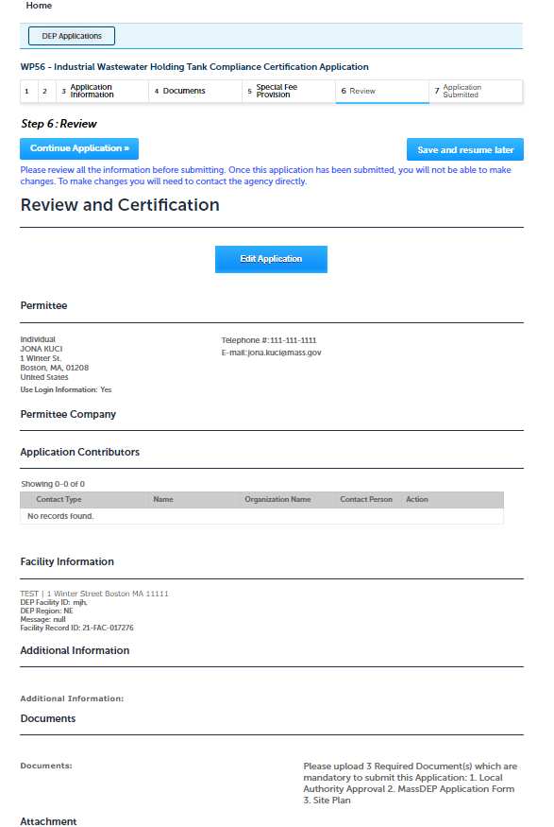
Step 6: Review
The entire application is shown on a single page for your review
If you note something you want to change, click “Edit Application”
Otherwise, continue to the bottom of the page

Slide 19
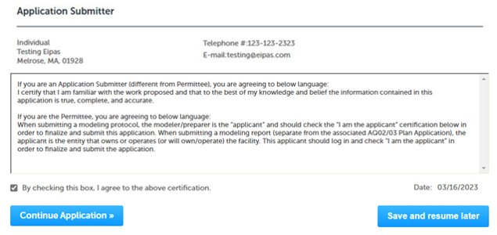
Step 6: Review
Read the Certification Statement
Click the check box to complete your certification
Click on “Continue Application” to proceed with the submittal of your application

Slide 20
ATTENTION!!!
If you are the Permittee for this Application, next the system will submit the application.
The Agency will start review of your application
_____________________________________________________________
If you are not the Permittee for this Application, next the system will submit the initial application.
A notification will be sent to the Application Submitter and to the individual who is identified as the Permittee for this application.
Permittee must complete the Permittee Certification Step
NOTE – The review of the application by Agency will start once the Permittee Certification of the application is completed.

Slide 21
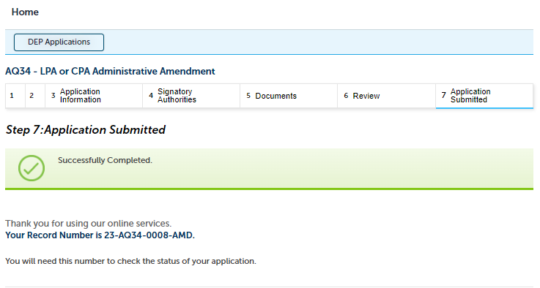
Step 7: Submission Successful!
When you submit your application, you will receive a Record ID so you can track the status of your application online
Upon submission of your application please make sure to check your email for system notifications

Slide 22
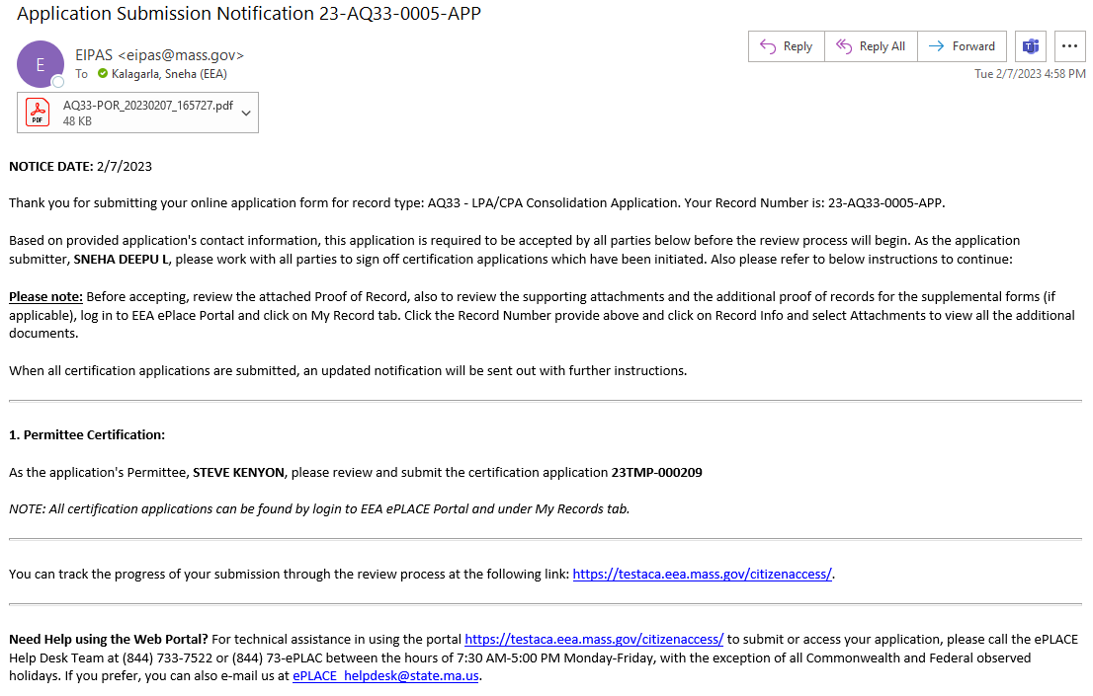
Permittee Certification
If you are not the Permittee for this Application, system will send a notification from eipas@mass.gov
Review the email and follow all steps accordingly

Slide 23
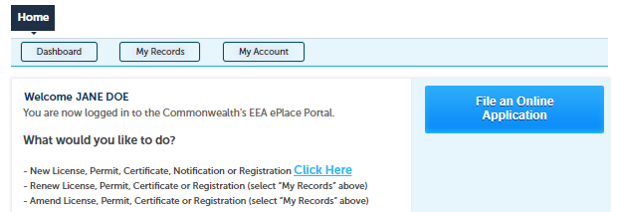
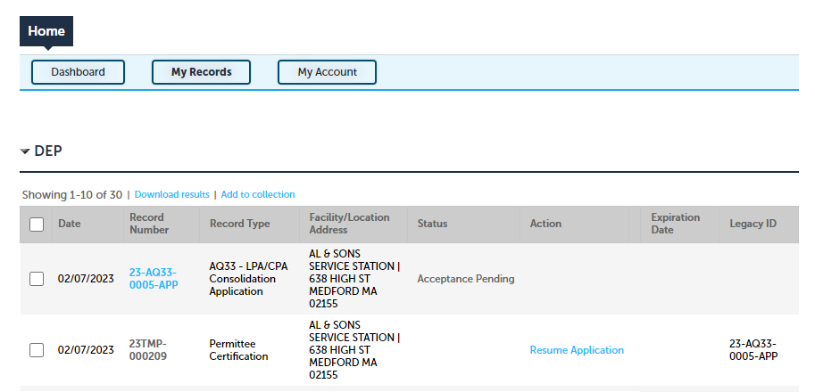
Permittee Certification
Log on to EEA ePlace portal
https://eplace.eea.mass.gov/citizenaccess
Go to “My Records” page to the Permittee Certification Record
The Permittee Certification Record will be listed along with its associated Application Number
Select “Resume Application”
Notes:
https://eplace.eea.mass.gov/citizenaccess/

Slide 24
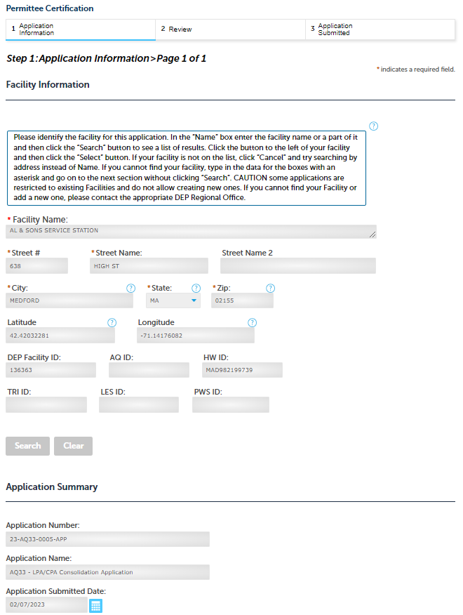
Permittee Certification
The facility information and Application details are populated
Please verify the information
Notes:
https://eplace.eea.mass.gov/citizenaccess/

Slide 25
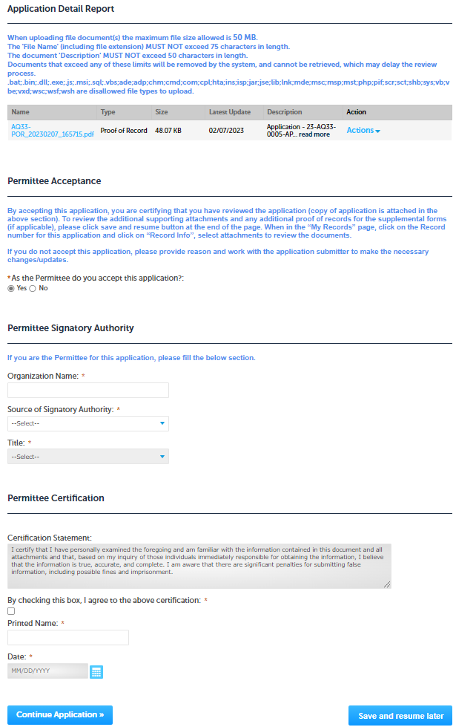
Permittee Certification
Review the Proof of Record i.e., copy of the submitted Application
Please read the instructions and procced accordingly
Click “Continue Application” to proceed
Notes:
https://eplace.eea.mass.gov/citizenaccess/

Slide 26
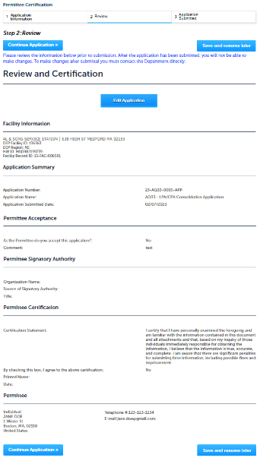
Permittee Certification
The entire application is shown on a single page for your review
If you note something you want to change, click “Edit Application”
Otherwise, click on “Continue Application” to proceed with the submittal of your application
Notes:
https://eplace.eea.mass.gov/citizenaccess/

Slide 27
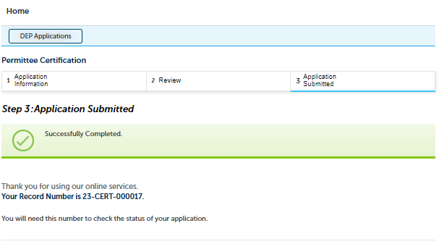
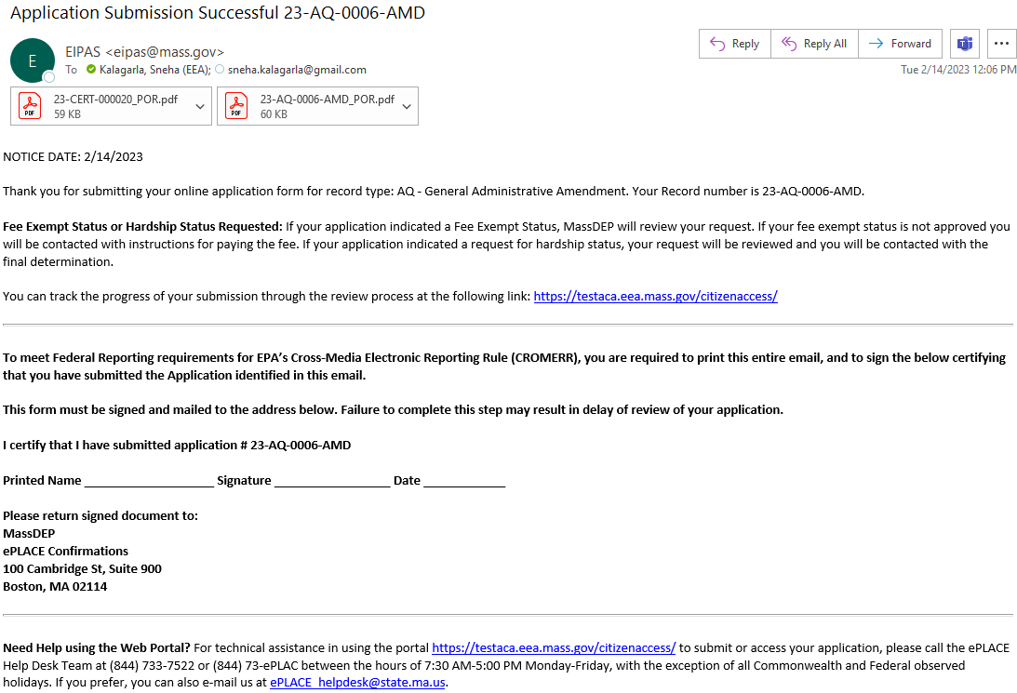
Permittee Certification - Submission Successful!
When you submit your certification, you will receive a Record ID as confirmation
Upon submission of your certification the system will send a notification with the complete application which include the Proof of Record of submitted Application and Permittee Certification
Read Instructions on this notification for next steps

Slide 28
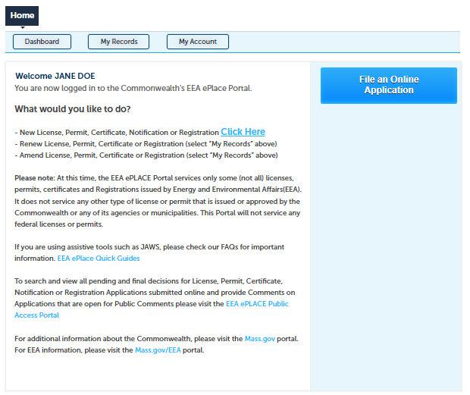
To check the status of an application
Log on to EEA ePlace portal
https://eplace.eea.mass.gov/citizenaccess
Go to your “My Records” page to see and/or track the status of an application
Notes:
https://eplace.eea.mass.gov/citizenaccess/

Slide 29
Questions?
For technical assistance:
Contact the ePlace Help Desk Team at (844) 733-7522
Or send an email to: ePLACE_helpdesk@state.ma.us
For business related questions, please visit the link below:
LPA/CPA: Administrative Amendment to Previous Plan Approval (AQ 34) | Mass.gov

