Slide 1
The LTS Coordinator: Role and Benefits for One Care Enrollees

Slide 2
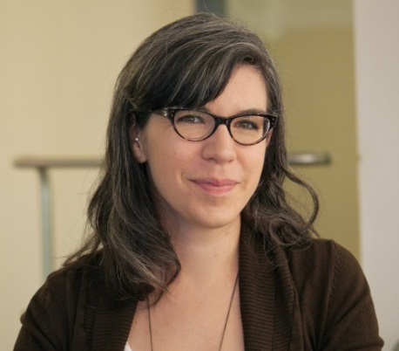
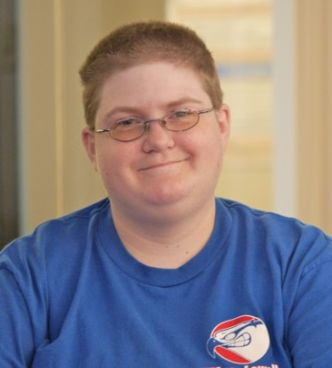
Presenters
David Healey,
Clinical Manager
One Care
MassHealth
Jennifer Turpin, LTS Coordinator
Boston Center for Independent Living
Olivia Richard, Implementation Council Member
& One Care Enrollee
Facilitator
Lisa McGlinchy, Acting Associate Director of Performance Improvement
Disability and Community Services (DCS), UMass Medical School
Notes:
Introduction of presenters

Slide 3
Housekeeping Items
This webinar is being recorded and will be made available at a later date.
Audio is provided through your phone line. Call in to 617-410-9095 to join.
We will use the “mute” feature on this conference call.
For best results, turn off your computer speakers.

Slide 4
We encourage your participation!
Question and Answer period at the end of the webinar.
We will ask you to participate in a Polling Questions.
Notes:
Even though this is a webinar we encourage and expect your participation! We will keep the Question and Answer pods open for you throughout the webinar. When you have a question type it into the Q&A box on the left hand side of your screen and send the question. It will go to the us here but other participants will not see it. We will pause periodically to answer the questions that come in.
We will ask you to participate in Polling Questions that can help us all to get a sense of who other participants are and allow us to “hear” your thoughts. And we will also ask you to think about the reflection questions that come to think about how the content applies to your work.

Slide 5
Polling Question: Your Primary Role
Notes:
Our first polling question is the one we have done at the beginning of our webinars to get a sense of who else is “in the room”.

Slide 6
Goals of this Webinar
Refer to LTS Coordinator
Engage with LTS Coordinators
on Care Team
Explain the role

Slide 7
Learning Objectives
Clarify the role of the LTS Coordinator
Discuss benefits of the role for the enrollee and the care team
Differentiate between the Care Coordinator and LTS Coordinator roles

Slide 8
Polling Question: Your Confidence
Notes:
Our first polling question is the one we have done at the beginning of our webinars to get a sense of who else is “in the room”.

Slide 9
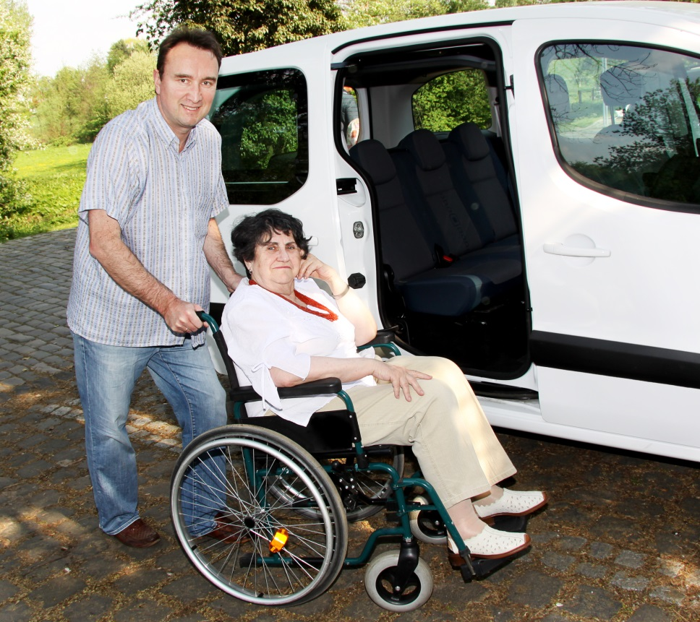
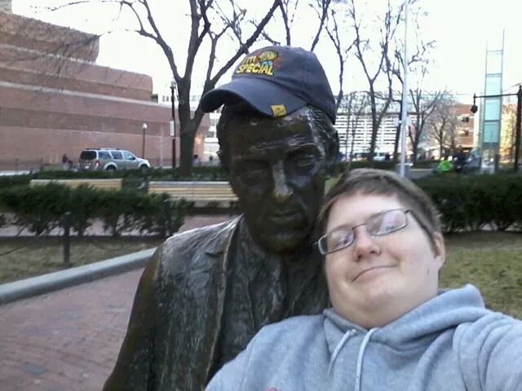
Long-Term Supports and Services (LTSS)

Slide 10
Long-Term Services & Supports Coordinator
Care
Coordinator
Clinical Care
Manager
Enrollee
Primary
Care
Provider
Behavioral
Health
Provider
LTS
Coordinator

Slide 11
David Healey
Background and Vision of the LTS Coordinator Role

Slide 12
Development of the Role
Collaborative Process with CMS and
One Care stakeholders
Independent Living and Recovery Principles
To ensure integration of LTSS in person-centered care
LTS
Coordinator

Slide 13
Long-Term Services & Supports (LTSS)
Assistance with ADLs (Activities of Daily Living)
Assistance with IADLs (Instrumental Activities of Daily Living)
Skills training and education
Peer support
Nonmedical transportation
Assistive technology
Home modifications

Slide 14
LTSS in One Care
All MassHealth LTSS
+
Additional Community–Based Services
+
LTS Coordinator
Self-Directed

Slide 15
Potential Additional Services
LTS Coordinators in CBOs
Housing
Food
Employment
Other community supports

Slide 16
One Care approaching 1 year mark!
LTS Coordinator role evolves to fit needs of enrollee
Particularly important to define LTS Coordinators for auto-enrolled people
MassHealth, plans and CBOs have been creative to help enrollees reach their goals

Slide 17
Benefits to Enrollee
Identify
Needs & wants for LTSS
Advocate
For enrollee
Act as a bridge
Help
Enrollees protect their rights
Care team members incorporate LTSS
Develop & Coordinate & Monitor
Community resources
Care Plan with community based supports

Slide 18
Olivia Richard
Benefits to Enrollees

Slide 19
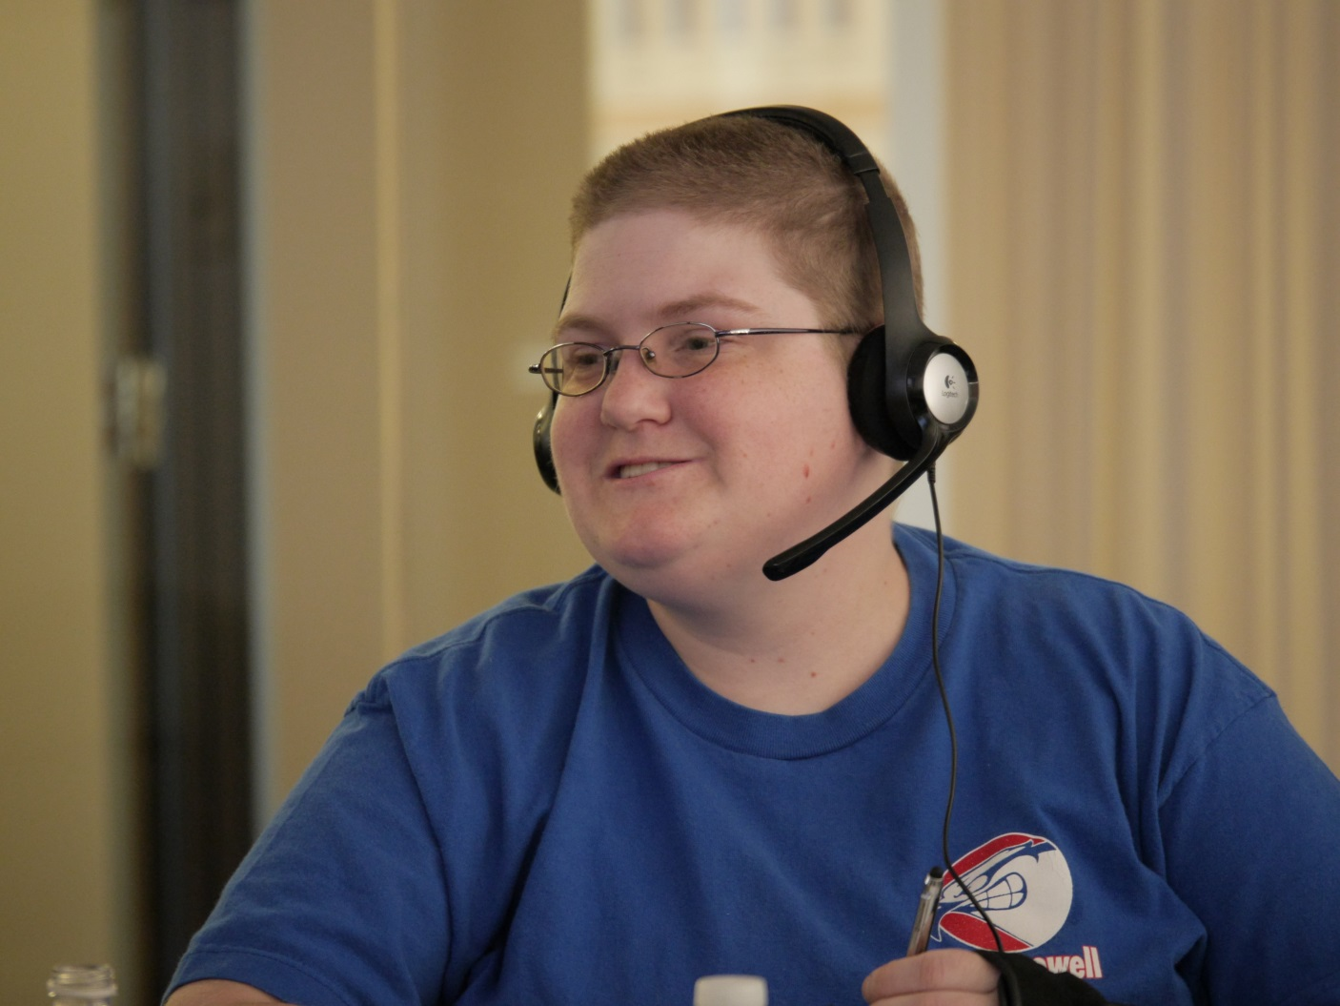
Olivia’s Perspective
Accessing One Care
Navigating the system before One Care

Slide 20
When to Access an LTS Coordinator
At enrollment
During assessment if indicated or requested
By request of the enrollee at any time
When LTSS need is identified
If admitted to a facility

Slide 21
Enrollee Role
Always have a choice
Right to pick their own and/or change
Right to choose the CBO to work with

Slide 22
Jennifer Turpin
LTS Coordinator Role

Slide 23
Jennifer’s Perspective
Meeting Olivia
Her approach

Slide 24
Major Roles of LTS Coordinator
1
To help enrollee develop and work toward goals for independent living, wellness and recovery
To work as a care team member, providing expertise in LTSS, Independent Living Philosophy and Recovery Model
To provide expertise on community services and community service providers
2
3

Slide 25
Connection to One Care Plans
Independent CBO:
Independent Living Centers (ILCs)
Recovery Learning Communities (RLCs)
Aging Service Access Points (ASAPs)
One Care plans:
CCA
Tufts/ Network Health
Fallon Total Care

Slide 26
Qualifications
BA in Social Work or 2 years experience
Training in person-centered planning
Experience in LTSS assessments
Cultural competence
Independent CBO
One Care plans

Slide 27
Care Coordinator
Single
point of contact for One Care plan
Coordination, monitoring of MassHealth and Medicare services
Works with
to create and ensure delivery
of Personal Care Plan

Slide 28
Example of Working with Care Team

Slide 29
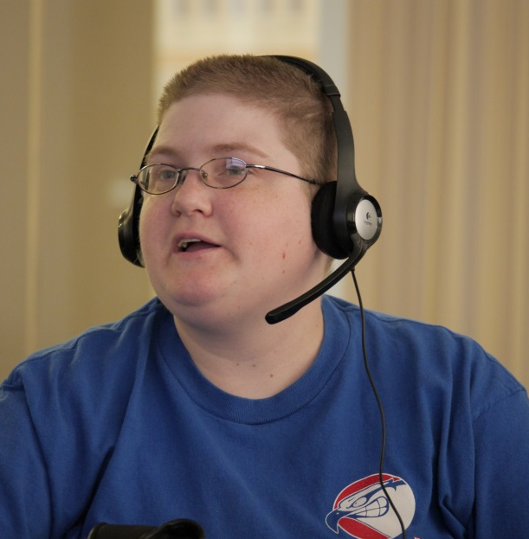
Questions and Answers
David Healey,
Clinical Manager
One Care
MassHealth
Olivia Richard, Implementation Council Member
& One Care Enrollee
Jennifer Turpin, LTS Coordinator
Boston Center for Independent Living

Slide 30
Value of the LTS Coordinator
Assists enrollees in working towards quality of life goals
Has experience with specific groups of people with disabilities
Facilitates integration of LTSS
Knows services to support wellness, independent living and/or recovery

Slide 31
Additional Questions?
After the webinar, for further information, please see:
www.mass.gov/masshealth/onecare

Slide 32
One Care Website

Slide 33
Disabilityinfo.org website

Slide 34
Future Training Efforts
Check the Shared Learning Website for:
Online Modules
Videos
Upcoming Events
www.mass.gov/masshealth/onecare/learning

Slide 35
THANK YOU!
To receive credit for this webinar and a
certificate of completion, go to this link:
https://onecarelearning.ehs.state.ma.us/mod/lesson/view.php?id=104
If you have any questions email us at learning.onecare@umassmed.edu

