Slide 1

Massachusetts Advisory Council on Alzheimer’s Disease and All Other Dementias
Executive Office of Aging & Independence
Robin Lipson, Secretary – AGE
Meeting Chair
June 9th, 2026
3:30-5:00 pm
Video Conference

Slide 2


Agenda
1. Welcome, Logistics, and Announcements
(5 min)
2. Approval of Minutes
(5 min)
3. Looking Back and Moving Forward
(5 min)
4. State Plan Refresh Workgroup Update
(20 min)
5. Discussion: Council Member Perspectives
(50 min)
Caregiver Support, Education & Systems Navigation
Early Recognition, Detection & Diagnosis of ADRD
6. Next Steps and Vote to Adjourn
(5 min)
Newest “Member” of AGE
Baby Romich`

Slide 3
Welcome and Announcements
Welcome Council Member Chelsea Gordon!
Appointed to the representative for a state-based advocacy organization seat in April 2026, Chelsea brings experience in health policy and advocacy, and works to support policies that improve the lives of individuals living with Alzheimer’s disease and other dementias, as well as their family caregivers in Massachusetts.
Council Support Team
AGE ADRD Collaboration Team
Bree Bernat Shems, Sr. Director, Policy, Strategy & Innovation
Molly Evans, Sr. Manager, Strategic Programs (Caregiver)
Deanna Mazina Nourai, Director, Public Health Policy & Outreach
Bonnie-May Shantz, Policy Director, Age- & Dementia-Friendly Lead
Liz Gallagher, PhD, Strategy & Analytics Manager
Robin Lipson, Secretary of AGE & Today’s Mtg. Chair
Whitney Moyer, COO & Council Chair
Elisha Goodman, Special Projects Manager
Bill Travascio Special Assistant to the Secretary
Abigail Concaugh, Summer Intern
Gabriel Cohen, Program Planning and Implementation Manager, Office of the EOHHS Secretary

Slide 4

Vote: Approve the March Meeting Minutes
Motion Required
The Council is asked to vote to approve the minutes from the March Council Meeting.
A motion, a second, and a roll-call vote are required.

Slide 5

Moving Forward: State Plan Refresh
and 2026 – 2027 Council Actions
Alzheimer’s Disease and All Other Dementias (ADAOD) State Plan Refresh Timeline
Dec 2025 – Mar 2026
Mar – Jun 2026
Mar – Jun 2026
Jul – Sep 2026
Sep – Nov 2026
Scoping, Work Group formation, discovery & data collection
Analyze approaches & prioritization of current state data; Drafting principles, purpose, vision
Draft full Plan with goals, strategies; Provide Plan for review and feedback; Reviews
Approvals & Launch: World Alzheimer’s Month & Family Caregivers Month
Actions for 2026–2027
Complete the State Plan Refresh – through the established Work Group and timeline
Fill Vacant Council Seat – Caregiver seat
Begin Annual Implementation Plan – Draft potential actions and tactical commitments for Annual Implementation Plan
Identify Key Metrics – Analyze and define publicly available data sources that might be used to develop success metrics for the next Annual Plan & Report (Summer Intern)

Slide 6
Moving Forward: ADAOD State Plan Refresh
Workgroup
Work Group Mission (January – July 2026)
Provide strategic guidance, insight, and ideas on emerging opportunities, challenges, and proposed solutions. Analyze the current state and provide recommendations on goals, strategies, and actions.
Work Group Members
Dr. Christine Ritchie
Susan Antkowiak
Dr. Brent Forester
Barb Meehan
Hector Montesino
Whitney Moyer
Elisha Goodman
Bonnie-May Shantz
Liz Gallagher

Slide 7



Moving Forward: Setting Strategy, Taking Action, Measuring Impact
Three-Tier Planning and Report Structure
This structure ensures the Massachusetts State Plan on Alzheimer’s Disease and All Other Dementias remains a durable strategic document while allowing flexibility for annual tactical adjustments.
ADAOD State Plan
Vision, goals, and strategic direction
3–5 years (2026–2030)
Strategic
Council’s Annual Implementation
Plan
Tactical commitments, specific and measurable actions, responsible parties
1 year (annual)
Tactical
Council’s Annual Report
Reflection on achievements against the implementation plan
1 year (annual retrospective)
Accountability

Slide 8
ADAOD State Plan Refresh – Status Update
ADAOD Refresh Work Group –
Mapped Achievements Aligned to ReiMAgine Aging 2030 - Completed Actions Mapped to Statewide Goals
Validated Previous State Plan Key Achievements: 2021 – 2025
Reviewed approaches taken in the Previous State Plan – Considering types of action were most effective
Developed Refreshed Plan 2026 Structure
Began Current State Research - Last 5 years
Confirmed State Plan Purpose
Crafted State Plan Guiding Principles
Designed State Plan Vision 2030 and Beyond
Began Discussion on State Plan Draft Goals & Strategies

Slide 9
Refreshed ADAOD State Plan 2026 Structure
Proposed Outline for the Refreshed State Plan
Introduction
Strategic Priority Areas
Purpose, legislative mandate, how to use this Plan, who it serves, acknowledgments
Early Recognition, Detection & Diagnosis of ADRD; Caregiver Support, Education & Systems Navigation
Executive Summary
Goals and Strategies
Where we have been, vision and recommendations, what success looks like in 2030
Analysis and alignment to ReiMAgine Aging 2030 and other plans; actionable goals with strategies
Current State
Appendix
Impact on people and communities; reducing risk; MA demographics; what’s new in treatment, detection, workforce, and policy
Supporting data, sources, and supplementary materials

Slide 10
Refreshed Massachusetts Alzheimer’s Disease and All Other Dementias (ADAOD) State Plan Purpose
Purpose
The refreshed ADAOD Plan will provide strategic direction to further embed Alzheimer’s Disease and All Other Dementias good practice and a vision to move the Commonwealth forward to better serve those living with dementia and their families.

Slide 11
Guiding Principles of Refreshed ADAOD State Plan
Be Person- and Care partner-centered - Ensure collaboration and enhance engagement of individuals, families, and care-partners affected by dementia.
Be Open & Culturally responsive - Listen to, learn from, respect, and value diverse life experiences and perspectives. Highlight and address inequities in access to health care and support services as we develop policy recommendations, programs, and resources for individuals and families affected by dementia.
Be Clear – Create clear information, processes, and pathways for clinicians, specialist, those experiencing dementia and their caregivers.
Be Collaborative - Create and integrate a community of researchers, health system providers, policymakers, community partners and other interested parties.
Be Bold – Be a catalyst for rapid improvement, an incubator of novel ideas, and supporter of the first critical step of diagnosis.
Be Excellent – Elevate and promote the highest quality evidenced-based research, processes, and protocols.
Be Accountable – Be transparent about our work and ensure that scientific knowledge is translated into practical information and actions. Measure and demonstrate the impact of the work as we move forward.

Slide 12
Overall Vision of the Refreshed ADAOD State Plan
In a few powerful sentences –
Empower individuals living with dementia, their families and care-partners to live the best possible lives throughout the disease journey.
Create clarity around access to supports that individuals, families, care-partners and professionals need. Building clearer pathways so people know where to go, what comes next, and what supports are available.
Shift the experience from confusion and crisis toward empowerment and living well with dementia.
Develop strategies to ensure that routine, standard primary care practice includes early and accurate Alzheimer’s or dementia diagnosis.
Position Alzheimer’s disease and related dementias as a major part of the broader Reimagine Aging 2030 vision.

Slide 13
State Plan Vision 2030 and Beyond
Key Themes
Primary Care
Access to Care & Caregiver Support
Primary care is better equipped to screen, identify, and support people with dementia.
Families and care-partners have more support before they reach crisis. Caregivers can afford to keep loved ones at home with required in-home care.
Early and accurate diagnosis becomes standard practice
Good triage in primary care to route people is high need of a specialist
Improved early detection in primary care helps to relieve specialist wait-list challenge
People are diagnosed earlier (at MCI stage), so they are able to meaningfully participate in decision-making and care planning.
Clearer Pathways - Upon diagnosis, individuals and care partners leave with something in hand (e.g., an app, a document, a resource guide, etc.) that outlines next steps and potential support
Cohesive peer support model
Care-partners have access to physical, emotional, and financial support
Public-facing services are easier to find and navigate
Families have assistance navigating ombudsman processes, addressing long-term care quality concerns, and advocacy needs
No one is denied access to resources for financial reasons
Specialty Dementia Centers
Dementia care is more like cancer care in the sense that people are supported and guided through the process with a team based approach offering both expert clinical care and opportunities for participation in research.

Slide 14
State Plan Vision 2030 and Beyond Cont.
Key Themes
Investment in Infrastructure
Partners: State agencies, philanthropy, and community
There is investment in; diagnosis infrastructure, treatment capacity, primary care screening, dementia-capable care pathways, research and clinical care integration, public-facing supports and navigation, and caregiver support.
State agencies help define the vision and align partners. Community partners are better connected to clinical systems. A statewide dashboard tracks progress on dementia diagnosis, caregiver burden & service utilization.
Environmental Support Structures
Training
Health insurers are engaged
Cohesive peer support model
Alzheimer’s Disease and dementia are destigmatized
Integrated, cross-sector climate resilience support
Researchers and academic medical centers translate findings into plain language and practical implications
MA requires dementia-specific training for all direct care staff
Strategies have been implemented to attract and retain direct care workers, geriatricians and dementia-capable providers
Every acute care hospital has a dementia care plan
Required training for prescribing clinicians (one session per lifetime) and acute care workers with direct patient contact is implemented and there is a clear accountability mechanism
Required dementia-specific training for all direct care staff (not just direct care staff in long-term care) within first 90 days of employment
Police officer dementia training is tracked and shows high numbers of trained police officers

Slide 15
Refreshed ADAOD State Plan 2026 Goals
There will be one Goal for each of the plan priority areas:
  Early Recognition, Detection & Diagnosis of ADAOD
  Education, Systems Navigation & Caregiver Support
  There will be a series of related strategies underneath these goals. Collectively, this will provide the framework for the Refreshed Plan.
Each Goal will:
Describe the desired outcome for people with Alzheimer’s Disease and All Other Dementias and their care-partners –or – the desired broader ADAOD environment in Massachusetts
Focus on what the plan is striving to deliver in these two areas
Be clear, concise, and memorable

Slide 16
Refreshed ADAOD State Plan 2026 Next Steps
Next Steps: July - September 2026
Design - Develop and prioritize potential goals and strategies
Draft - Draft Refreshed ADAOD State Plan including vision, current state, goals, strategies and all sections
Review - Provide Draft Refreshed ADAOD State Plan for Council review
Gather - Begin assembling a draft set of potential actions and tactical commitments for Annual Implementation Plan

Slide 17
Council Member Perspectives
Priority Area #2: Caregiver Support, Education, & System Navigation
Landscape Overview (Molly Evans) (5 min)
Potential Strategies (Bonnie-May) (5 min)
Council Members Round Robin (15 min)
Priority Area #1: Early Recognition, Detection, and Diagnosis
Landscape Overview (Dr. Budson) (10 min)
Potential Strategies (Bonnie-May) (5 min)
Council Members’ Round Robin (10 min)

Slide 18
Caregiving (1/8)
Ongoing Caregiver Resources and Supports
Massachusetts Family Caregiver Support Program
Quarterly Caregiver Newsletter
Caregiver Support Groups
Caring for the Caregiver Webinar Series

Slide 19
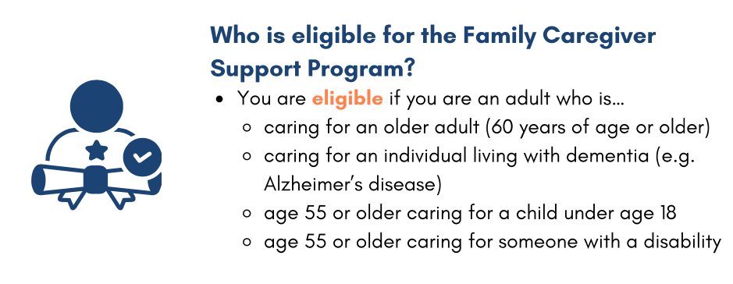
Caregiving (2/8)
Massachusetts Family Caregiver Support Program
The Program provides free support services to eligible caregivers.
The program is administered by AGE and provided by the local ASAPs & AAAs.

Slide 20
Caregiving (3/8)
Program Services
Care Consultations
Information & Referrals
Educational Materials
Respite & Supplemental Services Stipends
Evidence Based & Evidence Informed Programs
Habilitation Therapy/Dementia Education
Support Groups
Memory Cafes
Technology
Events & Workshops

Slide 21

Caregiving (4/8)
Support Groups:
Opportunity to connect with others, express feelings and concerns in a judgement free zone, and gain valuable information from their peers
Day and evening groups are available both in person or virtually
https://www.mass.gov/info-details/support-groups-for-family-caregivers
Memory Cafes:
Welcoming place for individuals with cognitive impairment or any form of dementia or brain disorder and their caregiver to participate in activities together

Slide 22
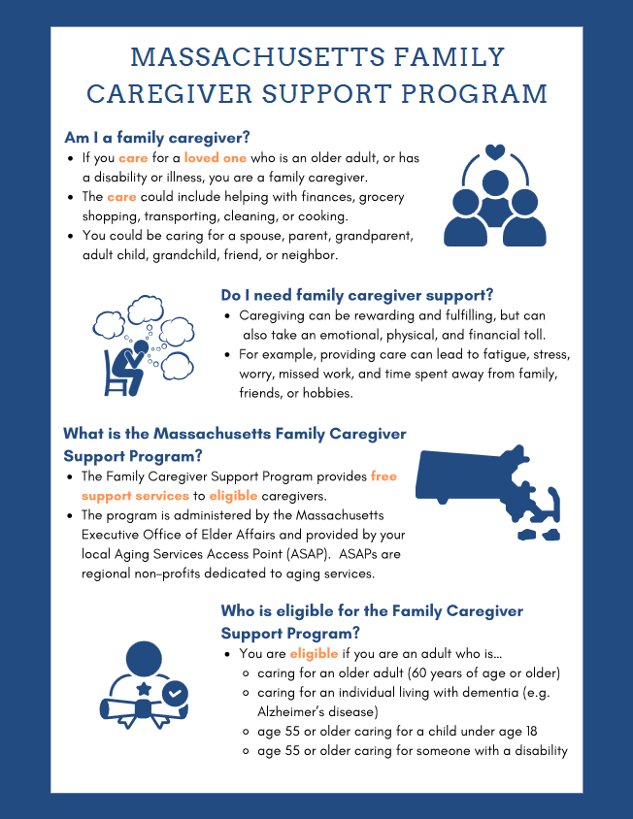
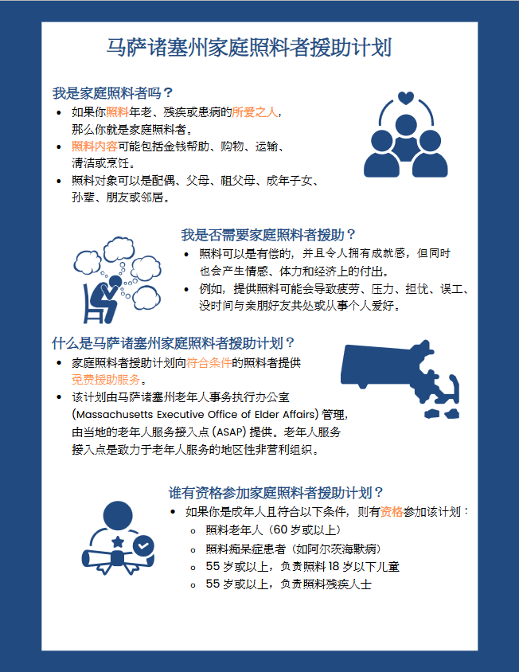
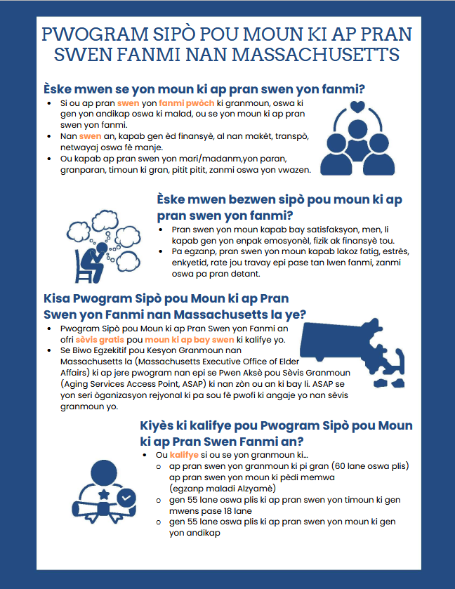
Caregiving (5/8)

Slide 23
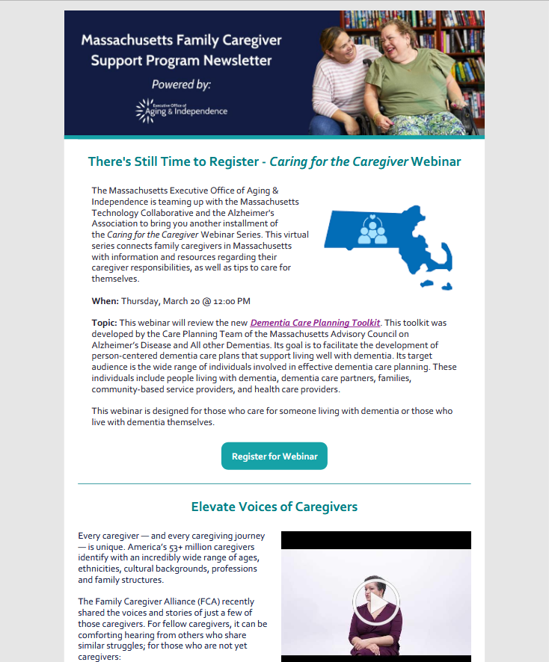
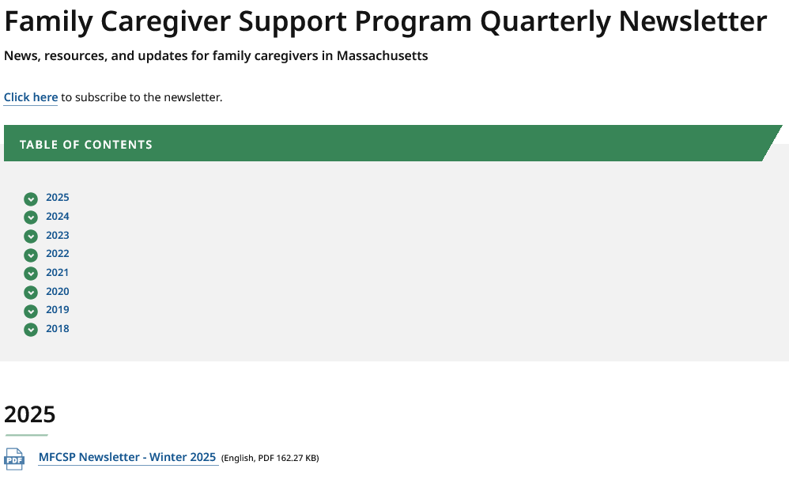
Caregiving (6/8)
Ongoing Caregiver Resources and Supports
Massachusetts Family Caregiver Support Program
Quarterly Caregiver Newsletter
Caregiver Support Groups
Caring for the Caregiver Webinar Series

Slide 24
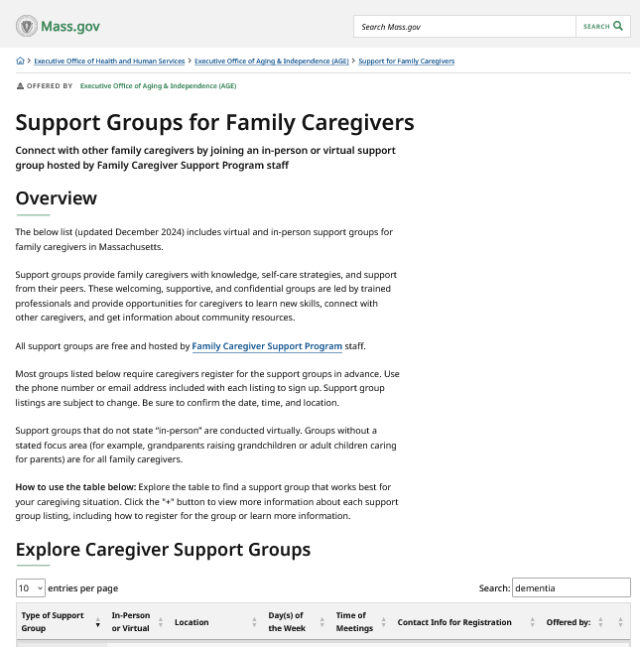
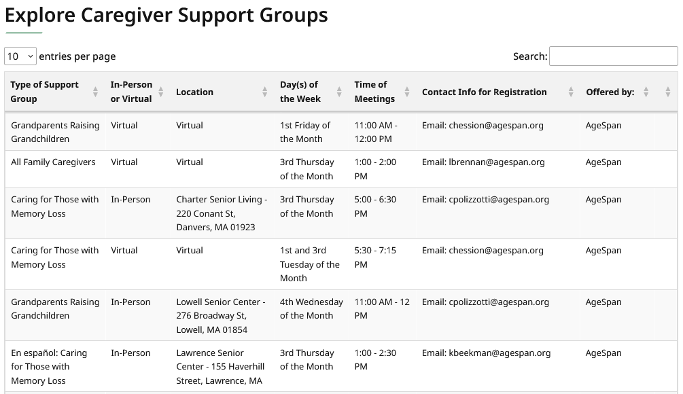
Caregiving (7/8)
Ongoing Caregiver Resources and Supports
Massachusetts Family Caregiver Support Program
Quarterly Caregiver Newsletter
Caregiver Support Groups
Caring for the Caregiver Webinar Series

Slide 25
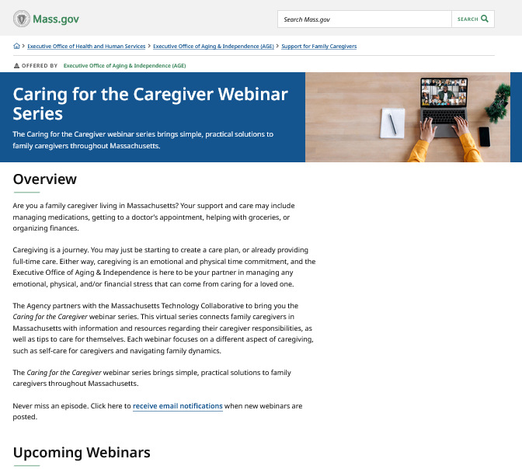
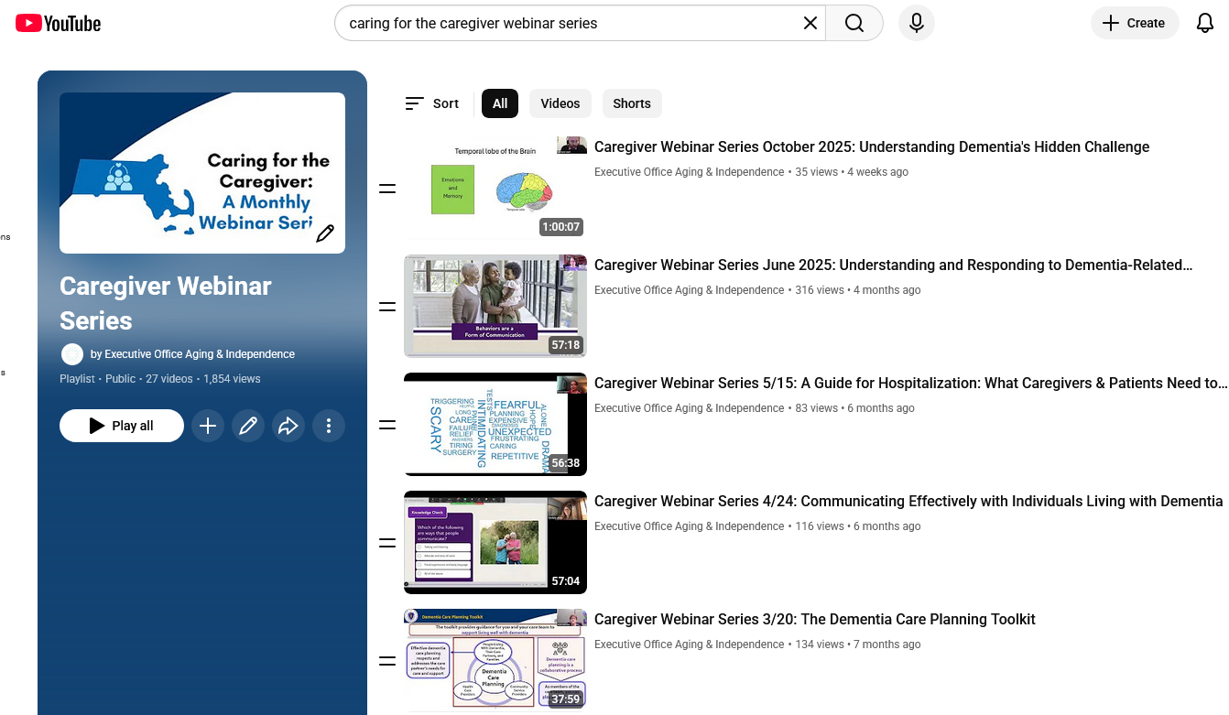
Caregiving (8/8)
Ongoing Caregiver Resources and Supports
Massachusetts Family Caregiver Support Program
Quarterly Caregiver Newsletter
Caregiver Support Groups
Caring for the Caregiver Webinar Series

Slide 26
Priority Area 2 - Education, Systems Navigation & Caregiver Support - Potential Strategies
Council Meeting Reflections (March 24, 2026)
Provide support for those developing dementia who do not have natural care partners, since this is a growing population
Increase competency in the community to support those developing dementia, so there is a higher level of compassion and engagement
Increased partnership with state-based agencies
Work with MA Department of Public Health to raise awareness in underserved areas to normalize the conversation about early recognition and detection of dementia
Support ongoing educational initiatives
Advocate for reducing dementia in the future through prevention and partner with organizations that are leading that work
ReiMAgine Aging 2030: The Massachusetts Plan
Build a greater understanding of good brain health and effective dementia risk reduction strategies
Ensure older adults, including those living with dementia, and caregivers have access to community-based programs, social connection, and services that support their ability to live long and healthy lives
Collaborate with partners to understand the impact of age- and dementia-friendly action statewide and locally

Slide 27
Discussion: Council Member Perspectives
Strategies to Advance Priority Area 2 –
Education, Systems Navigation & Caregiver Support Discussion (15 min)
1
What strategies could make the biggest impact?
2
Which strategies will focus on areas where the Commonwealth as a whole can successfully drive systems change?
3
What strategies will help our partners understand how they can prioritize their work to engage and align with this plan?
(e.g., healthcare, community-based organizations, philanthropies, the private sector etc.)

Slide 28
Early Recognition, Detection, and Diagnosis
Priority Area #1: Early Recognition, Detection, and Diagnosis Landscape Overview (Dr. Budson) (10 minutes)

Slide 29
Priority Area 1 - Early Recognition, Detection & Diagnosis - Potential Strategies
Council Meeting Reflections (March 24, 2026)
Support Alzheimer’s research centers and clinical care centers to be housed under the same roof, following the model of the cancer centers for excellence
Support the development of linkages between primary care and specialty clinics
Support programs where primary care practices develop standard workflows for screening, initial assessments, and supporting the practices through diagnosis and referrals
The Council continues to make connections and join efforts with other organizations to support early detection and diagnosis

Slide 30
Discussion: Council Member Perspectives Cont.
Strategies to Advance Priority Area 1 –
Early Recognition, Detection & Diagnosis Discussion (10 min)
1
What strategies could make the biggest impact?
2
Which strategies will focus on areas where the Commonwealth as a whole can successfully drive systems change?
3
What strategies will help our partners understand how they can prioritize their work to engage and align with this plan?
(e.g., healthcare, community-based organizations, philanthropies, the private sector, etc.)

Slide 31

Next Steps & Vote to Adjourn
Next Council Meetings
Tuesday, September 29th from 3:30 to 5:00 pm on Zoom
Reply to Bill with Availability for the late 2026 meeting (mid-November or early December)
Upcoming Focus Areas
State Plan Refresh Work Group undertakes analysis and prioritization of goals, strategies and actions
Council members provide insight on State Plan development and translate strategies into concrete actions for two identified priority areas
Identify and define existing data sources for Council Member consideration to develop success metrics for the Council’s next Annual Implementation Plan (AGE Summer Intern). Council Members can email Elisha with any possible data sets they would like to be part of the analysis.
Filling Caregiver Council Seat – Council Members can outreach to Elisha/Bill with any candidate recommendations
Vote to Adjourn

Slide 32
Appendix

Slide 33
Looking Back
Council Decisions and Work
Two Priority Areas Identified
Key Council Meeting Topics
1. Early Recognition, Detection & Diagnosis
Sep 18, 2025
Addresses stigma, provider knowledge gaps, and equitable access to screening
EOHHS agency survey findings; strategy discussion; priority area establishment
Dec 16, 2025
Aligning the State Plan on Dementia with ReiMAgine Aging 2030 and Executive Order 642 for one coherent statewide approach
2. Caregiver Support, Education & Systems Navigation
Mar 24, 2026
Focuses on caregiver education, navigation, respite, and disparities for underserved communities
Annual Report Review and Vote; Began Round Robin on 2 Key priority areas

Slide 34
Priority Areas Key Challenges
In 2025, the Council identified these areas as having the most urgent opportunities for system-level improvement.
Early Recognition, Detection & Diagnosis Challenges
  Timeliness of recognition within healthcare settings
  Impact of stigma, fear, and cultural/linguistic barriers
  Need for equitable access to screening and assessment
  Late or early detection and diagnosis can change the trajectory of an entire family unit’s life
Caregiver Support, Education & Systems Navigation Challenges
  Early and ongoing caregiver education
  Low public and professional awareness of supports
  Navigation challenges and financial strain
  Disparities for low-income and non-English-speaking families

Slide 35
Looking Back: Council Member Perspectives (1/4)
During the March Council Meeting, Council Members began a Round Robin Discussion on the Council’s two key priority areas that will continue today later in the meeting.
Council Members responded to the following prompts for each priority area:
1
What work or initiatives are happening within your organization and/or groups related to these priority areas?
2
What do you think needs to happen in the next 3–5 years (broadly, beyond the Council’s work)?
3
Where do you identify strategy gaps that the Council can help address and/or fill?
Priority Area 1
Early Recognition, Detection
& Diagnosis
Priority Area 2
Caregiver Support, Education
& Systems Navigation

Slide 36
Looking Back: Council Member Perspectives (2/4)
March 2026 Discussion Summary
Highlights from the March Council Member perspectives conversation on the 2 priority areas were shared with Council Members along with the March meeting minutes and include:
The VA Boston has made 2 changes:
.
Tufts Medicine and the University of Utah selected by the Davos Alzheimer’s Collaborative for their second wave of work to provide timely and accurate diagnosis.
Moved to a consultative care model for those diagnosed with dementia. (Once a person starts receiving treatment, their care is either transferred to their primary care provider or to a geriatrician, depending upon the complexity of the case. )
Primary care doctors made aware of what tests should be ordered before their patient is referred (MRI, blood work, and a cognitive test).
Goal to diagnose the undiagnosed
Tufts Health will work with five primary care practices to develop standard workflows for screening, initial assessments, and supporting the practices through diagnosis and referrals.
There is a demographic imperative and population health opportunity to develop and scale models like this. However, it will require significant structural support and a financial model to support it.

Slide 37
Looking Back: Council Member Perspectives (3/4)
March 2026 Discussion Summary
Highlights from the March Council Member perspectives conversation on the 2 priority areas were shared with Council Members with the March meeting minutes and include (Continued):
Alzheimer’s Council MA/NH Chapter:
.
The MA Legislature’s Joint Committee on Aging & Independence
Working with MA Department of Public Health to raise awareness in underserved areas to normalize the conversation about early recognition and detection of dementia.
Several ongoing educational initiatives.
Reported favorably on two pieces of legislation (the Alzheimer’s 2.0 bill and the Home Care Licensure bill).
Home Care Licensure bill has since been voted on by the MA House of Representatives. If enacted it would require Home Care workers to be trained in patient centered care for those living with Alzheimer’s or other dementias. It would also establish a special commission to study caregiving policy and the feasibility of allowing spouses to be paid caregivers under MassHealth.
Mass General Brigham:
.
Developing new interventions to support caregivers who are caring for people living with dementia and behavioral challenges.

Slide 38
Looking Back: Council Member Perspectives (4/4)
March 2026 Discussion Summary
Highlights from the March Council Member perspectives conversation on the 2 priority areas were shared with Council Members with the March meeting minutes and include (Continued):
Gaps and Opportunities Identified by Council Members:
.
Work with MA Department of Public Health to raise awareness in underserved areas to normalize the conversation about early recognition and detection of dementia.
Provide support for those developing dementia who do not have natural care partners, since this is a growing population.
Increase competency in the community to support those developing dementia, so there is a higher level of compassion and engagement - increased partnership with state-based agencies would go a long way.
Co-locate Alzheimer’s research centers and clinical care centers under the same roof, following the model of cancer centers for excellence. Currently, Alzheimer’s research centers funded by National Institutes of Health (NIH) are not designed for clinical care. There is also a need to link specialty clinics with primary care.
Join efforts and make connections with other organizations.
.

Slide 39


Looking Back and Moving Forward
Key Themes from the December 2025 Meeting
Two Council Priority
Areas Confirmed
ReiMAgine Aging
Alignment
Agency Findings &
Strategies
Early Recognition, Detection & Diagnosis
Caregiver Support, Education & Systems Navigation
Aligning the State Plan on Dementia with ReiMAgine Aging 2030 and Executive Order 642 for one coherent statewide approach
EOHHS agency surveys revealed shared challenges and informed strategies to consider for the State Plan refresh

Slide 40
Annual Report: Overview
April 2025 – March 2026
The Annual Report documents the Council’s activities, achievements, and strategic direction for the April 2025 through March 2026 reporting period. Today the Council is asked to review and vote to approve this report.
Council Overview
Strategic Prioritization
Leadership changes, new members, support team, meetings held
Two priority areas confirmed through member survey and Council consensus
EOHHS Agency Surveys
White Paper
Findings from 7 agencies on dementia touchpoints, challenges, and strategies
Social-Medical Model for Dementia Care published August 2025
State Plan Refresh
Looking Ahead
Roadmap, Work Group, and timeline for refreshing the State Plan
Priorities for 2026–2027 reporting period

Slide 41

Annual Report: EOHHS Agency Findings
Cross-Agency Survey and Interview Results
Participating Agencies: AGE, DDS, MCB, MassAbility, ORI, DMH, MassHealth
All participating agencies interact with people who may have undiagnosed dementia
Other conditions sometimes mask signs of dementia, including mental health conditions and medication side effects
Frontline and I&R staff sometimes notice possible dementia before clinical providers, but many are uncertain about what to do
All agencies expressed a strong need for greater staff awareness of dementia symptoms and available services
Diagnostic complexity increases significantly when serious mental illness is also present
No single, coordinated Medicaid dementia strategy exists; efforts are largely plan- or provider-driven

Slide 42
Annual Report: Challenges and Strategies
Common Challenges Identified
Strategies to Consider for State Plan
Dementia symptoms overlooked or confused with normal aging
Stigma and fear impeding recognition and action
Primary care provider knowledge gaps and lack of specialists
Hard-to-reach communities and cultural/linguistic barriers
Caregiver stress and limited awareness of respite or behavioral supports
Fragmented systems and limited cross-agency coordination
Training for frontline & I&R staff on early recognition and services
Joint outreach with Alzheimer’s Association & AGE at senior centers, faith communities
Providing PCPs with resources about early detection
Developing simple, user-friendly step-by-step guides
Exploring early detection within MassOptions redesign
Identifying opportunities to expand respite services
Incorporating screening into PASRR and medical clearance processes
Building MassHealth–DMH–AGE alignment on dementia pathways

Slide 43
Annual Report: White Paper
A Social-Medical Model for Dementia Care (August 2025)
Developed over two years by the Interdisciplinary Dementia Care (IDC) team, this white paper represents one of the Council’s most significant deliverables. It proposes a pilot program grounded in the evidence-based Care Ecosystem model.
Key Findings
Proposed Pilot & Pathway
Fragmented services and poor integration of medical and social care
Lack of support for both caregivers and primary care providers
IDC is essential but cannot be sustained without supportive infrastructure
Examined 40 key service elements and evidence-based care models
Care Ecosystem model: clinical consultants, care navigators, PCPs, and community organizations
Pilot in at least one region by at least one healthcare system
Seven-phase pathway from pilot to statewide adoption
Goal: equitable, insurance-agnostic, person-centered dementia care for all MA residents

