Slide 1
MA Downtown Initiative Program Guidance Webinar
Community One Stop for Growth

Slide 2
Road Map
What is the Community One Stop for Growth?
Program Overview
Where does the Program Fit in the One Stop?
Important Program Parameters
How to Be Competitive
Examples of Successful Applications
Completing the Full Application
Key Dates and Opportunities to Get Guidance

Slide 3
What is the Community One Stop for Growth?
The Community One Stop for Growth is the main driver of economic development in the Commonwealth.
The One Stop is a single application portal and collaborative review process designed to streamline the experience for the applicant and better coordinate economic development programs and staff on engagement and grant making.
Executive Office of Economic Development | MassDevelopment Finance Agency | Executive Office of Housing and Livable Communities
MassWorks Infrastructure Program Rural Development Fund Urban Agenda Grant Program Massachusetts Downtown Initiative | Underutilized Properties Program Site Readiness Program Collaborative Workspaces Program Brownfields Redevelopment Fund Real Estate Services Technical Assistance | HousingWorks Infrastructure Program Housing Choice Grant Program Community Planning Grants Program

Slide 4
MA Downtown Initiative Overview
Program Staff | Elizabeth (Emmy) Hahn, Program Coordinator- elizabeth.hahn@mass.gov
What is the Purpose of the Program? | What is the purpose of the program? The primary mission of the MDI is to make downtown revitalization an integral part of community development in cities and towns across the Commonwealth. MDI's guiding principles are that the most effective approach to downtown revitalization is a holistic one; that it addresses economic and community development needs; and that it provides a framework of interrelated activities that promote positive change in a downtown to keep it healthy and prosperous.
Who is Eligible? | What types of organizations can receive funding? All 351 communities in the Commonwealth are eligible to apply. MDI funds are applied for by the municipality. The technical assistance provided should be implemented with both the public and private involved.

Slide 5
Where Does MDI Fit in the One Stop?
Preparing for Growth |  |  | Catalyzing Specific Projects
Community Activation & Placemaking | Planning & Zoning | Site Preparation | Building | Infrastructure
Technical Assistance for Downtowns Downtown Design Consultant Services Downtown Mobility/Parking Consultant Services Downtown Wayfinding/Branding Consultant Services Economics of Downtown Consultant Services Pedestrian Orientation/Placemaking Consultant Services Small Business Support/E-commerce Consultant Services Forming a Downtown Management District Equitable Workforce and Business Development Programming Entrepreneurship and Small Business Development Workforce Development and Training Initiatives Community Organizing and Leadership Development | Community Plan Master Plan Neighborhood Plan Downtown Plan Urban Renewal Plan Housing Production Plan Regional Plan Corridor Plan Zoning Revision Zoning Revision to Comply with Section 3A of MGL c.40A Comprehensive Zoning Review & Revision Planning for Housing Housing Feasibility Plan Housing Site Master Plan Housing Infrastructure Plan Housing Site Design Plan District Redevelopment Technical Assistance Planning for Growth in a Commercial/Industrial District | Brownfield Site Clean Up Brownfields Site Assessment Brownfields Remediation Site Improvements to Unlock Development Site Readiness Pre-Construction Site Readiness Construction Municipal Surplus Property Disposition Municipal Surplus Property Disposition Study | Underutilized Property Rehabilitation Underutilized Property Pre-Construction Underutilized Property Construction Creating Collaborative Workspace Collaborative Workspace Feasibility Study Collaborative Workspace Fit-Out or Equipment Community Lead Housing Production Support Housing Production Support Housing Rehabilitation Support Housing Preservation | Public Infrastructure to Support Housing Growth (Residential Only) Pre-construction - Design / Engineering Documents Only Construction Public Infrastructure to Support Mixed-Use and Commercial/Industrial Growth Pre-construction - Design / Engineering Documents Only Construction Small Town Road Improvements to Enhance Public Safety (STRAP) Construction of Road Improvements to Enhance Public Safety

Slide 6
Types of Technical Assistance
Downtown Design Consultant Services
Downtown Mobility/Parking Consultant Services
Downtown Wayfinding/Branding Consultant Services
Creating an Equitable Downtown
Economics of Downtown Consultant Services
Pedestrian Orientation/Placemaking Consultant Services
Small Business Support/E-commerce Consultant Services
Forming a Downtown Management District

Slide 7
Important Project Parameters
Project Budget | There is not a match requirement. The total amount for consultant services is $25,000. The consultant is paid by the MDI program. There is no RFP process.
Project Timeline Requirements | The technical assistance must be completed by June 30, 2025
Eligible Use of Funds | The program provides funding for technical assistance in design, mobility/parking, wayfinding/branding, equity, small business assistance, economics of downtown or creation of a district management entity. A grantee community can expect its consultant to develop a specific scope of services that may include research, analysis, preliminary design ideas, and a strategic outline of next steps
Funding Restrictions | Only one project per municipality will be reviewed under MA Downtown Initiative Technical Assistance Program. The grant does not pay for staff salaries, software, or physical improvements.

Slide 8
How To Be Competitive
What is the key information that program reviewers take into consideration?
Achievable Project Scope
Ability to Execute and Leadership
Achievable Timeline
Reasonable Budget, Showing Commitment
Outcomes and Impact
Progress to Date, Showing Commitment
Responsiveness to support of Commonwealth’s Sustainable Development Principles
Are there any particularly important questions?
What attachments should applicants be prepared to include in their applications?
Map of Area
Pictures if useful

Slide 9
Successful Application Example #1
Applicant: | Town of Brookline/Coolidge Corner City of Lowell City of Greenfield
Project Description: | Coolidge Corner- continued support of BID implementation Lowell- BID start-up Greenfield- Organizational road-map for efforts in the downtown
What Made the Project Successful: | All 3 examples had strong narratives on how the district management technical assistance would impact the sustainability of their downtowns.

Slide 10
Successful Application Example #2
Applicant: | City of Framingham Town of Athol
Project Description: | Technical assistance provided assisting with the creation of design guidelines.
What Made the Project Successful: | The application demonstrated how this technical assistance would build on previous work in the centers and the timing was right to create design guidelines.

Slide 11
Successful Application Example #3
Applicant: | City of Quincy City of Attleboro
Project Description: | Pedestrian Orientation Plans
What Made the Project Successful: | Narratives described the importance of creating a more pedestrian friendly environment due to increased housing in the center. Plans also are encouraging pedestrian wayfinding cues to businesses in the downtown.

Slide 12
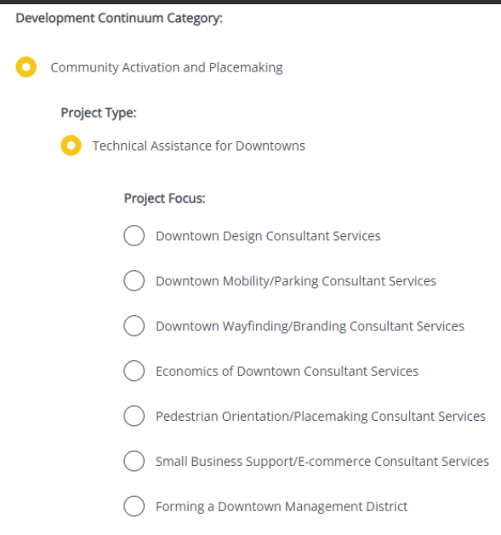
Completing the Full Application
Key Question: In Section 2 of the Full Application, applicants are asked to indicate the Project Category. To be reviewed by MA Downtown Initiative, applicants should make the following selections in question 2.4:
For more information on completing the Full Application, visit www.mass.gov/onestop to view One Stop Webinar 2: Application Guidance
Development Continuum: | Community Activation & Placemaking
Project Type: | Technical Assistance for Downtown
Project Focus: | Select the most appropriate Project Focus option for your application

Slide 13
FY25 Round Timeline
JAN
Jan.
Full Application and Expression of Interest Open (January) – The Full Application is the official form for submitting all funding requests. Applicants may now begin to work on applications in the IGX system, however applications will only be accepted during the submission period.
One Stop Guidance Phase (January – May) – A series of webinars will be hosted be both the One Stop Team and staff from each program within the One Stop. In addition, office hours will be hosted to answer applicant questions. Visit www.mass.gov/onestop for the full schedule of webinars and office hours.
Full Application Submission Period (May-June) – Applicants may submit their Full Application(s) beginning May 6, 2024. All applications must be submitted by the Full Application deadline of 11:59 p.m. on Wednesday, June 5.
Review and Evaluation (July – August) – All complete and eligible Full Applications submitted by the deadline will be reviewed and evaluated by the corresponding program managers at each state agency. The One Stop team will also conduct joint application reviews across agencies. Based on the program’s criteria, each program will prepare its list of applications recommended for funding, to be further reviewed and approved by agency and Secretariat leadership.
Notification of Grant Decisions (September) – Once final recommendation have been approved, applicants will be notified of grant decisions in writing, and announcement events will be scheduled.
Sept.

Slide 14
Opportunities for Guidance
Visit www.mass.gov/onestop for more information on:
Expression of Interest
Complete an Expression of Interest form to see if your project(s) is eligible for funding through the One Stop and get tips for preparing your application
One Stop and Program Webinars
Recordings of all One Stop webinars are now available on the One Stop website
Office Hours
One Stop General Guidance Office Hours – One Stop staff will hold office hours to discuss general One Stop process and technology questions
Program Office Hours – Staff from each program will hold an office hour to answer applicant questions related to the program
MA Downtown Initiative’s office hours will be held on February 27, 2024 at 12:00 p.m.

