Slide 1
Our Webinar Will Begin Shortly
Note: This session is for Massachusetts Fee-For-Service (FFS) providers in Home Health (HH), Group Adult Foster Care (GAFC), and Acquired Brain Injury (ABI) and Moving Forward Plan (MFP) Waiver programs.

Slide 2

Massachusetts – EVV FFS Program Hard Edits Preparation
Session 2: June 4, 2026

Slide 3
Session Logistics
This webinar is being recorded. The recording and slides will be made available after the session. ​
Your camera and mics are turned off.​
Q&A will be answered throughout the presentation. Please submit your questions in the Q&A box by selecting the Q&A button at the bottom of the screen to pop out this box.​
Please do not submit Personal Information (PI) in the Q&A. Any questions including PI can be submitted to the MA EVV Inbox: EVVfeedback@MassMail.State.MA.US
This webinar is Closed Caption enabled. Please proceed by selecting Show Captions option at the bottom of your screen to enable feature.
Notes:
Presenter: Jim

Slide 4



Session Presenters
Jim O’Brien
Kristin Davidson
Leah Klein
Title: Director of Federal EVV Compliance MassHealth
Areas of Expertise: EOHHS State Program
Role: EVV Business Solution Architect
Areas of Expertise: EVV Business Rules, EVV Compliance
Title: Customer Success Manager
Areas of Expertise: Sandata EVV Appications and Sandata EVV Aggregator
Notes:
Presenter: Jim

Slide 5
Am I in the Right Place?
This session is designed for Providers who:
Are Fee-For-Service (FFS) providers in Home Health (HH), Group Adult Foster Care (GAFC), or Acquired Brain Injury (ABI) and Moving Forward Plan (MFP) Waiver programs
Are already capturing EVV
Have their 3rd Party System integrated (if applicable)
Need to boost their EVV Claims Matching to EVV Visits in preparation for Claims Denials for mismatches (Hard Edits)
Special Note: Thresholds of EVV Compliance will continue to be set and announced through each MA program area (Home Health, Group Adult Foster Care, ABI and MFP Waivers).
Notes:
Presenter: Jim

Slide 6
MA EVV FFS Live Webinar Schedule
Session | Date | Time | Registration Link
Session #1 | April 30, 2026 | 10am – 11am ET
Session #2 | Today June 4, 2026 | 2pm – 3pm ET
Session #3 | June 25, 2026 | 2pm – 3pm ET | Webinar Registration - Zoom
Special Note: Any additional live training opportunities post Session #3 will continue to be communicated via program channels to support providers in the transition to hard edits.
Notes:
Presenter: Jim

Slide 7
Agenda
1 | Compliance Timeline
2 | Claims to Visit Match
3 | How to Research Mismatches
4 | Alt EVV Import
5 | Common Roadblocks Review
6 | Resources
Notes:
Presenter: Jim

Slide 8
Compliance Timeline
Notes:
Presenter: Jim

Slide 9
FFS Programs Compliance Phases
Phase 1
Phase 2
Phase 3
 | Registration/Onboarding | EVV Usage/Visit Monitoring | Claims to EVV Match/Implementation of Claims Edits
Description | In this phase of compliance, providers take the first step in the EVV process which is to register for EVV (making the determination if they are using the state-sponsored system, Sandata, or an Alt EVV) and beginning the necessary training to understand and set-up EVV. | In this phase of compliance, providers have advanced from the initial Registration and onboarding to capturing visit information electronically. This includes capturing EVV via mobile devices or other available technologies and performing visit maintenance to document visits appropriately. | In this phase of compliance, providers are experienced in documenting their visits electronically and are now refining their systems and processes so that their claims and visits match.
Goal | The goal for this phase is that providers have registered and declared their EVV system so that they can begin training, system and technology setup, and roll out the processes to their organizations to support EVV. | The goal for this phase is that providers are using their chosen EVV system and are capturing and maintaining visit data electronically. | The goal for this phase is for the EVV visit data to support the provider billing by matching on the 6 key CMS data elements prior to claims payment.
Jan 2025 – Sep 2025
April 2025 – Ongoing
July 2026 – Ongoing
Notes:
Presenter: Jim

Slide 10
Phase 2 VS Phase 3 Compliance Phases
What is the difference between Phase 2 and Phase 3 EVV Compliance Phases?
Phase 2 EVV Usage/Visit Monitoring:
EVV Compliance is an assessment and measurement of a Provider's overall EVV performance across a reporting period (Quarterly).
A Provider must attain a certain established % threshold of visits that are fully EVV Compliant.
For Phase 2, a visit is fully EVV Compliant when it includes all required data elements and is not manually entered or edited after the fact.
  Required data elements: Date, Time, Employee, Client, Location, Service, and Payer
Penalties for Provider non-compliance are enforced by program/contracting entity.
Phase 3 Claims to Visit Match/Implementation of Claims Edits:
Claims edits are a pre-payment review of the Provider's visits on a 1:1 claim-to-visit level.
For each claim a Provider submits, there must be a matching Verified (Auto Verified or Manually Verified) visit in the Sandata system.
A Verified visit is one that include all required data elements. Required data elements are either automatically captured by EVV when the employee clocks in and clocks out or manually entered by the Provider after the visit has occurred.
Penalties for a Provider not having a matching visit in the Sandata system when a claim is submitted is a denial for that claim.
Although Auto-Verification Percentage and Claims Edits are different, they compliment and support one another. A Provider who is performing well overall with capturing auto-verified visits will increase their success with Claims Edits.
Notes:
Presenter: Jim

Slide 11
Auto Verified VS Manually Verified
What is the difference between Auto Verified and Manually Verified?
    Verified: The visit has no exceptions. A visit in this status is eligible to be matched to a claim.
      Auto-Verified: An Auto-Verified Visit is defined has having the 6 required Cures Act elements captured electronically when an Employee clocks in and clocks out of their visit. An Auto-Verified Visit is not manually entered or edited after the fact by the Provider.
      Manually Verified: A visit that was manually entered into the EVV system by the Provider or edited after the fact.
Visits in a "Verified" status, both Auto-Verified and Manually Verified, are eligibile to be matched to a claim.
Notes:
Presenter: Jim

Slide 12
FFS Programs Compliance Timeline
We Are Here
 | April |  |  |  | May |  |  |  | June |  |  |  | July |  |  |  | August |  |  |  | September
Trainings
FFS Compliance Phases
FFS Phase 2 Compliance Reports
April Training Session #1
Hard Edits Preparation
Training Session #2
Hard Edits Preparation
Training Session #3
Hard Edits Preparation
Ongoing Available Self-Paced Online Training & Support Materials
FFS Compliance Phase 2
FFS Compliance Phase 3
Soft Edits
Hard Edits
Quarterly report pull for FFS
Compliance – 1/1/26-3/31/26 data​
Quarterly report pull for FFS
Compliance – 4/1/26-6/30/26 data​
Notes:
Presenter: Jim

Slide 13
Claims to Visit Match
Notes:
Presenter: Jim

Slide 14
High-Level Claims to Visit Matching
The EVV claims matching process ensures that claims submitted for EVV services are matched to verified EVV visit transactions. This is critical for confirming that a service visit occurred.
The State’s claims system matches claims against criteria before deciding to pay/deny a claim.
For EVV services, the matching process compares critical data elements which includes:
  Provider ID (PID) from the Billing Provider (even if billed at PID/SL level) matches the Provider ID (PID) on the Visit
  Client ID (Medicaid ID) Billed = Client ID of Visit
  EVV Service Code/HCPCS Code Billed = EVV Service Code of Visit (excluding billing modifiers)
  Billed Units are <= Visit Units
  Date of Service = Date of Visit
  Visit is in a “Verified” state (visit has all required data elements of the above as well as Payer, Employee and Location to be able to be matched to a claim)
Notes:
Presenter: Jim

Slide 15
High-Level Claims to Visit Matching Workflow
Start
Claim does not pass MMIS Validation
Employee performs EVV at time of Visit
Sandata EVV Provider performs Visit Maintenance to get visit to Verified status (if needed)
AltEVV Provider imports visit data to Sandata
Provider submits claim through MMIS
Claims runs through existing validation checks by MMIS system
Claim does pass MMIS Validation
Visit: Is in a Verified status and contains the following data which matches the claim: Provider ID, Client ID, Date of Service, Service, Units
End
MMIS sends Claim to Sandata System in real-time to search for matching Visit
Visit: Is not in the Sandata system at all, submitted after the claim, is in an Incomplete status, OR does not contain data that matches all of the following: Provider ID, Client ID, Date of Service, Service, Units
Notes:
Presenter: Jim

Slide 16
How to Research Claims Mismatches

Slide 17
Reason Codes & Edits on Remittance Advice (RA)
Edit | Edit Description | EOB Health Care Claim Status Code | Adjustment Reason Code | Remark Code
2105: EVV Claim matches EVV Visit | The EVV units cover the claim detail. | 20 – ACCEPTED FOR PROCESSING | 193 – ORIGINAL PAYMENT DECISION IS BEING MAINTAINED. UPON REVIEW, IT WAS DETERMINED THAT THIS CLAIM WAS PROCESSED PROPERLY. | N883 - ALERT: PROCEESSED ACCORDING TO STATE LAW
2106: EVV Visit Units Less Than EVV Claim Units | The EVV units are less than the billed units and do not cover the detail lines. | 784- ELECTRONIC VISIT VERIFICATION CRITERIA DO NOT MATCH | 272- COVERAGE/PROGRAM GUIDELINES WERE NOT MET | N820: EVV SYSTEM UNITS DO NOT MEET REQUIREMENTS OF VISIT
2107: EVV UNTS > UNITS ALLOWED | The EVV units are more than enough to cover the billed units. | 20- ACCEPTED FOR PROCESSING | 193 – ORIGINAL PAYMENT DECISION IS BEING MAINTAINED. UPON REVIEW, IT WAS DETERMINED THAT THIS CLAIM WAS PROCESSED PROPERLY. | N883 - ALERT: PROCEESSED ACCORDING TO STATE LAW
2108: No EVV Visit Found to match the EVV Claim | The EVV visit not found. | 784- ELECTRONIC VISIT VERIFICATION CRITERIA DO NOT MATCH | 272- COVERAGE/PROGRAM GUIDELINES WERE NOT MET | N821- ELECTRONIC VISIT VERIFICATION SYSTEM VISIT NOT FOUND.
2109: EVV visit to EVV Claim Mismatch | At least one of the 6 required visit elements not matching. | 784- ELECTRONIC VISIT VERIFICATION CRITERIA DO NOT MATCH | 272- COVERAGE/PROGRAM GUIDELINES WERE NOT MET | N820: EVV SYSTEM UNITS DO NOT MEET REQUIREMENTS OF VISIT
For more detailed information on MA EVV claims errors and examples of what codes may be visible on the RA, please reference the Massachusetts Electronic Visit Verification (EVV) Edits and Reason Codes.
Notes:
Presenter: Kristin

Slide 18
Conduct Visit Maintenance for EVV Related Errors
Providers can update visits with correct information that will allow claims identified with errors to match. Make sure to first identify the point of data that is incorrect and needs to be updated.
For Claims that have EOB 784 Error on the RA: •
Navigate to your Sandata EVV or Aggregator platform
Search for the visit in the Visit Maintenance section or pull the Detail Visit Maintenance Report
If the claim needs updating:
Providers may need to resubmit the claim through current processes and/or confirm the visit submission date is received prior to the claim
If the visit needs updating:
If there is no visit associated with the claim in the EVV system, create or send a visit for the service rendered for this claim
If there is a visit associated with the claim, ensure the visit has no listed exceptions and is in a verified status
Once the visit in question has been updated to a “Verified” status, then the claim can be resubmitted through current processes
Note: If there is an EVV record submitted with all 6 CMS required elements that does not have an associated claim, providers may need to resubmit the claim through current processes and/or confirm the visit submission date is received prior to the claim.

Slide 19
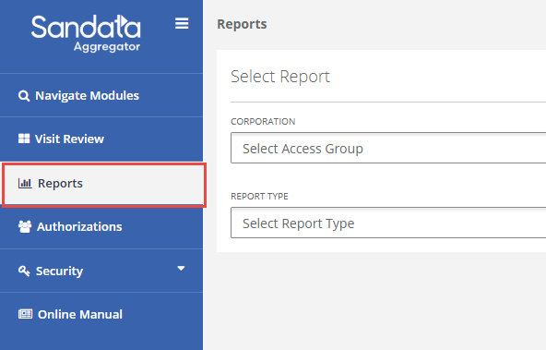
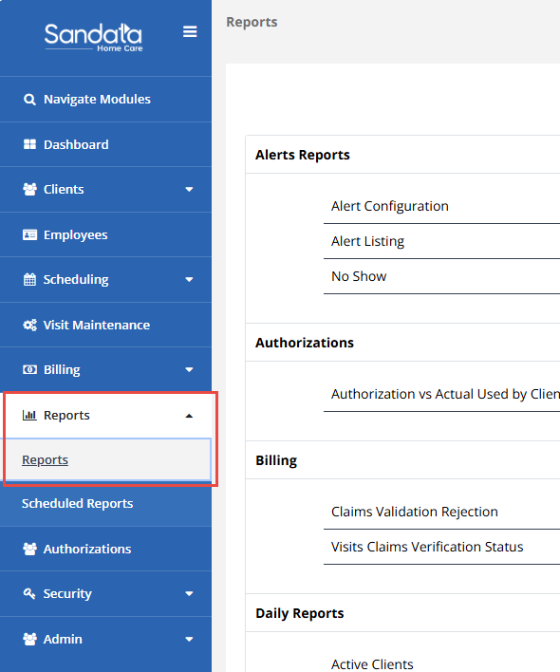
Accessing Reports
  Log into your Sandata EVV Account or Aggregator (AltEVV)
Reports Module
AltEVV Providers
Reports Module
Sandata EVV Providers

Slide 20
What Metrics to Look For
  On your Sandata EVV Account or Aggregator (AltEVV), these are the most helpful metrics to look for when researching visit data for claims to visit match:
  Payer
  Client Identifier (e.g., Client MassHealth/Medicaid ID)
  HCPCS Service Code
  Visit Date
  Clock in & Clock out times
  Units
  Visit Status (e.g., Incomplete, Verified, etc.)
    Timestamp of visit entry

Slide 21
Report to Run on the Aggregator
Alt EVV Providers

Slide 22
Visit Review Module
The Visit Review Module is the best option for AltEVV Providers to view metrics that will assist with researching visit data. AltEVV Providers should click the “Show Display” options and ensure all the following are selected:
  Payer
  Client Identifier
  Visit Date
  Clock In & Clock Out + Adjusted In & Adjusted Out
  Units
  Visit Status
  Visit Received (date visit imported to Aggregator)
What’s Missing:
  HCPCS Code – Visit Review does list the Service Description which can be used in conjunction with the AltEVV Specs to derive the HCPCS code.

Slide 23
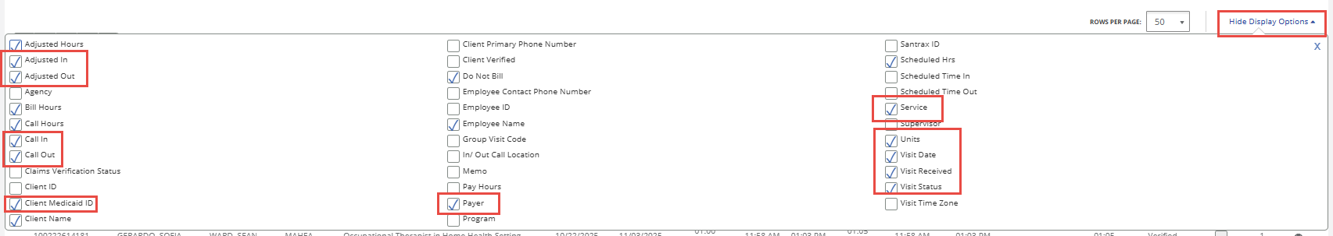
Steps to View Visit Review Module
Step 1 | Log into the Sandata Aggregator
Step 2 | Navigate to the Visit Review module
Step 3 | Select the Account from the "Agency" drop down. Note: You may have multiple accounts if you use multiple AltEVV Vendors.
Step 4 | Select desired date range
Step 5 | Edit "Filter Visits By" to "All Visits"
Step 6 | Select "Show Advanced Filter Options" and Select "MAHEA" from the "Payer" filter drop down
Step 7 | Click "Search"
Step 8 | Click "Show Display Options" and ensure the below selections are checked
Payer
Client Medicaid ID
Service
Call In, Call Out, Adjusted In, and Adjusted Out
Units
Visit date
Visit Received
Visit Status

Slide 24
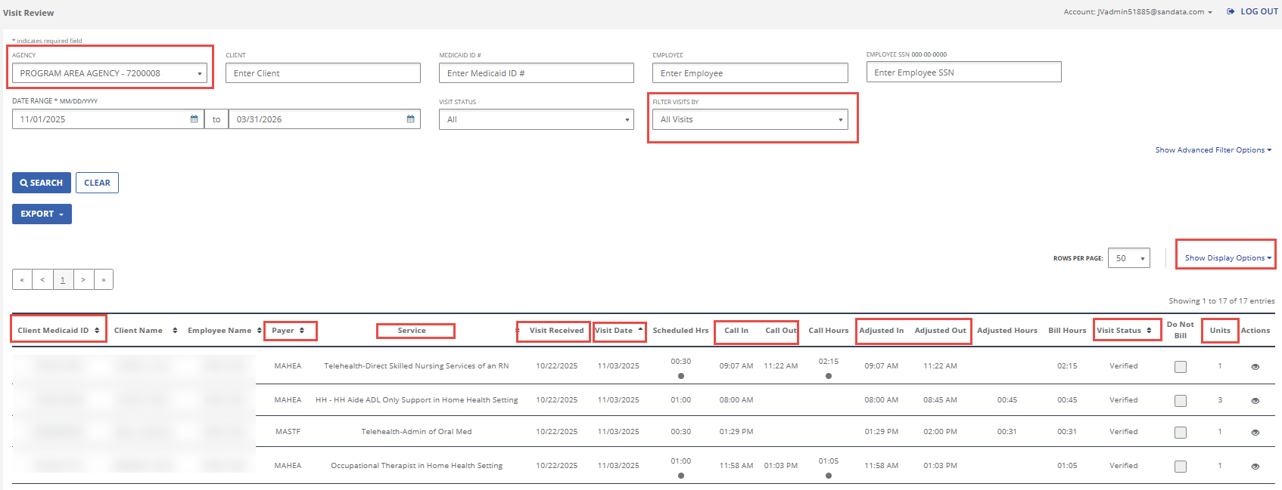
Visit Review Module - Example

Slide 25
Report to Run on Sandata EVV
Sandata Providers

Slide 26
Full Visit Export
The Full Visit Export is the best option for Sandata EVV Providers to view metrics that will assist with researching visit data. Sandata Providers will find the following elements on this export:
  Payer
  Client Identifier
  HCPCS Code
  Visit Date
  Clock In & Clock Out + Adjusted In & Adjusted Out
  Units
  Visit Status
What’s Missing:
  Timestamp of visit entry – Providers can find this by running the Visit Verification Report in conjuction to view visits manually entered & verified.

Slide 27
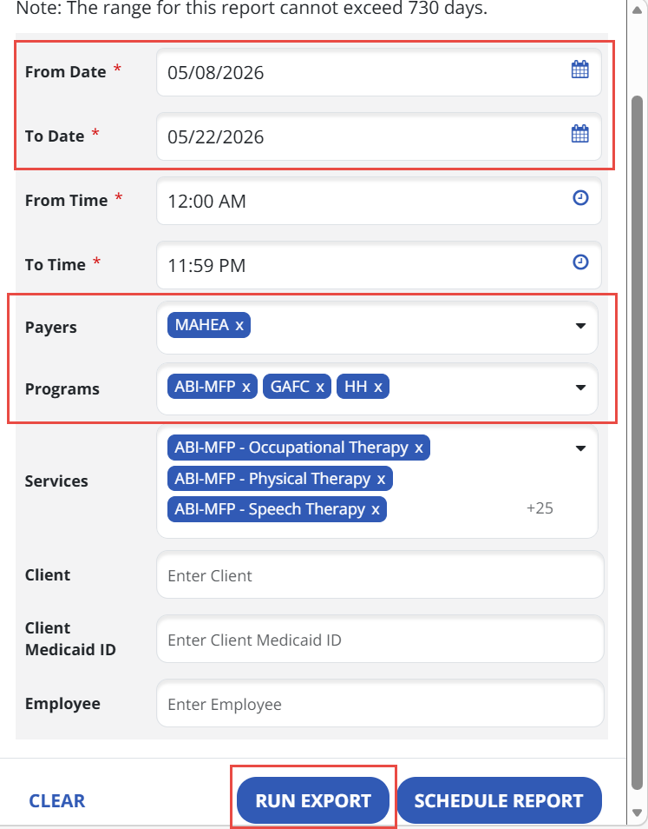
Step to View Full Visit Export
Step 1 | Log into your Sandata EVV Account
Step 2 | Navigate to the Reports Module and click "Report"
Step 3 | Scroll to "Date Range Reports" and select "Full Visit Export"
Step 4 | Select desired date range
Step 5 | Filter to Payer = MAHEA and Programs = ABI-MFP, GAFC, and HH (as applicable)
Step 6 | Click "Run Export" Report to export in Excel format

Slide 28
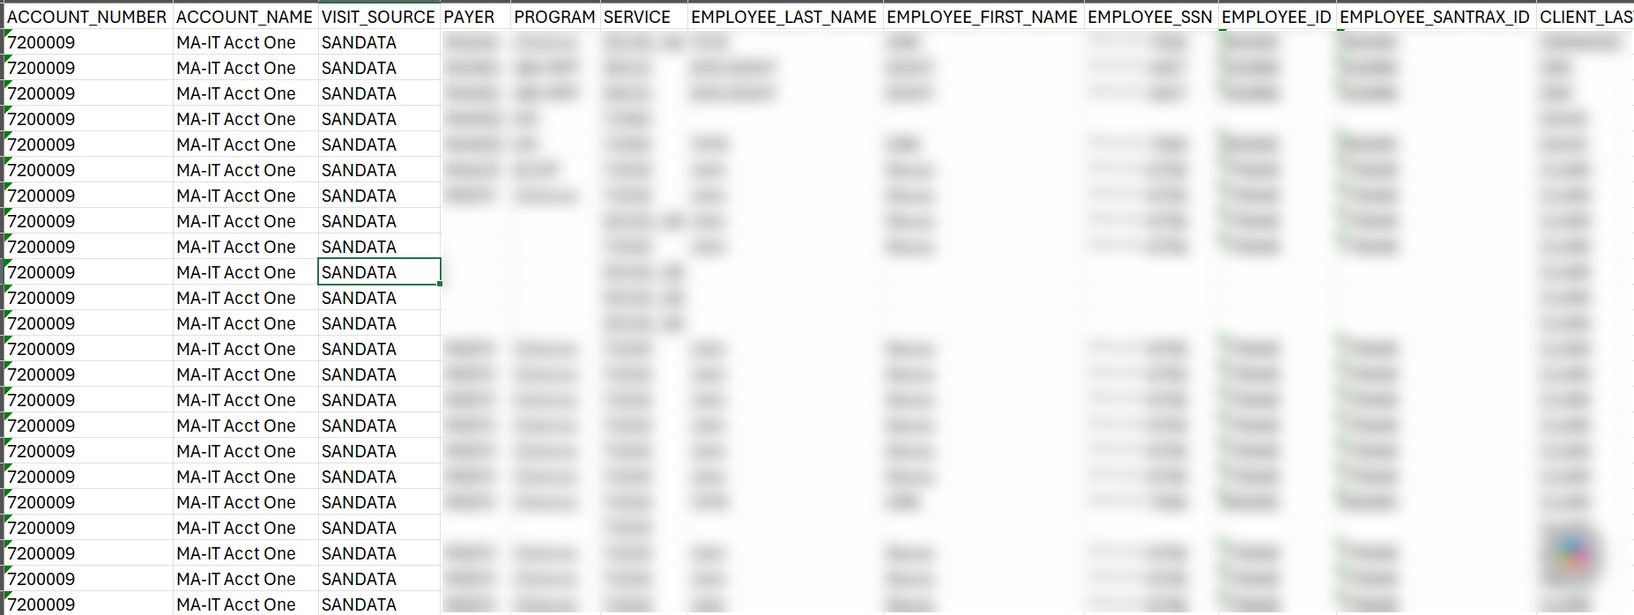
Full Visit Export - Example

Slide 29
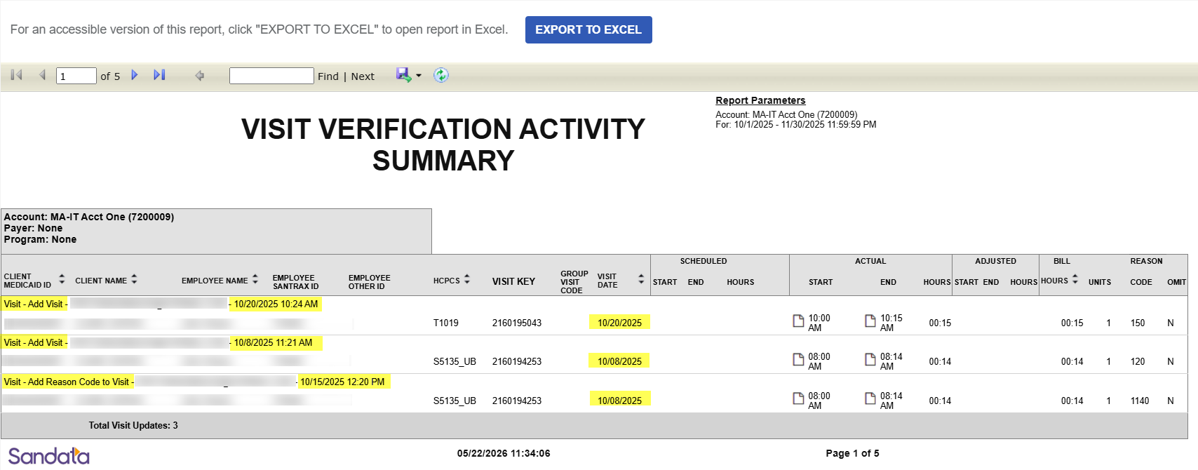
Visit Verification Report
The Visit Verification Activity Summary report provides visibility into when a manually entered visit was added to the Sandata System and who made the updates.

Slide 30
Alt EVV Import 101
Notes:
Presenter: Jim

Slide 31
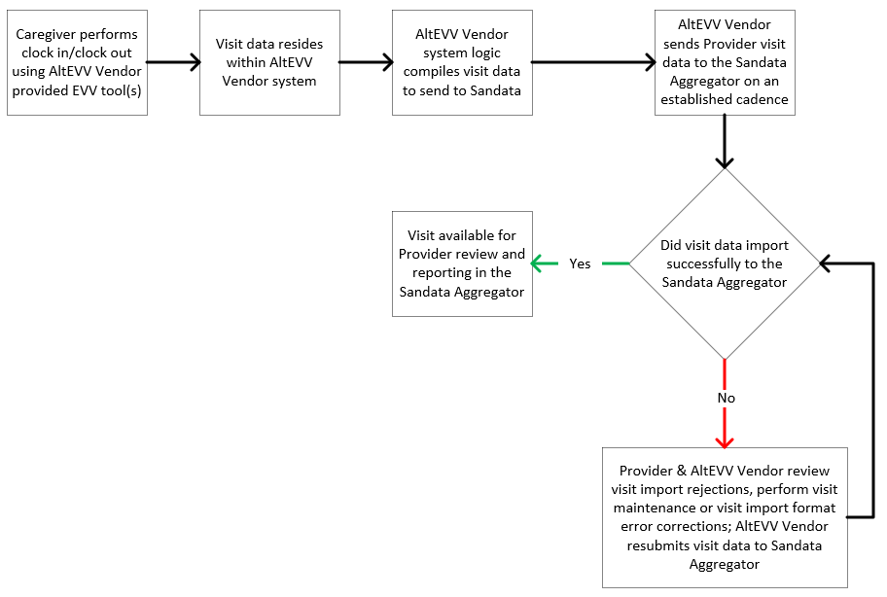
Alt EVV Imports - Workflow
High-Level Visit
Data Workflow
Start
End
Notes:
Presenter: Jim

Slide 32
Alt EVV Imports - Troubleshooting
Visit Import Troubleshooting Pre-Requisites
Providers, along with their AltEVV Vendors, should:
  Be aware of who their AtlEVV Vendor is and know a key point of contact at the Vendor who can support visit import troubleshooting
  Know at what cadence visits are imported from the AltEVV Vendor's system to the Sandata Aggregator (e.g., Nightly, bi-weekly, Monthly, etc.)
  Know how to retreieve and review JSON data for visits failing to import to the Sandata Aggregator
  Know how to retreieve and understand the most recent copy of the Massachusetts AltEVV Technical Specifications
  Know how to identify and resolve basic visit import rejection errors such as:
    Missing or incorrectly formatted data
    Incorrect client identifiers
    Incorrect Payer, Program, and Service Combinations
Notes:
Presenter: Jim

Slide 33
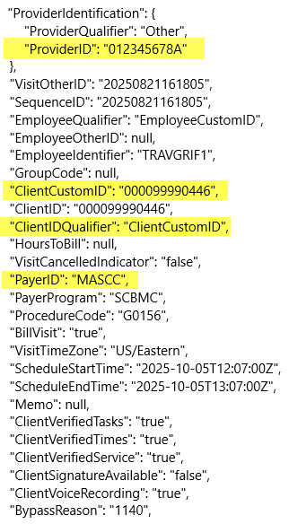
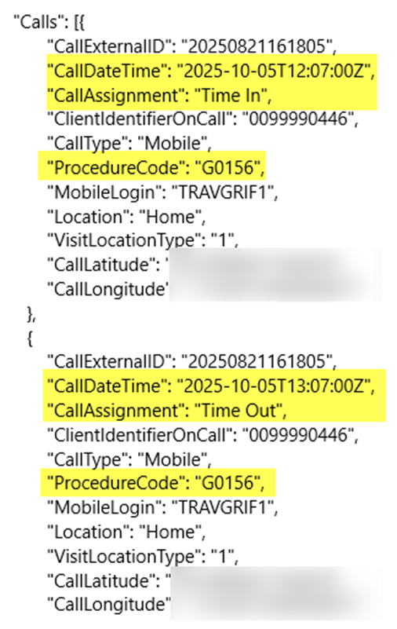
Alt EVV Imports - Example Visit Import JSON
Notes:
Presenter: Jim

Slide 34
Service Code Matching - Example
Example of Claim Matching with a Service Code and Billing Modifier
AltEVV providers submit visits using service codes aligned with AltEVV technical specifications: Example: G0299
Providers submit claims to MMIS with billing modifiers Example: G0299_UD_U1
MMIS removes modifiers before sending claims to Sandata Example: From G0299_UD_U1 to G0299
Sandata performs claims matching using the service code the Provider imported into the Aggregator and the service code sent by MMIS on the claim
Visit import Service Code:
G0299
Aggregator Visit Service Code:
G0299
MMIS To Sandata Service Code:
G0299
Claim to MMIS
Service Code:
G0299_UD_U1
G0299
Notes:
Presenter: Kristin

Slide 35
Common Roadblocks Review
Notes:
Presenter: Jim

Slide 36
EVV Compliance Best Practices
Prior to Claims Submission
Send EVV data to the Aggregator timely and with valid data and format
Verify visits contain all 6 CMS required elements
Clear any exceptions on visits
Managing Sandata schedules, if used
Check visits are sent from an Alt EVV Vendor AND in a Verified state
Check visits are captured in Sandata portal AND in a Verified state
Confirm providers with subcontractors:
  Understand where visits are being reported to.
  know who is submitting the claim under which Provider Medicaid ID
Ensuring client, Provider Medicaid ID, units, and service code match the visit verified in the Sandata System as is submitted on the claim
Post Claims Submission
Check Remittance Advice (RA) for any EVV edits or reason codes and determine if the claim or visit needs to be updated
Run reports in the Sandata Aggregator to ensure EVV data is correctly captured and matching claims data
Notes:
Presenter: Kristin

Slide 37
Common Roadblocks
In reviewing claims that do not have a matching EVV visit, there are some common reasons for the mismatch:
Visits not importing –"Client Not Found"
Visits not importing – Invalid Service Code
Visit is submitted after the claim (therefore the visit was not present when the claim is submitted)
Visit is not in a "Verified" state at the time the claim is submitted
Service Code on the claim does not match the service code on the visit
  In the instances where the modifier is included in Sandata where the modifier represents a completely different service. The service code should be selected based on the service provided.
Units on the claim do not match or are more than the units on the visit
Notes:
Presenter: Kristin

Slide 38
Common Roadblocks - Timing
The EVV Visit must be in a Verified status in the Sandata EVV Aggregator at the time the claim is processed.
The visit must be free of exceptions and in a "Verified" status (not Incomplete or Omit) to be matched to a claim
The visit must be received by the Sandata EVV Aggregator BEFORE the claim is received and processed by MassHealth. MassHealth will not "hold" a claim awaiting an EVV visit record.
If the visit record comes in after the claim is processed, the disposition of the claim will not change, i.e the claim would still be rejected.
Example of No Match due to timing error:
1/10/2026
1/24/2026
1/31/2026
Visit Occurred
Claim Sent to Process
Visit is in a verified state
All data elements match
Visit sent from Alt EVV Vendor to Sandata EVV Aggregator
The claim will receive NO MATCH since there was no matching EVV visit at the time the claim was processed.​
Notes:
Presenter: Kristin

Slide 39
Common Roadblocks - Service Code Matching
The EVV service code on the claim is matched against the EVV service code on the visits in a Verified status in the EVV Sandata Aggregator at the time the claim is processed/adjudicated.
There is no change to the way that services are billed through MassHealth, only that visits are in a Verified state in the EVV Sandata Aggregator before the claim is submitted.
For EVV services that have a HCPCS code AND a modifier, both should continue to be included on the claim.
In instances where the modifier is only used in billing (i.e. the service provided is the same regardless of modifier), Sandata does not include the modifier in the visit.
In the instances where the modifier is included in Sandata where the modifier represents a completely different service. The service code should be selected based on the service provided.
Notes:
Presenter: Kristin

Slide 40
Service Code Matching - Examples
Example of Claim Matching with a Service Code and Service Modifier
Claim submitted with G0299 UB for Complex Care Training and Oversight by an RN
Visit submitted with G0299 UB Complex Care Training and Oversight by an RN
Claim and visit match on the service
The HCPCS code and modifier are present for both the claim and the visit
2. Example of Claim Matching with a Service Code and Billing Modifier
Claim submitted with G0299 UD U1 for Direct Skilled Nursing Services of an RN
Visit submitted with G0299 Direct Skilled Nursing Services of an RN
Claim and visit match on the service
The billing modifier are not used in the match
3. Example of Claim Mismatch on Service Code
Claim submitted with G0299 UD U1 for Direct Skilled Nursing Services of an RN
Visit submitted with G0299 UB Complex Care Training and Oversight by an RN
Claim and visit do not match
The modifier on the visit indicates a different service than the service billed on the claim
Notes:
Presenter: Kristin

Slide 41
Common Roadblocks – Unit Matching
The Units Billed on the Claim must be equal to or less than the visit.
If a Claim has more billed units than the visit, the claim will receive the 2106: EVV Visit Units Less Than EVV Claim Units and therefore 784- ELECTRONIC VISIT VERIFICATION CRITERIA DO NOT MATCH
  Example: The claim has 24 units, but the visit has only 12 units. The visit does not have enough units to match the claim.
The Unit of Measure can either be a Per Diem (once per day service) or a 15-minute Service
In instances where the Unit of Measure is a Per Diem (once per day service) the units should always be 1.
  Example of a Per Diem Service = H0043 (GAFC- Per Diem Visit). For this service the unit is always 1 regardless of the length of the service.
In instances where the Unit of Measure is a 15-minute service, and there are multiple visits, the visit units will be summed.
Example of a 15 Minute Service = G0156 (Services of HH Aide in Home Health Setting)
If there are multiple visits for the same provider, same client, same service, same date in a verified status, the visits will be summed.
  Example: Claim has 24 units. There are 2 visits for the same provider, client, service, and date in a verified status and each visit is for 15 units. The claim will receive a match as the summed visit units are greater than the claim.
Notes:
Presenter: Kristin

Slide 42
Common Roadblocks – Rounding Rules
Rounding rules define how the total duration of a home care visit is converted into billable units by grouping time into fixed intervals. The visit’s total seconds are compared against predefined time ranges, with each range corresponding to a specific number of units. Using clearly defined, non‑overlapping ranges ensures visits are billed consistently, accurately, and fairly based on actual time worked. Note the clock in and clock out times are captured independently - the billable units are calculated by rounding the total visit duration.
How Visit Time Rounding Works:
  Visit time is measured in total seconds from check‑in to check‑out
  Time is converted into billable units using fixed time bands
  Each band represents a 15‑minute interval, starting after an initial minimum threshold
  This ensures accurate reimbursement and consistent billing across visits
Units | Seconds | Minutes
0 Units | 0 – 479 | < 8 min
1 Units | 480 – 1379 | 8–22.99 min
2 Units | 1380 – 2279 | 23–37.99 min
3 Units | 2280 – 3179 | 38–52.99 min
4 Units | 3180 – 4079 | 53–67.99 min
Notes:
Presenter: Kristin

Slide 43
Units/Rounding Rule Example #1
Example of units calculation and rounding 15 minute services - Rounding Down
A visit with a 15 minute unit of measure G0156 (Services of HH Aide in Home Health Setting) has:
Clock In Time at 1:08pm and a Clock Out Time at 2pm
The total duration for this visit is 52 and therefore 3 units
The total duration was rounded down to 3 units instead of 4 because the visit minutes were less than 53 minutes (see the table on the previous slide)
The claim would need to have units that were 3 or less to match this visit.
Note: The visit's total duration is rounded (not rounded at the individual clock in and clock out times).
Notes:
Presenter: Kristin

Slide 44
Units/Rounding Rule Example #2
Example of units calculation and rounding 15 minute services – Rounding Up
A visit with a 15 minute unit of measure G0156 (Services of HH Aide in Home Health Setting) has:
Clock In Time at 1:06pm and a Clock Out Time at 2pm
The total duration for this visit is 54 and therefore 4 units
The total duration was rounded up to 4 units even though the visit was less than an hour as the visit minutes were greater than or equal to 53 minutes (see the table on the previous slide)
The claim would need to have units of 4 or less to match this visit.
Note: The visit's total duration is rounded (not rounded at the individual clock in and clock out times).
Notes:
Presenter: Kristin

Slide 45
Units/Rounding Rule Example #3
Some services are always 1 unit regardless of the duration of the visit per existing State billing policies.
Example of units calculation for a Per Diem/Visit Based service
A visit with a Per Diem/Per Visit unit of measure S9131 (ABI-MFP - Physical Therapy) has:
Clock In Time at 9:12am and a Clock Out Time at 10:47pm. The total duration for this visit is 95 minutes, but since it is a per visit service, the unit is 1 regardless of the total duration length.
The claim would have 1 unit and the visit would have 1 unit and the claim and visit would match.
Notes:
Presenter: Kristin

Slide 46
EVV Per Diem/Per Visit Based Service Codes
Sandata Service Code | Service Description
T1503 | Administration of Medication Other than Oral and/or Injectable
T1502 | Admin of Oral, Intramuscular, Subcutaneous Med
T1502_GT | Telehealth-Admin of Oral Med
S9129_UB | Home Safety/Independence Evaluation by an OT
H0043 | GAFC - Per Diem Visit
G0493 | HH - RN Observation and Assessment Visit HH ADL Only
G0300 | Direct Skilled Nursing Services of an LPN
G0300_UB | Complex Care Training and Oversight by an LPN
G0300_GT | Telehealth-Direct Skilled Nursing Services of an LPN
G0299 | Direct Skilled Nursing Services of an RN
G0299_UB | Complex Care Training and Oversight by an RN
G0299_GT | Telehealth-Direct Skilled Nursing Services of an RN
G0153 | Speech Language Pathologist in Home Health Setting
G0152 | Occupational Therapist in Home Health Setting
G0151 | Physical Therapist in Home Health Setting
S9129 | ABI-MFP - Occupational Therapy
S9131 | ABI-MFP - Physical Therapy
S9128 | ABI-MFP - Speech Therapy
Notes:
Presenter: Kristin

Slide 47
Units/Rounding Rules – Overnight Billing
Per State policies, services must be billed on the date of service they occurred. If a service spans midnight, the units are split between the 2 dates of service per the time for each day.
Example of a visit that crosses over midnight:
  A Visit = Clock In: 4/15 11pm Clock Out: 4/16 2am, Units = 12
Example of claim billing:
  Claim should have 4/15 4 units and a claim for 4/16 for 8 units
Sandata Users:
In Sandata, the Sandata system will systematically split the visit data above into 2 visits:
Visit for 4/15 from 11pm – 11:59pm = 4 units
Visit for 4/16 from 12am – 2am = 8 units
Alt EVV Users:
Alt EVV users should either force a clock out at midnight OR split the visit into the 2 dates of service when the visit is submitted to the Sandata EVV Aggregator.
Note: To match to the claim, the visit must be split as the claim has 2 dates of service so the visit data must have 2 dates of service with the corresponding units for each date.
Notes:
Presenter: Kristin

Slide 48
Helpful Resources
Notes:
Presenter: Leah

Slide 49
Sandata Knowledge Base – Helpful, Quick Links
Sandata EVV Providers
Sandata EVV Enhanced
Adding Clients
Adding Mobile App Device Access for Employee
Sandata Mobile Connect (SMC) Resources
Visit Maintenance
Reports Listing
Alt EVV Providers
Sandata Aggregator
Visit Review
Reports Listing
Massachusetts EOHHS Alternative EVV Technical Specifications
Vendor Solutions FAQs
Notes:
Presenter: Leah

Slide 50
Compliance Plans by Program
Please refer to the individual Program area compliance plans to understand compliance expectations.
Program/Plan | Bulletins/Posted Resources
Group Adult Foster Care (GAFC) | Adult Foster Care Bulletin 33 GAFC Compliance Checkpoints
Home Health (HH) | Home Health Bulletin 94 HH Compliance Checkpoints
Home and Community Based Services (HCBS) Acquired Brain Injury (ABI) and Moving Forward Plan (MFP) Waiver | HCBS Waiver Bulletin 24 HCBS Waiver Compliance Checkpoints
Aging & Independence (AGE) | Providers need to work with their ASAPs to understand EVV Compliance.
Managed Care Entities (MCE) | Providers need to work with their MCEs to understand EVV Compliance for their payer.
Notes:
Presenter: Jim

Slide 51
Contacts & Resources
For the FFS HH, GAFC, and ABI/MFP Waivers Programs Hard Edits Cheat Sheet, presentation from the Hard Edits Preparation Training Session, and other helpful materials, navigate to Electronic Visit Verification for Agency-based Providers | Mass.gov.
For technical help in using the Sandata EVV portal or Aggregator, please contact Customer Support through at Contact and Support | HHAeXchange Knowledge Base. You may also call the Customer Support line at 833.511.0164.
For virtual training for both Sandata EVV and the Aggregator, please sign in to the HHAeXchange University, HHAeXchange University.
For general questions about the Massachusetts EVV program, please email EVVfeedback@Mass.gov. You can also visit the MA-EOHHS EVV website for more information.
For assistance with your Remittance Advice or claim processing, please contact the LTSS Provider Service Center at (844) 368-5184 or email support@masshealthltss.com.
Notes:
Presenter: Leah

Slide 52
MA EVV FFS Live Webinar Schedule
Session | Date | Time | Registration Link
Session #1 | April 30, 2026 | 10am – 11am ET
Session #2 | Today June 4, 2026 | 2pm – 3pm ET
Session #3 | June 25, 2026 | 2pm – 3pm ET | Webinar Registration - Zoom
Special Note: Any additional live training opportunities post Session #3 will continue to be communicated via program channels to support providers in the transition to hard edits.
Notes:
Presenter: Jim

Slide 53
Feedback Survey
Notes:
Presenter: Leah

Slide 54
Thank You!

