Slide 1


Massachusetts Tier II Reporting

Slide 2

Massachusetts Tier II Reporting
All facilities covered by EPCRA guidelines are required to submit chemical reports to the State Emergency Response Commission (SERC), the Local Emergency Planning Committee (LEPC), and the local fire department annually.
In Massachusetts, the SERC receives the reports through submissions in the Massachusetts Hazconnect Tier II system. If the LEPC Chair is in Hazconnect as a Jurisdictional Planner, they also have access, so reports don’t need to be sent to them.
Section 302 Notifications: Extremely Hazardous Substances (EHS) that reach reporting thresholds require special emergency planning and the SERC/LEPC must be notified of their presence. Reports submitted and/or updated in Hazconnect satisfy this requirement.

Slide 3
New Users
  If you are a new user, you must register for an account on the MA Hazconnect site
    If you are submitting reports for a facility, choose, “Reporting Facility/Business user” from the dropdown box. Any other choice will cause your registration to be denied.
    If your facility has submitted reports in MA Hazconnect in the past, DO NOT create a new facility. This will cause exceptions for you. If you are taking over for someone, we will transfer the facility. Once you have an account, submit a ticket using the Help Desk button on the login page, provide your new username and the facility information and we will transfer the facility to your username.
    This is a one-time process. You do not need to register again once you have an account

Slide 4
Users
    If you are an LEPC/REPC chair who needs access to your jurisdiction, choose Responder/Planner/ or System Admin
      Once you are in the next screen, choose “other/Jurisdictional Planner” and add the communities in your LEPC/REPC
      If one or more of your communities is not in the dropdown box, please submit a Help Desk Ticket

Slide 5
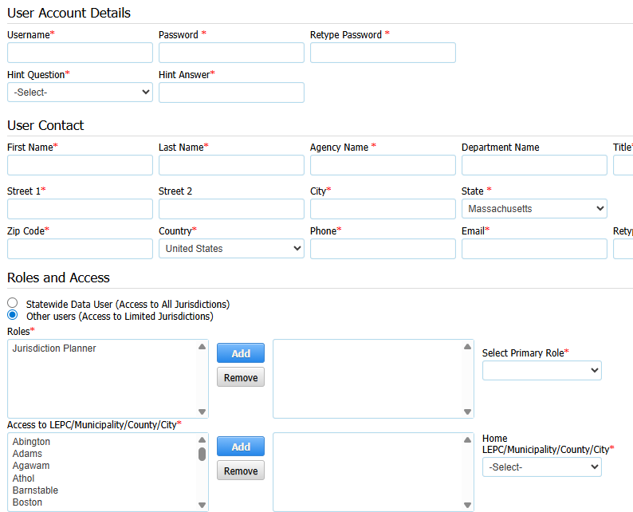
Users (Account Details)

Slide 6
Annual Reporting
The reporting period for annual reports is from the first week in January to March 1 each year. Changes and updates can be made any time throughout the year.
Reports are submitted for the previous year. A report filed in January 2026 will be titled, “2025 Annual Tier II Report.”
If a company has multiple sites within the state, reports for each facility must be submitted.
If you choose to use a contractor for Tier II reports, a letter authorizing them to submit on behalf of the company must be sent to tier2@mass.gov
If a facility closes, an annual report must still be submitted if there were chemicals that met the reporting thresholds onsite at any time during the year. The status of the facility should be changed to, “inactive” after the annual report is submitted.

Slide 7
Annual Reports
  If your facility has previous reports in the Hazconnect system, choose the “(year) Annual Tier II Report” type from the dropdown box
    The information from the most recent report will populate for you, so you won’t have to enter the information manually
    DO NOT choose “New Report”, unless your facility has not submitted Tier II reports in the MA Hazconnect system in the past
    Choosing an incorrect report type will result in duplicate files for your facility
  If you need to make corrections any time after the annual report has been submitted, use the, “(year) Update Tier II Report” type. You can do this at any time.

Slide 8
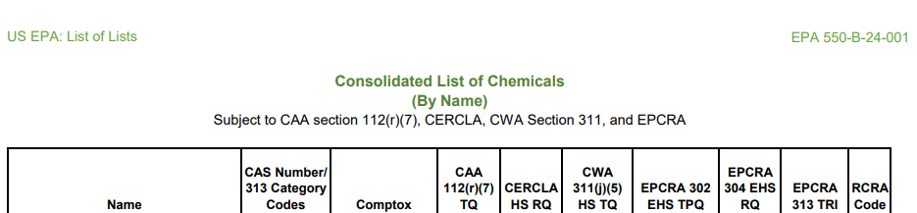
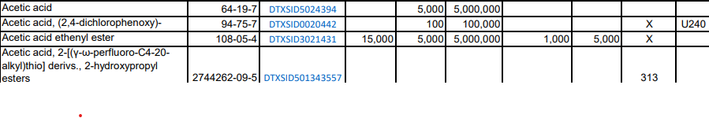
List of Lists

Slide 9
Exporting Reports
Once a report has been submitted, it can be exported into a Cameo compatible file (.t2s), PDF, Excel or XML format to provide to the LEPC/REPC and Local Fire Department. Contact your local organizations/agencies to determine the format needed.
While it is not required, the EPA Tier II Submit tool, which is a free download from the EPA website, can be used to validate information.
  It is important to enter the information into the Massachusetts Hazconnect Tier II system first to satisfy the EPCRA requirement. Once completed, an exported file can be dragged to the EPA Tier II Submit tool and most of the information will upload automatically. It does not work the other way. If you submit to the EPA tool first, you will need to manually enter all the information into Hazconnect.

Slide 10
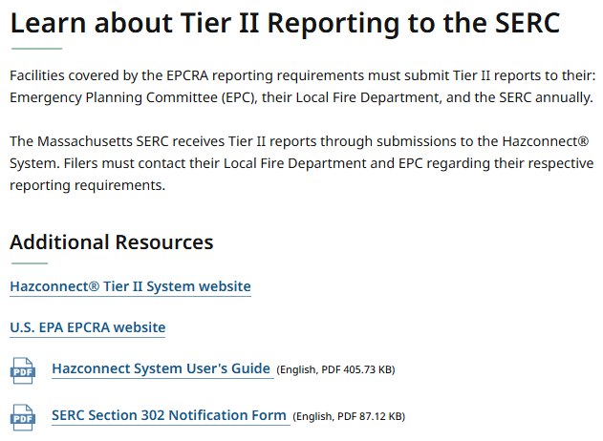
Guidance
The MEMA website has a link to the Massachusetts
SERC site with Tier II resources
screenshot of website

Slide 11

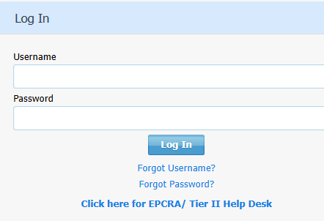
MA Tier II Support
Screenshots of website

Slide 12
MA Tier II Support Team
  Massachusetts Tier II Support Team
  Login issues:
    If you can’t remember your password, first try the “forgot” password on the MA Hazconnect login page.
    When requesting assistance with login issues through the help desk, please provide your username and facility information, and describe the problem: don’t remember login credentials, unable to reset password, account inactivated, error message, etc
  Transferring facilities to new users
    When facilities are transferred to your username, you will have access to all previous reports.
  Assistance with setting up new accounts

Slide 13
Quick Reference
Each facility can have only one username assigned to it, so this should be the person who will be submitting reports.
Submitting reports in only the EPA Tier II Submit tool, does NOT satisfy the EPCRA requirement of reporting to the SERC.
The Massachusetts SERC does not require a filing fee however; some local jurisdictions do.
The MA SERC does not require Safety Data Sheets for each chemical to be attached to the Tier II report. However, they should be given to the fire department with the report.
The MA does not require, but recommends site plans be attached to the report

Slide 14
Contacts (1 of 2)
EPA Consolidated List of Lists
https://www.epa.gov/epcra/consolidated-list-lists
Emergency Planning and Community Right-To-Know (EPCRA)
https://www.epa.gov/epcra

Slide 15
Contacts (2 of 2)
Massachusetts Tier II support email: Tier2@mass.gov
Massachusetts SERC website:
https://www.mass.gov/info-details/massachusetts-state-emergency-response-commission-serc
MA HazConnect Tier II reporting system
https://massachusetts.hazconnect.com/Account/Login.aspx

