Slide 1

Massachusetts Advisory Council on Alzheimer’s Disease and All Other Dementias
Executive Office of Aging & Independence
Whitney Moyer, Chair
December 16th, 2025
3:30-5:00 pm
Video Conference

Slide 2
Agenda
Welcome, Logistics, and Announcements (10 min)
Looking Back and Moving Forward (5 min)
    What we Agreed on at September’s Meeting
    Progress Made Since September
ReiMAgine Aging & Linkages (20 min)
ADRD State Plan (20 min)
    Purpose, Goals, Timeframe (2030)
Agency Survey and Interviews (15 min)
    Highlights, Challenges, and Key Findings
    Strategies to Consider
Discussion: Council Member Perspectives (15 min)
Next Steps and Vote to Adjourn (5 min)

Slide 3
Announcements
Alzheimer’s Advisory Council Support Team
  Whitney Moyer, Chief Operating Officer & Chair of Massachusetts Advisory Council on Alzheimer’s Disease and All Other Dementias
  Elisha Goodman, Special Projects Manager
AGE ADRD Collaboration Team Members
  Bree Bernat Shems, Senior Director of Policy, Strategy, and Innovation
  Molly Evans, Senior Manager, Strategic Programs & Innovation with focus on Caregiver Supports
  Deanna Mazina, Director of Public Health Policy and Outreach
  Bonnie-May Shantz, Policy Manager and Statewide Lead on the Age- and Dementia-Friendly Work
  Plus: Elisha Goodman and Whitney Moyer

Slide 4
Looking Back and Moving Forward
What we Discussed at September’s Meeting (1 of 2)
Council Priority Areas Reaffirmed
In September, the Council revisited and refined the two priority challenge areas identified in May for the next Alzheimer’s State Plan:
Early Recognition, Detection & Diagnosis
  Timeliness of recognition within healthcare settings
  Impact of stigma, fear, and cultural/linguistic barriers
  Need for equitable access to screening and assessment
Caregiver Support, Education & Systems Navigation
  Early and ongoing caregiver education
  Low public and professional awareness of supports
  Navigation challenges and financial strain
  Disparities for low-income and non-English-speaking families
The Council confirmed that these areas continue to represent the most urgent opportunities for system-level improvement.

Slide 5





Looking Back and Moving Forward
What we Discussed at September’s Meeting (2 of 2)
What We Learned from Executive Office of Health and Human Services (EOHHS) Agencies
At the September meeting, AGE shared early findings from agency surveys and interviews examining how people with dementia and caregivers interact with state programs. Highlights included:
Cross-Agency Touchpoints
  Agencies regularly encounter individuals with possible dementia through:
    Home care & case management
    Meals on Wheels & senior centers
    Housing/transportation assistance
    Behavioral health, screenings, and caregiver support
  Dementia concerns are often first noticed by frontline or I&R staff,
  not clinical providers.
Common Challenges Identified
  Symptoms mistaken for “normal aging”
  Stigma and fear delaying diagnosis
  PCP knowledge gaps and limited specialists
  Cultural/linguistic barriers
  Fragmented systems and limited awareness of supports
  Lack of affordable residential memory care options
These findings established a shared baseline for Council strategy development.
September Feedback Included:

Slide 6
Connecting the Dots
Linking ReiMAgine Aging¹ and the ADRD State Plan
As the Council works to refresh the ADRD State Plan, we recommend intentionally aligning the ADRD State Plan with ReiMAgine Aging, Massachusetts’ broader statewide aging strategy, so that dementia priorities are embedded—not siloed—within the Commonwealth’s long-term vision for aging.
This alignment:
Positions ADRD as a core component of statewide health, wellness, and caregiver strategy (ReiMAgine Aging = statewide vision and framework; ADRD Plan = dementia-specific strategy for execution)
Clarifies where key dementia priorities fit within the larger system, including:
  Early recognition, detection, and diagnosis
  Caregiver education, navigation, and support
Creates a shared roadmap for partners—healthcare, community-based organizations, and the private sector—to see where and how to engage
Ensures consistency across goals, language, and outcomes, reducing duplication and strengthening impact
Provides a framework for the Council to “pressure test” priorities, ensuring ADRD strategies advance—not compete with—statewide aging goals

Slide 7
Where We’re Going
Council’s Role in ADRD Plan
Help define purpose, goals, and audiences for the updated ADRD Plan
Shape a plan that is strategic, actionable, and aligned with ReiMAgine Aging
Form a small Council workgroup (~4 members) for monthly engagement
Annual Report
Becomes the annual update to the ADRD “actions table” in the State Plan
Ensures visibility, accountability, and alignment with statewide strategy
What we’ll do today
Walk through the ReiMAgine Aging framework
Use it as the foundation for rethinking the ADRD Plan’s purpose, audience, and goals
Discuss direction and approach
Confirm that our direction creates one coherent statewide approach, not two separate plans

Slide 8
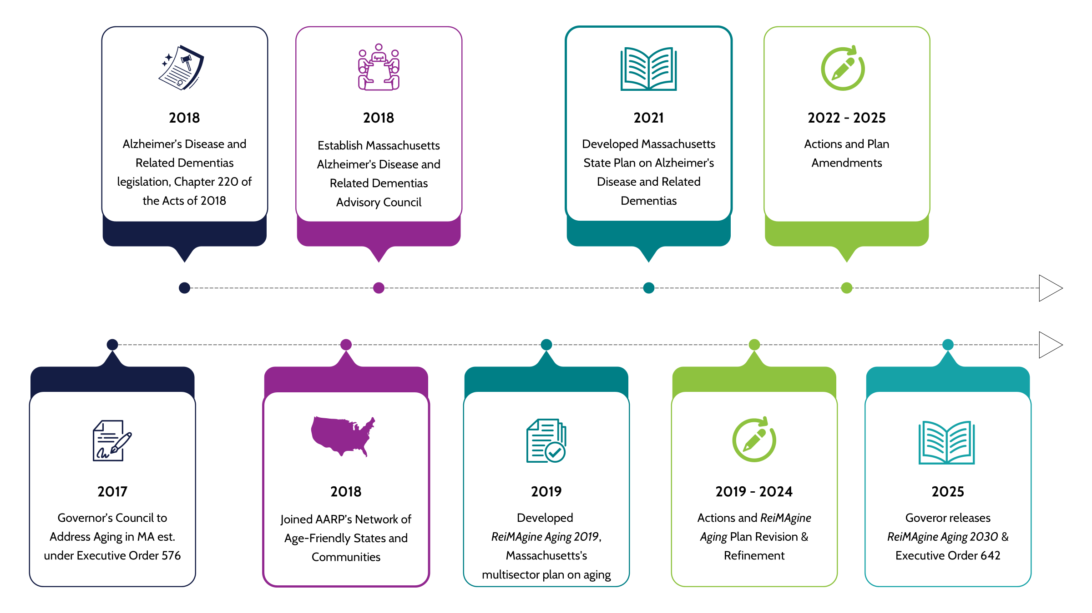
Alzheimer’s Disease & Related Dementias Plan and ReiMAgine Aging, Age-Friendly
Alzheimer’s Council & ADRD State Plan
ReiMAgine Aging

Slide 9
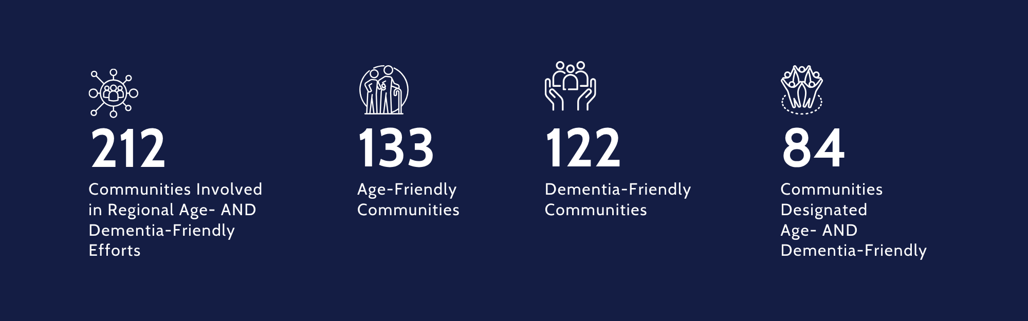
Committed Massachusetts Communities Foster
Age- and Dementia-Friendly Movement
2025

Slide 10
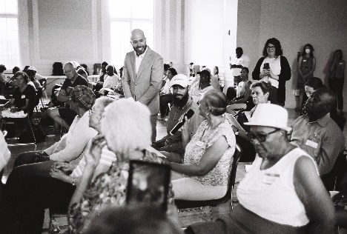
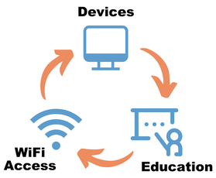
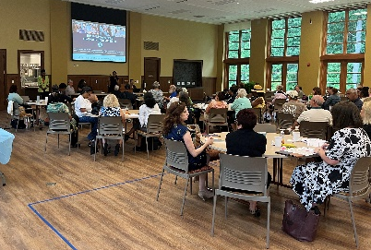

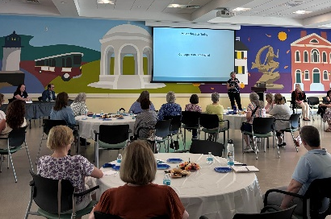

ReiMAgine Aging 2023 Refresh – Public Feedback
Rising Challenges:
  Digital Access
  Environment & Climate Resilience
  Caregiving
"Improve transportation so that it is not devastating to one's life when they can no longer drive."
"Older people are having an increasingly difficult time coordinating their medical care. Coordinating medical appointments has become much more complicated, and more of the burden is now placed on patients."
"Cost of living in Massachusetts is forcing many older adults to leave; many of my friends have moved to North Carolina because they cannot afford to stay..."

Slide 11
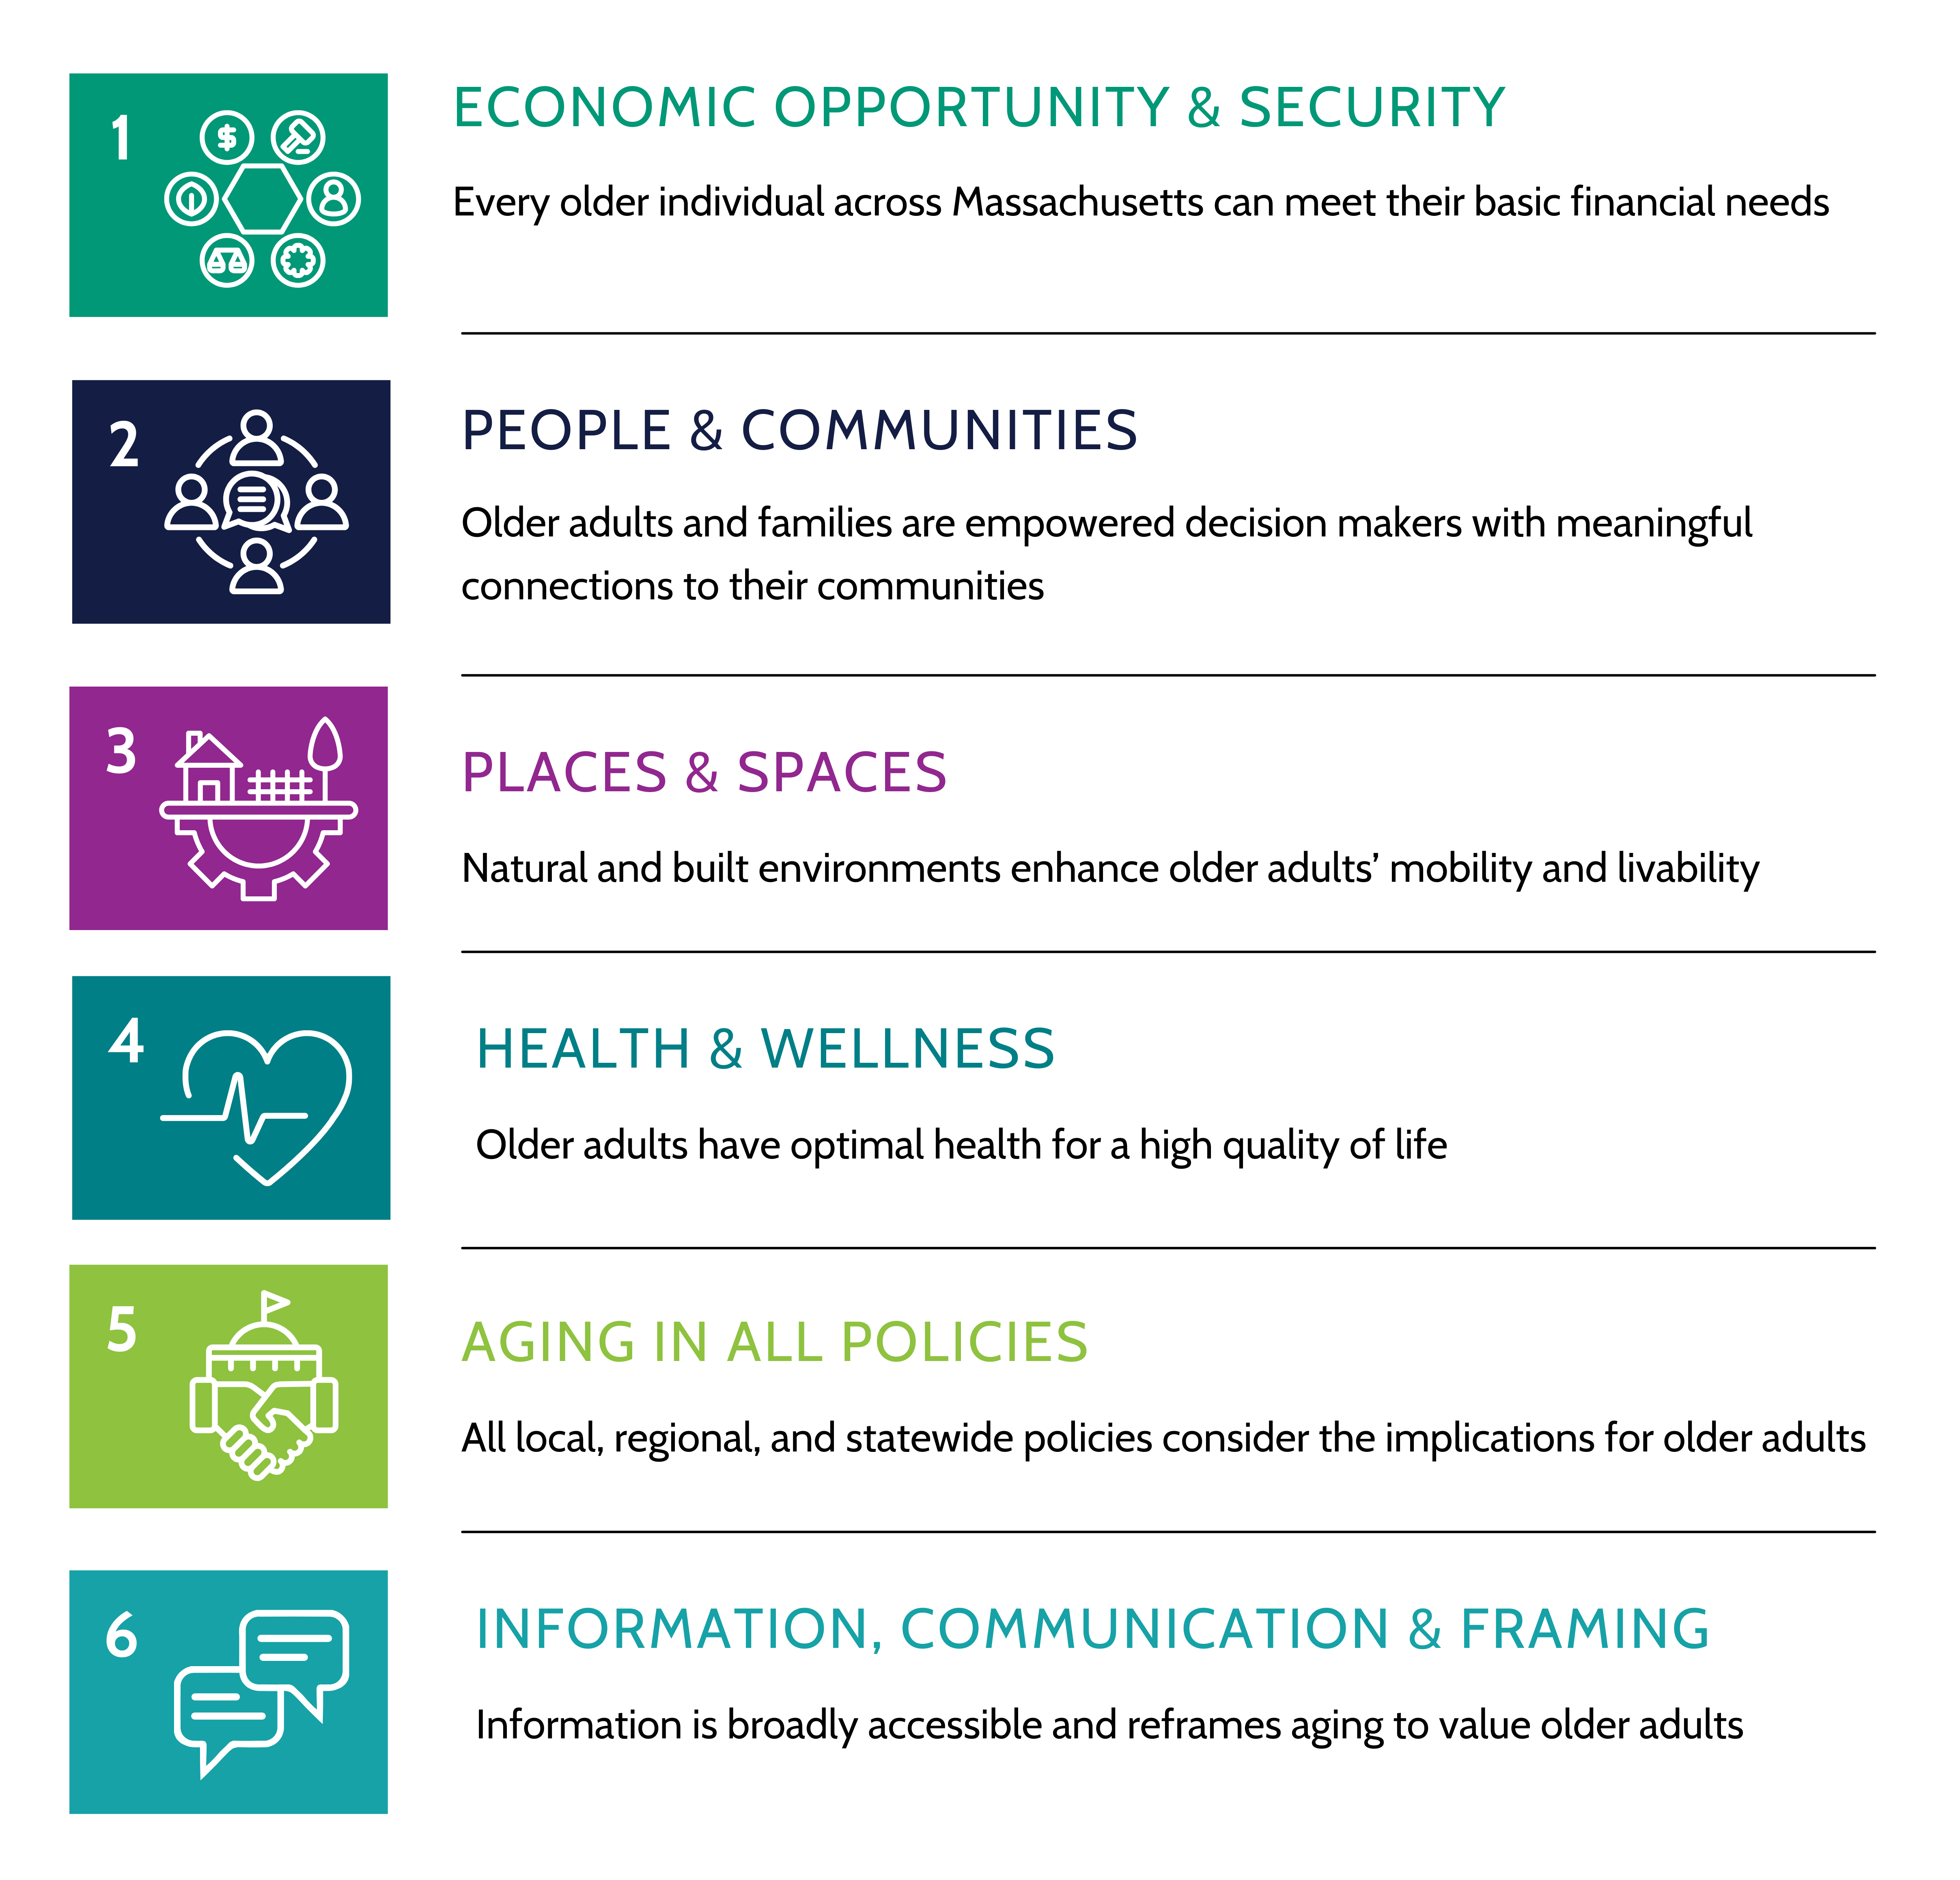
ReiMAgine Aging 2023: The Massachusetts Plan
(1 of 3)
This Plan is….
Framework for both communities and state agencies to guide their actions for the next five years
Includes an analysis of the state’s aging population, identifies key challenges
Outlines goals, strategies, and specific actions

Slide 12
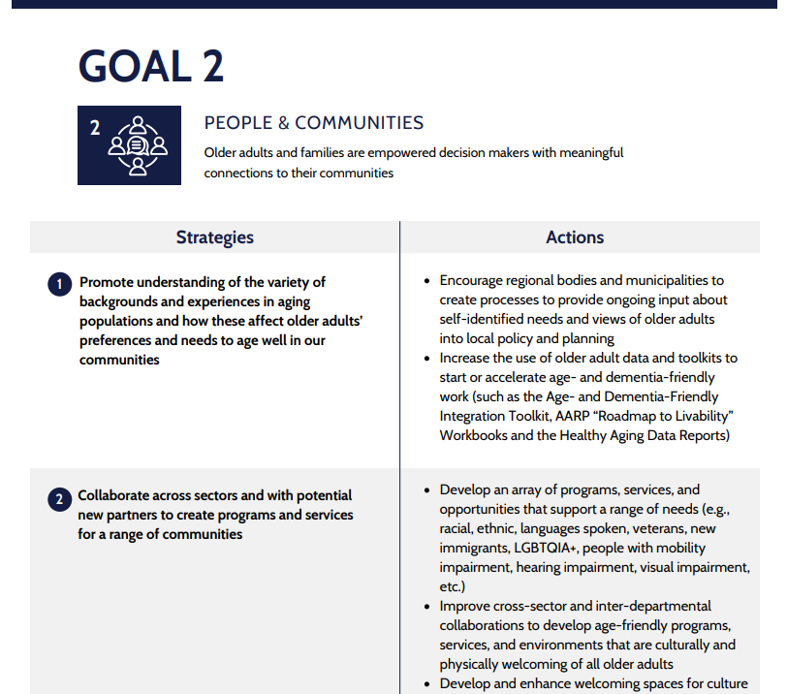
ReiMAgine Aging 2023: The Massachusetts Plan
(2 of 3)
Strategies and actions related to Alzheimer’s Disease, dementia, caregiving, and respite care are incorporated through-out ReiMAgine Aging 2030 Plan

Slide 13
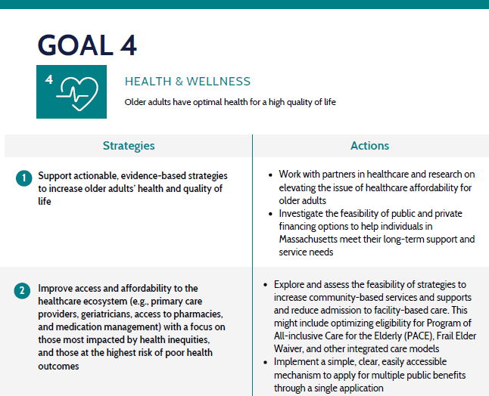
ReiMAgine Aging 2023: The Massachusetts Plan
(3 of 3)

Slide 14
How the Plans Connect
ReiMAgine Aging 2030 Plan
ADRD Council Identified Priorities
GOAL 4
HEALTH & WELLNESS
Supports →
ADRD early recognition, detection & diagnosis
  Lower stigma, improve provider knowledge, strengthen referral pathways
  Early detection work supports the statewide wellness strategy
Older adults have optimal health for a high quality life
Build a greater understanding of good brain health and effective dementia risk reduction strategies
GOAL 2
PEOPLE & COMMUNITIES
Supports →
Dementia caregiver support
  Education, navigation, respite, culturally responsive supports
  Dementia caregiver supports advance ReiMAgine’s caregiver priorities
Older adults and families are empowered decision makers with meaningful connections to their communities
Increase availability of family caregiver support, with a focus on dementia care, to enhance the capacity of families and communities to care for older adults
Connect paid and family caregivers with resources that acknowledge the range of family experiences and include multiple generations and families of choice
Convene webinars for people living with dementia, their caregivers, community-based service providers, and healthcare providers to facilitate the development of person-centered, person-directed dementia care plans

Slide 15
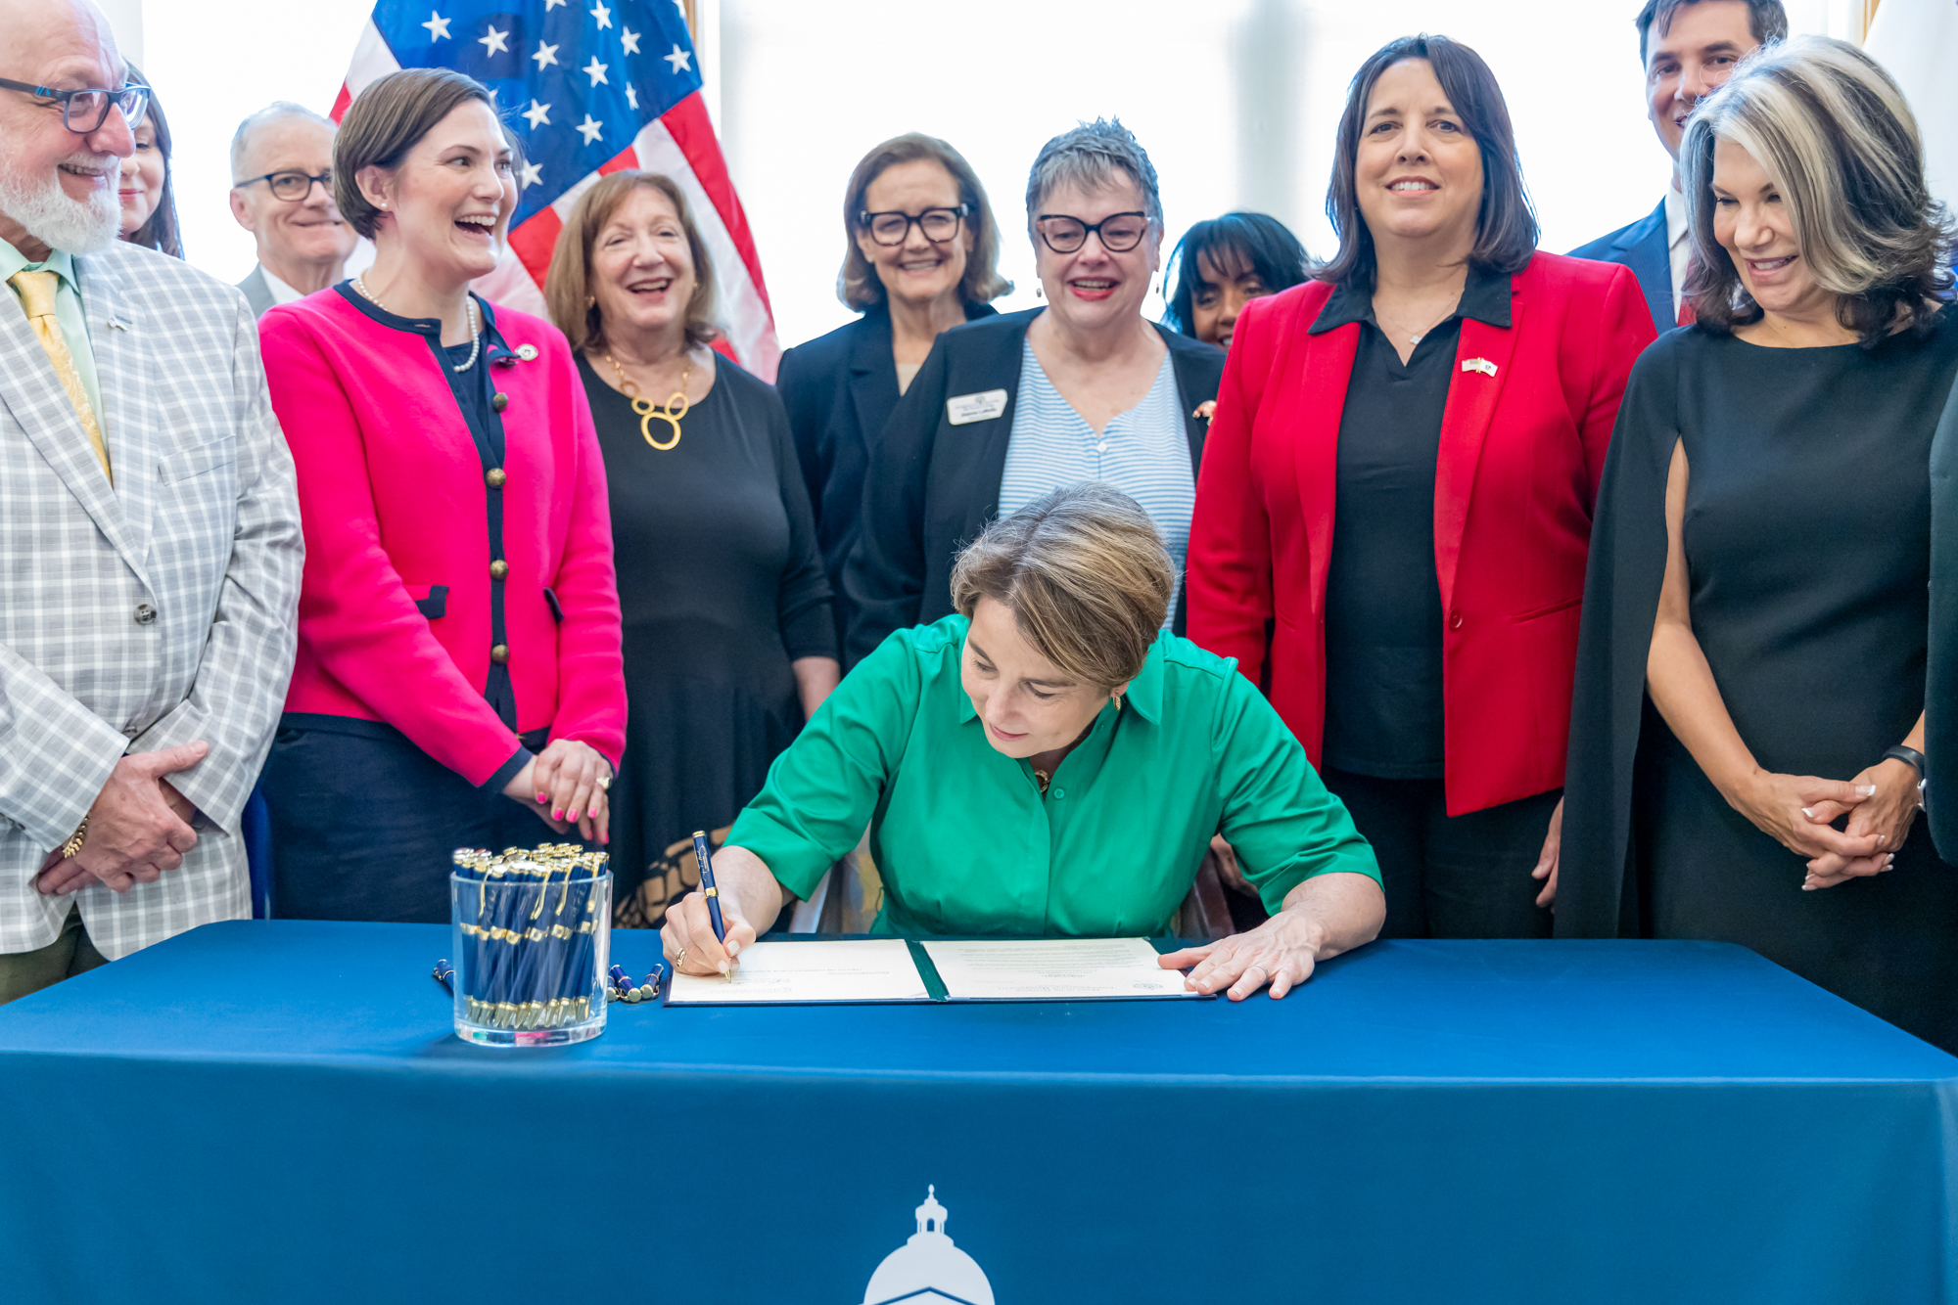
Executive Order 642:
Instituting Age-Friendly Practice (1 of 2)
The Executive Order directs all offices across the executive branch to identify areas where age-friendly policies and practices can be embedded in their work to improve the health and wellbeing of aging adults in Massachusetts.
All Executive Offices will undertake a policy review:
  to identify ways the goals of ReiMAgine Aging 2030: The Massachusetts Plan can inform agencies’ programs and resources to best meet the needs of older adults.
  including reviewing and updating the language, concepts, and images used to describe older adults to be inclusive and person-centered.
Establishes the Governor’s Advisory Group on Age-Friendly Policies and Practices

Slide 16
Executive Order 642:
Instituting Age-Friendly Practice (2 of 2)
The Executive Offices policy review includes:
  Appoint a point person to liaise with AGE
  Identify best practices or innovations
  that other agencies, cities, and towns can apply to their own programs and practices
  Identify new actions and key milestones
  that will be taken in the next year to embed positive aging in policies, practices, and services
  Review and update communications approach and materials to ensure older adults are portrayed in an inclusive and person-centered manner (including age-friendly language, concepts, and images)

Slide 17
Alzheimer’s Disease and Related Dementias (ADRD) Plan & ReiMAgine Aging 2030
Opportune moment to …
Fully Integrated Approach at all levels within AGE & EOHHS and beyond. Align with ReiMAgine Aging 2030 and other cross-sectoral priorities – to accelerate ADRD action and leverage the current momentum
Expand - Over the first Plan, the Council has functioned as an independent engine of serious work. Alongside this, there is an opportunity to lift the plan to become a strategic framework that provides guidance for state agencies, local communities, community-based organizations, and the private sector to align their work and create a pathway for others to take meaningful action
Maximize resources – By coordinating activities and identifying possibilities to collaborate or coordinate action, share data, and resources
Potential to…
Broaden Advisory Role
Expand use of Annual Report

Slide 18
  General Discussion & Questions

Slide 19
Refresh Alzheimer’s Disease and Related Dementias (ADRD) Plan 2026 (1 of 3)
DRAFT Purpose
DRAFT Refresh Goals
ADRD Plan Refresh Work Group
ADRD Refresh Timeline

Slide 20
Refresh Alzheimer’s Disease and Related Dementias (ADRD) Plan 2026 (2 of 3)
DRAFT Purpose
The refreshed ADRD Plan will provide strategic direction to further embed ADRD good practice and a vision to move the Commonwealth forward to better serve those living with dementia and their families.

Slide 21
Refresh Alzheimer’s Disease and Related Dementias (ADRD) Plan 2026 (3 of 3)
DRAFT Refresh Goals
  Strengthen the ADRD Plan by focusing on a few strategies and deepening our actions in the areas of highest priority
  Incorporate new evidenced-based data and lessons learned over the last 5 years
  Expand the work - Galvanize current stakeholders to take further action in Alzheimer’s disease and related dementia’s work and intentionally expand our focus to enlist new cross-sector potential stakeholders
  Build on the legacy of successes while remaining flexible and ensuring the work’s sustainability into the future

Slide 22
Refresh ADRD Plan Work Group
ADRD Plan Refresh Work Group
  Provide strategic guidance, insight, and ideas on emerging opportunities, challenges, and proposed solutions
  Analyze current state
  Provide recommendations goals, strategies and actions
  January – July 2026
  ~4 ADRD Council members serve on the ADRD Refresh Subgroup

Slide 23
Refresh Alzheimer’s Disease and Related Dementias Plan
Timeline
December ‘25 – March ‘26
  Scope – Set purpose, vision, objectives, and timeline, etc.
  Establish ADRD Refresh Work Group – Guide refresh through strategic planning sessions
  Discovery – ADRD Context - Collect data, demographics, current state information, potential subject matter expert interviews, and stakeholder engagement (e.g., EOHHS sister agencies)
March – June
  Develop current state background section key points
  Develop and review draft goals, strategies and action
  Analysis & Prioritization – ADRD Refresh Subgroup and ADRD Council review & discussion
  Draft refreshed ADRD Plan
July – September
  Revise final refreshed ADRD Plan based on feedback
  Reviews & Approvals
September – November – Launch - World Alzheimer’s Month & Family Caregivers Awareness Month

Slide 24
  ADRD Discussion & Questions

Slide 25


Agency Survey and Interviews (1 of 4)
What We Additionally Learned from the Department of Mental Health (DMH) & MassHealth
DMH staff encounter possible or emerging dementia across multiple settings, often before a formal diagnosis is made:
Community Clinical Services & Case Management - Early cognitive changes noticed during routine contact.
Community-Based Flexible Supports (CBFS) - Support staff identify behavioral shifts or unsafe actions that may reflect dementia.
Nursing Facilities & Behavioral Management Units - Dementia signs appear among older residents with SMI; NFs report difficulty managing overlap.
Nursing Facility Pre-Admission Screening and PASRR Reviews - Natural cross-agency touchpoint where dementia concerns are often noted but may not lead to diagnosis; strong opportunity for collaboration.
Inpatient, Crisis, Medical Clearance Settings - Medical clearance may surface cognitive impairment, but dementia screening not systematically included.
Family & Caregiver Conversations - Collateral discussions reveal functional decline or safety concerns that differ from prior mental health presentations.
Provider & Residential Program Consultations - Programs frequently seek DMH guidance when observing new cognitive symptoms among older adults.
MassHealth encounters and supports individuals with dementia across managed care, waiver, and institutional settings, primarily through payment mechanisms:
Senior Care Options (SCO) & Program for All-Inclusive Care for the Elderly (PACE) populations – Serve individuals with dementia; SCO accounts for a population with dementia in their rating category development, driving population-health approaches and plan-level dementia programs.
Payment strategies – Medicaid payment structures (e.g., AFC, GAFC, Nursing Facilities) can support providers serving members with behavioral complexity, which sometimes includes dementia-related needs.
Frail Elder Waiver supports – Includes Alzheimer’s/Dementia Coaching service.
Care coordination touchpoints – Cognitive concerns are often identified through primary care, care management, and behavioral health assessments, though screening is not systematic.
Gap identified – While need is well recognized, there is no single, coordinated Medicaid dementia strategy; efforts are largely plan- or provider-driven.

Slide 26
Agency Survey and Interviews (2 of 4)
Common Challenges Identified Across DMH & MassHealth
Diagnostic complexity when mental illness is present
  Dementia symptoms overlap with bipolar disorder, schizophrenia, depression, or medication side effects.
  Difficult for staff and providers to determine whether primary mental health symptoms or early dementia are driving behaviors.
  Individuals with serious mental illness (SMI) and co-occurring dementia present high diagnostic complexity and may require advanced clinical expertise.
  Nursing facilities struggle to manage residents who have both dementia and serious mental illness (SMI)
  Staff often notice memory loss, behavioral changes, agitation, or increased care needs well before a formal diagnosis is made.
  Cultural stigma persists — in some communities, dementia is more acceptable than mental illness, creating confusion and silence around both.
Lack of frontline staff training for detection and screening, limited clinical confidence for diagnosing, and workforce constraints
  DMH staff are not trained to identify early dementia signs, screen or manage behavioral symptoms when dementia is suspected.
  Many providers lack knowledge to distinguish dementia from psychiatric conditions or normal aging.
  PCPs lack training, time, and clinical confidence to assess and diagnose dementia, despite being well-positioned to do so for many patients, resulting in many referrals to neurologists
  Current care models do not clearly differentiate which clinician type is appropriate based on diagnostic complexity, leading to bottlenecks.
System barriers to consistent screening
  Dementia screening not integrated into standard processes.
  Limited access to neurologists, psychiatrists, and coordinated medical review
  Supports and assessments vary widely; current efforts are case-by-case rather than systemic.
Caregiver gaps remain significant
  Families lack training on managing behavioral changes, especially when combined with mental health symptoms.
  Safety concerns are high; caregivers often “push through” until crisis.
  Caregivers have limited awareness of respite or behavioral supports that could help.

Slide 27

Agency Survey and Interviews (3 of 4)
Key Findings
  All interact with people who may have undiagnosed dementia
  Other conditions sometimes mask signs of dementia
  Frontline and information & referral staff sometimes notice possible dementia
  Some aren’t sure what to say to a person or family when dementia is suspected.
  All expressed a strong need for greater awareness of dementia symptoms and services

Slide 28
Agency Survey and Interviews (4 of 4)
Opportunities Highlighted for the State Plan
Build Systemwide Screening & Diagnostic Pathways
  Incorporate dementia/neurocognitive screening into medical clearance, PASRR, and other routinely used review processes.
  Strengthen collaboration between psychiatry, neurology, and primary care.
  Develop clear guidance for distinguishing dementia from mental illness or medication effects.
Invest in Workforce Training Across Mental Health, NF, and Community Settings
  Provide training for direct care staff, clinicians, case managers, and NF staff on early signs of dementia—especially when SMI is also present.
  Create modules on managing co-occurring dementia and mental health behaviors.
Leverage Existing Cross-Agency Structures
  Use PASRR, NFTT teams, and behavioral health collaboratives as shared platforms for early detection, training, and care-planning improvements.
  Strengthen MassHealth–DMH–AGE alignment on dementia pathways.
Expand Caregiver Supports
  Increase respite capacity and ensure caregivers supporting individuals with both dementia and mental illness can access training, behavioral strategies, and navigation support.
  Explore partnerships with Older Adult Behavioral Health Collaborative, NAMI, and culturally specific organizations.
Strengthen Provider Education & Communication Tools
  Develop simple guides for differentiating dementia from psychiatric symptoms.

Slide 29
Strategies to Consider for ADRD State Plan
Training - Frontline & information and Referral staff: early recognition, support, services, benefits of early detection
Joint Outreach - With Alzheimer’s Association & AGE:
• State agency staff at trainings/meetings
• Senior center staff at conferences
• Public at senior centers, faith communities, gatherings
Service Connections - Share information through existing touchpoints, Meals on Wheels and Senior Centers
PCP Connections - Provide PCPs with resources about early detection and services.
Outreach Materials - Develop simple, user-friendly step-by-step guides
MassOptions - Explore approaches to encourage early detection in redesign
Respite - Identify opportunities to expand respite
Regular Cadence - Promote trainings and resources more often and at a regular cadence with repeated reminders
Hopeful Stories - Share positive early diagnosis examples
Establish New Touchpoints - Place materials in food pantry bags; disseminate at meal programs
Physician/Senior Center Partnerships - Connect senior centers with physicians
Health Departments - Partner with local health departments to spread awareness of early signs, services, and supports, e.g., at vaccine clinics

Slide 30
Discussion: Council Member Perspectives
Round Robin Discussion
What’s Going on at your Organization with Initiatives (15 min)

Slide 31
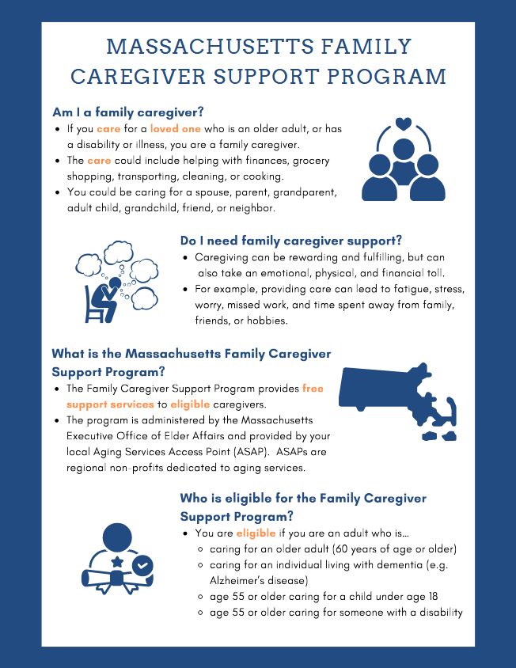
Caregiving (1 of 5)
Ongoing Caregiver Resources and Supports
Massachusetts Family Caregiver Support Program
Quarterly Caregiver Newsletter
Caregiver Support Groups
Caring for the Caregiver Webinar Series
Notes:
https://www.mass.gov/info-details/family-caregiver-support-program

Slide 32
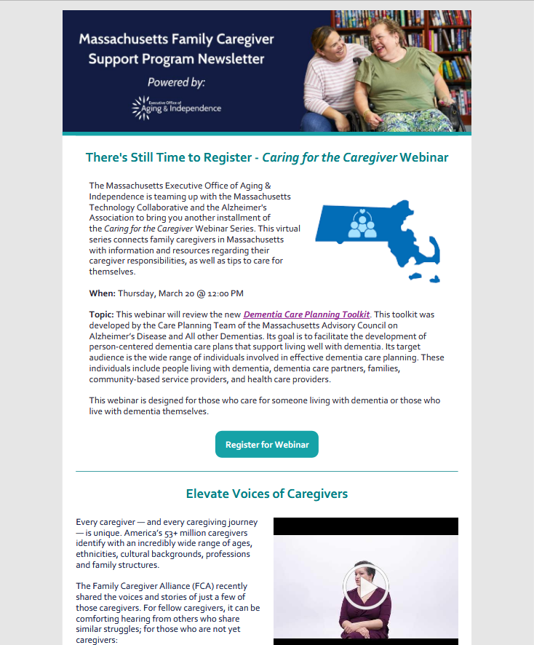
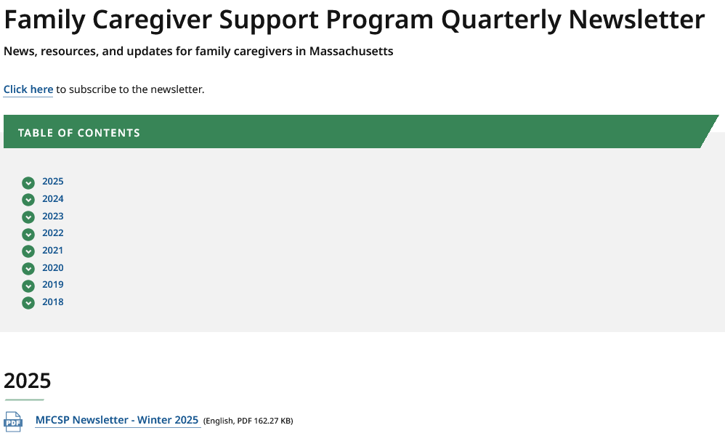
Caregiving (2 of 5)
Ongoing Caregiver Resources and Supports
Massachusetts Family Caregiver Support Program
Quarterly Caregiver Newsletter
Caregiver Support Groups
Caring for the Caregiver Webinar Series
Notes:
https://www.mass.gov/lists/family-caregiver-support-program-quarterly-newsletter

Slide 33
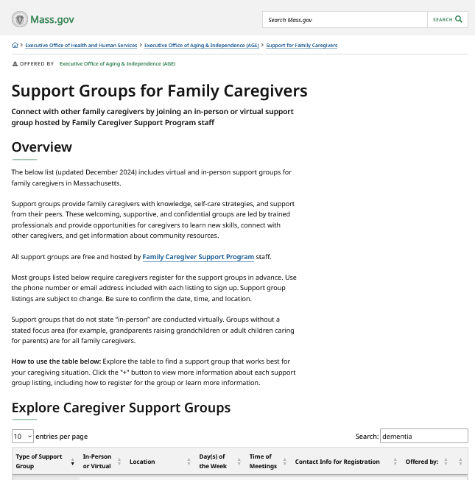
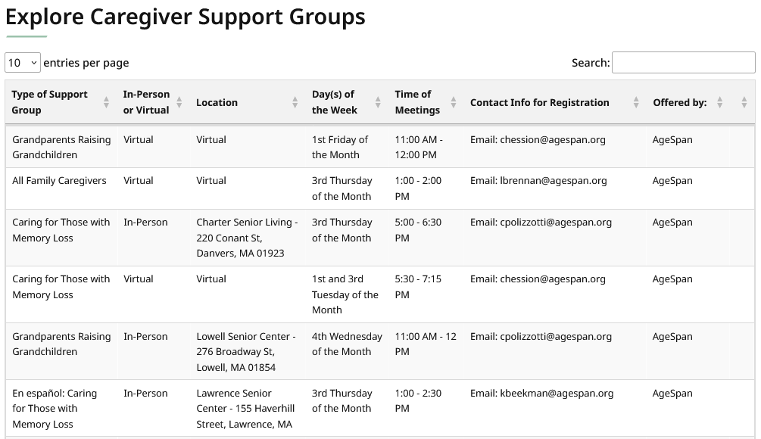
Caregiving (3 of 5)
Ongoing Caregiver Resources and Supports
Massachusetts Family Caregiver Support Program
Quarterly Caregiver Newsletter
Caregiver Support Groups
Caring for the Caregiver Webinar Series
Notes:
https://www.mass.gov/info-details/support-groups-for-family-caregivers

Slide 34
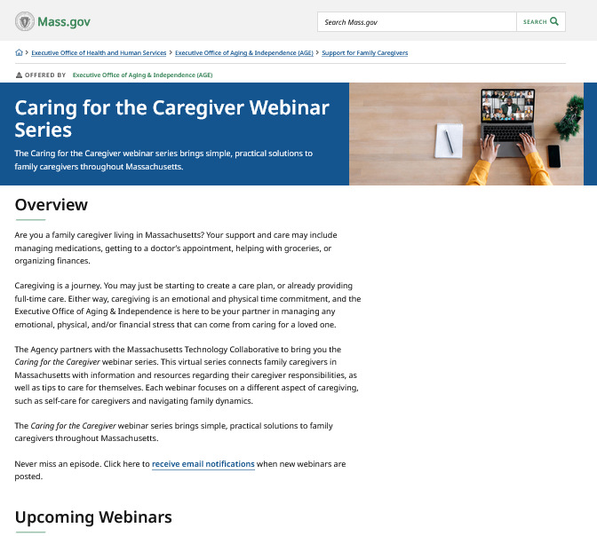
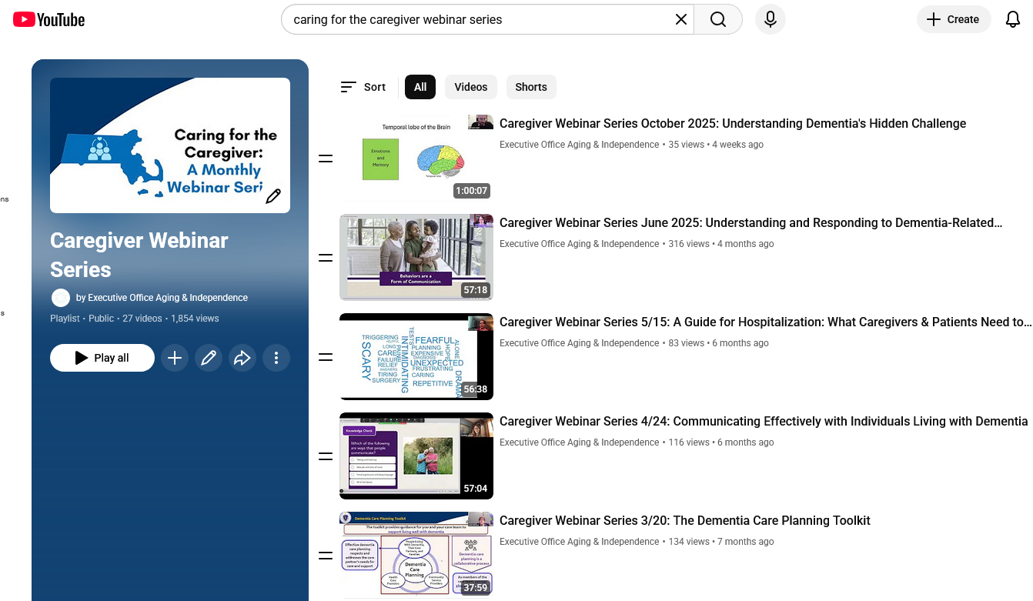
Caregiving (4 of 5)
Ongoing Caregiver Resources and Supports
Massachusetts Family Caregiver Support Program
Quarterly Caregiver Newsletter
Caregiver Support Groups
Caring for the Caregiver Webinar Series
Notes:
https://www.mass.gov/info-details/caring-for-the-caregiver-webinar-series
https://www.youtube.com/playlist?list=PLoJinQ2S5Edhksz8CErgM0uYVMkvCdxlE

Slide 35
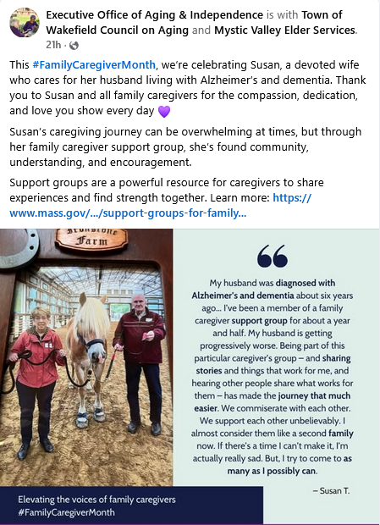
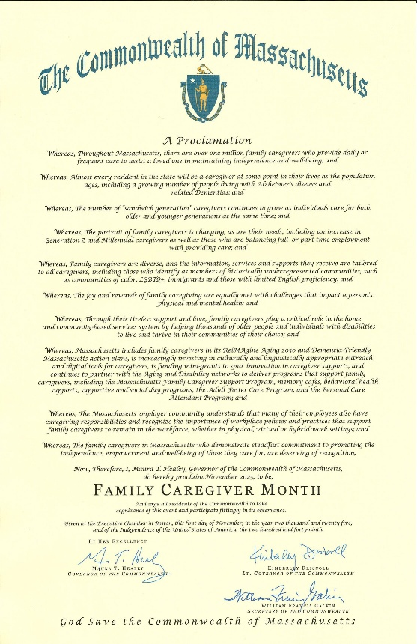
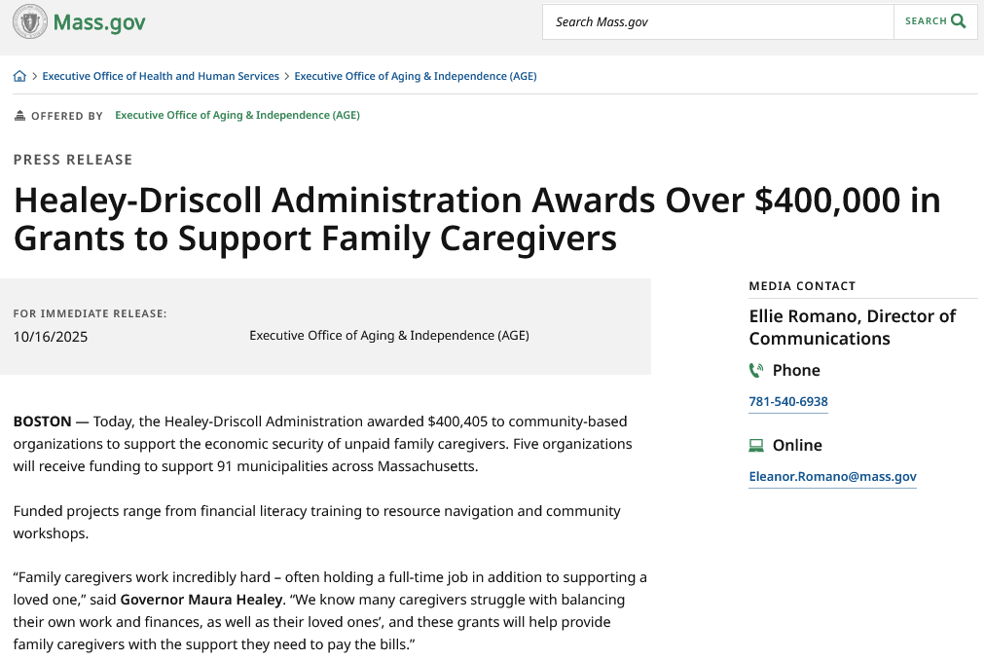
Caregiving (5 of 5)
Special Updates in the Caregiving Space @ AGE
Caregiver Innovation Grants
Caregiver Month Proclamation
Caregiver Month Social Media Awareness Campaign
Notes:
https://www.mass.gov/news/governor-healey-proclaims-november-as-family-caregiver-month-0
https://www.mass.gov/news/healey-driscoll-administration-awards-over-400000-in-grants-to-support-family-caregivers
Social media caregiver month awareness campaign for caregiver month that included:
Inputs from 5 EHS agencies that included caregiver photos, stories, and quotes
Snippets from MFCSP caregiver specialist interviews, conducted in-person at agencies across the state

Slide 36


Next Steps & Vote to Adjourn (3 min)
Next Council Meeting
Tuesday, March 17, OR Thursday March 19, 2025
3:30 pm to 5:00 pm
Vote to Adjourn

