Slide 1
HRCMS/UMASS/MUNICIPAL AGENCIES
ANNUAL ENROLLMENT
MAGIC INSTRUCTIONS
FOR GIC HEALTH COVERAGE
ENROLLMENTS/CHANGES
March 2021

Slide 2
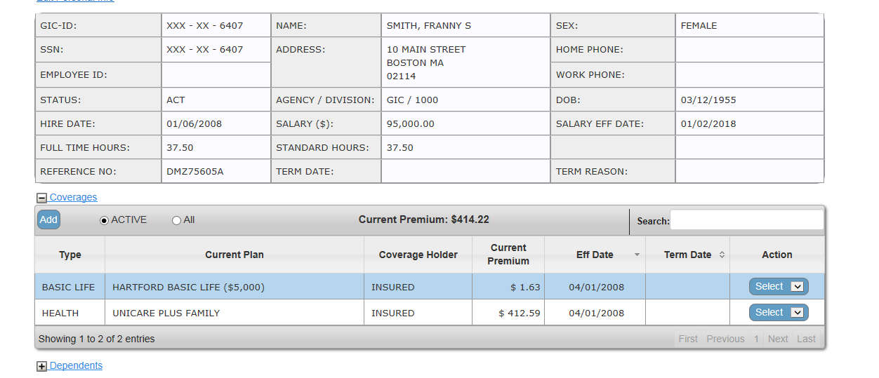
CHANGING HEALTH PLANS
To change an employee’s health plan, choose Select, then choose Edit.
*Municipal agencies do not have Basic Life Insurance.

Slide 3
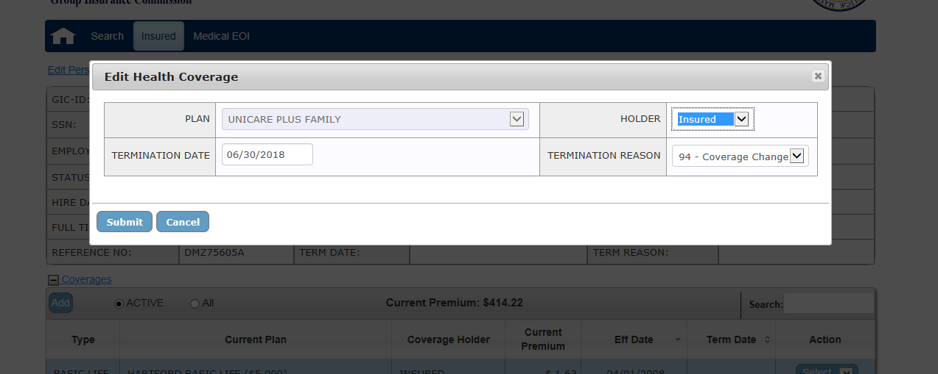
06/30/2021
Enter Health Plan Termination Date 6/30/2021
Select Termination Reason 94 – Coverage Change from drop down menu
Click Submit

Slide 4
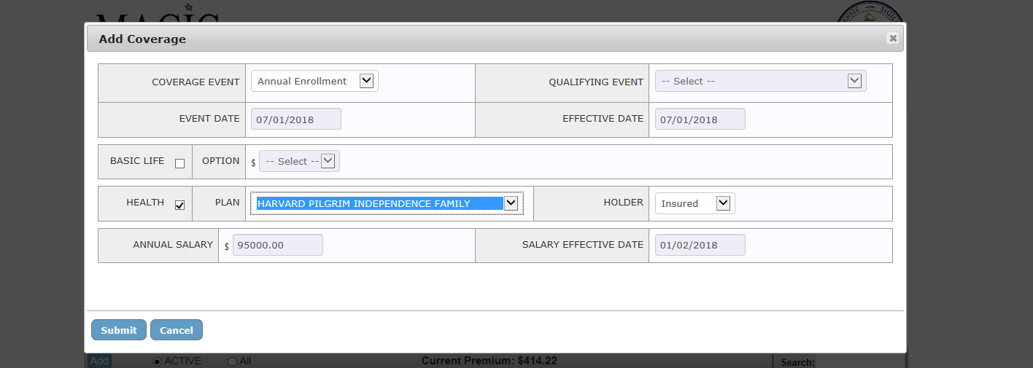
07/01/2021
07/01/2021
Select COVERAGE EVENT Annual Enrollment in drop down menu
Select the HEALTH checkbox and choose new plan from drop down menu
Click Submit

Slide 5
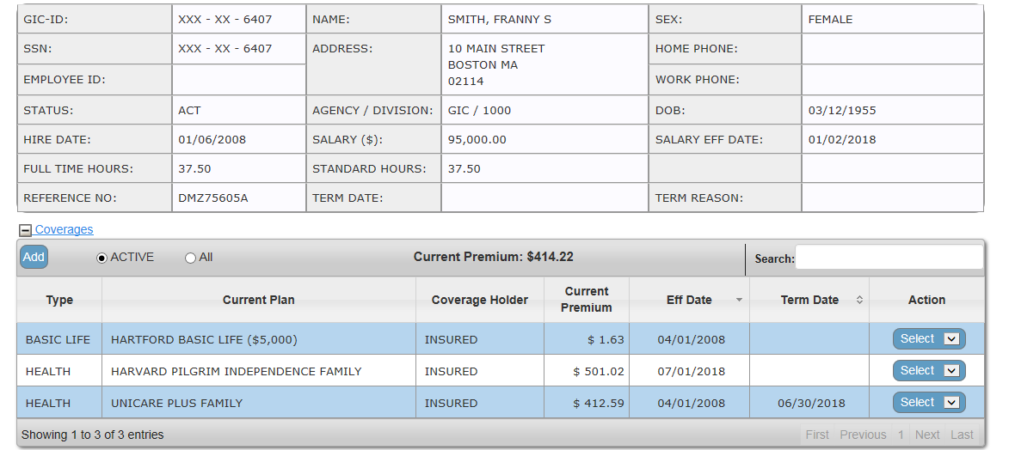
07/01/2021
06/30/2021
MAGIC system will show the cancelled plan effective 6/30/2021
and new plan effective 07/01/2021

Slide 6
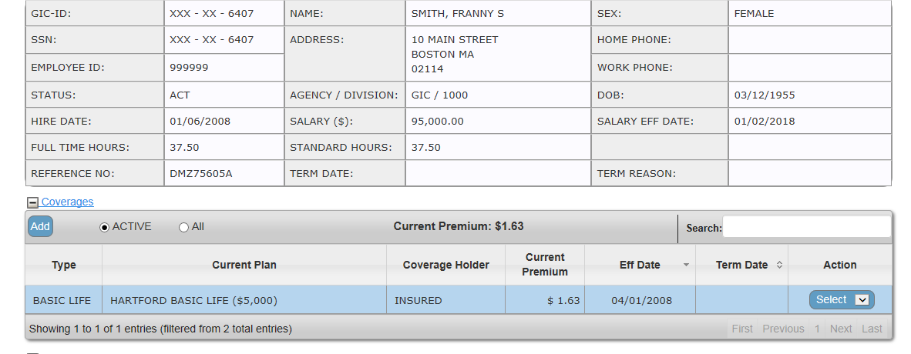
HEALTH PLAN ENROLLMENT
To enroll an employee in a health plan, click Add
*Municipal agencies do not have Basic Life Insurance

Slide 7
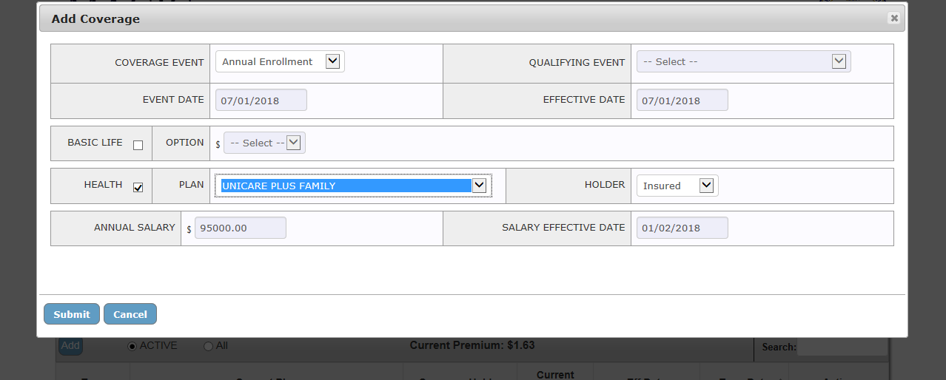
07/01/2021
07/01/2021
Select COVERAGE EVENT Annual Enrollment in drop down menu
Select the HEALTH checkbox and choose new plan from drop down menu
Click Submit

Slide 8
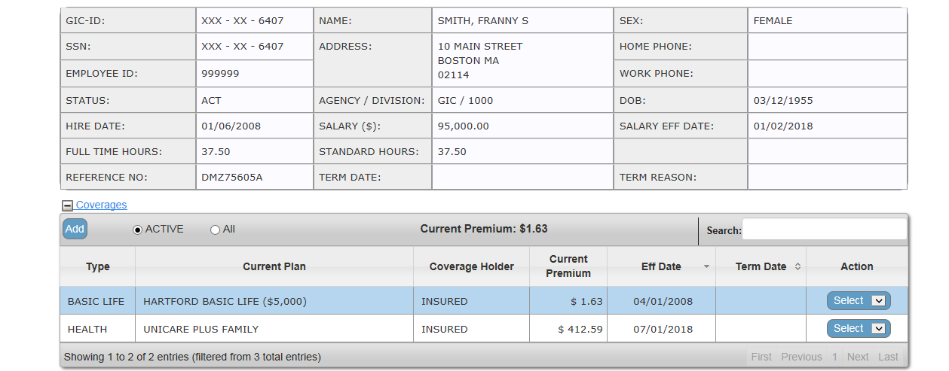
07/01/2021
MAGIC system will show the new plan effective 07/01/2021
IMPORTANT! You will not be able to add dependents to family coverage.
Enrollment/change forms and required documentation (i.e. marriage and birth certificates)
must be sent by mail or submit using myGICLink no later than Monday, May 10, 2021.
Questions? Please email magic.help@mass.gov

