Slide 1
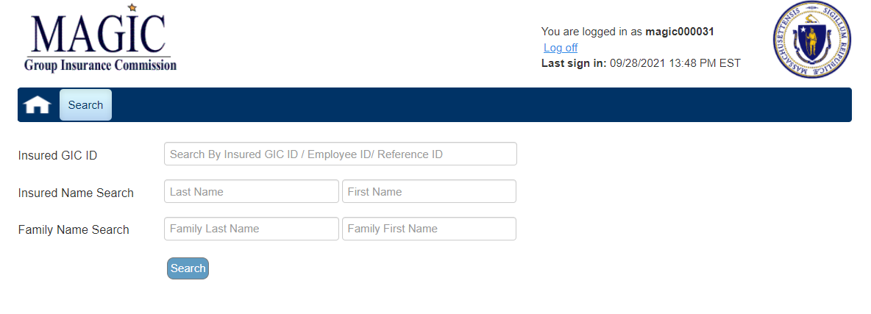
Entering New Hire Information in MAGIC (Municipal Coordinators Only)
Notes:
From the Magic “Search” page enter the new employee’s social security number in the “Insured GIC ID” field

Slide 2
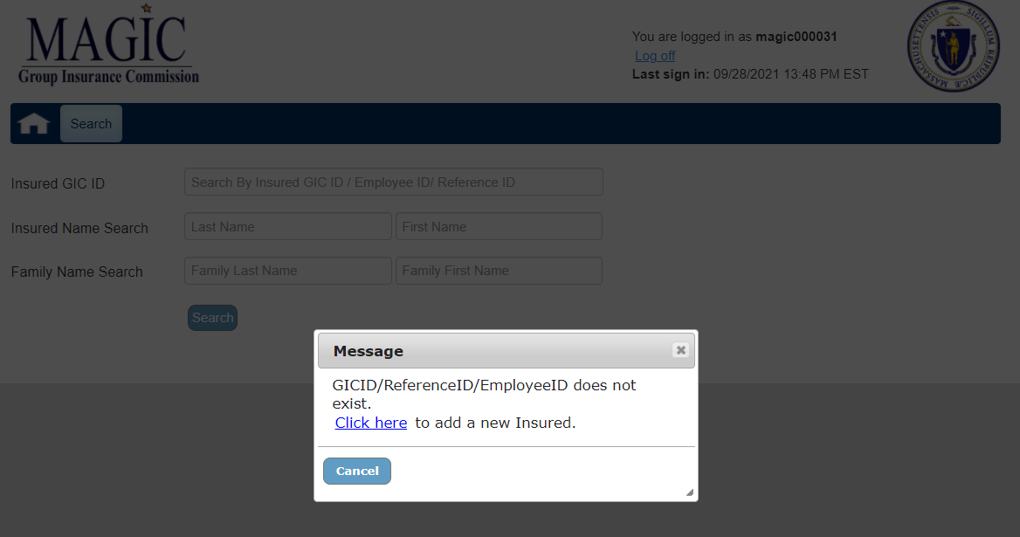
Entering New Hire Information in MAGIC (Municipal Coordinators Only)
Notes:
Click the blue hyperlink “Click Here” to add the new employee’s personal data to Magic.

Slide 3
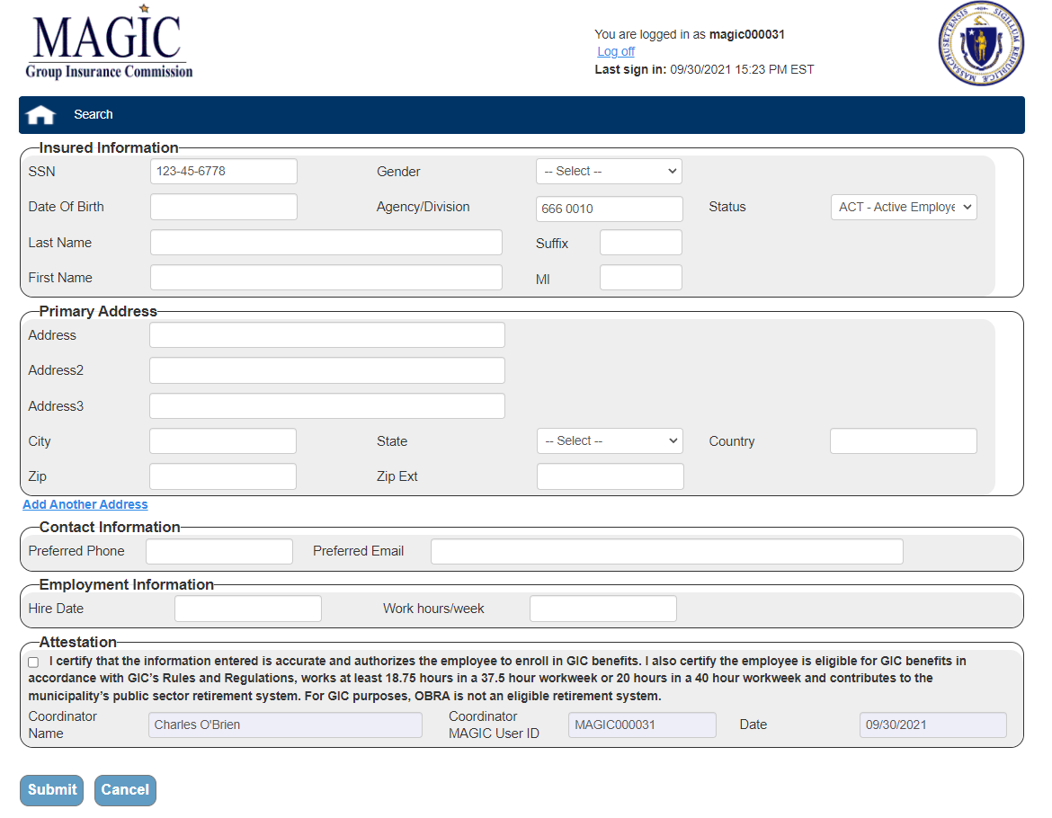
Entering New Hire Information in MAGIC (Municipal Coordinators Only)
Notes:
Sample of the screen where you will enter the new employee’s personal data.
You will need to complete all the sections: Insured Information, Primary Address, Contact Information, Employment Information and Attestation.
Click the “Submit” button. If any Required information is missing you will be prompted to enter the required information.

Slide 4
Entering New Hire Information in MAGIC (Municipal Coordinators Only)
Important:
You can add a new hire record in Magic starting 14 days prior to the new employee's hire date or up to 7 days after the new employee's hire date.
Preferred Email is a required field for the employee to get the New Hire Welcome Email for the Portal. Registration emails will not go out prior to the new employee’s hire date.
The social security number validation on the “Search” page is done across all GIC records, if the member is/was employed by another State Agency or Municipality, you will not be able to add them. You will receive a message to use myGICLink to request forms for this employee to enroll.
Employees will have 21 days from the “date of hire” to enroll in GIC benefits.

