Slide 1
Department of Public Health
Medication Administration Program (MAP)
Stakeholder Workgroup
April 2nd, 2026

Slide 2
Agenda, April 2nd, 2026.
1. Welcome
2. eMAR and Impruvon updates
3. MAP hotline analysis and guidance discussion
4. MAP training and testing performance in 2025
6. Additional items
5. MAP communications framework

Slide 3

eMAR & Impruvon
Status Update

Slide 4
The Need for Modernization
In 2021-22, challenges in the MAP program exposed by the pandemic accelerated the urgency for modernization.
ERG Study
An independent study by Eastern Research Group (ERG) in 2022 produced 30 modernization recommendations. The introduction of a single, state-sponsored eMAR system for all MAP providers was key to the success of these.
eMAR Impact: A state-sponsored eMAR would provide a standardized, efficient, and safer medication administration process.
eMAR Consultation: A workgroup was convened in early 2023 and was unanimously in support of this recommendation. However, they recognized that successful implementation would require significant state support and funding. The workgroup asked DPH to pursue this with EHS to the extent possible.
A 2023 survey of MAP providers found that 95% of them would adopt a state-sponsored eMAR if made available (assuming it was of sufficient quality and could integrate with existing EHR systems). Alongside this, a pilot for nine providers focused on utilizing multi-dose packaging in conjunction with an eMAR system successfully.

Slide 5
Benefits of eMAR
Findings from other states in the ERG’s report demonstrate that the use of a single state-sponsored eMAR will:
1
2
3
Allow for uniform medication administration training and protocols and enhance the safety of medication administration to individuals served.
Facilitate remote management and oversight of medication administration activity.
Enhance the ability of providers and state agencies to be more proactive/strategic. We can see trends in care and patient needs and address these.
4
5
6
Provide access for DPH and the four MAP agencies to data that would assist in quality improvement and planning.
Upgrade or replace the eMAR systems currently in use that vary significantly in the quality of safety features, ease of use, and compliance with MAP policy.
Strengthen communication with
pharmacies and enhance control of medication supplies.

Slide 6
Implementation with Impruvon Health
Impruvon electronic medication administration record (eMAR)
Full MAP compliance
Through collaboration between the State, Impruvon Health, and MAP
providers, eMAR supports safe, compliant medication administration.
Notes:
Impruvon
Successfully implemented in over 20 other states, Impruvon offers a simplified day-to-day medication process—from pharmacy to provider to person served—by automating the most time-consuming tasks, minimizing human error, and providing real-time documentation to serve the unique needs of the 18,000 individuals across Massachusetts who receive medications from MAP certified staff.

Slide 7
Impruvon eMAR: MAP Compliant
Final work was completed in December to ensure that the Impruvon eMAR is compliant with MAP Policy. What does this mean for staff?
1. Real time alerts are sent if a medication is due and not administered.
a. Alerts can be generated to as many people (e.g., supervisors, nurses, Program Directors, etc.) in your organization as you choose.
b. The supervisor can send a ‘remind’ alert to the staff.
c. Staff can set up alerts (via text or email) to remind themselves when meds are due.
2. When progress notes are required during the medication administration process, they are presented as a “pop-up” feature.
a. If a medication is omitted, Impruvon will prompt the staff to contact a MAP consultant and to write a progress note.
b. Impruvon can be set up to track data, such as bowel data, vital signs, BGM, etc. (an alert will be sent if criteria is met – e.g., day two of no BM).
3. When data tracking is attached to a medication, the system will prompt staff to enter the data prior to med admin.
a. If criteria has been met (e.g., hold for b/p less than 90/60) the system will tell staff not to administer the medication. If notification to the HCP is required, staff will be prompted to do so and write a progress note.
4. Impruvon allows for different access levels, for example non-MAP staff may sign in and enter bowel data.
Notes:
Add info re: change in testing

Slide 8
Impruvon eMAR: MAP Compliant (cont)
7. When a PRN med is administered, staff will be prompted to write a note, including a follow up note.
A second staff can document the follow-up note.
8. Impruvon will track medications even when the medication is to be administered by an outside agency such as the VNA
a. Staff will be prompted to indicate if the licensed staff arrived to administer the medication, or even if the individual was brought to the HCP office for administration. If not, an alert will be generated to key personnel (e.g., supervisor, nurse, program director, etc.) in your organization as you choose.
9. Prepopulated MAP forms.
a. HCP orders.
b. LOA and transfer.
c. Current medication list.
10. Effective feedback loop.
a. Because Impruvon is the state contracted eMAR system, we can receive feedback from YOU and make improvements to the system; this is just the beginning!
b. We can think about "wish list" items such as advanced ordering and receiving, electronic reconciliation of schedule II-V medications, integrated training/retraining features, etc.
5. Impruvon will prompt staff through the second check process (e.g., for Warfarin sodium) to help ensure the medication is checked by a second staff. If only one staff is on duty the code NSS is used.
6. If a medication needs to be held prior to a lab test, Impruvon allows for this information to be entered ahead of time to help ensure the medication is not given when it should be held.
Notes:
Add info re: change in testing

Slide 9
New resources in development
Single-sign on
Frontline staff will not be required to access Impruvon Health eMAR via the Virtual Gateway (VG) system.
Staff will have a simplified single-sign on to access eMAR.
HCP encounter/order form
Following pharmacy integration, the HCP order template will prepopulate with the current medication list.
But staff will still have the opportunity to customize the encounter form with the specific medications for the HCP visit.
In the event of sign on issues, Impruvon Health offers 24/7 support.
Only service administrators and MAP agency directors will need to use the VG to access service data securely.

Slide 10
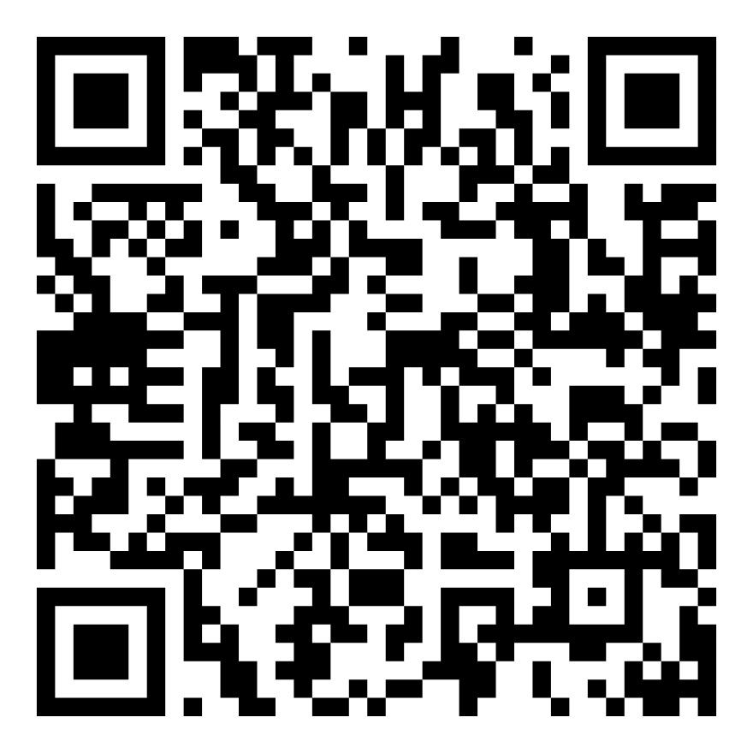
Sign up below:
Learn More series offered bi-weekly
beginning March 2026 will:
Offer a live demonstration of the eMAR.
Provide details about the implementation and onboarding process for eMAR.
Begin the adoption process for your organization.
Registration also available on the What’s New Page at www.mass.gov/dph/map
Link provided here.

Slide 11
Options for Flexible Implementation of Impruvon eMAR
Providers may adopt a staggered approach to onboard their sites, tailored to their needs.
Onboarding sites in smaller batches may help providers to address any implementation or training issues in a more practicable way.
If providers have existing contracts with eMARs, they may sign up now but delay implementation until existing contracts expire.
Impruvon’ s dedicated implementation and training team will work with providers individually to determine readiness and available resources and agree a suitable approach.
The Commonwealth Virtual Gateway can consolidate health and human services programs and information in a single online site to strengthen data analysis and make data more secure.

Slide 12
Hotline Analysis and Discussion

Slide 13
Background to research undertaken
In MAP, a hotline event is a medication error that is followed by a significant
adverse outcome, such as illness, injury, medical intervention, or death.
Increases in the complexity and risk of medication administration in MAP are clearly reflected in the data available on hotline events.
There were 558 adverse outcomes due to errors in medication administration at MAP sites from 2023 through 2025.
Of these cases, 82.26% resulted in emergency care and/or hospitalization.
Summary of research methodology

Slide 14
Steady increase in hotline events from 2023 to 2025.
As of March 20th, 43 hotlines had been reported in 2026.

Slide 15
Method
Analyzed 562 hotline events reported to the Department between 2023 and 2025.
Thematically evaluated events based on the following criteria:
  What was the primary/underlying cause of the hotline?
  Did the medication occurrence result in hospitalization?
  Could the event have been prevented by the utilization of an electronic medication administration record (eMAR)?
Used data on remediations to:
  Identify frequently implemented retraining
  Highlight areas where additional staff training may be beneficial to staff

Slide 16
Subsequent Necessary
Medical Response
20.43% of all hotline events over 3 years resulted in hospitalization (112 cases).
61.83% resulted in an ER visit and discharge (345 cases).
Research from the MA Health Policy Commission in 2021 determined that the average commercial payment (excluding professional fees) per inpatient hospital stay was $20,900.
  The Commonwealth, therefore, spends approximately $2.38 million in a 3-year period on hotline events resulting in hospital stays.
According to a report from Mira Healthcare, the average out-of-pocket cost for a moderate to severe ER visit in Massachusetts is $1,313.
  Therefore, the Commonwealth spends approximately $452,985 in a 3-year period.
Source: MA Health Policy Commission | Mira Healthcare

Slide 17
Hotline Events Preventable by eMAR
33.1% of 562 events were deemed potentially preventable by eMAR.
Out of preventable events, 33.86% resulted in hospitalization, costing the Commonwealth approximately $1.34 million in 2023-25.
44.62% of preventable events resulted in ED visits, costing approximately $107k in 2023-25.

Slide 18
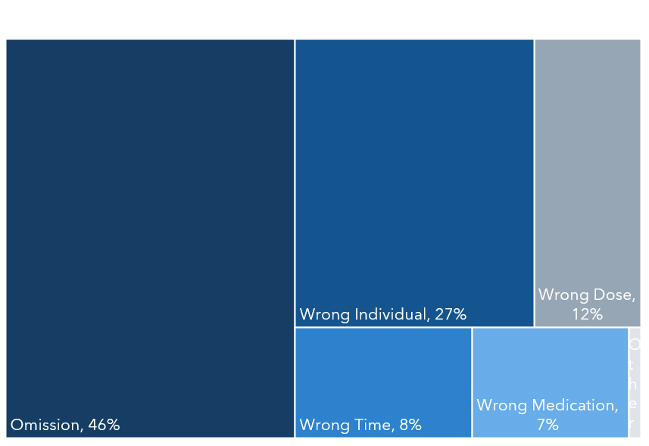
Overview of Occurrence by Category
Events were grouped based on the nature of occurrence into 5 categories: Medication Omission, Wrong Individual, Wrong Dose, Wrong Time of Administration, and Wrong Medication.
Medication Omission, with 46% of events, is the most frequent occurrence.

Slide 19
Types of Omission
Omission is the most frequently occurring hotline event. The category can be further broken down into
8 distinct reasons for omission, highlighting more specific areas for further training or improvement:
Staff unable to obtain medication from pharmacy.
Medication not transcribed correctly on medication sheet.
MAP staff error.
Prior authorization issue.
Medication ran out.
Refusal to attend health care provider appointments, resulting in no refill.
No VNA staff present to administer medication.
Unclear instructions, no medication administered.
1
2
3
4
5
6
7
8

Slide 20
Preventability of Omission Occurrences in 2025 by Type
Out of 222 hotlines reported in 2025, 114 were omission occurrences.
The most frequent type of omission in 2025 was MAP staff error.
  54.29% of MAP staff errors were preventable with eMAR.
In total, 61.11% of omissions were preventable with eMAR.

Slide 21
Instances of Noteworthy Remediation Orders
Medication Occurrence: how to determine if a medication occurrence has taken place
MAP Consultant explains the role of the MAP Consultant and details examples of when MAP certified staff should contact a MAP Consultant
Supervised Medication Pass: 1:1 supervision practice until supervisor is satisfied of correct practice
Mindfulness: covers remaining alert and focused during medication administration
5 Rights: right person, medication, dose, time, route (violation of these 5 rights constitutes a medication occurrence)
Checks of the Rights: comparison of 5 rights between pharmacy label and medication sheet
Emergency Contact List: where to find contact information for MAP consultant, HCP, poison control, etc.
Accuracy Checks: monthly review of medication sheets for accurate information and documentation of check
Source: Responsibilities in Action, September 2024

Slide 22
Training Discussion Material
Retraining following MAP staff errors should be specific to the error which occurred.
MAP Staff Error:
Suggested Training Responses:
Staff did not complete the checks of the rights during the medication administration process.
1:1 supervised medication passes until the supervisor is satisfied with correct practice.
Role of eMAR in Training: Implementation of a high functioning eMAR has the potential to identify specific training topics beneficial to MAP staff.
After a visit to the HCP, a patient’s, change in medication was not transcribed to the medication sheet.
Require a monthly review of medication sheets to ensure accurate information and med checks.
A medication ran out and was subsequently not available for the next med pass. No staff contacted a MAP consultant.
Review the role of a MAP consultant and ensure staff understand when contact with a consultant is required.

Slide 23
Recommendations
A high functioning eMAR system could have potentially prevented ~33% of hotline events from occurring and saved the Commonwealth $495K annually in hospital stays and ED visits resulting from medication occurrences.
Tailoring training improvements for MAP certified staff to commonly ordered retraining topics could be beneficial in prevention of future hotline events.

Slide 24
MAP Training and Testing Performance

Slide 25
Background
Data Source
  Data vendor provided student-level data related to training, testing, and certification.
  Student IDs and Student Training IDs were used for analysis of multiple datasets.
Inclusion Criteria
  Students who completed training between June 2024 – February 2025 (9 months) compared to training between May 2025 – Nov 2025 (7 months)
  Of those who trained, students who attempted testing between June 2024 – May 2025 (12 months) compared to testing between May 2025 – Feb 2026 (10 months)
Limitations
  Demographic data related to students is unavailable at this time.
  Work site and funding sources for testing and training are only partially available.
Notes:
*Note that May 2025 appears in both testing windows; however, pool only includes those who completed training in specified time frame, so no repeats caused.

Slide 26
Percent of Students Tested & Certified
*Took at least one part of the test: Knowledge and/or Med Admin
**Note that this table counts individuals, not training attempts
Notes:
9 months of training for 2024-25
7 months of training for 2025-26

Slide 27
Training Attempts
The percentage of students certified after their first training attempt increased from 52% to 55%.
The percentage of students who were not yet certified 3 months after training completion was reduced from 41% to 40%.

Slide 28
Pass Rate
Pass rates for those who took the tests (subset of the 3,046 trained) increased from 78.9% to 80% for Knowledge and decreased slightly from 87.7% to 87.2% for Medication Administration.
Note that the number tested for Knowledge and number tested for Med Admin are not mutually exclusive.

Slide 29
Time Since Training
Median Days from Training Completion to Test Date
The Policy Manual version published in November 2023 announced that the time frame for testing would be shortened from 6 months to 3 months to encourage testing closer to training completion (applicable to students who had not yet completed training).

Slide 30
Testing Attempts
Note that this table measures test attempts, not unique students.
Pass rates for the first attempt on the Knowledge exam increased from 53.5% to 57.8%.
Pass rates for the first attempt on the Medication Administration exam increased slightly from 63.9% to 64.7%.

Slide 31
MAP Communication Framework

Slide 32
Background
Since the beginning of the program, the MAP team has sought to establish effective and responsive communication with MAP service providers, with the stakeholder group being a key component.
This group began as a smaller collective of MAP providers and DPH staff, creating a vital opportunity for discussion about successes, concerns, and frustrations within the MAP program.
As time progressed, this stakeholder group has expanded to over 100 members, with dynamics shifting to accommodate from discussion-based to presentation-based meetings.
The MAP team is thrilled with the ever-increasing interest in involvement with the MAP stakeholder group. However, expanding involvement should not come at the expense of stakeholder feedback and engagement.
The newly proposed communication plan will establish new platforms for communication as well as create a consistent channel for information exchange between the DPH staff and service providers.
The newly proposed communication plan brings the workgroup back to its original intentions: a platform for stakeholder engagement. It encourages increased MAP compliance and, ultimately, improved outcomes.

Slide 33
New Communication Framework
Objective: To provide MAP service providers with an established platform and frequency for the sharing of information. Establish a feedback loop.
Goal: Increased MAP compliance by effective communication with MAP service providers via information sharing and feedback loop to drive future developments.
Communication Form | Platform | Target Audience | Frequency | Feedback Loop
MAP Quarterly Newsletter | Mass.gov/dhp/map What’s New Page | Certified staff Supervisory staff Nursing Service provider administrators | Quarterly January April July October | Each newsletter can ask readers for specific agenda items that they would like to have addressed in the next issue.
MAP Service Provider Open Forum | Teams registration link posted on Mass.gov/dph/map What’s New Page | Any interested MAP service provider parties | Yearly in January | Data Questions listed in chat Post Q & A following the meeting

Slide 34
New Communication Framework Continued
Communication Form | Platform | Target Audience | Frequency | Feedback Loop
Stakeholder/Advisory Meeting | Teams Invitation only | Approx. 20 attendees including: DPH State agency MAP Directors MAP Associations Reps from 2-3 large service providers; chosen by the MAP Association members Etc. | 3 or 4 times per year or as determined by the group | Feedback obtained from members of the group which drive policy and curriculum development

Slide 35

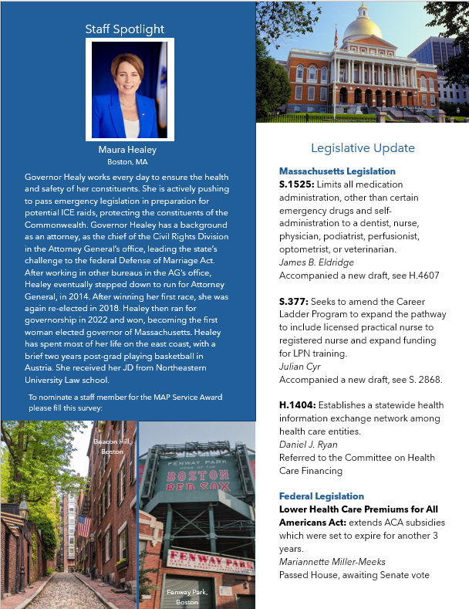

Newsletter Preview
Areas for Your Involvement:
Staff Spotlight and Service Award nominations
FAQ topics
Events Page photos
Content suggestions

Slide 36
Additional Items

Slide 37
Thank you
Additional discussion items or questions?

