Slide 1
DAEGB – Community Outreach
Contact Information
Brian Mac Donald
President & CEO
National Braille Press (NBP)
bmacdonald@nbp.org
617-425-2416
www.nbp.org
Notes:
LIKE TO START w/ QUICK OVERVIEW OF NBP & LITTLE BACKGRND BLINDNESS for REF

Slide 2
NBP Mission
  NBP empowers the blind and visually impaired with programs, technology, and materials supporting braille literacy and learning through touch.
  Support braille and tactile literacy to empower the blind and visually impaired.
  Identify and Leverage innovative technologies for e-braille solutions – that are affordable
  Produce high quality, affordable braille and tactile graphic materials
Notes:
NON PROFIT … TOOLS TO SUPPORT BRAILLE LITERACY AND LIFE LONG LEARNING.. 2 WAYS TO PRODUCE BRAILLE

Slide 3
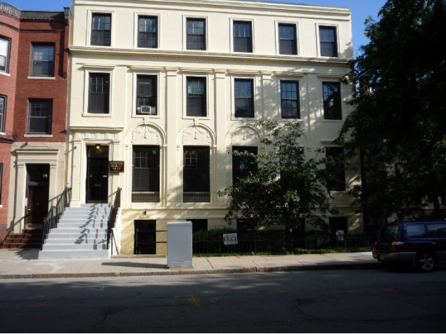
NBP Headquarters
88 Saint Stephen Street – Boston, MA
Notes:
FENWAY AREA SURROUNDED BY NE UNIV. INVITE TOUR IF IN CITY.

Slide 4
Brief History of NBP
Founded by Frances Ierardi – Italian Immigrant, lost vision age 12, attended Perkins School with Helen Keller.
Graduated 1918 - wanted blind people to have information current and accurate
9 years later on March 17, 1927 1st edition of the The Weekly News was published as a braille newspaper in Boston.
It was also the first braille newspaper in the western hemisphere.
Incorporated non-profit in 1929 by a group of prominent Bostonians including Christian Herter who was subsequently elected as a US Congressman, Governor of Massachusetts, US Secretary of State.

Slide 5
NBP History continued
1938 Commenced publishing The Rehabilitation Teacher, a professional journal for teachers and rehabilitation workers serving the blind, published continuously through 1975.
1945 Organized volunteer corps to transcribe college textbooks and training materials into braille. And by the 1950s and 60s, the initiative progressed to recordings & large print formats.
1975 NBP started doing publications for NLS-LOC National Geographic. Sports Illustrated.
Early 1980s began focusing more on Educational programs to support braille literacy.

Slide 6
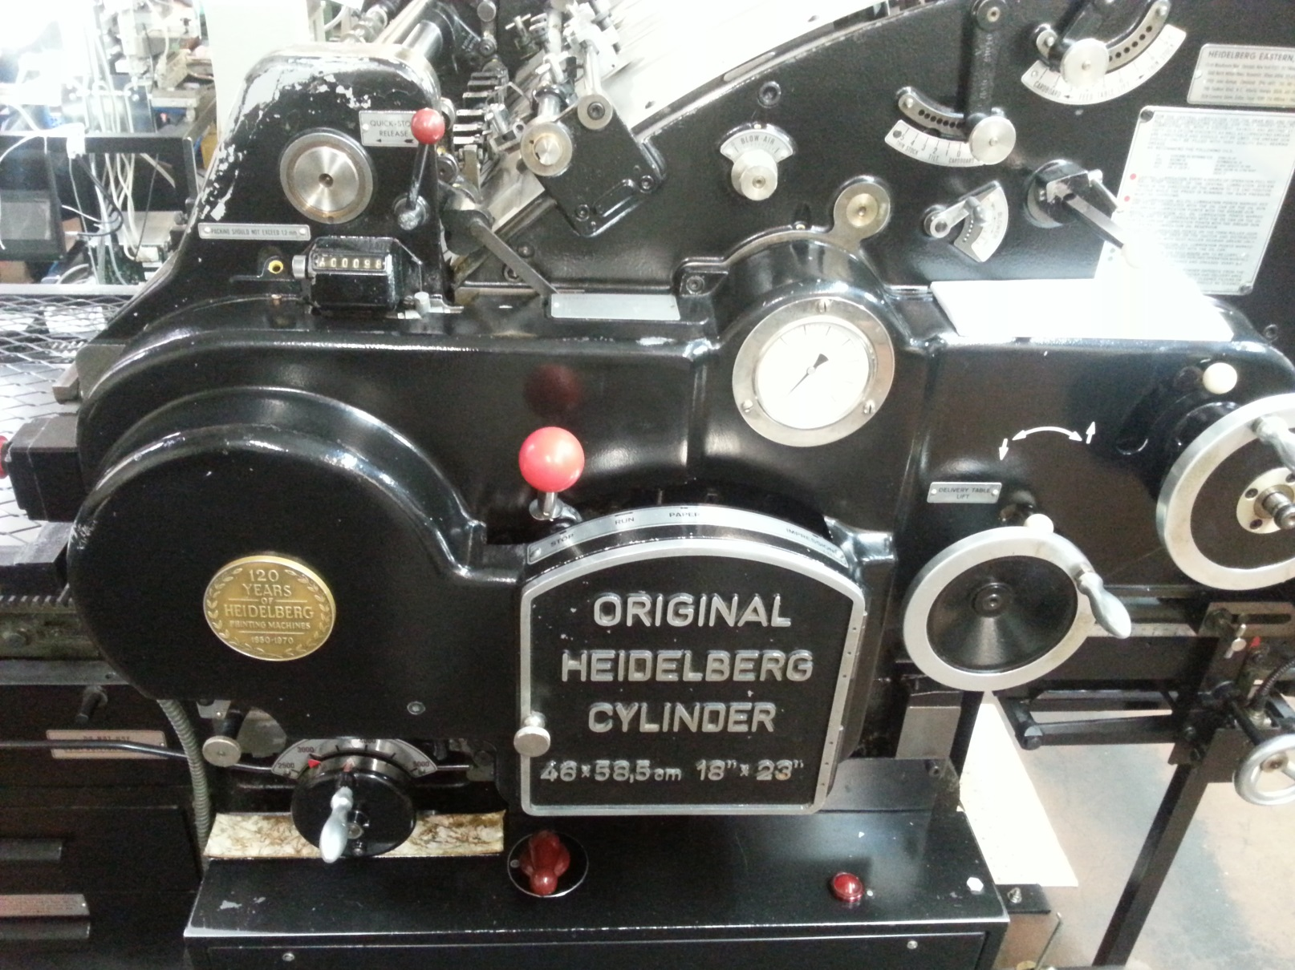
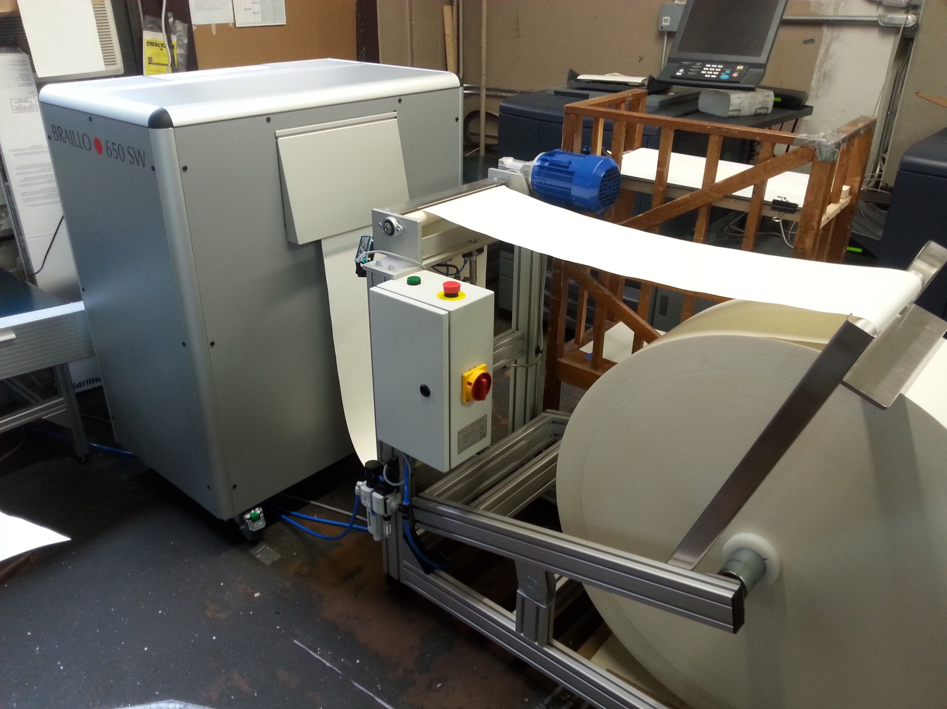
What We Do
NBP produces millions of pages of paper braille/yr two methods to produce braille Press or Embossing
Heidelberg Press
Braillo Embossers

Slide 7
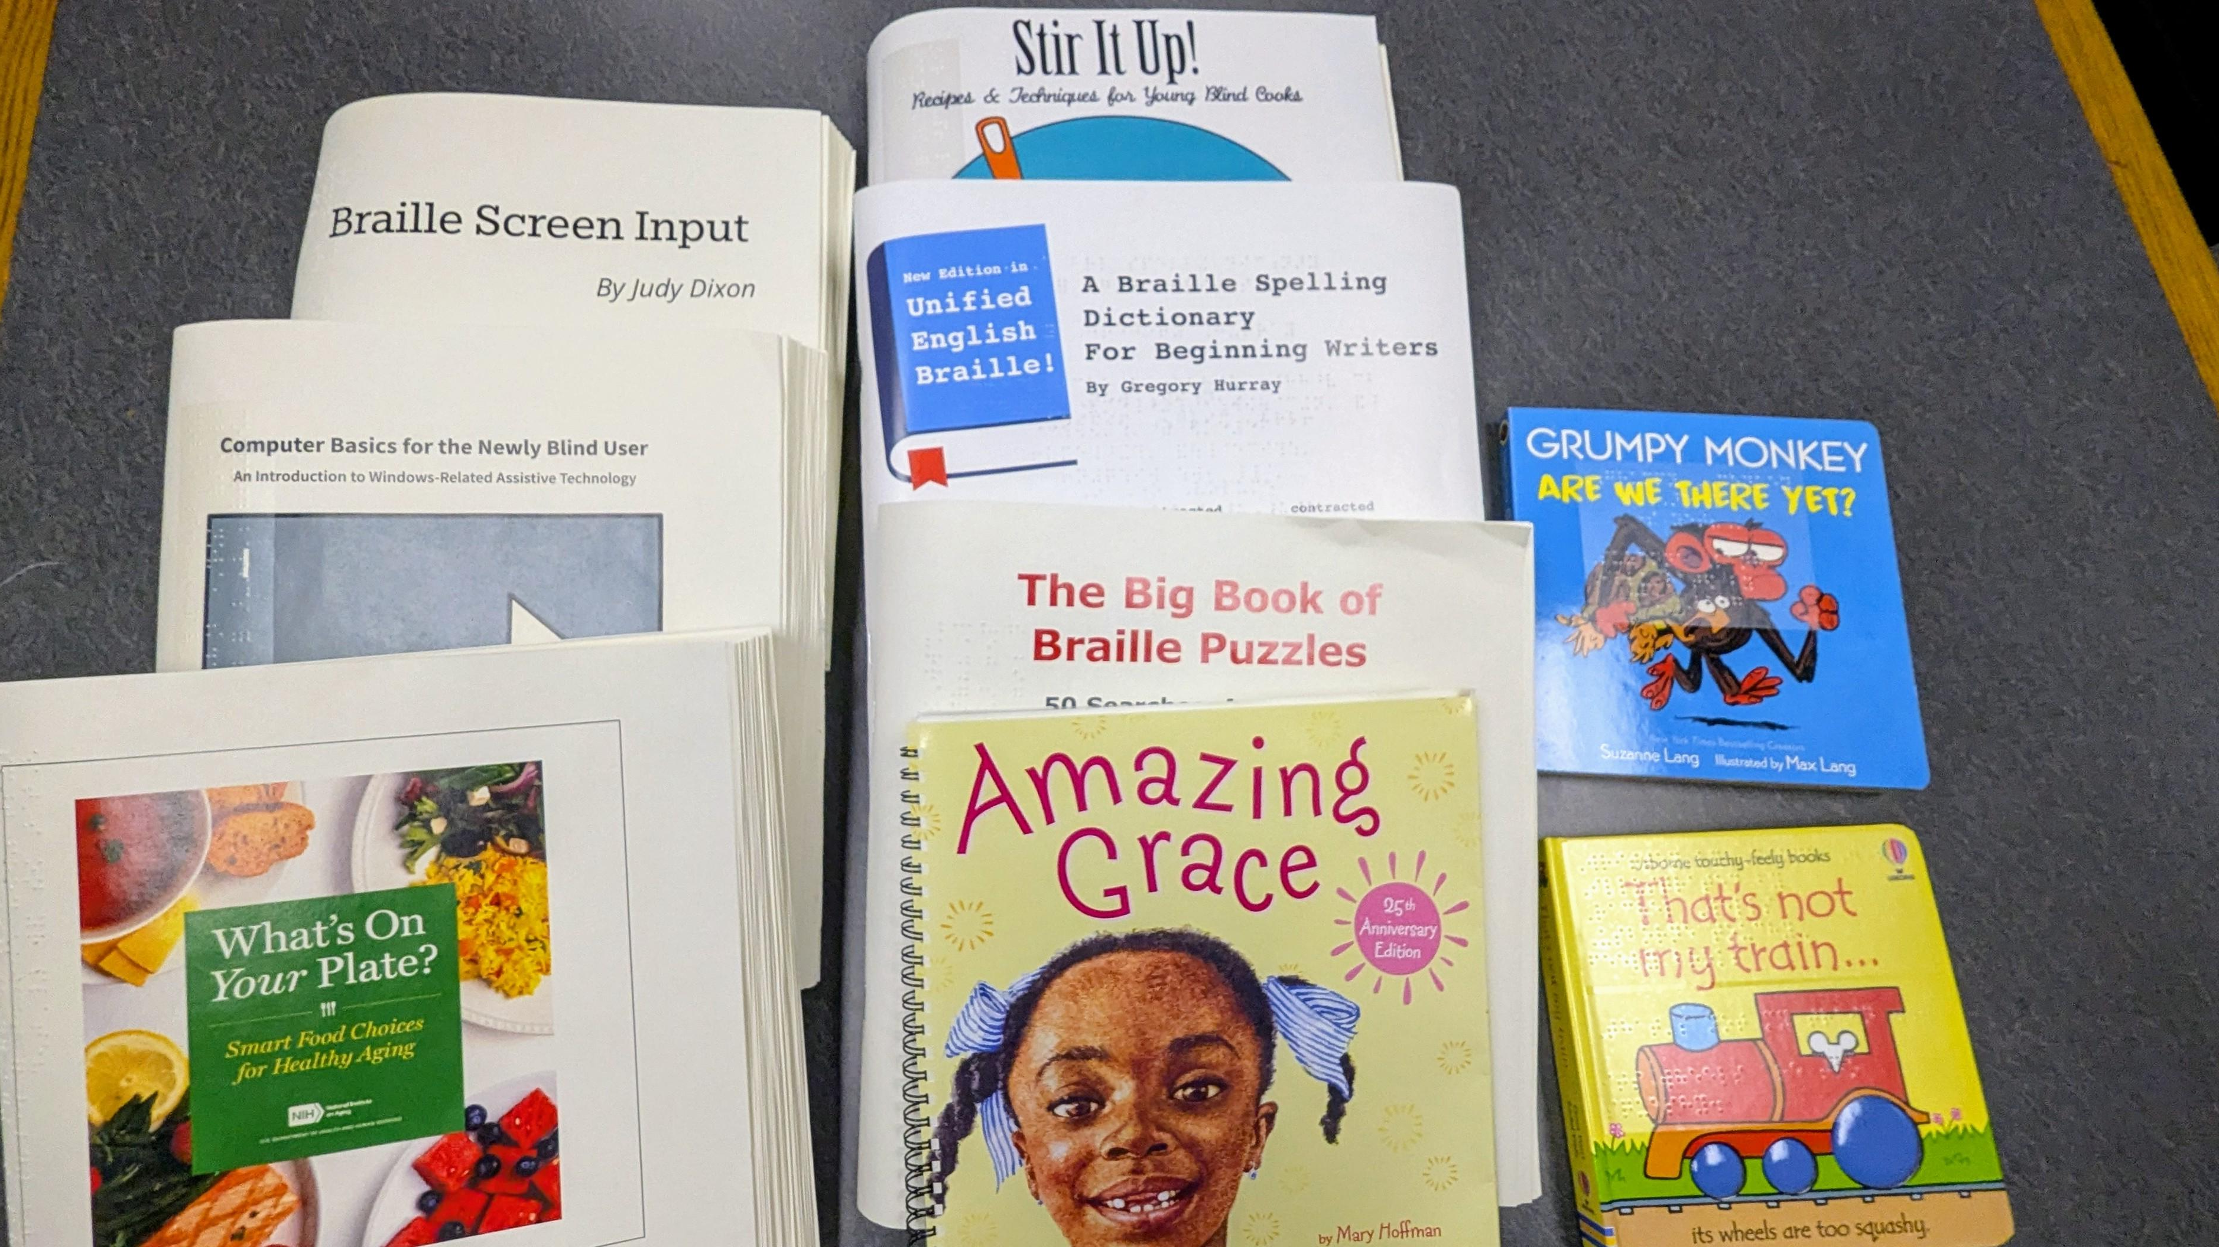
Braille Literacy for Children & Adults
We have braille literacy programs for children to learn braille. Bumpy Basics, Readbooks, Children’s Braille Book Club.
Books for adults written by blind authors, including how-to books on technology, health, cooking, travel and leisure activities.

Slide 8
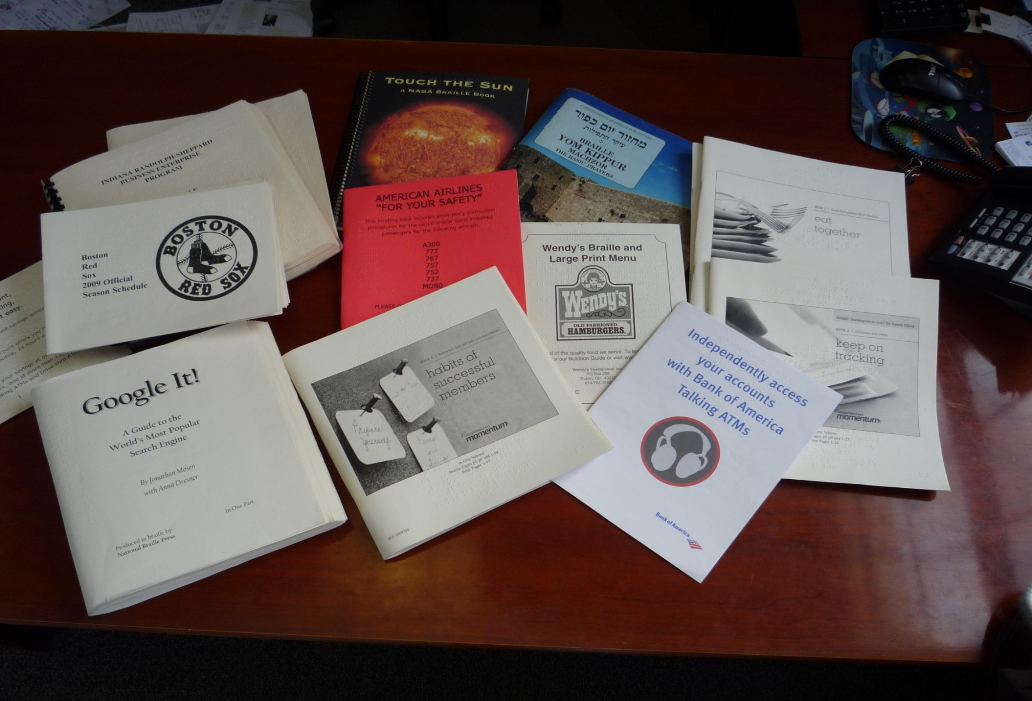
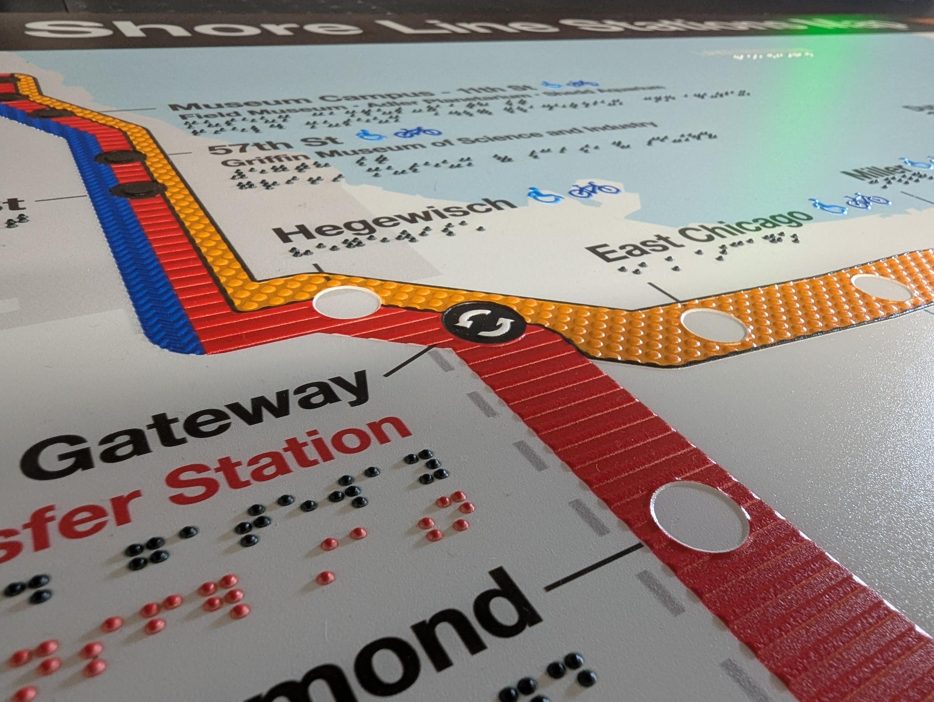
B2B Contract Work
Airline evacuation plans
Menus Starbucks in US and Canada
Macy’s Parade program
Corporate documents
Braille business cards
Award plaques in print and braille and acrylic awards and promotional items with print and braille
ADA signs with raised lettering, large print and braille, evacuation maps, etc.

Slide 9
Education Dept
Many don’t realize we do textbooks K-12, colleges
Standardized tests primary, secondary grades (approx. 35 states) including MCAS
College entrance exams and graduate exams
Not just braille… but tactile graphics, bar charts, line curves, chemistry, bio, diagrams etc.

Slide 10
Center for Braille Innovation (CBI)
Launched 2008 – Just started at NBP cost of RBD very high -
Group of 25 volunteers - Deane Blazie, CTO Motorola, Head of Accessibility IBM, Google, Apple, MIT, educators, blind professionals.
Purpose: To identify and leverage innovative, emerging technologies to support and develop e-braille products and tactile graphics solutions for the blind & visually impaired.
Allow students and adults in workplace to have affordable tools to be connected to digital world.
First two projects: produce a lower cost Braille Display and a lower cost, full page graphic tablet for the blind (dynamic tests)

Slide 11
Research Collaborations
Research Partners/Collaborators:
Univ of Michigan [New Haptics]
U Maine [AI],
UCLA
Orbit Research
Disney Research
Innovision in India
Bristol Braille Technology - UK
MIT, NC State [Polymer Braille]
Northeastern University
China Braille Press
Dot Inc. – So. Korea
Non-Profit and Corporate Collaborations:
Google, Amazon, Apple, IBM, RNIB, CNIB, NFB
NBP Touch of Genius Prize for Innovation

Slide 12
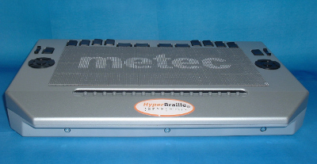
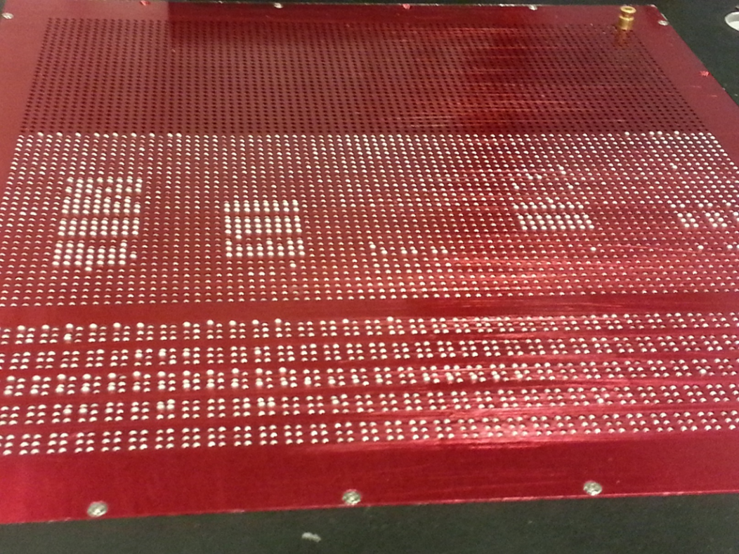
Early Full Page Projects
Metec – hyperbraille 40K Euro
NBP - 2012 Graph and Braille combo – Nitinol activation

Slide 13
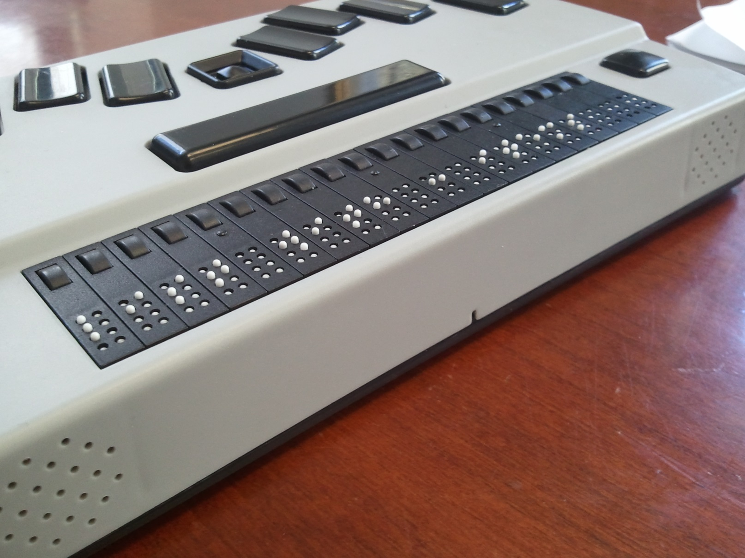
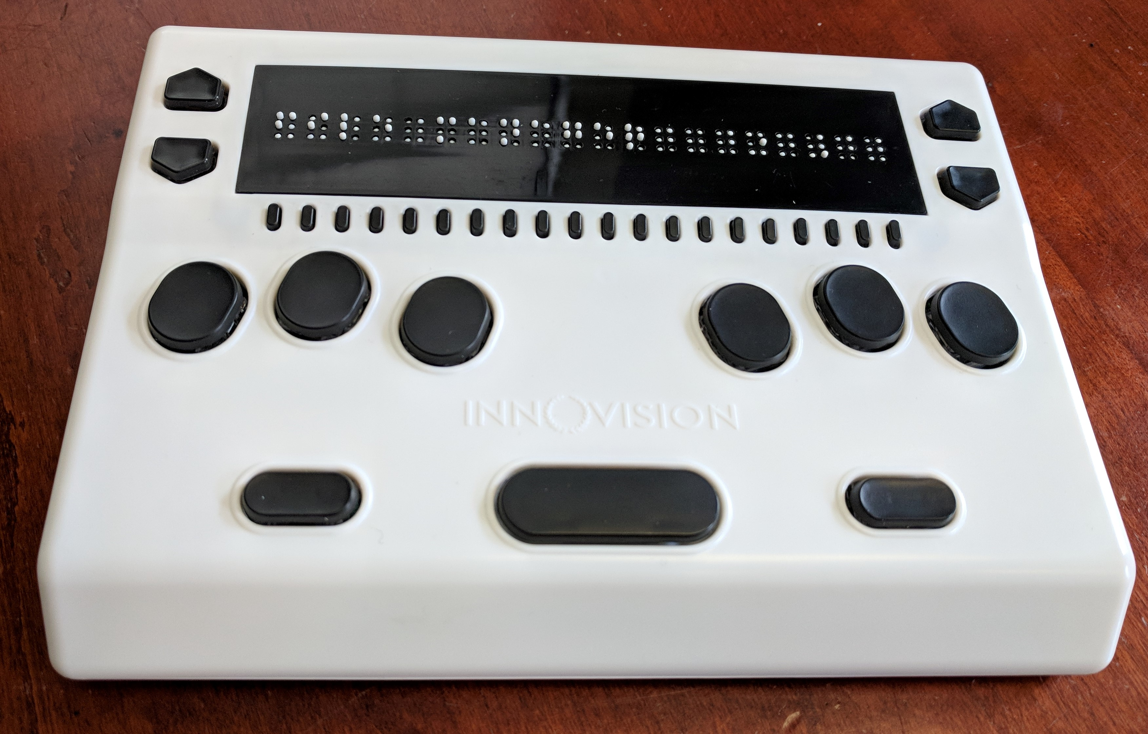
Refreshable Braille Technologies
2016, 2018
NBP – B2G Android RBD
Innovision India BrailleMe
Notes:
NBP’s BETTER MOUSETRAP – piezo actuation, more features

Slide 14
RBDs -Actuation R&D
  Piezoelectric Benders – electro mechanical
  Conductive graphite/paraffin actuators & pneumatics
  Solenoids & plastic membranes
  Microfluidics/Pneumatics – Michigan
  Micro camera motors cell (phones)
  Magnetic Actuation –Innovision India
  Rubber belts & wheels
  EAPs (Electro Active Polymers) - Various materials, plastic sheets, (EAP film) dielectric elastomers, rolled polymers.
  SMAs (shape memory alloys) M.I.T. Ceramic based
Notes:
RED MOST PROMISE

Slide 15
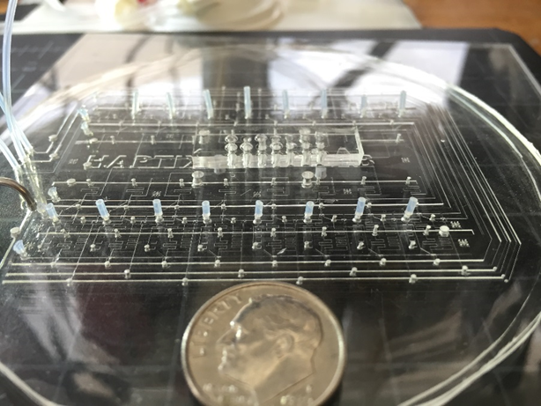
Leveraging existing Medical Technology
Micro machining pneumatic technology on a nano scale
Clear polymer layer created with cad cam
100 nm tubules, with a logic layer to control flow (pin actuation)

Slide 16
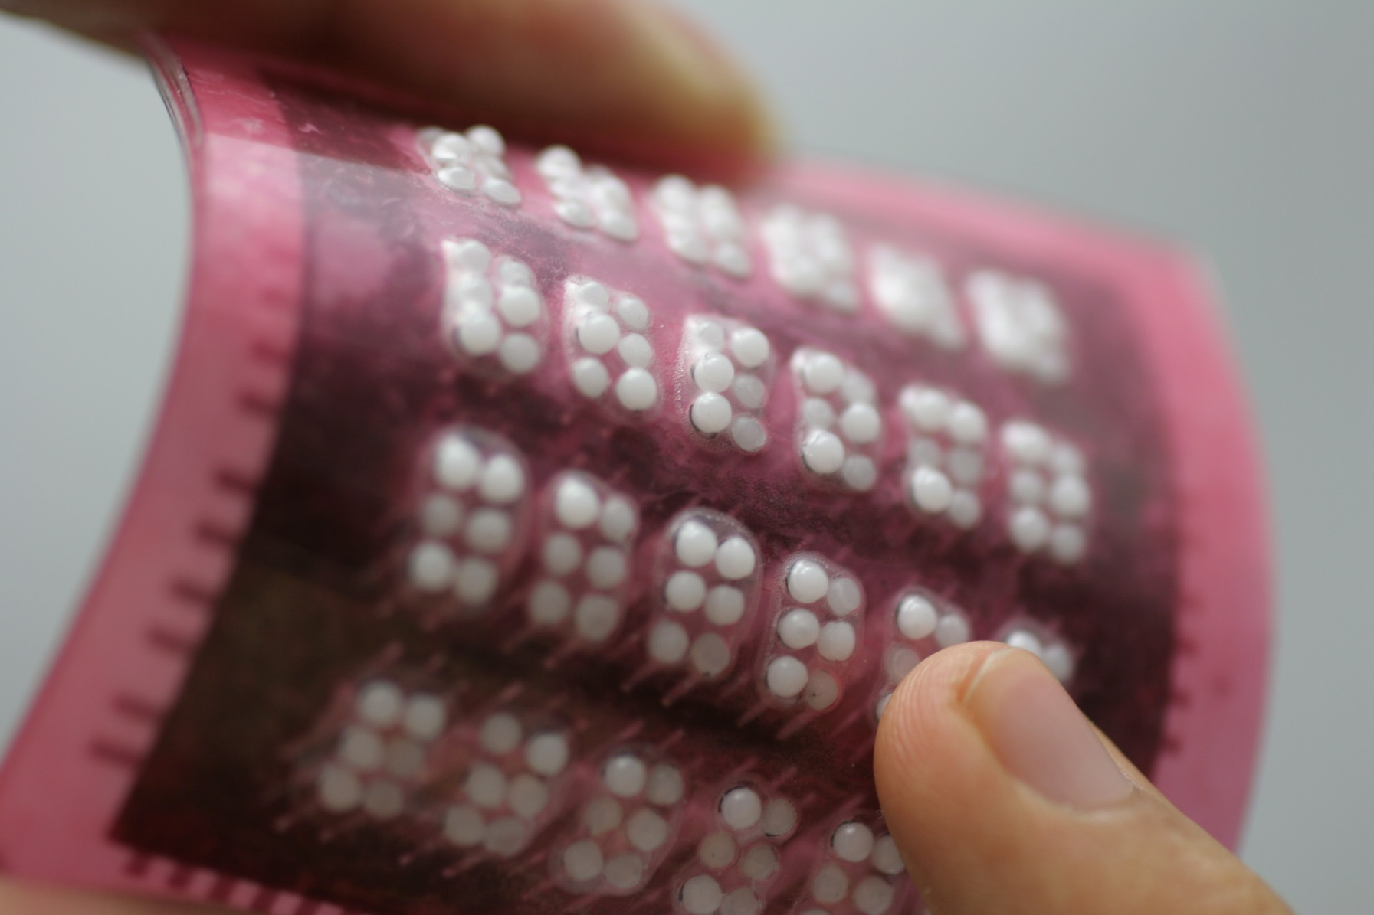
Electroactive Polymers – EAPs
Plastic material, prosthetics, artificial muscles, robot skin

Slide 17
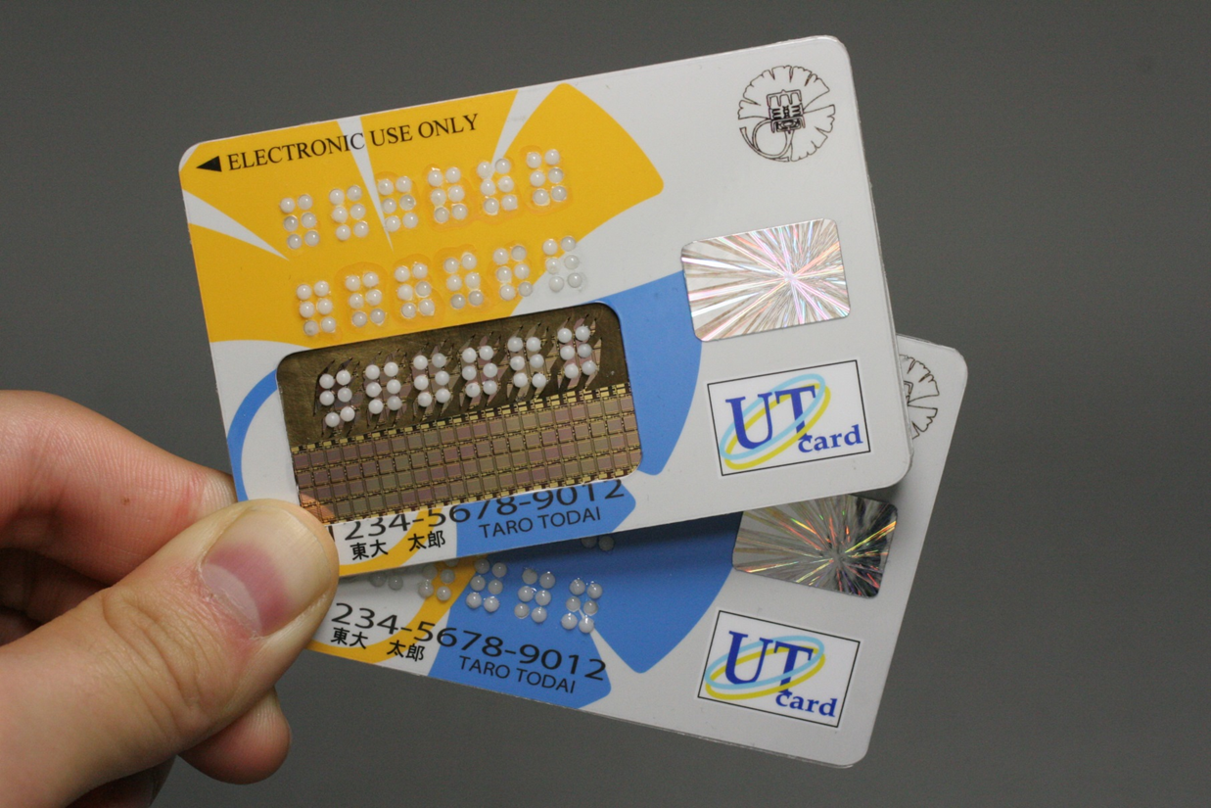
EAP Phone credit card
Takao Someya - Japan

Slide 18
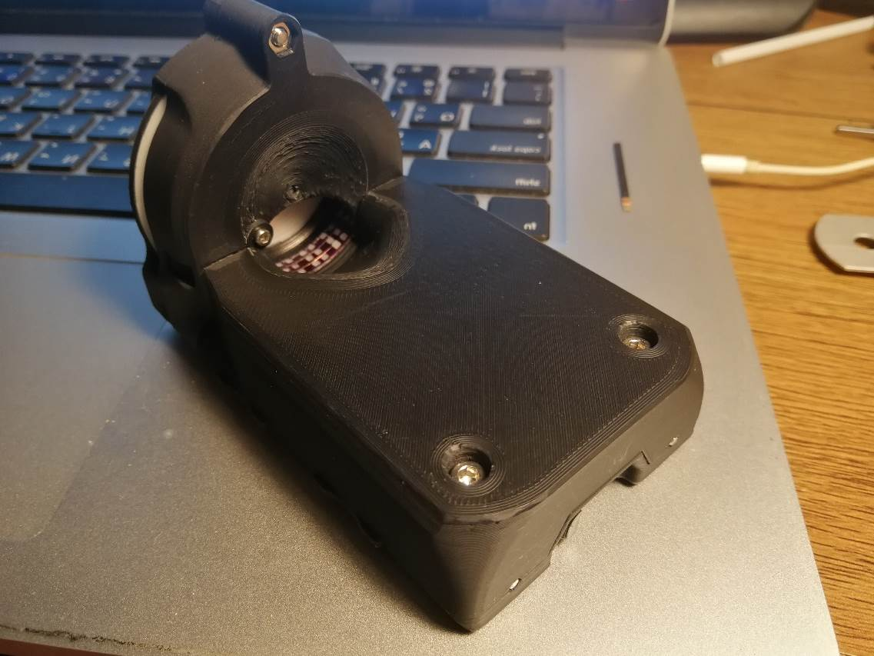
Touch of Genius Winner 2021
Read-Ring - Thailand

Slide 19
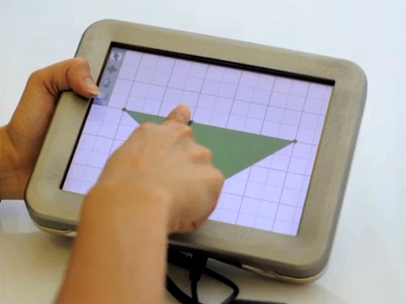
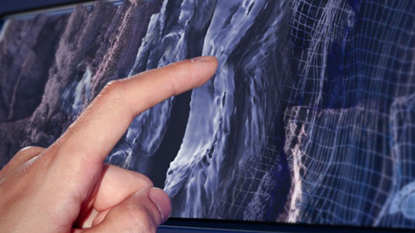
Disney Reseach CMU, Senseg Finland, Tanvas Chicago NWU

Slide 20
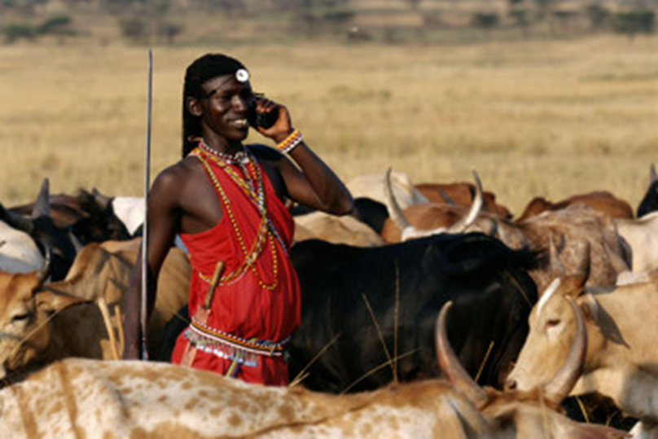
Electrostatic Haptics – If successful
Over 8.3 Billion people on earth
Only 6.5 Billion have access to toilets, but
6 Billion have access to cell phones
Fastest way to integrate tools for Braille Literacy & Tactile Graphics in developing countries to teach children.

Slide 21

Q & A

