Slide 1
March 2026 Meeting
Alice Colegrove
Ayala Livny & Thaliana Paulino
Director, Homeless Youth Services
Chair, UHYC on behalf of Secretary Mahaniah
Senior Consultants
Homeless Youth Services & UHYC

Slide 2
Welcome !
Please introduce yourself in the chat with your name, pronouns, org/role
+ Question of the day: What is giving you hope today?

Slide 3
Agreements
Assume good intentions
Use respectful language
Ask for and use people’s pronouns
Engage in differences of opinion with courtesy and respect
Welcome all into the conversation, especially young adults
Understand that a commitment to inclusion may mean that the norms of “professional meetings” may need to be altered
Notes:
Thaliana & Ayala

Slide 4
Acronyms
UHYC = Unaccompanied Homeless Youth Commission
HYS = Homeless Youth Services
YYA = Youth and Young Adult
EOHHS = Executive Office of Health & Human Services
UHY = Unaccompanied Homeless Youth
Notes:
Thaliana & Ayala

Slide 5
Agenda
Workgroup Updates
Youth Count 2026
Announcements
Transitions & Reflections
Notes:
1:05 Alice

Slide 6
The purpose
of the MA Unaccompanied Homeless Youth
Commission is to “study and
make recommendations for services
for unaccompanied youth and young adults experiencing homelessness in Massachusetts, to ultimately
provide comprehensive & effective responses to the unique needs of this population.”
www.mass.gov/orgs/ma-unaccompanied-homeless-youth-commission

Slide 7
The purpose of
Homeless Youth Services
is to ensure that every region in Massachusetts has both prevention and intervention services specifically for young adults,
including emergency shelter or crisis housing.
www.mass.gov/orgs/homeless-youth-services
Notes:
We will leave you with resources today on how to connect to these services!

Slide 8
MA defines an unaccompanied homeless youth (UHY) as a person who:
1) Is 24 years of age or younger; and
2) Is not in the physical custody or care of a parent or legal guardian; and
3) Lacks a fixed, regular, and adequate nighttime residence.

Slide 9

GOAL
To make experiences of youth homelessness in Massachusetts
rare
brief
& non-recurring
UHYC March 2026 Meeting

Slide 10
Ultimate Goal:
Youth Housing Stability!
UHYC March 2026 Meeting

Slide 11

UHYC Workgroup Updates
Minors: 3/18/26
3rd Wed 10-11 am
Parents Under 25: 4/8/26
2nd Wed 4-5 pm
ESN: 4/7/26
1-2 pm

Slide 12

April 1-30, 2026

Slide 13



Slide 14



Research To Action 2024
Notes:
https://www.mass.gov/orgs/ma-unaccompanied-homeless-youth-commission

Slide 15
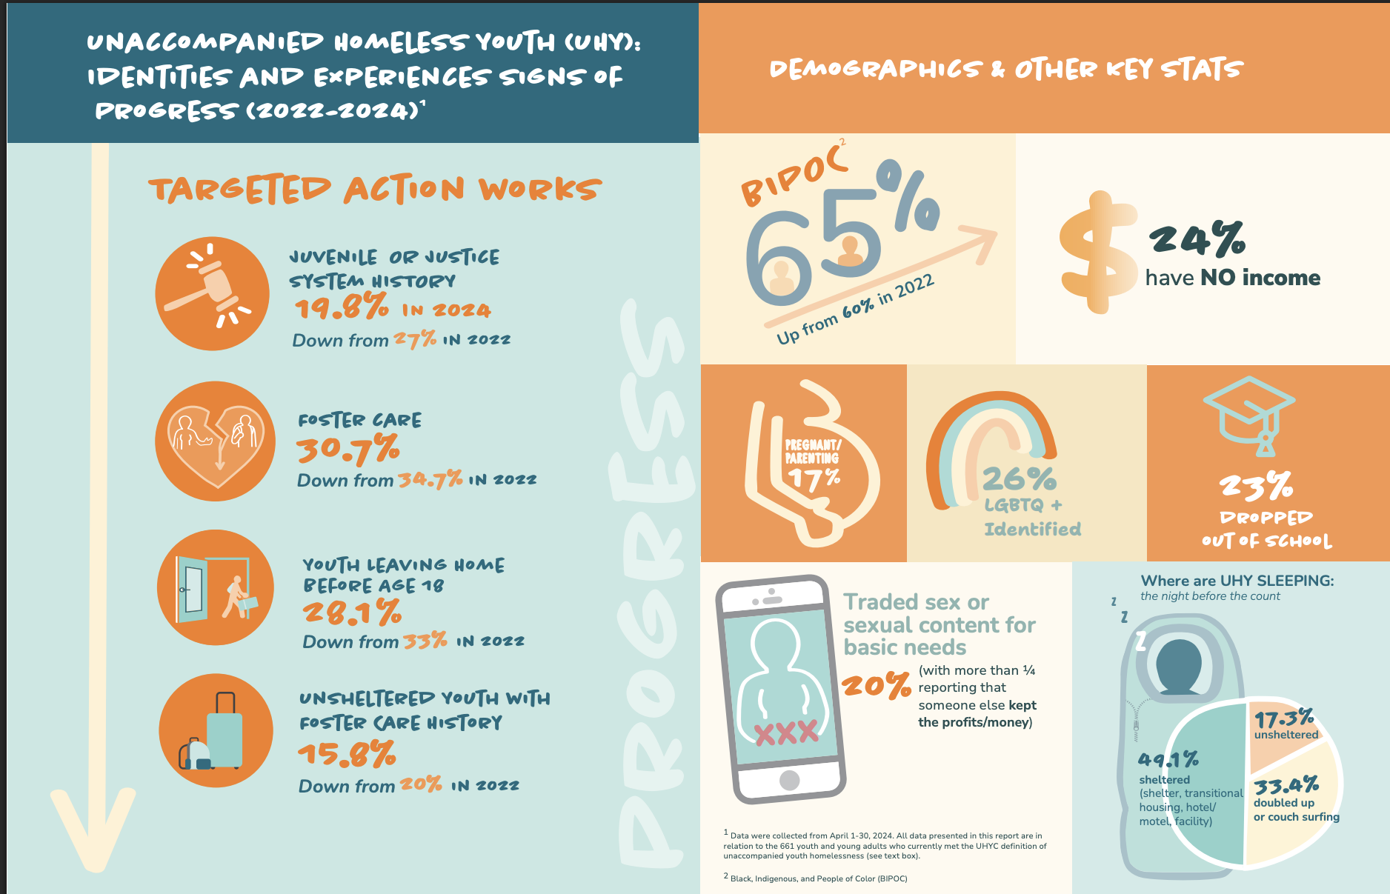
Research To Action 2024
Notes:
https://www.mass.gov/orgs/ma-unaccompanied-homeless-youth-commission

Slide 16


Other Announcements!

Slide 17
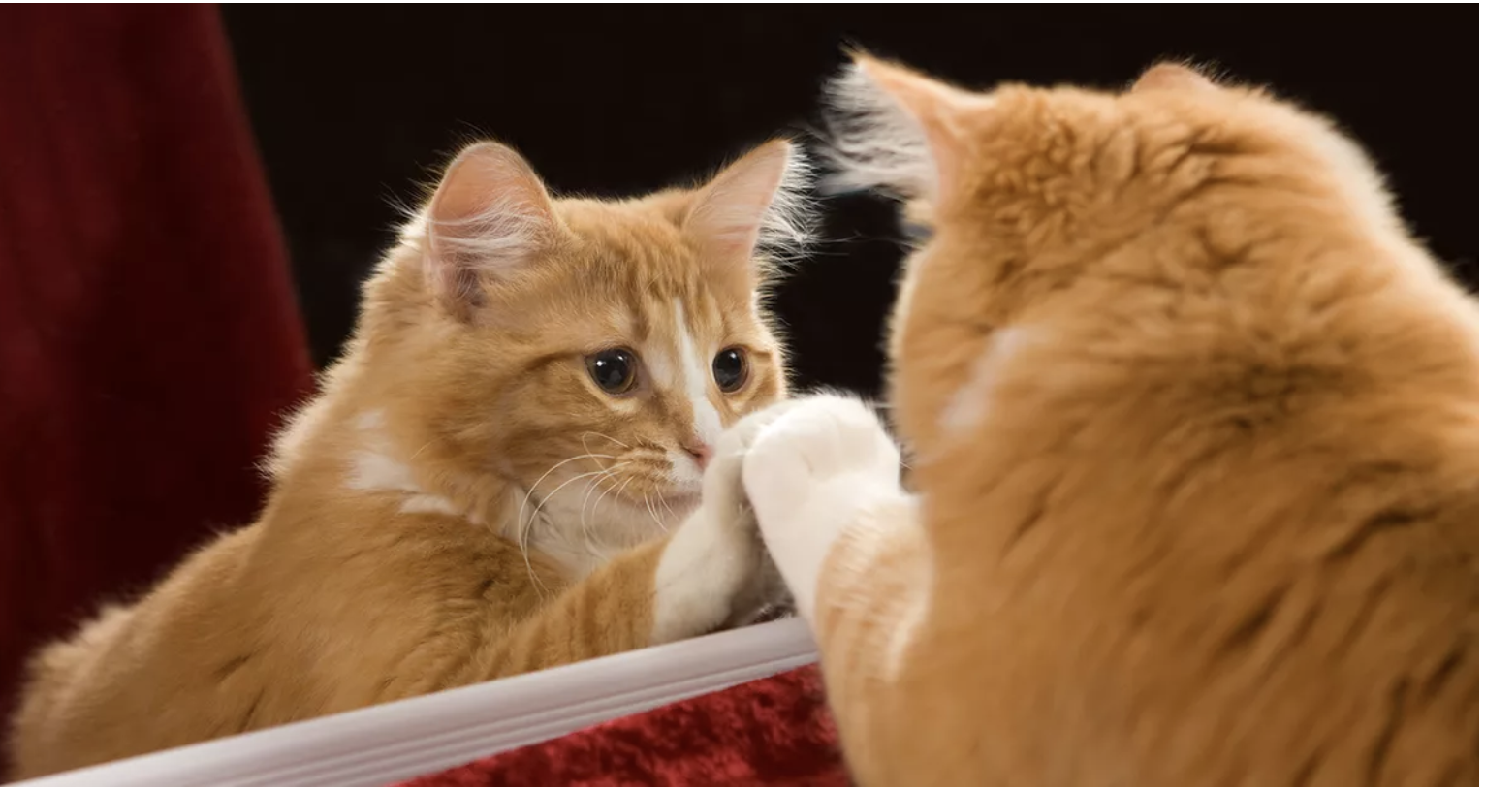
Reflections

Slide 18
What We Built Together
A statewide response to youth homelessness that didn’t exist before
Cross-agency partnership between government, providers, researchers, and young leaders
MA Youth Count – one of the strongest youth data efforts in the country
Programs designed with youth and young adults, not just for them
A growing system focused on prevention, housing & long-term stability

Slide 19

What We Built Together
A data system deduplicating EOHHS-HYS &HLC clients
tracking both prevention & homelessness outcomes
Massachusetts is doing something many states are still trying to figure out.

Slide 20
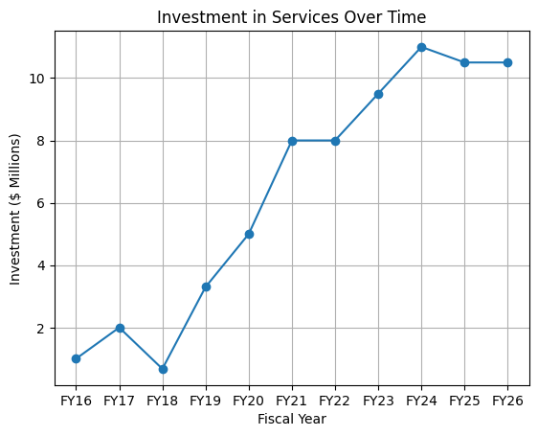
Annual HYS Funding Levels: Over 10x growth since initial pilot.
Increased investment has enabled statewide coverage, expanded housing capacity, and stronger regional coordination.

Slide 21
The Work Ahead
The UHYC has always worked because of:
Young people with lived experience leading the way
Legislators willing to listen and act
Providers pushing for better solutions
Agencies willing to collaborate across systems
Keep doing all this!!

Slide 22
Youth homelessness is solvable.
We have the partnerships.
We have the knowledge.
We have the voices of young people guiding us.
Let’s keep going!
Notes:
I’ve had the privilege of being part of this Commission since its beginning, and one thing I know for certain is that this work has never belonged to one person. It belongs to this community. What we’ve built together is real, and it’s making a difference for young people across Massachusetts…And I can’t wait to see where you take it next.

Slide 23
Next Steps
Next meeting: June 16, 2026; 1-2:30pm
Email Glenn Daly or Ayala Linvy or with questions: Glenn.Daly@mass.gov or Ayala.Livny.Consulting@gmail.com

Slide 24
THANK YOU!

