Slide 1
Commonwealth of Massachusetts Department of Early Education and Care
Board Meeting
Department Updates
March 8, 2022

Slide 2
Department Updates – March 2022
COVID and Testing Metrics
C3 Operational Grants Dashboard
System-Wide Capacity Summary
Caseload Updates

Slide 3
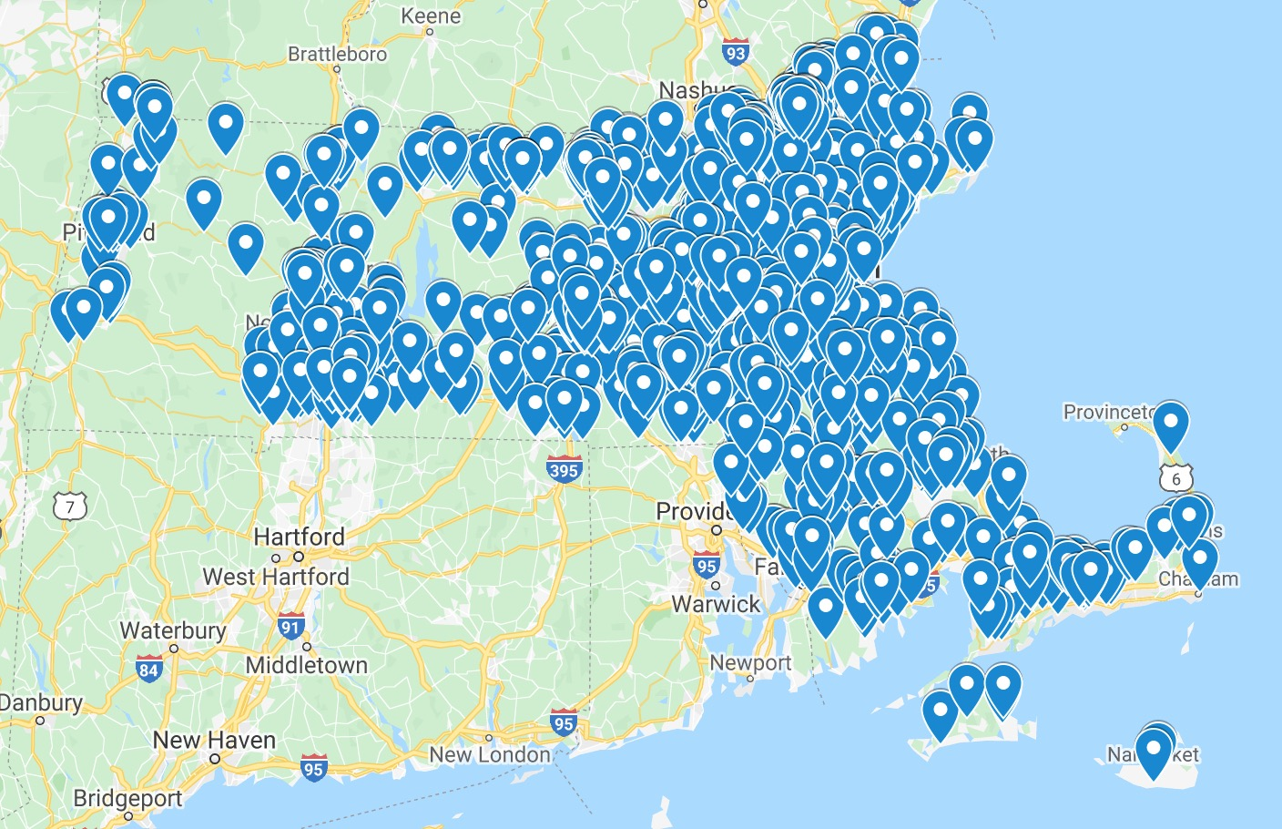
Update on Testing for Child Care Strategies
To enroll, visit https://www.maearlyedtesting.com/
EEC’s partnership Neighborhood Villages continues to include:
Ongoing access to free supplies for weekly PCR surveillance testing
Ongoing access to free rapid antigen tests to maintain access to care
Access to an online portal and navigation to support reporting requirements to Department of Public Health
Training for staff and others responsible for administering rapid antigen tests
Support in understanding and operationalizing the COVID-19 Mitigation Protocols and Guidelines for Child Care
New: On February 21, 2022 EEC launched the EEC Healthline, a resource staffed with health experts to support programs in implementing the Testing for Child Care program and navigating COVID-19 issues and concerns. This resource is available to all EEC-affiliated programs, and providers can access help in English and Spanish by phone or email.
Uptake/Enrollment:
Nearly 1,400 programs are enrolled in pooled testing
Over 3,000 enrolled in rapid testing in the first month of the program
Enrollment represents 120,000 individuals who are rapid testing
Over 900,000 tests have been distributed to over 3,000 programs​
Notes:
EEC has partnered with Neighborhood Villages to launch testing supports
Pooled Testing Program: Asymptomatic surveillance testing for ~8,000 individuals at ~270 childcare programs statewide weekly
Rapid Test Supports: EEC has been partnering with Neighborhood Villages to distribute rapid antigen test kits to programs
~3,000 programs have opted in to this program within the past week, at a roughly even split of FCC and GSA programs. This represents:
~26,000 staff
~94,500 students

Slide 4
C3 Operational Grants - Dashboard as of March 3, 2022
Region and Type | % providers applied for grants (as of 2/3) | % providers applied for grants (as of 3/3) | %capacity enrolled (Sept 2022) | %capacity enrolled (Feb 2022)
1 – Western FCC | ~82% | ~83% | ~86% | ~84%
1 – Western GSA | ~86% | ~87% | ~80% | ~85%
2 – Central FCC | ~82% | ~83% | ~83% | ~84%
2 – Central GSA | ~85% | ~90% | ~87% | ~91%
3 – Northeast FCC | ~89% | ~90% | ~81% | ~82%
3 – Northeast GSA | ~81% | ~87% | ~85% | ~91%
5 – Southeast & Cape FCC | ~81% | ~82% | ~93% | ~91%
5 – Southeast & Cape GSA | ~87% | ~90% | ~91% | ~95%
6 – Metro Boston FCC | ~88% | ~89% | ~78% | ~77%
6 – Metro Boston GSA | ~79% | ~87% | ~80% | ~84%
6,440 programs submitted applications for funding (~86% of all eligible programs)
Projected ~$260M by end of March 2022, sustained at ~$30 million/month
~65% of funding has been distributed to
subsidized programs
~20% of applicants chose Spanish as their primary form of communication
4

Slide 5
System-Wide Capacity Summary
Region and Type | # programs open March 2020 | # programs open Feb 24, 2022 | % of pre- COVID programs | Total Licensed Capacity
1 – Western FCC | 873 | 771 | 88.3% | 6,114
1 – Western GSA | 394 | 378 | 95.9% | 22,226
2 – Central FCC | 1157 | 1,035 | 89.5% | 8,169
2 – Central GSA | 522 | 506 | 96.9% | 34,692
3 – Northeast FCC | 1296 | 1,142 | 88.1% | 9,145
3 – Northeast GSA | 675 | 673 | 99.7% | 49,376
5 – Southeast & Cape FCC | 938 | 855 | 91.2% | 6,811
5 – Southeast & Cape GSA | 614 | 574 | 93.5% | 36,766
6 – Metro Boston FCC | 1066 | 985 | 92.4% | 8,013
6 – Metro Boston GSA | 687 | 659 | 95.9% | 40,094
 | 8,222 | 7,578 | 92.2% | 221,406
Note: This represents the number of programs currently open. This does not represent the full picture of programs that re-opened or closed since March 2020 – as new programs have opened, they have offset closures. This dashboard was last reviewed by the board in October 2021. It is intended to support monitoring for child care infrastructure return.

Slide 6
FY22 Caseload Account Spending Update

Slide 7
Income Eligible Utilization - Overview
Source:
Voucher information based on CCRR weekly report for week ending 2/26/2022.
Contract information based on contract utilization on 2/28/2022.

Slide 8
Income Eligible Utilization – Voucher Detail
Source:
Voucher information based on CCRR weekly report for the week ending 2/26/2022.
Waitlist information based on active children as of 2/28/2022

Slide 9
Income Eligible Utilization – Contract Detail
Source:
Contract information based on contract utilization on 2/28/2022; Waitlist information based on active children as of 2/28/2022.

Slide 10
Income Eligible Utilization – Waitlist Detail
Source:
Waitlist information based on active children as of 2/28/2022

