Slide 1
MART and GATRA
Brokerage Technology Improvements
Non-Emergency Human Service Transportation Task Force
2/14/2022

Slide 2

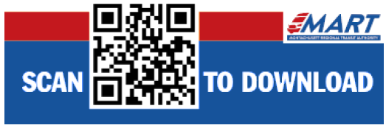
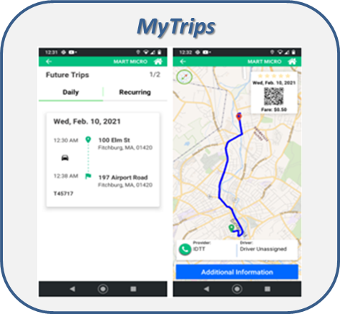
Brokerage Technology Improvements
New Consumer Smartphone Application:
  FREE on all internet connected mobile devices; available on Google Play and Apple Stores
  An efficient and user-friendly way to book and manage trips
  Ability to track and monitor rides and receive updates on arrival and departure times
  Members can review past trips and submit feedback directly within the application
  Expanded utilization through distribution of flyers with QR code to download the apps throughout all Demand Response vendor vehicles
Enhanced Member Portal:
  Allows consumers to book and manage rides through any web browser
  View past and future trips, as well as a list of all active MassHealth PT1’s
    For past trips, members can submit feedback about the trip from directly within the portal
New Facility Portal: Allows facilities to book and manage rides on behalf of their clients
QRyde Supplier Application: Mobile version of broker’s online Vendor Portal
  Vendors can accept or reject trips/standing orders on the go
  Vendors can assign trips to their drivers via the app
  Same day trip updates are reflected directly on the Drivers app, cutting communication time from the broker to dispatch, as well as dispatch to driver
  Automated Billing
QRyde Driver Application: Allows vendors to manage trips assigned to their drivers. The apps built-in GPS technology will be used to track vehicles, improve on-time performance and trip verification
Phone Reminders to customers with the ETA of their scheduled ride

Slide 3
New Technologies Deployment: Vendor On-boarding
QRyde Supplier Application/Portal:
  GATRA 57 / MART 260 vendors registered; GATRA 57 / MART 146 vendors have downloaded the app
  Allows vendors to add drivers to its portal
    GATRA 176 / MART 407 drivers have downloaded and are Utilizing the Driver App
  Includes GPS tracking functionality for trip verification, resolving service issues, etc.
  Allows vendors to assign rides to drivers (mini-mobile dispatch)
  Provides access to electronic driver manifests
  Vendors can also push trip notifications and changes to drivers in real-time
Vendor Technology Onboarding Process:
  Vendor Focus Groups
  Online Videos and Tutorials
  Support Channels:
    Online Chat and Dedicated Technical Support at 1-888-318-9043; Available M-F 8:30 – 7:00 PM
  Webinars offered twice daily at 11AM and 3PM
  GATRA / MART provide live support, electronic “how-to” step-by-step guide for all vendors; 1:1 video and/or phone support; 1:1 tutorial’s utilizing screen share

Slide 4
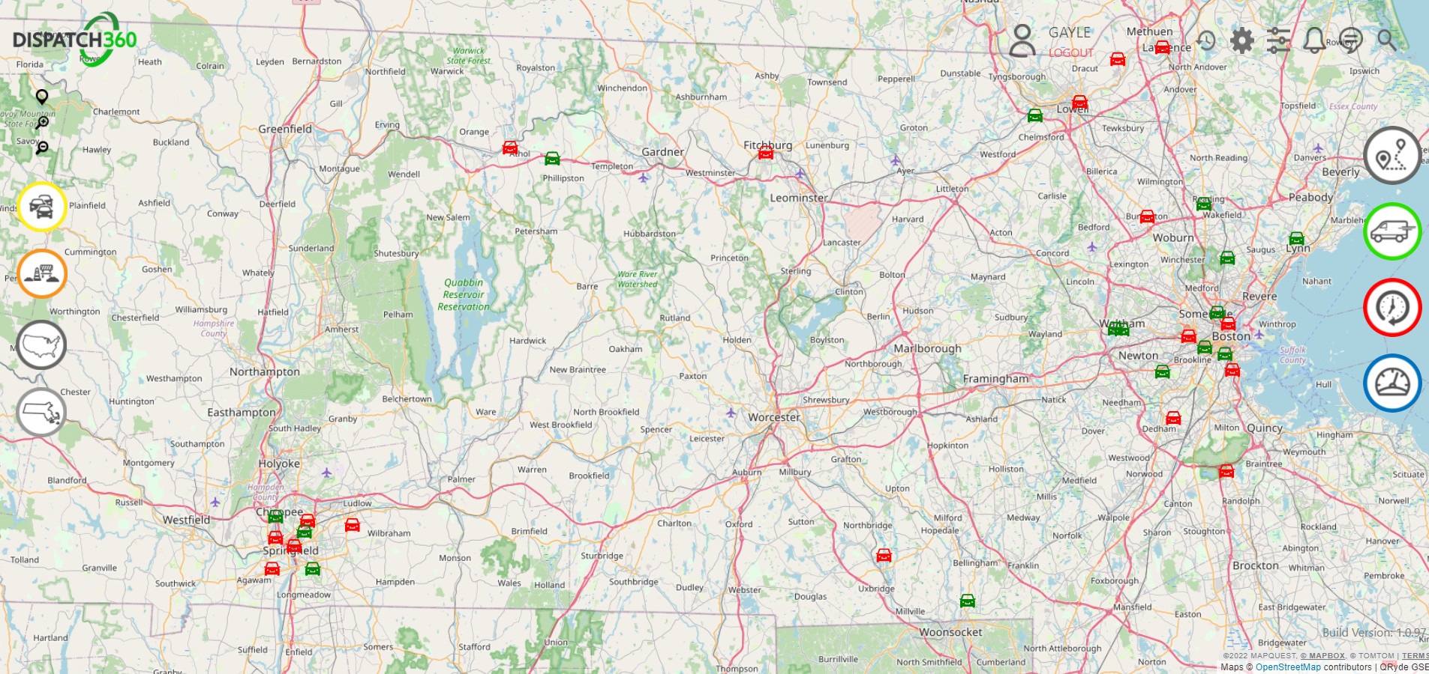
MART Vehicle Tracking
Screenshot of the vehicle tracking capabilities available on the Navigation Portal

Slide 5
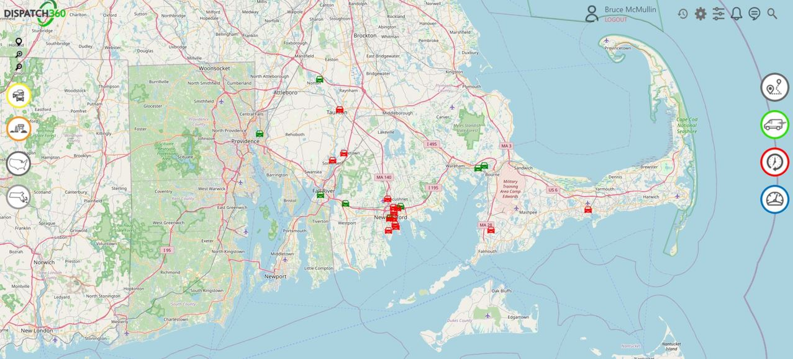
GATRA Vehicle Tracking
Screenshot of the vehicle tracking capabilities available on the Navigation Portal

Slide 6
On Time Performance Tracking
Example of Broker capabilities to track on time performance for various metrics and information available on each driver and trip:
Actual Arrival Time
Pickup Time
Actual Arrival Time
Appointment Time

Slide 7

On Time Performance Trends:
Performance Criteria:
  Allowed Time Windows for Ambulatory and WC trips
Performance Scoring by:
  Vendor Total Score
  Vendor Average Score
  On time Trips as a % of total
    For All Vendors
    By a Specific Vendor
    By Driver by Vendor
  Total Trips Assigned by Supplier App and as a % of total assigned trips
  Total Trips tracked/recorded on the Driver App and as a % of total
How MART / GATRA Utilize Vendor Performance Scoring:
  Track on-time arrival via GPS functionality to measure performance
  Analyze vendor performance / compliance with contract performance standards. Failure to meet established standard results in:
    Reduced volume of work
    Establishment of Corrective Action Plans
    Suspension of drivers and/or vendors
    Contract Termination

Slide 8
MART Call Center Investments
43 Multi-lingual (56 total) Call Center Agents / 3 Supervisors / 1 Call Center Manager:
  Available Monday – Friday from 7AM-7PM EST
  Languages available via in house staff: English, Spanish and Russian
  Language line available for all staff to access for any other consumer language needs
Added a third-party call center for increased customer service
  Reduced call hold times
  Achieved compliance with time to answer and call abandonment standards in HST contract
  Improved customer experience offering a comprehensive 24/7 and weekend call support for consumers
  Enhanced business continuity for both regular business hours and after-hours consumer needs
Upgrading Call Center software with major benefits to MART, as well as our members
  Some of the features are:
    Advanced integration with our trip booking software:
      When a member’s call is answered, this new feature automatically pulls up the member's profile within our trip booking software for quicker service and reduced call handling times
    Advanced Quality Management: Cutting-edge scorecards and agent evaluation methods
    Skills-based call routing based on customer requested language preference, including ATT Language Line
    New and improved post call survey to gather additional feedback from members to improve customer service

Slide 9
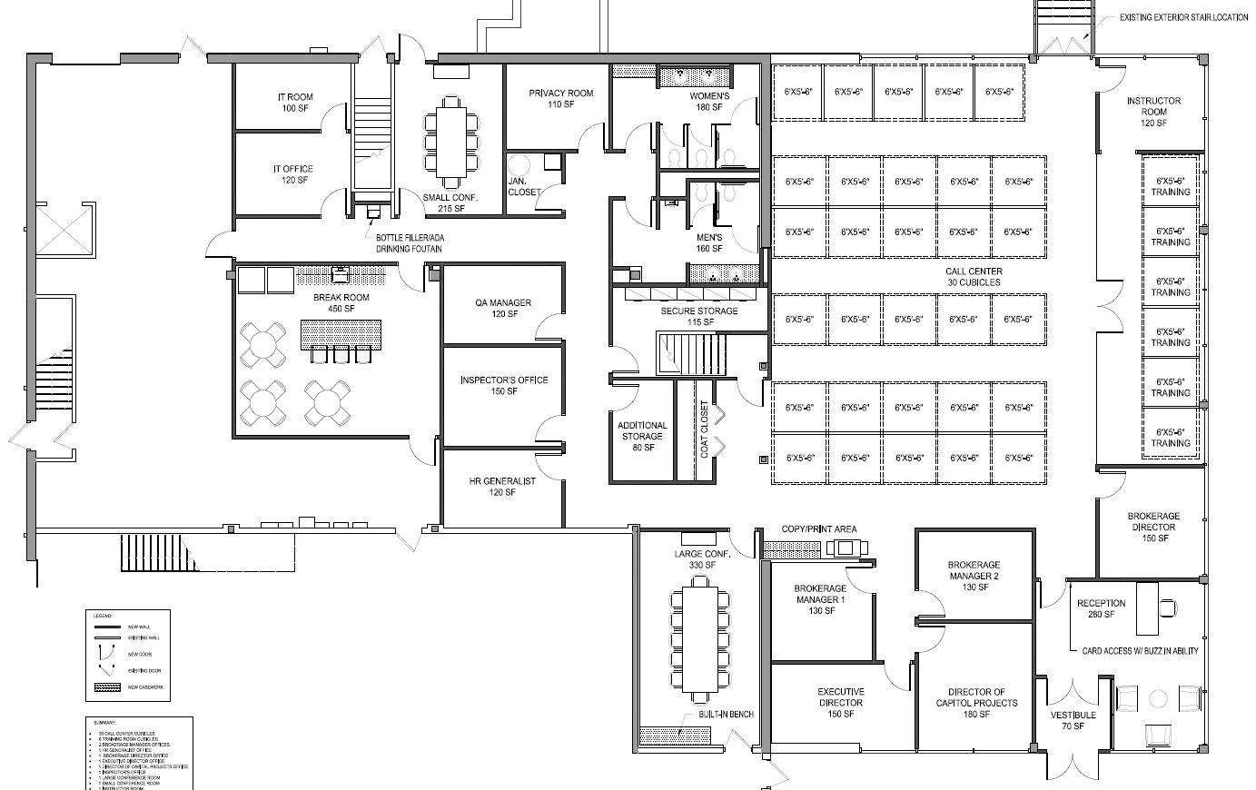
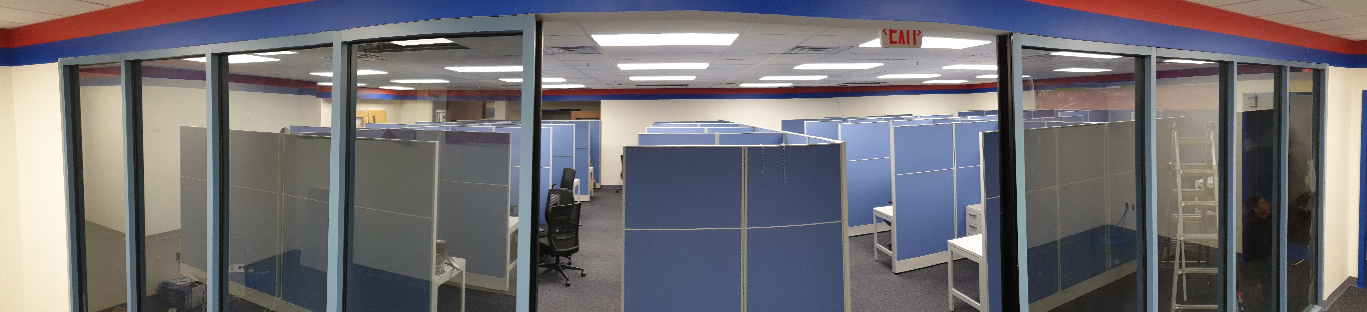
Second MART Operations Center
Features:
State of the Art design
Capacity for 45 employees
Dedicated training space
Telcom Upgrades and Enhanced IT infrastructure
Voice & Data redundancy
Disaster Recovery Continuity

Slide 10
GATRA Call Center Investments
11 Call Center Agents, 4 Supervisors and 1 Office Manager:
  Available Monday – Friday from 7AM-6PM EST
  Languages available via in house staff: English, Spanish and Portuguese
  Language line available for all staff to access for any other consumer language needs
Finalizing Implementation of 3rd party Call Center for increased customer service, which will result in:
  Improved customer experience by offering a comprehensive 24/7 and weekend support experience for consumers
  Reduced wait times for callers
  Enhanced business continuity
Upgrading Call Center software with major benefits to GATRA, as well as our members
  Some of the features are:
    Skills-based routing to ensure callers speaking Spanish/Portuguese are routed to a CSR capable of communicating in that language without the need to be manually transferred
    Advanced Quality Management: Cutting-edge scorecards and agent evaluation methods

