Slide 1
Consumer Orientation Session
Notes:
Presenter: SO
Good Morning/Afternoon everyone, and welcome to the Montachusett Regional Transit Authority’s Consumer Orientation Session.
My name is Stephen Oldfield I am the Executive Director of Brokerage and one of the hosts of this event.
My pronouns are he/him. I’m a Caucasian male, with short dirty blonde hair and hazel eyes. I joined MART in January 2021, coming from a IT & Data Analytics company with the goal of improving our member experience during this transition.
Next I am going to go over the accessibility of today’s meeting and the agenda before we discuss the services we provide, as well as some of the improvements we are making.
Next slide please…

Slide 2
Accessibility at Today’s Meeting
Interpreters
CART
Use the chat box to contact the hosts for assistance at any time
Notes:
Presenter: SO
In terms of accessibility for this meeting, we have American Sign Language interpreters, Certified Deaf Interpreters, and CART real-time captioning services.
To access captioning outside of Zoom you can click on the streaming link that we have posted in the chat.
To access captions within Zoom you will need to turn on subtitles on the device you are using to access this meeting.
Zoom also lets you adjust the size of the videos and slides that appear on your screen. Side-by-side mode allows you to see the shared screen alongside either the Speaker view or Gallery view, depending on which view you choose.
You can also adjust the location of the separator between the shared screen and video to change the relative size of each slide compared to the videos.
If you have any questions or concerns about accessibility, please use the chat feature to contact us at any time during this session.
Anything that you tell us in the chat can only be seen by hosts and will not be posted or read publicly.
Next Slide Please…

Slide 3
Today’s Agenda
Welcome and introductions
Overview of Services
What you can expect
Recent updates and improvements
Questions & comments
Submit your questions at any time
Q&A box
Raise your hand during the Questions & Comments section
Notes:
Presenters: SO, DD, RB
Now I’d like to review the agenda for this morning’s/afternoon’s event.
First, the two other hosts of this event, David Dunn and Rebecca Badgley, will do some brief introductions before we present an overview of the services we provide, as well as some of the improvements we are making.
Finally, we will hold a ‘questions and comments’ section where you may ask questions or offer feedback.
---------------------------
If you would like to submit a question before that part of the agenda, you may do so at any time using the Q & A feature in Zoom and we will read your question out loud during questions and comments.
During that part of today’s meeting you will also be able to ask your question verbally or through the interpreters in addition to writing it in the Q&A box.
If you will be communicating your question or comment visually, please let us know in the chat so we can turn on your video at that time. We ask that each person identify themselves every time they speak during this morning’s event.
Without further adieu, I turn it over to the Director of Brokerage at MART, Rebecca Badgley…
---------------------------
Thanks Stephen and hello everyone. My name is Rebecca Badgley and I am the Director of Brokerage Operations at Montachusett Regional Transit Authority
I am a Irish American Caucasian female with blonde hair and blue eyes
I have been with MART for 32 years and oversee the day-to-day operations of the Brokerage
I’ll turn it over to David to introduce himself, before I dive into an overview of our services…
---------------------------
Thanks Becky. Hi everyone. My name is David Dunn, and my role at MART is the Director of Quality Assurance & Call Center
I am a Caucasian male, bald with a goatee, and blue eyes.
I have been with MART for 4 years and oversee the Call Center, Quality Assurance department, and Inspectors
Next Slide Please…
-----------------------------

Slide 4
Effective July 1, 2021 MART will be the broker for the newly defined HST Area 1 and 2
Rides funded by MassHealth and other state Health & Human services agencies
Office of Medicaid (MassHealth PT-1)
Department of Developmental Services (DDS)
Department of Public Health (DPH)
Massachusetts Rehabilitation Commission (MRC)
Massachusetts Commission for the Blind (MCB)
Department of Mental Health (DMH)
Notes:
Presenter: RB
Effective July 1, 2021, MART will be responsible as the broker for Human Service Transportation for the newly defined Region 1 & 2 which will include the transportation oversight for the following agencies.
Because we recognize the importance of transportation to medical appointments as a critical component of health care, the Montachusett Regional Transit Authority focuses on providing high-quality, reliable non-emergency medical transportation, to assist MassHealth members with getting to and from health care appointments through the PT-1 system.
We also provide transportation for several other Health and Human Services agencies:
the Department of Developmental Services (DDS),
the Department of Public Health (DPH),
the Massachusetts Rehabilitation Commission (MRC),
the Massachusetts Commission for the Blind (MCB),
and the Department of Mental Health (DMH)
Next Slide Please…

Slide 5
State Contracts with Regional Brokers
MART
MART
GATRA
Notes:
Presenter: RB
On this slide, we have a map showing the newly defined HST areas that will go into effect on July 1, we will have two brokers covering three regions.
GATRA will be the broker for Region 3 which covers Southeastern Mass, Cape, Islands. MART will be the broker for Regions 1 and 2, covering the rest of the state – Western Mass, Central Mass, Metro Boston, and Northeastern Mass.
If are currently a member with BRTA, FRTA or CATA, you will be served by MART effective July 1, 2021.
Next Slide Please…

Slide 6
What you can expect
Seamless transition
Exceptional customer service
Timely responses to issues and concerns
Extended call center hours
Notes:
Presenter: RB
We’re excited to tell you about the improvements we have coming for you starting July 1, but before we get into that, we want to reassure you that the important things will stay the same. You can expect a seamless transition for your services as MART will be working closely with current RTA for transfer of data as well as Mass Health will be updating us with all current PT1 information.
If you get rides now, you will continue to get rides. That’s true whether you’re getting MassHealth rides through the PT-1 or agency-funded trips to your program.
MART is also contracting with the transportation providers that are providing services under the current RTA’s so you will continue to see familiar transportation providers.
MART is currently hiring and training additional call center, scheduling and quality assurance agents that will be ready serve you needs. MART will be ready to start taking your calls on June 17, 2021 to for any appointments that you may have to schedule for July 1, onward.
MART’s call center also has extended hours of service -- agents are available Monday through Friday from 7am to 7pm.
Next, I’ll turn it back over to Stephen to talk about some of the new and exciting improvements we are making…
Next Slide Please…

Slide 7
New and exciting improvements coming July 1, 2021
Notes:
Presenter: SO
Thanks Becky! In this next section, I am going to cover some of the new and exciting improvements that are coming as of July 1st.
Next Slide Please…

Slide 8
On-Time Performance & Reliability
Coming July 1
New consumer smartphone application
Enhanced Member Portal
Enhanced transportation provider performance monitoring dashboard
Other improvements:
GPS tracking on vehicles
Ride-hail pilots
Notes:
Presenter: SO
The first topic we wanted to cover today is the importance of On-Time Performance and Reliability of our Transportations providers. We know how important it is for you to get to your appointments on time, so were making the following improvements to help our customers get to their appoints promptly and more consistently.
Starting July 1st, MART will be introducing a new consumer smartphone application, which will provide an efficient and user friendly way to book and monitor trips in real time.
Through the application, you, the members, will be able to track and monitor your ride and receive updates on arrival and departure times.
We will use this data in an effort to improve timeliness of our transportation providers, and allow us to take quick action if a transportation provider fails to provide on-time service.
You will also have the ability to review your past trips and submit feedback directly within the application.
The app will be very easy to download and free on all internet connected devices.
We will also be enhancing our transportation provider performance monitoring dashboard to better track our transportation providers with additional data and metrics. This will help keep the transportation providers accountable, and ultimately provide a better experience for you, our members.
_______________________________________________________________
We are also working on some other improvements, which will not be ready by July 1st, but we wanted to share what is coming!
We will be adding Global Positioning Systems, also commonly known as GPS, in all of our vehicles. This means, we will have technology on every vehicle to track exactly where the vehicle is, and provide updates on when your ride will arrive. With this added technology, we will be able to track on-time performance of our transportation providers and follow up immediately if your ride is going to be late.
We are in preliminary discussion on developing ride-hail pilots through a partnership with companies such as Uber and Lyft to help with transportation requests, so that you can get to where you need to go in a timely fashion.
Next Slide Please…

Slide 9
Efficient Call Center
Currently in place
Members can call into our Call Center to book a trip through one of our multilingual call center agents
Hours: Monday – Friday from 7am-7pm
Languages offered: English, Spanish, Russian
Coming July 1
Additional Call Center staff to reduce wait times and improve upon our high customer service standards
Enhanced Consumer and Provider portals
Mobile App (free, available on all devices)
Notes:
Presenter: SO
Next, I am going to cover how we are making our call center more efficient.
Currently, we have multilingual call center agents available Monday – Friday, 7am to 7pm. When you call into our call center, you have the option to speak to an agent that speaks English, Spanish, or Russian.
For all of you that prefer to call, we have added additional call center agents to our team, so we can handle your calls as efficiently as possible, while maintaining our high customer service standards.
Starting on July 1st, you will have access to our new and improved Member app and portal so you can now book trips without having to call into the Call Center, but our agents are always standing by to assist with calls if that is how you prefer to book your rides.
The Member Portal is a web based application that can be accessed on any internet connected devices. In the member portal, you can book and edit trips, see past and future trips, and submit feedback -- just to list a few of the new features.
The Member App is a mobile device application which will have all the same functionalities as the Member Portal, but can be downloaded for free on any mobile device, and accessible to all.
We will take a deeper dive on the Member Application, as well as the Member Portal, further in the presentation.
Next Slide Please…

Slide 10
Prioritizing Driver & Vehicle Safety
Currently in place
Mobile inspectors perform random safety and spot checks & conduct annual audits
Coming July 1
Increased number of inspectors
Enhanced driver training system
Updated facilities portal
Notes:
Presenter: SO
Safety is of the utmost importance to MART and we will continue to hold our transportation providers to a high standard.
Currently we have multiple inspectors that perform daily random vehicle inspections, as well as annual vehicle inspections and transportation provider audits.
We want to ensure that all transportation providers are providing safe transportation, so prior to July 1st, MART will have added and trained additional inspectors to ensure we maintain the highest quality standards.
As new transportation provider’s onboard, as well as when current providers add new drivers, we review all contractual requirements which included driver’s license, driving history and completed trainings.
We also review all vehicle records, including the transportation provider’s insurance coverage to validate that all drivers and vehicles are in line with our contractual safety standards.
Any failure to meet requirements will disqualify the provider, driver and vehicle to transport under the contract.
To ensure that drivers being hired are trained properly, MART is creating a robust driver training program. This program will be very comprehensive to ensure all drivers are providing safe and comfortable transportation to all our riders.
The updated facilities portal, which will be ready for deployment on July 1, will include new a feature that will allow for facilities to submit complaints on behalf of members who may not be able to submit them on there own.
Next Slide Please…

Slide 11
Timely & Transparent Complaints Process
Currently in place
Multiple ways to file a complaint (phone, email, mail)
Quality Assurance Unit/Customer Complaints Division
Text notification of complaint resolution
Details available by mail by request
Coming July 1
Additional ways to file complaints – including app and member portal
Notification system for complaint resolution
Notes:
Presenter: SO
Next up, a timely and transparent complaint process.
We understand a timely and transparent complaint process is important, and at MART, we take members’ feedback very seriously. Our continuous goal is to address feedback quickly and provide responses in a timely manner.
We have multiple ways to file a complaint including through our call center staff, email communication, or mail. Our Quality Assurance department is dedicated to addressing your complaints and providing resolutions.
Once a resolution on the complaint has been addressed by one of our quality assurance agents, our text notification feature will alert you with details on the resolution. You also have the ability to obtain details on a complaint by mail request.
Starting on July 1st, there will be additional ways to submit feedback:
You will be able to communicate feedback through the enhanced mobile app and member portal in real time. There will also be a link available via our updated website
Once the feedback is addressed, you will receive a notification with details on the resolution and what steps we took to address it.
Next, to go over the enhanced Member Portal, and new Member Application in more detail, I’ll had it over to my colleague, David Dunn…
Next Slide Please…

Slide 12
Enhanced Member Portal
As of July 1st, the improved Member Portal will be available to all members
Data security and privacy are of the utmost important to us. We implemented multi-layered measures on the Member Portal that are designed to protect the personal data under our control.
Within the improved Member Portal, you will be able to:
Book trips to approved PT-1 locations
View past and future trips
View a list of your PT1’s
Log a complaint
The member portal and facilities will be located at: http://www.mrta.us/masshealth/customer-information
Notes:
Presenter: DD
Thanks Stephen!
I would also like to discuss the upgrade to our existing member portal that can be located on our website @ http://www.mrta.us/masshealth/customer-information.
The improvement will allow you to book your trips more efficiently without having to use the traditional method of calling into our call-center and allowing you the member easier access, although you can still call into our Call Center if you prefer…
Additionally if you have your medical facility book your trips for you they will have access to the similar system to book those rides for you. Both updates will now allow you to submit feedback, directly within the portal or application.
Once a resolution on the complaint has been addressed by one of our quality assurance agents, our text notification feature will alert you with details on the resolution. You also have the ability to obtain details on a complaint by mail request.
Next Slide Please…

Slide 13
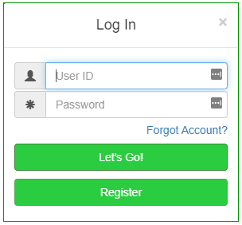
Member Portal: Login and Registration
Registering and logging into your account is easy!
Below are the steps to start using the improved Member Portal:
How to Log In:
1. Select ‘Login’ on the top right of your browser
2. Enter your User ID and Password
3. Select Let’s Go!
Member Portal Quick Guide URL: http://www.mrta.us/sites/default/files/pdf/Member%20portal%20quick%20guide.pdf
Notes:
Presenter: DD
Registering and logging into your account is easy! On this page, there are steps to start on how to log in to the portal on the left side of the slide, and a screenshot of login popout window
To Login… (Read slide as presented.)
Next Slide Please…

Slide 14
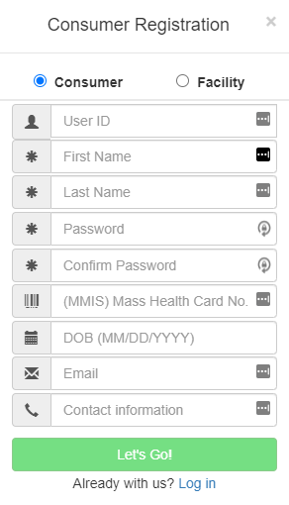
Member Portal: Login and Registration
Registering and logging into your account is easy!
Below are the steps to start using the improved Member Portal:
How to Register:
1. Select ‘Login’ on the top right of your browser
2. Select ‘Register’ at the Login screen.
3. Fill in all required fields and select ‘Let’s Go!’
- If information is successfully entered, you will be notified; otherwise, you will have to correct the information.
(Please note: While creating your profile all fields are case sensitive)
Member Portal Quick Guide URL: http://www.mrta.us/sites/default/files/pdf/Member%20portal%20quick%20guide.pdf
Notes:
Presenter: DD
Read slide as presented.
Next Slide Please…

Slide 15
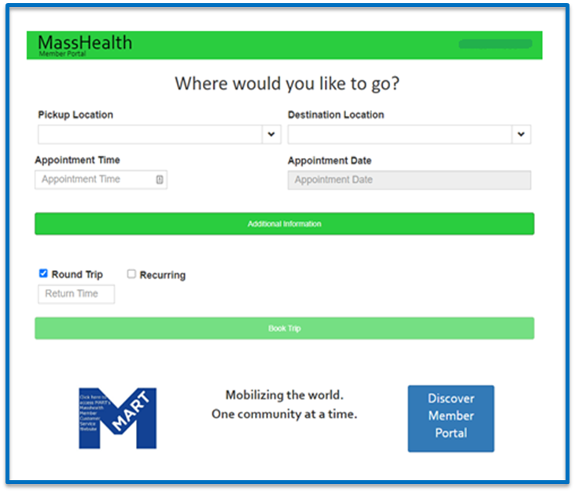
Member Portal: How to book a trip
Once logged in, you will see areas to enter your ride information
Select prepopulated ‘Pickup’ and ‘Destination’ Location based on your approved PT1(s)
Input Appointment Time and Date
Select ‘Single Trip’ or ‘Recurring’
Enter any ‘Additional Information’ that are needed for the trip
Review and Confirm your trip details. If all the information is correct, click ‘Book Trip’
Notes:
Presenter: DD
Lets go over how to book a trip via the Member Portal…
Read slide as presented.
Next Slide Please…

Slide 16
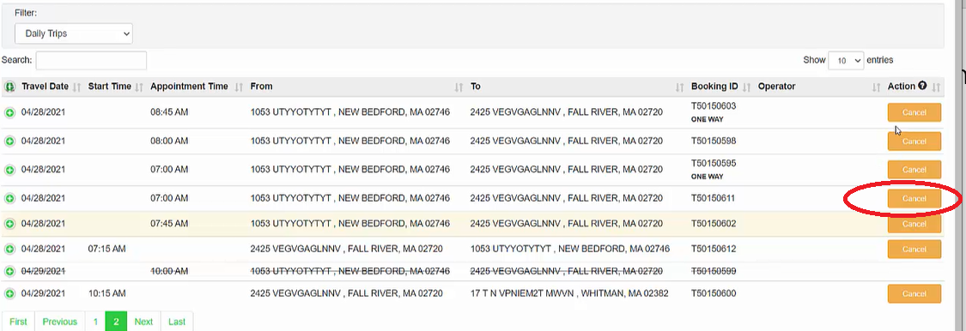
All trips will be displayed and you will have the ability to cancel any previously scheduled trip(s) in real-time.
Member Portal: View & Cancel Trips
Notes:
Presenter: DD
Read slide as presented.
Next Slide Please…

Slide 17
Member Portal: View Your PT1s
You can view your current PT1s by selecting ‘PT1s from the drop down menu on the top right of your browser.
You can expand each PT1 by clicking the button to see additional information
Notes:
Presenter: DD
Read slide as presented.
Next Slide Please…

Slide 18
Member Portal: Submitting Feedback
You can register a complaint in the Member Portal by following these steps:
Once you are logged into the portal, go to the top right corner of the browser and select ‘My Trips’
Select ‘Past Trips’ under the drop down filter under ‘My Rydes’
Expand the trip you’d like to submit a complaint under by clicking the button.
Click the green ‘Complain’ button
Notes:
Presenter: DD
Read slide as presented.
Next Slide Please…

Slide 19
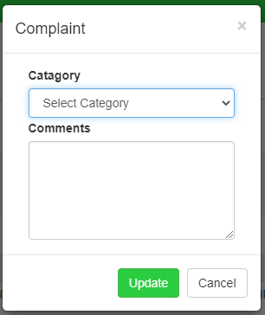
Member Portal: Submitting a Complaint (Cont.)
Once you click on the ‘Complain’ button, a pop out window will appear. From there, you will:
Select your complaint ‘Category’
Type your complaint in the ‘Comments’ field
When you are completed, select ‘Update’ to submit your complaint
Notes:
Presenter: DD
Read slide as presented.
Next Slide Please…

Slide 20
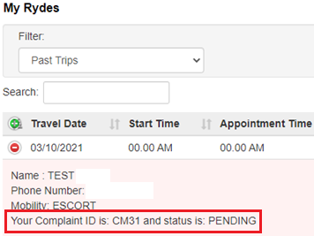
Member Portal: Submitting a Complaint (Cont.)
Once your complaint is submitted, the complaint number and status is listed under the trip
Once the complaint has been addressed by one of our Quality Assurance Agents, the complaint will be updated in the portal with resolution of the complaint.
Notes:
Presenter: DD
Read slide as presented.
Next Slide Please…

Slide 21
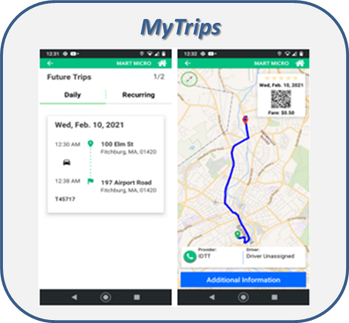
New Member Application
The new member app will…
…allow members to book trips to approved PT-1 locations
…monitor trips in real-time with reporting updates of any delays related to the trip
…allow the user to file a complaint directly through the application
…be accessible to all
…be easy to download and free on all internet connected devices
…be secure, and all data will be protected
Notes:
Presenter: DD
Lets switch gears to go over the different functionalities of the new Member Application.
The new member app will…
Read slide as presented.

Slide 22
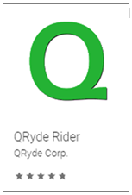
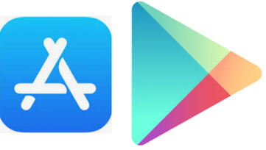
New Member Application: How to Download
Downloading the app is easy, just follow these steps:
1. To download the application on your device, navigate to Apple’s App Store or the Google Play store depending on your device.
2. Search for QRyde Rider and install onto your device.
3. Once installed, open the application and proceed to registering for an account.
Notes:
Presenter: DD
Read slide as presented.
Next Slide Please…

Slide 23
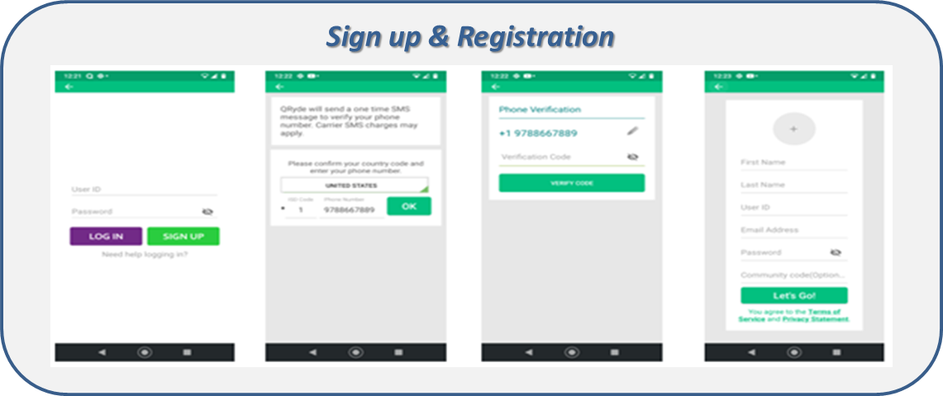
Member Application: Sign Up & Registration
How to Register:
1. Open the application on your device
2. Select ‘SIGN UP’
3. Enter your phone number
4. Verify the SMS code
5. Fill in all required fields and select ‘Let’s Go!’
(Please note: While creating your profile, all fields are case sensitive)
How to Log In:
1. Open the application on your device
2. Enter your User ID and Password
3. Select ‘LOG IN’
Notes:
Presenter: DD
Registering and logging into your account is easy!
Below are the steps to start using the Member Application:
Read Slide as presented.
Next Slide Please…

Slide 24
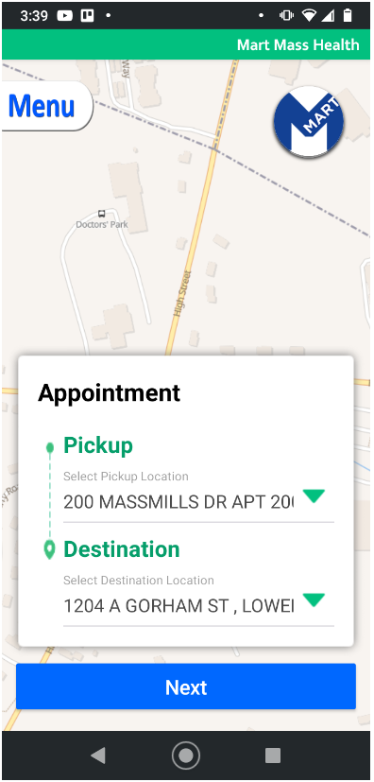
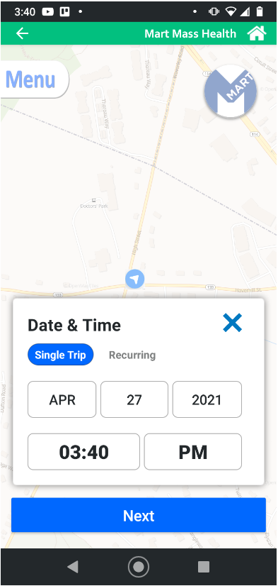
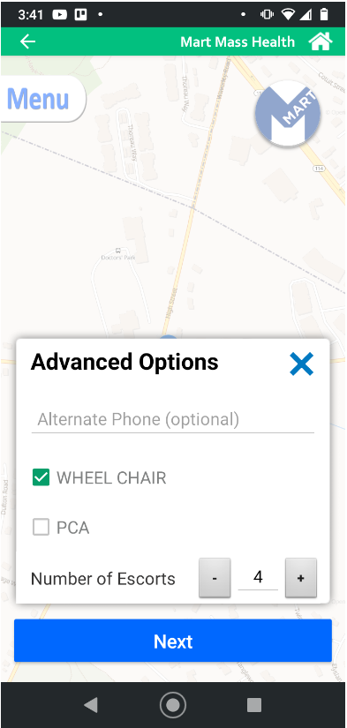
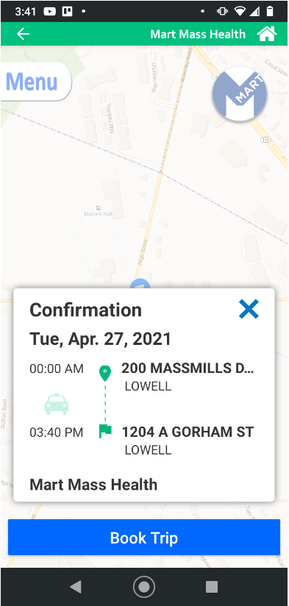
Member Application: Booking a Ride
Select prepopulated ‘Pickup’ and ‘Destination’ location based on your approved PT1(s)
Select ‘Single Trip’ or ‘Recurring’
Enter Date & Time of your trip and then click ‘Next’
Enter any ‘Advanced Options’ (if applicable) and then click ‘Next’
Review and confirm your trip details. If all the information is correct, click ‘Book Trip’
Notes:
Presenter: DD
Here are the steps to book a ride → Read Slide as presented.
Next Slide Please…

Slide 25
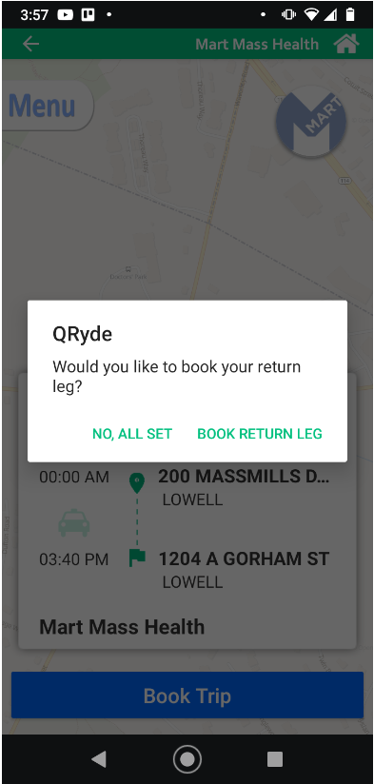
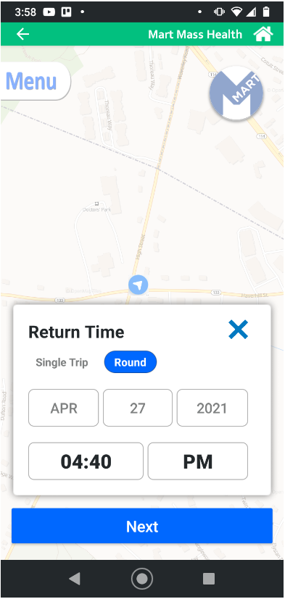
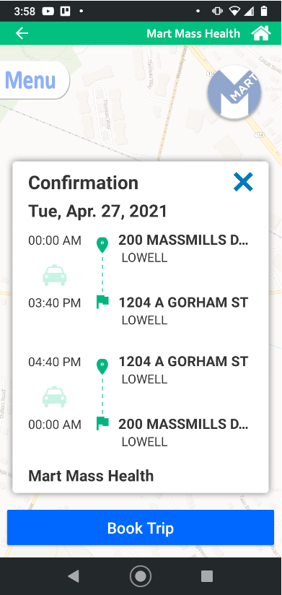
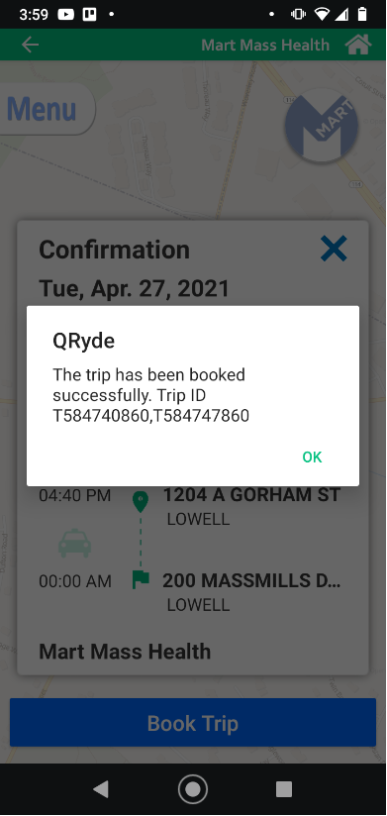
Member Application: Booking a Ride
After you confirm your single trip, a pop out screen will appear and ask you if you want to book a return leg. If so, select ‘Book Return Leg’
Enter Date & Time of your return trip and then click ‘Next’
Review and confirm your full trip details. If all the information is correct, click ‘Book Trip’
Once the trip is booked, you will receive confirmation, which includes the trip ID associated with your scheduled trip.
Notes:
Presenter: DD
Read Slide as presented.
Next Slide Please…

Slide 26
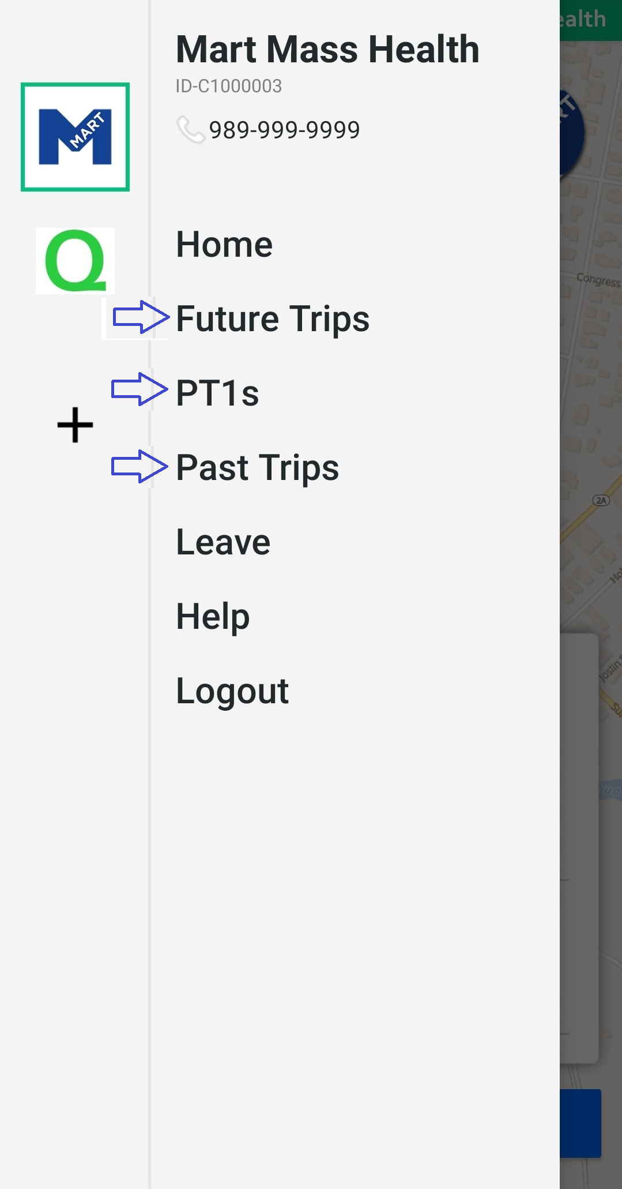
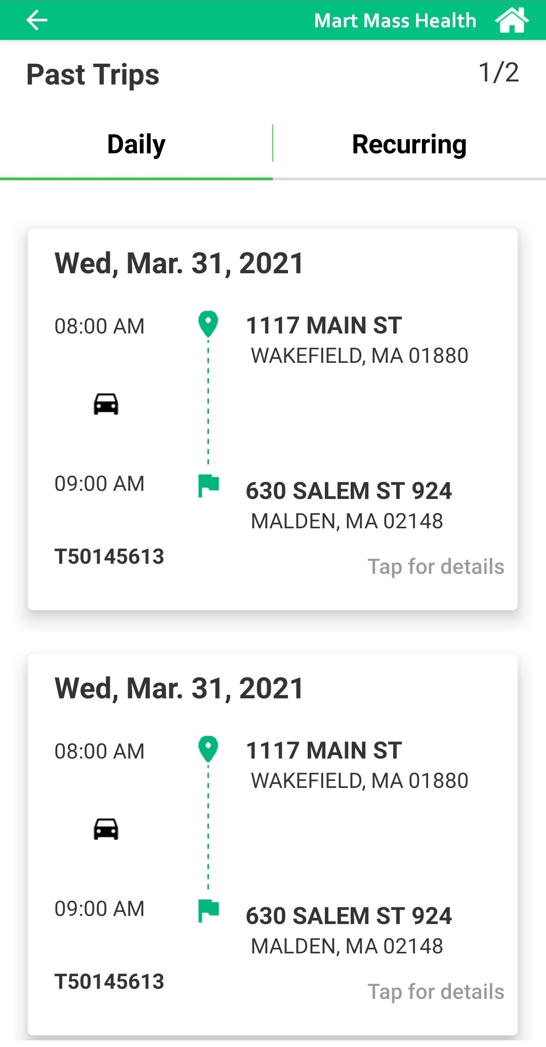
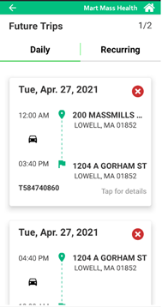
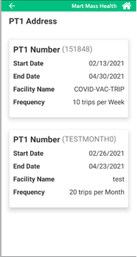
Member Application: Viewing Trips & PT1s
You can view Future Trips, Past Trips, and PT1s by taping the “Menu” option located in the upper left corner of the screen
Notes:
Presenter: DD
Read Slide as presented.
Next Slide Please…

Slide 27
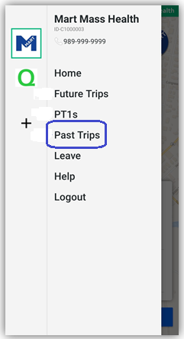
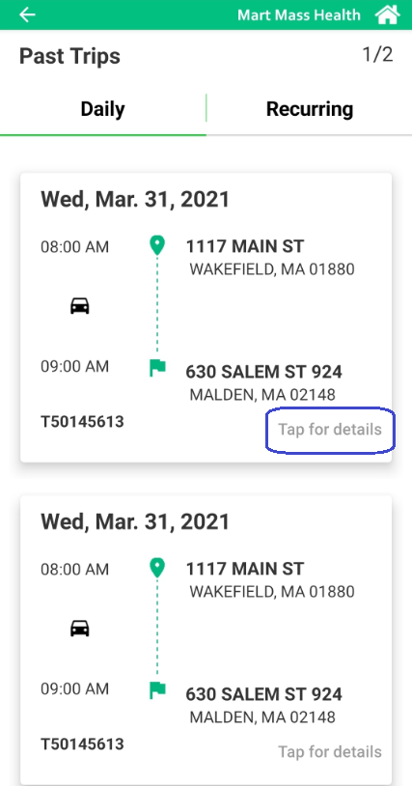
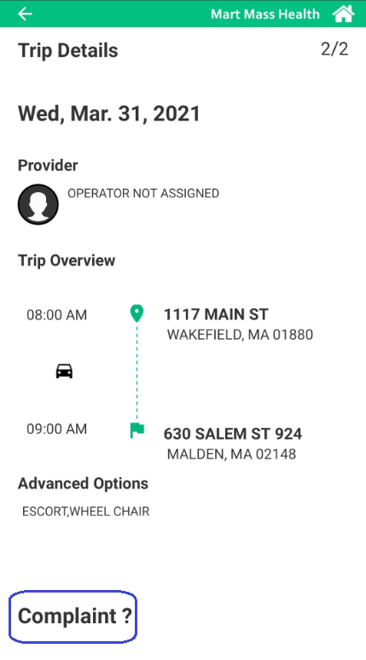
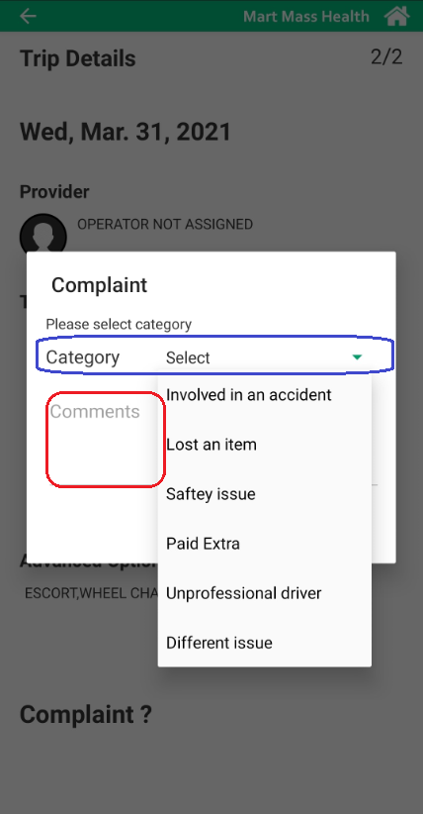
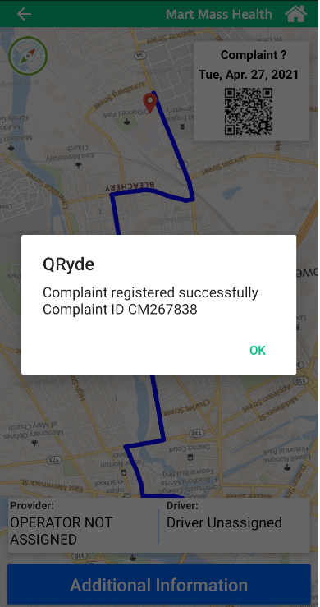
Member App: Submitting Feedback
Navigate to the “Menu” option located in the upper left corner of the screen and select ‘Past Trips’
Find the trip that you would like to submit feedback on and select ‘Tap for details’
Once the trip details are shown, you will tap ‘Complaint?’
Select a category from the drop down menu, and then type in your feedback in the ‘Comments’ section.
Once your feedback has been submitted, a pop up screen will appear with confirmation that your complaint was registered successfully, and provide the ‘Complaint ID’
Notes:
Presenter: DD
Read Slide as presented.
Next Slide Please…

Slide 28
We welcome your feedback!
Submit a complaint or share your ideas:
Monday-Friday 7 AM to 7 PM Toll Free: 1-866-834-9991
More ways to contact us coming July 1
Notes:
Presenter: RB
We welcome your feedback!
We invite you to submit a complaint or share your ideas at any time.
It is recommended that you contact MART directly and not the individual transportation providers if you experience issues this way MART will be able to insure that this issues are addressed and rectified in a timely manner.
- Right now, you can call us Toll Free, Monday-Friday, from 7 AM to 7 PM ET, at 1-866-834-9991
- Starting July 1, you’ll still be able to call, but you’ll also be able to reach us via the member portal and member app.
- Thank you all for your time today. We will now move onto the Question and Comment’ section of today’s meeting.

Slide 29
Questions & Comments
Raise your hand
Click on “Raise Hand”
Use Alt+Y for Windows or Option+Y for Mac
If you are calling in, dial *9
Or type into the Q&A box
Notes:
Presenter: RB
Now we will transition to audience Questions and Comments for the rest of the meeting.
If you have a question for any of the presenters or a comment or feedback to share, you can either submit it through the Q&A box or you can raise your hand to have a chance to speak.
If you want to type your question into the Q&A box, I will read it out loud. If you have already typed your question into the Q&A box, I have it, and you do not need to submit it again. Please make sure to use the Q&A box, not the chat box, so we are sure not to miss any of your questions and comments
If you want a chance to speak, use the “raise your hand” feature on Zoom. There are a few different ways to raise your hand.
You can click on the “raise hand” icon at the bottom of your screen or you can hit the Alt and Y keys at the same time on a Windows device, or Option and Y at the same time if you’re on a Mac.
If you’re dialing in by phone, dial star 9 and that will raise your hand.
If you will be asking your question in sign language, you will need video access. If you need video access for this reason, let us know in the chat, and we will make sure you have that.
Once your hand is raised, I will see it, and I will take turns calling on people so you each have a chance to share your comment or ask your question.
I’ll let you know when I’m about to call on you, so you can get ready. When I call on you, you will be able to unmute yourself to speak
We want to make sure everyone gets to ask their questions, so please keep your questions or comments brief
If you have more than one comment or multiple questions, please ask one at a time so everyone who wants to has a turn. After you’ve asked one question or shared one comment, we will put you back on mute. You can raise your hand again if you would like to submit additional comments or questions.
So with that said, let’s get started! Remember, to raise your hand you can click on “raise hand,” or dial star 9 if you’re on the phone.
I’ll start with a question that came in to the Q&A box…

Slide 30
Thanks for attending!
Keep in touch
To submit complaints about a specific trip or vendor or to provide positive feedback on your experience
Contact MART at 1-866-834-9991
Additionally if you feel that your issue was not addressed to your satisfaction you are welcome to reach out to the HST office.
Contact HST at hstcomplaintincident@mass.gov or (617) 847-3427
Notes:
Presenter: SO
On behalf of the entire staff of the Montachusett Regional Transit Authority, I want to thank you for attending today, and for your thoughtful questions and comments. We really appreciate your feedback and encourage you to keep in touch.
The PowerPoint presentation that we are using for this meeting is also on our website
If you would like to submit feedback about a specific trip or vendor, you can call us at 1-866-834-9991
Thank you so much for attending today’s meeting. Today’s presentation has formally concluded
You are welcome to log off if you have no more questions or comments to share
We will stick around so if you do have questions or comments, you can continue to submit them in the Q&A box or raise your hand – hit the raise hand icon, or dial *9 if you are on a phone
Thank you again to all our presenters, interpreters, and attendees. Have a great remainder of the day / evening!

