Slide 1

Commonwealth of Massachusetts
Massachusetts Olmstead Planning
Stakeholder Engagement and Input

Slide 2
Overview of Olmstead/Planning
What Is an Olmstead Plan?
In 1999, the U.S. Supreme Court rendered a decision in Olmstead v. L.C., 527 U.S. 581 (1999), indicating that states have a legal obligation to administer programs and activities in the most integrated setting appropriate to the needs of qualified individuals with disabilities.
The Olmstead decision, and subsequent Department of Justice guidance, recognized that a state may satisfy this obligation through development of a comprehensive, effective working plan for placing qualified persons with disabilities in less restrictive settings.
These plans are known as Olmstead Plans.

Slide 3
Overview of Olmstead/Planning
Why is the Commonwealth Updating its Olmstead Plan?
The Commonwealth’s current Olmstead Plan was finalized in 2008.
The Commonwealth will update the Olmstead plan, to include recommendations to improve and highlight the important integration work that has been done over the past 8 years, such as:
  Reducing the number of state schools
  Reducing the number of state hospital beds
  Closing sheltered workshops
  Expanding capacity for services and supports that allow individuals with disabilities to live, work and spend leisure time in settings that are integrated into the community
The Commonwealth is committed to updating the plan to include timeframes and a multi year road map to identify and address the need for additional community-based housing.

Slide 4
Overview of Olmstead/Planning
Who is leading this process?
Olmstead Planning Committee with representatives from the EOHHS agencies, DHCD, and MassHousing will guide the review and development of the new Olmstead Plan.
The Olmstead Planning Committee is co-chaired by the Executive Director of the Interagency Council on Housing and Homelessness (ICHH) and the Chief Counsel of DHCD and contains representatives from various state agencies.
Olmstead Planning Committee will work with the Undersecretary of Health, the Undersecretary of Human Services, the Undersecretary of DHCD, and the Executive Director of the ICHH, and others throughout the development, review, and release of the Commonwealth’s Olmstead Plan.
Since Olmstead planning is a state obligation, the Olmstead Planning Committee will be the developers and final authors of the revised Commonwealth’s Olmstead Plan.

Slide 5
Overview of Olmstead/Planning
What are the Common Features of an Olmstead Plan?
Among other things, a typical Olmstead Plan will:
  Describe the state’s current system of providing community-based services and supports to people with disabilities;
  Assess the strengths and weaknesses of that system; and
  Describe the state’s plan and goals for expanding opportunities for providing community-based services and supports to people with disabilities.

Slide 6
Importance of Stakeholder Engagement in Planning
Input
Transparency
  Identifying what’s working
  Identify Barriers, Perceived Barriers and Needs
  Identify/Prioritize Solutions
  Ensure draft plans include input from Stakeholders and are available for public review and comment
  Active and Collective Engagement to Develop the Plan
  Build support for the goals of the plan

Slide 7
Opportunities for Stakeholder Input
Olmstead Advisory Council
Existing Statewide and Regional
Stakeholder Meetings
Listening Sessions
On-line Input and Feedback

Slide 8
Olmstead Advisory Council
The Commonwealth, through the Olmstead Planning Committee, will establish an Advisory Council with subject matter expertise to assist in developing the Commonwealth’s Olmstead Plan
The roles and responsibilities of the Olmstead Advisory Council may include:
  Providing relevant factual background, data, and opinions (including representing other interested stakeholders) relating to the development of an updated Olmstead Plan
  Reviewing and suggesting edits to the content of draft Olmstead plans
  Identifying gaps and challenges in draft plans, and providing recommendations
Membership determined via RFR Process to balance experience, expertise, geography, roles within the system, disabilities, and age groups represented.

Slide 9
Existing Statewide/Regional Stakeholder Meetings
Throughout this process, staff from state agencies will join with stakeholder groups to provide opportunities for input to the plan, and subsequently to review, respond, and react to, the draft Olmstead plan before completion.
Initial meetings designed to identify:
  Strengths of the existing system that promote community integration
  Barriers to accessing housing, services, and supports
  Recommended improvements to systems of housing, services, and supports and means to promote opportunities for community inclusion
Follow-up sessions to provide feedback on draft Plan

Slide 10
Listening Sessions
The state will hold community-based meetings, inviting broad-based stakeholder attendance to provide state agency leadership with opportunities to hear directly from constituents.
Attendees will be asked to identify:
  Strengths of the existing system that promote community integration
  Barriers to accessing housing, services, and supports
  Recommended improvements to systems of housing, services, and supports and means to promote opportunities for community inclusion

Slide 11
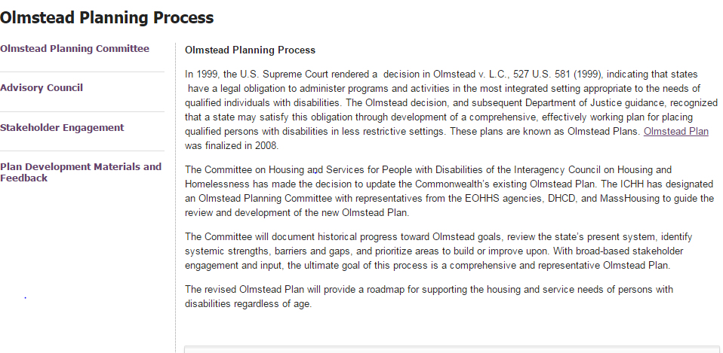
On-Line Presence
http://www.mass.gov/eohhs/gov/commissions-and-initiatives/commonwealth-of-massachusetts-olmstead-planning-committee/

Slide 12
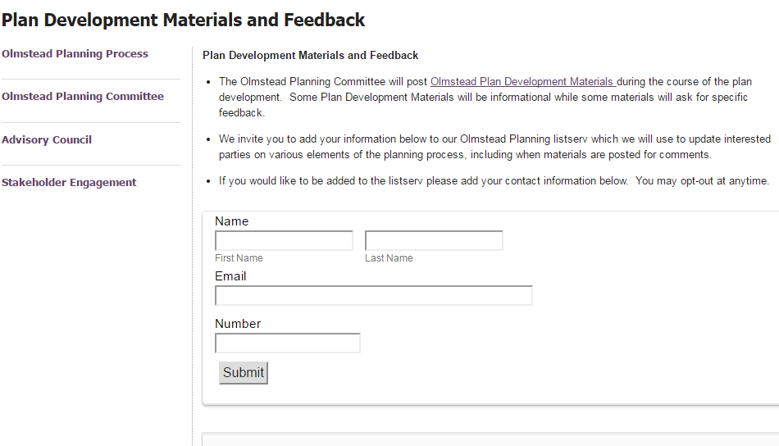
On-Line Input and Feedback

Slide 13
Sequencing Stakeholder Input
Data Collection
Listening Sessions
Existing Meetings
Olmstead Plan Update Drafted
Plan Revised Based on Feedback
Plan shared with Olmstead Advisory Council and constituent groups
Listening Sessions
Existing Meetings
Phase I: Info Gathering
Phase II: Initial Plan Drafted
Phase III: Plan Revised/Final
ADVISORY GROUP

Slide 14
Proposed Activities
Consult with agencies for plan development
Olmstead Planning Advisory Council established
State Agency Committee Members attend meetings of Existing Formalized Stakeholder Groups
Stakeholder Listening Sessions
Stakeholder Feedback Synthesized and Analyzed for Common Themes, Unique Needs and Innovative Solutions
Feedback incorporated into draft Olmstead Plan Update
Draft Plan issued for public comment
Public Comments incorporated
Final Updated Olmstead Plan Promulgated

Slide 15
Stakeholder Questions
In your opinion, which portions of the existing housing and services systems best contribute to enabling individuals with disabilities to integrate into and live successfully in the communities of their choice?
In your opinion, what types of services and supports best allow or assist individuals with disabilities to participate in daily activities and employment settings that are integrated into the community?
Do you believe that there are barriers that prevent or limit some individuals with disabilities from integrating into and living successfully in the communities of their choice?

Slide 16
Stakeholder Questions, continued
Do you believe that the service and support systems in the Commonwealth should be changed in order to promote, and increase opportunities for, community inclusion for people with disabilities? If so, how, and if you had to prioritize, which would be the most important?
Bullying poses a problem for vulnerable tenants in some public and subsidized, multi-family housing. What are some policies, practices or other solutions the Commonwealth should consider in order to address this issue?

