Slide 1
MA Quality Rating and Improvement System (QRIS)
Updates, Validation Study and Next Steps
MA Department of Early Education and Care Board Meeting
January 12, 2016

Slide 2
Presentation Goals
Explore what the validation study is telling us about
the MA Quality Rating and Improvement System.
Discuss key next steps with QRIS
and EEC program quality integration.

Slide 3

Agenda for Today’s Presentation
1. QRIS background information
2. Validation study details
3. Validation study results
4. Recommendations going forward
5. Improvement grants - details and effects
6. QRIS strengths, challenges and opportunities

Slide 4
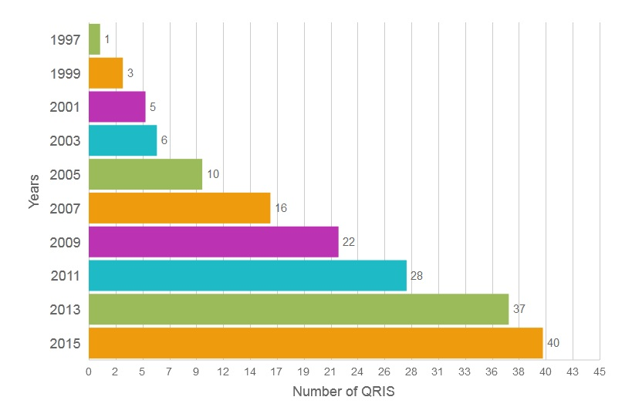
Movement Toward Quality Child Care
Nationally, engagement in QRIS has steadily increased across the U.S. and territories since 1997
(source: www.QRISCompendium.org)

Slide 5
MA Statutory Requirements for a Quality Rating Improvement System (QRIS)
In 2008, EEC was charged with establishing a method of measuring quality in early education and care programs.
Massachusetts General Laws Part I, Title II, Chapter 15D, sec. 12
  (a) The department shall establish a comprehensive system for measuring the performance and effectiveness of programs providing early education and care and services. This system shall include, but not be limited to, outcomes of the kindergarten readiness assessment system and additional educationally sound, evaluative tools or developmental screenings that are adopted by the department to assess developmental status, age-appropriate progress and school readiness of each child; outcomes of evidence-based intervention and prevention practices to reduce expulsion rates; and evaluations of overall program performance and compliance with applicable laws, standards and requirements;
  (e) The comprehensive system for measuring the performance and effectiveness of programs shall be designed to measure the extent to which every preschool-aged child receiving early education and care in the commonwealth through the Massachusetts universal pre-kindergarten program has a fair and full opportunity to reach such child's full developmental potential and shall maximize every child's capacity and opportunity to enter kindergarten ready to learn.

Slide 6
EEC’s Goals for the MA QRIS
Support educators, providers, programs, and systems across the Commonwealth to engage in a process of continuous quality improvement.
Collaborate with local, state and federal partners, and align early childhood initiatives.
Enhance outcomes for all children in Massachusetts, especially those populations most at risk.
Educate and engage families in an easy to understand rating system that enhances participation in high quality programs.
Provide policymakers and legislators with information and data that will allow allocation of resources most effectively.

Slide 7
MA QRIS Development
2008
EEC formally began developing its Quality Rating and Improvement System in Massachusetts. Stakeholders across the Commonwealth contributed to the development of the system, including early educators and researchers.
2009-2010
EEC piloted a QRIS that was supported by a first round of Program Quality Improvement Grants.
QRIS standards were revised based on the pilot study.
EEC Board voted to adopt the revised QRIS standards in December 2010.

Slide 8
MA QRIS Implementation
2011
EEC launched QRIS to the field. Educators and programs participating in the system span all geographic areas of the state and all program types including; family child care, center based, Head Start, public school and Out of School Time.
Programs and providers receiving child care subsidies required to participate in QRIS
2012
EEC hired QRIS Staff including 6 Program Quality Specialists and 4 QRIS Health Advisors. EEC began verifying QRIS applications and granting Level 2 ratings.
2013
May 2013 EEC Board supported a moratorium on the requirement that programs move up one level each year.
EEC worked on establishing policies and procedures to support providers and improve accountability and monitoring practices.

Slide 9
Strengthening the MA QRIS
2014 - 2015
Continued to enhance accountability and monitoring procedures
EEC increased collaborations with external partners and stakeholders, monthly meetings with RTT-ELC Federal Technical Assistance Providers and formed QRIS Working Groups
QRIS moved under the oversight of the EEC Board Policy and Research Committee, monthly updates became a standing agenda item
QRIS/NAEYC Alignment project
Revised policy for Environment Rating Scales (ERS)
Revised QRIS Validation Study design
Board voted on changes to the CBSB QRIS standards including:
    Addition of Early English Language Development Standards, QRIS Health and Safety training modules, language access plan and Alternative Path for a Bachelor Degree
    Require all classrooms at Level 2 to have a Lead Teacher
QRIS/Head Start Alignment project
QRIS/DESE Alignment project
Began granting Level 3 and Level 4 ratings

Slide 10
Early Childhood Programs Eligible for QRIS Participation
The MA QRIS is open to all programs across the mixed-delivery system*
Total QRIS eligible programs: 9,644
Excluding residential.
Data from December 2015, unique count. Includes 9,126 licensed programs and 518 license-exempt programs. 206 Programs with both center based and out-of-school time QRIS applications included twice.
Notes:
Unique Count

Slide 11
Current QRIS Program Participation
The MA QRIS is open to all programs across the mixed-delivery system:
Total: 6,035 Programs and Providers
(63% of all eligible programs)
Data from December 2015, unique count

Slide 12
Current QRIS Participation by Percentage of Eligible Programs
The MA QRIS is open to all programs across the mixed-delivery system:
Data from December 2015, unique count

Slide 13
QRIS Continuum
QRIS COMPONENT | DESCRIPTION | QRIS LEVEL 1 Licensing Requirements | QRIS LEVEL 2 Commitment to Quality | QRIS LEVEL 3 Focused Development | QRIS LEVEL 4 Full Integration
Reliable Rater Program Assessment | Environment Rating Scales classroom observations (60% of classrooms)
QRIS Health Consultant Site Visit | Annual visit by a community based R.N., N.P., or M.D.
Individualized Technical Assistance Site Visit | EEC Program Quality Specialist (PQS) site visit. Classroom observation and support with Continuous Quality Improvement Plan (CQIP)
Continuous Quality Improvement Plan | Identify strengths, challenges, and action steps based on program data
Program Self-Assessment – Measurement Tools | Measurement tools (ERS, BAS/PAS, Arnett/CLASS, Strengthening Families, APT)
Expanded Health and Safety Practices | Increasingly stringent requirements for indoor and outdoor environment
Documentation of Best Practice and Policy | Program practice (ex. assessment, curriculum, family engagement, supervision)
Formal Professional Development | Staff and administrator qualifications, professional development and experience
Technical Assistance | EEC staff, EPS coaches/mentors, FCC system support, webinars, orientations, and trainings
Quality Grants | Program planning and durable goods to support upward movement in the QRIS
EEC Licensed Program OR Self-Assessment and Agreement | Program has an EEC license in good standing, or for public school or license exempt- meets specific health and safety requirements

Slide 14


QRIS Validation Study
Presented to the Massachusetts Department of Early Education and Care
1-12-16
This study was funded by the Massachusetts Department of Early Education and Care with funding from a US Department of Education Race to the Top – Early Learning Challenge Grant. The study was conducted by the UMass Donahue Institute in partnership with the Wellesley Centers for Women.
14

Slide 15
Introduction to Today’s Presentation
What is a Validation Study and what value do these type of studies have?
What can we now say about the Massachusetts QRIS?
Recommendations and next steps

Slide 16
Why conduct a Validation Study of QRIS?
A QRIS is a primary strategy states employ to improve the quality of early childhood education programs.
Validation studies can …
Lend credibility to a QRIS
Allow states to target quality improvement efforts
Support continuous improvement of a QRIS

Slide 17
Introduction to Validation Question Findings
Who’s in the different levels?
Do high quality program practices vary across levels?
Do the levels accurately distinguish quality?
Do children who attend programs in higher QRIS levels have better outcomes?

Slide 18
Key Research Design Elements
Program level data
  Director interviews
  Program information questionnaires
  Staff rosters
  Supervisor supplements
  Classroom level observations
  Environment Rating Scales (ECERS-R and ITERS-R)
  Arnett Caregiver Interaction Scale
  Child level
  Pre-Post direct child assessments
  Pre-Post teacher rating scales
  Child rosters

Slide 19
Who Was in the Study?
Program Sample
  Random selection by QRIS Level of center-based programs with strong state-wide representation
  126 center-based programs
Classroom Sample
  Random selection of up to two classrooms at each program – preschool and infant/toddler
  124 preschool classrooms, 74 infant/toddler
Child Sample
  Pre-post design that followed randomly selected children attending observed classrooms from fall to spring
  481 preschool age children and 190 toddler age children were assessed

Slide 20
Do QRIS Level Distributions Vary by Key Program Characteristics?
At higher QRIS levels, a larger proportion of programs identified themselves as part of early education systems or networks, which suggests a relationship between access to resources and organizational support and progression in QRIS.
MA QRIS reflects a system in which programs are offering opportunities for quality care for all children, and particularly in communities with the highest need and linguistic diversity.
Programs at higher QRIS levels are comprised of children who receive subsidized tuition at far greater proportions than programs in lower levels.
A significantly larger percentage of programs with an infant/toddler classroom(s) are found in lower QRIS levels compared with programs that have preschool classrooms only.

Slide 21
How Do Key Practices Vary Across Levels?
Programs at higher levels were more often engaged in practices associated with quality, including:
  Regular screenings and assessments
  Tracking health services for children
  Preparing individual professional development plans for staff
  Promoting family engagement within the program
  Tracking and monitoring teacher turnover
  Providing frequent feedback for staff
Teachers with bachelor’s degrees in an EEC related field made up a greater proportion of a program’s staff at Levels 3 and 4. College degrees were also more common among administrators responsible for supervising staff at higher QRIS levels
Some practices were nearly universal and did not show significant differences across QRIS levels

Slide 22
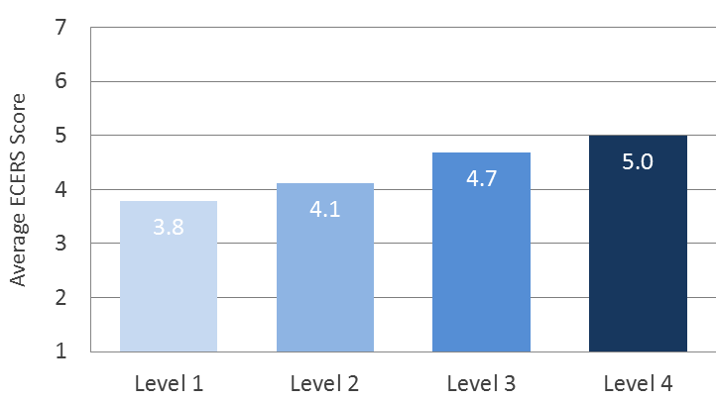
Do the Levels Distinguish Quality?
Preschool classrooms in higher QRIS levels have higher ECERS-R scores

Slide 23
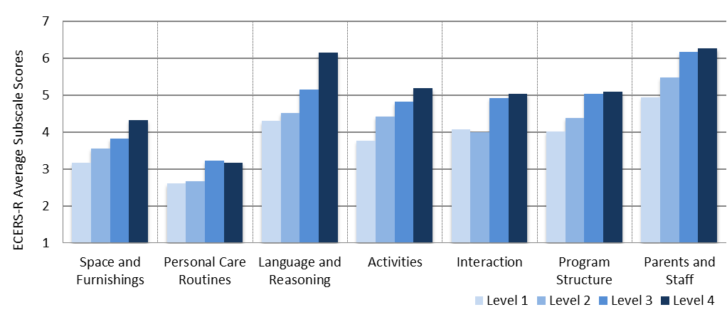
Do the Levels Distinguish Quality?
Preschool rooms at higher levels also have higher ECERS subscale scores; scores show both areas of strength and areas of need

Slide 24
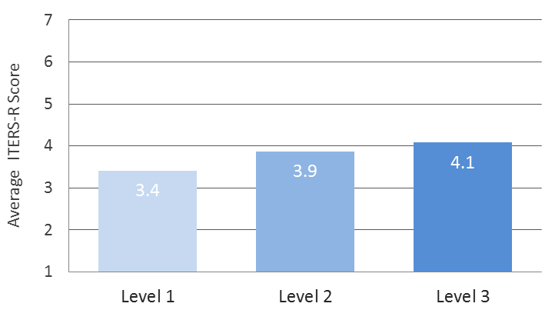
Do the Levels Distinguish Quality?
Infant/toddler classrooms in higher QRIS levels have higher ITERS-R scores

Slide 25
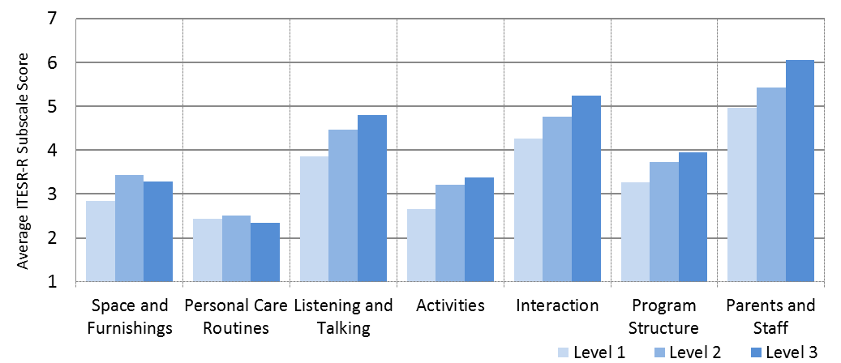
Do the Levels Distinguish Quality?
Infant/toddler rooms at higher levels also have higher ITERS subscale scores; scores also show both strengths and potential areas of need

Slide 26
Do the Levels Distinguish Quality?
The Massachusetts QRIS levels are distinguishing quality for center-based preschool and infant and toddler care providers.
For both preschool and infant and toddler care, classrooms in higher QRIS levels received significantly higher global quality ratings, as measured by the ECERS-R and ITERS-R, than those in lower QRIS levels.
The range of global quality scores was narrower at higher QRIS levels, meaning that not only was observed quality higher in the upper tiers of the QRIS, it was also more consistent.
The quality of caregiver interactions in preschool classrooms, as measured by the Arnett CIS, was significantly higher at Level 3 programs compared to Level 2 programs. Caregiver interaction scores tended to be strong overall, across both preschool, infant, and toddler classrooms.

Slide 27
Do the Levels Relate to Child Outcomes?
Quality, as defined by the Massachusetts QRIS and its levels, was found to be related to outcomes for children in several important areas.
Preschoolers attending a Level 3 program, on average, had significantly larger gains in receptive language, as measured by the PPVT-4, than children attending programs at Level 2, after controlling for key demographics of children.
There is substantial literature that indicates receptive vocabulary, and scores on the PPVT-4 in particular, are associated with later academic outcomes for children.
Assessment | QRIS Levels | Effect Size | P-value
Peabody Picture Vocabulary Test | 3 higher than 2 | .28 | .046

Slide 28
Do the Levels Relate to Child Outcomes?
Preschoolers attending a Level 2 program, on average, made significantly larger gains in letter-word identification, as measured by the WJ-III Letter-Word Identification subtest, than children attending programs at Level 1, above and beyond key demographics.
Assessment | QRIS Levels | Effect Size | p-value
Woodcock-Johnson: Letter-Word Identification | 2 higher than 1 | .855 | .001

Slide 29
Do the Levels Relate to Child Outcomes?
Preschoolers attending a Level 3 program, on average, made significantly greater gains in attachment and relationships than children attending programs at Level 1, as measured by the Attachment/Relationships subscale of the DECA, after controlling for key demographics.
Research has demonstrated strong connections between protective factors (including attachment) and positive social-emotional and academic outcomes for children.
Assessment | QRIS Levels | Effect Size | p-value
Devereux Early Childhood Assessment for Preschoolers | 3 higher than 1 | .223 | .011

Slide 30
Do the Levels Relate to Child Outcomes?
One finding that was counterintuitive to expectations involved the Attention and Persistence subscale of the PLBS. Children in Level 2 programs, on average, had significantly larger gains than those in Level 3 programs, with key demographics included in the model.
The reason for this finding is not immediately clear and may warrant further attention and additional data analysis.
Assessment | QRIS Levels | Effect Size | p-value
Preschool Learning Behavior Scale | 2 higher than 3 | -.257 | .040

Slide 31
QRIS Validation Study Recommendations
Validation study results show that programs that have reached higher levels do demonstrate higher quality, in terms of everyday practice aligned with the QRIS categories, observed classroom quality, and some better outcomes for children in key areas. Progression through the QRIS Levels should be promoted through sustained momentum in support of the MA QRIS.
  Ensure sufficient infrastructure to support timely and continuous progression of programs to higher levels, especially as it relates to Program Quality Specialists and Reliable Raters.
  Provide targeted supports and resources to independent community-based programs to reach higher QRIS levels.
  Provide additional supports for center-based programs serving infants and toddlers to assist them in progressing through the system at rates comparable to programs with preschool classrooms only. Particular areas of attention include: Space and Furnishings, Personal Care Routines, and Activities.
  Revise or remove QRIS requirements that do not distinguish quality among levels.

Slide 32

QRIS Improvement Grants
Support for programs is a key component of the MA QRIS.
Quality Improvement Grant play a crucial role in supporting programs toward upward movement in QRIS. In 2015:
349 programs received funding
13,850 children were impacted by quality funding
$2,100,000 was awarded
  $630,000 for Program Planning to support development of CQI Plans
  $1,470,000 for Durable Goods to support implementation of CQI Plans

Slide 33

The QRIS Quality Improvement Grants have effectively reached programs at all levels, proportion to QRIS enrollment:
QRIS Improvement Grant Participation by Level
Notes:
This is key because it means that the grants are accessible to all programs, not just better resourced and large organizations that the validation study has shown are at level 3. For a grant program to be successful, the process of applying and administering the grant needs to work for all types of organizations, regardless of their internal supports.

Slide 34
The QRIS Quality Improvement Grants have also been effective in reaching all types of providers and center-based programs:
QRIS Improvement Grant Participation by Program Type
Types of Programs Funded
Center-based programs funded
Notes:
Multiple types of program have been funded, including many FCC homes which often have little experience with grant writing. Again, this stresses the accessibility of the grants to all programs and as such increases the accessibility of QRIS. Additionally, significant numbers of FCC and Afterschool programs were funded. These program are proportionally under-represented at the higher levels of QRIS and subsequently, may need added supports such as grant funding.
Among center-based providers, multi types have been funded. Including a significant number of single site early care and education providers. Again, this speaks to the accessibility of the grant process as being open to all types of programs. Additionally, results of the validation study suggest that the single site community based providers are the type of program in need of the additional QRIS supports. Data suggests that the grants are reaching this important group.

Slide 35
Programs largely purchased durable goods they needed, which is consistent with data on program improvement needs.
Grantee Durable Goods Purchases
Notes:
Grantees, through self-assessment using the ERS measures, reported needing numerous durable goods. Of particular note, many of the programs (over 40%) report needing basic furnishings such as tables, chairs and cribs/mats. These are essential for quality and are often expensive items. Additionally, high numbers of programs reported intending to buy dramatic play, math, science, gross motor materials and books. These activities are all incorporated in the Environmental Rating Scale. Importantly, data from the Reliable Raters observations highlights; Gross Motor equipment (particularly indoors); a variety of books; a variety of math and science materials; and a variety of dramatic play materials and themes, as areas of particular needs among the Activity requirements. Generally, programs made purchases according to need. Programs slightly under purchased some items, such as materials related to furnishings and gross motor, likely as a result of limited funding and having to make choices as these materials tend to be more expensive.

Slide 36
QRIS Improvement Grantees and Upward Movement in QRIS
18 programs moved from Level 2 to Level 3, and one program moved from Level 3 to Level 4
62 programs started a QRIS application for the next level, during the grant period

Slide 37
Next Steps: QRIS Revisions
Disseminate validation study findings with stakeholders
Create draft of revised QRIS model, which will be informed by national research, the MA QRIS Validation Study results, feedback from QRIS Working Groups, and other relevant information
Convene a QRIS Advisory Committee to provide feedback on recommended QRIS revisions

Slide 38
Next Steps: Workforce Qualifications
and Professional Development Analysis
UMDI will analyze Validation Study data to explore the relationship between early education teachers’ participation in (a) formal education, (b) professional development/training, and (c) their early education work experience with:
  Observed classroom quality
  Child outcomes
Examination of the relationship between teacher turnover and observed classroom quality will also be included in the analysis.

Slide 39
Next Steps: QRIS Field Survey
Repeat field survey of early education and care providers:
  Target participation of 400-600 providers
  Mixed method survey administration
  Survey will measure changes from the QRIS Field Survey completed in 2013

Slide 40
QRIS Strengths
QRIS tiers: Distinguishing quality levels and demonstrating positive child outcomes
QRIS applications: 94.33% processed by PQS within 30 days
Accountability and monitoring: Strong verification/inter-rater reliability protocols
Robust and varied opportunities for technical assistance: Orientations, webinars, site visits, trainings, on-line resources, Continous Quality Improvement Plan (CQIP)
Integration within EEC: Licensors, CFCE, EPS, UPK, IPLE, PEG, Head Start, Teacher Qualifications
Collaboration with state-wide and national stakeholders: QRIS Working Groups, CCDBG requirements, DPH Health Advisors, DESE, DHE, Family Child Care System support, Massachusetts Head Start State Collaboration Office (MAHSSCO), Child Care Resource and Referral Agencies (CCR&Rs), University of Massachusetts Donahue Institute, Wellesley Centers for Women, NIOST, Office of Child Care - Child Development Block Grant (CCDBG), Race to the Top, BUILD/QRIS Learning Network, National Association for the Education of Young Children (NAEYC), Environment Rating Scales Institute (ERSI), American Montessori Society (AMS)

Slide 41
QRIS Challenges
Funding for quality programming: Salaries for qualified staff, materials, education/professional development, resources/supports, incentives
Information technology: On-line application system, professional qualifications system, licensing, e-learning, on-line community, family website
PQ staffing: High caseloads (currently 1 PQS: 1,097 QRIS participants)

Slide 42
QRIS Opportunities
Workforce: Alignment between QRIS requirements and EEC Certification; B-3 Licensure; DESE Licensure; transitional pathway for B.A., and Head Start P.D.
QRIS communications and engagement: QRIS Field Survey, quality communications project, QRIS Advisory Group
QRIS structure: Revision and simplification, exploration of hybrid model

Slide 43
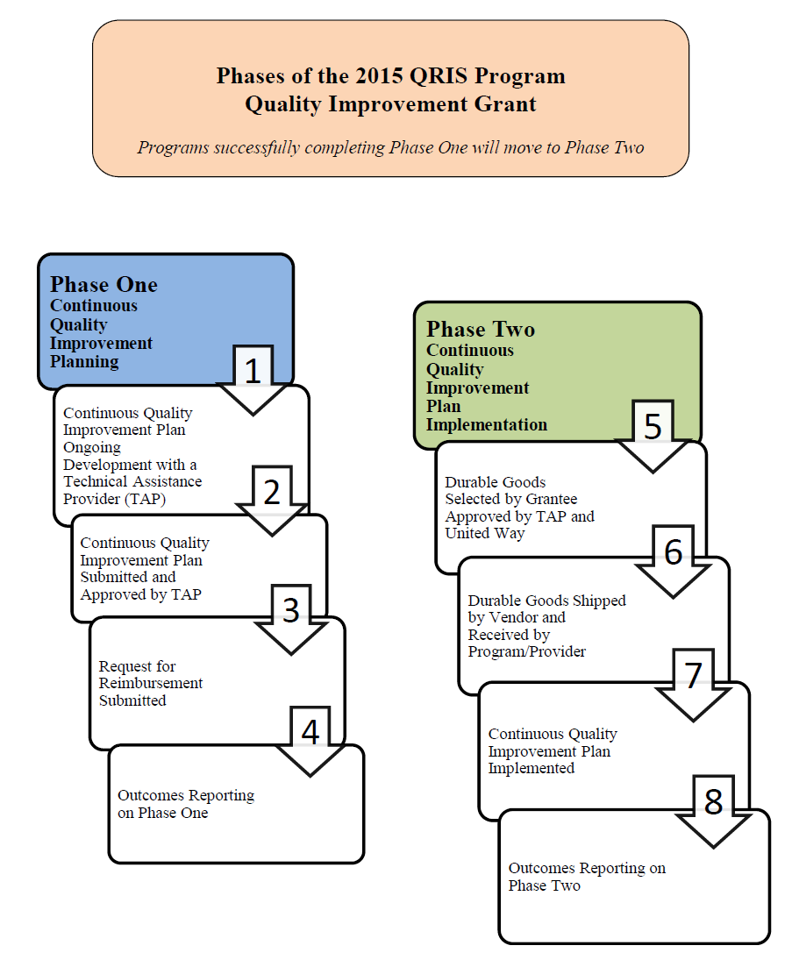
Appendix A: Phases of the 2015
QRIS Program Quality Improvement Grant

Slide 44
Generally grant recipients view QRIS positively
Appendix B: QRIS Improvement Grantee Outlook on QRIS

Slide 45
Grants appear to motivate and support programs to apply for the next level:
Appendix C: QRIS Improvement Grantee
Motivation Toward QRIS

Slide 46
Appendix D: Grantees and Continuous Quality Improvement
QRIS Quality Improvement Grantees are making changes to their programs
based on QRIS measurement tools:
Notes:
Grantees indicate that they have begun making changes to their programs based on QRIS measurement tools.

Slide 47
Significant numbers of QRIS grantees are engaging in QRIS quality activities:
Appendix E: QRIS Grantees Engage in QRIS Quality Activities
Notes:
Large portions of grantees are engaging in QRIS quality activities. Importantly, 89% of respondents feel that they are somewhat or very familiar with QRIS. It is important to note that this data was collected during the grantee process, we anticipate that these numbers will increase once post data analysis is complete.

Slide 48
Appendix F: Engagement in the MA QRIS Continues to Increase
Not a unique count. Programs and Providers in upper tiers may have more than one application.
Does not include programs that have since closed.
In 2012 providers receiving child care subsidies were required to participate in QRIS.

Slide 49
Appendix G: EEC Child Care Subsidies in MA QRIS Programs
*The most recent data available is from 8/1/15 due to changes in EEC’s I.T. system.
In 2012 providers receiving child care subsidies were required to participate in QRIS.

Slide 50
Appendix H: EEC Child Care Subsidies in MA QRIS Programs
*The most recent data available is from 8/1/15 due to changes in EEC’s I.T. system.
In 2012 providers receiving child care subsidies were required to participate in QRIS.

