Slide 1
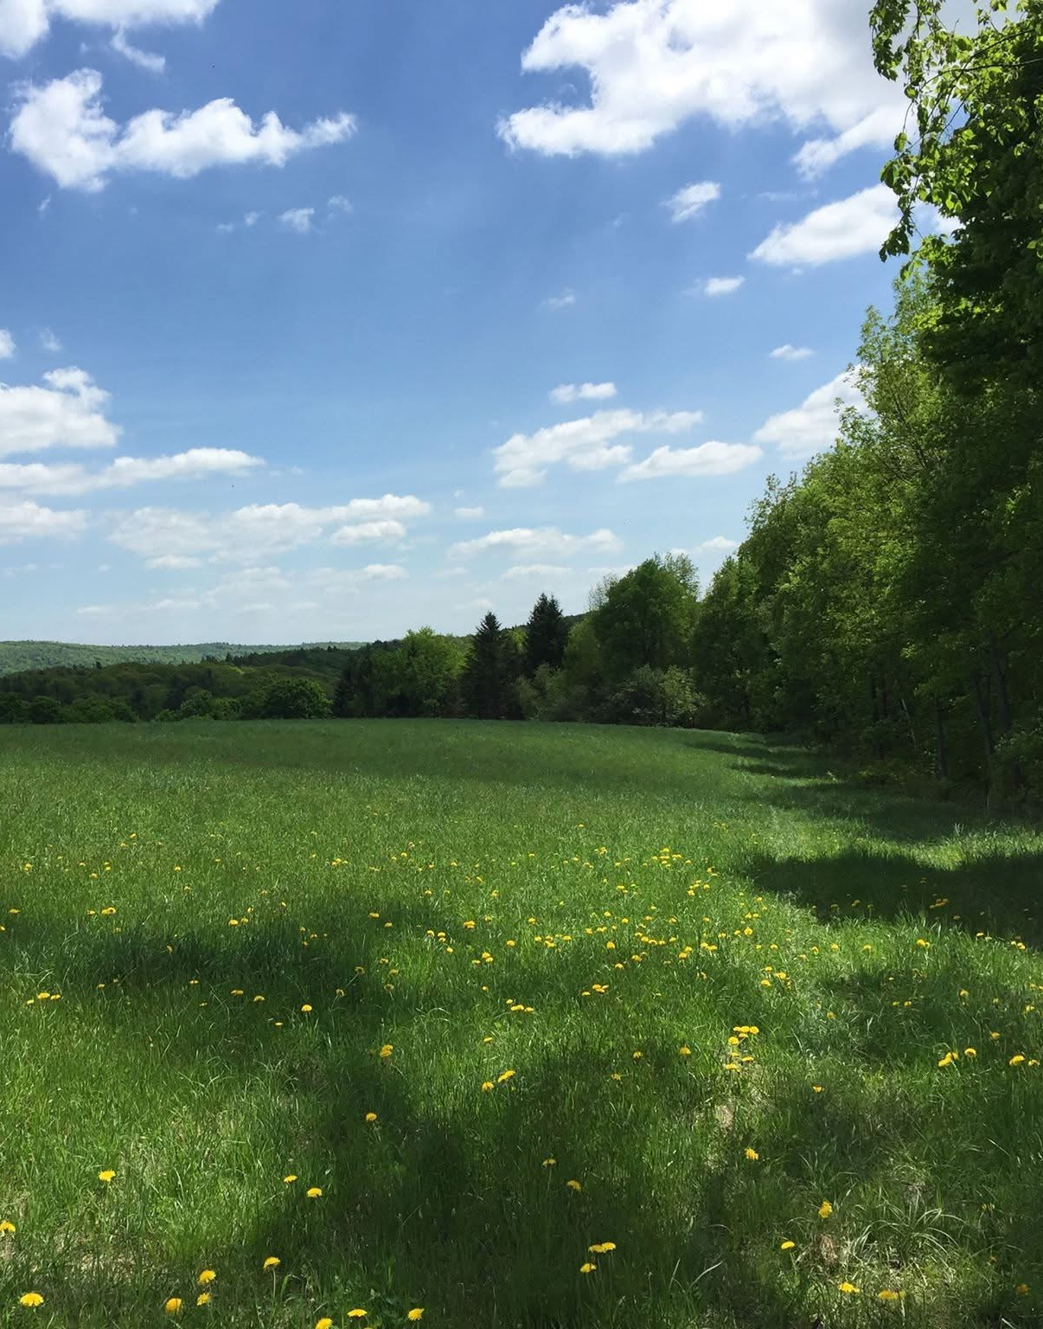
Rural Health Transformation Program (RHTP)
Meeting the Moment
Community Conversation
_____
July 14, 2026

Slide 2
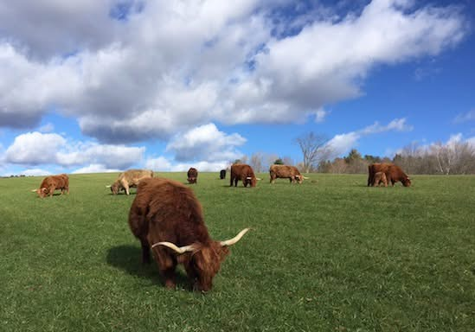
This presentation is supported by the Centers for Medicare & Medicaid Services (CMS) of the U.S. Department of Health and Human Services (HHS) as part of a financial assistance award totaling $162,005,238.13 with 100 percent funded by CMS/HHS. The contents are those of the author(s) and do not necessarily represent the official views of, nor an endorsement, by CMS/HHS, or the U.S. Government.
Notes:
To be included in every presentation.

Slide 3
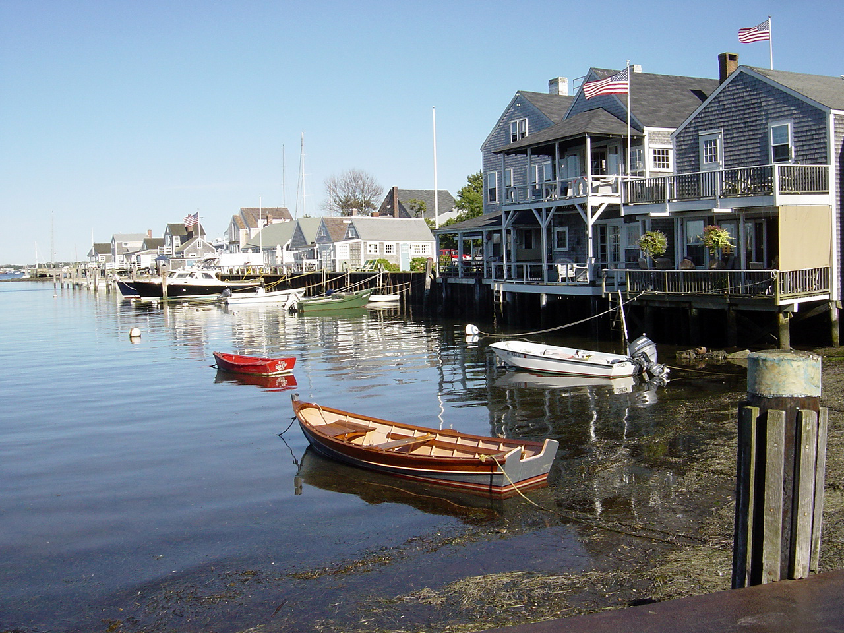
Rural Health Transformation Program
The Rural Health Transformation Program (RHTP) is a 5-year program authorized by H.R.1 One Big Beautiful Bill Act to empower states to improve healthcare access, quality, and outcomes by transforming the healthcare delivery ecosystem in rural communities across the country. The RHTP focuses on promoting innovation, strategic partnerships, infrastructure development, and workforce investment.
In the fall of 2025, states responded to a Notice of Funding Opportunity (NOFO) from the Centers of Medicare and Medicaid Services (CMS). Massachusetts received a Notice of Award of $162,005,238.13 as a first-year award in the form of a cooperative agreement from CMS. Future years of funding will be redetermined by CMS annually.

Slide 4
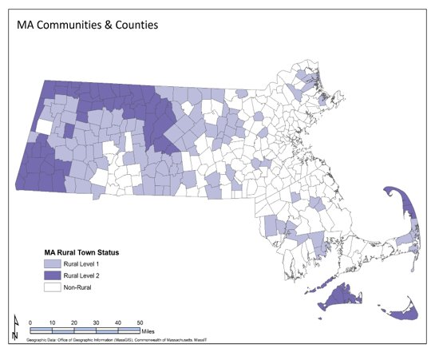
What is “Rural” in Massachusetts?
160 of Massachusetts’ 351 towns are designated Rural
The MA Department of Public Health created a state definition framework in 2002 with guidance and input from rural communities and leaders. The definition is updated every ten years with the updated census data. To be considered rural, municipalities must meet at least 1 of 3 federal rural definitions at the sub-county level
The number of criteria a town meets, determines the level of rurality:
RURAL LEVEL 1 TOWNS have more population than level 2 and are closer to urban core areas.
RURAL LEVEL 2 TOWNS
are less populated, more remote, and isolated from urban core areas.
10% of MA residents live in rural communities.

Slide 5
Regional Health Indicator Data
​Place-based approaches and regionally representative data have been a long-standing focus
of the state’s rural health approach.
Health Indicator | Non-Rural | Rural Lv.2 | North Quabbin | Quaboag Valley | Outer Cape
Heart Disease (18+ ever diagnosed) | 6.4% | 8.1% | 8.4% | 7.6% | 9.6%
Hypertension (18+ ever diagnosed) | 28.5% | 32.4% | 43.6% | 42.3% | 43.2%
Diabetes (18+ ever diagnosed) | 9.6% | 10.6% | 11.6% | 10.8% | 11.2%
Tobacco Use (past month) | 13.6% | 15.3% | 20.2% | 14.6% | 11.5%

Slide 6
Rural Health Ecosystem
RHTP is making investments and building capacity across the entire rural health ecosystem.
Community Based Organizations
Pharmacies
Behavioral Health
Rural Hospitals
Rural Health Transformation Program
Municipalities (LBOH, EMS)
Skilled Nursing & Long-Term Care
Social Services
Primary & Secondary Education
Primary Care (FQHC, RHC, Providers)

Slide 7
Vision, Goals, and Strategies
Goal 1
Ensure rural residents can readily access healthcare services.
Goal 2
Generate opportunities to improve the health and well-being of rural residents
Goal 3
Scale systems, policies, and investments to meet unique needs of rural communities.

Slide 8
Summary of MA Initiatives & Objectives
I. Population Health Advancement
II. Innovation in Rural Care Models
III. Training Healthcare
Improve clinical infrastructure
Enhance clinical- community coordination
Expand value-based payment models
Rural-appropriate care models
Expansion of proven models
Improve delivery & efficiency
Strengthen the healthcare workforce in rural communities
IV. Healthy Rural Communities
V. EMS Service Integration
VI. Enhancing Technology
VII. Facility
Modernization &
Re-Use
Support community infrastructure
Create linkages to clinical activities
Leverage community-based networks
New EMS services in rural areas
Increase role of EMS in clinical care
Operational stability for local EMS agencies
Promote statewide connectivity
Modernize rural health IT systems
Enhance secure data exchange
Minor renovations & enhancements of rural healthcare facilities

Slide 9
RHTP Activities to Support Healthcare Workforce
A key challenge for rural providers is recruitment and retention of health professionals, complicated by strained financial resources, rising cost of living, and limited educational and professional development opportunities for new or existing staff.
RHTP Activities will strengthen the full continuum of the healthcare workforce in rural communities:
  Expanding rural training networks to support shortages and upskill local workforce to meet local needs and increase economic opportunities for rural residents
  Supporting rural facilities to build capacity to host field placements and expand Nurse Practitioner residency training.
  Creating pathways to home ownership and providing childcare offsets to enable healthcare workers to stay long-term in rural communities.
  Building facility capacity by providing on-site technical assistance to create and implement long term recruitment and retention action plans.
  Leveraging technology to support virtual training to encourage professional connections and provide continuing education opportunities locally.

Slide 10
RHTP Activities to Support Health Infrastructure
Our focus is on capacity-building.
Lack of appropriate technology and population health platforms to successfully implement value-based care models, workforce shortages, and a lack of capital to modify facilities are just some of the challenges faced by rural providers in maintaining fiscal and operational sustainability.
RHTP Activities to Support Stabilization of Health Infrastructure:
Create new financial incentives and technical assistance to support rural providers in expanding population health management and value-based payment models
Upgrade rural infrastructure and connect facilities to statewide technology platforms
Support rural health providers to make critical updates to existing rural health facilities to expand service lines to increase access and generate more revenue
Implement a pilot reimbursement program for EMS programs for uncompensated services such as transport to non-emergency department healthcare facilities, patient evaluations, providing treatment on scene with no transport, and supporting population health activities

Slide 11
Ongoing Public Engagement
RHTP
Community Advisory Council
Purpose: Advise leadership, support project governance, and liaise with key constituent groups.
Composition: Appointed seats from key rural and trade groups.
Solicited Statewide and community-level organizations, associations,
and residents.
RHTP
Initiative Workgroups
Purpose: Bring technical, subject-matter, and rural expertise to activity development; improve coordination and alignment across initiatives.
Composition: Internal state agencies/programs. External organizations and community members. Technical experts.

Slide 12
Estimated Program Timeline
April 2026
Recruitment for Community
Advisory Council
July 2026
Activity Procurement begins
May 2026
Stand up Initiative Workgroups
October 2026
All funds into contract

Slide 13
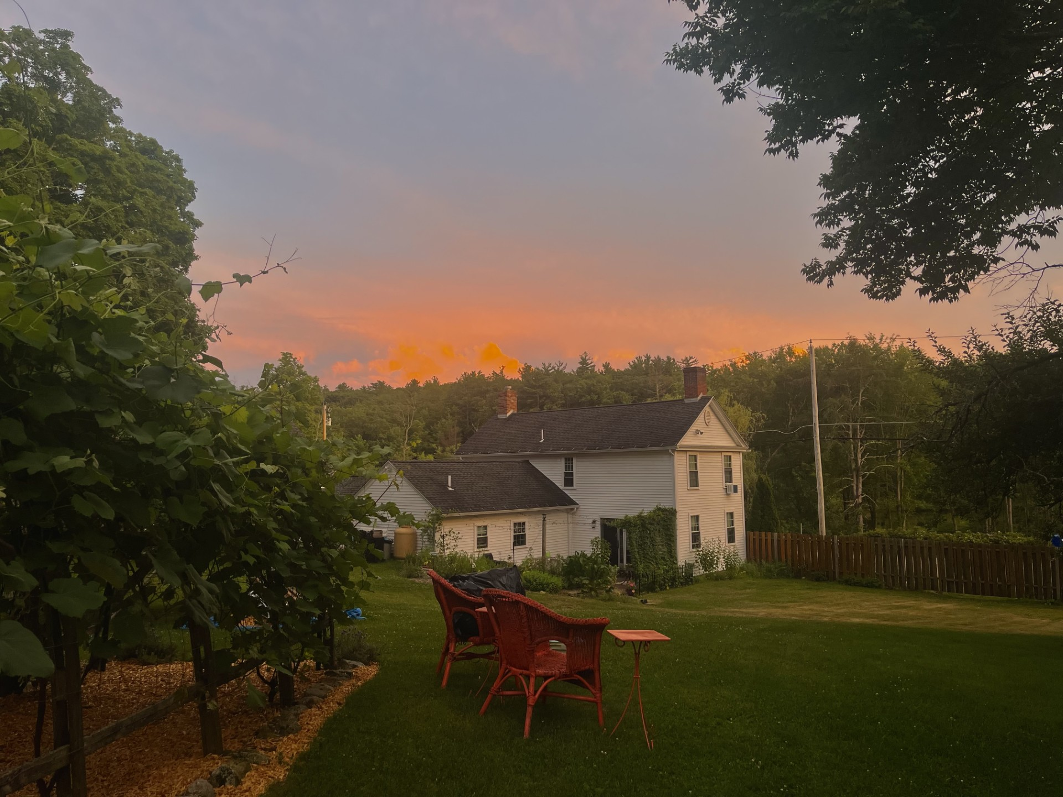
Thank you!
If you have questions,
please email RHTP@Mass.Gov

