Slide 1
Massachusetts  Puerto Rico
National Peer-to-Peer
Technical Assistance and Training
Collaborative Business Services
Ken Messina
March 5 - 7, 2018

Slide 2
Partner and Stakeholder Engagement
WIOA Stakeholder Engagement Process
Massachusetts Workforce Development Board established WIOA Steering Committee to take on key strategies to redesign the workforce system to align with vision of WIOA
Steering Committee comprised of State Core Partners and other Workforce Partners
Steering Committee establishes workgroups to address priorities in WIOA and provide recommendations to the Steering Committee on how to move WIOA implementation forward
All workgroup include membership from State Core Partners

Slide 3
Partner and Stakeholder Engagement
WIOA STEERING COMMITTEE: VISION BRAINSTORM
Demand Driven
Employer-driven model, “flip the model”
Be truly job-driven
Regular/routine contact with industry re: changing hiring needs/process (e.g. online applications)
Define why we have an employer-driven model, and make mission/vision clear: to gather intelligence and form operational partners
Look at effective models like Apprenticeship
Partnerships
Look at system in partnership with all stakeholders
Stabilize partner networks
Service Delivery & Systems Improvement
Re-think approach to workforce system, refocus service delivery models
Think about those “screened out”, and resources that can be brought to bear to address their needs, ramps to basic skills
Look at Local Board composition (effective & engaged Board members)
Need better system collecting and sharing consumer information on training (Community Colleges, proprietary training programs)
Robust use of technology and social media
Professional development of staff (training about training)

Slide 4
Massachusetts
16 Workforce Boards
29 full service Career Centers
Monthly Partners meetings
WIOA implementation - more partner collaborations and business focus
Rapid Response – Centrally managed and operated

Slide 5
Massachusetts Rapid Response Team
One Team consisting of Regionally and locally based staff that report to the State-Wide Rapid Response Manager
Focus on a proactive approach - Layoff Aversion/Business relationship building (Mindset)
MA Rapid Response Process Policy
Consistent materials and services
All services are captured in the statewide Rapid Response database (MOSES)
Mass BizWorks facilitation and promotion
Partnerships/ Linkages with all Partner agencies/programs

Slide 6
Rapid Response Initiates
Trade Act Program
National Dislocated Worker Grants
Rapid Response Set Aside Fund (RRSA Policy)
WorkShare
Department of Unemployment Assistance (UI) for businesses and employees
Mass BizWorks Program

Slide 7
Rapid Response Locations
Boston
Leominster
Lawrence
Taunton
Cambridge
Holyoke
AFL/CIO Union Staff

Slide 8
Rapid Response Flow Chart
LWDB - Local Workforce Development Board
NDWG – National Dislocated Worker Grant
OSCC - One-Stop Career Center
TAA - Trade Adjustment Assistance
UI - Unemployment Insurance
WDB - Workforce Development Board

Slide 9
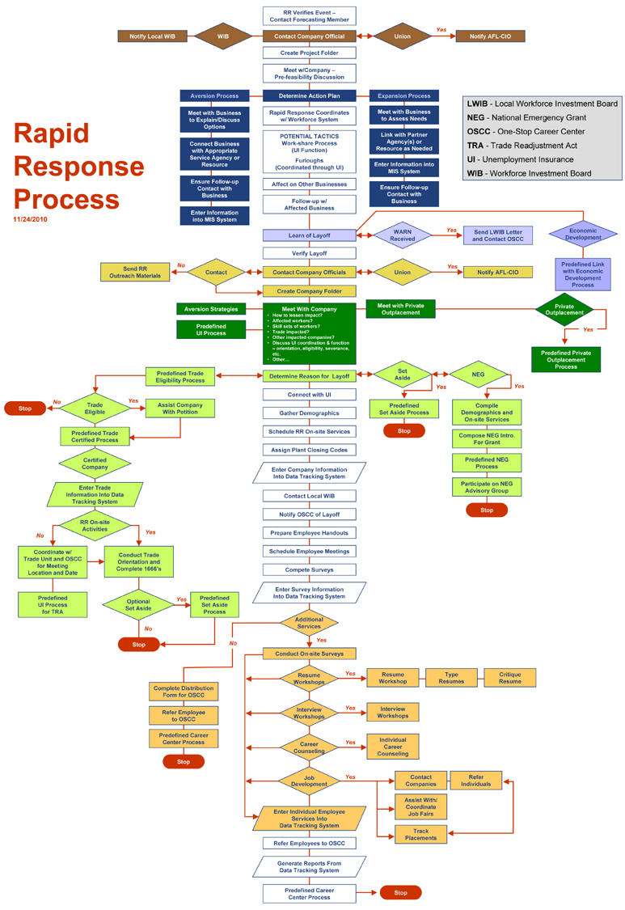
LWDB - Local Workforce Development Board
DWG – Dislocated Worker Grant
OSCC - One-Stop Career Center
TAA - Trade Adjustment Assistance
UI - Unemployment Insurance
WDB - Workforce Development Board

Slide 10
Employer Findings
Employers who used Rapid Response services were highly satisfied
Most employers only heard of Rapid Response after filing a WARN notice
Employers would have preferred to have known about Rapid Response services prior to any layoff plans

Slide 11
Why More Employers Aren’t Using Rapid Response Services
Government program stigma?
It’s free - how good can it be?
Confidentiality!
What about sabotage?
Need to keep layoff information from the employees as long as possible
Rapid Response, Who?

Slide 12
Lessons Learned
Get into the companies as early as possible before signs of trouble
Have one point of contact or designated lead to coordinate all of the available economic development tools
Think of Rapid Response funding as one of the many economic development tools

Slide 13
Company Evaluation Summary Sheet
Company Name: _________________________________________________________________________
Company Contact: ______________________________________Phone: ____________________________
Date: __________________________________________________________________________________
Please rate each item by circling the applicable number on a scale of 1 to 4, with 4 as the highest score.
Strongly Agree - 4 Agree - 3 Disagree - 2 Strongly Disagree - 1 Does Not Apply – 0
Rapid Response provided all agreed upon services. 4 3 2 1 0
All services were provided in a timely fashion. 4 3 2 1 0
The employee meeting was effective. 4 3 2 1 0
The employees were satisfied with Rapid Response services. 4 3 2 1 0
The quality of the services provided met your expectation. 4 3 2 1 0
The Rapid Response services increase morale. 4 3 2 1 0
The onsite services decrease tensions between employees/company.4 3 2 1 0
The Rapid Response services improved productivity. 4 3 2 1 0
Rapid Response worked well with company representatives. 4 3 2 1 0
The Rapid Response staff was knowledgeable and accommodating 4 3 2 1 0
I would use Rapid Response again. 4 3 2 1 0
COMMENTS:
What can we do to improve our services?

Slide 14
Biz Works Icon in MOSES

Slide 15
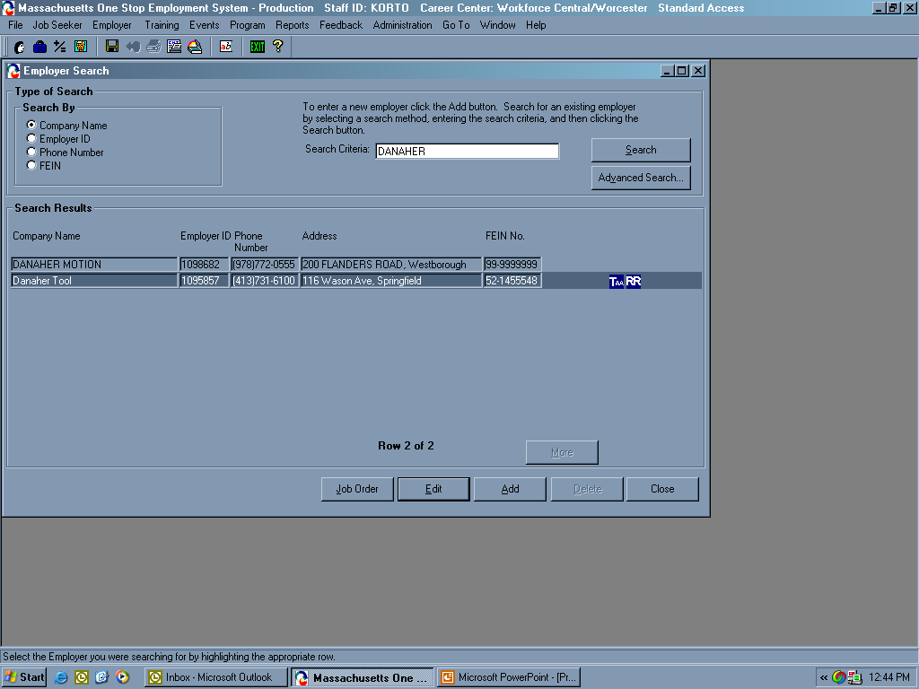

Slide 16
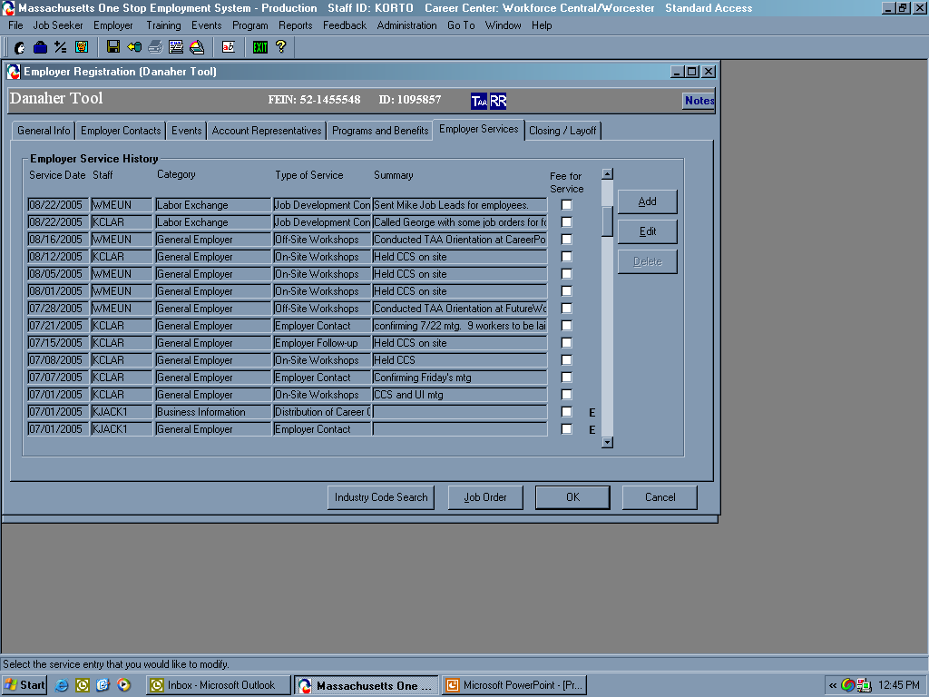

Slide 17
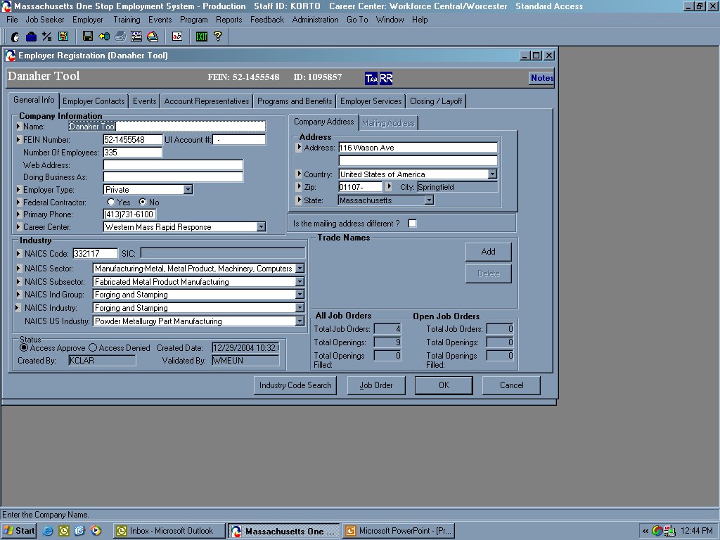

Slide 18
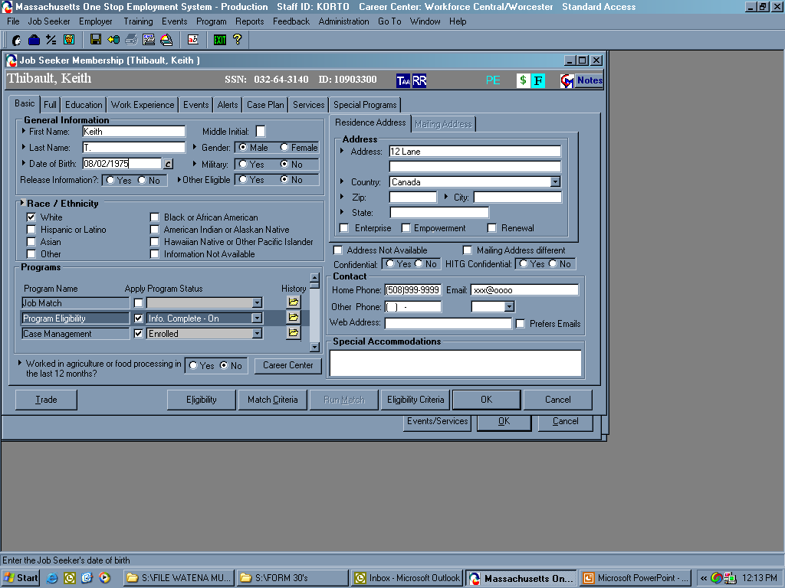
T

Slide 19
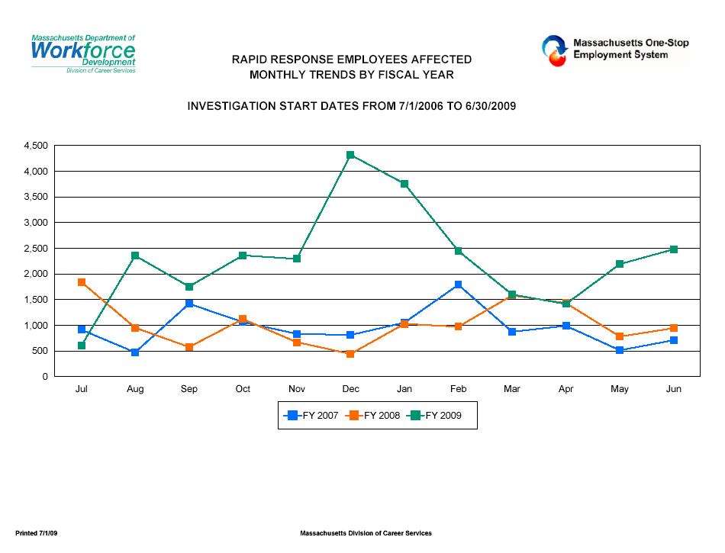
Rapid Response Employees Affected
Monthly Trends by Fiscal Year
Investigation Start Date From 7/1/2006 to 6/30/2009

Slide 20
RR First With Business Engagement
1987 Regulations
Linking with economic development
Layoff aversion
Union collaborations (Labor/Mgmt.com)
Community focus
Informing business of government / state programs
First face of government to meet with business
1997 RR Summit
Career Center focus on employees

Slide 21
What is Mass BizWork$
Mass BizWorks is designed to meet business needs
State and Federal collaboration - TEAM Effort
Funded by USDOL’s Expanding Business Engagement
Connect businesses to resources
“We need to make it as easy as possible for Massachusetts business owners to take advantage of all of the services the state offers. Whether they are growing their business or downsizing, Mass BizWorks pulls all these services together in one easy to find place.”

Slide 22
BizWork$ Flow Chart
Mass BizWorks
1st Regional Meeting
West/Central Regions
2nd Regional Meeting
Boston/Southeast
3rd Regional Meeting
Metro Southwest/Metro North/Northeast
Marketing Committee
Staff Training/Development Committee
BizWorks Information & Knowledge Exchange Committee
Business Focus Group
Metro Southwest/Central/West Regions
Business Focus Group
Boston/Southeast Regions
Business Focus Group
Metro Southeast/Metro North/Northeast Regions
Greater Boston Regional Operations Team
Northeast Regional Operations Team
Southeast Regional Operations Team
Central
Regional Operations Team
Western
Regional Operations Team
Coordinated, real-time sharing of information and results

Slide 23
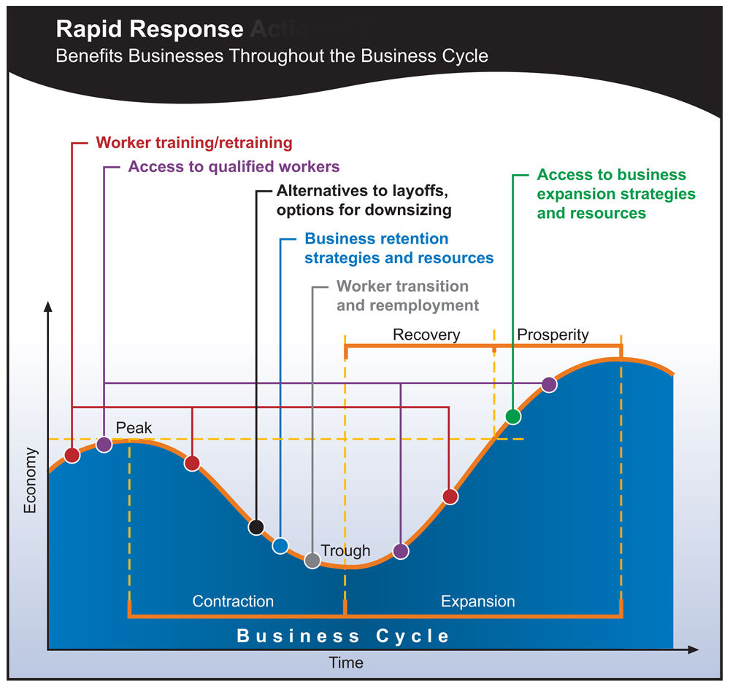
BizWork$ Business Cycle

Slide 24
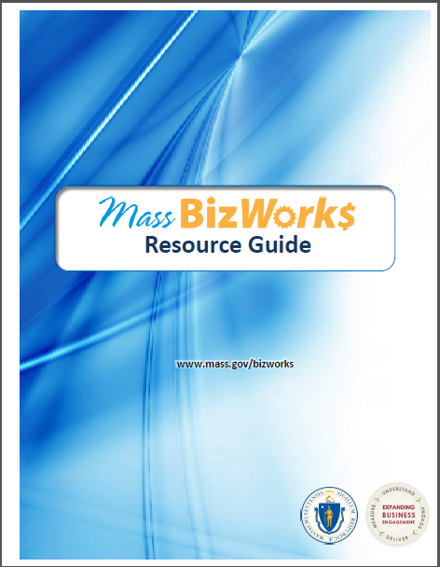
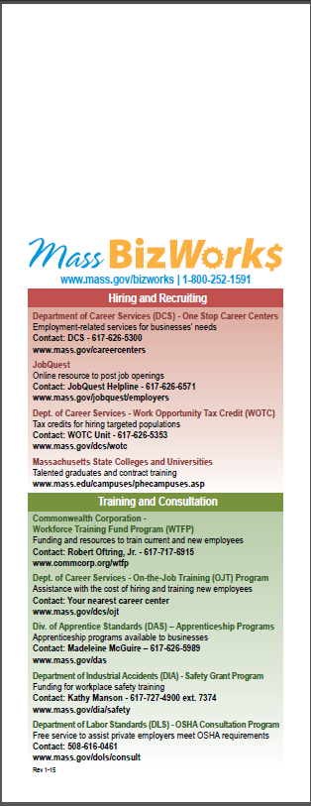
BizWork$ Resources

Slide 25
BizWork$ Programs and Services
Training grants and programs
Tax credits for hiring
Incentive programs for growth or expansion
Business development/mentoring services
Manufacturing support
Workplace safety grant and consultation
Recruitment services
Layoff aversion
One-Stop support for businesses

Slide 26
BizWork$ Staff Training & Development Group
Mass BizWork$ Training
Modular One training - Trained over 350 Business Services Representatives
Modular Two Training – Trained over 170 Business Services Representatives
Modular Three - Trained over 200 Business Services Representatives
Now training non-Business Services career center staff
Connecticut training collaboration

Slide 27
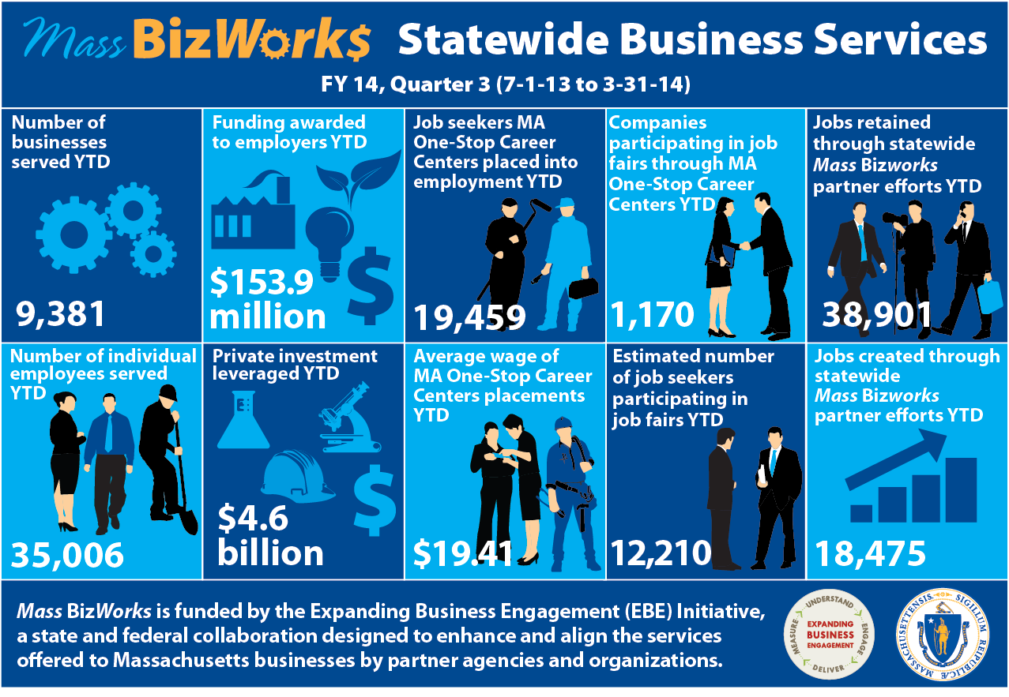

Slide 28
Challenges
Identify staffing needs and resources
BSR’s availability to meet with companies
Businesses are often unaware of the services available to assist them
Collaboration and cooperation between agencies
Business services follow up plan
Develop a system that will ensure that we are not duplicating efforts with businesses
Performance metrics, crystal report and tracking activities

Slide 29
Moving Forward
Create a Unified Employer Engagement Strategy
Develop an infrastructure that promotes teamwork
System to measure performance metrics
Service Delivery Strategies
Goals of the Technical Assistance Initiative
Review existing outreach efforts and services provided to companies

Slide 30
Moving Forward (continued)
Review ways to increase and expand employer engagement
How to measure improvements
Defining appropriate roles and responsibilities
Programs and services that could add value to our relationship with business
Staff training needs, especially around new programs and services
Develop Policies

Slide 31
Layoff Aversion
What is Layoff Aversion?
Many do not understand the full meaning
Some think it really doesn't work
Some think you have to bring in a white knight company to save a business from closing
There are many facets to layoff aversion!

Slide 32
Layoff Aversion - Definition
The Employment and Training Administration (ETA) defines layoff aversion as the prevention or minimization of unemployment, either for employees of companies that have announced layoffs, are struggling, or are looking to retool for new products or industries, through a range of strategies and approaches.

Slide 33
What If?
We were never surprised by the news of a layoff!
Employees that received a layoff notice never got laid off!
When Rapid Response responds to a layoff 5 companies willing to hire the affected workers were already setup.
What if everybody was working together to ensure better connections with businesses!

Slide 34
Two Sides of Layoff Aversion
Saving the Company or Jobs | BROADER IDEA: Lessening the Impact of Layoffs / incorporating the business cycle mindset
Lessen number of employees that company needs to layoff WorkShare Furloughs ESOPs - Employee buyouts Finding a buyer for the closing business Linking with Economic Development Incumbent worker programs - based on affected company | Fewer people filing for UI benefits Linking with other companies that are hiring (Company Match) OJT programs-linking with growing companies Early warning networks Effective partnerships Linking Mass BizWorks services

Slide 35
Examples of Layoff Aversion
Polaroid
40 employees affected by layoff
Trained employees prior to layoff
Placed 34 of 38 employees trained
Method used Rapid Response set aside funds to train employees in new career
ROI = $238,000 saved on UI funds @ 7000 per claim
NECCO - 400 employees retained their jobs
Jabil/Raytheon -19 employees hired in one day (Union jobs) 135 additional placed
Haskon – attempted ESOP (Union/RR/ESOP office)
Polaroid – 38 employees (Chemical Department) trained in Bio-Tech, 34 placed in new jobs most prior to layoff

Slide 36
Data Collection
Data collection can help in predicting trends
Information when marketing services
For use when company matching
Linking with Economic Development
Indicating return on investment
Assisting Businesses with information
History of services

Slide 37
Company Furloughs
Companies have been using furloughs in an attempt to avoid layoffs
Rapid Response offers assistance to companies and their employees in the delivery of services through the furlough process
Furloughs may be an indicator of concern that could allow for future services due to the partnerships that are built - future services could include an aversion plan

Slide 38
WorkShare
Rapid Response staff must be well versed in the Unemployment Insurance (UI) WorkShare program and able to connect companies to this service as an alternative to layoffs
WorkShare allows companies to defray costs during slow periods

Slide 39
Forecasting / Early Warning Signs
Creating mechanisms to try to predict layoffs before they happen and develop a strategy to avert or lessen the number of employees affected by downsizing and company closures
Use of data
Effective strategic partnerships, including:
Business community
Unions
Local and state agencies

Slide 40
Incumbent Worker Training Programs
Can be funded with Rapid Response with approved waiver from ETA
Incumbent worker training must be part of broad layoff aversion strategy to receive waiver
Rapid Response can play an important role in facilitating IWT even without spending Rapid Response funds

Slide 41
Company Match
Minimize the impact of the layoffs that are occurring at a particular plant closing or downsizing by placing employees in new jobs prior to layoff - Also to minimize the length of unemployment if not placed prior to layoff
Matching the skills of employees who have been notified of a layoff (and not yet laid off) with those of companies that are in need of skilled employees. Jabil/Raytheon - Direct Match
Training employees and placing them in new careers prior to layoff Biotech Training -Polaroid/Bose

Slide 42
On The Job Training (OJT) Programs
Connect employers with workers losing their jobs
Use OJT funds to assist employers to be able to hire needed workers
Think of OJT as a layoff aversion program in addition to a jobs program

Slide 43
Light Control – Plympton, MA (ESOP)
Employee owned/Union company
200 – employees
High end Light Control systems
Company decision to stay in Plympton, MA & sell to employees 15 year plan paid off in 7 years

Slide 44
Collaborations With Other States
Rapid Response – bordering states/national connections
Mass BizWorks – collaborations span through out the country examples but not limited to Connecticut, Pennsylvania, Colorado, California, Ohio, Maryland, Virginia, etc.
40 plus states attended the recent summit and continue to collaborate

Slide 45
Contact
www.mass.gov/bizworks
800-252-1591
Direct Contact:
Ken Messina, Rapid Response/Business Services Manager
Ken.Messina@MassMail.State.MA.US
617-626-5703
We can help you

