Slide 1
MassCEC EVICC Program Updates

Slide 2


EVICC Program Outcomes
Program Impact
V2X
Ride-For-Hire
EVSE
MHD Mobile
Charging
Curbside EVSE
Grid reliability will increase Timeline and $ for future EVSE installation will decrease
DCFC availability at major hubs Charging availability in neighborhoods with high concentration of drivers
Fleet will electrify sooner Fleet will reduce overbuild $ Fleet will derisk loss of asset ownership
Pole-mounted charging stations installed in neighborhoods with low off-street parking access
2

Slide 3
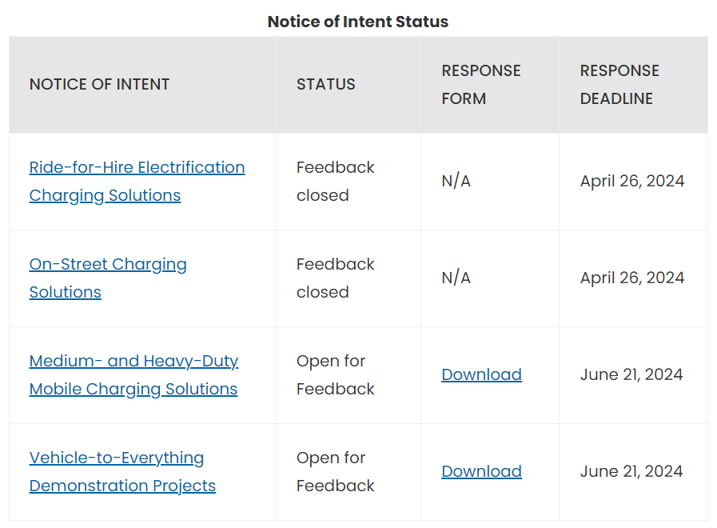
Notices of Intent
MassCEC is soliciting industry feedback from key stakeholders to help design the programs
Feedback received for: Ride-for-Hire Electrification Charging Solutions and On-Street Charging Solutions
NOIs upcoming for: Medium- and Heavy-Duty Mobile Charging Solutions and Vehicle-to-Everything Demonstration Projects
Anticipated release in mid-May, feedback due early June
Provide feedback here.

