Slide 1
Sustainable Materials Recovery Program (SMRP) Grants
May 10, 2023
Rachel Smith, MassDEP
Regional Planner

Slide 2
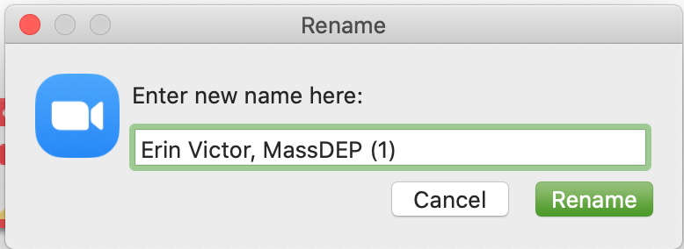
3. Rename yourself.
1. Mute yourself during presentations.
2. Feel free to keep your video on if you don’t have a distracting background.
4. Chat with other attendees & ask questions.
5. We are recording and will share with all.
6. Reactions function can be used to raise your hand.
Zoom Tips & Tricks

Slide 3
Meeting Agenda
SMRP Background – Rachel Smith
Minimum Eligibility Requirements – Micaela Guglielmi
Drop-off Universal Waste Sheds
Organics Carts
Mattress Collection Containers – Rachel Smith
Pay-As-You-Throw (PAYT)
Permanent HHW Facility – Brooke Nash
Recycling Dividends Program – Will Mbah
Regional Small-Scale Initiatives

Slide 4
SMRP Background
Created through the Green Communities Act
MassDEP regulations (310 CMR 19.300)
Six municipal waste combustors qualified to earn Waste Energy Certificates(WECs)
50% of WECs revenue goes to “DEP approved recycling programs”
Municipal Grant Program – Year 14

Slide 5
Solid Waste Master Plan (SWMP)
2010 – 2020 SWMP: Waste Reduction Goal
Reduce solid waste disposal by 30% by 2020, from 6.5 million tons to 4.5 million tons
2020 – 2030 SWMP: Waste Reduction Goal
Reduce solid waste disposal by 30% by 2030, from 5.7 million tons to 4.0 million tons
www.mass.gov/doc/2030-solid-waste-master-plan-working-together-toward-zero-waste/download

Slide 7
Application Year | Specifics | Grant | Number Applications/ Awarded | Amount Awarded
2013 | Small Scale only | RDP | N/A | N/A
 |  | Small Scale | 99 | $ 98,500
2014 | First Year RDP 6 of 20 pts SS and RDP | RDP | 108/96 | $ 358,800
 |  | Small Scale | 157 | $ 161,250
2015 | CS and DO separate 6 of 20 pts SS and RDP | RDP | 152/137 | $ 1,322,550
 |  | Small Scale | 79 | $ 78,000
2016 | CS and DO separate 6 of 20 pts SS and RDP | RDP | 169/166 | $ 1,548,500
 |  | Small Scale | 51 | $ 50,250
2017 | CS and DO separate 6 of 23 pts SS or RDP | RDP | 185/185 | $ 2,250,100
 |  | Small Scale | 53 | $ 53,750

Slide 8
Application Year | Specifics | Grant | Number Applications/ Awarded | Amount Awarded
2018 | CS and DO separate 6 of 24 pts Subscription Munis SS or RDP | RDP | 204/194 | $ 2,564,500
 |  | Small Scale | 53 | $ 51,000
2019 | CS and DO combined 8 of 26 pts SS or RPD | RDP | 230/219 | $ 2,934,500
 |  | Small Scale | 43 | $ 44,000
2020 | CS and DO combined 8 of 26 pts SS or RPD | RDP | 235/227 | $ 3,164,250
 |  | Small Scale | 42 | $ 45,250
2021 | CS and DO combined 8 of 26 pts SS or RDP | RDP | 242/226 | $ 3,132,850
 |  | Small Scale | 42 | $ 46,250
2022 | CS and DO combined 1 of 26 points | RDP | 265/265 | $3,362,540

Slide 11
Environmental Justice Populations (in MA)
In Massachusetts, an environmental justice population is a neighborhood where one or more of the following criteria are true:
The annual median household income is 65% or less of the statewide annual median household income
Minorities make up 40% or more of the population
25% or more of households identify as speaking English less than “very well”
Minorities make up 25% or more of the population and the annual median household income of the municipality in which the neighborhood is located does not exceed 150% of the statewide annual median household income.
www.mass.gov/info-details/environmental-justice-populations-in-massachusetts

Slide 12
RDP Environmental Justice Populations
45% or more of residents live in an EJ census block group, and:
The annual media household income is not more than 65% of the statewide annual median household income,
Minorities comprise 40% or more of the population,
25% or more of households lack English language proficiency
OR
Minorities comprise 25% or more of the population and the annual median household income of the municipality in which the neighborhood is located does not exceed 150% of the statewide annual median household income

Slide 13
RDP Environmental Justice Populations

Slide 14
RDP Criteria Points Claimed 2022
Bulky Items | 191
CHARM | 177
Curbside Recycling Regulations | 84
Diversity, Equity, & Inclusion | 63
Household Hazardous Waste | 181
Organics | 117
Recycling Access | 87
Reuse | 173
Solid Waste | 133
Textile Recovery | 149
Waste Prevention Outreach | 166
Yard Waste | 187

Slide 15
Submission Requirements February 15 Deadline
2022 Recycling and Solid Waste Survey
2022 RDP Spending Report
FY23 Notification of Buy Recycled Policy

Slide 16
Minimum Eligibility
Requirements
Micaela Guglielmi
Micaela.Guglielmi@mass.gov

Slide 17
Minimum Eligibility Requirements
for SMRP Grants
Certification form has 4 parts:
Annual Notification of Buy Recycled Policy (NBRP)
Municipal Recycling Data Reporting
Waste Ban Compliance
Compliance Issues
Must submit this form FIRST before submitting any grant applications.

Slide 18
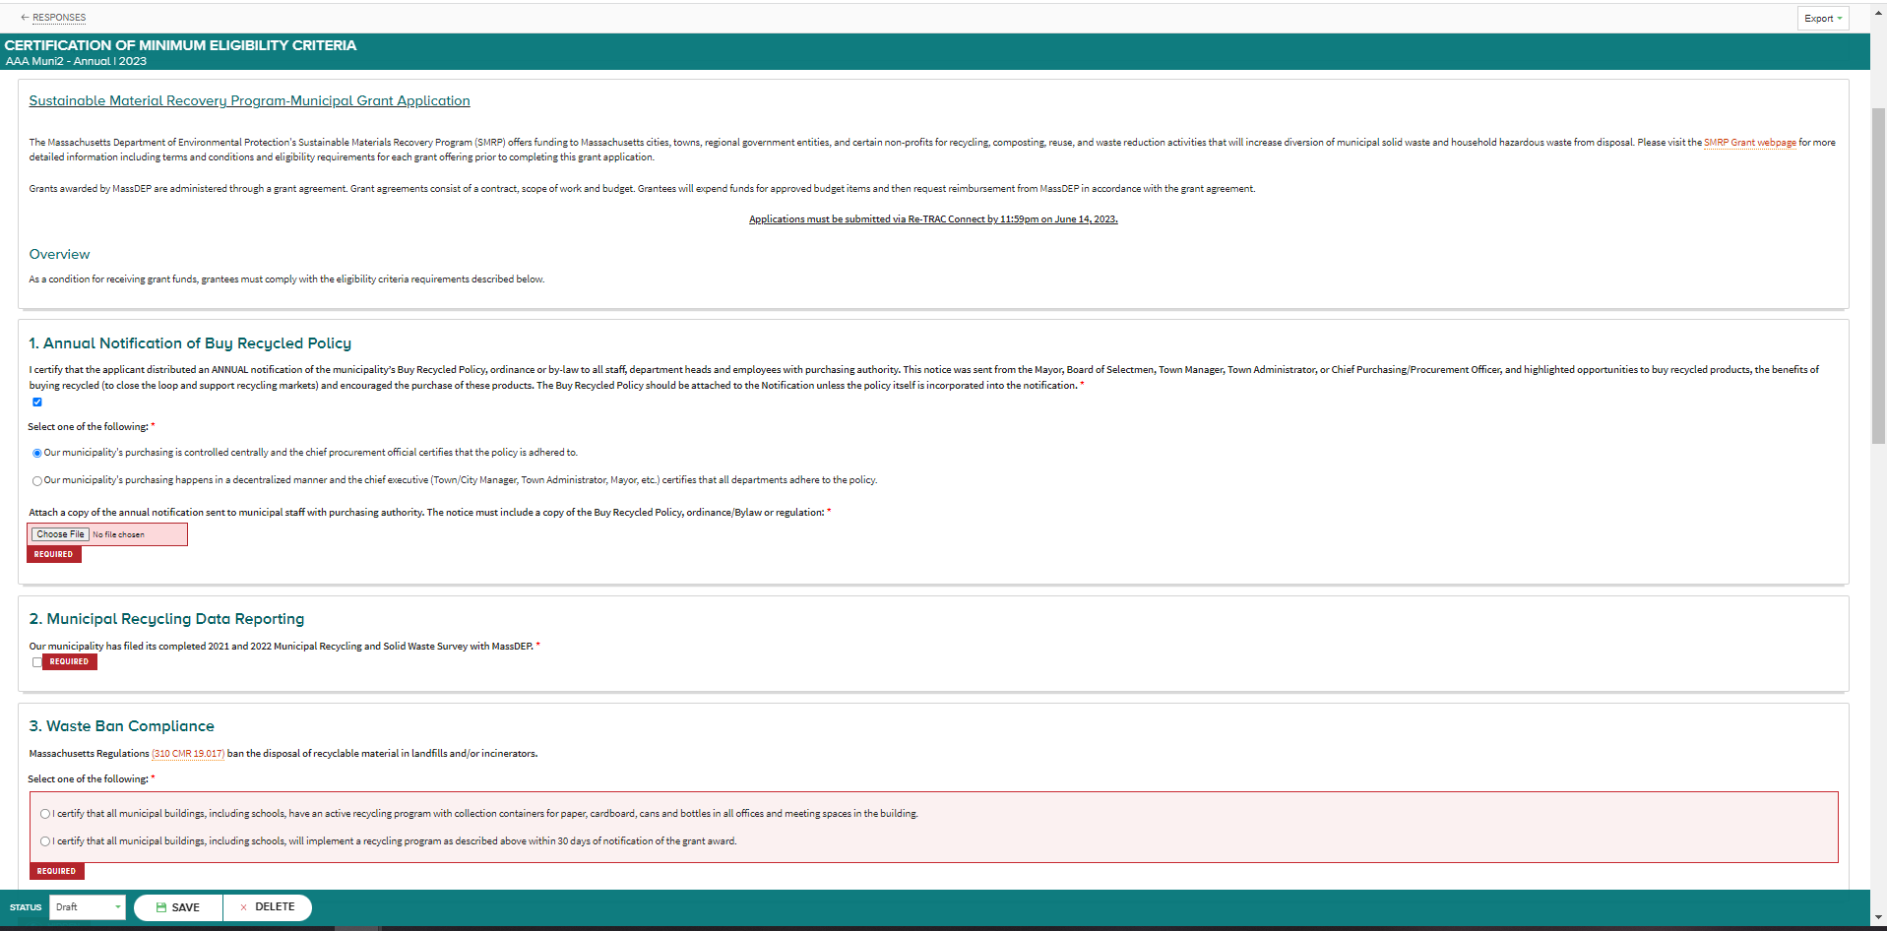

Slide 19
1
Notification of Buy Recycled Policy
Email or memo
Dated within the Fiscal Year
Sent to department heads and staff
Sent from Mayor/Board of Selectmen/Town Manager/Town Administrator OR Chief Purchasing Officer
Contains content on the importance of buying products made with recycled content
Actual Buy Recycled Policy included as attachment
Click here for model language for a new policy

Slide 20
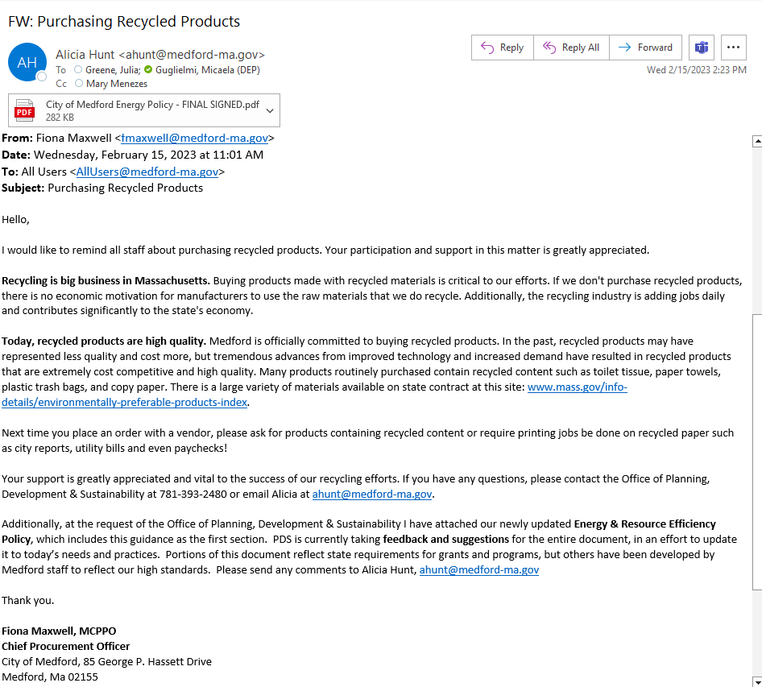
Good Example of Memo with Policy Attached

Slide 21
Buy Recycled Policy - Updates

Slide 22
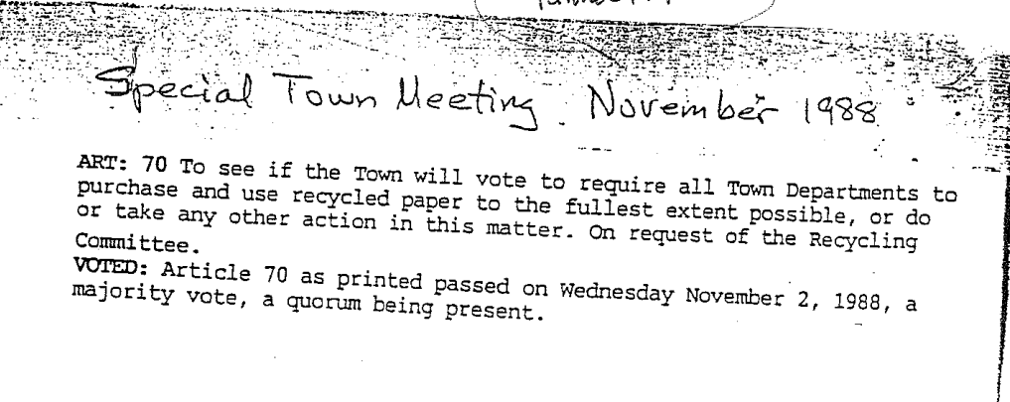
Buy Recycled Policy on File

Slide 23
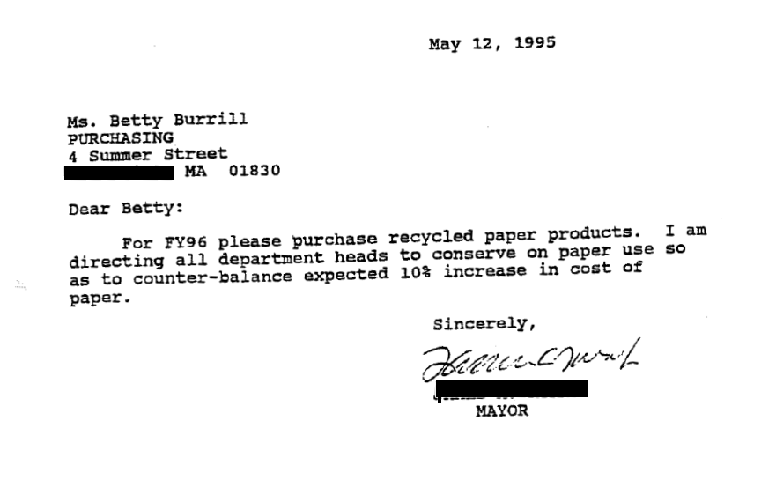
Buy Recycled Policy on File

Slide 24
Environmentally Preferred Purchasing/ Sustainable Purchasing Policies
Support recycling markets by purchasing products with recycled content
Conserve natural resources such as energy and water
Minimize environmental impacts from pollution, including greenhouse gases
Prioritize reuse by identifying alternate options to new products
Eliminate or reduce toxins that create hazards to employees, the community, and the environment
Reduce waste sent for disposal by optimizing product efficiency and effectiveness

Slide 25
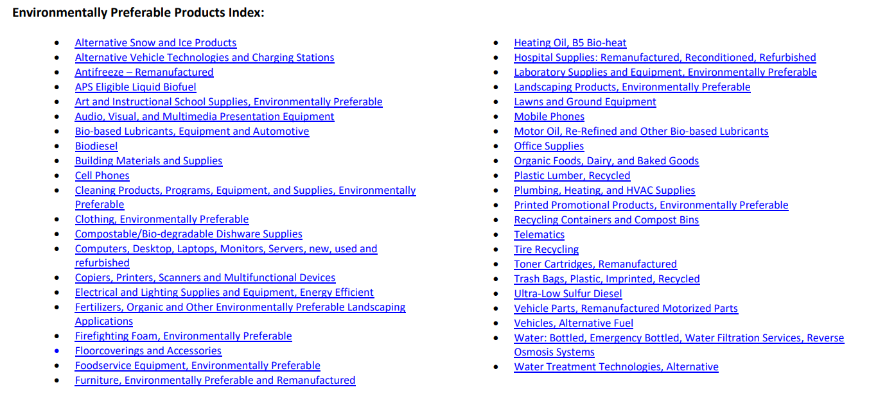
EPP Products and Services Guide
Environmentally preferable products and environmentally preferable services that are found within statewide contract
Click here for the guide from OSD (Operational Services Division)

Slide 26
Municipal Recycling Data Reporting (RSW Surveys)
2
Municipal applicants must submit the 2021 and 2022 Recycling and Solid Waste Surveys on ReTRAC
303 municipalities submitted the 2022 Recycling and Solid Waste Survey by 2/15/23 – well done!

Slide 27
Waste Ban Compliance
3
Applicants must certify that they have active recycling programs in all municipal offices and in schools.
OR
Applicants must certify that they will implement a recycling program in all municipal offices and in schools within 30 days of award.

Slide 28
4
Compliance Issues
Any past due required reports will not necessarily disqualify a municipality from receiving an award, but an award may be conditioned on satisfactory resolution of any compliance issues.

Slide 29
Drop-off Equipment:
Universal Waste Sheds
Micaela Guglielmi
Micaela.Guglielmi@mass.gov

Slide 30
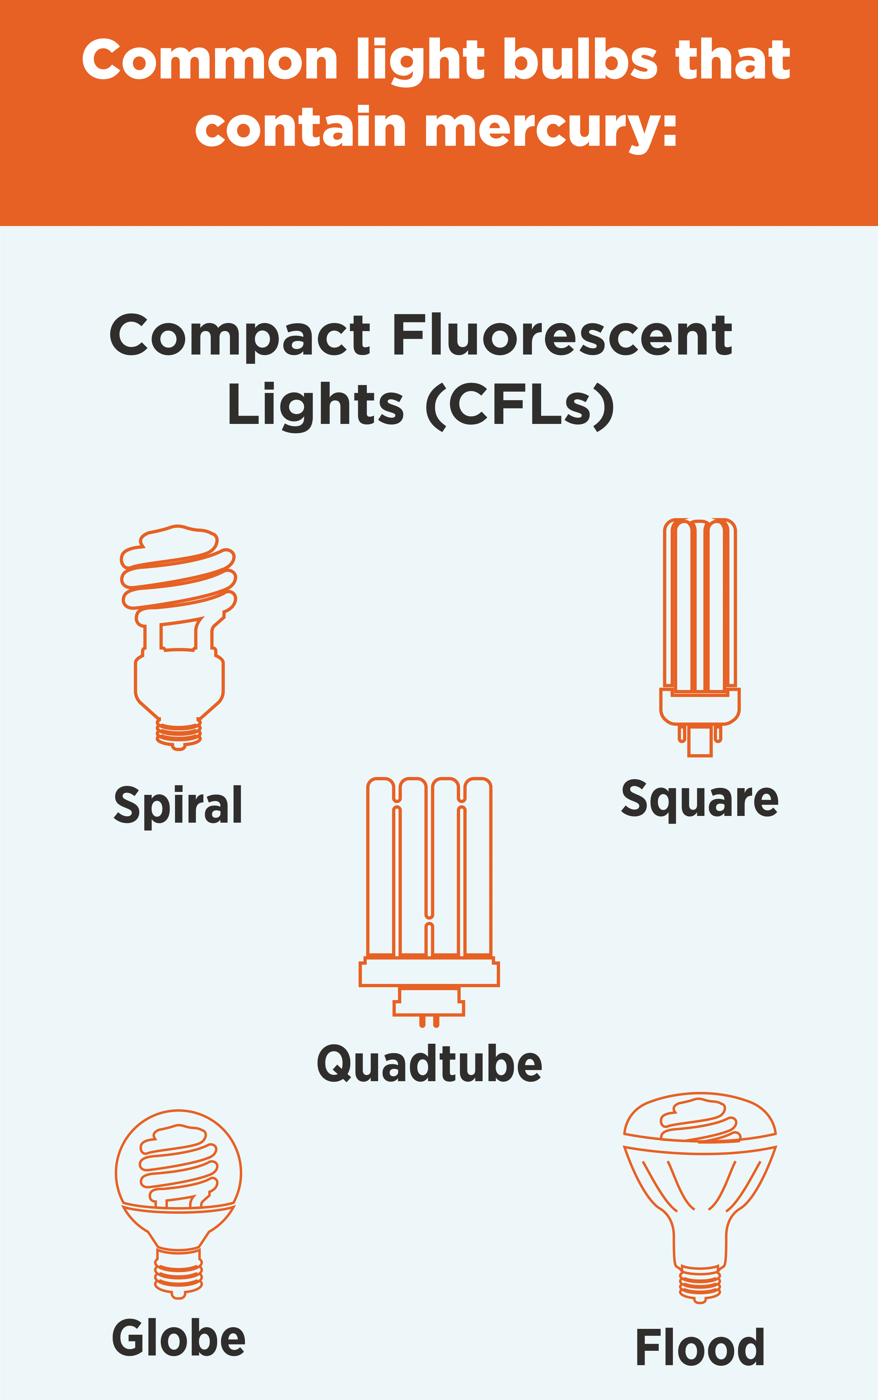
Drop-off: U-waste Shed
Applicable materials for collection include:
fluorescent lamps
certain batteries
mercury containing devices (thermostats, thermometers, etc.)
Details: Universal Waste Shed

Slide 31
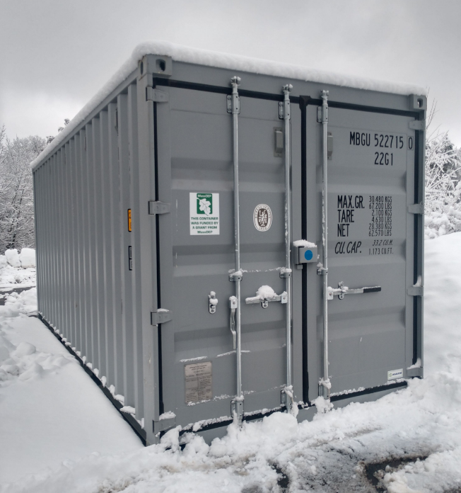
Drop-off: U-waste Shed
Reimbursement of up to $5,000
Enclosed, rigid, weather-proof shed
FAC110 for processors
Universal Waste Shed (Muni22)

Slide 32
Organics Carts
Micaela Guglielmi
Micaela.Guglielmi@mass.gov

Slide 33
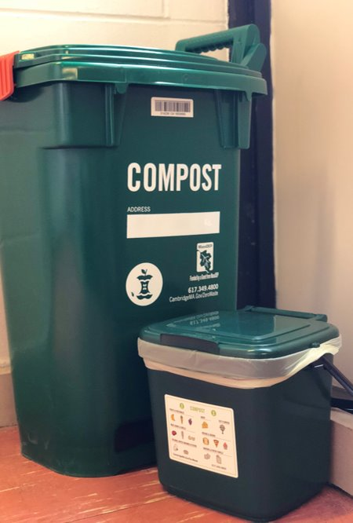
Curbside Wheeled Organics Carts
Reimbursement will be $20 per cart,
Plus $1 per cart for the required in-molded label
Maximum award amount: $105,000
Vendors available on FAC113
Details: Food Waste Carts
Courtesy Cambridge Works Announcement

Slide 34
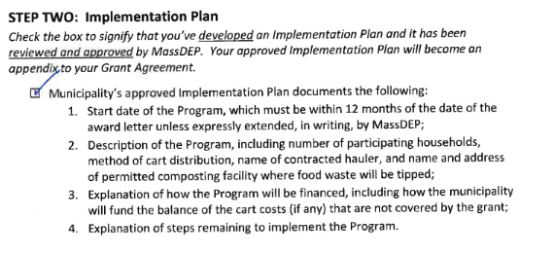
Curbside Wheeled Organics Carts Implementation Plan

Slide 35
Questions?

Slide 36
Mattress Recycling Incentive:
Collection Containers
Rachel Smith
Rachel.smith@mass.gov
Notes:
8

Slide 37
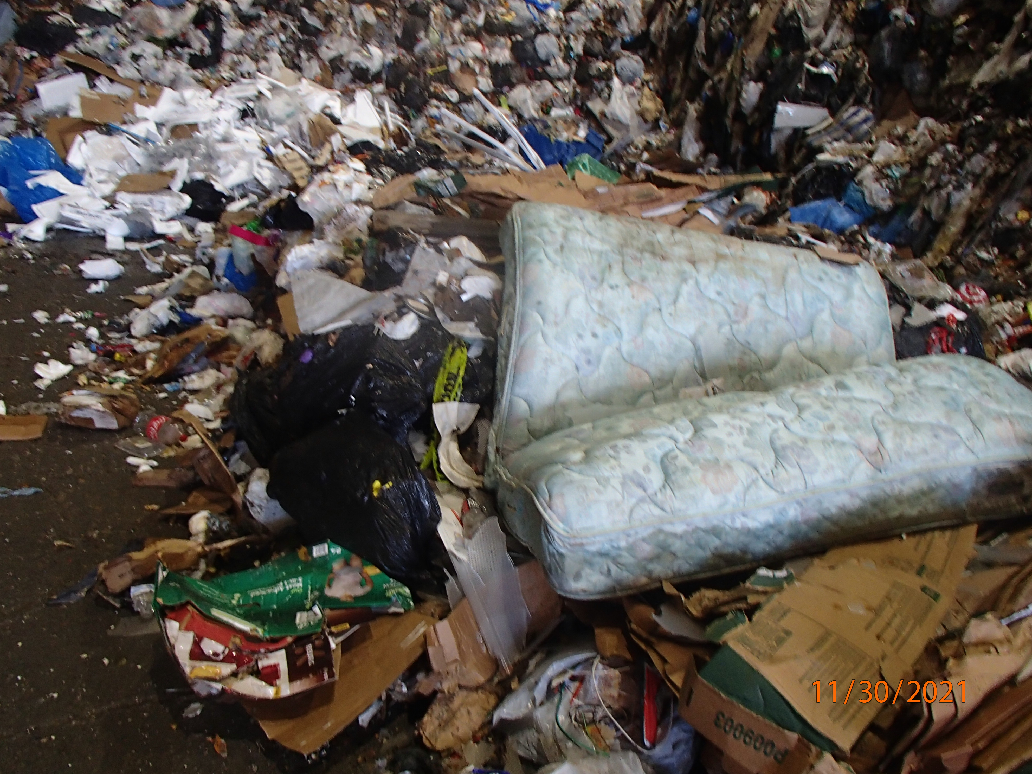
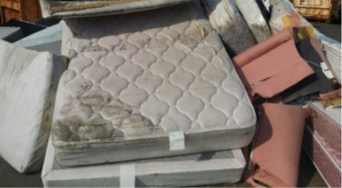
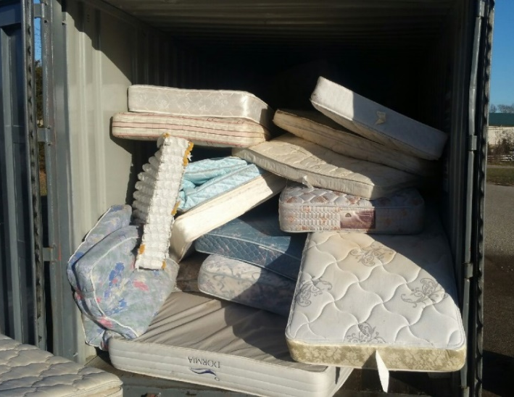
Mattress Waste Disposal Ban
Solid Waste Master Plan published in October 2021
Goal to reduce disposal by 30% by 2030 and 90% by 2050
MassDEP also published revised waste ban regulations
Bans mattresses from disposal as of November 1, 2022

Slide 38
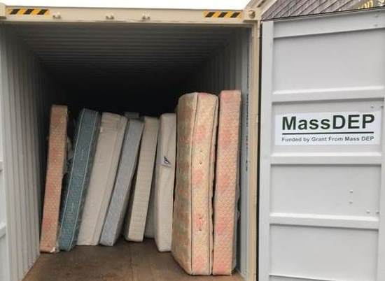
Mattress Recycling Incentive Grant
Promote source-separated residential mattresses and box springs collected at a drop-off site OR collected curbside and aggregated at a central drop-off location.
Grant provides reimbursement for a collection container up to $10,000.

Slide 39
Mattress Recycling Incentive Grant
Preference will be given to municipalities that have not previously been awarded a mattress collection container.
Preference will be given to regional sites where multiple municipalities may benefit and have access to the collection container.
MassDEP anticipates awarding this grant to up to 10 municipalities.

Slide 40
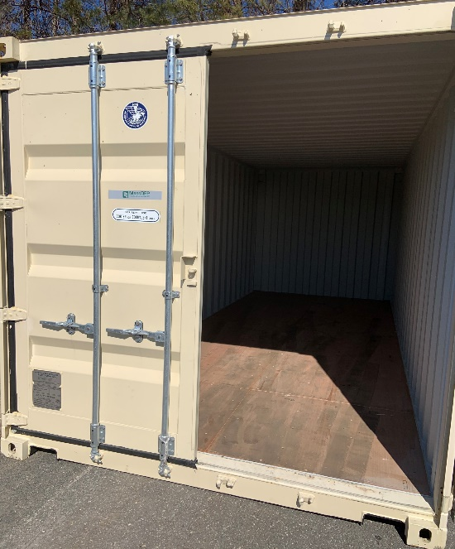
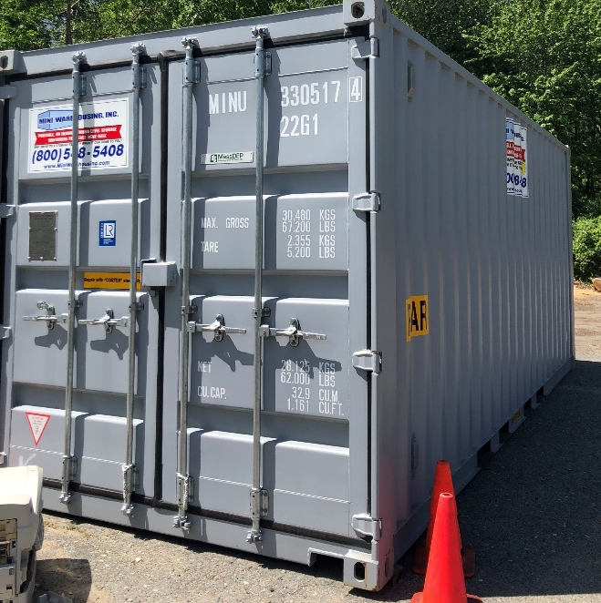
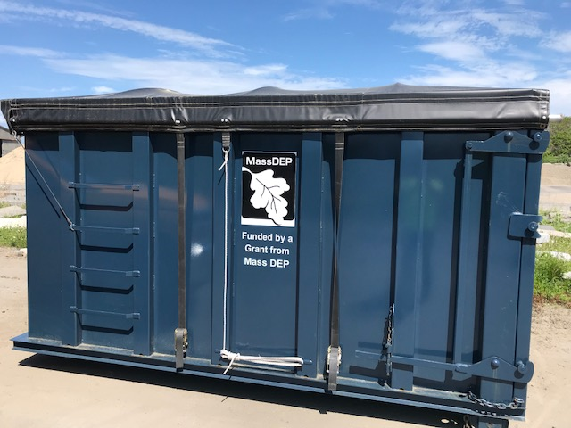
Mattress Collection Containers
Massachusetts State Contracts FAC113, FAC86, FAC90: www.commbuys.com/bso/

Slide 41
Getting Ready to Apply
Container size – roll-off or stationary container, transfer trailer, other proposal.
Site considerations – do you need to modify a site permit, hours of operation, accessibility, collection methods.
Logistics – how mattresses will be collected/stacked, potential mattress recycling company that will pick-up their mattresses.

Slide 42
Additional Resources
Detailed Grant Guidance for Mattress Recycling Incentive: www.mass.gov/doc/details-mattress-recycling-incentive-program/download
MassDEP MRI Website: www.mass.gov/service-details/mattress-recycling

Slide 43
Pay-As-You-Throw (PAYT) Program Assistance
Rachel Smith
Rachel.smith@mass.gov

Slide 44
Why PAYT?
Single most effective tool to reduce waste and increase recycling
Equitable – like utilities, you pay for what you use
Environmental benefits – reduces trash sent to landfills and incinerators, which reduces emissions
More reuse and recycling less waste
Savings in avoided disposal costs
Signals to residents the true costs of SW management

Slide 45
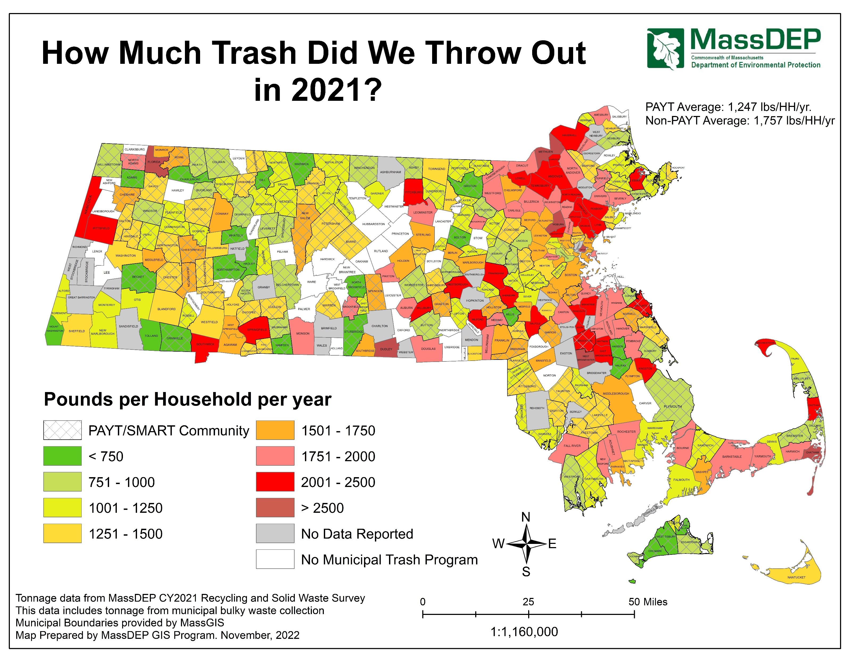
PAYT Municipalities have 29% LESS Trash than Non-PAYT

Slide 46
PAYT Technical Assistance (TA) Grant
80 hours dedicated in-kind technical assistance from your MAC
Provide background information on comparable PAYT communities
Set up site visits at communities with PAYT programs
Provide financial analysis of PAYT and variations under consideration
Attend public meetings and forums
Provide support for public outreach materials such as FAQ documents and PPT presentations
Help develop of Draft Implementation Plan

Slide 47
PAYT Grant Program
New Drop-off PAYT Program = $10 per HH
New Curbside PAYT Program
One bag/barrel free (e.g., hybrid program) = $10 per HH
No bags/barrels free (e.g., full PAYT w/ bags) = $20 per HH
One 35-gallon trash cart = $30 per HH
One 64-gallon trash cart collected every other week = $10 per HH
Upgrade to Existing PAYT Program
Convert from 1 bag/barrel free to Full PAYT = $5 per HH
Transition from a sticker program to a bag program = $5 per HH
Provide automated trash carts of <35-gallon capacity = $30 per HH

Slide 48
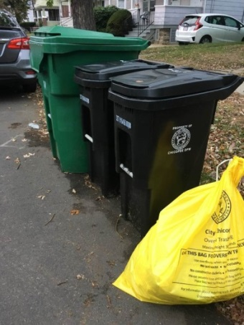
PAYT Grant Program
Available for both new PAYT programs and program upgrades.
Funding is dependent on type of program and # HHs served. Maximum of $300,000.
Grant funds may be used to fund the cost of bags, <35-gallon trash carts, outreach and education materials, program coordinator, and other approved expenses.

Slide 49
Getting Ready to Apply
Applicants MUST have submitted and have been approved for a TA Grant for PAYT technical assistance.
Applicants that are full PAYT (all bags/tags/stickers) MUST have a municipal bylaw/ordinance/regulation requiring private haulers to provide integrated trash and recycling services.

Slide 50
Additional Resources
Detailed Grant Guidance for PAYT Assistance: www.mass.gov/doc/details-pay-as-you-throw-assistance/download
MassDEP PAYT Website: www.mass.gov/lists/pay-as-you-throw-paytsave-money-and-reduce-trash-smart
2022 Webinar on PAYT for Municipalities: www.youtube.com/watch?v=do6c7-SZRhs

Slide 51
Household Hazardous Waste (HHW): Grants for Permanent Collection Facilities
Brooke Nash
Brooke.Nash@mass.gov
Notes:
8

Slide 52
Why a Permanent Collection Facility?
Costs of one-day events increasing
Challenges scheduling vendors for events
Permanent centers are:
More sustainable model
Greater access for residents
Lower cost per resident

Slide 53
HHW Grant Details
Municipality, muni acting as a lead, or regional entity
Serves residents; may serve small businesses
Establish new facility or upgrade an existing one
Up to $50,000 for a single municipality
Up to $250,000 for a regional facility serving multiple municipalities
Open one weekend day per month, 8 months per year

Slide 54
Application Process
Must use the Mandatory Proposal Outline HHW on SMRP website
Complete in MS Word; upload to ReTRAC
Regional applicants must ensure all municipalities have met SMRP grant pre-requisites
Read the HHW Details Document on SMRP webpage
Email Brooke Nash to discuss proposal: brooke.nash@mass.gov
Site should be identified in application

Slide 55
Use of Grant Funds
Equipment (storage lockers, tanks, & other equipment)
Site preparation/site improvement, signage, fencing
Professional services (engineering, design, legal, permitting) – maximum of 15%
Dedicated personnel for project development (consultants, contractors)
Training costs for staff
NO funds for HHW collection/processing/disposal
Award amount dependent on population and entities served
Up to 2 years to expend funds.

Slide 56
HHW Facility Permitting
Application for Permanent Center for Hazardous Products
Serves residents and VSQGs (small businesses) only
Pre-Application meeting strongly recommended
James Paterson, Branch Chief, HW Programs james.paterson@mass.gov
April 5, 2023 Meeting Recording: https://drive.google.com/file/d/19-TqsoOEnzUXkiIS8Jxlry5xOv_OWiG0/view

Slide 57
Visit a Municipally Operated Permanent HHW Facility!
Facility list and contact info: MassDEP’s website here

Slide 58
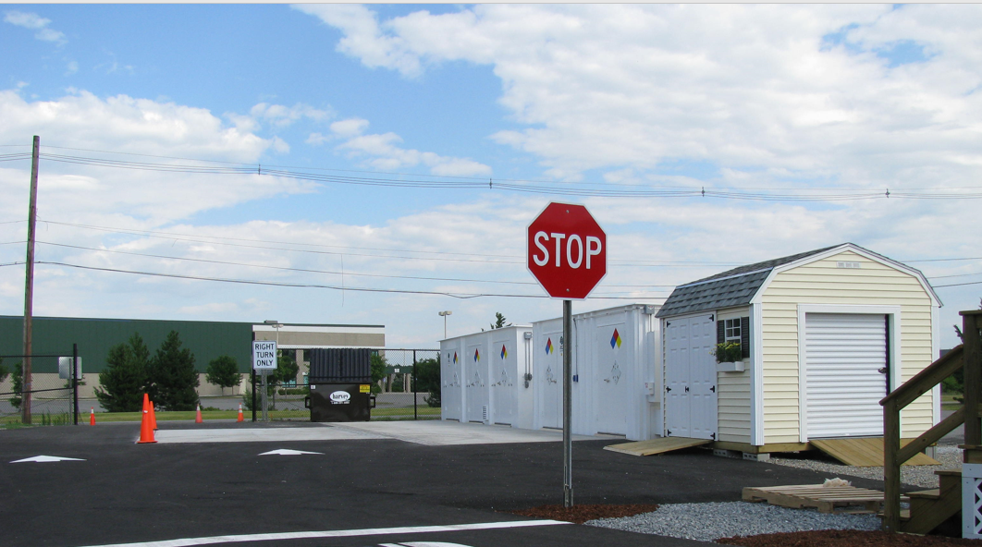
Devens Regional HHW Facility

Slide 59
Questions?

Slide 60
Recycling Dividends
Program (RDP) &
Regional Small-Scale Initiatives
Wilfred Mbah
Wilfred.Mbah@mass.gov

Slide 61
Regional Small-Scale Initiatives
Regional groups only
Population based
Same spending as RDP

Slide 62
Regional Small-Scale Initiatives

Slide 63
RDP Refresher
Maximize reuse, recycling, and waste reduction
Only one option/category per criteria allowed
Households served by the municipal trash program
Programs claimed must be in place and operational from July 1st , 2022 through June 30th, 2023.
Website postings must be accurate

Slide 64
Recycling Dividends Program (RDP) Criteria
Recycling Center Access
Reuse Programs
Solid Waste Reduction
Textile Recovery Initiative
Waste Prevention Outreach and Education
Yard Waste
Bulky Items
CHARM
Curbside Recycling Regulations
Diversity, Equity, and Inclusion (DEI) in Recycling Programs
Household Hazardous Waste
Organics

Slide 65
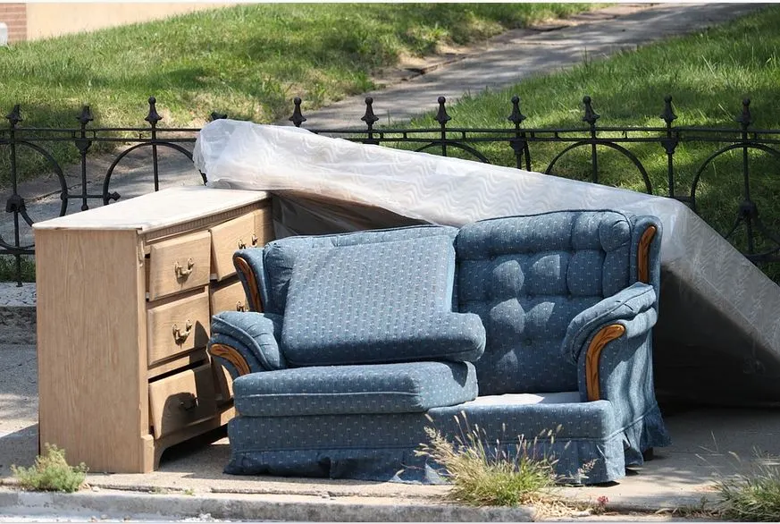
Bulky Items
Minimum fee of at least $5 for at least 3 of the listed items [2 pts]
Up to 4 items included per year at no charge before minimum fee applies [1 pt]
Mattresses
Upholstered furniture
Wood furniture
Toilets
Sinks
Carpet

Slide 66
Center for Hard to Recycle Materials – CHARM
Must collect 8 materials
Mattresses will still qualify as three items
Fire Extinguishers and 20 lb propane tanks qualify as one item – no longer need to collect 1lb propane tanks to qualify under this item.
Carpet and Styrofoam no longer qualify
Christmas lights, shredded paper, marine wrap and/or agricultural wrap may be collected 1x/yr at alternative location qualifies
Source Separated gypsum wallboard
Open 12x year [2 pts]
Open 6x year [1 pt]

Slide 67
Curbside Recycling Regulations
Imposed on the Hauler:
ADOPTED - MassDEP's Model Comprehensive Hauler Regulations that require haulers provide recycling to all generators, residential and commercial as bundled service. Mandatory Recycling is required of all generators. [2 pts]
ADOPTED - Comprehensive Hauler Regulations that require haulers provide recycling to all generators, residential and commercial as bundled service. Mandatory Recycling is required of all generators. [1 pt]

Slide 68
Curbside Recycling Regulations
Continued…
ENFORCED - Comprehensive Hauler Regulations that require haulers provide recycling to all generators, residential and commercial as bundled service. Mandatory Recycling is required of all generators. [4 pts]
ENFORCED - Municipality enforces hauler regulation that requires private haulers provide bundled service to all residential generators at a rate that reflects the cost of both services. [3 pts]

Slide 69
Curbside Recycling Regulations
Imposed on Residents:
ENFORCED – Municipality enforces Mandatory and/or Quality Recyclables
Min. 19 hrs/wk [3 pts]
Min. 10 hrs/wk [1 pt]
ENFORCED - Hauler enforces Mandatory and/or Quality Recyclables via hauler contract or municipal standard operating procedures [1 pt]

Slide 70
Diversity, Equity, and Inclusion (DEI) in Recycling Programs
Two or more of the following activities [1 pt]:
Reduced or subsidized PAYT bag or sticker fees
Multilingual recycling & trash guides available on website and/or sent as a mailer
Sent multilingual materials to property managers of multifamily homes/apt/condo complexes
Multilingual recycling & trash reminders/signage at drop-off location
Next…

Slide 71
Diversity, Equity, and Inclusion (DEI) in Recycling Programs
Continued…
Multilingual guides for handling HHW properly available on website and/or sent as mailer
Multilingual handouts/guides available at schools
Reduced Transfer Station/Recycling Center access fee
Reduced costs for HHW collection/bulky waste/zero waste collection events
Hosts multilingual webinar or social media live stream/video or Cable TV program 1x/year for recycling education/outreach

Slide 72
Diversity, Equity, and Inclusion (DEI) in Recycling Programs
Continued…
Recycling services were provided by the municipality at large apartment buildings (4 or more units)
Municipal ordinance, bylaw, and/or regulation required all new residential construction to include a provision that requires recycling services
Municipal curbside contract includes a provision requiring haulers to ensure alternative recycling collection for residents with disabilities

Slide 73
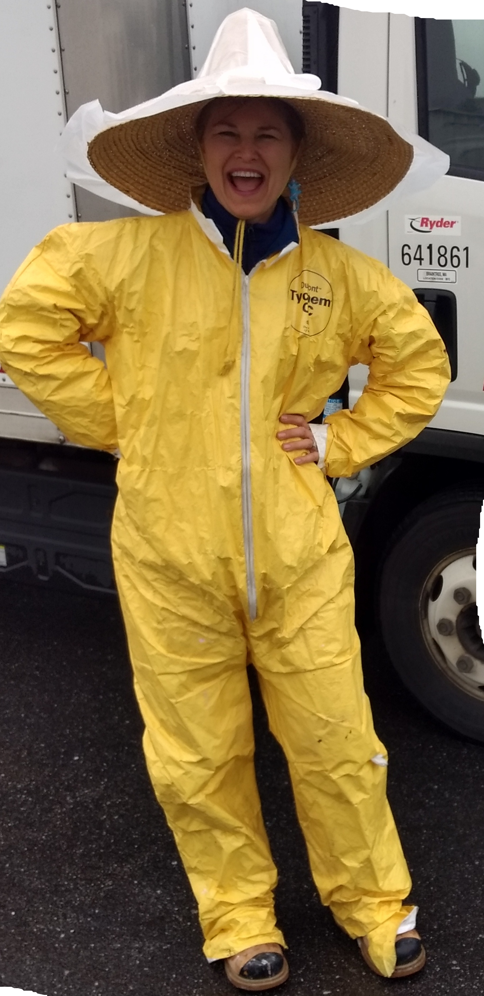
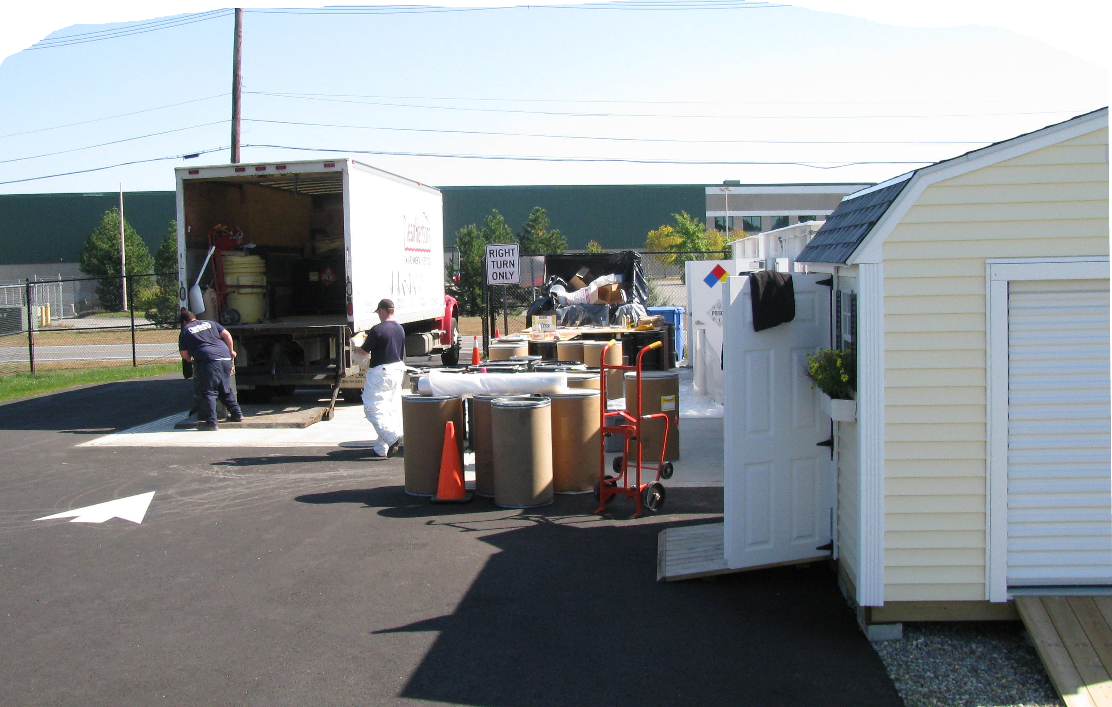
Household Hazardous Waste (HHW)
Municipality organizes, hosts, participates, or funds comprehensive household hazardous waste event(s):
Minimum 6x/year [2 pts]
Minimum 2x/year [1 pt]

Slide 74
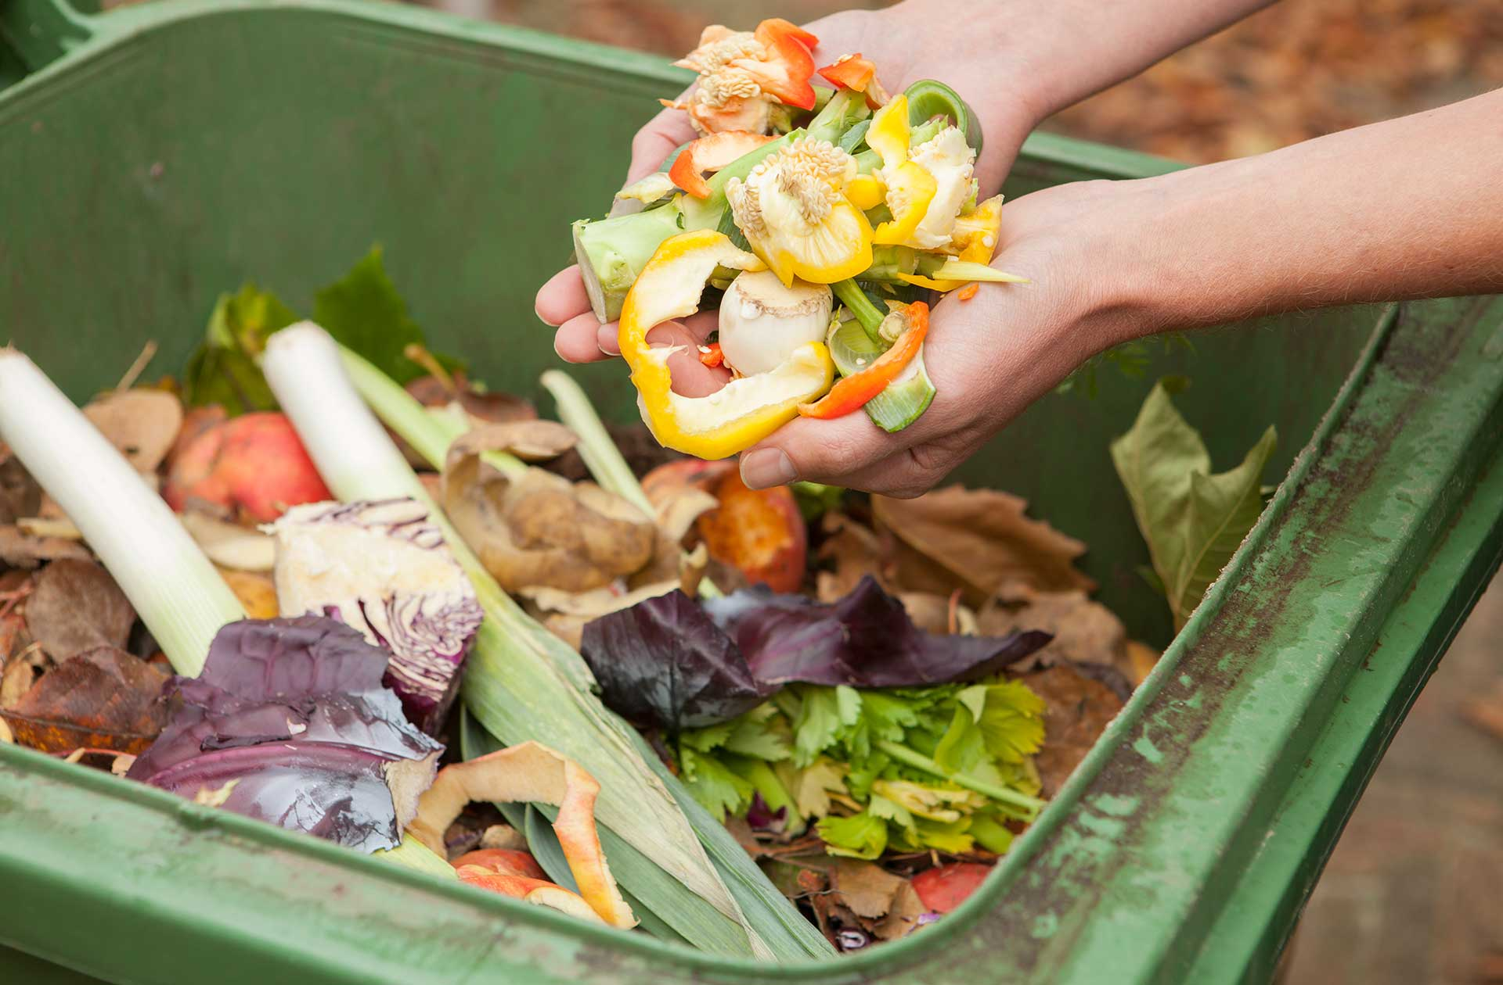
Source Separated Organics
Town-wide organics collection [3 pts]
Source separated food waste for municipalities that go out to bid with preferred vendor [1 pt]
Organics collected weekly – pilot – municipally funded, 400 HH min [1 pt]

Slide 75
Source Separated Organics
Continued…
Source separated food waste for municipalities that go out to bid with preferred vendor, with rate partially (minimum $35/yr) or fully offset by municipality or food waste cart provided to resident [2 pts]
Drop-off collection of organics AND home compost bins at cost with effective promotion and outreach [2 pts]
Home compost bins sold at cost or less with effective promotion and outreach [1 pt]

Slide 76
Access to the
Municipal Recycling Center
Open to local haulers to tip recyclables [2 pts]
Open to local businesses, annual reminder* [1 pt]
Open to non-residents* [1 pt]
Open to residents not served by the municipal program, i.e., condos, multi-family units, etc.* [1 pt]
*Access no longer required to be free of charge.

Slide 77
Reuse Programs
Municipally run, permanent enclosed swap shop [2 pts]
Repair Events, 1/yr [1 pt] - 3/yr [2 pts]
Zero Waste Days, 1/yr [1 pt] – 2/yr [2 pts]
Tool Library/Library of Things [1 pt]

Slide 78
Reuse Programs
Building permits require deconstruction, reuse and/or source separation of C&D waste. [2 pts]
Engaged in a pilot deconstruction project. [2 pts]
Adopted and enforces regulations banning single use items in favor of reusables. [2 pts]

Slide 79
Reuse Programs
Dishwashers and reusable dishware are utilized in pre-K through 12th grade school cafeterias [1 pt]
Majority of the student population in the municipality or regional district attended a school that utilized dishwashers and dishware in cafeteria [2 pts]

Slide 80
Solid Waste Reduction
Full PAYT [5 pts]
Modified PAYT excess in bags [4 pts]
EOW with 64-gal carts [4 pts]
Modified PAYT excess tags/stickers [4 pts]
48-gal trash limit [3 pts]
EOW with 96-gal carts [3 pts]

Slide 81
Textile Recovery
Complete 6 activities from list of 13 activities [1 pt]

Slide 82
Outreach & Education
Complete 5 activities from a list of 22 options [1 pt]
A recycling campaign, or recycling 101 refresher course, for municipal buildings and schools was conducted

Slide 83
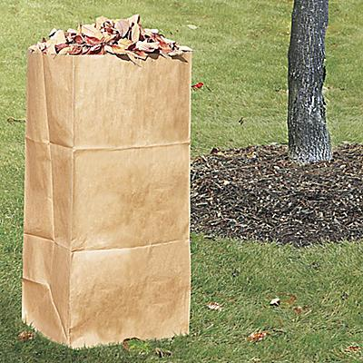
Yard Waste
Curbside collection at least 20 wks/yr [2 pts]
Drop-off open for at least 50 wks/yr [2 pts]
Drop-off open for at least 30 wks/yr [1 pt]

Slide 84
Approved Spending Categories
Same spending for RDP and Regional Small Scale Initiatives
Please see approved spending categories for a list of approved expenditures
No special spending requests to be considered

Slide 86
Additional Resources
Detailed Grant Guidance for RDP: www.mass.gov/doc/details-recycling-dividends-program/download
MassDEP RDP Website: www.mass.gov/how-to/apply-for-smrp-recycling-dividends-program-funds
RDP Approved Spending Categories: www.mass.gov/doc/rdp-small-scale-initiative-approved-spending-categories/download

Slide 87
Questions?

Slide 88
Contact Info
General SMRP Questions| Mattress Containers| PAYT Programs – Rachel Smith (Rachel.Smith@mass.gov)
Minimum Eligibility Requirements| Drop-off Universal Waste Sheds | Organics Carts – Micaela Guglielmi (Micaela.Guglielmi@mass.gov)
Permanent HHW Collection Facility – Brooke Nash (Brooke.Nash@mass.gov)
Recycling Dividends Program | Regional Small Scale Initiatives – Wilfred Mbah (Wilfred.Mbah@mass.gov)

Slide 89
Spring 2023 SMRP Grant Webinar List of Links
Website Title | URL
Solid Waste Master Plan | www.mass.gov/doc/final-massachusetts-2030-solid-waste-master-plan-working-together-toward-zero-waste-october-2021/download
SMRP Grant Website | www.mass.gov/how-to/apply-for-a-sustainable-materials-recovery-program-smrp-municipal-grant
Environmental Justice Populations | www.mass.gov/info-details/environmental-justice-populations-in-massachusetts
Re-TRAC Connect | https://connect.re-trac.com/login
Certification of Minimum Eligibility Criteria | www.mass.gov/doc/certification-of-smrp-minimum-eligibility-criteria/download

Slide 90
Spring 2023 SMRP Grant Webinar List of Links
Buy Recycled Policy Webinar | www.mass.gov/doc/presentation-notification-of-buy-recycled-policy/download
Environmentally Preferable Purchasing | www.mass.gov/guides/epp-program-environmentally-preferable-products-and-services-on-statewide-contracts
Drop off Recycling Equipment Guidance | www.mass.gov/doc/details-universal-waste-shed/download
FAC110 – UW Processers | www.mass.gov/doc/fac110/download
Curbside Wheeled Organics Carts Guidance | www.mass.gov/doc/details-wheeled-organics-carts/download

Slide 91
Spring 2023 SMRP Grant Webinar List of Links
Mattress Recycling Incentive Guidance | www.mass.gov/doc/details-mattress-recycling-incentive-program/download
FAC113 – Mattress Containers | www.mass.gov/doc/fac113designateddep/download
FAC90 – Mattress Recycling Vendors | www.mass.gov/doc/fac90designateddep/download
MassDEP Mattress Website | www.mass.gov/service-details/mattress-recycling
FAC86 – Solid Waste & Recycling Services | www.mass.gov/doc/fac86/download
PAYT Technical Assistance Grant | www.mass.gov/how-to/apply-for-smrp-municipal-technical-assistance
PAYT Grant Guidance | www.mass.gov/doc/details-pay-as-you-throw-assistance/download

Slide 92
Spring 2023 SMRP Grant Webinar List of Links
MassDEP PAYT Website | www.mass.gov/lists/pay-as-you-throw-paytsave-money-and-reduce-trash-smart
Municipal Assistance Coordinators (MACs) | www.mass.gov/guides/massdep-municipal-assistance-coordinators
MassDEP RDP Webpage | www.mass.gov/how-to/apply-for-smrp-recycling-dividends-program-funds
RDP Worksheet | www.mass.gov/doc/rdp-worksheet/download
RDP & Small-Scale Approved Spending | www.mass.gov/doc/rdp-small-scale-initiative-approved-spending-categories/download
Recycling Dividends Program Guidance | www.mass.gov/doc/details-recycling-dividends-program/download

