Slide 1





Massachusetts Virtual Brownfields Roundtable
MassDEP
David Foss, CPG, LSP, Statewide Brownfields Coord.
Abigail Anderson, Brownfields –
Environmental Justice Coordinator
US EPA
Jim Byrne, Brownfields Coordinator
MassDevelopment
David Bancroft, SVP Community Development
UConn Technical Assistance to Brownfields
Randi Mendes, Program Director
Central Mass. Regional Planning Commission
Kerrie Salwa, Director of Economic Development

Slide 2

Virtual Meeting Guidelines
Please keep your microphone muted unless you are speaking.
We will hold a group Q&A session following the presentations. Please type your question in the chat or use the “Raise Hand” function during the Q&A.
We are recording this webinar.

Slide 3
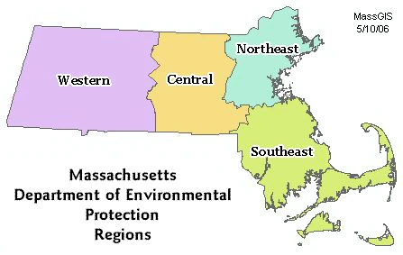
MassDEP BWSC Brownfields Team
Central Kevin Daoust
Northeast Joanne Fagan
Southeast Kait Carvalho
Western Caprice Shaw
David Foss, CPG, LSP
Statewide Brownfields Coordinator
MassDEP | Bureau of Waste Site Cleanup
David.Foss@Mass.Gov
Abigail Anderson
Brownfields Environmental Justice Coordinator
MassDEP | Bureau of Waste Site Cleanup
Abigail.E.Anderson@Mass.Gov

Slide 4
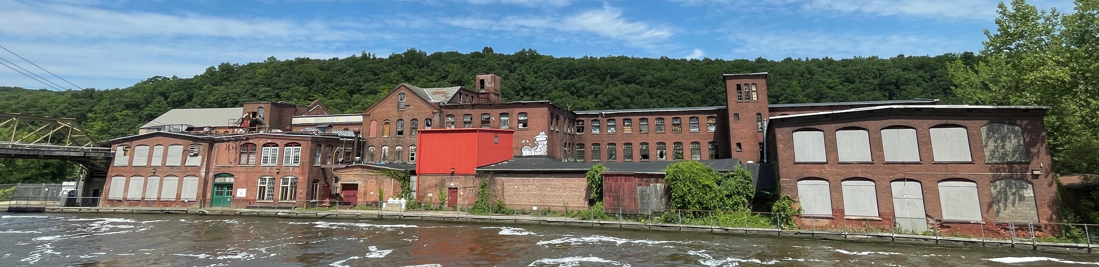
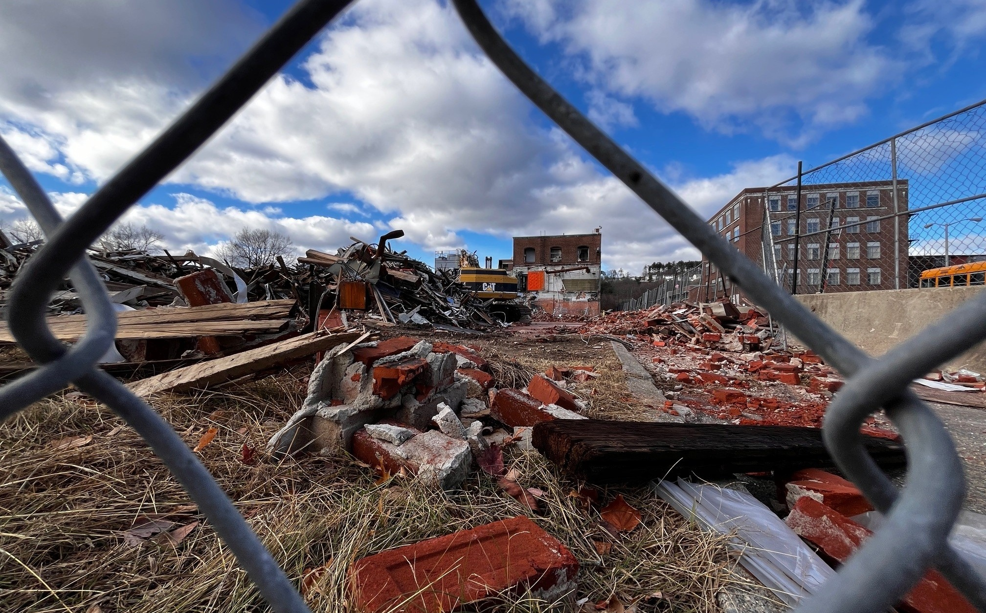
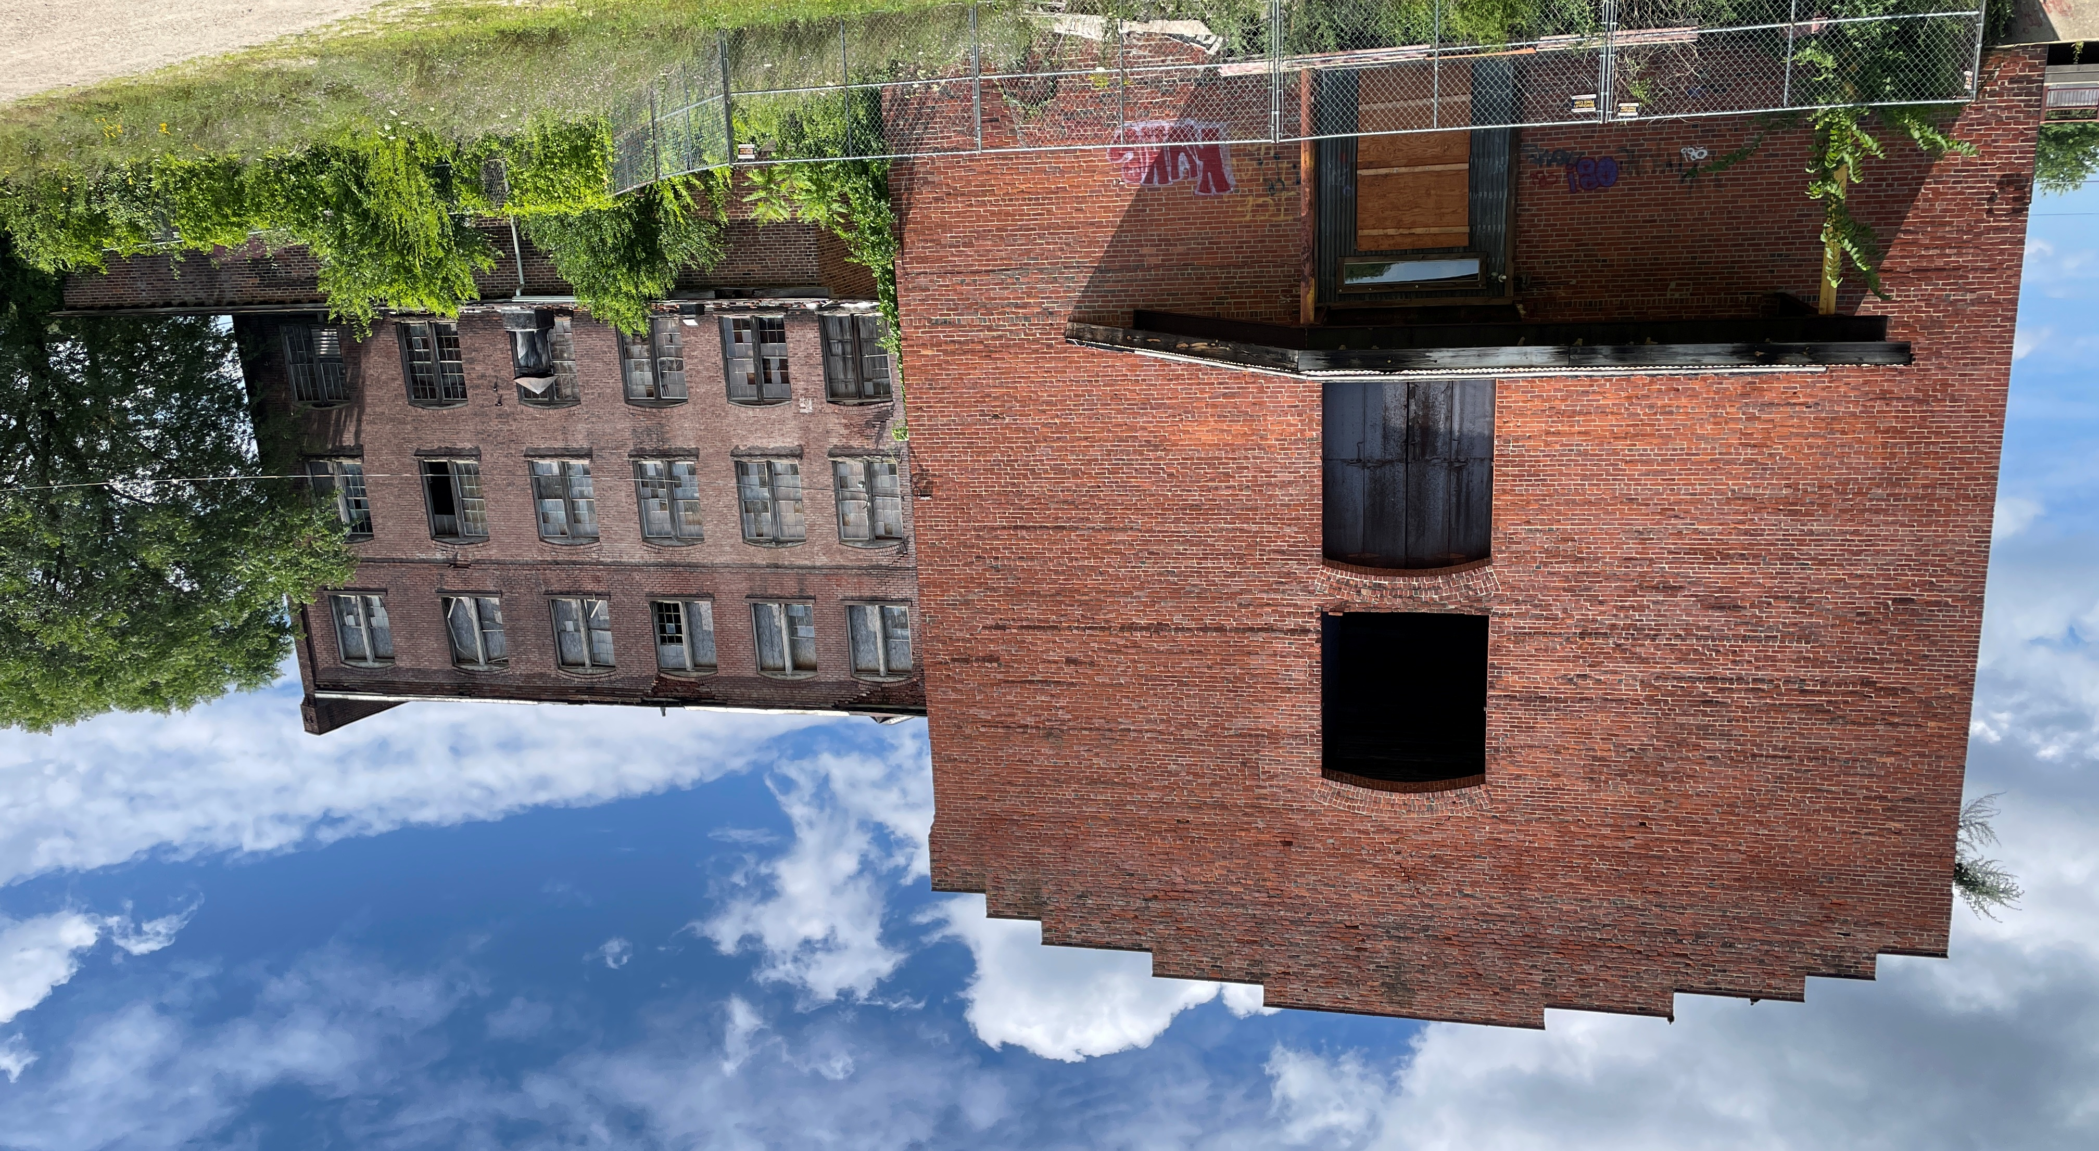
Opportunities

Slide 5
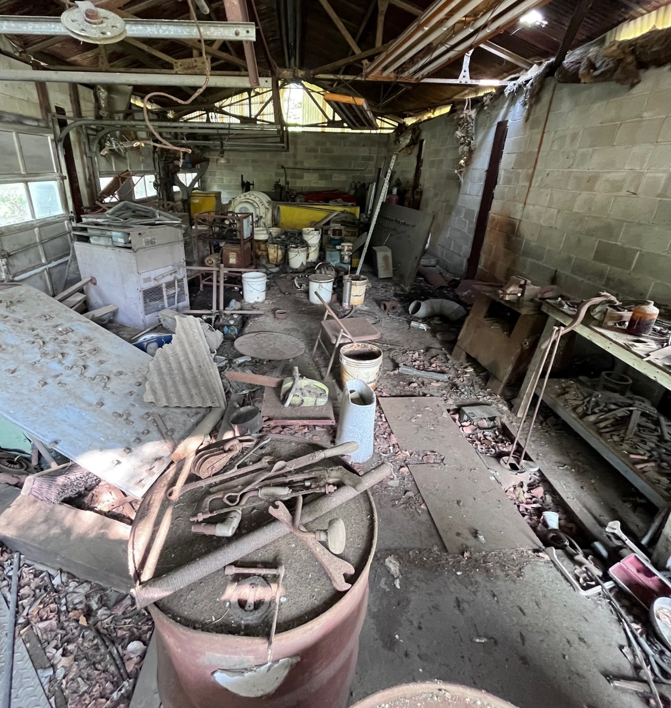
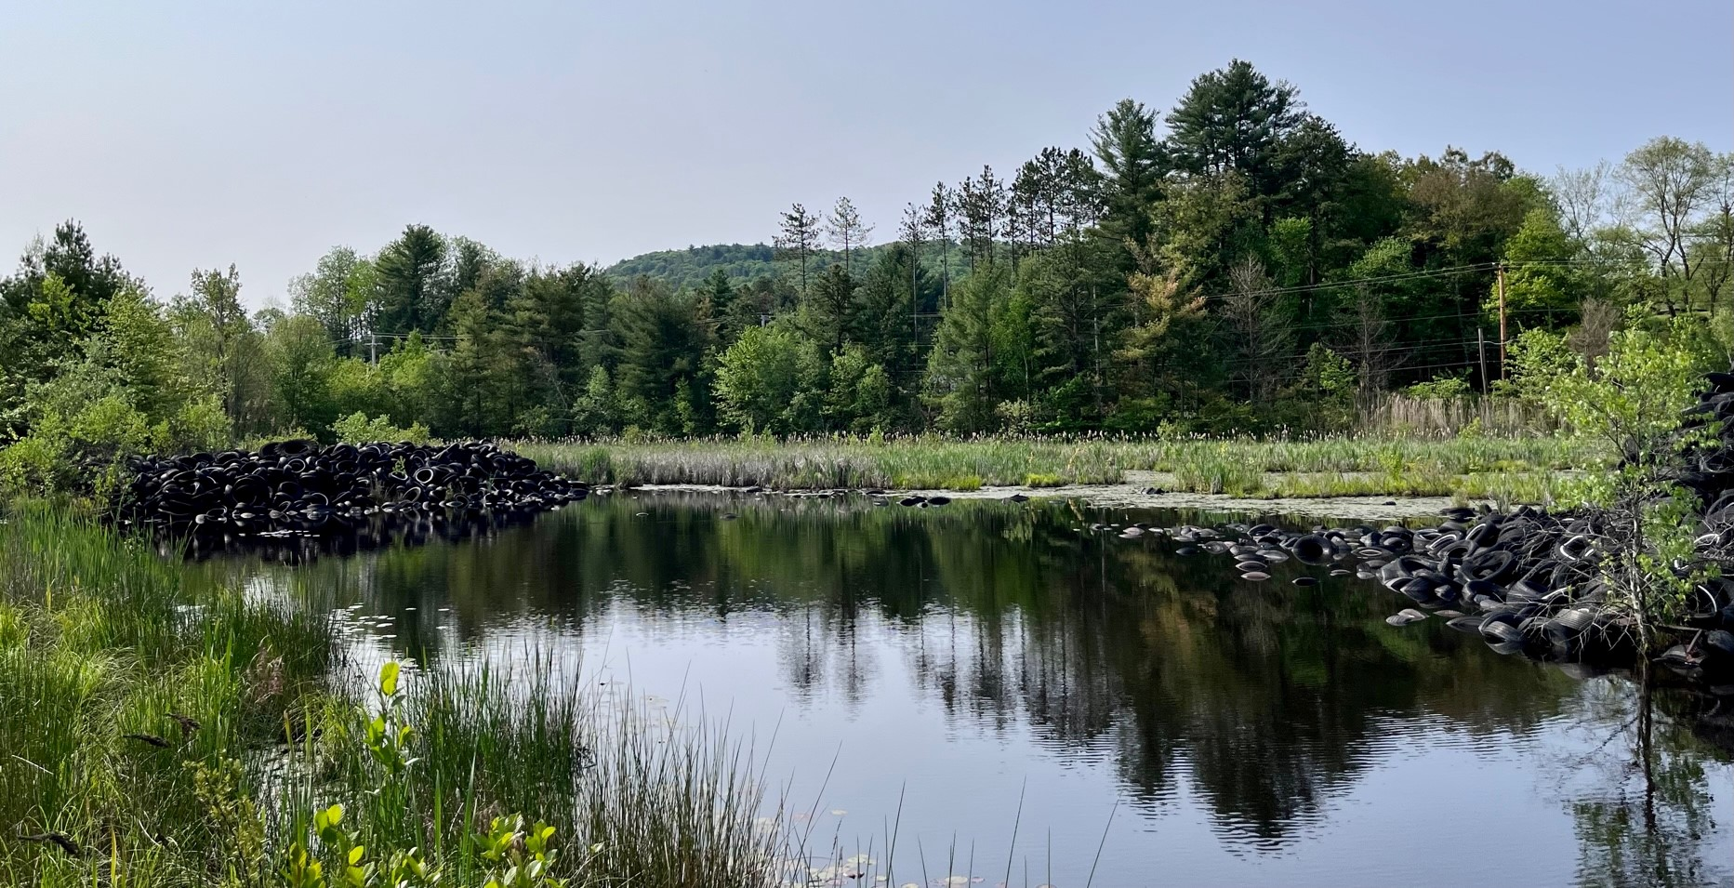
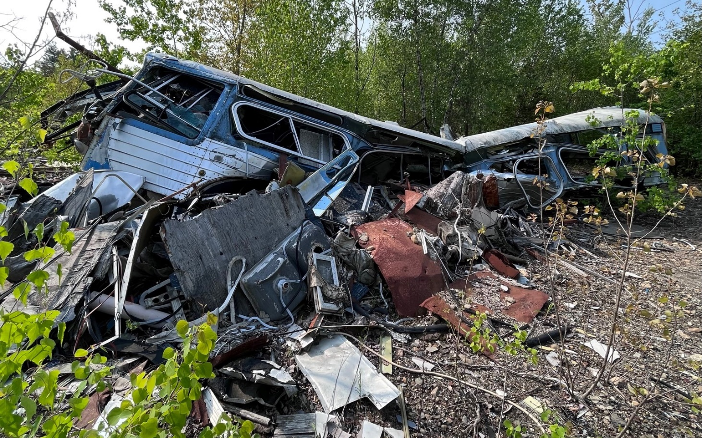
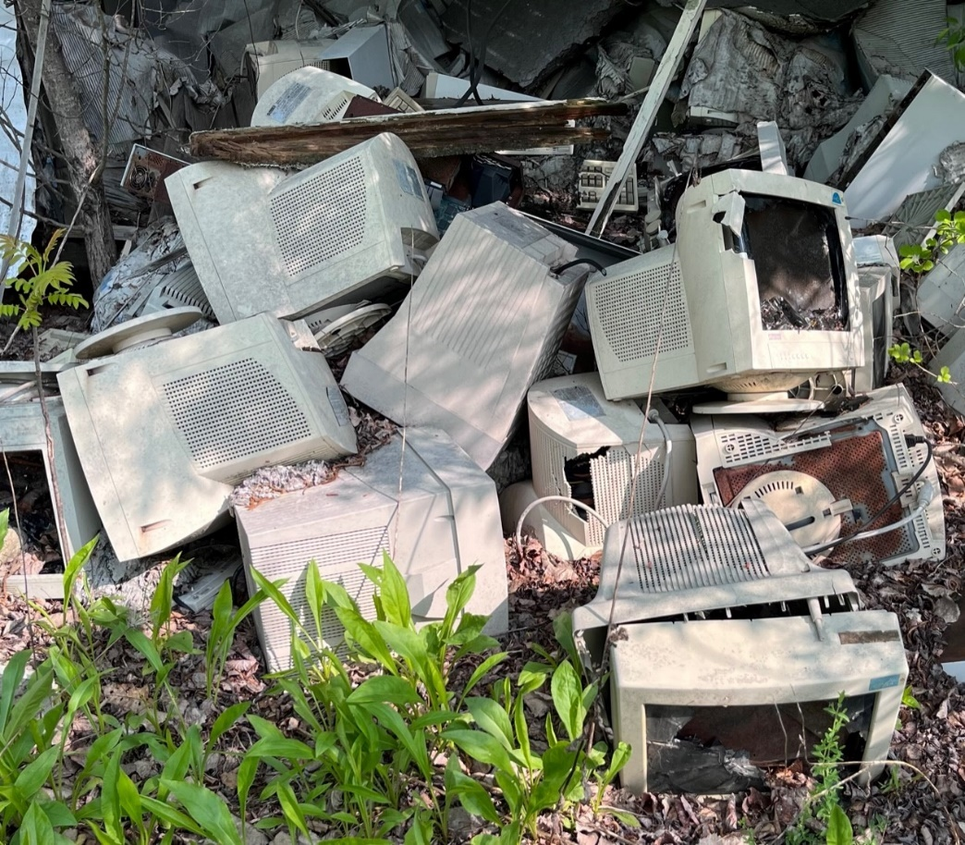
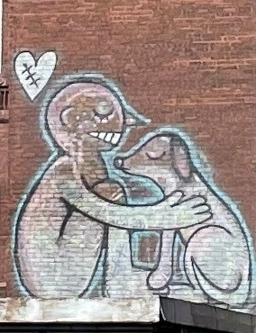
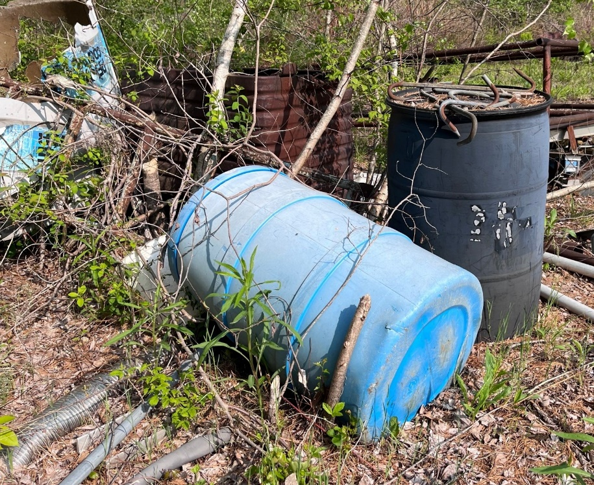
Opportunities

Slide 6
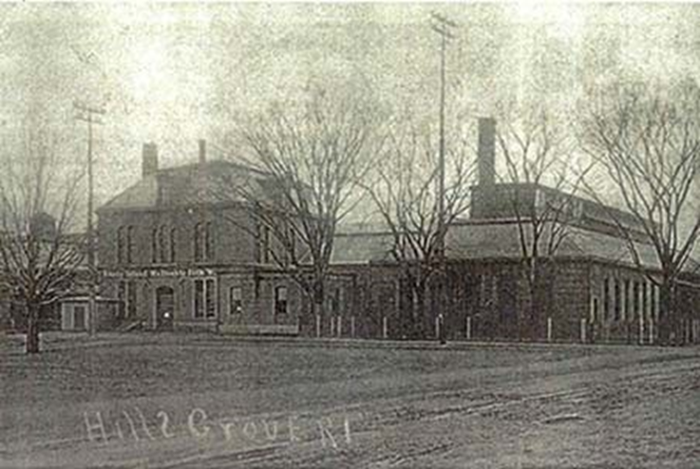
What is a Brownfields?
EPA Definition
US EPA: “Real property, the expansion, redevelopment, or reuse of which may be complicated by the presence or potential presence of a hazardous substance, pollutant, or contaminant.”
Contamination may not be confirmed!
Examples
Vacant or underutilized: commercial / industrial buildings or former commercial / industrial sites; warehouses; gas / service stations; public / institutional facilities; agricultural sites, rail yards / corridors

Slide 7
MGL 21E Ch 2. Brownfields Liability Relief
The Brownfields Act established statutory liability relief for certain parties undertaking brownfields projects. Parties interested in determining if they are eligible for this protection should refer to MGL 21E Chapter 2, and consult with an attorney with expertise in liability relating to OHM releases.
Eligible Person
    “Eligible” Owners & Operators
    Downgradient Property Owners
    Tenants
    Redevelopment Authorities & CDCs
    Secured Lenders
Relief After Meeting Cleanup Standards
No Significant Risk
Permanent Solution or ROS
Link to the MCP

Slide 8
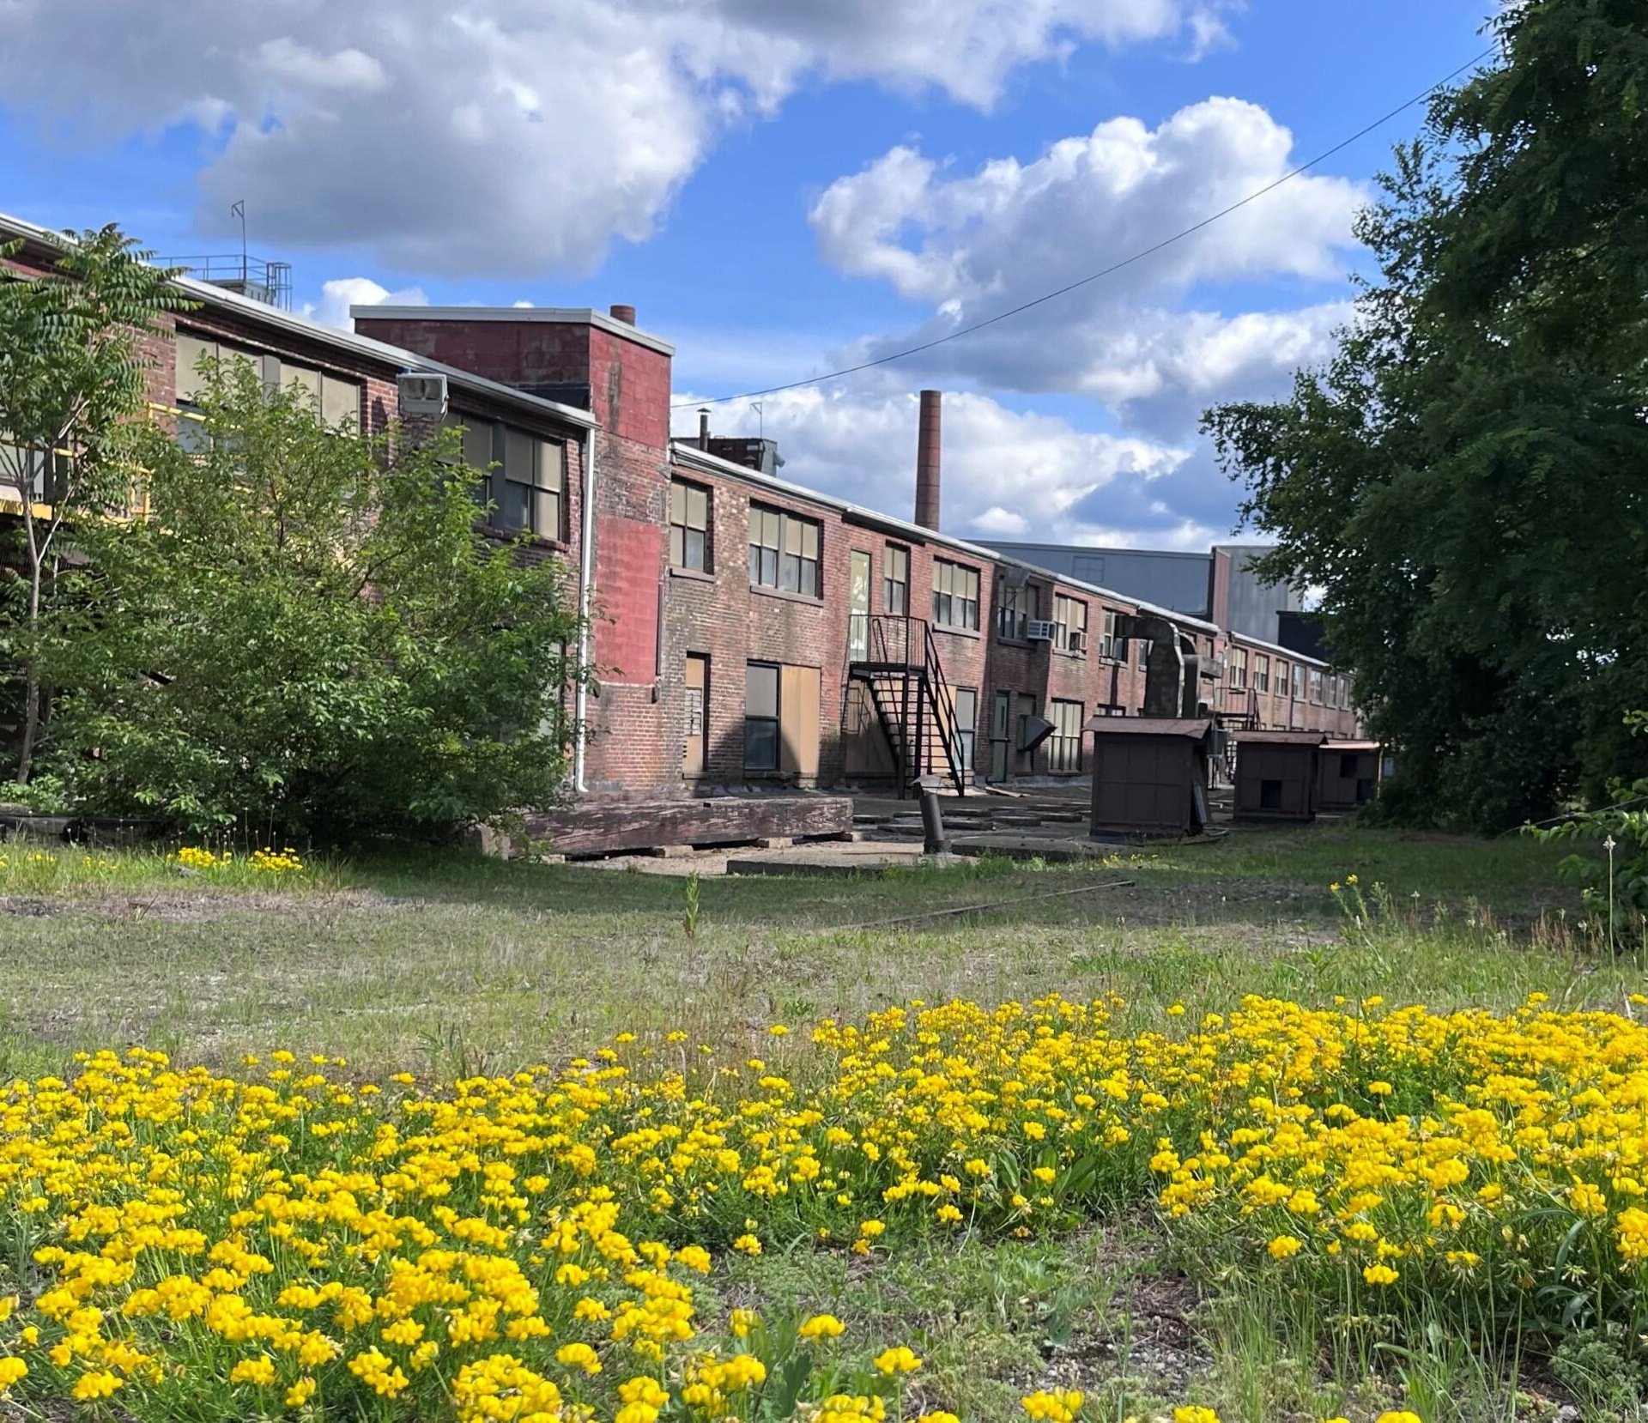
ASTM Phase I Environmental Site Assessment
Conduct environmental due diligence prior to acquisition of property; less than 180 days before acquisition
Evaluate the property’s environmental conditions and assesses potential liability for contamination
Satisfy EPA's “All Appropriate Inquiries”
standard
AAI Final Rule – EPA Fact Sheet
Pre-purchase due diligence

Slide 9
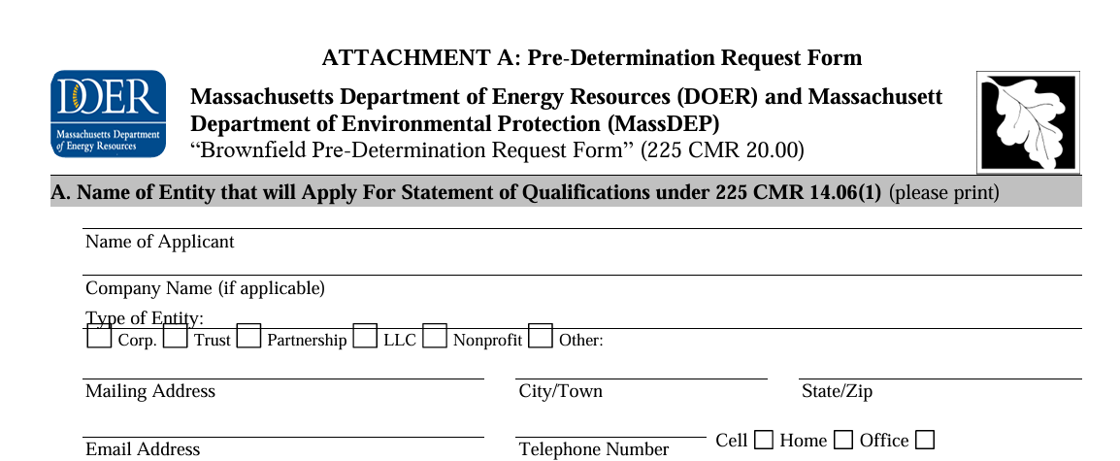
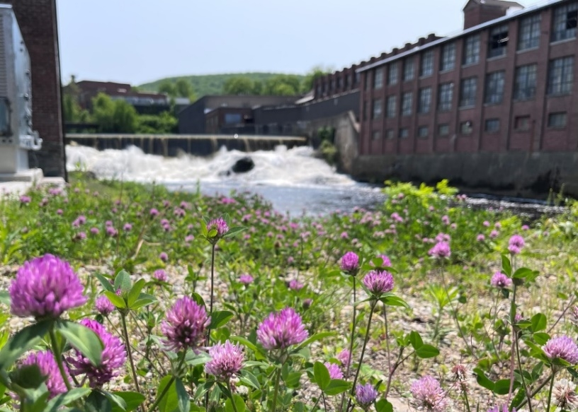

(Other) State Resources
DOER - SMART Program
AGO - BF Covenant not to Sue
MassDevelopment - Brownfields Redevelopment Fund
DOR - Brownfields Tax Credits

Slide 10
Dept. of Revenue (DOR) Brownfields Tax Credit
MGL 21E Section 2. “Eligible Person”
“Eligible person,” an owner or operator of a site or a portion thereof from or at which there is or has been a release of oil or hazardous material who:
(i) would be liable under this chapter solely pursuant to clause (1) of paragraph (a) of section 5; and
(ii) did not cause or contribute to the release of oil or hazardous material from or at the site and did not own or operate the site at the time of the release.
Potentially Responsible Party (PRP) solely due to being current Owner or Operator

Slide 11
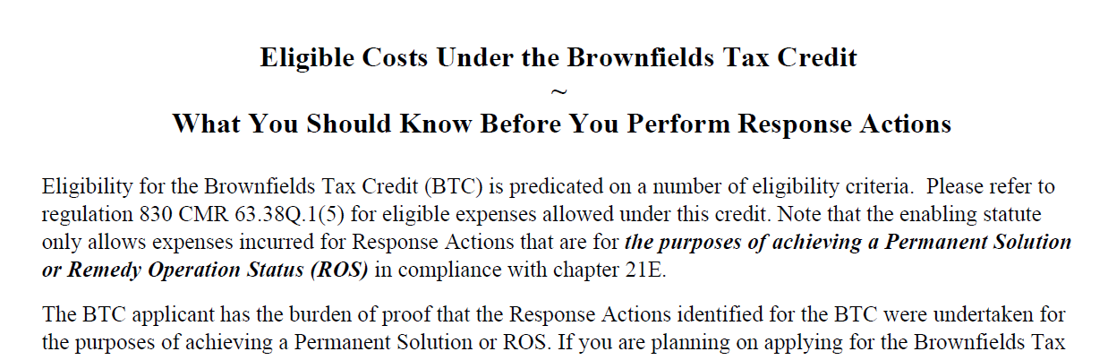

DOR Brownfields Tax Credit
830 CMR 63.38Q.1 and Administrative Procedure 636
https://www.mass.gov/info-details/massachusetts-brownfields-tax-credit-btc
MassDOR may contact MassDEP with questions
  Was soil removed for construction or for remediation purposes?
  Was risk documented prior to soil removal
  Have a good plan in place prior to soil removal activities.
50% for PSNC
25% for AUL
Questions?
Call DOR
617-887-6786

Slide 12
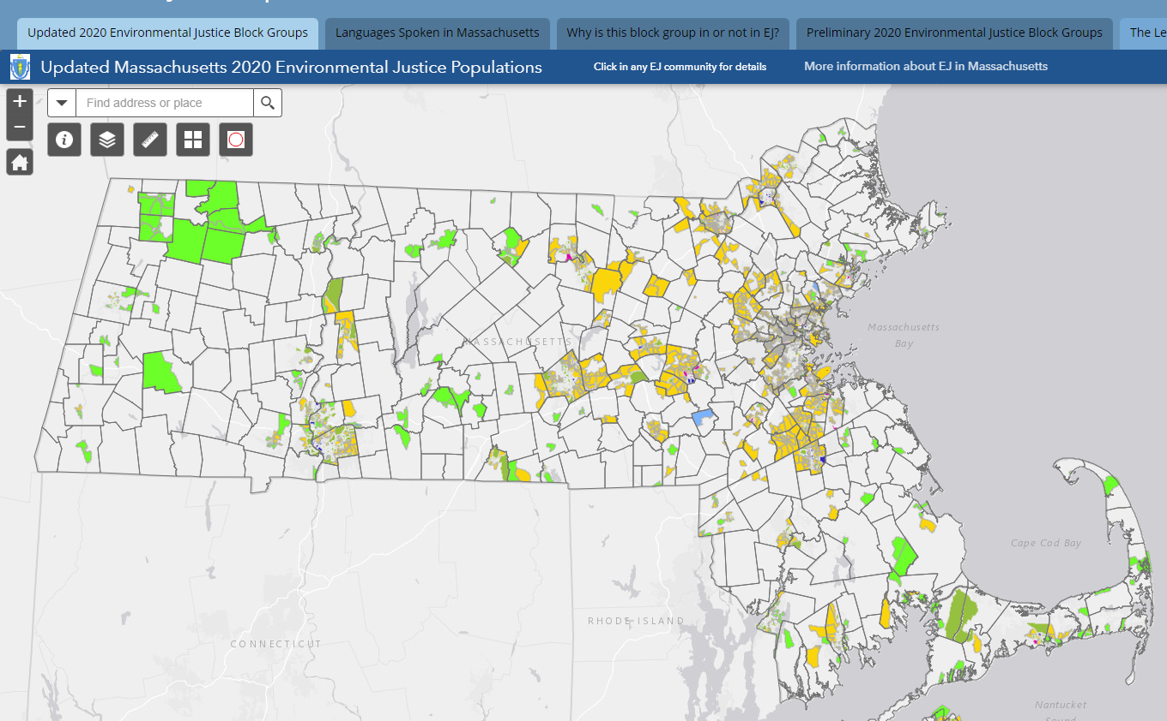
Community Wide Assessment Grant
Seeking Requests for Assistance!
Massachusetts
Assessment Program
Tyngsborough
$2,000,000
over 5 years
Municipal Benefit
Historically
Disadvantaged
Communities
Low population towns
Leominster
Lancaster
Chelsea
Spencer
Holyoke
Worcester
Medway
Brimfield
Habitat-for-Humanity
Wrentham
Municipalities
Non-Profits
Community Development Corp.
Eligible Parties
Taunton

Slide 13
CERCLA 128a IIJA Funding
Attleboro
SVE Soil Remediation
Montague
Soil Remediation
Worcester 60+ Drums
Source Removal
Bridgewater Assess & Remediation to achieve regulatory closure
Templeton
Montague
Fitchburg
Peabody
Lynn
Peabody Assess → Cleanup Grant
Worcester
North Brookfield
Framingham
No. Brookfield Assess → EPA Removal Action
Brimfield
Bridgewater
Attleboro
Lynn & Framingham
Subgrants Remediation
Wareham
Templeton Assess
Budget: $250,000 per site

Slide 14
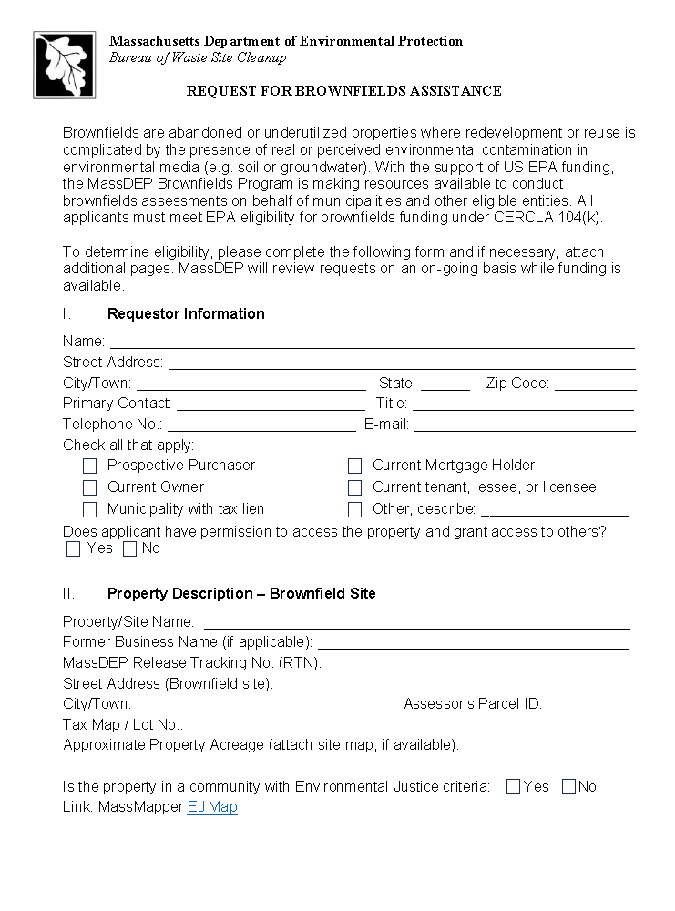
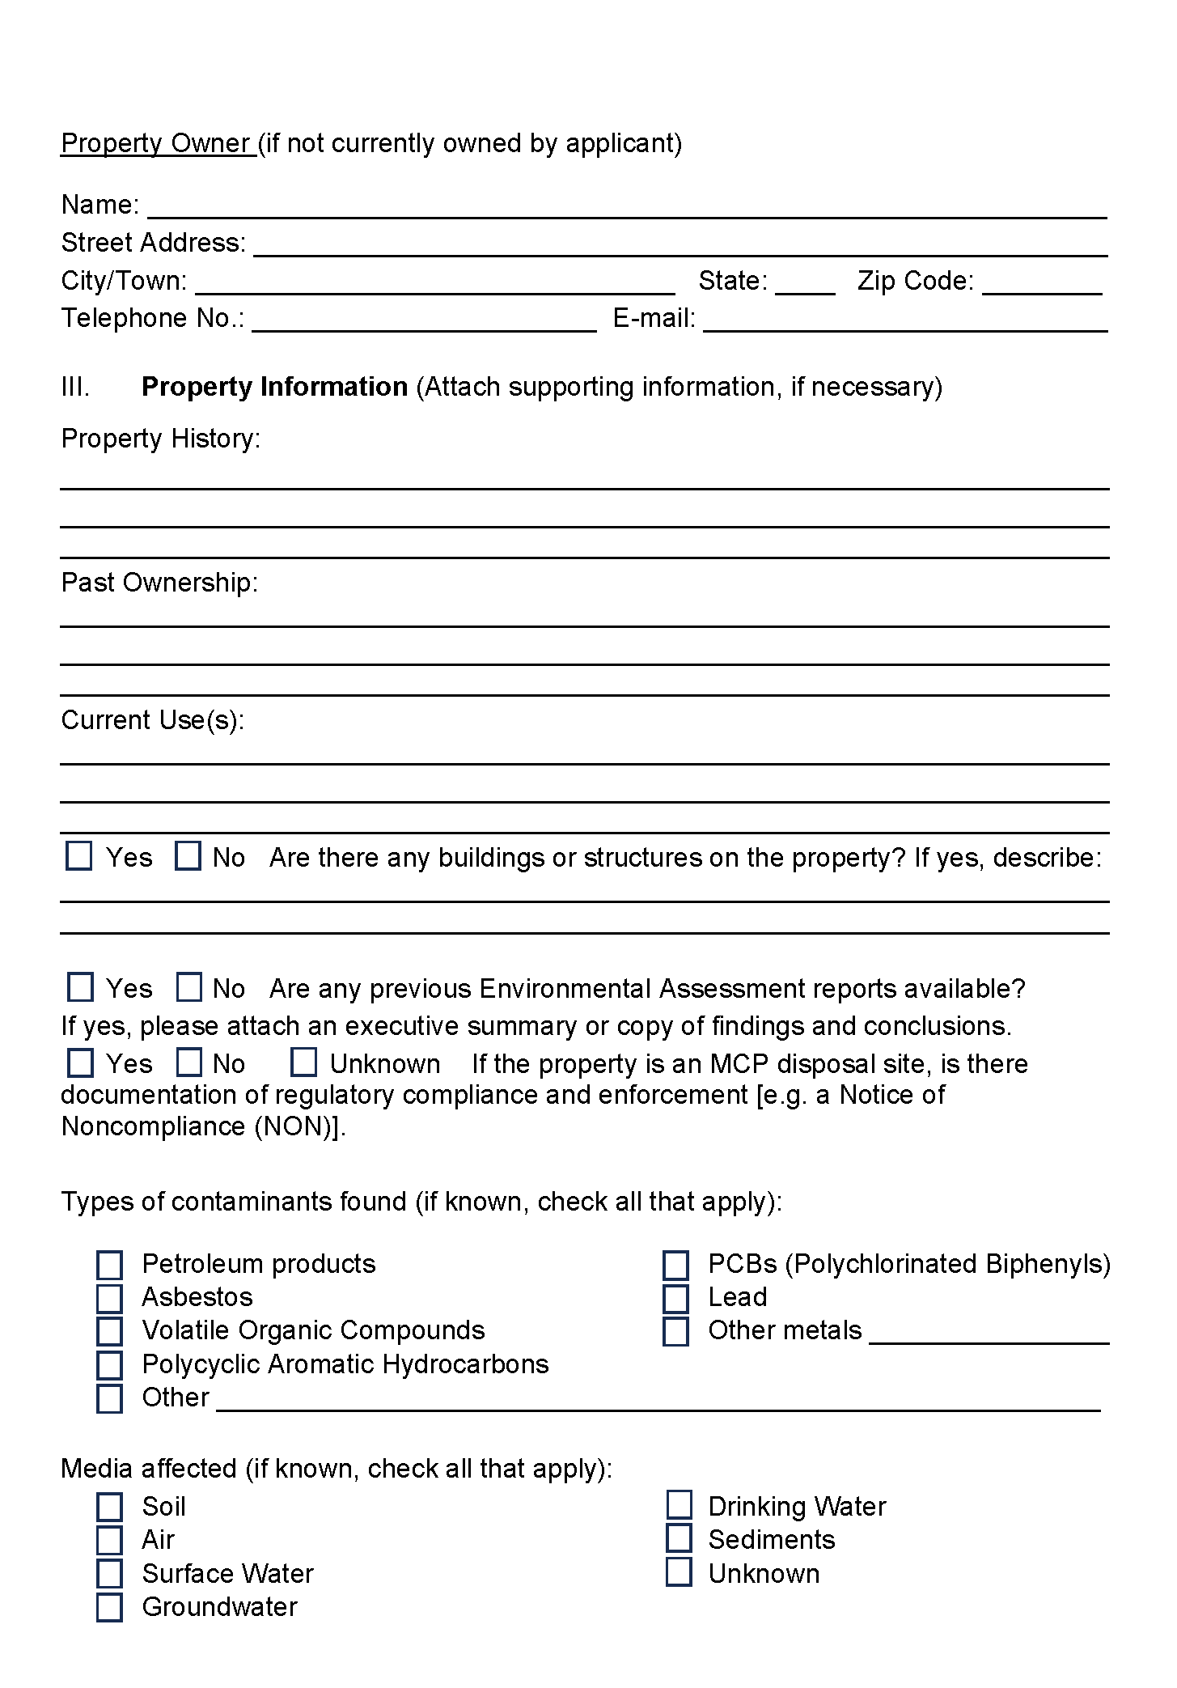
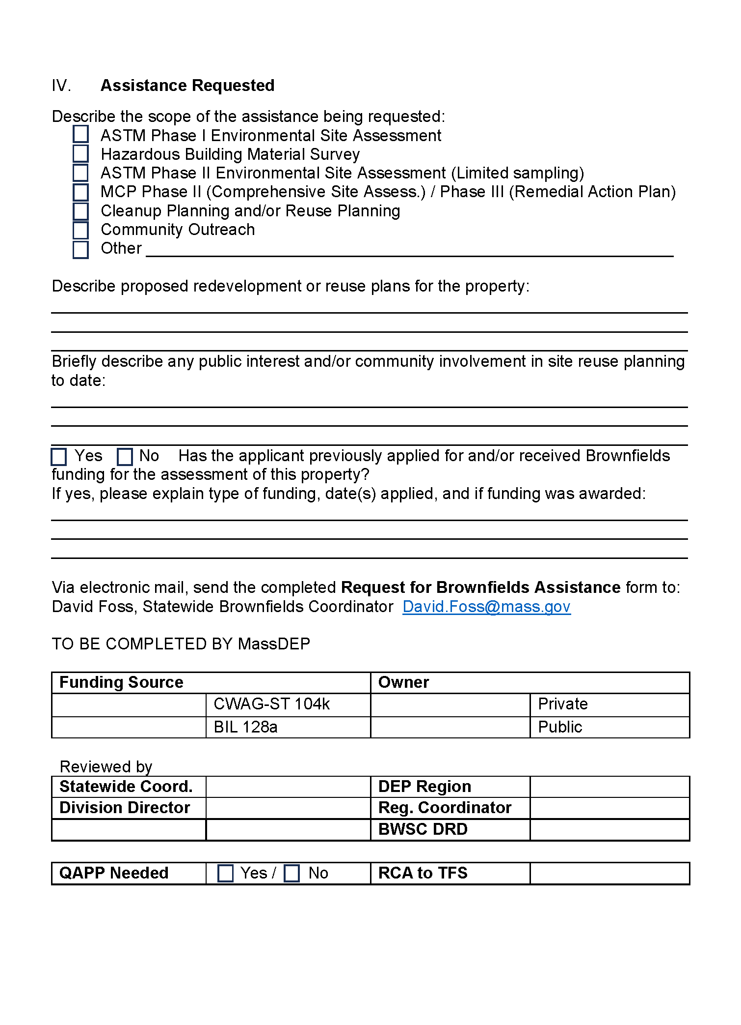
Assistance Request Form
Request for Brownfields Assistance Form
https://www.mass.gov/info-details/brownfield-resources

Slide 15
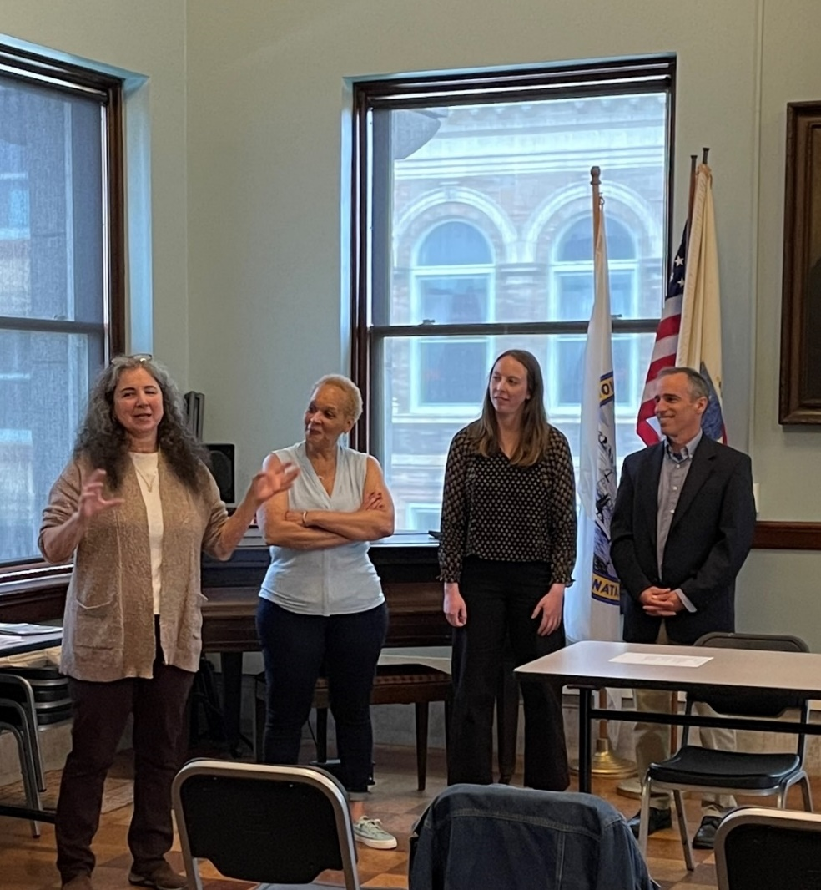
Community Engagement
Focus resources on historically disadvantaged communities
Stakeholder Engagement
  Public meetings, career fairs,
  library events
Coordinate efforts across DEP programs to include community voices
  DEP Technical Assistance Grants
  Language Access
DEP Staff at “Brownfields 101” public meeting at the New Bedford Public Library (April 2024).

Slide 16
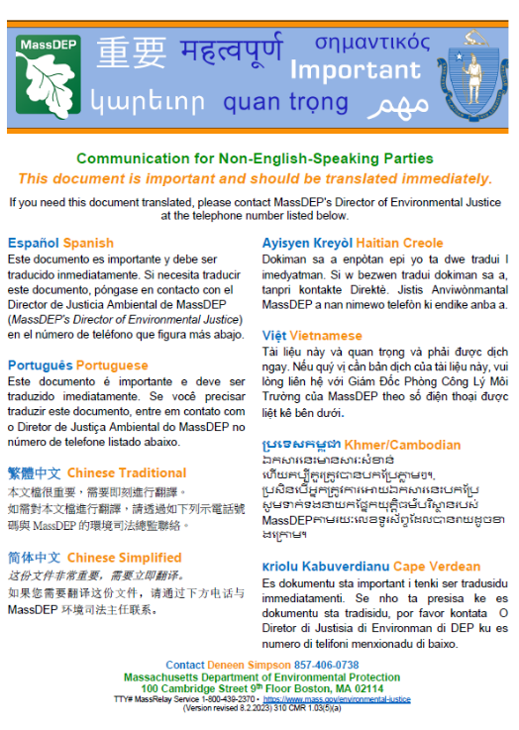
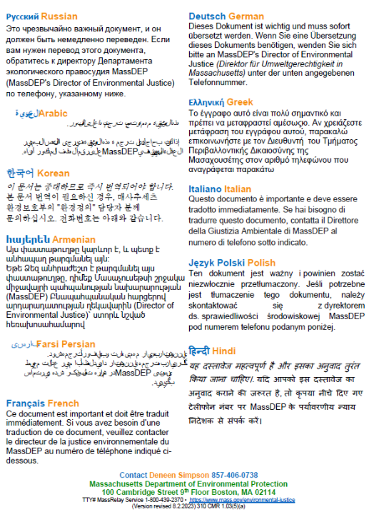
Importance of Language Access
It’s the right thing to do … and it’s required by Title VI, State policy and the Massachusetts Climate Roadmap Act!
Statewide contract for translation, in-person interpreter needs, telephonic interpreter service, and video remote interpretation
Inclusive & culturally sensitive and aware of the limited English proficient individuals in the community
Allows over-burdened community to participate in the process
Affirmatively stating we want the community to be included in the conversation and contribute to decision-making
To request document translation, click here, or contact Abby Anderson (Abigail.E.Anderson@mass.gov)

Slide 17
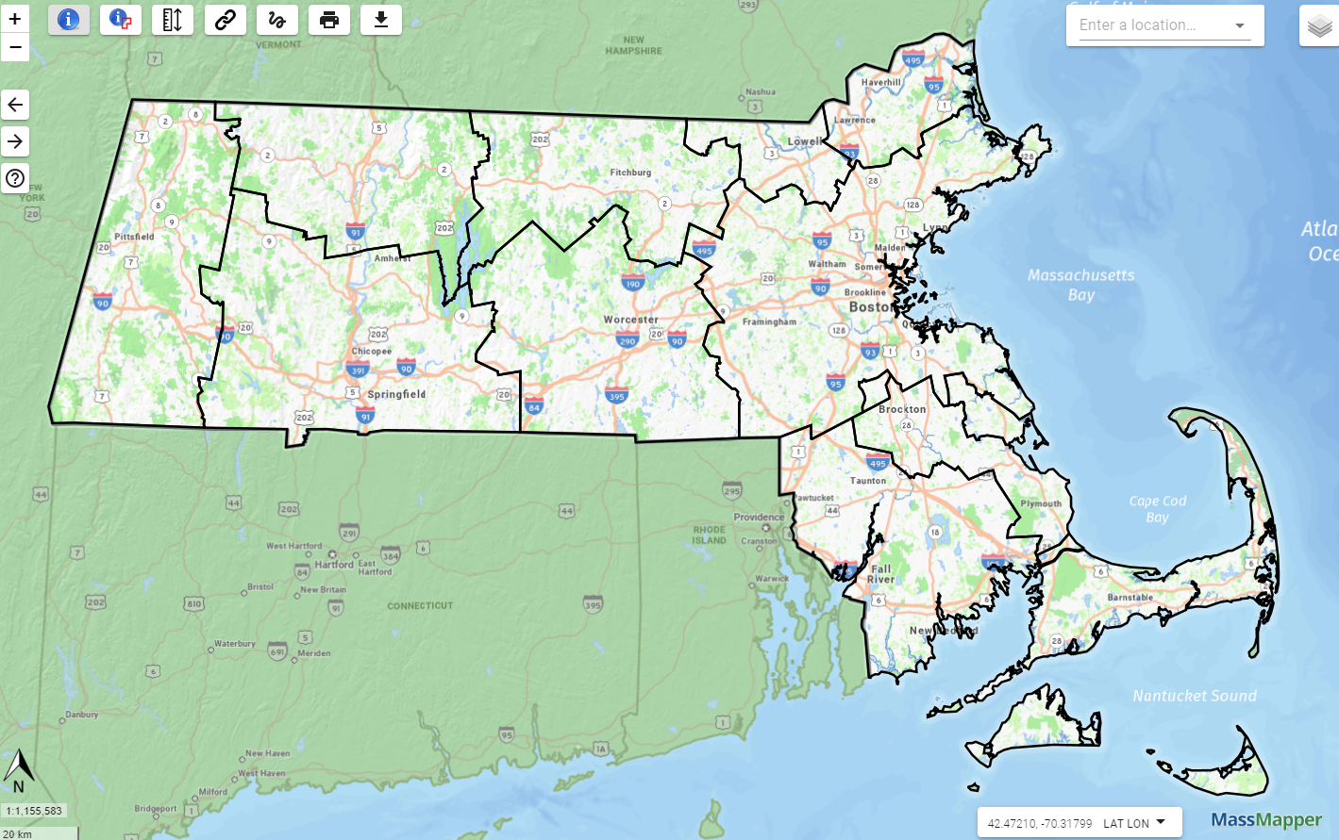
In-Person Brownfields Roundtables
2023
2024
More roundtables to take place in 2026!
2025

Slide 18
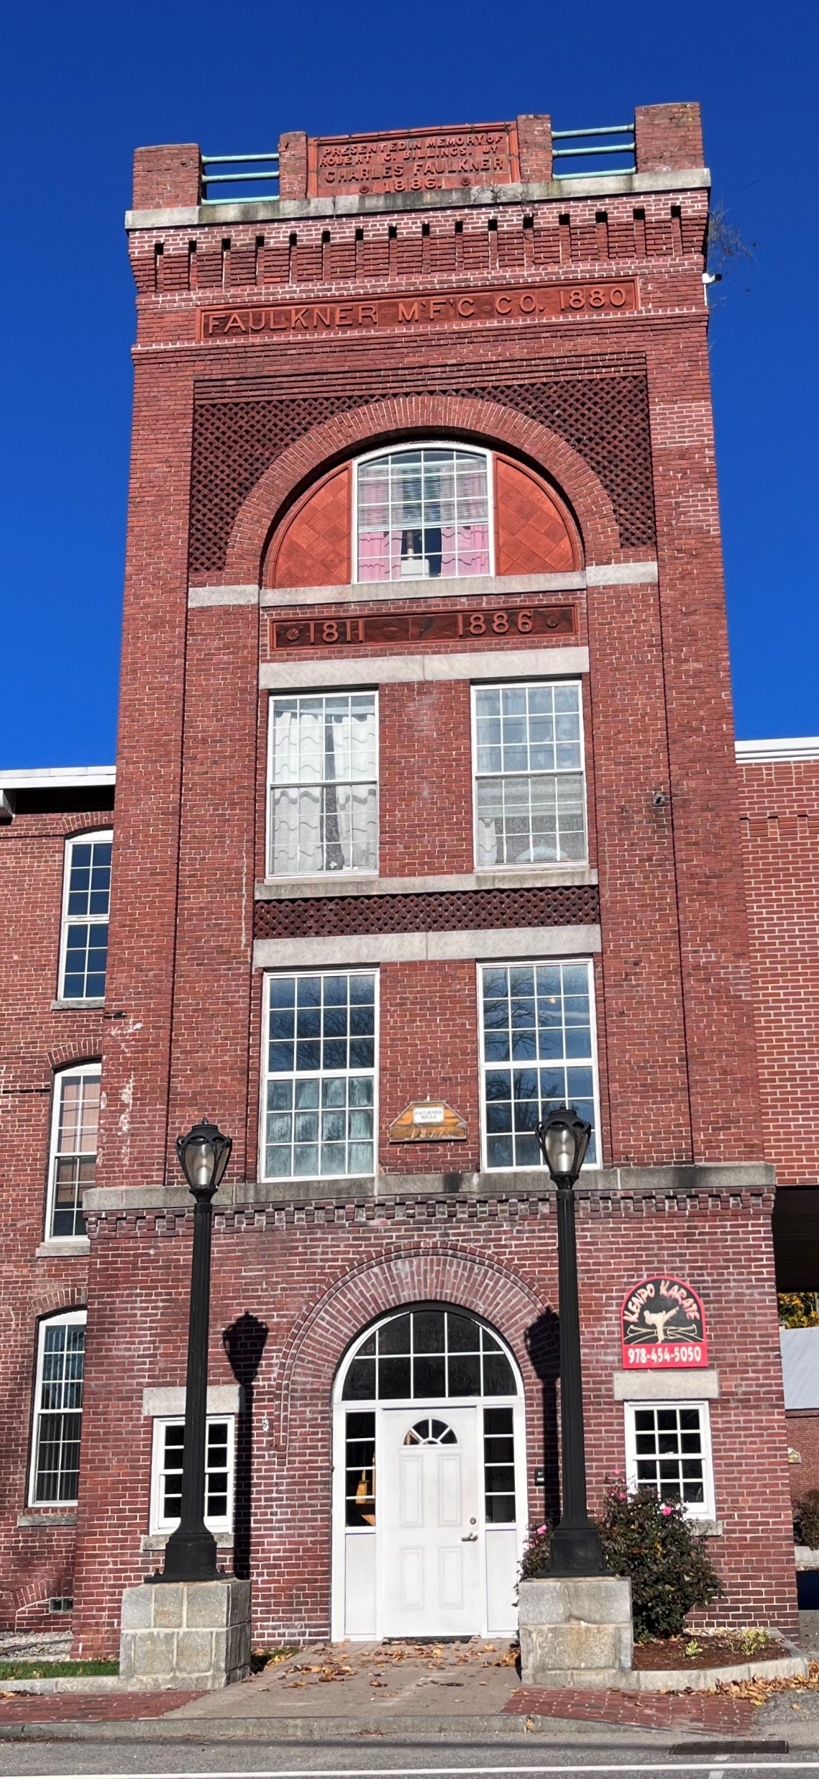
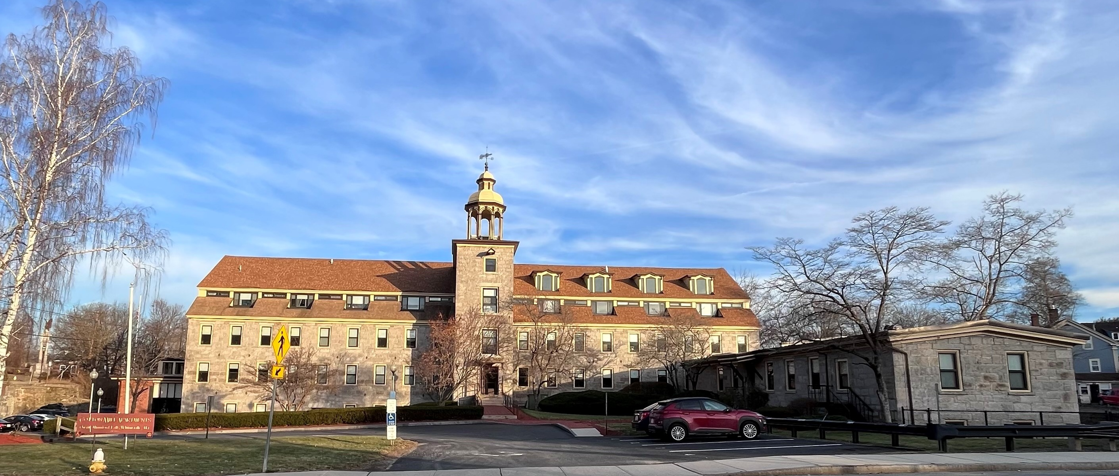
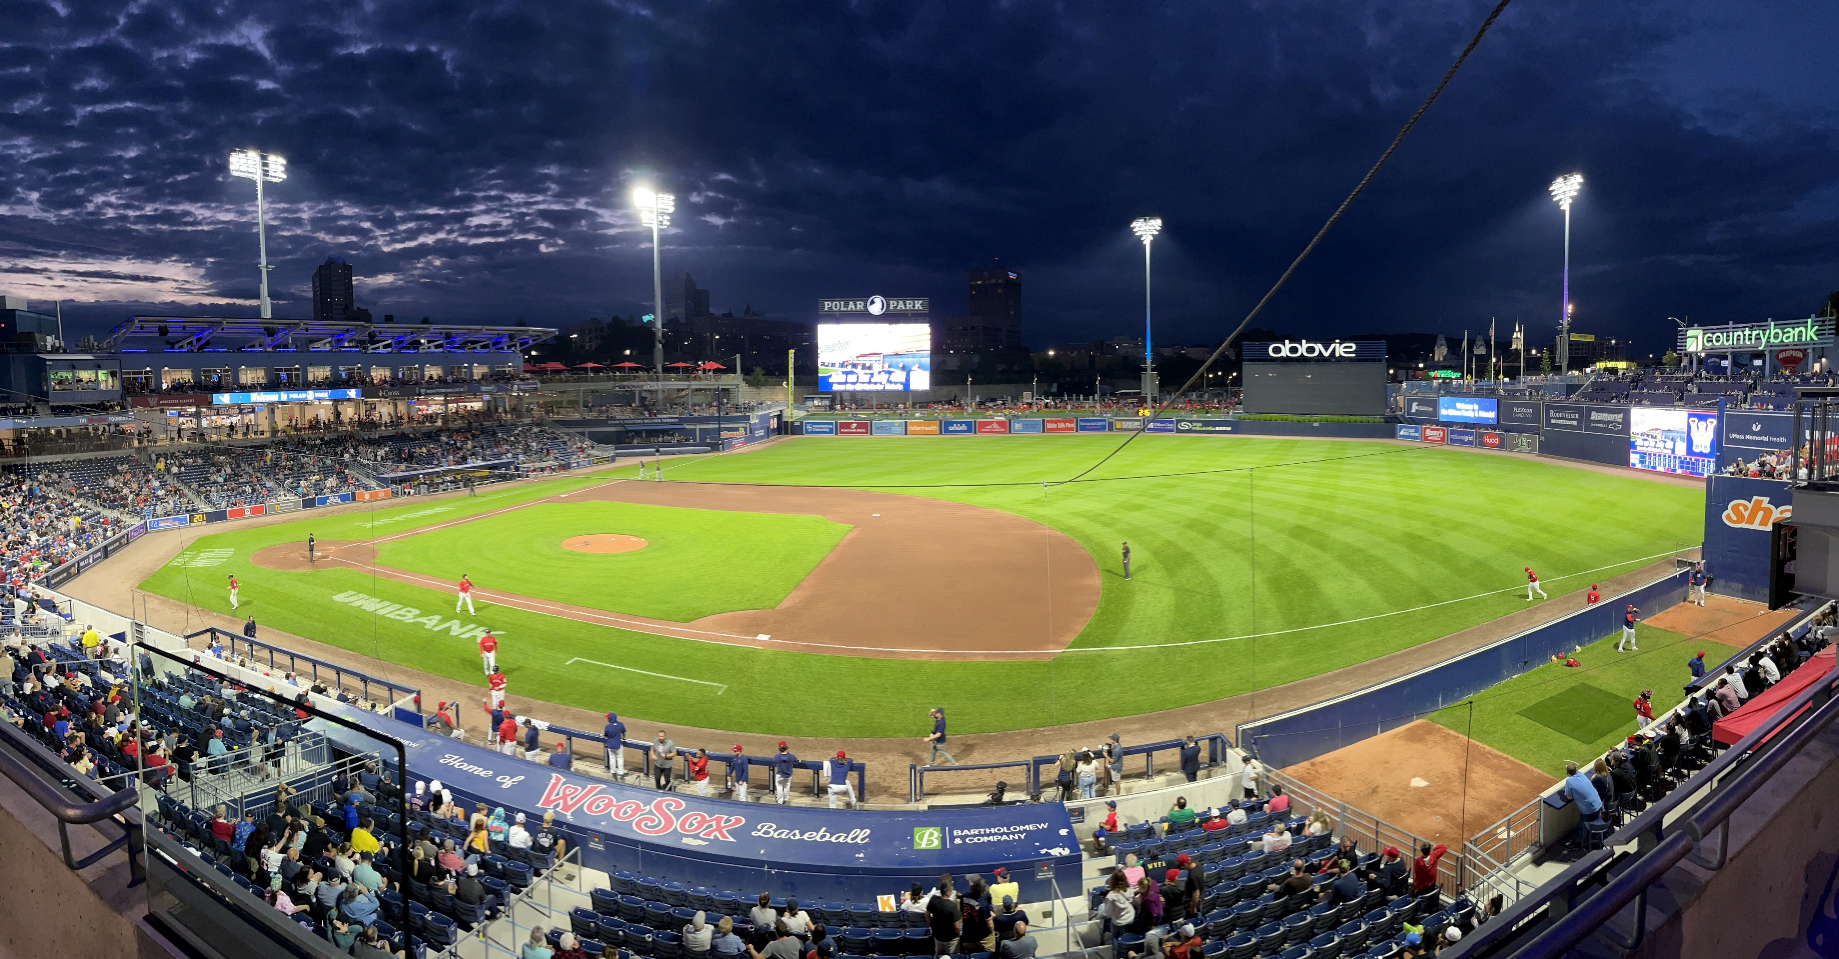
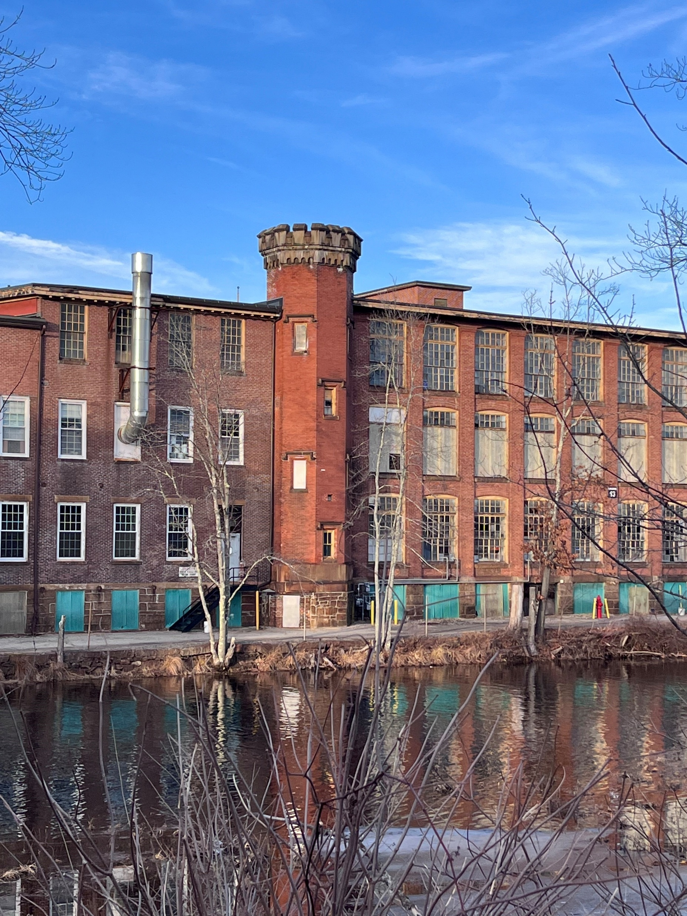
Success
Stories

