Slide 1
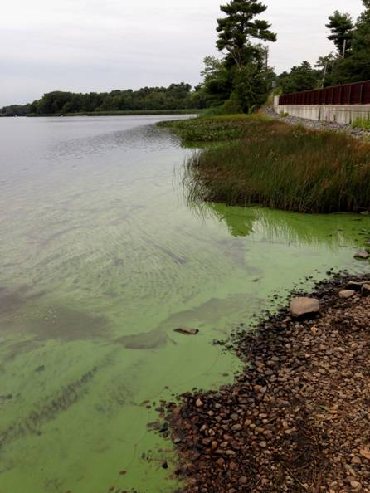
MassDEP
Cyanobacteria &
Cyanotoxins:
What PWSs
should know
Massachusetts Water Works Association
Membership Meeting
March 15, 2018
Photo Credit: G. Zoto, MassDEP

Slide 2
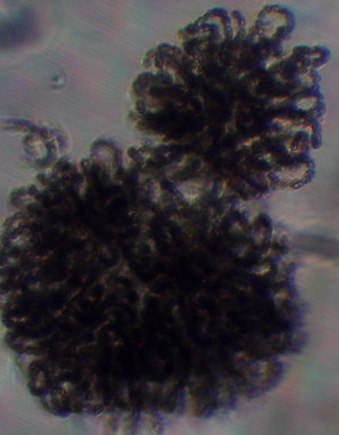
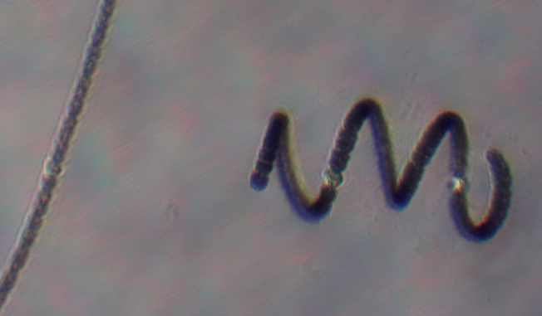
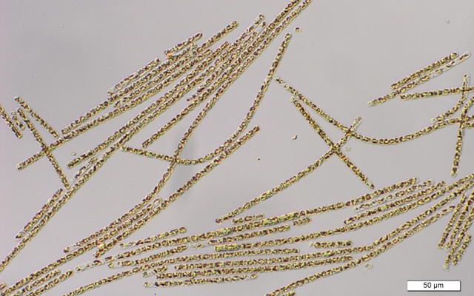
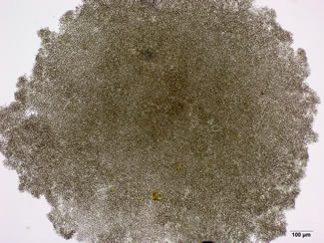
Cyanobacteria: The Basics
Naturally occurring microorganisms (bacteria) formerly known as blue-green algae
Present in all waterbodies in low numbers
Cyanobacterial species number in the thousands
Single cells, thread-like filaments or colonies and groups
Grow as benthic or planktonic populations
Four most common cyanobacteria in Massachusetts
Anabaena
Aphanizomenon
Microcystis
Planktothrix

Slide 3
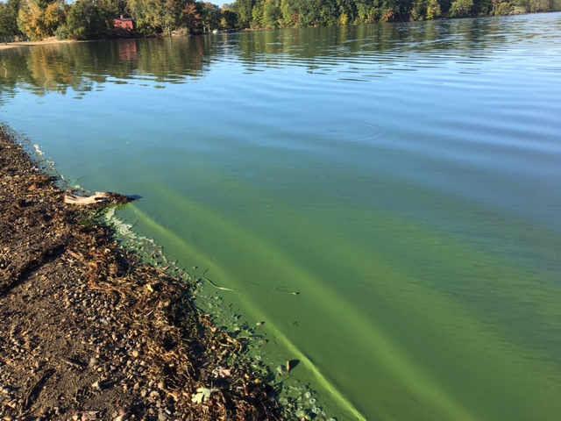
Cyanobacteria: Blooms
Dramatic cyanobacteria increases can lead to cyanobacterial Harmful Algal Blooms (CyanoHABs)
May cause dissolved oxygen, taste and odor, public health issues
Discoloration

Slide 4
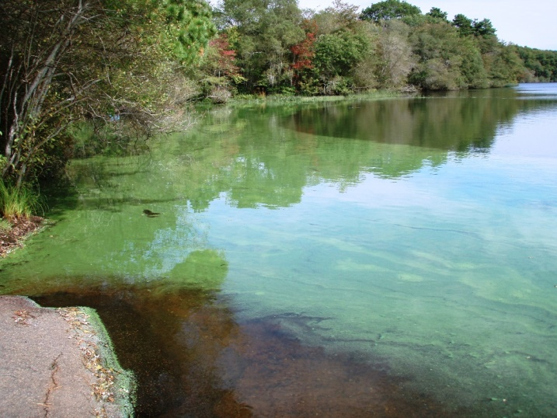

Slide 5
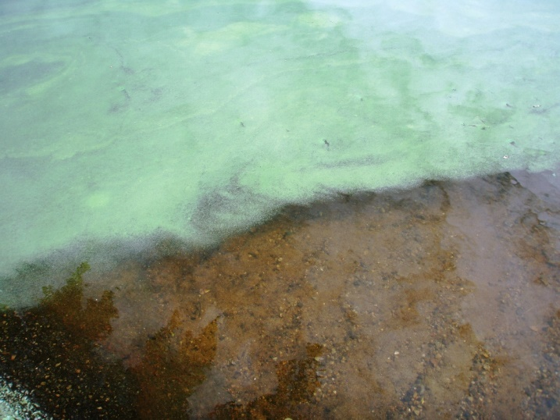

Slide 6
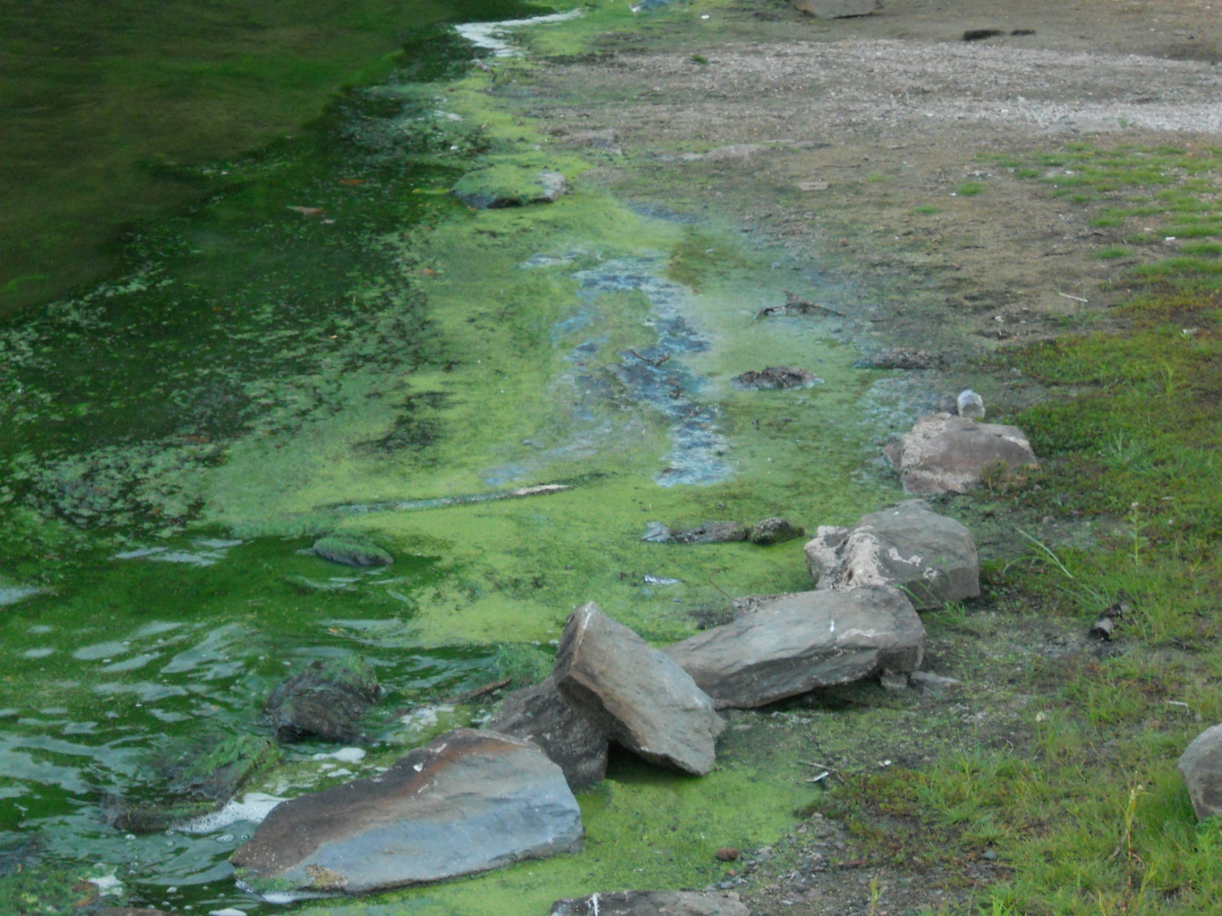

Slide 7
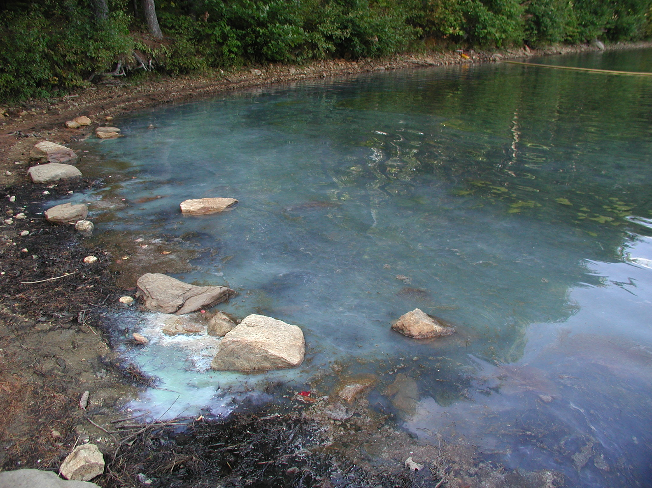

Slide 8
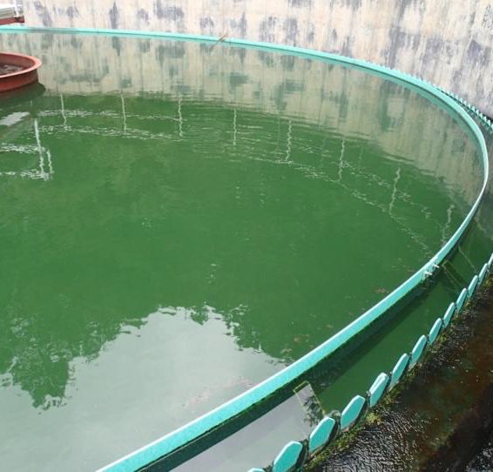
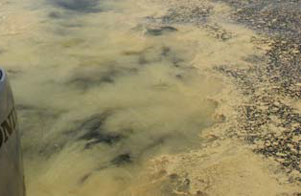
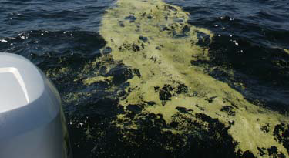
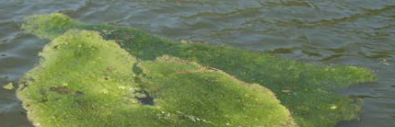
Cyanobacteria: Misidentifications
Pollen
Paint or dye spills
Duckweed
Green algae

Slide 9
CyanoHABs: Risk Factors
Predominant Indicators
Reduced flow/high residence time
Wind
Potential for cyanobacterial blooms in waterbodies based upon environmental factors.
Bloom Risk level | History of Blooms | Water Temp ºC | Total Phosphorous micrograms per liter (µg/L) | Thermal Stratification
Very low | No | <15 | <10 | Rare or never
Low | Yes | <15-20 | <10 | Infrequent
Moderate | Yes | 20-25 | 10-25 | Occasional
High | Yes | >25 | 25-100 | Frequent and persistent
Very high | Yes | >25 | >100 | Frequent and persistent/strong
Based on Newcombe et.al., 2010

Slide 10
Cyanotoxins
Cyanotoxins Produced
Anabaena – Anatoxins, Microcystins, Saxitoxins
Aphanizomenon – Saxitoxins, Cylindrospermopsins
Microcystis – Microcystins
Planktothrix – Anatoxins, Aplysiatoxins, Microcystins, Saxitoxins
Intracellular and Extracellular
Number of species that produce toxins is unknown
Cyanotoxin identification requires laboratory analysis

Slide 11
Cyanotoxins: Exposure & Health Effects
Exposure Routes
Dermal, oral and inhalation
Health Effects
Dermatological Effects & Illness
Hepatotoxins
Neurotoxins
Possible Reactions
Rashes, abdominal pain, fever, vomiting, diarrhea, respiratory irritation, liver and kidney damage; and, and effects to the nervous system

Slide 12
USEPA Human Health Risks to Cyanotoxins Exposure: https://www.epa.gov/nutrient-policy-data/health-and-ecological-effects#what1
CYANOTOXINS | ACUTE HEALTH EFFECTS IN HUMANS | MOST COMMON CYANOBACTERIA PRODUCING TOXIN
Microcystin-LR | Abdominal pain, Headache, Sore throat, Vomiting and nausea, Dry cough, Diarrhea, Blistering around the mouth, and Pneumonia | Microcystis, Anabaena, Nodularia, Planktothrix, Fisherella, Nostoc, Oscillatoria, and Gloeotrichia
Cylindrospermopsin | Fever, Headache, Vomiting, Bloody diarrhea | Cylindrospermopsis raciborskii, Aphanizomenon flos-aquae, Aphanizomenon gracile, Aphanizomenon ovalisporum, Umezakia natans, Anabaena bergii, Anabaena lapponica, Anabaena planctonica, Lyngbya wollei, Rhaphidiopsis curvata, and Rhaphidiopsis mediterranea
Anatoxin-a group | Tingling, Burning, Numbness, Drowsiness, Incoherent speech, Salivation, Respiratory paralysis leading to death* | Chrysosporum (Aphanizomenon) ovalisporum, Cuspidothrix, Cylindrospermopsis, Cylindrospermum, Dolichospermum, Microcystis, Oscillatoria, Planktothrix, Phormidium, Anabaena flos-aquae, A. lemmermannii Raphidiopsis mediterranea (strain of Cylindrospermopsis raciborskii), Tychonema and Woronichinia
*Symptoms observed in animals.

Slide 13
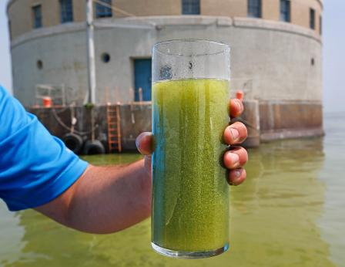
CyanoHABs: Regulations/Guidance
EMERGING ISSUE: NO current federal or Massachusetts regulations for cyanobacteria or cyanotoxins
US EPA Health Advisories (HAs)
US EPA Required UCMR4 Monitoring
Massachusetts Department of Public Health (MDPH) Guidance (public beaches)
MassDEP Guidance for Public Water Systems (PWSs)
Photo Credit: David Zapotosky

Slide 14
US EPA DW Health Advisories
Two (2) HAs - microcystins and cylindrospermopsin
Non-regulatory concentrations at or below which adverse health effects are not anticipated to occur by oral ingestion of DW over specific exposure durations.
US EPA DW Health Advisories
Cyanotoxin | US EPA 10-day HA
 | Bottle-fed infants & pre-school children | School-age children and adults
Microcystins | 0.3 µg/L | 1.6 µg/L
Cylindrospermopsin | 0.7 µg/L | 3 µg/L

Slide 15
Cyanotoxins Monitoring: UCMR4
Cyanotoxins Sampling between 2018-2020
Ten (10) Cyanotoxins: total microcystins, microcystin-LA, microcystin-LF, microcystin-LR, microcystin-LY, microcystin-RR, microcystin-YR, nodularin, anatoxin-a, and cylindrospermopsin
Data from the UCMR serves as a primary source of research information, which US EPA utilizes to develop regulatory decisions.
Three (3) US EPA approved methods for drinking water
EPA 544 (LC/MS/MS – MC/NOD)
EPA 545 (LC/MS/MS – CYN/Ana)
EPA 546 (ELISA – MC/NOD)
For further information on UCMR4 and cyanotoxins assessment monitoring, please see: https://www.epa.gov/dwucmr/fourth-unregulated-contaminant-monitoring-rule.

Slide 16
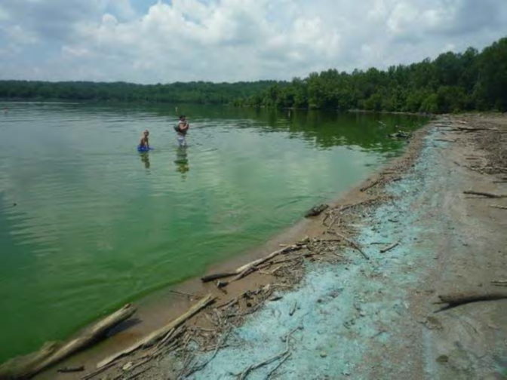
Cyanobacteria: MDPH Guidance
MDPH has developed health-based guidance levels for recreational exposure to cyanobacteria.
MDPH recommends that beaches be posted and individuals limit all contact with a waterbody if the waterbody has
cyanobacteria cell counts exceeding 70,000 cells/milliliter (mL) or microcystin concentrations that meet or exceed 14 micrograms per liter (µg/L).
Online Photo Credit: US EPA

Slide 17
Coming Soon: MassDEP Guidance
Collaborative Development
MDPH, Office of Research and Standards (ORS)
Regional DW Programs, Watershed Planning Program (WPP)
Safe Drinking Water Act Advisory Committee (SDWAAC)
Watershed Management & Source Water Protection Focus
Cyanobacteria/Cyanotoxin Information
Critical factors for assessing source vulnerability
Fact Sheet & PWS Bloom Tracking Form
Treatment options
In-reservoir & within treatment facility
Additional resource materials and MassDEP contacts
Website Update & Internal/Interagency Protocols

Slide 18
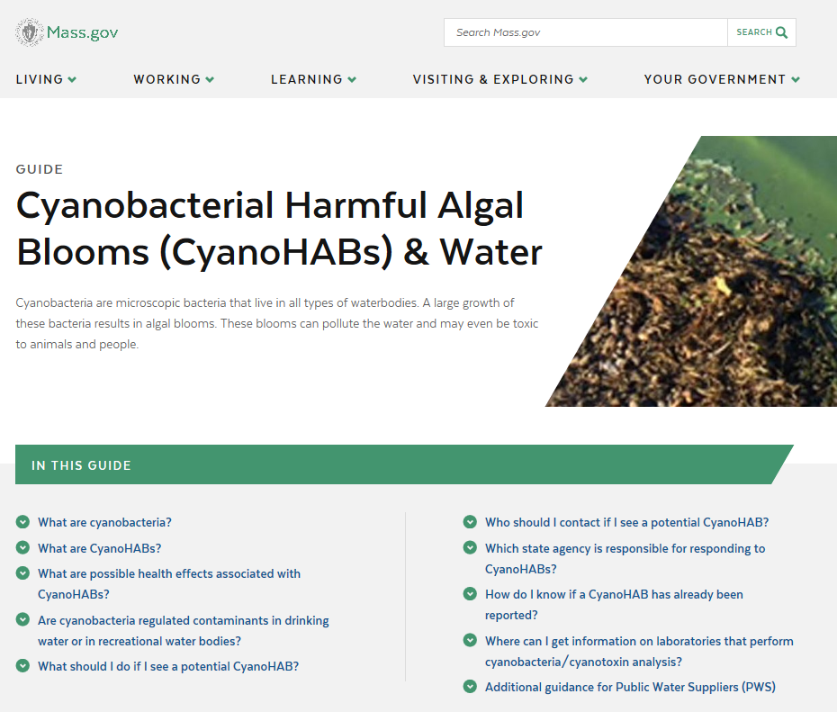
Helpful Resources
US EPA Website: https://www.epa.gov/nutrient-policy-data/cyanohabs
MA EOEEA Website:
https://www.mass.gov/guides/cyanobacterial-harmful-algal-blooms-cyanohabs-water
MDPH Website: https://www.mass.gov/lists/algae-information
University of New Hampshire Online Guide: http://cfb.unh.edu/CyanoKey/indexCyanoQuickGuide.htm

Slide 19
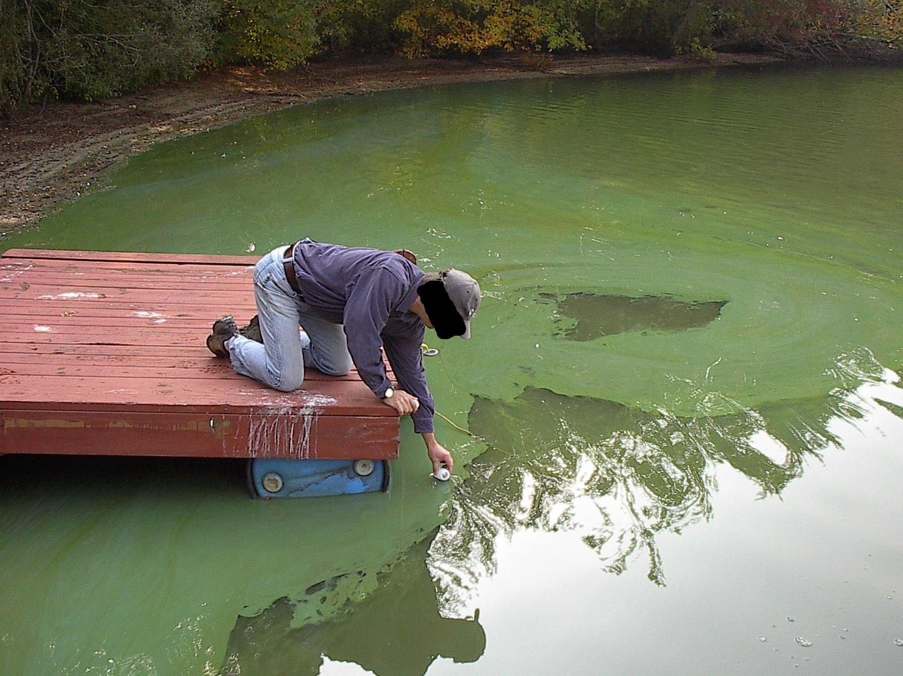
SAFETY FIRST!

Slide 20
CyanoHAB QUESTIONS/COMMENTS?
Contact Information
Kristin Divris
Water Utility Resilience Program (WURP)
DWP Emergency Preparedness & Security
kristin.divris@state.ma.us
508-849-4028

