Slide 1
MassDevelopment
Presentation to:
Brownfields Roundtable
September 9th, 2025

Slide 2
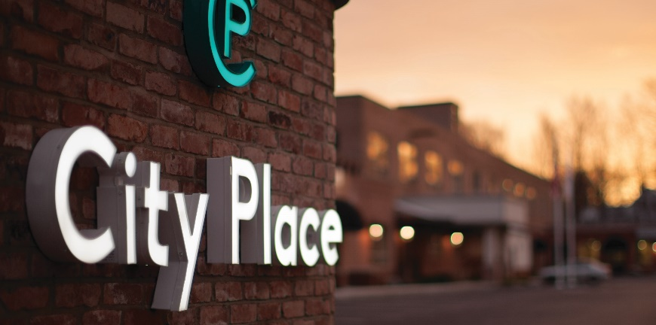

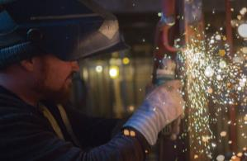
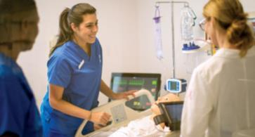
MassDevelopment Overview
MassDevelopment, the state’s development finance agency and land bank, works with businesses, nonprofits, banks, and communities to stimulate economic growth across the Commonwealth.
In February 2025, the Massachusetts Growth Capital Corporation was merged into MassDevelopment, enhancing the agency’s ability to support small businesses in Massachusetts through alternative funding, resources, and individualized services.
During FY24, MassDevelopment financed:
  Financed or managed 349 projects
  Invested more than $3.5 billion in the Massachusetts economy
  Created or supported 22,426 jobs and built or preserved 1,754 housing units.

Slide 3







Who We Serve
Businesses
Helping companies expand, modernize,
and relocate.
Developers
Making the difference at every stage of development.
Housing
Building expertise, from predevelopment to construction.
Manufacturers
Finding skilled
employees, opening
global markets.
Municipalities
Eliminating blight, revitalizing downtowns, creating opportunities.
Nonprofits
Working with nonprofits to upgrade, renovate and expand.
Banks
Partnering with banks
to provide creative financing.

Slide 4
Brownfields Redevelopment Fund
Program
Purpose of the Program
To encourage the re-use of vacant, abandoned, idle or underutilized industrial or commercial properties in areas where redevelopment or improvement is impacted by real or perceived environmental contamination or liability. Program Funds are used to advance environmental site assessment or remediation activities on these sites.
Two Major Funding Buckets for this Program
The Commonwealth’s One Stop for Growth: available to all 351 municipalities, their agencies or authorities seeking environmental assessment or remediation of municipally owned or controlled sites. There is no developer selected for the site. Budget is set annually by EOED.
Rolling Round Applications: available to non-profits, community development corporations and municipalities for public land with a selected developer chosen to develop the site. We received $20M in July 2024. We have awarded $4,965,000. Balance of $14,035,000 remains.

Slide 5
Program Parameters
Award Limits | One Stop Program: Up to $100,000 for Site Assessment assistance and $250,000 for remediation assistance. Rolling Applications: Up to $250,000 for Site Assessment assistance and up to $750,000 for Remediation assistance
Types of Awards | Primarily Grants Loans may be available if funds are available from existing loan repayments
Eligible Use of Funds | Funds may be used for services provided by Licensed Site Professionals (LSPs) or Contractor for the sampling, testing, analysis and reporting of soil or groundwater conditions. Funds may also be used for the excavation, hauling, and disposal of contaminated soils from a site to an approved receiving facility.
Ineligible Activities | Building demolition is not eligible under this program. Project sites that are intended for reuse as a Municipal or Public building or space. Funds may not be used for geotechnical surveys or evaluations. Applicants cannot be the primary Responsible Party (PRP) for the contamination.

Slide 6
Project Awards in the Past Year
One Stop for Growth – Municipal Projects
$1,380,000 in funding to 7 Municipalities. These include Brockton, Hanson, Lynn, Merrimac, Southbridge, Springfield and Taunton
33.94 acres of land being environmental assessed and remediated and will be made available for development and will provide future property tax revenue to these communities.
Rolling Applications
$4,965,000 in funding to 15 Grantees. These Grantees are located in 9 communities. These include Athol, Boston (7 projects), Gloucester, Holyoke, Lawrence, New Bedford, Salem, Winchendon and Worcester.
18.39 acres of land being redeveloped, 832,400 square feet of new development (104,500 in commercial and 728,900 in residential). These awards total 690 new residential units.

Slide 7
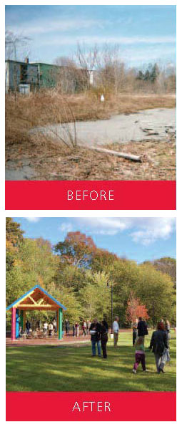
Brownfields Redevelopment Fund
Rolling Round Eligible Entities
Brownfields Redevelopment Fund grant-eligible entities:
  CDCs
  Certain Nonprofit organizations
  Municipalities and their agencies – with a defined project and developer
  EDICs – with a defined project and developer
  Undertaking a project with a demonstrable public benefit that already has an identified development opportunity with a committed developer in place.

Slide 8
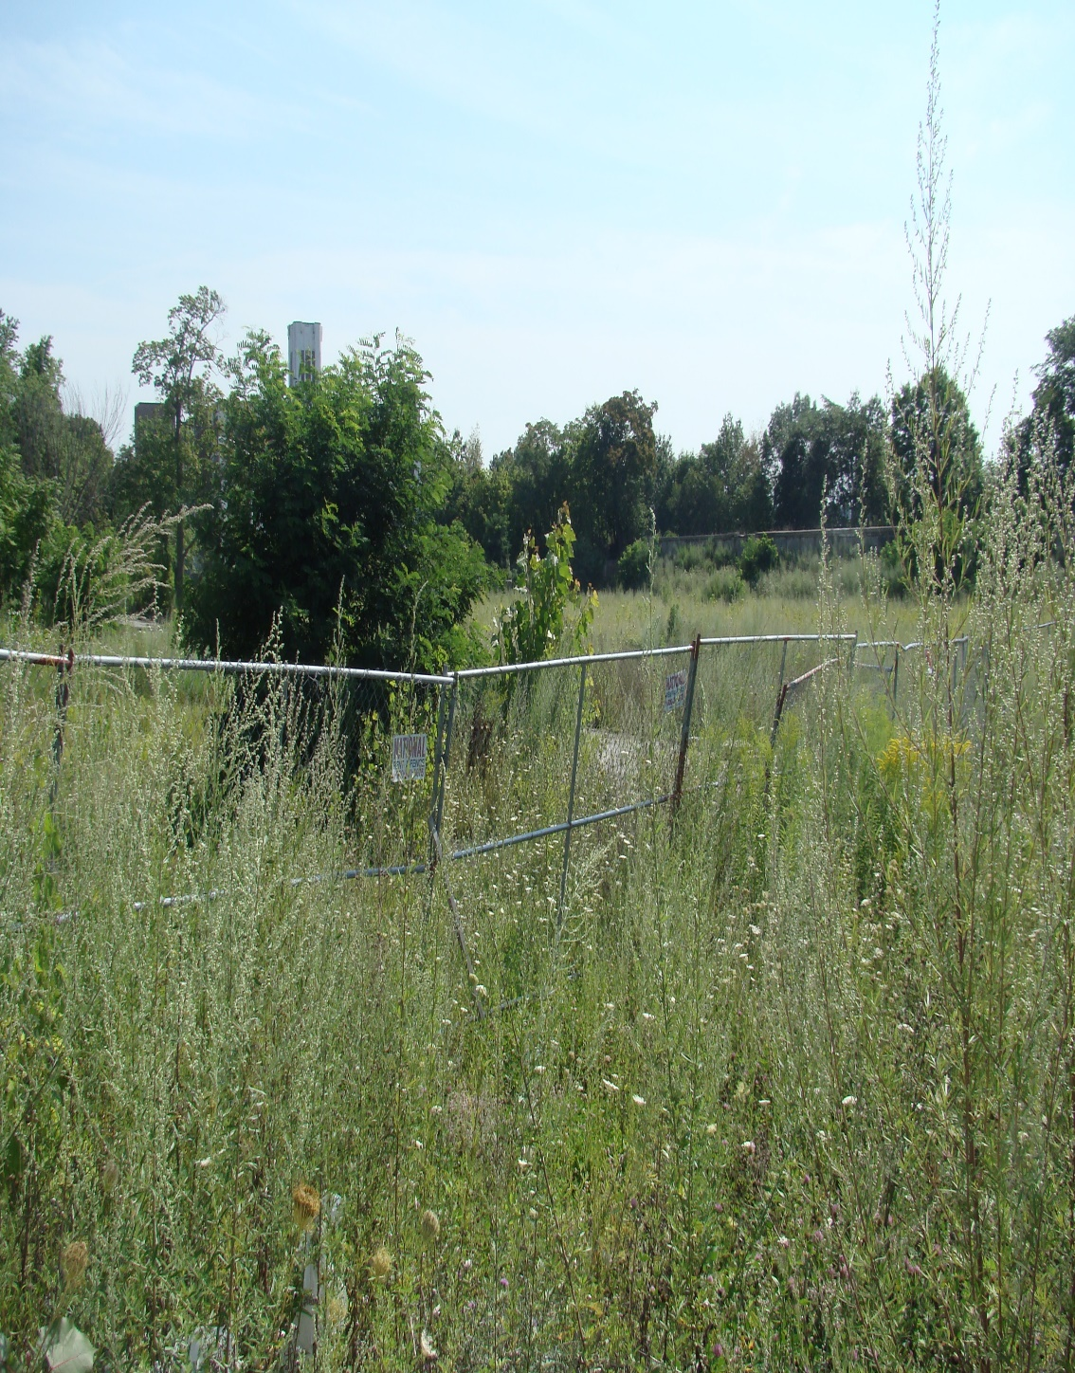
Brownfields Site Assessment
Funding up to $100,000
(OneStop Awards) and
$250,000 (Rolling Round
Awards) per redevelopment
site is available for
environmental testing.
Required to be conducted
by a Massachusetts
Licensed Site Professional
on Mass Contingency Plan
(21E) perceived contaminants.
Applicant must have control or right to enter to perform testing.
A site assessment document to identify, the extent, if any,
of contamination and allows you to develop a remediation plan.

Slide 9
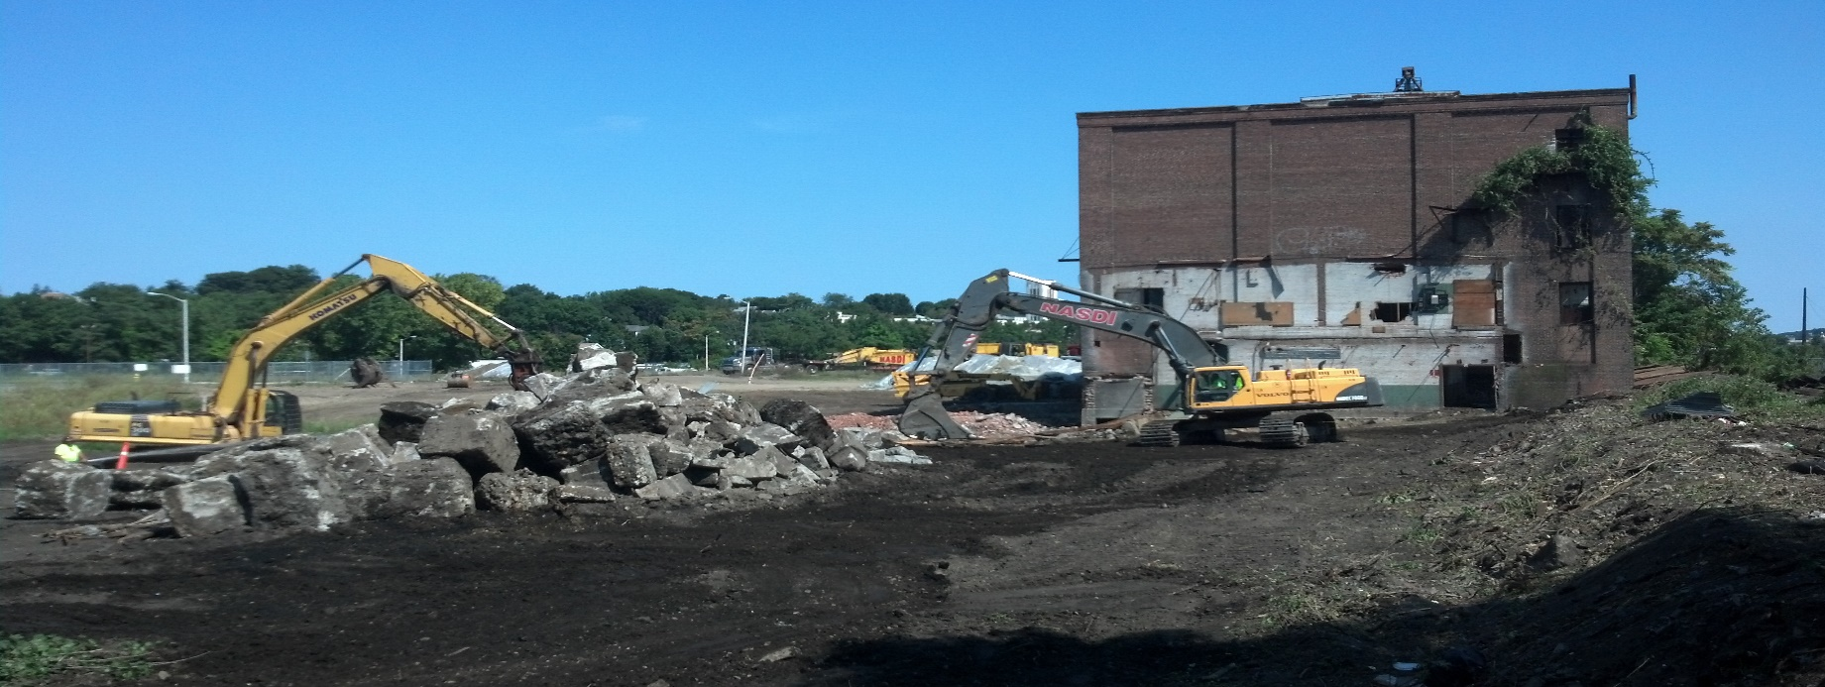
Brownfields Remediation
Applicant must not have:
  Owned or operated the site at the time the contamination occurred;
  Caused or contributed to the contamination;
  Possessed a business or familial relationship with the contaminator; and
  Possessed any outstanding administrative or judicial enforcement actions against their MA properties.
Funding of up to $250,000 (OneStop Awards) and $750,000 (Rolling Round Awards) per site is available for environmental clean-up required for redevelopment.
  Eligible borrowers include, nonprofits, municipalities, economic development organizations, businesses and individuals.

Slide 10
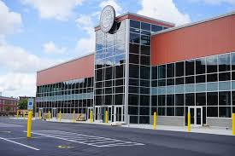
Brownfields Case Study
Fidelity Bank Worcester Ice Center
  MassDevelopment Awarded $1.98 MM
  ‘forgivable loan’ through BRLF to
  New Garden Park (WBDC) for clean up
  of contaminated former Presmet
  industrial property at Harding and
  Winter Streets in Worcester.
  Total clean up costs app. $3.5 MM.
  EPA and City of Worcester provided
  app. $1.0 MM in grants
  Total project cost over $17 MM.
  Hockey rink financed by Fidelity Bank
  NGP/WBDC leases land to owner/operator of the rink (LT lease).
  BRLF repayment based on cash flow.

Slide 11
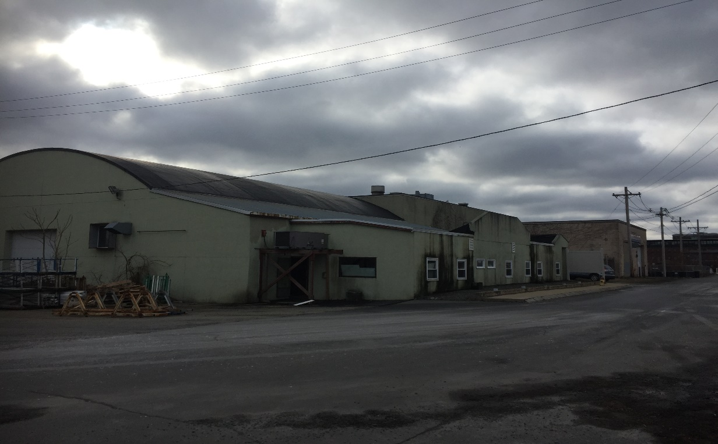
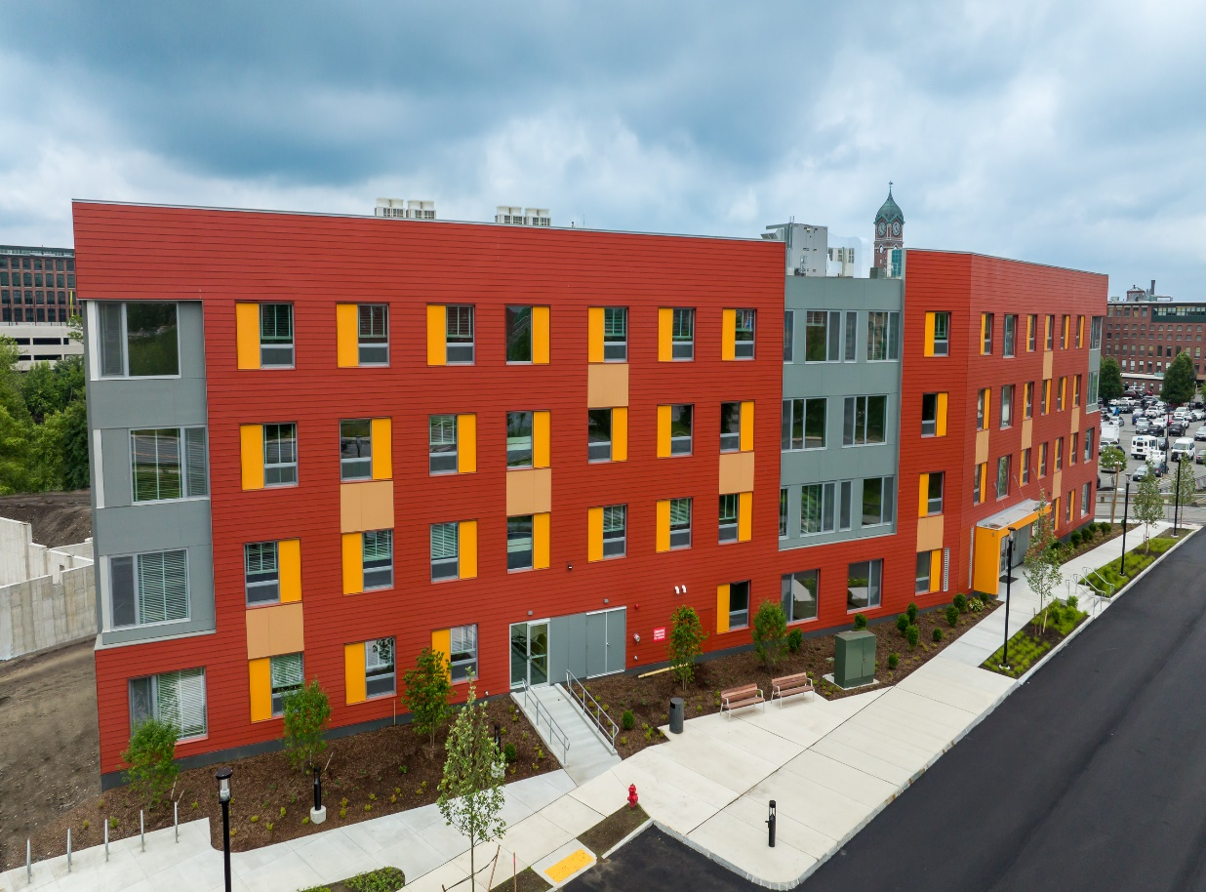
Brownfields Redevelopment In Action:
Lawrence Community Works, Lawrence
  MassDevelopment awarded a combined $955K in site assessment and remediation funding to the redevelopment of a former 4.0 acre manufacturing site with over 100 years of history with a variety of former tenants – most recently Ultimate Window, located at 20-20 Island Street in the City of Lawrence.
  In partnership with funding from the City of Lawrence and the Commonwealth of MA including the MassHousing, MA DHCD and private capital.
  >20,000 tons of soil will need to be
  excavated, managed, and transported.
  Project will result in 80-units of affordable rental housing and home for a non-profit focused on mentoring young urban youth.

Slide 12
Community One Stop for Growth www.mass.gov/onestop
A single application portal and collaborative review process of community and economic development grant programs in Massachusetts.
  Brownfields Program - assessments or remediation financing for brownfields sites for municipalities only.
  Underutilized Properties Program - feasibility studies or construction capital to bring underused or vacant buildings to code to support further development.
  Real Estate Services Technical Assistance - Address site-specific and/or district-wide economic development challenges for municipalities
  Site Readiness Program- Increase the Commonwealth’s inventory of large project ready sites for municipalities, EDICs and certain nonprofits.
FY26 Round closed June 4, 2025

Slide 13
MassDevelopment – Community Investment
Point of Contact
David Bancroft
Senior Vice President, Community Investment, Brownfields Redevelopment Fund, Lawrence Office
dbancroft@massdevelopment.com
Or visit our website at
www.massdevelopment.com

