Slide 1
Maintaining Standardized Parcel Mapping: Assessors
Standardized Parcels QA Process
MAAO Fall Conference: October 2, 2024
Craig Austin
GIS Analyst: Parcels and Owner Data QA Review Process

Slide 2
MAINTAINING STANDARDIZED PARCEL MAPPING
Webinar Overview
What’s Covered
PART I – GIS Concepts, The Standard, Model and, FGDB
Some GIS Concepts
Core Concepts: “Bundle of Rights” and Property Tax Maps
The MassGIS Parcels Standard
Components of the Standardized Parcels Database
PART 2 – Maintaining Parcels and Owner Data
The Parcel/Owner Data Update Process – Routes 1 and 2
Collecting Data
Editing the FGDB
Creating LOC_ID Change List
QA Reviewing The FGDB
Uploading Parcels via the Parcels QA Community ArcHub Portal
Notes:
Here is what we’ll cover.
Note: direct references to the Parcels Standard are marked as [PS], currently version 3.0.

Slide 3
MAINTAINING STANDARDIZED PARCEL MAPPING
Webinar Overview
PART 3 - Advanced Topics
TAX-FEE Relations
Municipal Boundary
Metadata
Notes:
Here is what we’ll cover.
Note: direct references to the Parcels Standard are marked as [PS], currently version 3.0.

Slide 4
MAINTAINING STANDARDIZED PARCEL MAPPING
Webinar Overview
Part 1: GIS Concepts and Parcels Standard

Slide 5
MAINTAINING STANDARDIZED PARCEL MAPPING
PART I – GIS Concepts, The Model, Standard, and FGDB
What is a GIS
GIS – Geographic Information System
A Relational Database where data can be compared through links between tables (such as an owner record to a parcel record) or by a spatial comparison (such as overlaying a zoning map onto a parcel map).
“A system for capturing, storing, checking, integrating, manipulating, analyzing and displaying spatial data” (Source: MIT Openware Course)
Notes:
What is GIS?
For more in-depth exploration of GIS:
MIT Openware Course:
https://ocw.mit.edu/courses/res-str-001-geographic-information-system-gis-tutorial-january-iap-2022/resources/mitres_str001iap22_level1_pres/
Listed as a resource at the end

Slide 6
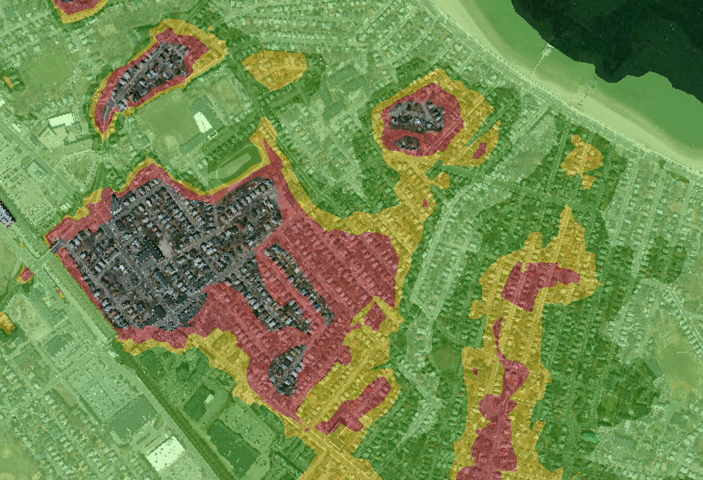
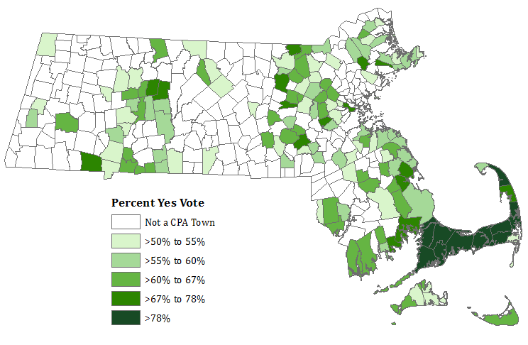
MAINTAINING STANDARDIZED PARCEL MAPPING
PART I – GIS Concepts, The Model, Standard, and FGDB
“Layers” of Information
Vector (Thematic) Layer Raster Layer Point Cloud Layer
Notes:
I’ll be referencing “Layers” in my presentation
Here are three kinds of layers – there are more.
Vector Layer – objects or areas represented by points, lines or polygons. (Municipalities)
Raster – a grid of rows and columns tied to geography that contain values that can be represented as changes in color or grayscale. (Ortho Imagery)
Point Cloud Layer – points that are tied to x, y, z coordinates in virtual space (LiDAR)

Slide 7
MAINTAINING STANDARDIZED PARCEL MAPPING
PART I – GIS Concepts, The Model, Standard, and FGDB
File Types
.gdb – file geodatabase – a proprietary file that contains all components (layers, tables, and more) of a spatial database
.shp –”shapefile” - a group of files (.shp, .shx, .dbf, more) that make up a geographic database. Though more accessible, this format has significant limitations.
.txt, .csv – text file – two of several kinds of files that contain tables of data records that can be exported by one program and imported into another.
.xls, .xlsx – files that can be opened by MS Excel and used to transfer data.
Notes:
Here are some common file types that I will mention:
.gdb – file geodatabase – ESRI has created this file type. Unfortunately, it can only be edited through ESRI ArcMap/ArcGIS Pro.
.shp – Shapefile – Is an older file format – most or all CAMA systems can import it and display it as a viewer. Attribute (tabular) data are stored in a .dbf file.
.txt, .csv – two formats that a CAMA system can export data within. I’ll cover that in part 2.
.xlx, .xlsx – another format – Microsoft’s proprietary format. Again, I’ll cover this in part 2.

Slide 8
MAINTAINING STANDARDIZED PARCEL MAPPING
PART I – GIS Concepts, The Model, Standard, and FGDB
Other Terms
Domain – A list of codes that must be used within a given field.
Field Types –
Integer - Both Long and Short types are used.
Text - Fields will have lengths (<254 char) specified by the Std.
Date/Time – Not used. Use Integer or Text with YYYYMMDD format
Real – contains a decimal point with Single or Double precision.
Notes:
Domain – A list of codes that must be used within a given field, for instance a list of months in a year. This cuts down on ‘mistyping’ and provides a consistent way to categorize things.
Field Types –
Integer - Both Long and Short types are used.
Text - Fields will have lengths (<254 char) specified by the Std.
Date/Time – Not used. Use Integer or Text with YYYYMMDD format
Real – contains a decimal point with Single or Double precision.

Slide 9
MAINTAINING STANDARDIZED PARCEL MAPPING
PART I – GIS Concepts, The Model, Standard, and FGDB
Core Concepts: “Bundle of Rights” and Property Tax Maps

Slide 10
MAINTAINING STANDARDIZED PARCEL MAPPING
PART I – GIS Concepts, The Model, Standard, and FGDB
“Bundle of Rights”
Rights Transferred
to Another Entity
Rights that the
Owner Retains
Par #1
Par #2
Par #3
Rights Transferred
To Another Entity
CR
Sewer Ease
Other Kinds of Rights
Par #4
Surface Development
Access Ease
Rights Transferred
to State/Loc Govt
Sub-surface Development
Mineral Rights
Air Rights
Notes:
“Bundle of Rights”
[Some content source: http://extension.illinois.edu/lcr/propertyrights.cfm – no longer works]
Property rights have been likened to a bundle of sticks where each stick represents a right or interest in land. These rights may all be owned by one person, known as “FEE simple ownership,” or specific rights may be transferred to a govt or other entity.

Slide 11
MAINTAINING STANDARDIZED PARCEL MAPPING
PART I – GIS Concepts, The Model, Standard, and FGDB
Property Tax Map
Source: Littleton Board of Assessors Web Site
Notes:
Tax Map Ownership Representation
Tax maps are a representation where defined areas of land are associated with individuals or entities that have a claim to ownership within that area of land. The Bureau of Local Assessment can provide more information about Property Taxes and Tax Maps. However, this link between areas of land (properties and rights of way) to owners provides a structure that can be incorporated into the NextGen911 GIS datalayers and other uses, for instance, in maintaining infrastructure within a community.
Property representations on tax maps often only approximate actual boundaries, so drawn property lines are not considered “authoritative.” For our purposes, it’s sufficient, though we will always advocate for higher accuracy.

Slide 12
MAINTAINING STANDARDIZED PARCEL MAPPING
PART I – GIS Concepts, The Model, Standard, and FGDB
The MassGIS Parcels Standard

Slide 13
MAINTAINING STANDARDIZED PARCEL MAPPING
PART I – GIS Concepts, The Model, Standard, and FGDB
Standardized Parcels: A History
July 2001 - Version 1 of the Parcels Standard released. It contains Level 1 (L1), L2 and L3 as quality levels of parcels.
Bundle of Rights
Tax Parcel Maps
Assessor Input
GIS People Input
October 2010 – Version 2.0/May 2012 – Version 2.1 of the Parcels Standard released.
Level 1 was dropped, while elements of L2 were incorporated into L3.
June 2022 – Version 3.0 of the Parcels Standard released that streamlined the documentation. Name is now “Standardized Parcels”
Notes:
These concepts plus input from the Assessors (via the MAAO) and other GIS People were referenced when creating the Parcels Standard.
Parcel Standard, Version 1, was released in July 2001. It contained different QUALITY LEVELS of COMPLIANCE for submitted parcels: L1, L2, and L3. L3 has key elements of the present Standard.
The Parcels Standard, Version 3.0, is the same Standard as Version 2.1, but the document, itself went through extensive rewriting and streamlining, including dropping out of date material.
The Parcels Standard has been around in some form for over 20 years, and the present standard has been around for over 10 years.

Slide 14
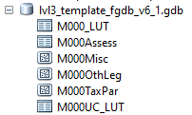
MAINTAINING STANDARDIZED PARCEL MAPPING
PART I – GIS Concepts, The Model, Standard, and FGDB
Development of the Template File Geodatabase
The Parcels Standard
Lays out what owner and data is included and how they are organized
And is modeled in the fGDB
Data Structure
Three Feature Classes:
M000TaxPar (“taxable” parcels)
M000OthLeg (“other legal interests”)
M000Misc (miscellaneous features)
Three Tables:
M000Assess (CAMA extract data table)
M000_LUT (Domain value Look-Up-Table)
M000UC_LUT (Use Code Look-Up-Table)
Other Topics Concerning Data:
TAX-FEE Parcels
Required Match Rates
Municipal Boundaries
The Massachusetts Parcels Standard
v. 3.0
Where “000” is a placeholder for your Town ID
Notes:
The standard describes: what data is collected and how it is organized [PS page 5-8]:
The three feature classes:
M000TaxPar (taxable parcels)
M000OthLeg (other legal interests and special “FEE” parcels)
M000Misc (miscellaneous feature class)
The three tables:
M000Assess (Assessing extract data table)
M000LUT (a type look up table)
M000UC_LUT (use code look up table)
Modeled in a template fGDB containing empty or prepopulated (template) FCs and tables. The names are preceded with M000, where ‘000’ is place holder for Town ID – When loaded with your town’s data, change to your Town ID - Left padded w/ zeros – Duxbury, here, has one zero: 082.
MassGIS provides a template fGDB, with the L3 Parcel QA Tool. You can also request it from us.

Slide 15
MAINTAINING STANDARDIZED PARCEL MAPPING
PART I – GIS Concepts, The Model, Standard, and FGDB
The Standard specifies the MINIMUM of what should be included. You can:
Have other features classes in the parcel fGDB
Have other attributes (fields) in the attribute tables
Group feature classes in feature data sets
The basic components are as follows:
Notes:
The Standard specifies the MINIMUM of what should be included.

Slide 16
MAINTAINING STANDARDIZED PARCEL MAPPING
PART I – GIS Concepts, The Model, Standard, and FGDB
Components of the Standardized Parcels Database:
TaxPar
OthLeg
Misc
LUT
UC_LUT
Assess
Notes:
The following slides cover these six components in more detail.

Slide 17
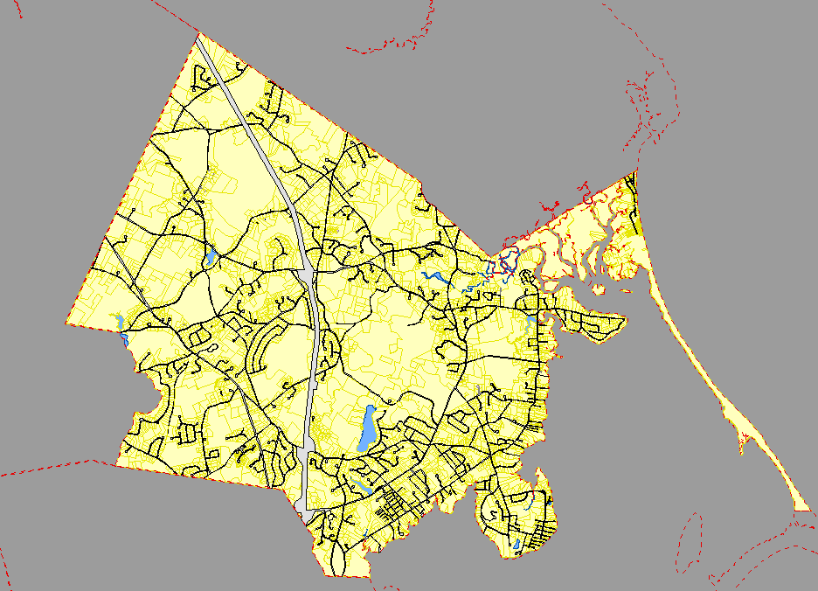
MAINTAINING STANDARDIZED PARCEL MAPPING
PART I – GIS Concepts, The Model, Standard, and FGDB
The TaxPar Feature Class
Represents both parcel polygons which are taxed in a tax bill and common areas of access (road, railroad, water) to them.
Spatial Component:
Should cover the entire area of a town/city (no gaps, no overlaps)
Disjointed areas should be multipart polygons
Notes:
TaxPar Feature Class
Contains both Spatial and Attribute components
All land areas covered within a town should be covered – leeway is given for municipalities along the shore – we don’t require ocean or harbors to be covered, so islands with isolated polygons can exist.
[PS, p 18, 19-21]

Slide 18
MAINTAINING STANDARDIZED PARCEL MAPPING
PART I – GIS Concepts, The Model, Standard, and FGDB
Attribute Component:
Tables of information tied to the polygons in the spatial view.
POLY_TYPE – sorts out types of polygons
LOC_ID – Unique Identifier
Attribute | Description
MAP_PAR_ID | Unique parcel identifier for a town that in the form of Map-Block-Lot, Map-Lot, Map-Block-Lot-Unit, or similar form.
LOC_ID | Unique parcel identifier based on a point inside the parcel polygon (the “centroid”).
POLY_TYPE | Domain values that categorize polygons, including FEE, TAX, ROW, PRIV_ROW, RAIL_ROW, and WATER.
MAP_NO | Map Sheet Number.
SOURCE | Source of information defining the parcel (ASSESS, SUBDIV, ANR, ROAD_LAYOUT, OTHER).
PLAN_ID | Source document ID, for example, Plan No.
LAST_EDIT | The most recent date a parcel polygon was altered based on a ‘real world’ change (split, combination, or swap in areas).
BND_CHK | Used to confirm boundaries drawn between parcels when boundaries appeared inconsistent with ortho features.
NO_MATCH | A flag that, under specific cases and advanced notice to MassGIS, that a parcel record can be excluded from match rate checks with CAMA records (default is ‘N.’).
Attributes in red must have valid values
Notes:
TaxPar contains these attributes: *- Focus on these attributes (See [PS] for specifics concerning these attributes
*MAP_PAR_ID - Unique parcel ID (Map/Lot, Map/Block/Lot, etc.).
*LOC_ID (Unique ID for FC, created within the FC-more on this later).
*POLY_TYPE (Domain of values – fixed - TAX, FEE, WATER, ROW, etc.).
MAP_NO – Map Sheet Number.
SOURCE (ASSESS, SUBDIV, ANR, etc.) – source of info defining parcel.
PLAN_ID - source doc. ID, for example Plan Number.
*LAST_EDIT (YYYYMMDD) – this is important- the most recent data a parcel polygon was altered based on a ‘real world change’ in 4 digit Year, 2 digit month, and 2 digit day (YYYYMMDD) format.
BND_CHK (Used to confirm whether bndry drawn betw parcels is consistent w/ feats seen on an ortho–now optional).
*NO_MATCH – Excluded from matching with a CAMA record. This is used only rarely, with advanced notice to MassGIS, and is for cases where deed research is needed to ID an owner.

Slide 19
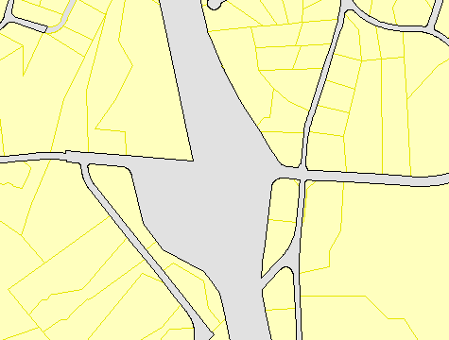
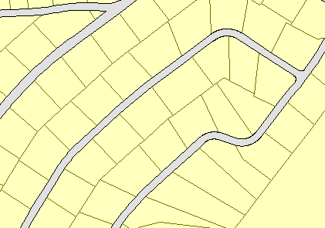
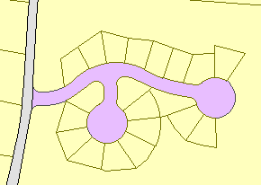
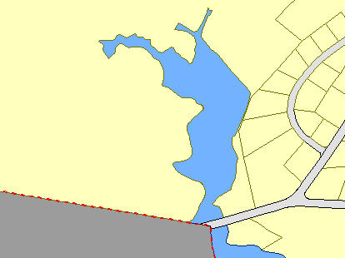
MAINTAINING STANDARDIZED PARCEL MAPPING
PART I – GIS Concepts, The Model, Standard, and FGDB
The TaxPar Feature Class: POLY_TYPE
FEE – Taxable, deeded Properties
ROW – Public Right of Way
PRIV_ROW – Private ROW
TAX – Special relation with deeded Properties
WATER – Unclaimed areas over water.
RAIL_ROW – Railroad Right of Way
Notes:
*POLY_TYPE (Domain of values – fixed - TAX, FEE, WATER, ROW, etc.).
- Two ways to represent taxable parcels in the standard:
- FEE – parcel polygon where one or more Assess records relates to a single parcel (can be multipart).
- TAX – polygon where two or more parcels are combined for tax purposes and having a single Assess record.
-Three others are kinds of Rights of Way:
- ROW – Public Right of Way
- PRIV_ROW – Private Right of Way
- RAIL_ROW – Railroad Right of Way
- One other:
- WATER – common area over water bodies that are not otherwise covered by another polygon.

Slide 20
MAINTAINING STANDARDIZED PARCEL MAPPING
PART I – GIS Concepts, The Model, Standard, and FGDB
The TaxPar Feature Class: (Locational ID or LOC_ID)
All polygons must have a unique LOC_ID value, created from the Polygon:
Starting with a point (often a centroid) inside the parcel polygon in TaxPar
Use the x, y coordinates from that point to create two number strings in the LOC_ID value
Then add an ‘M’ or ‘F’ to indicate the unit the coordinates are in.
Within a municipality, LOC_ID is in either Meters or Feet but not both
Parcel
(X= 288888, Y=988888)
M_288888_988888
M = Meters
F = U.S. Feet
Coord. In the
X Dir.
Coord. In the
Y Dir.
Notes:
LOC_ID – Introduction
All polygons must have a unique LOC_ID value, created from the Polygon:
Starting with a point (centroid) with in the polygon in TaxPar
The x,y coordinates are used to create two number strings in the LOC_ID
Within a municipality, the values are either in Feet or Meters, but not both.
Projection – a specific projection is used to assign coordinates: Massachusetts Mainland State Plane – Meters or Feet. This was created by the U.S. Geological Survey.

Slide 21
MAINTAINING STANDARDIZED PARCEL MAPPING
PART I – GIS Concepts, The Model, Standard, and FGDB
Why Use LOC_ID as the Unique Identifier in TaxPar and not MAP_PAR_ID:
LOC_ID | MAP_PAR_ID
Same format throughout the state: M/F_0000000_0000000 | Format varies across the state:
Are unique across the state | Only unique if concatenated with TOWN_ID
Can create x,y point coordinates from value. | Derived from one of several methods
Consistency improves exact matching between TaxPar and Assess. | MAP_PAR_ID <> PROP_ID Condo records?
Notes:
So, why can’t we use Map-Par-ID instead of creating a new type of parcel ID? [PS, pg. 10, 19]
LOC_ID: Contains the same format throughout the state: M_0000000_0000000 (Unit M or F _ x coord _ y coord). Only underscores are used to separate components
MAP_PAR_ID: Format varies across the state: (Map–Block-Lot, etc.)
LOC_ID: unique across the state.
MAP_PAR_ID: not unique across the state unless the TOWN_ID is added
LOC_ID: can be used to create x,y point coordinates.
MAP_PAR_ID: Derived from one of several methods.
LOC_ID: If placed in each PROP_ID owner record, then exact matching between TaxPar and Assess is maintained at a high-quality rate.
MAP_PAR_ID: MAP_PAR_ID <> PROP_ID (ex. condo records have a unique ‘unit’ designation).

Slide 22
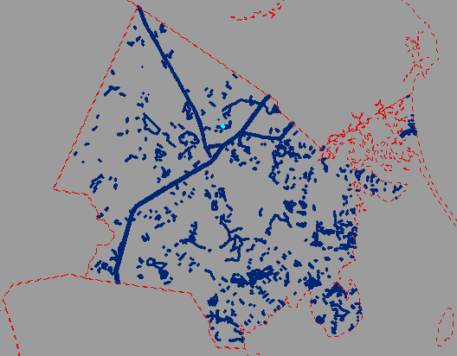
MAINTAINING STANDARDIZED PARCEL MAPPING
PART I – GIS Concepts, The Model, Standard, and FGDB
The OthLeg Feature Class
Contains polygons representing other legal claims like easements and restrictions over an area or representing some FEE parcels.
Spatial Component:
Polygons can be multipart polygons
Polygons can overlap one another.
Notes:
OTHLEG: (See [PS] for specifics]
OthLeg - contains polygons representing other legal claims like easements and restrictions over an area or representing some FEE parcels.

Slide 23
MAINTAINING STANDARDIZED PARCEL MAPPING
PART I – GIS Concepts, The Model, Standard, and FGDB
Attribute Component:
Tables of information tied to the polygons in the spatial view.
LEGAL_TYPE sorts out the types of polygons in OthLeg
TAX_PAR_ID – is the LOC_ID for FEE Polygons in OthLeg
Attribute | Description
LEGAL_TYPE | A domain of values that states whether the polygon is a FEE parcel part of a TAX parcel in TaxPar or an Easement (FEE, RAIL_OVER, ROW_OVER, EASE, CR, APR, CRX, APRX). The domain of valid values can be extended.
MAP_PAR_ID | Unique parcel identifier for a town that in the form of Map-Block-Lot, Map-Lot, Map-Block-Lot-Unit, or similar form (Req. for FEE polys).
TAX_PAR_ID | The LOC_ID of the TAX parcel in TaxPar that this polygon is associated with (Req. for FEE polys).
LS_BOOK | Last Sale Book
LS_PAGE | Last Sale Page
REG_ID | Registration ID for registered land, if relevant and available
Notes:
OTHLEG: (See [PS, p. 21] for specifics concerning these attributes]
LEGAL TYPE – (Required for all polys) Domain of attributes that records whether a polygon is a FEE parcel or some kind of easement.
MAP_PAR_ID – (Required for FEE polys) Unique identifier for a parcel in a community in the form of Map-Block-Lot or similar form.
TAXPAR_ID – (Required for FEE polys) This is the LOC_ID of the TAX parcel in TaxPar that covers it.
LS_BOOK - last sale book.
LS_PAGE - last sale page.
REG_ID – Equivalent to the Book and Page numbers in Registry of Deeds but these are for cases through Land or Probate Court.
The domain of valid values for the LEGAL_TYPE attribute can be expanded, for example, “EASE-SEWER” or “EASE-DRAIN.” However, if you do that, we want to know what they are. This is why we have a LUT for this domain.

Slide 24
MAINTAINING STANDARDIZED PARCEL MAPPING
PART I – GIS Concepts, The Model, Standard, and FGDB
The OthLeg Feature Class: LEGAL_TYPE
Classifies polygons in OthLeg as either a kind of Easement/Restriction or a FEE parcel.
Standard values in the domain include:
FEE
PRIV_ROW
RAIL_OVER and ROW_OVER
CR/CRX
APR/APRX
EASE
All records must have a LEGAL_TYPE code
The values are limited to a list of values (Domain) managed in the LUT.
Notes:
The domain of values used for LEGAL_TYPE in OthLeg is listed in the (M000_)LUT.
Standard values in the domain include:
FEE
PRIV_ROW
RAIL_OVER and ROW_OVER
CR/CRX
APR/APRX
EASE
As previously mentioned, custom attribute values for LEGAL_TYPE can be used. This will be covered in my discussion about the LUT.

Slide 25
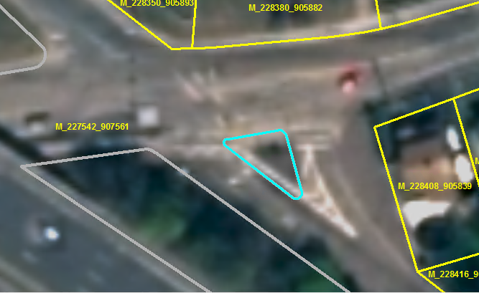
MAINTAINING STANDARDIZED PARCEL MAPPING
PART I – GIS Concepts, The Model, Standard, and FGDB
The Misc Feature Class
Contains polygons for features that need to appear on the Tax Map but that do not belong in either TaxPar or OthLeg
Spatial Component:
Polygons can be multipart polygons
Polygons can overlap one another.
Notes:
Misc FC: [PS, p. 22]
contains any other polygon features that you want represented on a tax map. The Misc FC typically includes a number of features such as TRAFFIC_ISLAND ( features found in a road intersection), WATER, and WETLAND.
You are not required to use this feature class. If you have other feature classes that have, for instance, ponds and lakes, use those feature classes, instead. But, even if you have no polygons in this FC, it must be present in the fGDB submitted to MassGIS.

Slide 26
MAINTAINING STANDARDIZED PARCEL MAPPING
PART I – GIS Concepts, The Model, Standard, and FGDB
Attribute Component:
Tables of information tied to the polygons in the spatial view.
A value is required in MISC_TYPE for all records.
Attribute | Description
MISC_TYPE | A domain of values that classified the polygon in a way that groups similar polygons.
Notes:
The polygons in MISC are identified in the MISC_TYPE attribute. The valid domain of values for this attribute can also be expanded provided they are included in the LUT.

Slide 27
MAINTAINING STANDARDIZED PARCEL MAPPING
PART I – GIS Concepts, The Model, Standard, and FGDB
The Look Up Table (LUT)
OthLeg
Contains a listing of codes for either the field, LEGAL_TYPE, in OthLeg, or MISC_TYPE in Misc.
There is no spatial component.
Misc
Notes:
The Look Up Table (LUT) [PS, p.22]
Contains a listing of codes for either field, LEGAL_TYPE in OthLeg or MISC_TYPE in Misc.
The table is prepopulated with codes to use – they are designated with TOWN_ID = 0.

Slide 28
MAINTAINING STANDARDIZED PARCEL MAPPING
PART I – GIS Concepts, The Model, Standard, and FGDB
Attributes
TOWN_ID –
If 0 indicate that the code is prepopulated in the table and apply to all towns and cities. I
If not 0, then the code is custom for that town/city.
FIELD_NM – groups the code with the domain it belongs to: LEGAL_TYPE or MISC_TYPE
CODE - the code value
CODE_DESC indicates what the value represents.
Notes:
Fields:
FIELD_NM
CODE
CODE_DESC

Slide 29
MAINTAINING STANDARDIZED PARCEL MAPPING
PART I – GIS Concepts, The Model, Standard, and FGDB
LUT: Adding a Custom Code
Custom codes can be added to the list
Start an edit session within the GIS on LUT
Add a record
Set:
TOWN_ID to the Town’s ID (This flags the code as custom)
Select “LEGAL_TYPE” or “MISC_TYPE” in FIELD_NM
Add the vale in CODE
Enter a short description in CODE_DESC
Now the code can be used in OthLeg or Misc.
Notes:
Each new custom value used must be entered in the LUT (Lookup Table) with the town id, the FIELD_NM = LEGAL_TYPE, the CODE value itself, and a description in CODE_DESC.

Slide 30
MAINTAINING STANDARDIZED PARCEL MAPPING
PART I – GIS Concepts, The Model, Standard, and FGDB
Assess Table:
PROP_ID
LOC_ID
CAMA_ID
BLDG_VAL
LAND_VAL
OTHER_VAL
TOTAL_VAL
FY (fiscal year)
SITE_ADDR
ADDR_NUM
FULL_STR
LOCATION (unit, side )
CITY
ZIP
UNITS (number of units)
YEAR_BUILT
BLD_AREA (commercial / industrial)
RES_AREA (gross living area)
STYLE
STORIES
NUM_ROOMS
OWNER1
OWN_ADDR
OWN_CITY
OWN_STATE
OWN_ZIP
OWN_CO
LS_BOOK (last sale book)
LS_PAGE (last sale page)
REG_ID
LS_DATE
LS_PRICE
ZONING
LOT_SIZE
USE_CODE
LOT_UNITS (units for lot size)
Identifiers and LOC_ID
Owner Info.
Valuations
Registry Info.
Site Address
Info.
Lot Info.
The Assess table MUST have these fields, and those fields must conform to the field type requirements of the standard.
Structure
Info.
Notes:
The Assess table developed from the MassGIS CAMA has these elements: valuations, site address information, owner and owner address information, registry information, and other useful items.
One of the data elements in the assessing extract is USE_CODE.
[PS, p.23-26]

Slide 31
MAINTAINING STANDARDIZED PARCEL MAPPING
PART I – GIS Concepts, The Model, Standard, and FGDB
The Use Code Look Up Table (UC_LUT)
Standard Codes
Every value in USE_CODE in Assess table must be entered in the UC_LUT.
Codes with TOWN_ID = 0 are prepopulated into the table and apply to all towns/cities.
Codes with TOWN_ID = the DOR town id are custom values to the town/city
Custom Codes
Notes:
[PS, p, 23] There are standard use code values, established by DOR. These are already populated in this table.
Munis can add custom values – we’ll cover it in Part 2.
USE_CODE is becoming more and more important as a way to characterize the human activity at a location. The use code is used for various types of regional analysis and is part of creating MassGIS land use-land cover mapping.

Slide 32
MAINTAINING STANDARDIZED PARCEL MAPPING
PART I – GIS Concepts, The Model, Standard, and FGDB
PAUSE – End of Part 1
Questions, so far?
NEXT - Part 2: Maintaining Parcels and Owner Data

Slide 33
MAINTAINING STANDARDIZED PARCEL MAPPING
PART 2 – Maintaining Parcels and Owner Data
Parcel/Owner Data Update Process – Route 1
Add New/Changed LOC_IDs to LOC_ID Change List
‘LOAD’ New Extract into empty Assess table
Collect Materials for Edits
Edit Copy
of FGDB
Run QA/Make Corrections
Submit to MassGIS for QA Review
Eng. Plans
CAMA Extract
(Initial)
LOC_ID
Change List
CAMA Extract
(Updated)
GIS Editor
Imagery
Export CAMA Data
Update LOC_IDs in CAMA and Export Data
Assessor
Notes:
Simplified Flow Chart of the Parcel Editing Process (Route 1 – Closed Loop):
-Collect edits to be made
-Make changes in the edit fGDB
-For every LOC_ID edited or changed, compile a change list of records with the PROP_ID associated with LOC_ID and send to Assessor
-Assessor copies and pastes LOC_ID in owner record in CAMA database
-CAMA exported via MassGIS standard output.
-Process and ‘LOAD’ CAMA output into empty, template Assess table
-Run QA/make corrections
-Submit to MassGIS for QA review and loading to statewide datalayer.

Slide 34
MAINTAINING STANDARDIZED PARCEL MAPPING
PART 2 – Maintaining Parcels and Owner Data
Parcel/Owner Data Update Process – Route 2
Add New/Changed LOC_IDs to LOC_ID Change List
‘LOAD’ New Extract into empty Assess table
Collect Materials for Edits
Edit Copy
of FGDB
Run QA/Make Corrections
Submit to MassGIS for QA Review
Eng. Plans
CAMA Extract
(Initial)
LOC_ID
Change List
GIS Editor
Imagery
Export CAMA Data
Update LOC_IDs in CAMA
Assessor
Notes:
Simplified Flow Chart of the Parcel Editing Process (Route 2 – Open Loop):
The process is generally the same as in the first route. The difference is that after the Assessor changes the LOC_ID values in the CAMA system, a second extract is not sent back to the GIS Editor for the editor to incorporate into the draft fGDB. If there is ample communication between Assessor and GIS Editor, this is OK. But this route doesn’t have the feedback that the first one has – avoid putting off putting in the new/changed LOC_IDs.

Slide 35
MAINTAINING STANDARDIZED PARCEL MAPPING
PART 2 – Maintaining Parcels and Owner Data
Collecting Materials for Edits
Authority: Varies – we assume the Assessor drives process.
Frequency: Edits to maps/CAMA data vary – MassGIS prefers annual submissions.
Materials: A variety of sources could be used: plans, imagery, deeds…
Notes:
Collecting Materials for Edits

Slide 36
MAINTAINING STANDARDIZED PARCEL MAPPING
PART 2 – Maintaining Parcels and Owner Data
Collecting Materials for Edits: Exporting CAMA Data
Exporting CAMA Data is done through a report script (.wrp)
The name and placement of this export routine is not consistent between towns/cities. Usually, it is placed with the “B&T Report”
Name of output should be something like “MassGIS Standard Output”
File outputs expected:
Patriot (Catalis): .txt PK Systems: .xls (NOT .xlsx)
Vision: .csv Tyler: .csv
Notes:
Collect Materials for Edits: Exporting CAMA Data

Slide 37
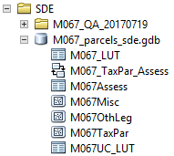
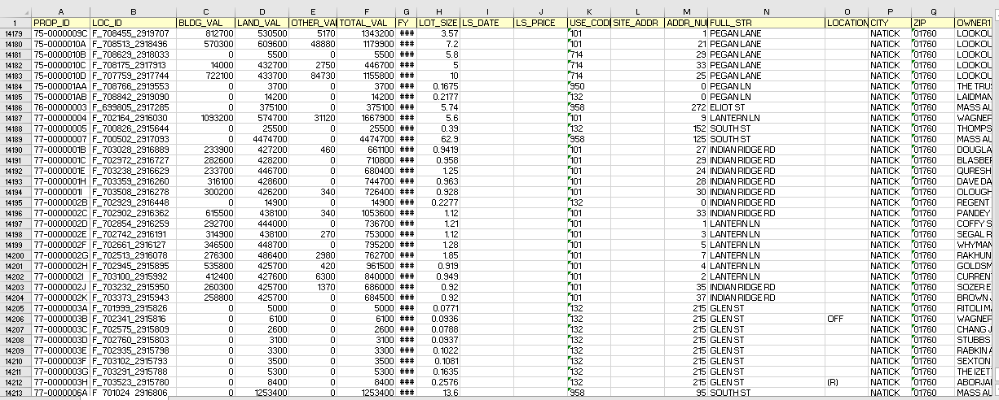
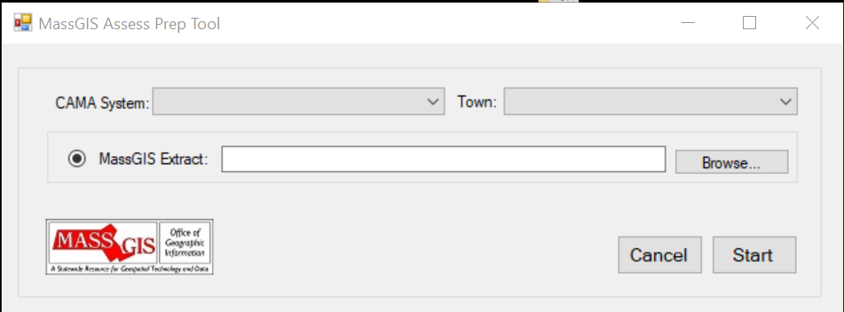
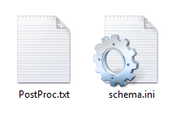
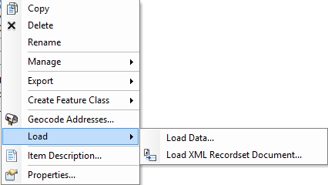
MAINTAINING STANDARDIZED PARCEL MAPPING
PART 2 – Maintaining Parcels and Owner Data
Editing the fGDB: Importing Extract into an fGDB (GIS Editor)
Step 1: Copy Assess Table Template* to your parcel fGDB, renaming it to include your TOWN_ID
Step 2: Run MassGIS’ AssessPrep Tool
MassGIS extract
Step 3: Use ArcCatalog Load->Load Data tool
* Included with AssessPrep Tool
Notes:
To populate the Assess table, follow these steps:
Copy the Assess Table Template to your edit version of your parcel fGDB (the template is found in the template fGDB, available in both the AssessPrep and Parcel QA Tools zipped files).
Run MassGIS AssessPrep Tool
Use ArcCatalog LOAD>LOAD DATA tool (or run the Append Tool in ArcGIS).
Follow the wizard forms

Slide 38
MAINTAINING STANDARDIZED PARCEL MAPPING
PART 2 – Maintaining Parcels and Owner Data
Editing the fGDB: Managing Use Codes
New use code values should be forwarded to the GIS Editor, who will enter it into the UC_LUT.
When entering a new code:
TOWN_ID = town/city ID
USE_CODE = custom code value
USE_DESC = short desc of what code represents.
Notes:
[PS, p. 26] There are standard use code values, established by DOR. These are already populated in this table.
Munis can add custom values. If custom values are used, they must be entered in the UC_LUT table. For each new value, create a new record, then enter your TOWN_ID, the use code value, and a brief description of what that value describes (you may need the Assessor to provide a description).

Slide 39
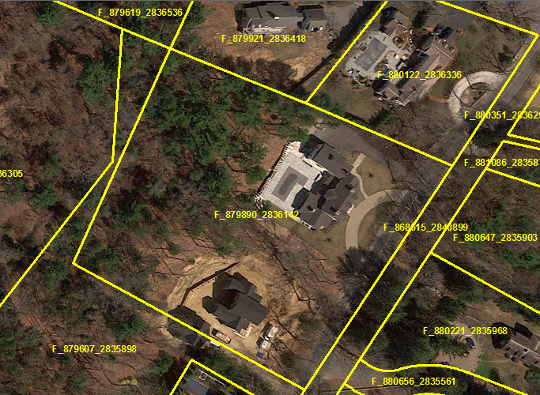
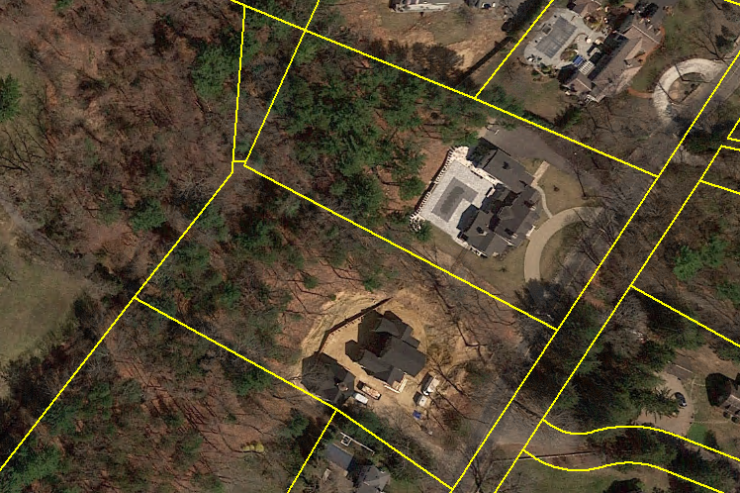
MAINTAINING STANDARDIZED PARCEL MAPPING
PART 2 – Maintaining Parcels and Owner Data
Editing the fGDB: Splitting Parcels (One Owner – One Parcel)
Before: Single Parcel
After: Two Parcels
Subdivision
Original LOC_ID
New LOC_IDs Needed for both parcels
Notes:
Maintaining Parcels in the L3 Standard –
When parcels are split, combined or areas swapped (not adjusting to align with visible features) a new LOC_ID needs to be generated.
In this example, one FEE parcel is split roughly down the middle into two smaller parcels and two LOC_ID values will be created.
The first thing the GIS EDITOR will do is use the ArcGIS tools to split the polygon into smaller polygons.

Slide 40
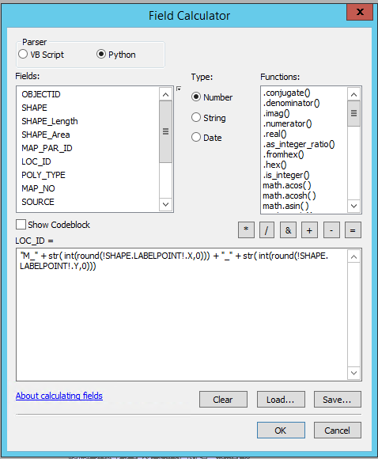
MAINTAINING STANDARDIZED PARCEL MAPPING
PART 2 – Maintaining Parcels and Owner Data
Editing the fGDB: Adding the LOC_ID
"M_" + str( int(round(!SHAPE.LABELPOINT!.X,0))) + "_" + str( int(round(!SHAPE. LABELPOINT!.Y,0)))
Notes:
Next, the editor will create LOC_IDs for each of these new polygons:
Select the split or combined polygons.
in the TaxPar attributes table, use Field Calculator to create a new LOC_ID value using a python command provided below. This process is documented step-by-step in the “Guide to Maintaining Parcels.” Note the use of the SHAPE.LABELPOINT command. [We have found that w/ “L” or “U” shaped parcels sometimes did not create an acceptable value when SHAPE.CENTROID was used.]
Formula: "M_" + str( int(round(!SHAPE.LABELPOINT!.X,0))) + "_" + str( int(round(!SHAPE. LABELPOINT!.Y,0)))
Finally, fill in the other attributes for the parcels.
Remember: each polygon has a unique LOC_ID value, including ROW and WATER polygons.
If a parcel has non-contiguous parts, then a single multipart polygon needs to be made, then a LOC_ID created.

Slide 41
MAINTAINING STANDARDIZED PARCEL MAPPING
PART 2 – Maintaining Parcels and Owner Data
Editing the FGDB: Enter Values in Attribute Table
LOC_ID: Done in previous slide
MAP_PAR_ID: Enter in the format consistent with other values
POLY_TYPE: Enter “FEE” (default) for a parcel polygon
SOURCE: Choose from values in the domain (ASSESS is default)
LAST_EDIT: Enter the date the parcel was changed (YYYYMMDD)
NO_MATCH: Enter “NO” (Default) unless permission given to enter “YES”
Notes:
Editing a copy of the fGDB: Entering Values in Attribute Table
LOC_ID – A unique value is created for each polygon in TaxPar
MAP_PAR_ID: There should be a standard way to assign Map Par IDs to parcels within a community. If not, we highly recommend that the town establish one!
POLY_TYPE: For Parcels, POLY_TYPE is usually FEE. TAX-FEE parcels will be explained later.
SOURCE: The default is ASSESS, but other choices are available.
LAST_EDIT: Enter the date that this parcel was created/significantly altered. This is not for small or superficial changes
NO_MATCH: Default is “NO.” For special cases where the owner is not known or would take a long deed search, then – with PRIOR approval from MassGIS, YES could be assigned. NO_MATCH = YES excludes the record from the match rate analysis done by the QA Script.

Slide 42
MAINTAINING STANDARDIZED PARCEL MAPPING
PART 2 – Maintaining Parcels and Owner Data
Editing the fGDB: Adding the LOC_ID to the Assess table
For the owner record that is associated with the parcel, the LOC_ID generated when the parcel was created must be inserted into the owner record.
There is a LOC_ID field in Assess.
The GIS Editor can find the corresponding record and copy the LOC_ID from the TaxPar parcel record to the Assess table owner record.
But, this only changes data in the Assess table, not the CAMA system.
Notes:
Adding the LOC_ID to the Assess table
Next, to associate an owner record to a parcel record, the LOC_ID created in TaxPar needs to be copied and pasted into the owner record in Assess associated with that parcel polygon.
DO NOT TYPE the value in – errors from mistyping can occur.

Slide 43
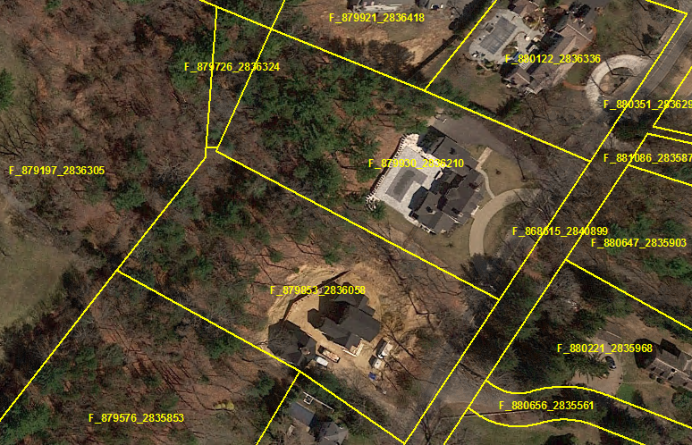
MAINTAINING STANDARDIZED PARCEL MAPPING
PART 2 – Maintaining Parcels and Owner Data
Editing the FGDB: Finished Task
Finished Parcel Update
Notes:
Done (from the fGDB standpoint).

Slide 44
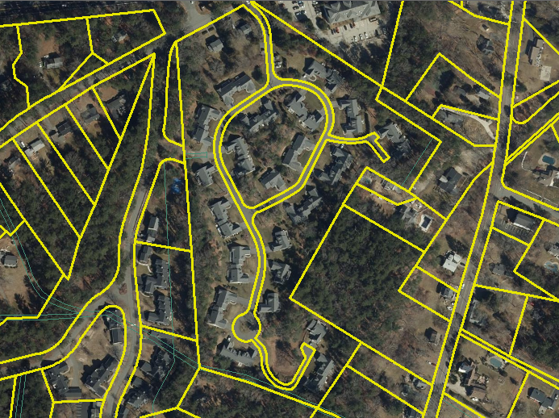
MAINTAINING STANDARDIZED PARCEL MAPPING
PART 2 – Maintaining Parcels and Owner Data
Editing the FGDB: Creating “Condo Relations” (Many Owners – One Parcel)
Parcel for Condominium Property
Creating a parcel for condominiums is the same as creating a parcel for single family homes
The difference is that you now have multiple owners pointing to the parcel.
Notes:
Editing a copy of the fGDB: Creating Condo Relations
We generally refer any situation where there are two or more owner records to a parcel as a ‘condo relation’ whether it is actually a condo or not.
Creating the parcel is the same.
In this situation, instead of just one owner record, the LOC_ID needs to be in all the owner records associated with that parcel. Here is one example.

Slide 45
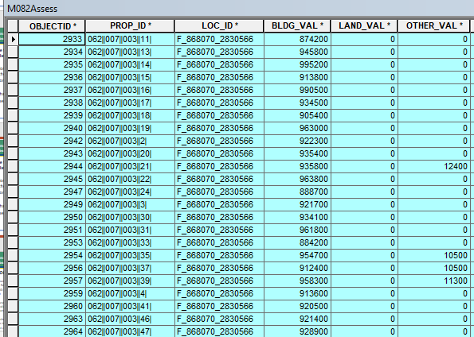
MAINTAINING STANDARDIZED PARCEL MAPPING
PART 2 – Maintaining Parcels and Owner Data
Editing the FGDB: Creating “Condo Relations” (Many Owners – One Parcel)
The LOC_ID must be copied/pasted in EACH owner record that associated with that property.
The LOC_ID is added to all new unit records created.
Notes:
Maintaining Parcels in the L3 Standard –
Find the polygon, then copy the LOC_ID in the parcel polygon and paste it into the LOC_ID in the Assess table of each owner record.
In the following year (or more), more units may be added. These need to have the LOC_ID added, as well.

Slide 46
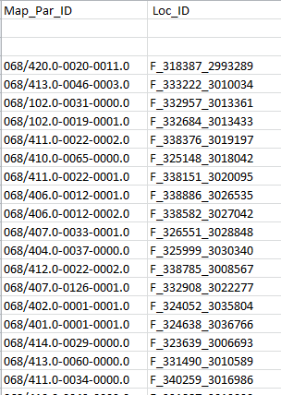
MAINTAINING STANDARDIZED PARCEL MAPPING
PART 2 – Maintaining Parcels and Owner Data
Creating a LOC_ID Change List
- “LOC_ID change list” – a list with the minimum fields:
PROP_ID
LOC_ID
Assessor uses list to Copy/Paste updated values into corresponding CAMA records
When finished the Assessor exports the results in a new extract or sends notice that changes were made in the CAMA
PROP_ID
Change List
Notes:
If you create LOC_ID per new or reconfigured parcels, then the Assessor needs to update the corresponding assessing records. How is it done?
This requires that the Assessor be provided a file with this info – at minimum - the PROP_ID for a CAMA record and the corresponding LOC_ID value. Other fields can be added such as site address if this is helpful to the Assessor. [PS]
The Assessor receives this change list and uses the PROP_ID to look for the CAMA record, then will COPY and PASTE the new LOC_ID in the CAMA, replacing any existing values already in the field. Any CAMA record to a parcel gets the LOC_ID value for that lot. For instance, individual condo owners get the same LOC_ID value in a lot. MassGIS has an instruction sheet for Assessors.
Remind the Assessor NOT TO TYPE IN THE LOC_ID VALUES –this introduces typos.
Patriot and Vision said they will develop a LOC_ID update tool for Assessors. When avail., MassGIS will provide updated info about this.

Slide 47
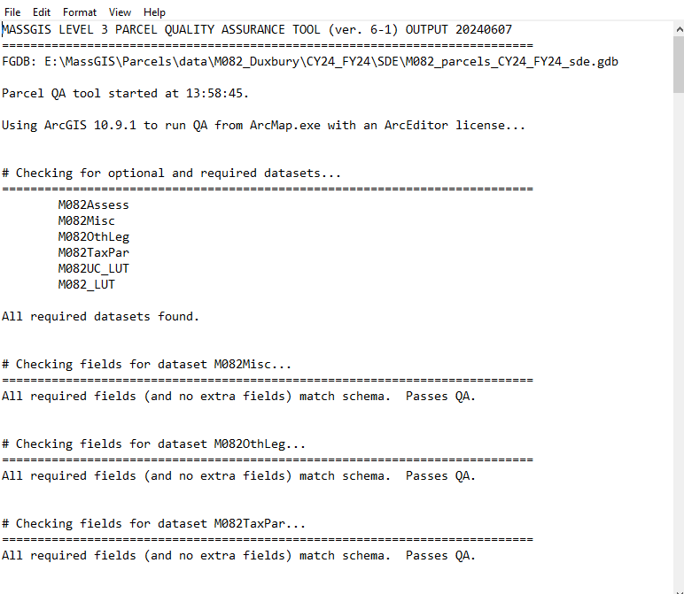
MAINTAINING STANDARDIZED PARCEL MAPPING
PART 2 – Maintaining Parcels and Owner Data
QA Reviewing the FGDB
Once the spatial and attribute portions have been updated, the fGDB should go through a rigorous QA review, using the QA Tool (available on the ArcHub portal).
QA Tool Report
Notes:
QA Reviewing Combined FGDB

Slide 48
MAINTAINING STANDARDIZED PARCEL MAPPING
PART 2 – Maintaining Parcels and Owner Data
QA Reviewing the FGDB
A Few of the Things Checked:
All layers are present –
TaxPar, OthLeg, and Misc FCs present
Assess, UC_LUT and LUT present
All fields in each layer-
Are present
Have the right field name
Have the right type
Have the right length
LOC_ID links between TaxPar and Assess reach minimum percentage levels
Topology in TaxPar passes (no gaps or overlaps)
LOC_ID correctly created for a polygon
All Use Codes in the Assess table are present in UC_LUT with a description
All rules concerning TAX-FEE relations are in conformance.
Notes:
QA Script Basic Rules and Checks:
All FCs and tables present. fields w/in them have correct type and length.
Values in the attribute tables conform to the schema from the standard.
LOC_IDs: one and only one per polygon; no duplicate values.
Links between the mapping and assessing dbase are correct [PS: App A].
match rFrom Assess records with Building or Other Values > $1K to TaxPar records (<= 1000 parcels – 99.0%, >1000 parcels – 99.8%).
From Assess records with Building or Other Values < $1K to TaxPar records (< 1000 parcels – 95%.0, > 1000 parcels – 97.0%).
From TaxPar records to Assess records.
Rates meet minimum percentage levels:
Identify gross discrepancies between parcel area measured by the GIS software and the lot-size recorded by the assessor;
There are no overlaps or gaps between parcel polygons (topology check)
TAX-FEE relationship correctly modeled, including:[
There are seven separate checks on TAX-FEE relationships.

Slide 49
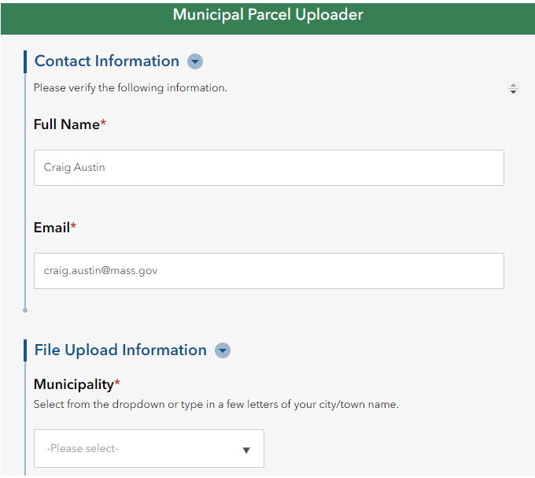
MAINTAINING STANDARDIZED PARCEL MAPPING
PART 2 – Maintaining Parcels and Owner Data
Uploading via the ArcHub Portal, Parcel QA Process Community
Updates MUST be delivered through the ArcHub “Uploader:”
For QA Review, must be a fGDB (zipped)
Other files such as extracts can be submitted as well.
Updates CANNOT be delivered via email
Request Uploader account via the Parcel QA Community on ArcHub.
Notes:
ArcHub Portal
Please let us know how we can make this portal more usable for the Assessing community.

Slide 50
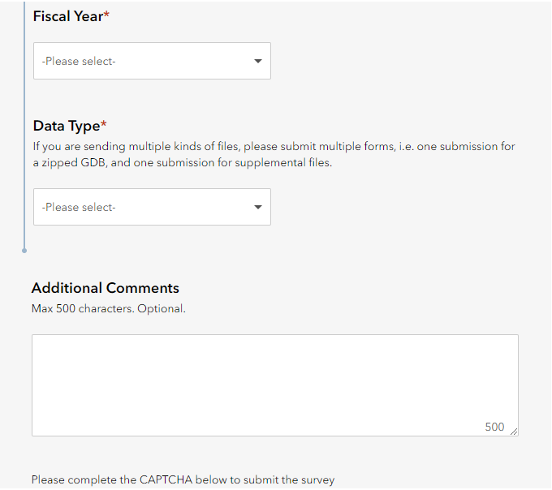
MAINTAINING STANDARDIZED PARCEL MAPPING
PART 2 – Maintaining Parcels and Owner Data
Once uploaded, scripts run overnight to download the file(s), prepare the workspace, and run the QA Tool.
In the morning, the results will be available for review and disposition (hopefully pass!).

Slide 51
MAINTAINING STANDARDIZED PARCEL MAPPING
PART 2 – Maintaining Parcels and Owner Data
PAUSE – End of Part 2
Questions, so far?
NEXT: Part 3: Maintaining Parcels and Owner Data:
Advanced Topics

Slide 52
MAINTAINING STANDARDIZED PARCEL MAPPING
PART 3: Maintaining Parcels and Owner Data: Advanced Topics
TAX – FEE Parcel Relations

Slide 53
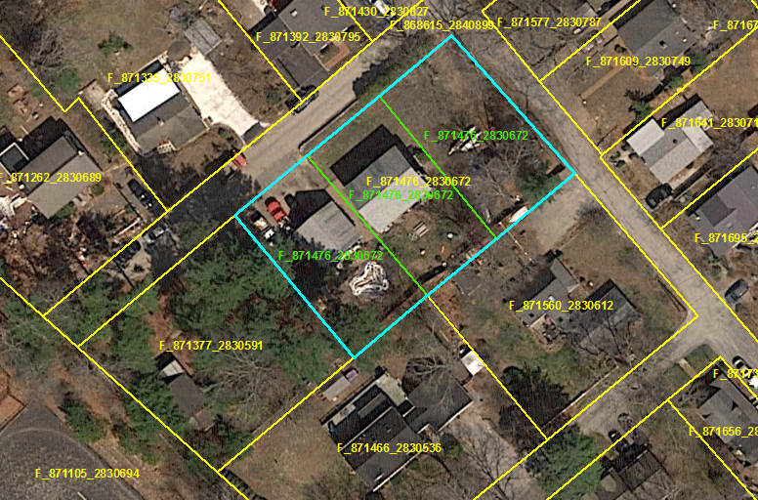
MAINTAINING STANDARDIZED PARCEL MAPPING
PART 3: Maintaining Parcels and Owner Data: Advanced Topics
Linking CAMA Records to Two + Parcel Records Using TAX-FEE Relationships:
TAX-FEE combines parcels (same owner, different MAP_PAR_ID values, and in most cases, adjacent to one another) for ‘TAX’ purposes so that one CAMA record is associated with multiple parcels. The assessor has combined the tax bills for either assessing or property owner convenience.
This is done using both the TaxPar and OthLeg FCs.
PROBLEM:
Three FEE parcels can only link to a single CAMA record
SOLUTION:
Single TAX polygon in TaxPar corresponding to tax bill
#1
#2
#3
#1
#2
#3
Three FEE polygons are moved to OthLeg and displayed with TAX Polygon
Notes:
Back when the TaxPar FC was introduced, the value, “TAX,” was introduced as one of the domain values in POLY_TYPE. There are two needs:
- The Assessor has the need to group two or more parcels for ‘tax purposes’ to create address lists and tax bills.
Engineering and other entities have the need to represent all deeded parcels on a tax map
TAX-FEE relationship is used to combine parcels (same owner, different MAP_PAR_ID values, and in most cases, adjacent to one another) for ‘TAX’ purposes so that one CAMA record is associated with multiple parcels [and to ID the entire area for that owner record]. This is done using both the TaxPar and OthLeg FCs. [PS, p. 27-8]
Not all communities create TAX parcels, but it’s the only way to apply one CAMA record over more than one separately deeded parcel.
The OthLeg FC can be empty IF there are no FEE parcels from a TAX-FEE relationship, and no digitized easements maintained in your GIS as polygons.

Slide 54
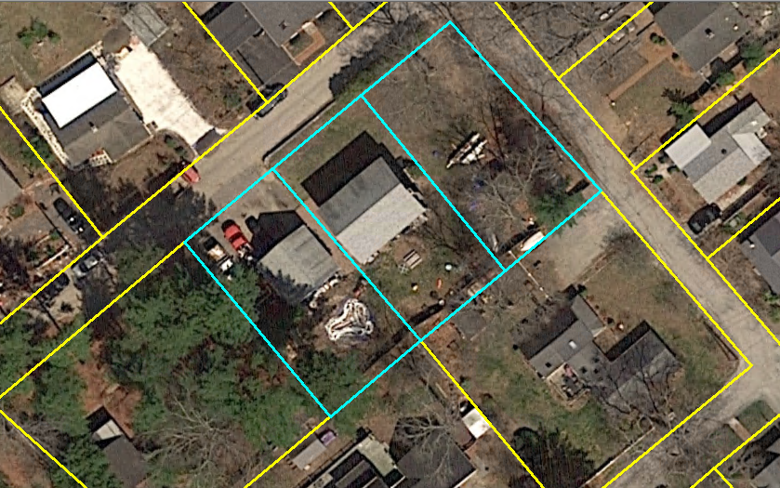
MAINTAINING STANDARDIZED PARCEL MAPPING
PART 3: Maintaining Parcels and Owner Data: Advanced Topics
Creating TAX Parcels in TaxPar: Case #1 – Adjacent Properties with One Owner Record
For a situation with two or more adjacent records “combined for tax purposes only” with a single owner record:
Select parcel polygons that are to be combined
Notes:
To create TAX-FEE parcel polygons:
Start by selecting parcel polygons that are to be combined for tax purposes and are represented by one CAMA record.
This is a situation where you should be in conversation with the Assessor. The Assessor should have created one record representing the three parcels owned by the same owner. If there are still records for each parcel, then it is NOT a TAX Parcel.
In this example, the Assessor has confirmed that there is only one CAMA record for these parcels.

Slide 55
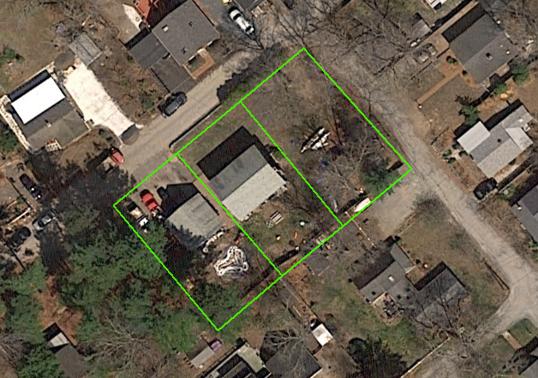
MAINTAINING STANDARDIZED PARCEL MAPPING
PART 3: Maintaining Parcels and Owner Data: Advanced Topics
Creating TAX Parcels in TaxPar: Case #1 – Adjacent Properties with One Owner Record
Copy component parcels from TaxPar into OthLeg
Make sure each component parcel in OthLeg has the correct MAP_PAR_ID attribute value
Notes:
Then,
-Copy component parcels from TaxPar and paste into OthLeg.
-Make sure each component parcel in OthLeg has the right MAP_PAR_ID value.

Slide 56
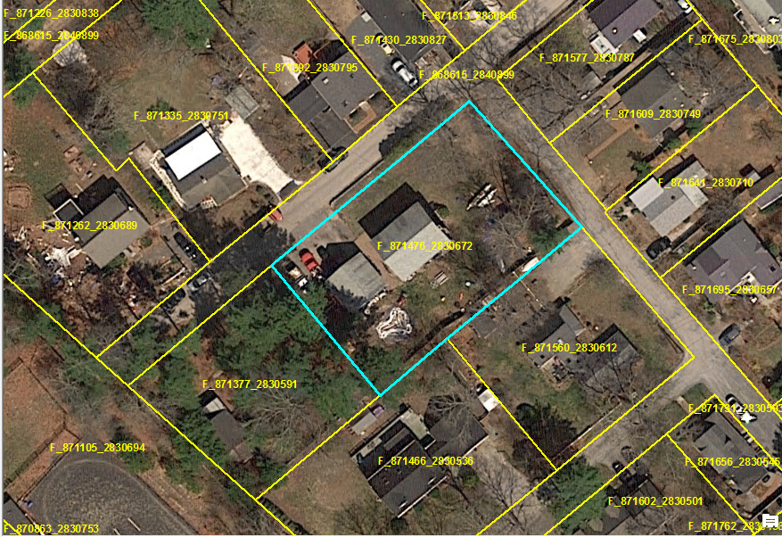
MAINTAINING STANDARDIZED PARCEL MAPPING
PART 3: Maintaining Parcels and Owner Data: Advanced Topics
Creating TAX Parcels in TaxPar: Case #1–Dissolve Adjacent Polys
In TaxPar, dissolve the copied parcels into one large parcel
Create a new LOC_ID value for that parcel
If present, delete the value in MAP_PAR_ID
Change POLY_TYPE to “TAX”
Notes:
Then,
In TaxPar, dissolve the selected parcels into one large polygon.
Create a new LOC_ID value for that parcel.
If present, delete the value in MAP_PAR_ID.
Change POLY_TYPE to “TAX.”
Also, enter the values for the other fields in the TaxPar record.

Slide 57
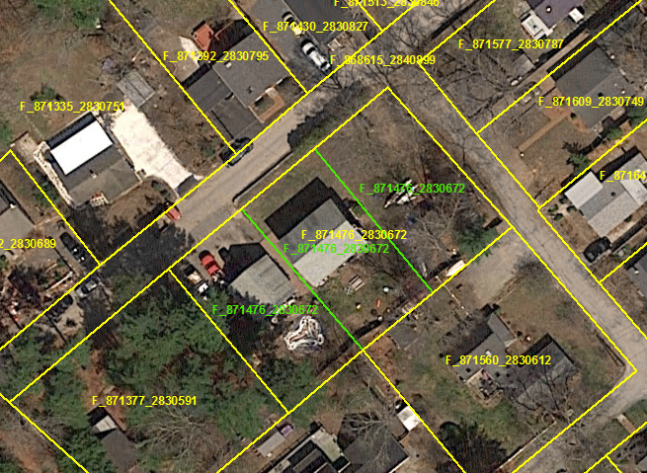
MAINTAINING STANDARDIZED PARCEL MAPPING
PART 3: Maintaining Parcels and Owner Data: Advanced Topics
Creating TAX Parcels in TaxPar: Case #1–Dissolve Adjacent Polys
Copy this LOC_ID value and paste it into TAXPAR_ID for each of the component OthLeg parcels.
Also, add the LOC_ID with the PROP_ID in the Change List for the Assessor to put in the corresponding CAMA record.
Notes:
Then,
- Copy this LOC_ID value and paste it into TAXPAR_ID for each of the component parcels in OthLeg.

Slide 58
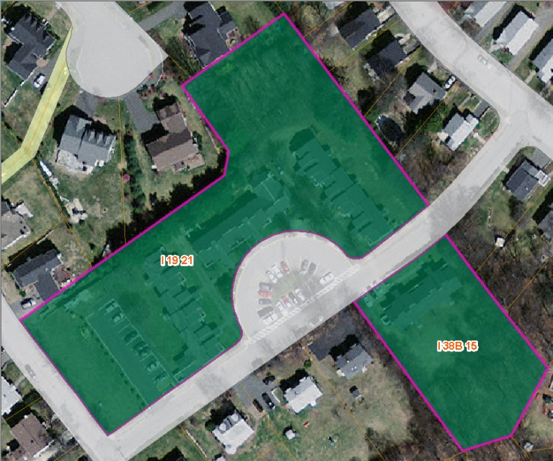
MAINTAINING STANDARDIZED PARCEL MAPPING
PART 3: Maintaining Parcels and Owner Data: Advanced Topics
Creating TAX Parcels in TaxPar: Case #2 – Non-Adjacent Polygons
These polygons are separated a short distance by a right of way or WATER poly. These parcels are separately deeded (have different MAP_PAR_ID values) and are “combined for tax purposes” under one owner
These are combined the same way as other ‘TAX-FEE’ relations but as a multi-part polygon.
Notes:
The second case is when one of the lots may be across a right of way or WATER polygon and, thus does not have a shared boundary. Again, each lot should have its own Map-Par-ID, and, of course, a common owner.
If the lots are far apart, for instance, across town, we don’t generally accept them as TAX parcels.

Slide 59
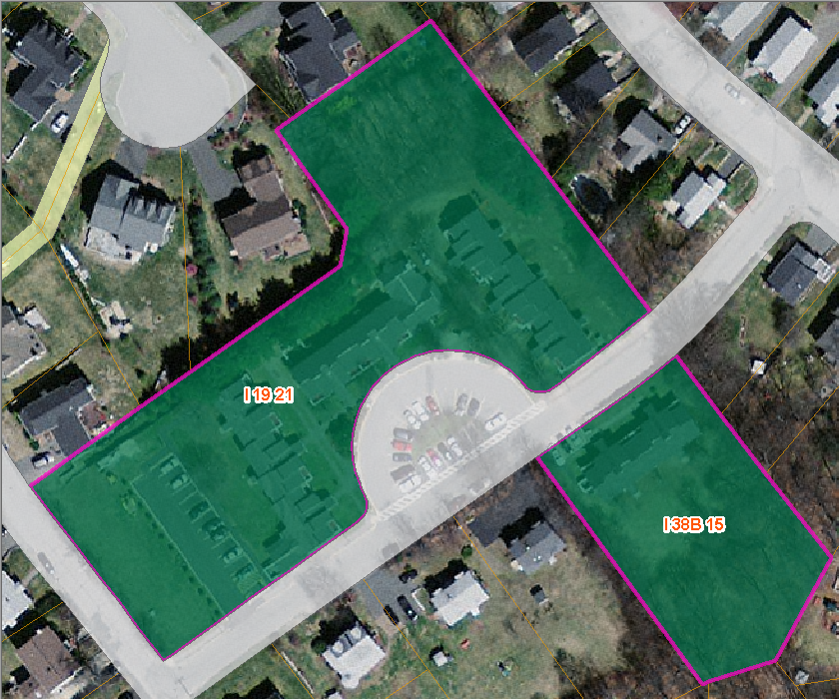
MAINTAINING STANDARDIZED PARCEL MAPPING
PART 3: Maintaining Parcels and Owner Data: Advanced Topics
This is NOT a TAX Parcel:
Same MAP_PAR_ID
Same MAP_PAR_ID
indicates parts of same
deeded parcel. Make
A single multipart FEE
Polygon in TaxPar, no
components in OthLeg.
Notes:
The above is NOT a TAX parcel. If the MAP_PAR_ID is the same in each polygon, then these are likely two parts of THE SAME PARCEL. If this is the case, then these two should be made into a multi-part polygon with POLY_TYPE value of FEE.
Multipart polygons are required where there are two or more non-adjacent portions of the same polygon, regardless of whether the polygon is TAX or FEE.

Slide 60
MAINTAINING STANDARDIZED PARCEL MAPPING
PART 3: Maintaining Parcels and Owner Data: Advanced Topics
Municipal Boundaries

Slide 61
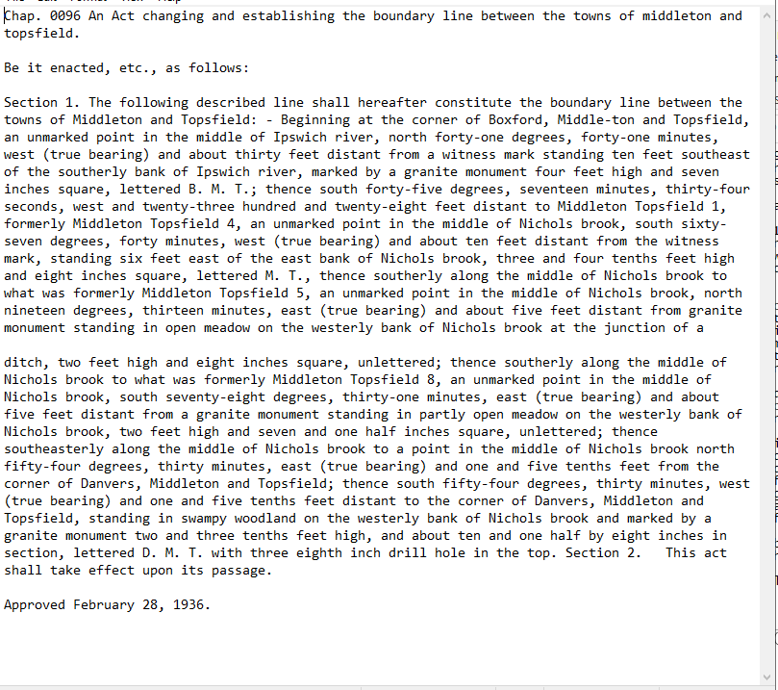
MAINTAINING STANDARDIZED PARCEL MAPPING
PART 3: Maintaining Parcels and Owner Data: Advanced Topics
MassGIS’s Boundary Mapping
Based on Harbor and Land Commission Atlas (published 1898 – 1915)
Updated from Mass. Acts and Resolves for boundaries modifications drawn since Atlas
Is augmented by USGS Topographical maps and other sources.
Notes:
PS, p. 30.
Based on the descriptions in the Harbor and Land Commission Atlas, published 1898-1915, and amended through the Mass. Acts and Resolves.
Excellent for descriptions of corners. Boundary descriptions are good but not perfect, and may need assistance from other sources such as the USGS Topographic Maps.
Remember, parcels and municipal lines are representations of the actual boundaries and are not considered “authoritative.” If such accuracy is required, then obtain the descriptions in the actual deed submitted to the county’s Registry of Deeds, or consult a Land Surveyor, who will assemble and compare the legal documents that apply to that property.

Slide 62
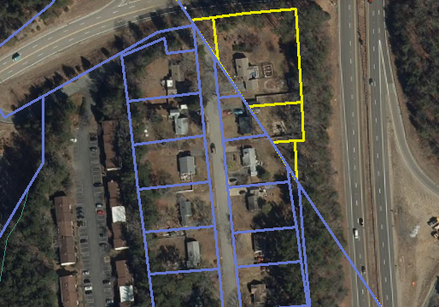
MAINTAINING STANDARDIZED PARCEL MAPPING
PART 3: Maintaining Parcels and Owner Data: Advanced Topics
Generally, parcel mapping should be clipped to the MassGIS boundary.
Cases where other boundary delineations may be accepted:
Water boundaries
Boundary follows along a road or rail right of way
Where sufficient ambiguity exists (must include geo-referenceable sources such as Engineering Plans.
Boundaries can be challenged – However. . .
Thorough documentation must be given (geo-referenceable sources such as Engineering plans and imagery
Must reference H&LCA corners. Roadstones, which are often NOT surveyed, are not acceptable.
Remember that the Municipal and Parcel layers are NOT Authoritative and CANNOT be used to settle legal boundary issues.
Notes:
Parcels along boundaries should be snapped to the municipal line.
There is some leeway on some boundary lines along features like rights of way and waterways.
Boundaries can be challenged: however, we rely on the H&LC Atlas for the majority of boundaries – overruling these descriptions is extremely rare. More likely, the corner coordinates were mistyped when entering and transposing them for the layer. Need geographically referenceable engineering level plans and imagery as evidence.

Slide 63
MAINTAINING STANDARDIZED PARCEL MAPPING
PART 3: Maintaining Parcels and Owner Data: Advanced Topics
Metadata
Notes:
[PS, p.36]

Slide 64
MAINTAINING STANDARDIZED PARCEL MAPPING
PART 3: Maintaining Parcels and Owner Data: Advanced Topics
Metadata
When the parcels were originally digitized and submitted (2011-2014) metadata was entered.
Currently, the metadata is viewed from the ESRI Metadata Editor, with the FGDC format.
With every submission, dates in two fields should be updated to represent the ‘currentness’ of the data: one in the Description (Abstract) field, and the other in the Citation/Dates/Publish Date field.

Slide 65
MAINTAINING STANDARDIZED PARCEL MAPPING
PART 3: Maintaining Parcels and Owner Data: Advanced Topics
Other Resources

Slide 66
MAINTAINING STANDARDIZED PARCEL MAPPING
MassGIS Tools and Resources
Resources for Assessors
Adding LOC_ID into CAMA Systems- https://www.mass.gov/info-details/why-add-the-locid-to-your-cama-database. It includes a link to a web page containing videos on adding LOC_IDs to each of the major CAMA Systems used.
Intro to GIS: MIT “Open ware” Course - https://ocw.mit.edu/courses/res-str-001-geographic-information-system-gis-tutorial-january-iap-2022/resources/mitres_str001iap22_level1_pres/
Parcel Standard, v 3.0 - https://www.mass.gov/doc/standard-for-digital-parcels-and-related-data-sets-version-3/download
ArcHub Portal - https://submitgisdata.mass.gov/

Slide 67
MAINTAINING STANDARDIZED PARCEL MAPPING
MassGIS Tools and Resources
Resources for GIS Editors
QA Tool – Available upon request and by joining the ArcHub community
Assess Prep Tool – Available upon request and by joining the ArcHub community
ArcHub Portal - https://submitgisdata.mass.gov/

Slide 68
MAINTAINING STANDARDIZED PARCEL MAPPING
Wrap Up
Remember:
We are here to help you in maintaining your parcel data to the Parcel Standard.
Craig Austin – craig.austin@mass.gov – 617.626.4592

