Slide 1
MassHealth Application, Eligibility and Enrollment for Agencies Working with People Experiencing Homelessness

Slide 2
Agenda
How to Apply
MassHealth Eligibility Overview
Resources
MassHealth Renewals
Health Plans
Q & A

Slide 3
Eligibility overview

Slide 4
Populations We Serve
Individuals younger than age 65 and not living in or about to go into a nursing facility
Individuals of any age who are
Parents of children younger than age 19
Adult relatives living with and taking care of children younger than 19 and neither parent is living in the home
Individuals older than age 65 and living at home
Individuals of any age needing long-term-care services in a medical institution or nursing facility
Individuals eligible under certain programs to get long-term-care services living at home
Members of a married couple living with a spouse who is 65 years of age or older
ACA Population
SACA Population

Slide 5
Factors to Determine Eligibility
Massachusetts Residency
Members in your household
Citizenship or Immigration Status
Income
Access to Health Insurance
Universal Eligibility
Categorical Member Criteria
Citizenship or Immigration Status
Financial Eligibility
Coverage Type = MassHealth Benefit

Slide 6
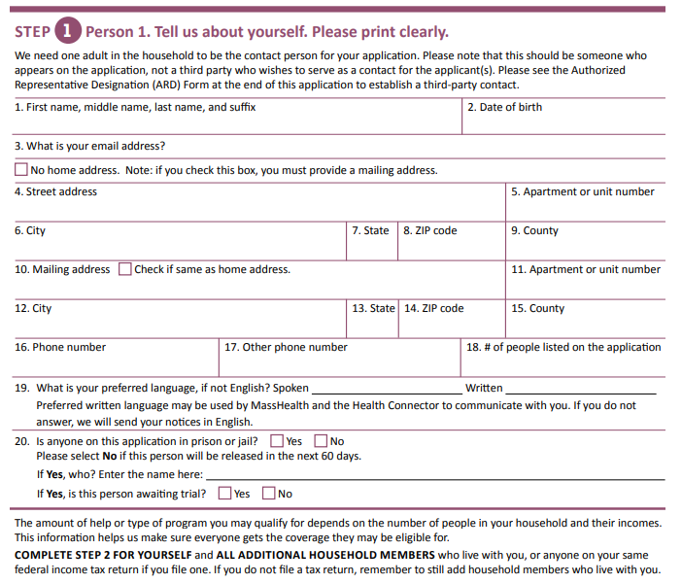
Massachusetts Residency
Intend to reside in the Commonwealth, with or without a fixed address
If you do not have a fixed address, must attest to intent to stay in Massachusetts
Entered the Commonwealth with a job commitment or are seeking employment
If you are experiencing homelessness and don’t have a permanent home address, you should let us know. You can include this information on your MassHealth application or tell us over the phone.
Residential address: If you’re staying in a shelter, use the shelter’s address as your residential address. If you are not in a shelter and are moving around, you can leave the residential address blank, but make sure you give us a mailing address.
Mailing address: For the mailing address on your application, you can enter the address of any place where you can regularly receive mail. This could be the address of a friend, a family member, or someone else, including a person in a different state. You can leave this field blank if you’ve entered a residential address.

Slide 7
Financial Eligibility
ACA
SACA
Modified Adjusted Gross Income (MAGI):
Household composition is used to determine financial eligibility for subsidized Health Connector plans including Premium Tax Credits, ConnectorCare and Cost Sharing Reductions.
An applicant’s age, household size, demographic and immigration/citizenship status all influence how their income is evaluated and then compared with the Federal Poverty Level guidelines.
Income
Single: $1255 monthly*
Couple: $1704 monthly*
Assets
Single: $2000
Couple: $3000
* Updated annually

Slide 8
Types of Assets
Cash
Vehicles
Bank Accounts
Real Estate
Securities
Life Insurance
Burial Plans
Annuities
Trusts

Slide 9
Continuous Eligibility
Continuous eligibility (CE) means that members retain coverage for a period of time, even if they experience changes in their circumstances that would impact eligibility
1
CE is a valuable tool that helps certain populations stay enrolled in the health coverage for which they are eligible and have consistent access to services
2
CE promotes health equity by limiting gaps in coverage for low-income children and adults who experience disproportionate rates of health disparities
3

Slide 10
Continuous Eligibility Populations
Members released from jail or prison
Provides 12-months continuous eligibility to adults under age 65 upon release from public institution for the first year they return to the community
Verified Homeless Adults
Provides 24-months continuous eligibility to adults under age 65 who are verified homeless for 6+ months through HMIS in the Rehousing Data Collective
Children
Provides 12-months continuous eligibility to children under age 19
Pregnant Individuals
Provides 12 months of continuous coverage following the end of pregnancy, no matter your immigration status or how the pregnancy ends

Slide 11
MassHealth Coverage Types
Each coverage type represents a different level of health benefits. The coverage type is determined by categorical and financial standards.
ACA
SACA
MassHealth Standard
MassHealth CommonHealth
MassHealth Family Assistance
MassHealth Limited
Health Safety Net
Careplus
Children’s Medical Security Plan
Most Comprehensive
MassHealth Standard
MassHealth CommonHealth
MassHealth Family Assistance
MassHealth Limited
Medicare Saving Program
Health Safety Net
Least Comprehensive

Slide 12
How to Apply

Slide 13
ACA: How to Apply for Coverage
Online at MAhealthconnector.org
Call MassHealth at 1-800-841-2900 (TTY: 711)
Mail: Health Insurance Processing Center
P.O. Box 4405 Taunton, MA 02760
Fax: 1-857-323-8300
Apply with a Certified Assister Or at a MassHealth Enrollment Center (MEC)
You can schedule a phone or video appointment with a MassHealth staff

Slide 14
SACA: How to Apply for Coverage
Call MassHealth at 1-800-841-2900 (TTY: 711)
Web portal: Complete Adobe Sign Application for Health Coverage for Seniors and People Needing Long-Term-Care Services
Mail: MassHealth Enrollment Center Central Processing Unit
P.O. Box 290794 Charlestown, MA 02129
Fax: 617-887-8799
Apply with a Certified Assister near you or at a MassHealth Enrollment Center (MEC)

Slide 15
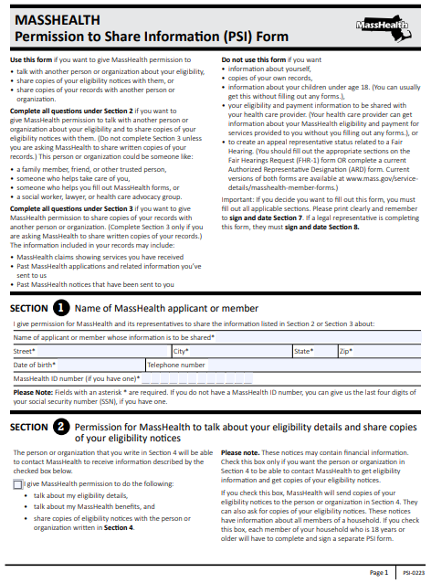
Permission to Share Form
Permission to Share (PSI) Form
This form gives MassHealth permission to give MassHealth permission to talk with another person or organization about the applicant or member’s eligibility, share copies of their eligibility notices with them, or share copies of your records with another person or organization.

Slide 16
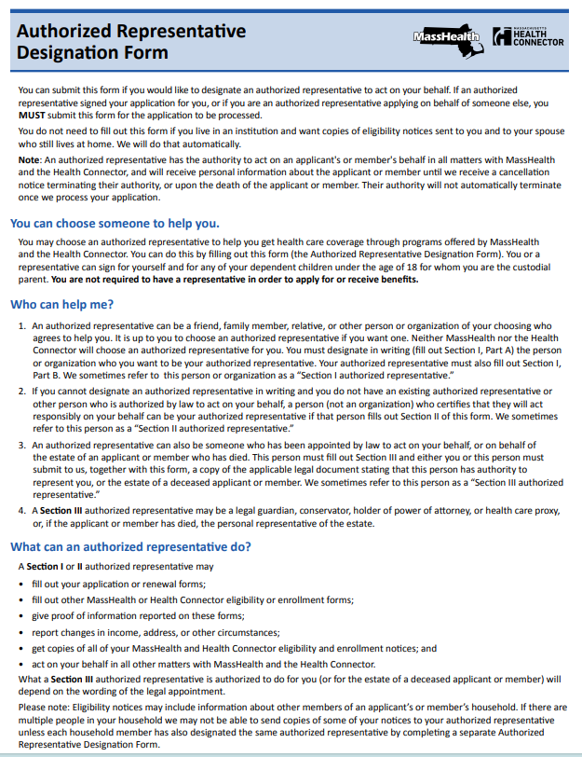
Authorized Representative Designation Form
Authorized Representative (ARD) Form
This form allows an individual or organization designated by the member or applicant to act on their behalf to help the applicant or member get health care coverage through programs offered by MassHealth and the Health Connector

Slide 17
Renewals

Slide 18
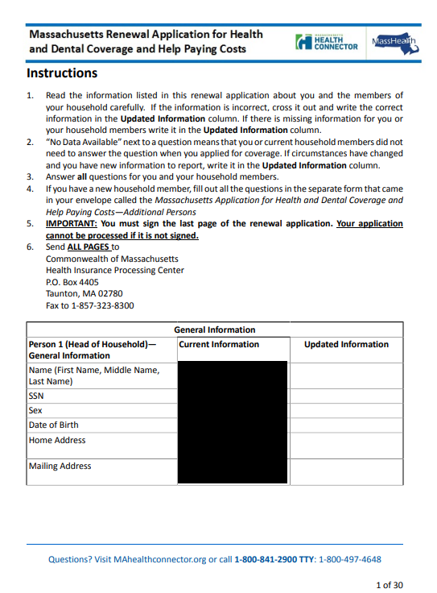
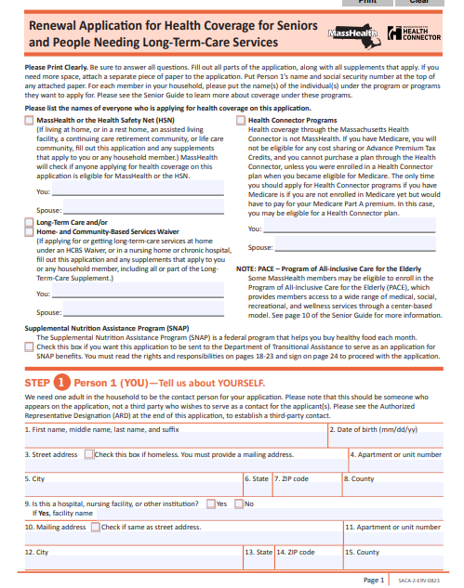
MassHealth Renewal Overview
MassHealth is required to renew households annually
For ACA Households will either be renewed either:
Automatically via systematic auto renewal
Asked to complete a pre-populated renewal form within 45 days
Applicants over 65 can renew online, over the phone or by paper

Slide 19
How to Report A Change
Online at MAhealthconnector.org
Call 1-800-841-2900 (TTY: 711)
Mail: Health Insurance Processing Center PO Box 4405 Taunton MA 02780
Fax 857-323-8300
In-Person at any of the MECs
Schedule a phone or video appointment with MassHealth
Any changes (address, household size, income, etc) should be reported to MassHealth within 10 days

Slide 20
MassHealth Renewal Resources
Learn more about how members can renew their coverage:
Renew your coverage for MassHealth, the Health Safety Net, or the Children's Medical Security Plan
Frequently asked questions for MassHealth members younger than 65
Renew your MassHealth coverage for seniors and people who need long-term-care services
Frequently asked questions for MassHealth members aged 65 and older

Slide 21
MassHealth Health Plans

Slide 22
MassHealth Managed-Care Eligible Members
Members who are managed care eligible can select from the following types of plans:
Accountable Care Partnership Plan
Primary Care ACO
Managed Care Organization (MCO)
Primary Care Clinician (PCC) Plan

Slide 23
Covered Services
Acute in-patient care
Behavioral health
Vision
Dental
Prescriptions
Full list provided: Chart of MassHealth Covered Services

Slide 24
Health Plan Enrollment Periods
When to enroll in a MassHealth health plan for those experiencing homelessness?
Once a member is considered MassHealth eligible and can enroll in a managed care plan, they have 14 days to select a plan or they will be auto-assigned
When can someone change health plan?
MassHealth members who are experiencing homelessness can change their health plan and doctor at any time.
Have you moved?
You may need to change your health plan to be closer to your doctors.
If you have moved, your primary care doctor or other providers may now be far from you, or they may not be available in your area. If you need to change your health plan, you have options. Your MassHealth eligibility and benefits will stay the same, even if you decide to change your health plan.
Tell us anytime you have a new address to make sure you get your MassHealth card and other important paperwork. To report an address change, go to this page.
If I have Medicare and MassHealth, do I need to enroll in a health plan?
If you are member with Medicare and MassHeath, you are not required to select a health plan. However, you do have the option of enrolling in One Care, Senior Care Options (SCO) or Program of All-inclusive Care for the Elderly (PACE). These programs provide additional services.

Slide 25
One Care
One Care is a way to get your MassHealth and Medicare benefits together. One Care offers services that you can't get when your MassHealth and Medicare benefits are separate. With One Care, you have one plan, one card, and one person to coordinate your care.
You can enroll in OneCare if you:
are between the ages of 21 and 64,
have a disability
have Medicare Parts A and B
qualify for Medicare Part D (drug coverage)
have MassHealth Standard or MassHealth CommonHealth
live in an area covered by a One Care plan.

Slide 26
Senior Care Options (SCO)
Senior Care Options (SCO) is a comprehensive health plan. SCO covers all of the services normally paid for through Medicare and MassHealth. This plan provides services to members through a senior care organization and its network of providers. SCO offers the opportunity to receive quality health care by combining health services with social support services. It does this by coordinating care and specialized geriatric support services, along with respite care for families and caregivers. SCO offers an important advantage for eligible members over traditional fee-for-service care. There are no copays for members enrolled in SCO.
Enrollment is open to MassHealth Standard members who meet the following criteria:
are aged 65 or older;
live at home or in a long-term-care facility (member cannot be an inpatient at a chronic or rehabilitation hospital or reside in an intermediate care facility for people with intellectual disabilities);
are not subject to a six-month deductible period under MassHealth regulations at; and
live in an area served by a SCO plan.

Slide 27
Program of All-inclusive Care for the Elderly (PACE)
The Program of All-inclusive Care for the Elderly (PACE) is administered by MassHealth and Medicare to provide a wide range of medical, social, recreational, and wellness services to eligible participants. The goal of PACE is to allow participants to live safely in their homes instead of in nursing homes. The PACE model is centered on the core belief that given a choice, most elders, the disabled, and their families would choose to receive care in their homes and communities rather than in a nursing home.
To enroll in PACE you must:
Be 55 or older
Live in the service area of a PACE organization
Be certified by the state as eligible for nursing home care
Live in the community (not a nursing home)
Be able to live safely in the community, and
Agree to receive health services exclusively through the PACE organization.
MassHealth income and asset rules for PACE include the following:
Countable income must not be greater than 300% of the federal benefit rate. The monthly premium charged to a PACE enrollee is based upon income.
Countable assets must not be greater than $2,000.
NOTE: if you are married, your spouse's income and assets are not counted.

Slide 28
Resources

Slide 29
MassHealth Verification Forms
Noncustodial Parent Form
Incarceration Status
Massachusetts Residency Affidavit
Affidavit to Verify Zero Income
Affidavit for Self Employment Income
These forms can assist with verifying some types of information MassHealth has sent a Request for Information regarding.
This is not a complete list of acceptable verifications but are forms that MassHealth provides as a template.

Slide 30
MassHealth Enrollment Centers (MECs)
All MassHealth Enrollment Centers (MECs) are open for walk-ins
There’s also the MassHealth Online Appointment Service available
The Online Member Portal will let member’s schedule phone appointments or video appointments
Schedule appointments for the following services:
Assistance with new applications & renewal forms | Reporting a change: address, family size, income, pregnancy, newborn or other
Verifications | General questions

Slide 31
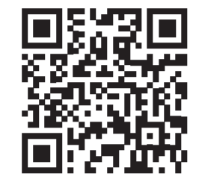
Online Appointment Scheduling Service
The portal enables appointment scheduling for 2 business days from the current date and 20 business days into the future
Individuals may also cancel an appointment directly through the portal
In-Person appointments are available to be scheduled with the Springfield Office ONLY
Go to www.mass.gov/masshealth/appointment to schedule a phone or video appointment or scan the QR code

Slide 32
Enrollment Assisters
Certified Application Counselors
Navigators
The Commonwealth has approximately 1,500 Certified Application Counselor (CACs) spread across nearly all hospitals and Community Health Centers
The Commonwealth has selected and Certified 22 Navigator organizations
Go to Enrollment Assister Search – Massachusetts Health Connector (mahealthconnector.org)
If you are interested in becoming a CAC organization and what it entails, email MAhealthconnectorTraining@MassMail.State.MA.US

Slide 33
My Ombudsman: For Help Accessing Services
My Ombudsman is an independent organization that helps MassHealth members, including their families and caregivers, address concerns or questions that may impact their experience with a MassHealth health plan or their ability to access their health plan benefits and services
Contact Information
Phone: 855-781-9898
Videophone: 339-224-6831
Website: https://www.myombudsman.org/
Email: info@myombudsman.org
Available language support (in-house staff): American Sign Language (ASL), Haitian-Creole, Portuguese, and Spanish. Interpreter services for other languages available as needed

Slide 34
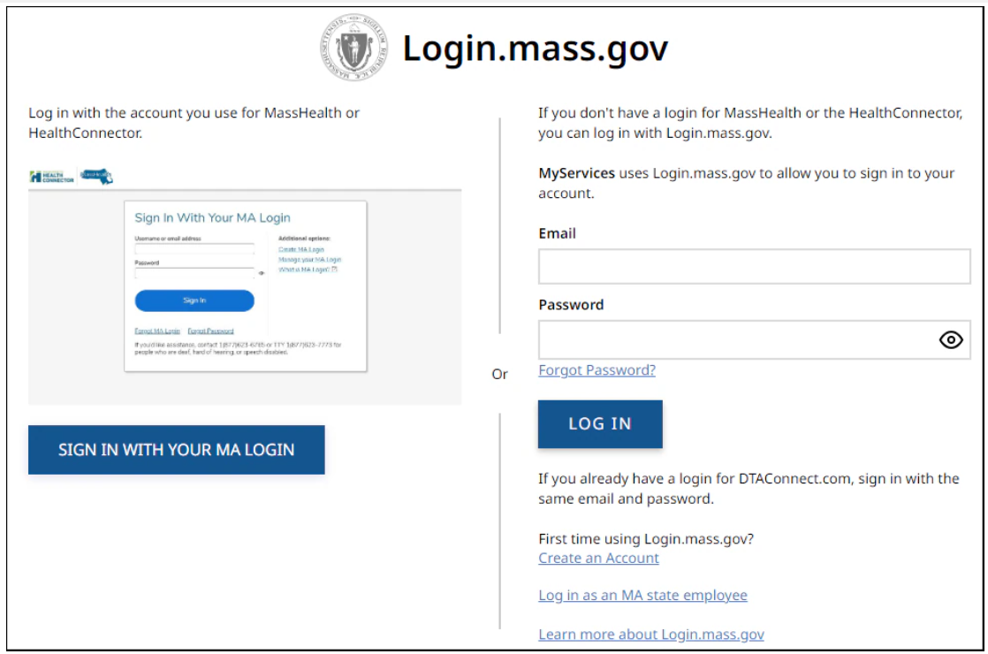
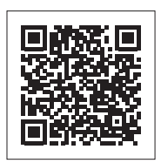
MyServices Portal
MyServices is a web portal designed for all applicants and members. With this portal, applicants and members can review:
Demographic information
Eligibility status
MassHealth enrollment information
Notices MassHealth sent
Receive alerts about important events and actions to take
Website is translated in six languages: English, Spanish, Brazilian Portuguese, Traditional Chinese, Vietnamese, and Haitian Creole

Slide 35
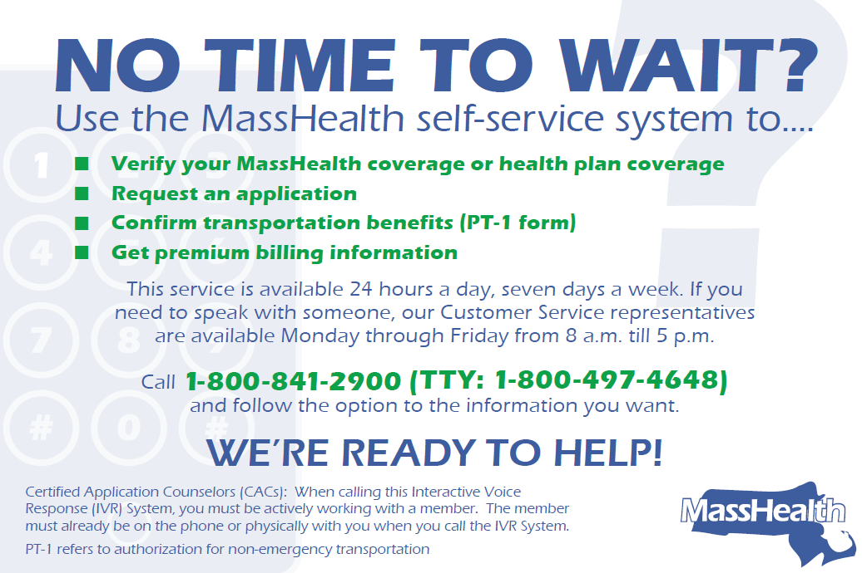
MassHealth Self-Service System

Slide 36
Thank you!

