Slide 1
MassHealth Housing, Homelessness, and Health Policy Webinar Series – Long Term Services and Supports
December 2024

Slide 2
MassHealth Coverage Types
Each coverage type represents a different level of health benefits. The coverage type is determined by categorical and financial standards.
ACA
SACA
MassHealth Standard
MassHealth CommonHealth
MassHealth Family Assistance
MassHealth Limited
Health Safety Net
Careplus
Children’s Medical Security Plan
Most Comprehensive
MassHealth Standard
MassHealth CommonHealth
MassHealth Family Assistance
MassHealth Limited
Medicare Saving Program
Health Safety Net
Least Comprehensive

Slide 3

MassHealth Managed-Care Eligible Members
Members who are managed care eligible can select from the following types of plans:
Accountable Care Partnership Plan
Primary Care ACO
Managed Care Organization (MCO)
Primary Care Clinician (PCC) Plan

Slide 4
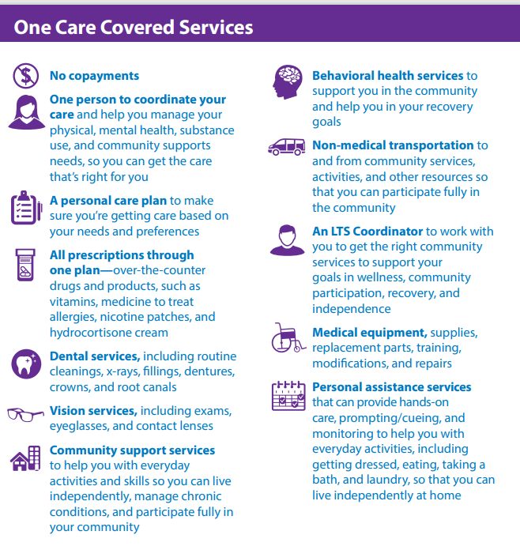
One Care
One Care is a way to get your MassHealth and Medicare benefits together.
One Care offers services that you can't get when your MassHealth and Medicare benefits are separate. With One Care, you have one plan, one card, and one person to coordinate your care.
You can enroll in OneCare if you:
  are between the ages of 21 and 64,
  have a disability
  have Medicare Parts A and B
  qualify for Medicare Part D (drug coverage)
  have MassHealth Standard or MassHealth CommonHealth
  live in an area covered by a One Care plan.

Slide 5
Senior Care Options (SCO)
Senior Care Options (SCO) is a comprehensive health plan. SCO covers all of the services normally paid for through Medicare and MassHealth. This plan provides services to members through a senior care organization and its network of providers. SCO offers the opportunity to receive quality health care by combining health services with social support services. It does this by coordinating care and specialized geriatric support services, along with respite care for families and caregivers. SCO offers an important advantage for eligible members over traditional fee-for-service care. There are no copays for members enrolled in SCO.
Enrollment is open to MassHealth Standard members who meet the following criteria:
  are aged 65 or older;
  live at home or in a long-term-care facility (member cannot be an inpatient at a chronic or rehabilitation hospital or reside in an intermediate care facility for people with intellectual disabilities);
  are not subject to a six-month deductible period under MassHealth regulations at; and
  live in an area served by a SCO plan.

Slide 6
Program of All-inclusive Care for the Elderly (PACE)
The Program of All-inclusive Care for the Elderly (PACE) is administered by MassHealth and Medicare to provide a wide range of medical, social, recreational, and wellness services to eligible participants. The goal of PACE is to allow participants to live safely in their homes instead of in nursing homes. The PACE model is centered on the core belief that given a choice, most elders, the disabled, and their families would choose to receive care in their homes and communities rather than in a nursing home.
To enroll in PACE you must:
Be 55 or older
Live in the service area of a PACE organization
Be certified by the state as eligible for nursing home care
Live in the community (not a nursing home)
Be able to live safely in the community, and
Agree to receive health services exclusively through the PACE organization.
MassHealth income and asset rules for PACE include the following:
Countable income must not be greater than 300% of the federal benefit rate. The monthly premium charged to a PACE enrollee is based upon income.
Countable assets must not be greater than $2,000.
NOTE: if you are married, your spouse's income and assets are not counted.

Slide 7
MassHealth Office of Long Term Services and Supports (OLTSS): Overview
Section I.

Slide 8
MassHealth is committed to a robust long-term services and supports program that delivers person-centered care, promotes independent living, and uses a “community first” approach
  Individuals who require long-term services and supports (LTSS) have diverse needs due to disabilities or chronic medical conditions, and most require assistance with Activities of Daily Living or Instrumental Activities of Daily Living to help meet their daily needs, promote independence, and improve the quality of their lives
  312,000 individuals (including dual-eligible members) receive LTSS funded by MassHealth.
  MassHealth offers the broadest array of State Plan LTSS of any state, including:
    Community-based programs and services : Adult Day Health, Adult Foster Care, Continuous Skilled Nursing, Day Habilitation, Durable Medical Equipment, Group Adult Foster Care, Home Health, Hospice, Personal Care Attendant, Therapies
    Facility-based programs and services: Chronic Disease and Rehabilitation Hospital and Nursing Facility
  Specialized services through Home and Community-Based Services (HCBS) Waivers: Acquired-Brain Injury, Traumatic Brain Injury, Adults with Intellectual Disabilities, Children with Autism Spectrum Disorder; Moving Forward Plan for Members transitioning from facilities, Frail Elder Waiver.

Slide 9
Who Qualifies for LTSS Services?
In order to qualify for LTSS services to be covered by MassHealth depends upon both:
  MassHealth Coverage Type
  Clinical Eligibility

Slide 10
How does a member start the process to get needed Long Term Services and Supports?
Reach out to Primary Care Provider and talk about needs and current supports. A member’s PCP can start the referral process
Contact MassHealth Customer Service at 800-849-2900 to confirm the MassHealth coverage type. Not all MassHealth coverage types cover all LTSS
Contact MassOptions at 800-243-4636 and ask about what services may be able to meet needs
If a member is enrolled in a health plan (including ACO, MCO One Care, SCO or PACE), the health plan can help with accessing LTSS.

Slide 11
What are the things LTSS can help an eligible member with?
Assistance with Activities of Daily Living (ADLs), like assistance dressing, bathing and mobility
Limited assistance with Instrumental Activities of Daily Living (IADLs), like laundry, shopping and housekeeping
Skilled care- such as wound care and therapies
Medical equipment and supplies

Slide 12
Group Adult Foster Care Services
Group Adult Foster Care (GAFC) 130 CMR 408.500
Description: The GAFC program provides daily assistance with ADLs, IADLs, nursing and case management services for people, age 22 and older, who are elderly and/or disabled, enrolled in MassHealth Standard who meet the clinical criteria. Direct Care workers come to a Member’s place of residence to provide care to the Member and nurses and case managers visit to monitor the Member’s care.
Type of MassHealth Coverage: MassHealth Standard and MassHealth CommonHealth
Member Clinical Eligibility: 130 CMR 408.506
Notes:
Must be 22 years of age or older; meet the financial criteria established to be eligible for the SSI-G Living Arrangement, if residing in an assisted living facility; require daily hands on physical assistance or daily supervision and cueing throughout the entire task with at least one Activity of Daily Living (ADL); receive an order recommendation from the primary care provider (Physician Summary Form); and receive clinical approval, prior to enrollment, from the designated screening agent, Coastline Elderly Services.

Slide 13
Group Adult Foster Care Services
Group Adult Foster Care (GAFC) 130 CMR 408.500
Population Served: Serves people age 22 with lower needs than some other LTSS services.
Other Conditions/Limitations: Requires pre-admission clinical eligibility assessment and determination performed by Coastline Elderly Services (ASAP). Rent and/or room and board fees are the Member’s responsibility. Members residing in Assisted Living Facility’s and receiving GAFC services may be eligible for a room and board subsidy from the Social Security Administration called Supplemental Security Income: Category G (SSI-G).
To get started: Call MassOptions for list of GAFC providers in your area.

Slide 14
Personal Care Attendant Services
Personal Care Attendant (PCA) 130 CMR 422.000
Description: PCA services are for people with permanent or chronic disabilities that require hands-on assistance with ADLs and IADLs. Program is consumer directed: members act as employers of the personal care attendants (PCAs) and are responsible for recruiting, hiring, training, and supervising their PCAs. No other insurance covers PCA.
Type of MassHealth Coverage: MassHealth Standard and MassHealth CommonHealth
Member Clinical Eligibility: 130 CMR 422.403
Notes:
Must have a chronic, permanent disability that impairs the member’s ability to perform ADLs and IADLs without hands-on assistance; require hands-on assistance with at least 2 of the following ADLs: mobility, including transfers, medications, bathing/grooming, dressing or undressing, range-of-motion exercises, eating, and toileting

Slide 15
Personal Care Attendant Services
Personal Care Attendant (PCA) 130 CMR 422.000
Providers: 17 Personal Care Management (PCM) evaluate members’ need for PCA services; assess need for surrogate; develop a Service Agreement; and provide intake/orientation and skills instruction to members regarding their employer responsibilities and managing their PCA services.
One Fiscal Intermediary (Tempus) act as employer agents for members; process payment checks for PCAs; withhold and pay all required employer taxes; deduct union dues and fees; and purchase workers’ compensation
The Member: recruits, hires and trains their own PCA
Population Served: Serves eligible Members of all ages and disabilities.
Other Conditions/Limitations: Prior authorization is required. Members must appoint a surrogate if they are assessed as requiring a surrogate to manage PCA services.
To get started- outreach to a PCM in your area: Personal Care Management (PCM) Agency List | Mass.gov

Slide 16
Home Health (HH) Services
Home Health Services (HH) 130 CMR 403.000
Description: HH Agencies provide nursing visits, home health aide services, physical therapy (PT), speech therapy (ST) and occupational therapy (OT) services to MassHealth members in their homes and communities. Home Health services are covered by other insurances, including Medicare.
Type of MassHealth Coverage: Standard, CommonHealth, Family Assistance, CarePlus, Family Assistance
Member Clinical Eligibility: 130 CMR 403.409
Medical Necessity Criteria: See Medical Necessity Guidelines for Home Health Services under Mass.Gov
Notes:
For HH nursing or therapy services, members must have a clearly identifiable, specific medical need, or skilled need, requiring the skills of a nurse of therapist. For CSN, members must have a specific medical condition that requires a nurse visit of more than 2 continuous hours of nursing services to receive CSN services. All services must be medically necessary and prescribed by physician or nurse practitioner, and the member must be under the care of a physician.

Slide 17
Home Health Services
Home Health Services (HH) 130 CMR 403.000
Population served: All ages, provided member has a need for skilled nursing or therapy services.
Other Conditions/Limitations: See prior authorizations requirements in 130 CMR 403.410
To get started: Ask your primary care physician for a referral- or call MassHealth Customer Service for a list of Home Health providers who accept MassHealth.

Slide 18
Durable Medical Equipment (DME)
DME Services130 CMR 409.000 & 427.000
Description: Provides members with medically necessary equipment, accessories, or supplies in member’s home. Certain customized DME may be provided to members in nursing facilities. Services include the purchase, rental, and repair of customized equipment, mobility equipment, absorbent products, Personal Emergency Response System (PERS), enteral and parenteral products, and oxygen and respiratory equipment, and instruction in its use, as appropriate. Other insurance covers DME/Oxygen.
Type of MassHealth Coverage: Standard, CommonHealth, Family Assistance, CarePlus, Family Assistance
Member Eligibility: Must meet eligibility requirements described in 130 CMR 409.000 or 427.000

Slide 19
Durable Medical Equipment (DME)
DME: 130 CMR 409.000 & 427.000
Providers: 81 DME providers- many pharmacies also provide certain DME. Providers may specialize in the provision of certain DME.
Population Served: Serves people of all ages and disabilities.
Other Conditions/Limitations: Services must be medically necessary in accordance with regulations and guidelines. Many products/services have maximum allowable units. Prior authorization is required for many products/services. Covered service codes, modifiers, service limitations, and prior authorization (PA) requirements are listed in the DME and Oxygen Payment and Coverage Guidelines Tool
To get started: PCP can make referral/write a prescription for DME

Slide 20
Hospice Services
Hospice Services 130 CMR 437.000
Description: Hospice is an all-inclusive benefit and uses an interdisciplinary team to meet all the member’s end-of-life medical needs related to their terminal illness as well as the member and their family’s psychosocial, spiritual, and emotional needs. Members voluntarily elect hospice and must be certified by a physician as being terminally ill (life expectancy of six months or less). Hospice is covered by other insurances, including Medicare.
Type of MassHealth Coverage: Standard, CommonHealth, Family Assistance, CarePlus, Family Assistance
Member Clinical Eligibility: Members must be certified as terminally ill in accordance with 130 CMR 437.411. Recertifications of the member’s terminal illness are required in accordance with 130 CMR 437.411

Slide 21
Hospice Services
Hospice Services 130 CMR 437.000
Providers: 79 MassHealth-enrolled Hospice providers.
Population Served: Serves people of all ages who are certified by a physician as having a terminal illness .
Other Conditions/Limitations: Members must agree to waive certain MassHealth benefits in accordance with 130 CMR 437.412, and must elect to receive hospice services. Members in hospice may also receive MassHealth PCA or AFC services if coordinated by the hospice as part of the member’s plan of care and authorized by MassHealth.
To access hospice services: Start with a discussion with PCP..

Slide 22

Community Partners Program 2023-2027
November 2024

Slide 23
What is the Community Partners Program?
The Community Partners (CP) Program is a program for community-based organizations contracted by MassHealth to provide enhanced Care Coordination to MassHealth Members with complex needs enrolled in Accountable Care Organizations (ACOs), Managed Care Organizations (MCOs), or with the Department of Mental Health (DMH).
There are two types of CPs:
  Behavioral Health Community Partners (BH CPs)
    Responsible for care management and coordination for members with significant BH needs, including Serious Mental Illness or Substance Use Disorders
    Program may support up to 26,000 ACO/MCO Members
    Supporting Members Ages 18-64
  Long-Term Services and Supports Community Partners (LTSS CPs)
    Responsible for care management and coordination for Members with complex LTSS needs
    Program may support up to 9,000 ACO/MCO Members
    Supporting Members Ages 3-64
ACO and MCO members should contact their health plan for additional information about the CP program. For patients enrolled in the Department of Mental Health Adult Community Clinical Services (ACCS) program, you may contact the patient's ACCS site office to initiate referral into the CP Program. If the patient already receives services from a provider that is also a Community Partner, you can request their assistance with referrals into the CP Program.
Notes:
reminds people that ACOs/MCOs are for people under age 65 who are not also enrolled in Medicare?
Remind folks that if members don’t choose an ACO/MCO when they enroll that MassHealth assigns them one

Slide 24


CP Supports
The CP Program utilizes a comprehensive care model (CP Supports). CPs are responsible for holistic care coordination and serve as the lead care coordination entities. Both types of CPs can provide both categories of services (for example, an LTSS CP connecting their enrollee to BH services). Placement in either a BH or and LTSS CP depends on which need(s) are more significant for the Member.
Eligible Individual
+
CP Staff
Outreach and engagement
Care coordination and care management
Connections to
Options Counseling
Comprehensive Assessment and HRSN screening
Support for Transitions of Care
Health and wellness coaching
Ongoing Care Planning
Medication review
Connection to social services and community resources
Notes:
If you are enrolled in an ACO/MCO but not enrolled in a CP?
-If you are enrolled in a BHCP?

Slide 25

My Ombudsman:
For Help Accessing Services
My Ombudsman is an independent organization that helps MassHealth members, including their families and caregivers, address concerns or questions that may impact their experience with a MassHealth health plan or their ability to access their health plan benefits and services
    Contact Information
      Phone: 855-781-9898
      Videophone: 339-224-6831
      Website: https://www.myombudsman.org/
      Email: info@myombudsman.org
Available language support (in-house staff): American Sign Language (ASL), Haitian-Creole, Portuguese, and Spanish. Interpreter services for other languages available as needed

Slide 26
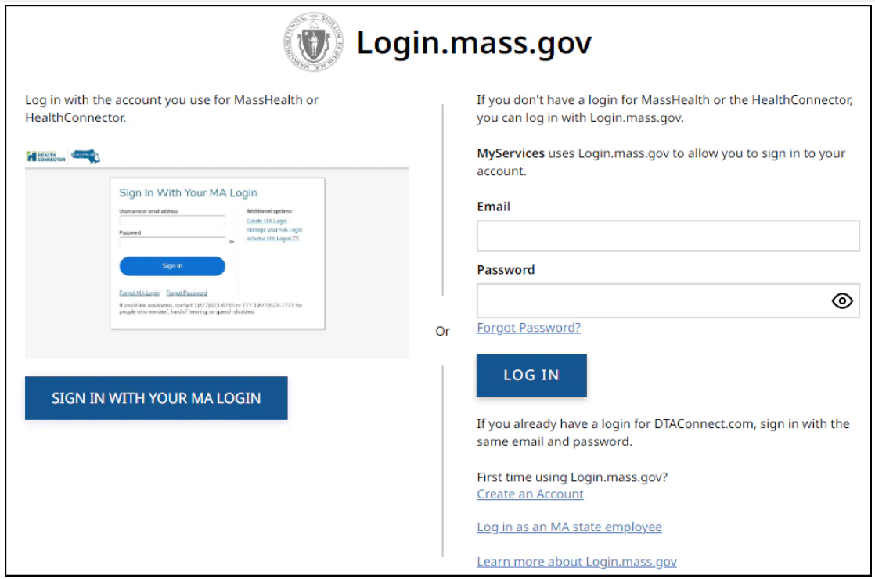
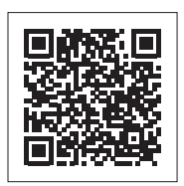
MyServices Portal
MyServices is a web portal designed for all applicants and members. With this portal, applicants and members can review:
  Demographic information
  Eligibility status
  MassHealth enrollment information
  Notices MassHealth sent
  Receive alerts about important events and actions to take
Website is translated in six languages: English, Spanish, Brazilian Portuguese, Traditional Chinese, Vietnamese, and Haitian Creole

Slide 27
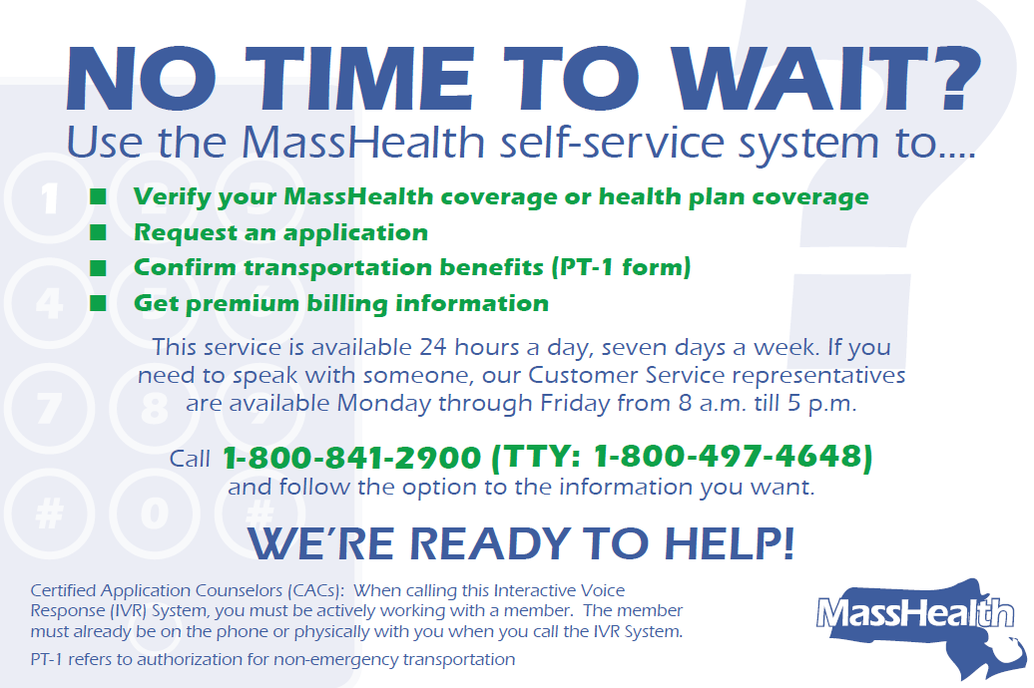
MassHealth Self-Service System

Slide 28
Appendix – List of Community Partners, Affiliated Partners, and Service Areas

Slide 29
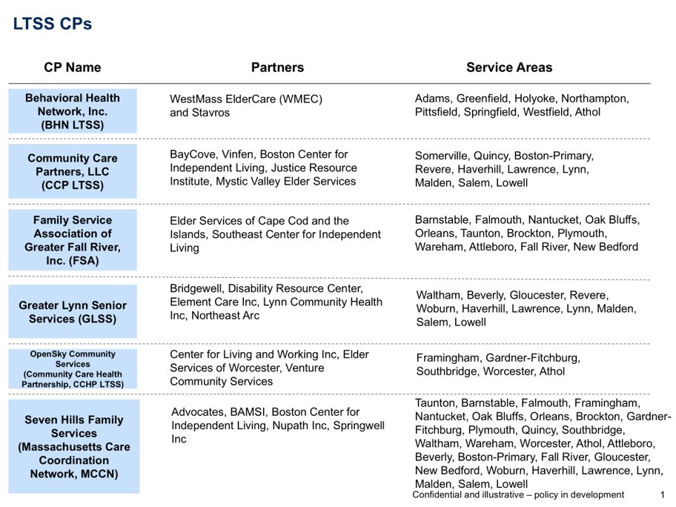

Slide 30
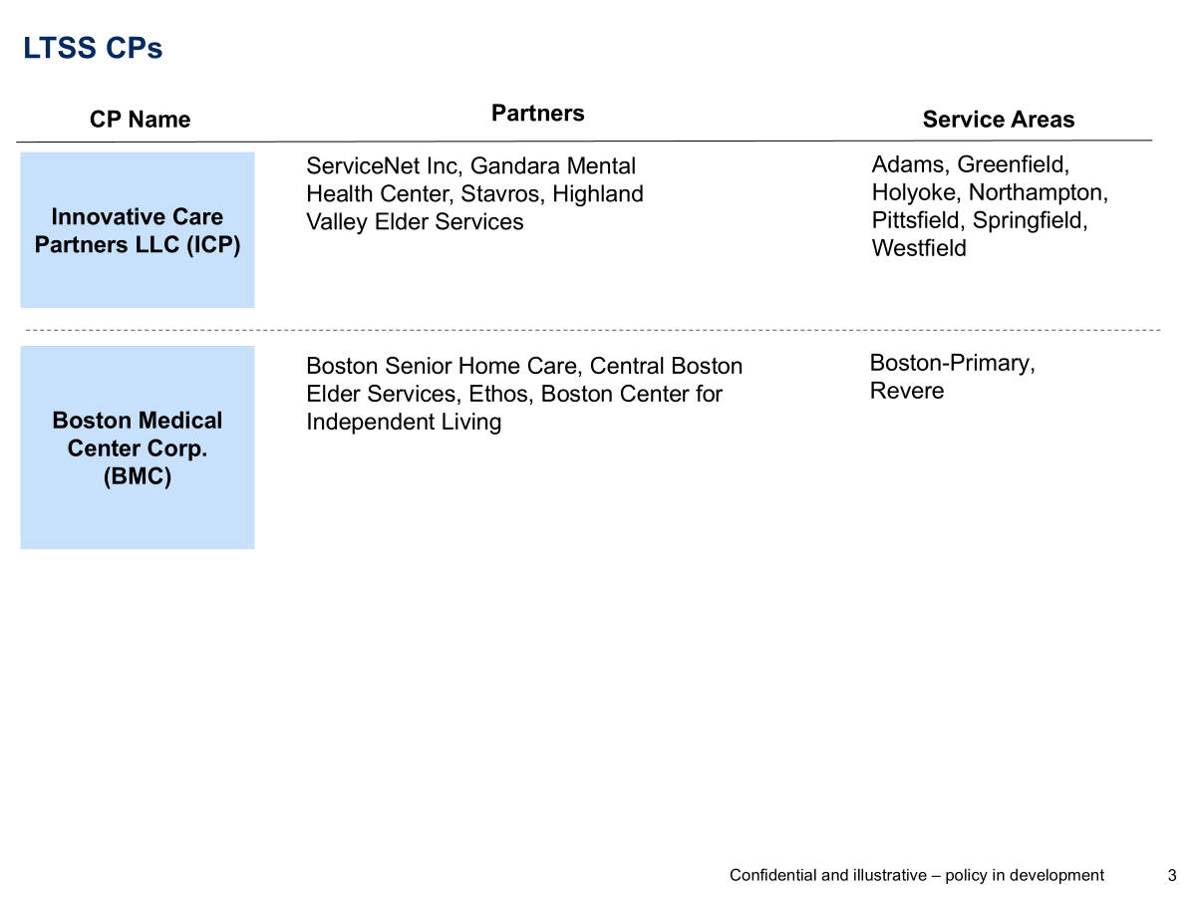

Slide 31
BH CPs
CP Name
Partners
Service Areas
Boston Health Care for the Homeless Program, Inc. (BHCHP)
Boston Medical Center, Boston Public Health Commission, Casa Esperanza, Massachusetts Housing and Shelter Alliance, New England Center and Home for Veterans, Pine St. Inn, St. Francis House and Victory Programs
Boston-Primary
Behavioral Health Network
(BHN BH)
N/A
Holyoke, Springfield, Westfield
Clinical and Support Options, Inc. (CSO)
N/A
Athol, Gardner-Fitchburg, Greenfield, Northampton, Pittsfield, Springfield
Community Counseling of Bristol County (CCBC)
N/A
Attleboro, Brockton, Fall River, New Bedford, Plymouth, Quincy, Taunton, Wareham
The Brien Center (Brien)
N/A
Adams, Pittsfield
The Bridge of Central MA
(Community Care Health Partnership, CCHP BH)
Venture Community Services; Elder Services of Worcester Area, Center for Living and Working.
Athol, Framingham, Gardner-Fitchburg, Southbridge, Worcester

Slide 32
BH CPs
CP Name
Partners
Service Areas
Behavioral Health Partners of MetroWest (BPHMW)
Advocates; Southern Middlesex Opportunity Council; Spectrum Health Systems; Wayside Youth and Family Support Network
Beverly, Framingham, Gardner-Fitchburg, Gloucester, Haverhill, Lawrence, Lynn, Lowell, Salem, Southbridge, Waltham, Woburn, Worcester
Stanley Street Treatment & Resources Inc (SSTAR)
Fairwinds-Nantucket’s Counseling Center; Elwyn Adult Behavioral Health Services; Martha’s Vineyard Community Services
Attleboro, Barnstable, Brockton, Fall River, Falmouth, Nantucket, New Bedford, Oak Bluffs, Orleans, Plymouth, Taunton, Wareham
Community Care Partners, LLC (CCP)
BayCove, Vinfen
Attleboro, Barnstable, Boston-Primary, Brockton, Fall River, Falmouth, Haverhill, Lawrence, Lowell, Malden, New Bedford, Orleans, Plymouth, Quincy, Revere, Salem, Somerville Taunton, Wareham
Riverside Community Care, Inc. (Riverside)
Bay State Community Services, Inc.; The Edinburg Center; North Suffolk Community Services; Uphams Community Care
Attleboro, Boston-Primary, Brockton, Framingham, Lynn, Malden, Quincy, Revere, Somerville, Southbridge, Waltham, Woburn
Eliot Community Human Services, Inc. (Eliot)
N/A
Beverly, Boston-Primary, Gloucester, Haverhill, Lawrence, Lowell, Lynn, Malden, Quincy, Revere, Salem, Somerville, Waltham, Woburn
Innovative Care Partners (ICP)
ServiceNet Inc, Gandara Mental Health Center, Stavros, Highland Valley Elder Services, Center for Human Development
Athol, Adams, Greenfield, Holyoke, Northampton, Springfield, Westfield

Slide 33
Community Partners Program
Behavioral Health (BH) CPs:
Behavioral Health Network Inc.
Behavioral Health Partners of MetroWest
Boston Health Care for the Homeless Program, Inc.
The Brien Center
Clinical and Support Options, Inc.
Community Care Partners, LLC
Community Counseling of Bristol County
Eliot Community Human Services, Inc.
Innovative Care Partners LLC
The Bridge of Central Massachusetts, Inc. (DBA OpenSky Community Services)
Riverside Community Care, Inc.
Stanley Street Treatment and Resources, Inc.
Long-Term Services and Supports (LTSS) CPs:
Behavioral Health Network, Inc.
Boston Medical Center Corp.
Community Care Partners, LLC
Family Service Association of Greater Fall River, Inc.
Greater Lynn Senior Services (DBA North Region LTSS Partnership)
Innovative Care Partners LLC
OpenSky Community Services
Seven Hills Family Services (DBA Massachusetts Care Coordination Network)

Slide 34
Appendix – List of Accountable Care Organizations and Managed Care Organizations

Slide 35
Accountable & Managed Care Organizations Participating in the CP Program
Community Care Cooperative (C3)
Fallon Health-Atrius Health Care Collaborative
Berkshire Fallon Health Collaborative
Fallon 365 Care
Mass General Brigham ACO
Revere Health Choice
Tufts Health Together with Cambridge Health Alliance (Tufts CHA)
Tufts Health Together with UMass Memorial Health (Tufts UMMH)
Tufts Health Together MCO
East Boston Neighborhood Health WellSense Alliance
WellSense Care Alliance
WellSense Community Alliance
WellSense Boston Children’s ACO (note: partnered with the LTSS CP Program ONLY)
WellSense BILH Performance Network ACO
WellSense Mercy Alliance
WellSense Signature Alliance
WellSense Southcoast Alliance
WellSense Essential MCO

