Slide 1
MassHealth Services for People in Need of Behavioral Health Support

Slide 2
What Behavioral Health Servies does MassHealth Cover?
Mental Health (& Substance Use Disorder) | Substance Use Disorder
Outpatient Services Outpatient behavioral health services Community Behavioral Health Centers (CBHC) Behavioral Health Urgent Care Intensive outpatient treatment Partial hospitalization and day treatment programs Overnight Services Inpatient psychiatric care 24-hr diversionary care settings | Outpatient Services Outpatient care (including Medication Assisted Treatment (MAT)) Intensive outpatient programs Day treatment programs Recovery support navigators and recovery coaches Overnight Services Acute treatment services (detox programs) Clinical stabilization services
Finding BH Providers
Behavioral Health Help Line (BHHL) The Massachusetts Behavioral Health Access (MABHA) website helps both providers and individuals locate openings in mental health and substance use disorder services: https://www.mabhaccess.com/ Massachusetts Behavioral Health Partnership: Find a Behavioral Health Provider: https://providers.masspartnership.com/member/FindBHProvider.aspx

Slide 3
MassHealth Service Access Options Most Helpful to People Experiencing Homelessness
  Though there are a variety of services that people experiencing homelessness are eligible for, some are more accessible and more tailored to the needs of this population.
Community Behavioral Health Centers | Community Mental Health Centers | Behavioral Health Urgent Care | Community Partners | Behavioral Health Helpline | Community Support Program
Mobile crisis intervention 24/7/365 for youth and adults 24 h crisis stabilization for youth and adults Provide access to psychopharmacology for BH and SUD Connects to resources for peer and family supports | Diagnostic services Psychological testing Short- and long-term therapy, including individual, group, couple, and family therapy Medication visits | Provide integrated behavioral health services more urgently and with extended hours than traditional clinics | Care Coordination (including across state agencies) Social Determinants of Health Resources Navigation | Provides warm handoffs to immediate crisis intervention, urgent, & routine services Resources for other needs such as transportation, childcare, and food | Resource navigation Referrals to transportation services, community-based resources, and more Crisis planning
Non-exhaustive, for demonstrative purposes only

Slide 4
Historical and Structural Challenges in Behavioral Health
  The Commonwealth has implemented recent legislation, policy reforms, and substantial public investment, despite these efforts further improvement is needed.
  In statewide listening sessions, nearly 700 individuals, families, and others identified challenges and gaps in the behavioral health system:
  Too many people struggle to find the right type of behavioral health treatment and clinical provider that accepts their insurance.
  Too often hospital emergency rooms are the entry point into seeking behavioral health treatment.
  Individuals often can’t get mental health and addiction treatment at the same location, even though mental health conditions and substance use disorder (SUD) often co-occur.
  Culturally competent behavioral health care for racially, ethnically and linguistically diverse communities can be difficult to find.
  These longstanding challenges were exacerbated by the pandemic.

Slide 5

The “Front Door” to Behavioral Health Care
  The new Roadmap for Behavioral Health Reform improved access to care across the treatment system. Individuals now have a centralized “front door” to treatment through the Behavioral Health Help Line, with several other entry points that support evaluation, stabilization and triage.
System Entry Points
Behavioral Health Help Line (BHHL)
Inpatient/24-hr Acute care
Community Behavioral Health Center (CBHC)
24-hr diversionary levels of care
Outpatient & Behavioral Health Urgent Care (BHUC)
Integrated Primary Care (PCP)
Other community-based care
Emergency Department (ED)
Non-exhaustive, for demonstrative purposes only

Slide 6

Behavioral Health Help Line (BHHL)
  The Help Line connects people directly to clinical help, anytime 24/7 through a chat or a phone line. Trained clinicians can help people find the treatment they need, including crisis support.
masshelpline.com | 833-773-2445 (BHHL)
Free and available to anyone in the Commonwealth of Massachusetts
Live interpretation in 200+ languages, with resources for deaf & hard of hearing
Provides warm handoffs to immediate crisis intervention, urgent, & routine services
Resources for other needs such as transportation, childcare,
and food
Call, text, or chat to access treatment, 24/7/365

Slide 7








Behavioral Health Help Line: Key Elements
Clinical assessment and triage
Formalized assessment tool supports appropriate triage pathway
Rapid determination of immediate crisis
& completion of appropriate handoff
Multi-channel access
Available 24/7/365
Multi-lingual live response
Phone, Text, Chat
Includes informative website
Knowledgeable clinical team
MA & BA clinicians, Peer Specialists
Expertise in appropriate crisis identification & action, de-escalation, & stabilization
Consistent Follow Up
Process to ensure Individual is successfully connecting with the right services
Within 48 hours for crisis handoffs
Within 14 days for outpatient referrals
Referral match & warm handoff
Staff search for & identify providers with appropriate expertise
Warm handoff to referring provider whenever possible and appropriate

Slide 8
Community Behavioral Health Centers
A community location where a person’s needs for mental health and substance use can be assessed, crisis and urgent services provided, and ongoing care is available and/or referred elsewhere as needed. People can access crisis services 24/7 and get real-time urgent care.
Each CBHC must offer the following services:
Adult CBHC
core services
Youth CBHC core services
Community Behavioral Health Centers (CBHC)
Note: YCCS is a regional model program. A CBHC either provides YCCS services directly or has pathways in place to refer a Member to another YCCS services within their region.
  Adult Mobile Crisis Intervention (AMCI)
  Adult Community Crisis Stabilization (ACCS)
Youth Mobile Crisis Intervention services (YMCI)
Youth Community Crisis Stabilization (YCCS)

Slide 9
Community Behavioral Health Centers: The Basics
Combine mobile crisis teams, crisis stabilization, and outpatient and urgent care for mental health and substance use
Mobile crisis intervention is available 24/7/365 to anyone and can be provided in the community, clinic, or via telehealth
24-hr crisis stabilization services are available for both youth and adults
Provides same or next day access to evaluation and assessment, psychopharmacology, and MAT initiation services
Outpatient services include acute therapy using evidence-based practices that are tailored to the client’s specific needs
Connects to resources for additional supports including peer and family supports

Slide 10
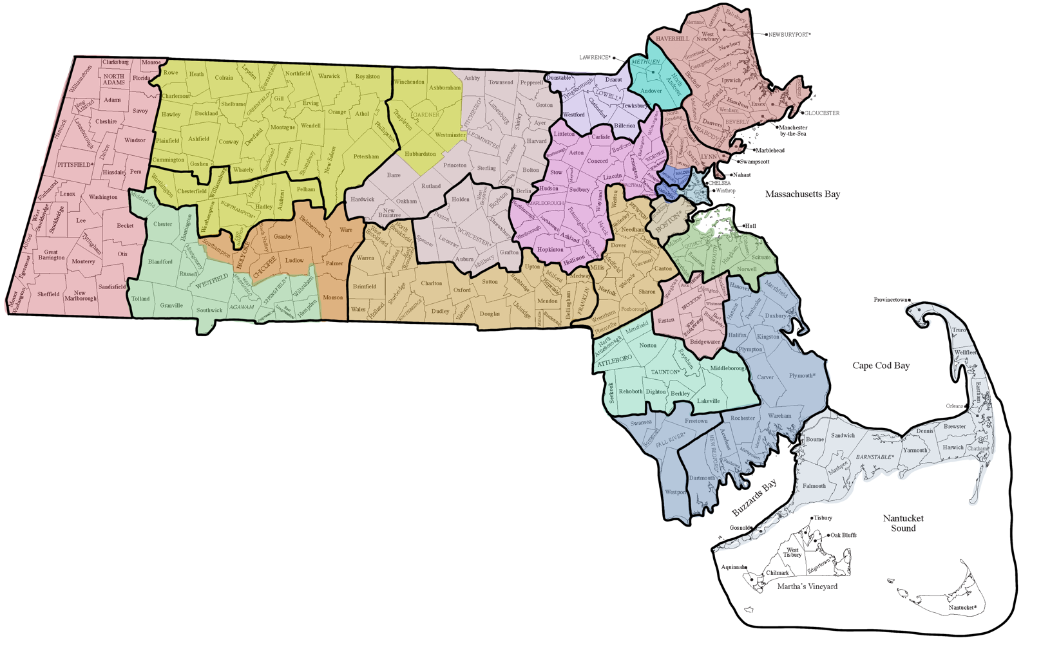

Community Behavioral Health Centers and their catchment areas
https://www.mass.gov/community-behavioral-health-centers
Community HealthLink
BILH Behavioral Services
The Brien Center
Clinical Support Options
Clinical Support Options
Advocates
Vinfen
NORTH ESSEX
Eliot Community Human Services
LAWRENCE
GREENFIELD
NORTH COUNTY
LOWELL
TRI-CITY
Cambridge Health Alliance
THE BERKSHIRES
METRO WEST
NORTHAMPTON
BOSTON/CAMBRIDGE/SOMERVILLE
WORCESTER
North Suffolk Mental Health Assoc.
Boston Medical Center
NORWOOD
SOUTH SHORE
Aspire Health Alliance
SOUTHERN PIONEER
High Point Treatment Center
SOUTH COUNTY
BROCKTON
Center for Human Development
Behavioral Health Network
Community HealthLink
Riverside Community Care
Child and Family Services
TAUNTON, ATTLEBORO
Community Counseling of Bristol County
SOUTHERN COAST
Bay Cove Human Services
FALL RIVER
Child and Family Services
CAPE COD & THE ISLANDS
Fairwinds
Martha's Vineyard Community Services

Slide 11
Community Mental Health Centers (CMHC)
  Community Mental Health Centers (CMHC)s deliver comprehensive diagnostic and psychotherapeutic treatment services to people with behavioral health disorders and their families. A CMHC must have services available to treat a wide range of mental and emotional disorders and it must provide comprehensive diagnostic assessments for a wide range of problems.
Services | Access and Eligibility
Diagnostic services Psychological testing Short- and long-term therapy, including individual, group, couple, and family therapy Medication visits Psychotherapy for crisis/emergency services | Serve all Massachusetts residents, including those who are uninsured and/or have limited insurance
Non-exhaustive, for demonstrative purposes only

Slide 12
Behavioral Health Urgent Care (BHUC)
  Behavioral Health Urgent Care (BHUC)s are Mental Health Centers that provide integrated mental health and addiction services more urgently and with extended hours than traditional clinics. MassHealth members with urgent behavioral health needs can be seen at a BH Urgent Care site. An “urgent BH need” may include changes in behavior or thoughts that cause distress and require immediate support through psychiatric evaluation or therapy.
Services | Access and Eligibility
BH Urgent Care gives members non-emergency access to more treatment services when and where them need them A same or next day evaluation Psychopharmacology appointments and addiction medication evaluation within 72 hours of an initial evaluation All other treatment appointments, including follow-up appointments, within 14 calendar days Behavioral Health Urgent Care sites also offer extended hours on weekdays, as well as weekend hours. Diagnostic services & Psychological testing Short- and long-term therapy, including individual, group, couple, and family therapy Medication visits Psychotherapy for crisis/emergency services | Serve all Massachusetts residents, including those who are uninsured and/or have limited insurance There are ~70 BHUCs across the state

Slide 13
Recovery coaches (RC) and recovery support navigators (RSN)
  Recovery coaches (RC) and recovery support navigators (RSN): As people who have experienced SUD recovery, RCs are in a unique position to serve as recovery guides and role models. They provide nonjudgemental problem solving, navigation, and advocacy to help members meet their recovery goals.
Recovery Coach | Recovery Support Navigators
Individuals currently in recovery who have lived experience with addiction and/or co-occurring mental health disorders and have been trained to help their peers with a similar experience. They provide emotional and social support by: Developing a "wellness plan" with the member Making at least five connections with the member over a 30-day period Eligibility: Have a diagnosis of substance use disorder and/or co-occurring mental health disorders and must be "attempting to achieve and/or maintain recovery" Sources: MassHealth Recovery Coach and Recovery Support Navigator Services | Bachelor's level paraprofessional who provides care management and system navigation and support MassHealth members in accessing treatment services and community resources Can help with: Accessing treatment services Finding a residential bed Facilitating warm hand-offs upon referral to other services and supports Navigating insurance issues Eligibility: Have a diagnosis of substance use disorder and/or co-occurring mental health disorders and are in need of further facilitation
Non-exhaustive, for demonstrative purposes only

Slide 14
Community Support Program (CSP)
  Community Support Program (CSP) is part of a larger organization that provides behavioral health services and is licensed within the state of Massachusetts. CSPs provide services to members with mental health or SUD diagnoses, delivered by community-based staff.
Services | Eligibility and Access
Resource Navigation Assist with obtaining benefits, housing, and healthcare and linking members with support and services Transportation Provide referrals for community-based transportation resources to and from medical and behavioral health appointments Crisis Planning Collaborating with providers to develop crisis prevention or safety plans | The CSPs have an open-referral program; initial intake and referral forms can be sent to CSP providers Once a client is accepted into a program, an employee will initiate contact within 24 hours of the approved referral
Non-exhaustive, for demonstrative purposes only

Slide 15

Community Partners Program 2023-2027
February 2025

Slide 16
What is the Community Partners Program?
The Community Partners (CP) Program is a program for community-based organizations contracted by MassHealth to provide enhanced Care Coordination to MassHealth Members with complex needs enrolled in Accountable Care Organizations (ACOs), Managed Care Organizations (MCOs), or with the Department of Mental Health (DMH).
There are two types of CPs:
  Behavioral Health Community Partners (BH CPs)
    Responsible for care management and coordination for members with significant BH needs, including Serious Mental Illness or Substance Use Disorders
    Program may support up to 26,000 ACO/MCO Members
    Supporting Members Ages 18-64
  Long-Term Services and Supports Community Partners (LTSS CPs)
    Responsible for care management and coordination for Members with complex LTSS needs
    Program may support up to 9,000 ACO/MCO Members
    Supporting Members Ages 3-64
ACO and MCO members should contact their health plan for additional information about the CP program. For patients enrolled in the Department of Mental Health Adult Community Clinical Services (ACCS) program, you may contact the patient's ACCS site office to initiate referral into the CP Program. If the patient already receives services from a provider that is also a Community Partner, you can request their assistance with referrals into the CP Program.

Slide 17


CP Supports
The CP Program utilizes a comprehensive care model (CP Supports). CPs are responsible for holistic care coordination and serve as the lead care coordination entities. Both types of CPs can provide both categories of services (for example, an LTSS CP connecting their enrollee to BH services). Placement in either a BH or and LTSS CP depends on which need(s) are more significant for the Member.
Eligible Individual
+
CP Staff
Outreach and engagement
Care coordination and care management
Connections to
Options Counseling
Comprehensive Assessment and HRSN screening
Support for Transitions of Care
Health and wellness coaching
Ongoing Care Planning
Medication review
Connection to social services and community resources

Slide 18
Appendix

Slide 19







Public Materials
  EOHHS created a Behavioral Health Roadmap Toolkit which includes pre-made marketing materials and key information about Massachusetts’ newest behavioral health services.
  Overview of the BH Roadmap for Reform
  https://www.mass.gov/bhroadmap
  Printable informational and promotional materials
  https://www.mass.gov/info-details/printable-materials-behavioral-health-roadmap
  Social media materials
  https://www.mass.gov/info-details/social-media-materials-behavioral-health-roadmap
  List of CBHCs in Massachusetts, filterable by zip code
  https://www.mass.gov/community-behavioral-health-centers/locations
  Fact sheets and FAQs about the Behavioral Health Helpline and CBHCs
  https://www.mass.gov/info-details/fact-sheets-behavioral-health-roadmap
  Information on 988
  https://www.mass.gov/988
  Questions can be sent to
  MassHealthOBHQuestions@mass.gov
  Any stakeholder can order free printed materials here: https://massclearinghouse.ehs.state.ma.us/category/BehavioralHealth.html
  Anyone can order free printed materials here: https://massclearinghouse.ehs.state.ma.us/category/BehavioralHealth.html

Slide 20
Crisis System Restructuring to Improve Access to Behavioral Health Services
  The Behavioral Health Roadmap seeks to streamline access to crisis services, including providing more options for treatment in community settings.
  Universal access to a Behavioral Health Help Line and mobile crisis intervention, allowing for increased access to treatment in community settings.
  New requirement for acute hospitals with EDs to staff EDs sufficiently to conduct behavioral health crisis evaluations, freeing up mobile crisis intervention teams to conduct more crisis evaluations in community settings.
  Community Behavioral Health Centers (CBHCs) with additional medical capabilities to appropriately screen individuals for medical risk so that more people can be safely treated for their behavioral health needs without going through an ED.
  EOHHS is working collaboratively with inpatient psychiatric hospitals to facilitate direct admissions from CBHCs for individuals found to be at low medical risk.
  Payments to acute hospitals to support provision of additional behavioral health supports to individuals experiencing an ongoing behavioral health crisis.
  Multi-year inpatient psychiatric payment reform moving toward acuity-based payment methodology.

Slide 21
Easier, more convenient access to behavioral health services in MA
Behavioral Health Help Line (BHHL)
(833) 773-BHHL
Community Behavioral Health Centers (CBHC)
www.mass.gov/CBHCs
All ages.
Mental health and addictions.
Multi-lingual live response.
Call, text, chat.
24/7/365.
No insurance necessary.
All ages.
Mental health and addictions.
Crisis identification and action when needed:
  Dispatch Mobile Crisis Intervention.
  911 connection when needed.
  Follow-up within 48 hours.
Clinical assessment, triage and warm handoff to a provider with appropriate expertise.
Follow-up to ensure connection is made.
Mobile Crisis Intervention
24/7/365.
No insurance necessary for initial evaluation.
At your home or other community location.
At the CBHC.
Clinical assessment, de-escalation, safety planning and triage.
Urgent & ongoing clinic services
Available to all MassHealth members and may be available through commercial insurance.
Same day evaluation, assessment, group therapy, peer support.
Same or next day appointments, including psychopharmacology and medication for addiction treatment.
Care coordination and referral to needed services.
Extended hours:
8 AM – 8 PM weekdays
9 AM -- 5 PM weekends
Adult & Youth Community Crisis Stabilization
24-hour diversionary level of care for individuals in crisis who don’t need inpatient level of care.
Available to all MassHealth members and available through some commercial insurance
Behavioral Health Urgent Care (BH UC)
Available to all MassHealth members and may be available through commercial insurance.
Same/next day appointments for diagnostic evaluation for new clients and urgent appointments for existing clients.
Urgent psychopharmacology, medication for addiction treatment evaluation.
Non-urgent appointments within 2 weeks.
Extended hours.
www.mass.gov/BHroadmap

Slide 22
CBHC Providers and Catchment Areas (1 of 2)
Region | Organization | Catchment Area
Central | Advocates | Acton, Ashland, Arlington, Bedford, Belmont, Boxborough, Burlington, Carlisle, Concord, Framingham, Holliston, Hopkinton, Hudson, Lexington, Lincoln, Littleton, Maynard, Marlborough, Natick, Northborough, Sherborn, Southborough, Stow, Sudbury, Waltham, Watertown, Wayland, Westborough, Wilmington, Winchester, and Woburn
 | Community HealthLink | Ashby, Ayer, Barre, Berlin, Bolton, Clinton, Fitchburg, Groton, Hardwick, Harvard, Lancaster, Leominster, Lunenburg, New Braintree, Oakham, Pepperell, Princeton, Rutland, Shirley, Sterling, and Townsend Auburn, Boylston, Grafton, Holden, Leicester, Millbury, Paxton, Shrewsbury, Spencer, West Boylston, and Worcester
 | Riverside Community Care | Bellingham, Blackstone, Brimfield, Brookfield, Charlton, Douglas, Dudley, East Brookfield, Franklin, Holland, Hopedale, Medway, Mendon, Milford, Millville, Northbridge, North Brookfield, Oxford, Southbridge, Sturbridge, Sutton, Upton, Uxbridge, Wales, Warren, Webster, and West Brookfield
 | Clinical Support Options | Ashburnham, Gardner, Hubbardston, Templeton, Westminster, and Winchendon
Southeast​ | High Point​ | Abington, Avon, Bridgewater, Brockton, East Bridgewater, Easton, Holbrook, Rockland, Stoughton, West Bridgewater, and Whitman​
 | Child and Family Services​ | Acushnet, Carver, Dartmouth, Duxbury, Fairhaven, Halifax, Hanover, Hanson, Kingston, Marion, Marshfield, Mattapoisett, New Bedford, Pembroke, Plymouth, Plympton, Rochester, and Wareham​ ​ Fall River, Freetown, Somerset, Swansea, and Westport​
 | Community Counseling of Bristol County​ | Attleboro, Berkley, Dighton, Lakeville, Mansfield, Middleborough, North Attleboro, Norton, Raynham, Rehoboth, Seekonk, and Taunton​
 | Bay Cove Human Services​ | Barnstable, Bourne, Brewster, Chatham, Chilmark, Cotuit, Dennis, Eastham, Falmouth, Harwich, Hyannis, Mashpee, Orleans, Osterville, Provincetown, Sandwich, Truro, Wellfleet, Woods Hole, and Yarmouth​
 | Fairwinds Center​ | Nantucket​

Slide 23
CBHC Providers and Catchment Areas (2 of 2)
Region | Organization | Catchment Area
Metro Boston | Cambridge Health Alliance | Cambridge, Somerville, Everett, Malden, and Medford
 | North Suffolk Mental Health Association | Chelsea, Revere, East Boston, Winthrop, and Charlestown
 | Boston Medical Center | Boston, Brighton, and Brookline
 | Riverside Community Care | Canton, Dedham, Dover, Foxboro, Medfield, Millis, Needham, Newton, Norfolk, Norwood, Plainville, Sharon, Walpole, Wellesley, Weston, Westwood, and Wrentham
 | Aspire Health Alliance | Braintree, Cohasset, Hingham, Hull, Milton, Norwell, Quincy, Randolph, Scituate, and Weymouth
Western | Clinical Support Options | Amherst, Chesterfield, Cummington, Easthampton, Florence, Goshen, Hadley, Hatfield, Middlefield, Northampton, Pelham, Plainfield, Westhampton, Williamsburg, and Worthington Ashfield, Athol, Bernardston, Buckland, Charlemont, Colrain, Conway, Deerfield, Erving, Gill, Greenfield, Hawley, Heath, Leverett, Leyden, Millers Falls, Montague, New Salem, Northfield, Orange, Petersham, Phillipston, Rowe, Royalston, Shelburne, Shutesbury, Sunderland, Turners Falls, Warwick, Wendell, and Whately
 | Behavioral Health Network | Agawam, Blandford, Chester, East Longmeadow, Granville, Hampden, Huntington, Indian Orchard, Longmeadow, Montgomery, Russell, Southwick, Springfield, Tolland, Westfield, West Springfield, and Wilbraham
 | Center for Human Development | Belchertown, Bondsville, Chicopee, Granby, Holyoke, Ludlow, Monson, Palmer, South Hadley, Southampton, Thorndike, Three Rivers, and Ware
 | The Brien Center | Adams, Alford, Becket, Cheshire, Clarksburg, Dalton, Egrement, Florida, Great Barrington, Hancock, Hinsdale, Lanesboro, Lee, Lenox, Monroe, Monterey, Mount Washington, New Ashford, New Marlboro, North Adams, Otis, Peru, Pittsfield, Richmond, Sandisfield, Savoy, Sheffield, Stockbridge, Tyringham, Washington, West Stockbridge, Williamstown, and Windsor
Northeast | Beth Israel Lahey Health BH Services | Andover, Lawrence, Methuen, and North Andover
 | Vinfen | Billerica, Chelmsford, Dracut, Dunstable, Lowell, Tewksbury, Tyngsboro, and Westford
 | Eliot Community Human Services | Lynn, Lynnfield, Melrose, Nahant, North Reading, Reading, Saugus, Stoneham, Swampscott, and Wakefield Amesbury, Beverly, Boxford, Danvers, Essex, Georgetown, Gloucester, Groveland, Hamilton, Haverhill, Ipswich, Manchester by the Sea, Marblehead, Merrimac, Middleton, Newbury, Newburyport, Peabody, Rockport, Rowley, Salem, Salisbury, Topsfield, Wenham, and West Newbury

Slide 24
Appendix – List of Community Partners, Affiliated Partners, and Service Areas

Slide 25
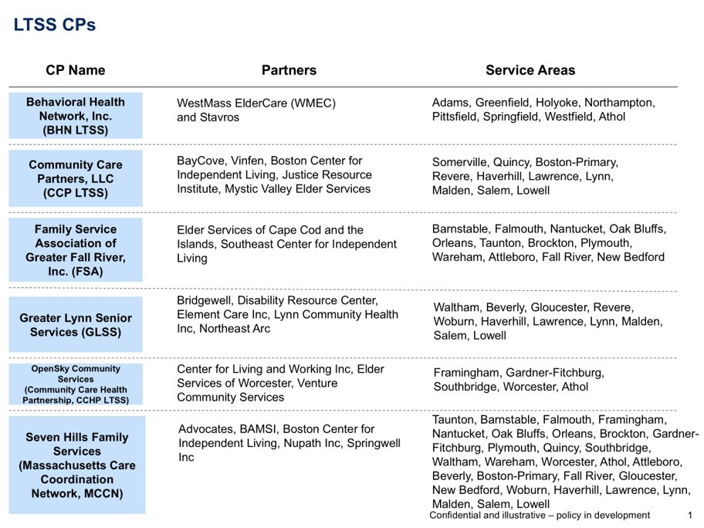

Slide 26
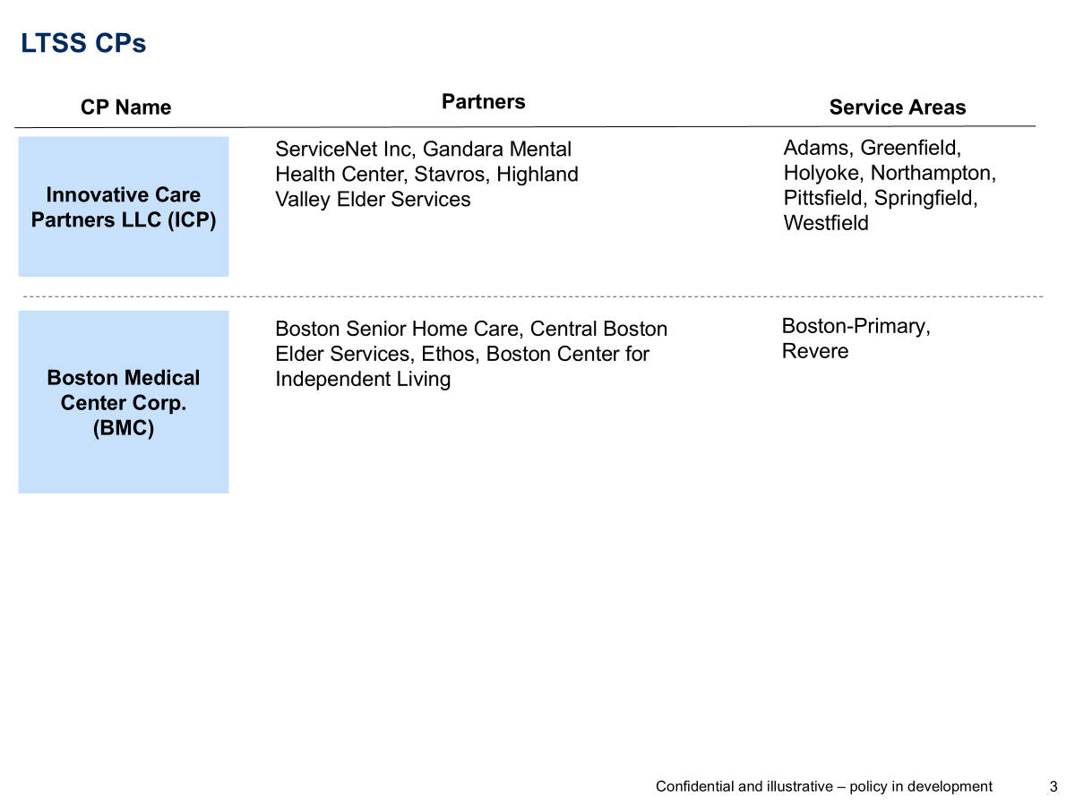

Slide 27
BH CPs
CP Name
Partners
Service Areas
Boston Health Care for the Homeless Program, Inc. (BHCHP)
Boston Medical Center, Boston Public Health Commission, Casa Esperanza, Massachusetts Housing and Shelter Alliance, New England Center and Home for Veterans, Pine St. Inn, St. Francis House and Victory Programs
Boston-Primary
Behavioral Health Network
(BHN BH)
N/A
Holyoke, Springfield, Westfield
Clinical and Support Options, Inc. (CSO)
N/A
Athol, Gardner-Fitchburg, Greenfield, Northampton, Pittsfield, Springfield
Community Counseling of Bristol County (CCBC)
N/A
Attleboro, Brockton, Fall River, New Bedford, Plymouth, Quincy, Taunton, Wareham
The Brien Center (Brien)
N/A
Adams, Pittsfield
The Bridge of Central MA
(Community Care Health Partnership, CCHP BH)
Venture Community Services; Elder Services of Worcester Area, Center for Living and Working.
Athol, Framingham, Gardner-Fitchburg, Southbridge, Worcester

Slide 28
BH CPs
CP Name
Partners
Service Areas
Behavioral Health Partners of MetroWest (BPHMW)
Advocates; Southern Middlesex Opportunity Council; Spectrum Health Systems; Wayside Youth and Family Support Network
Beverly, Framingham, Gardner-Fitchburg, Gloucester, Haverhill, Lawrence, Lynn, Lowell, Salem, Southbridge, Waltham, Woburn, Worcester
Stanley Street Treatment & Resources Inc (SSTAR)
Fairwinds-Nantucket’s Counseling Center; Elwyn Adult Behavioral Health Services; Martha’s Vineyard Community Services
Attleboro, Barnstable, Brockton, Fall River, Falmouth, Nantucket, New Bedford, Oak Bluffs, Orleans, Plymouth, Taunton, Wareham
Community Care Partners, LLC (CCP)
BayCove, Vinfen
Attleboro, Barnstable, Boston-Primary, Brockton, Fall River, Falmouth, Haverhill, Lawrence, Lowell, Malden, New Bedford, Orleans, Plymouth, Quincy, Revere, Salem, Somerville Taunton, Wareham
Riverside Community Care, Inc. (Riverside)
Bay State Community Services, Inc.; The Edinburg Center; North Suffolk Community Services; Uphams Community Care
Attleboro, Boston-Primary, Brockton, Framingham, Lynn, Malden, Quincy, Revere, Somerville, Southbridge, Waltham, Woburn
Eliot Community Human Services, Inc. (Eliot)
N/A
Beverly, Boston-Primary, Gloucester, Haverhill, Lawrence, Lowell, Lynn, Malden, Quincy, Revere, Salem, Somerville, Waltham, Woburn
Innovative Care Partners (ICP)
ServiceNet Inc, Gandara Mental Health Center, Stavros, Highland Valley Elder Services, Center for Human Development
Athol, Adams, Greenfield, Holyoke, Northampton, Springfield, Westfield

Slide 29
Community Partners Program
Behavioral Health (BH) CPs:
Behavioral Health Network Inc.
Behavioral Health Partners of MetroWest
Boston Health Care for the Homeless Program, Inc.
The Brien Center
Clinical and Support Options, Inc.
Community Care Partners, LLC
Community Counseling of Bristol County
Eliot Community Human Services, Inc.
Innovative Care Partners LLC
The Bridge of Central Massachusetts, Inc. (DBA OpenSky Community Services)
Riverside Community Care, Inc.
Stanley Street Treatment and Resources, Inc.
Long-Term Services and Supports (LTSS) CPs:
Behavioral Health Network, Inc.
Boston Medical Center Corp.
Community Care Partners, LLC
Family Service Association of Greater Fall River, Inc.
Greater Lynn Senior Services (DBA North Region LTSS Partnership)
Innovative Care Partners LLC
OpenSky Community Services
Seven Hills Family Services (DBA Massachusetts Care Coordination Network)

Slide 30
Appendix – List of Accountable Care Organizations and Managed Care Organizations

Slide 31
Accountable & Managed Care Organizations Participating in the CP Program
Community Care Cooperative (C3)
Fallon Health-Atrius Health Care Collaborative
Berkshire Fallon Health Collaborative
Fallon 365 Care
Mass General Brigham ACO
Revere Health Choice
Tufts Health Together with Cambridge Health Alliance (Tufts CHA)
Tufts Health Together with UMass Memorial Health (Tufts UMMH)
Tufts Health Together MCO
East Boston Neighborhood Health WellSense Alliance
WellSense Care Alliance
WellSense Community Alliance
WellSense Boston Children’s ACO (note: partnered with the LTSS CP Program ONLY)
WellSense BILH Performance Network ACO
WellSense Mercy Alliance
WellSense Signature Alliance
WellSense Southcoast Alliance
WellSense Essential MCO

