Slide 1
MassHealth Eligibility Overview
April 28, 2022

Slide 2
Agenda
MassHealth Mission Statement
MassHealth Eligibility Requirements
Universal Requirements
Citizenship/Immigration
Categorical
MassHealth Coverage Types
Information is current as of 04.08.2022

Slide 3
MassHealth Mission Statement
“To improve the health outcomes of our diverse members and their families by providing access to integrated health care services that promote sustainable & equitable health, well-being, independence and quality of life.”
Information is current as of 04.08.2022

Slide 4
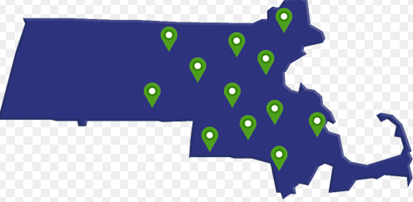
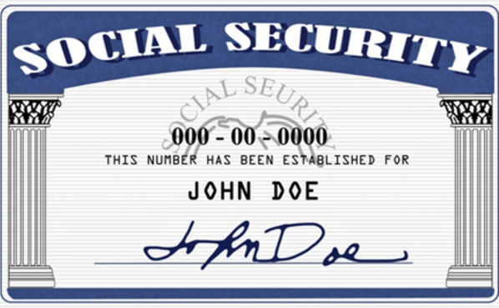
Universal Requirements
Residency and Income
Social Security Number (SSN)
Assignment of Rights to Medical Support and Third-Party Payments
Assignment of Third-Party Recoveries
Potential Sources of Health Care
Utilization of Potential Benefits
Information is current as of 04.08.22

Slide 5
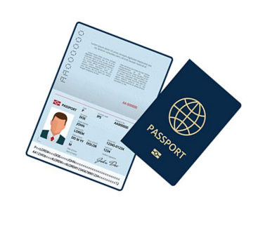
Citizenship/Immigration Status
Citizens
Lawfully Present Immigrants
Qualified Noncitizen
Qualified Noncitizen Barred
Nonqualified Individuals Lawfully Present
Nonqualified PRUCOLS
Other Noncitizens
Protected Noncitizens
Information is current as of 04.08.22

Slide 6
Categorical Eligibility
Parent
Caretaker Relative
Adults without Children (21 – 64)
Young Adults (19-20)
Children (through age 18)
Pregnant Women
Adults 65 and older
Disabled Individuals
Individuals who are HIV+
Individuals with Breast or Cervical Cancer (BCC)
Individuals who are Medically Frail
Independent Foster Care Adolescents
Information is current as of 04.08.22

Slide 7
Eligibility for Transportation Coverage
Eligible for transportation coverage:
MassHealth Standard
MassHealth CommonHealth
MassHealth CarePlus
Not eligible for transportation coverage:
MassHealth Family Assistance
MassHealth Premium Assistance
MassHealth Limited
Senior Buy-In- Qualified Medicare Beneficiaries (QMB)
Senior Buy-In- Specified Low-Income Medicare Beneficiary (SLMB)
Senior Buy-In Qualified Individual (QI)
Children’s Medical Security Plan (CMSP)
Health Safety Net
Information is current as of 04.08.22

Slide 8
Transportation Services and Operations

Slide 9
Transportation Services
There are two types of transportation
services covered by MassHealth:
1. Emergency Ambulance
2. Non-emergency Ambulance,
Wheelchair van, and Sedan
Managed Care Entities (MCE)
cover Emergency Ambulance
There are two delivery models for
non-emergency transportation:
1. Fee for Service (FFS)
Non-emergency Ambulance
2. Brokered/PT-1 wheelchair van and
sedan services
Members with MassHealth Standard, CommonHealth, and CarePlus are eligible for non-emergency transportation to MassHealth covered services.

Slide 10
Coverage and Medical Necessity
MassHealth pays for transportation services that meet the requirements of 130 CMR 407.000 when:
Transportation services are covered under the member’s MassHealth coverage type and
members are traveling to obtain medical services covered under the member’s coverage type
In the case of public transportation and brokered transportation (HST), MassHealth determines those services that are covered by MassHealth.

Slide 11
Noncovered Transportation Services
Noncovered Services. The following are examples of transportation services that are not covered by MassHealth:
Transportation to child day-care centers and nurseries
Transportation of persons who are elderly or disabled to adult day health programs, except when arranged by special contract with the MassHealth Adult Day Health Program
Transportation to schools, summer camps, and recreational programs (for example, swimming classes)
Transportation of family members to visit a hospitalized or institutionalized member
Transportation to government-agency offices
Transportation to visit a child in foster-care placement or in group-care placement
Transportation to a medical service that is within 0.75 miles of the member’s home or other MassHealth agency-approved point of origin, when the member is able to ambulate freely with or without an escort
Transportation to pharmacies to obtain medications

Slide 12
Public Transportation
Public Transportation
MassHealth pays transportation brokers or FFS transportation providers to furnish transportation services to eligible MassHealth members only when public transportation is not available.
Public transportation is considered available if all of the following criteria are met.
(a) Public transportation is accessible and suitable to the member’s medical condition and circumstances as determined by MassHealth, unless otherwise indicated by the member’s medical provider;
(b) Public transportation is operated in the member’s locality on a regularly scheduled basis. A wait of up to one hour for a regularly scheduled ride and up to two transfers in transit is considered reasonable; and
(c) The public transportation stops (i.e., bus or trolley stop, subway, or commuter rail station) are within 0.75 miles from the member’s residence or other authorized point of origin and the destination address.

Slide 13
PT-1 and NETA Overview
A PT-1 is an authorization request form that documents the medical necessity of the non-emergency transportation. Providers will submit this form online, via the Customer Web Portal (CWP), to request wheelchair van or sedan transportation for an eligible MassHealth member.
Information Included in a PT-1 Request:
Member ID (or Name & DOB), Address
Submitting Provider
Treating Provider Name, NPI, Address
Treatment Type (Day Habilitation, Early Intervention, Substance Abuse Disorder, Other Medical Treatment)
Treatment Frequency & Duration
Special Accommodations
NETA stands for the Non-Emergency Transportation Authorization Unit. NETA is a unit within MassHealth Business Support Services (BSS) that processes Provider Requests for Transportation (PT-1s) based on MassHealth guidelines.

Slide 14
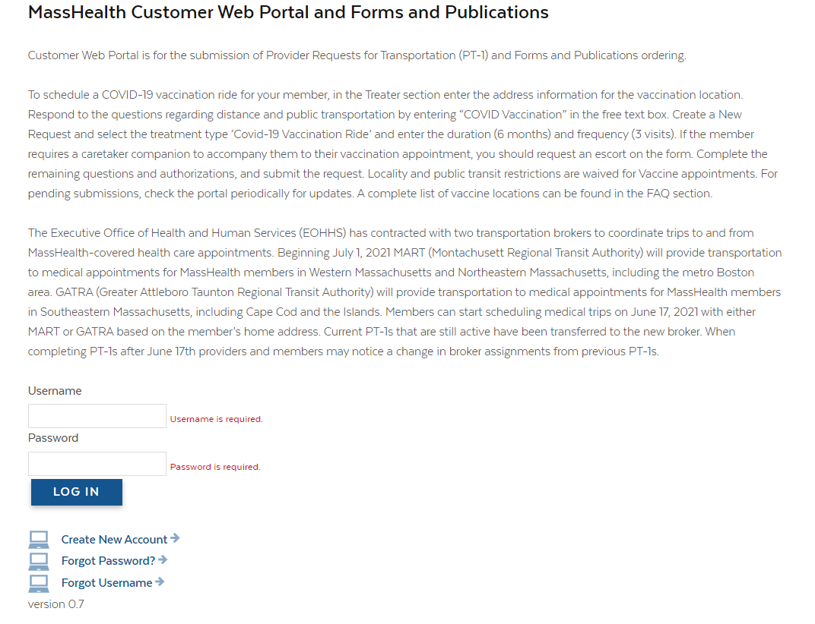
Customer Web Portal Overview
The Customer Web Portal
(CWP) is a web-based self-service system to submit Provider Requests for Transportation services (PT-1s) and view existing PT-1s.
Customer Web Portal Link: https://masshealth.ehs.state.ma.us/CWP/Default
To learn how to create or submit a PT-1, please take our Customer Web (PT-1) Portal Course located on the MassHealth Learning Management System (LMS)

Slide 15
Resources
MassHealth Customer Web Portal Log in page
https://masshealth.ehs.state.ma.us/CWP/Default
MassHealth Transportation Information for Providers
https://www.mass.gov/masshealth-transportation-information-for-providers
MassHealth All Provider Bulletin 339
https://www.mass.gov/doc/all-provider-bulletin-339-upcoming-changes-to-masshealth-nonemergency-wheelchair-van-transportation-services-0/download
MassHealth Provider Training
https://www.mass.gov/how-to/masshealth-provider-training
MassHealth Customer Service
 | Long-Term Services and Supports Providers | All Other Provider Types
Phone | (844) 368-5184 (toll free) | (800) 841-2900; TTY: (800) 497-4648
Email | support@masshealthltss.com | providersupport@mahealth.net
Fax | (888) 832-3006 | (617) 988-8974

